Slide 1
AlphaGenome

Slide 2
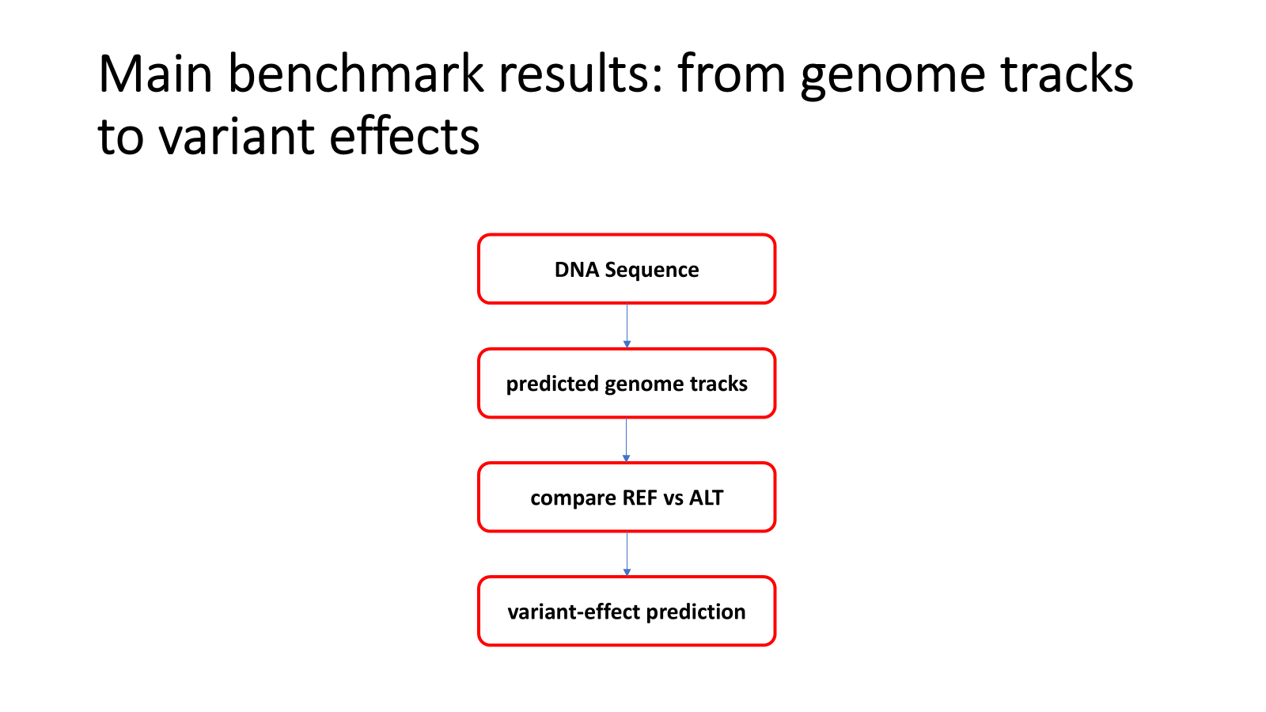
Notes:
For my part, I’ll focus on the main benchmark results.
The basic idea is that AlphaGenome first predicts functional genome tracks from DNA sequence.
These tracks are measurements like gene expression, splicing signals, chromatin accessibility, and transcription factor binding.
Then, to predict the effect of a variant, the model compares predictions from the reference DNA sequence and the altered DNA sequence.
So the results section is asking two questions: first, can AlphaGenome predict normal genome signals accurately, and second, can it predict how those signals change when there is a variant?

Slide 3
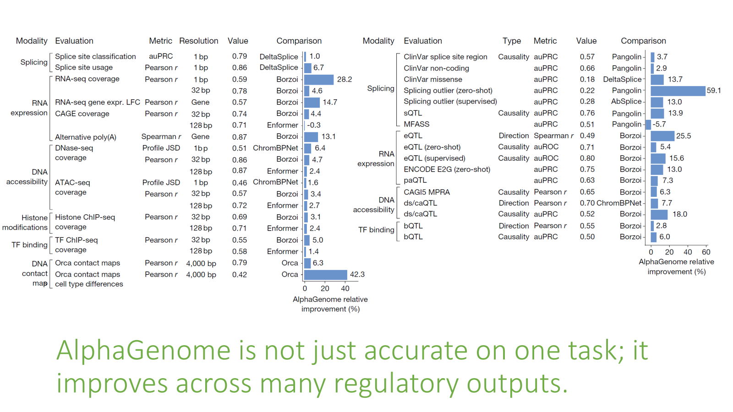
Notes:
This slide gives the headline result. The Figure On the left shows genome track prediction.
That means the model is tested on whether it can reproduce real biological signals from DNA sequences it has not seen during training.
The Figure on the right shows variant-effect prediction. That means the model is tested on whether it can predict what changes when the DNA sequence is altered.
The key result is that AlphaGenome outperforms external models on 22 out of 24 track prediction evaluations and matches or outperforms them on 25 out of 26 variant-effect evaluations.
So the paper’s main claim is not that AlphaGenome is good at one narrow task, but that it is broadly strong across many regulatory genomics tasks.

Slide 4
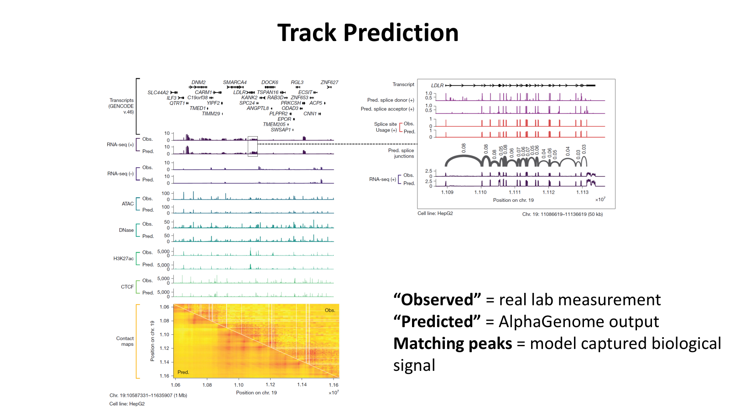
Notes:
Before looking at variant effects, the authors first check whether AlphaGenome can predict normal genome tracks.
In the Figure on the left, the observed tracks are real experimental measurements, and the predicted tracks are AlphaGenome’s outputs.
The important thing to notice is that many predicted peaks line up with the observed peaks.
For example, the model is predicting gene expression through RNA-seq, open chromatin through ATAC and DNase, histone or protein-related signals through ChIP-seq tracks, and even 3D contact patterns through contact maps.
This matters because variant-effect prediction depends on comparing two track predictions: one from the reference DNA and one from the altered DNA.

Slide 5
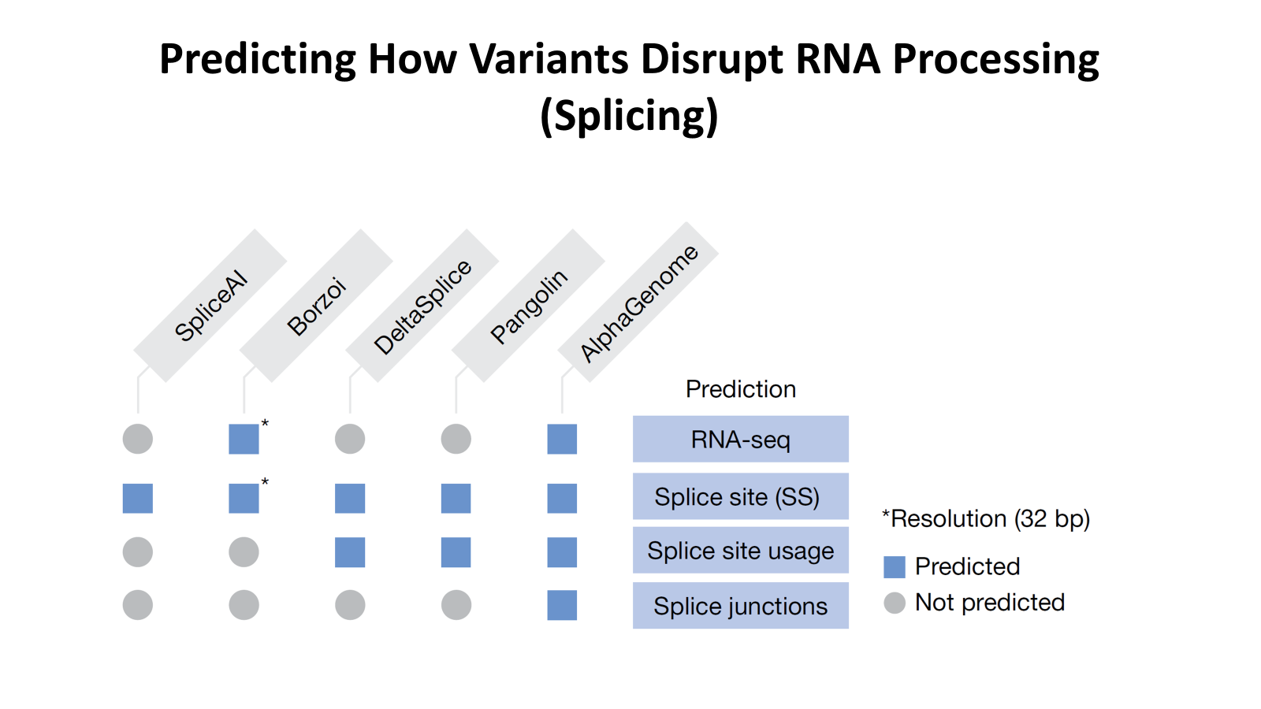
Notes:
Now we move from normal track prediction to variant-effect prediction, starting with splicing. (Splicing is the process where RNA is edited: introns are removed and exons are joined together. A variant can cause disease if it disrupts this cutting and joining process.)
In the Figure, the paper compares AlphaGenome with other splicing-related models.
The key point is that AlphaGenome predicts more types of splicing information.
It predicts RNA-seq, splice sites, splice site usage, and splice junctions. This is important because knowing that a position looks like a splice site is not always enough. We also want to know whether that site is actually used and which RNA pieces get joined.
Because of this, AlphaGenome performs best on six out of seven splicing variant benchmarks.
The one exception is MFASS, where Pangolin does better, so the result is strong but not perfect.

Slide 6
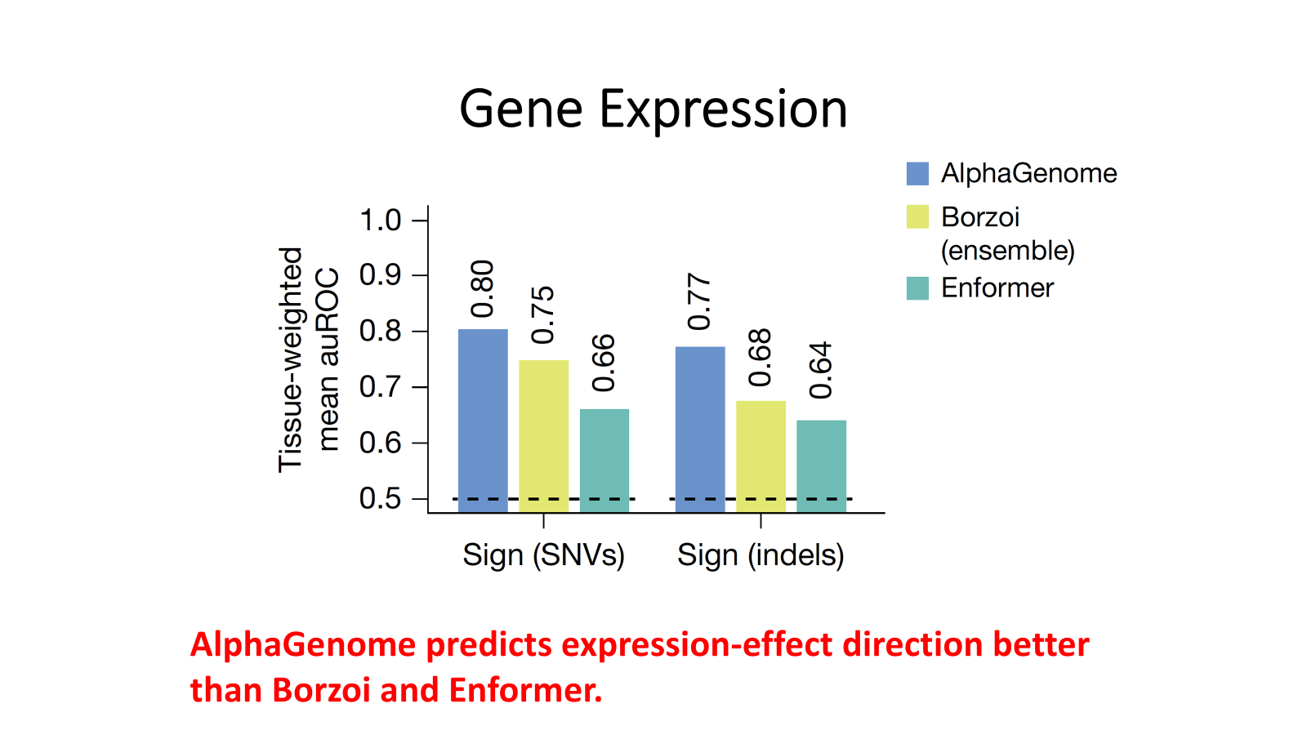
Notes:
Next is gene expression. (Gene expression means how active a gene is. Some variants, called eQTLs, are associated with changes in gene expression. For example, a variant might make a gene more active or less active.)
In this slide, Figure 4e shows how well different models predict the direction of that effect. (Direction means whether the variant increases or decreases expression.)
For single-nucleotide variants, AlphaGenome gets an AUROC of 0.80, compared with 0.75 for Borzoi and 0.66 for Enformer.
So the important result here is that AlphaGenome is better at predicting the sign, or direction, of gene-expression effects.
This is useful because in biology and medicine, it often matters whether a variant pushes a gene up or down.

Slide 7
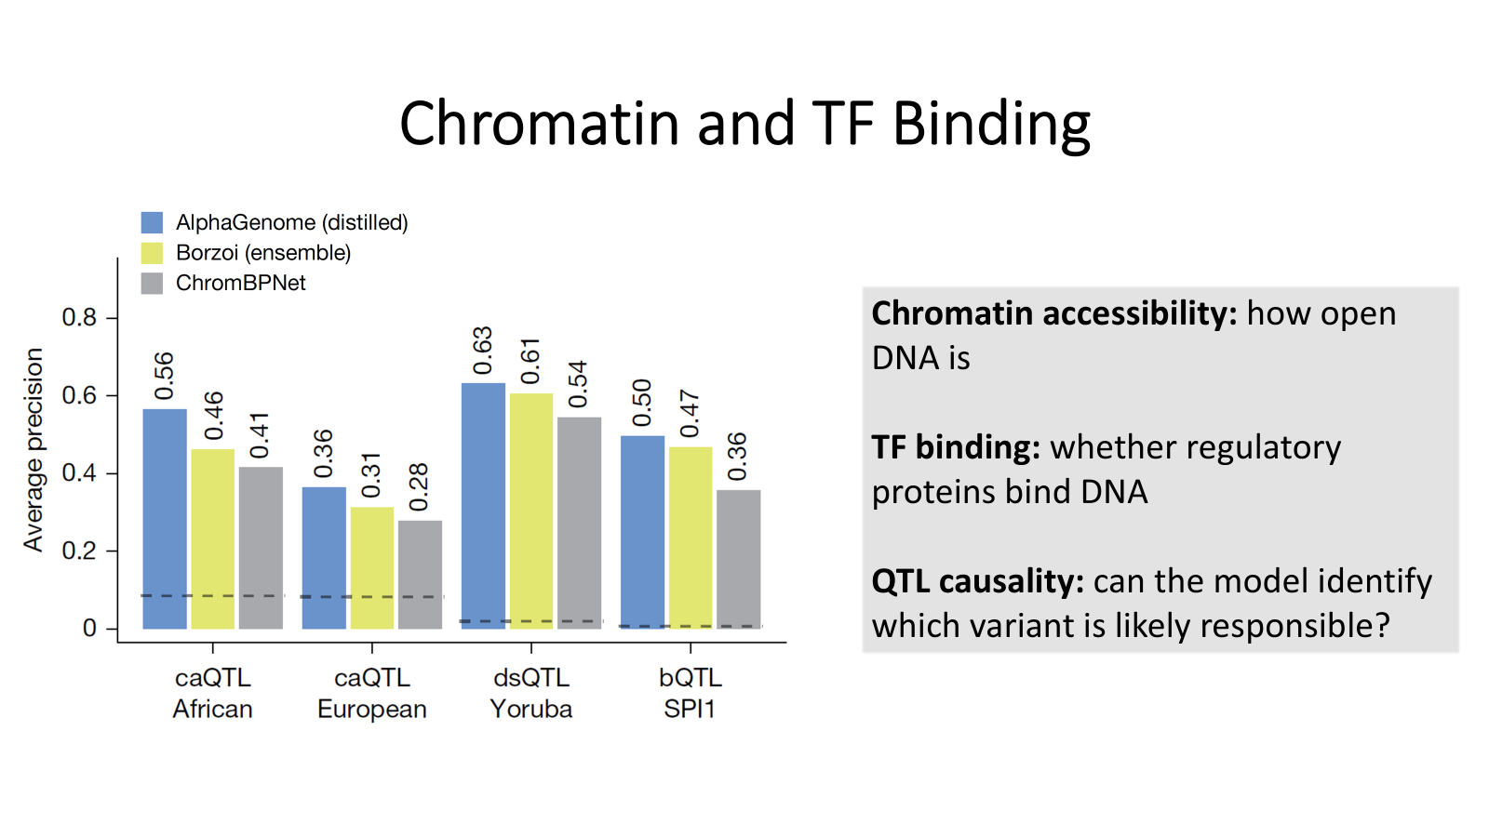
Notes:
The last benchmark category I’ll cover is chromatin accessibility and transcription factor binding.( Chromatin accessibility means how open the DNA is. If DNA is open, regulatory proteins can access it more easily. Transcription factors are proteins that bind DNA and help control gene activity).
In the Figure, the authors test whether AlphaGenome can identify causal regulatory variants across accessibility and binding QTL tasks.
The main comparison is against Borzoi and ChromBPNet. Across these tasks, AlphaGenome generally performs better.
This matters because it shows the model is not only predicting final gene expression. It can also predict upstream regulatory mechanisms, like whether a variant changes DNA accessibility or transcription factor binding.

Slide 8
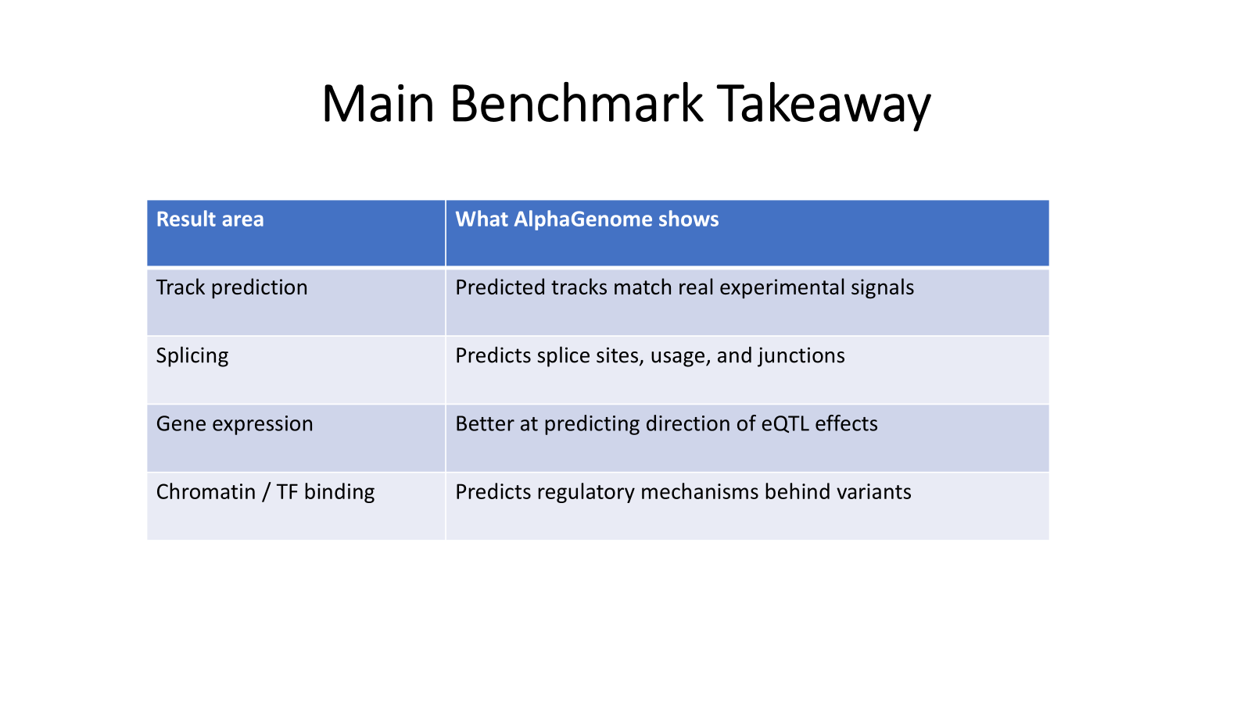
Notes:
To summarize my section, AlphaGenome’s benchmark results support four main points.
First, it can reproduce many real genome tracks from DNA sequence.
Second, for splicing, it is strong because it predicts not only splice sites, but also splice usage and splice junctions.
Third, for gene expression, it improves prediction of whether variants increase or decrease gene activity.
Fourth, for chromatin and transcription factor binding, it predicts regulatory mechanisms that happen before expression changes.
So overall, the results show that AlphaGenome is a broad variant-effect prediction model, not just a model for one specific genomic task.
This leads into the next part of the presentation, which is about how these predictions can be used to interpret real biological and disease-related variants.

Slide 9
Ablation studies
How to measure the impact of parts of the model?
Use ablation studies
Base-pair resolution of target tracks was found to be particularly impactful
Finer = better, 1-bp resolution was the best
Other resolutions proved more resilient
Assay tracks (i.e. contact-map Pearson)
A similar resilience was observed for variant effect prediction

Slide 10
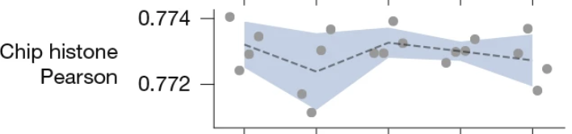
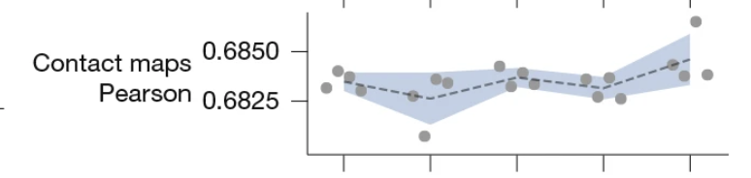
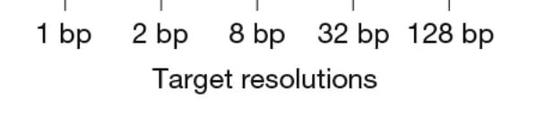
Assay-resolution graphs
They’re flat (excerpt from Figure 7a)

Slide 11
Training
Distillation comparable or better than ensemble
However, random mutation of input sequences is required
Supports “input pertubation strategy” presumably used for AlphaGenome

Slide 12
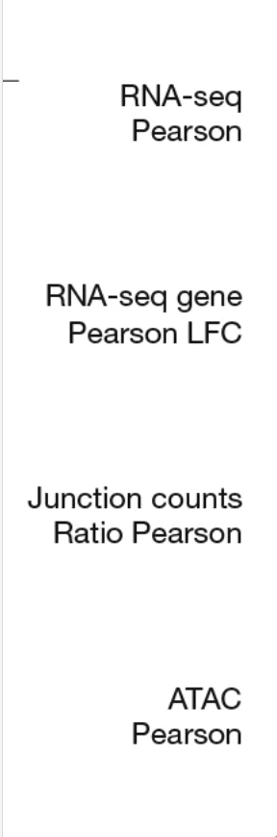
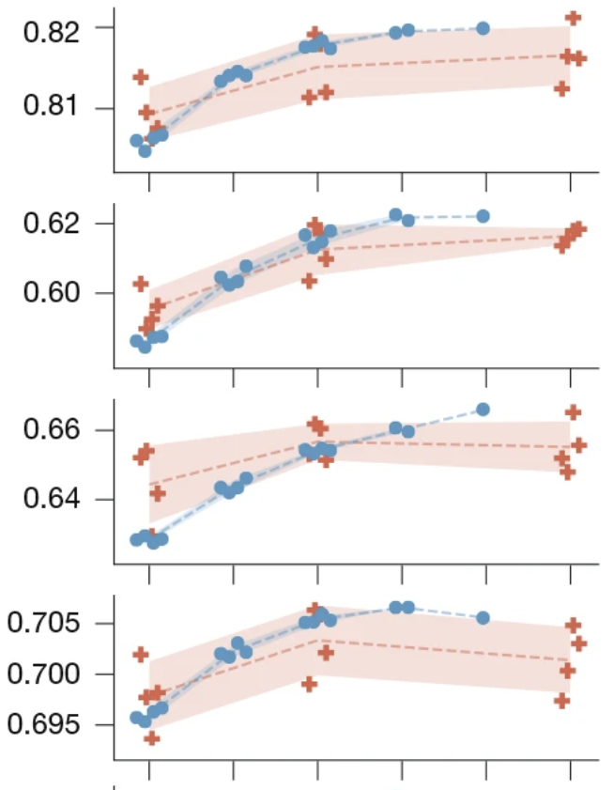
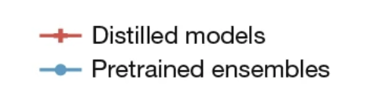
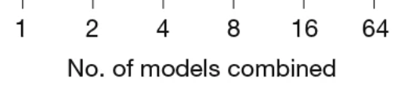
Distillation-ensemble comparison (fig. 7c excerpt)

Slide 13
Future work
Authors note that prediction of “tissue-specific alternate splicing” requires further work
Needs to be able to accommodate tissue-specific traits
Similar problems with “cell-type specific” expression levels

