Slide 1
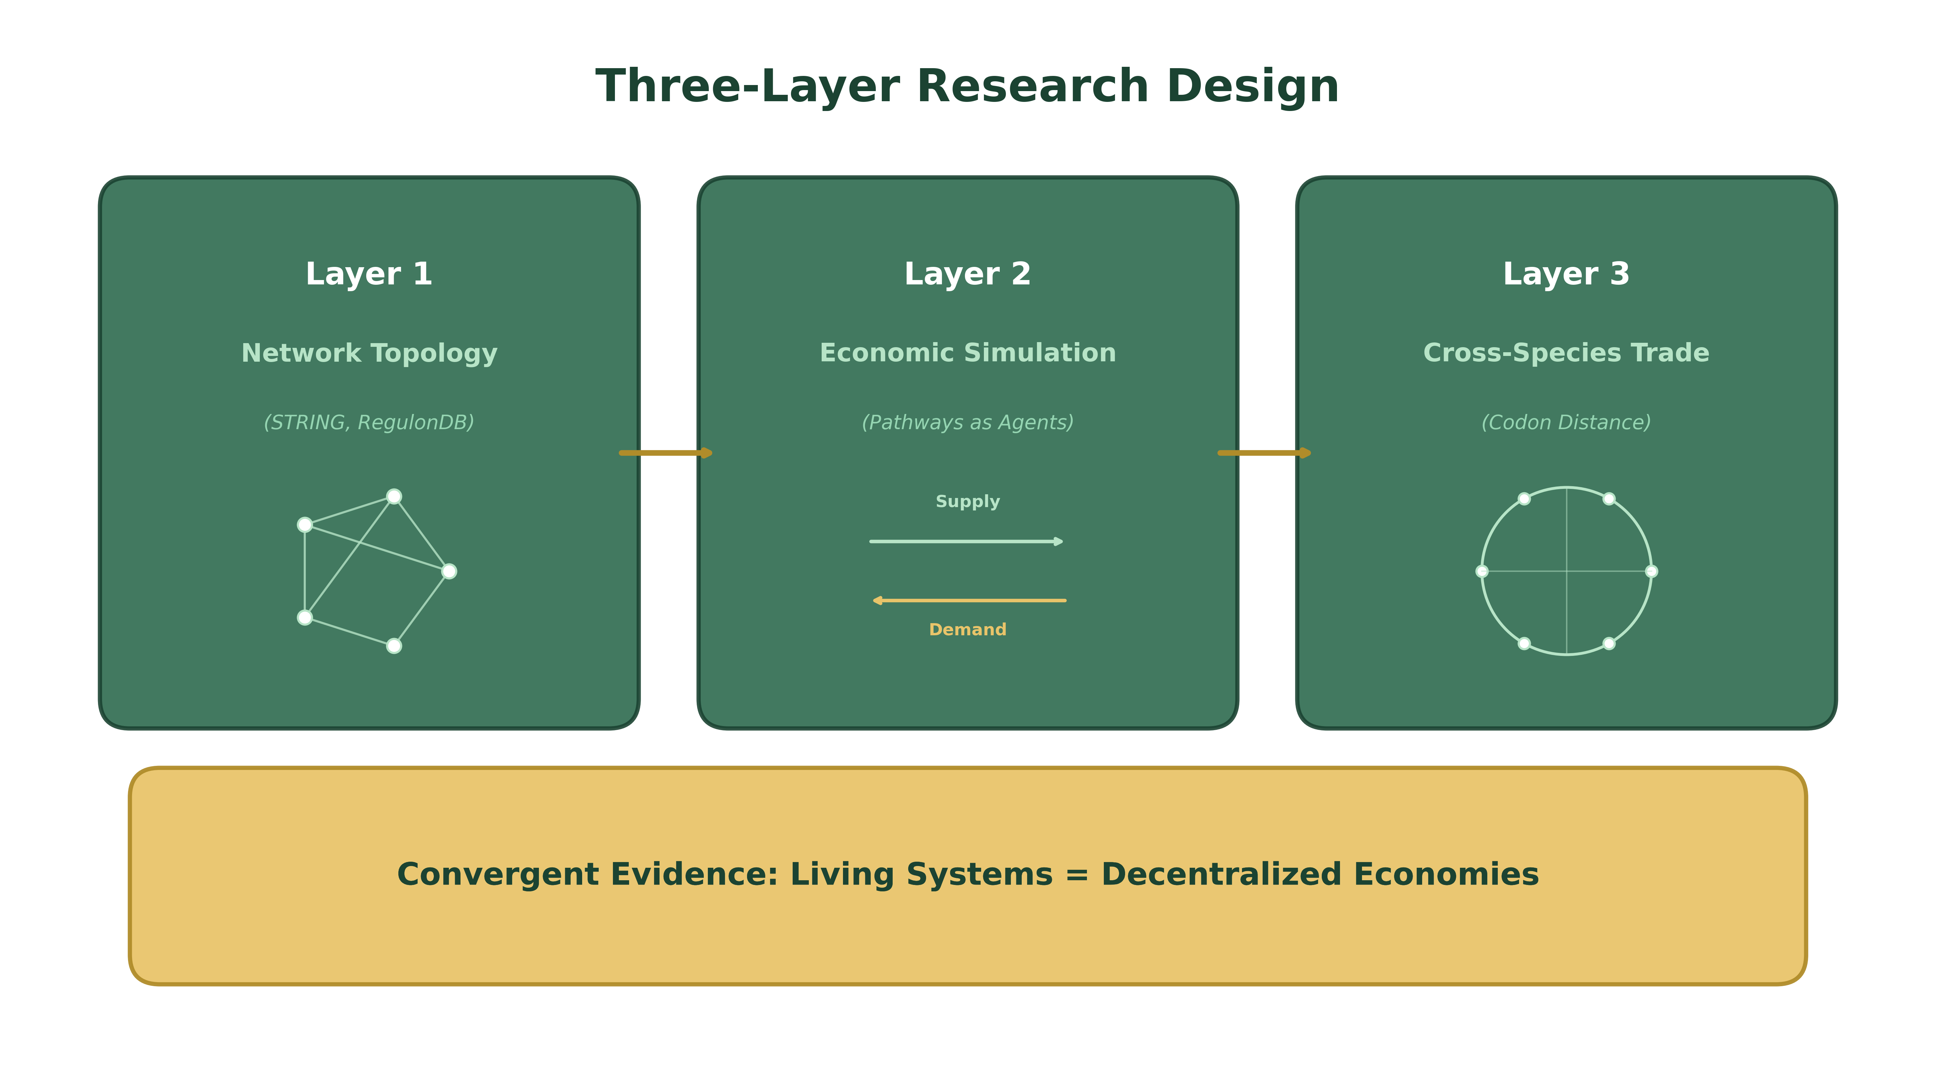
Living Systems as Decentralized Economies
Why the Molecular Biologist Should Be an Entrepreneur, Not a Central Planner
BME 129C Capstone | Progress Report
Sage Clokey | Spring 2026 | UC Santa Cruz

Slide 2
Goal & Approach
Are living systems literally decentralized economies?
Not metaphor -- measurable structural equivalence
Thesis: biological networks exhibit the same properties Austrian economists attribute to free markets
Scale-free topology, distributed information flow, robustness to failure
Three layers of convergent evidence from real data
Layer 1: Network topology (STRING DB, RegulonDB, KEGG)
Layer 2: Economic simulation (pathways as agents vs. central allocator)
Layer 3: Cross-species trade (comparative advantage via codon distance)

Slide 3
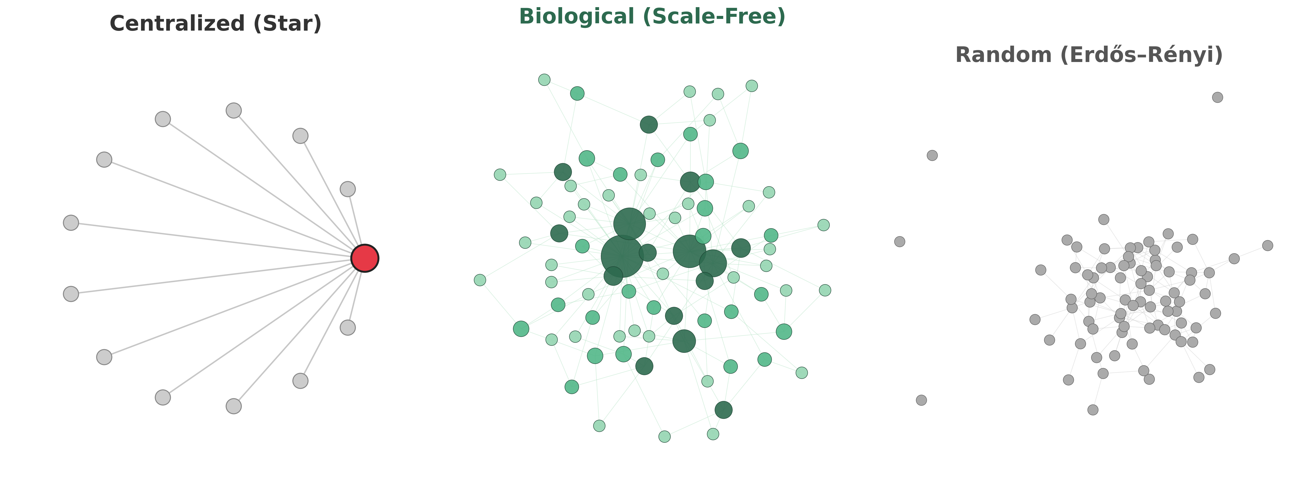
What Does Network Architecture Look Like?
One hub controls everything. Remove it = total collapse.
Multiple hubs, high clustering. Robust to failure -- like a real economy.
No structure, no hubs. Resilient but inefficient -- no specialization.

Slide 4
Accomplished So Far
Data Pipeline (Complete)
Analysis Framework (Complete)
STRING PPI: E. coli (529 proteins, 6,951 interactions)
STRING PPI: Yeast (573 proteins, 6,342 interactions)
RegulonDB GRN: 282 nodes, 308 regulatory edges
KEGG metabolic networks: E. coli + yeast
Single-cell RNA-seq: PBMC 3k (scanpy)
All data cached locally for reproducibility
Topology: degree distribution, power-law fitting, Gini coefficient
Robustness curves: random failure vs. targeted attack
5 centralized reference networks for comparison
Economic simulation: distributed vs. centralized allocation
Cross-species trade cost matrix (codon distance)
Automated figure generation pipeline

Slide 5
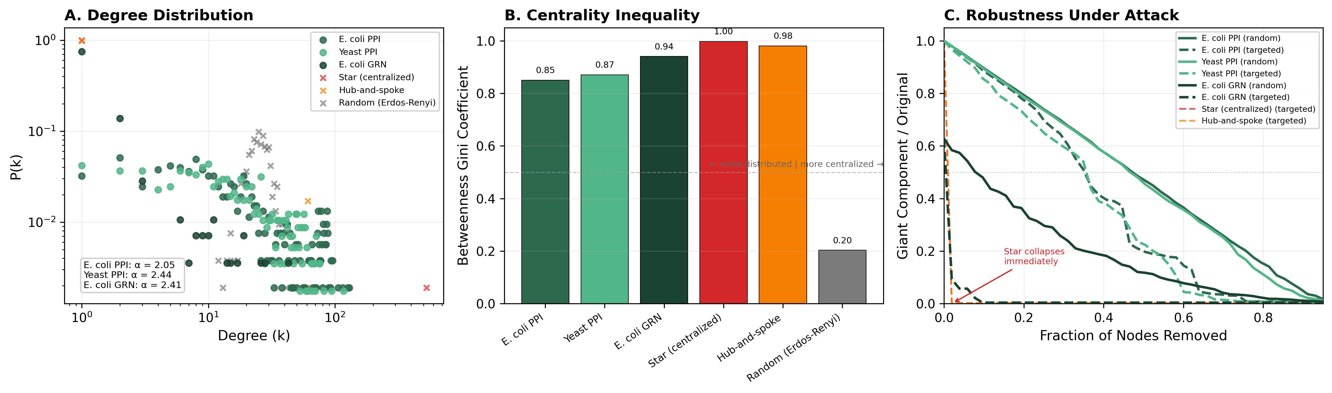
Figure 2: Biological Networks Are Decentralized
Figure 2. Topological analysis of E. coli and yeast PPI networks (STRING DB) and E. coli GRN (RegulonDB) compared to centralized references. (A) Power-law degree distributions (alpha = 2.05-2.44). (B) Betweenness Gini shows hubs exist but are distributed across multiple nodes. (C) PPI networks survive removing ~37% of top hubs; star/hub-spoke collapse at ~2%.

Slide 6
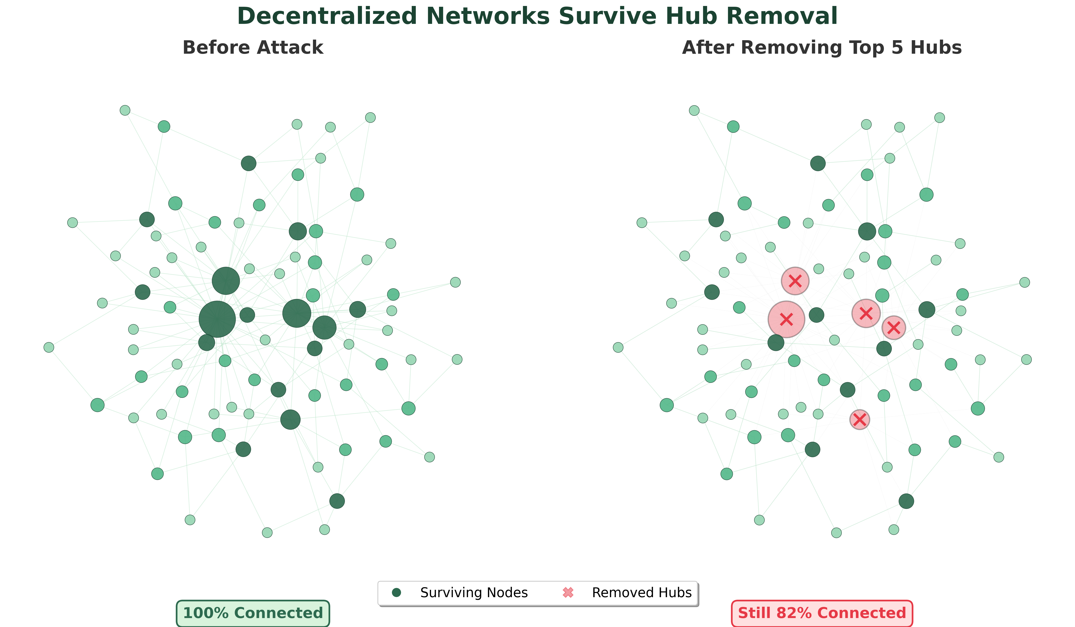
The Key Insight: Hubs Exist, But the System Doesn't Depend on Them
Robustness Comparison
Nodes removed before collapse: E. coli PPI (targeted): 37% Yeast PPI (targeted): 37% Star graph (targeted): 2% Hub-and-spoke (targeted): 2% Biological networks have multiple redundant paths. Centralized architectures have a single point of failure.
Life is not a machine with a master switch. It's an economy of cooperating agents.

Slide 7
Summary of Results
Network | Nodes / Edges | Power-law alpha | Clustering | Robustness (targeted)
E. coli PPI | 529 / 6,951 | 2.05 | 0.645 | 36.8%
Yeast PPI | 573 / 6,342 | 2.44 | 0.651 | 36.8%
E. coli GRN | 282 / 308 | 2.41 | 0.000 | 1.9%
Star (centralized) | 529 / 528 | 0.00 | 0.000 | 1.9%
Hub-and-spoke | 529 / 564 | 1.25 | 0.000 | 1.9%
Biological networks: scale-free degree distributions (alpha 2-3), high clustering (local cooperation), and 18x more robust than centralized architectures under targeted attack.

Slide 8
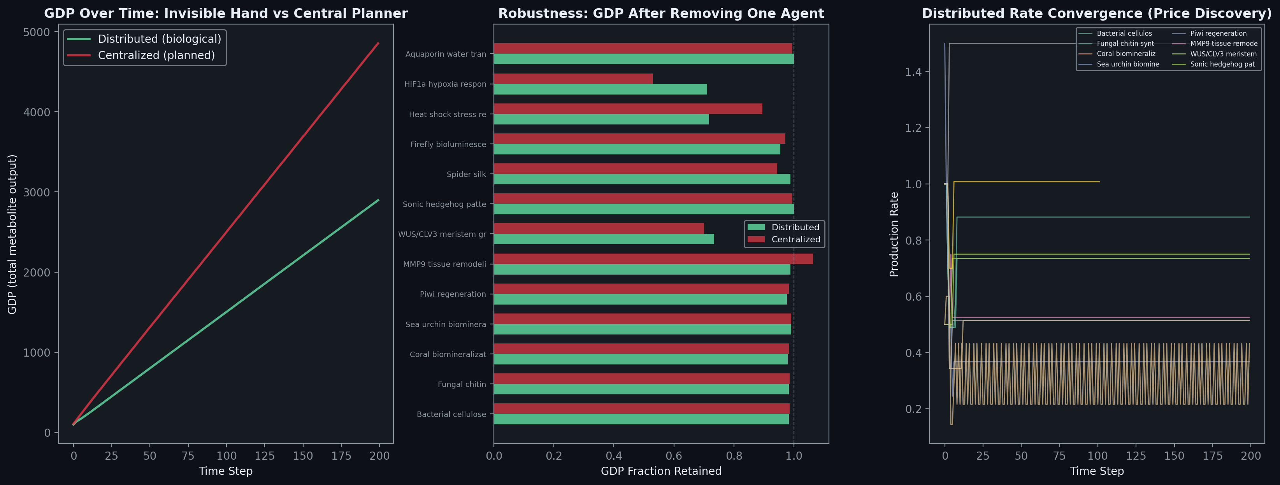
Next Steps
Layer 2: Distributed vs. centralized metabolic simulation
Does the 'market' outperform the 'planner' under perturbation?
Motif analysis: classify network motifs
Entrepreneurial = local feedback loops, adaptive
Central planning = hub-dependent cascades, brittle
Layer 3: Cross-species trade network
Does codon distance predict gene transfer cost?
Like the gravity model predicts international trade?
Paper: Results and discussion for all three layers
Preview: Layer 2 economic simulation results

