Slide 1
Spring Framework Core

Slide 2

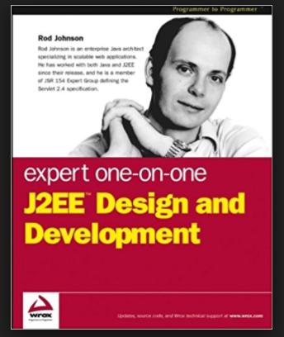

Genesis
What Does Numeric 21 In Interface21 Means?
Notes:
Courtesy & Links/Resources:
Google Image Search For Book , Interface 21 Logo

Slide 3
Motivation
Build Any Kind Of Application In Loosely Coupled Manner Using Pure Old Java Object(P0J0)
Notes:
Courtesy & Links/Resources:

Slide 4
Motivation
J2EE Frustration Over EJB.[EJB Is Heavy Weight , Was True Before EJB 2.0.Implement Too Many Interfaces To Make It Work For Remote Method Invocation.]
Notes:
Courtesy & Links/Resources:

Slide 5
Light-Weight/Heavy-Weight
Light-Weight-Ness Defines Spring Philosophy As A Whole Or Minimal Impact[Less Intrusive/ Invasiveness], It Is Not About Size Of Distribution Or Memory / Performance Footprint.
Notes:
Courtesy & Links/Resources:

Slide 6
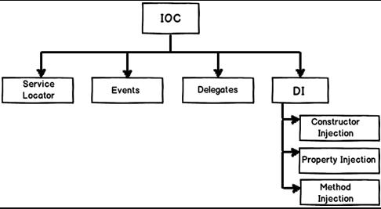
Dependency Injection[?:Pattern Like Service Locator] Or Inversion Of Control [?: Container]?
Inversion Of Control = Dependency Lookup Style||Dependency Injection Style
Inversion Here Means How To Look Up/Find A Implementation For A Specific Dependency [Assembler/Container Is Doing The Inversion]
Notes:
Courtesy & Links/Resources:
1.https://www.codeproject.com/Articles/592372/Dependency-Injection-DI-vs-Inversion-of-Control-IO

Slide 7
Dependency Injection[?:Pattern Like Service Locator] Or Inversion Of Control [?: Container]?
Dependency Lookup
Dependency Injection
Dependency Pull
Setter Dependency
Method Replacement
Contextualized Dependency Lookup
Constructor
Method Injection
Notes:
Courtesy & Links/Resources:
1.https://www.codeproject.com/Articles/592372/Dependency-Injection-DI-vs-Inversion-of-Control-IO

Slide 8
Code Session Core Java
Example “Welcome To Spring Framework Core”
Notes:
Courtesy & Links/Resources:

Slide 9
Complexity Of Wiring Together Using Interface Driven Approach Is High , DI/IOC Helps To Reduce This Complexity. Coding Over Interface Creates Loosely Coupled Application[Reduced Glue Code]
Notes:
Courtesy & Links/Resources:

Slide 10
Code Session Using Spring
Example “Welcome To Spring Framework Core”
Pre-Requisite:
Maven Basic
Java 8
Spring – 4.3.9
Notes:
Courtesy & Links/Resources:

Slide 11
History Re-Visited
What Does Numeric 21 In Interface21 Means?
Interface Driven Framework For 21st Century
Notes:
Courtesy & Links/Resources:
https://spring.io/blog/2006/12/16/why-the-name-interface21
Google Image Search For Book , Interface 21 Logo

Slide 12


History Quiz
Why Spring Framework Named “Spring”?
Notes:
Courtesy & Links/Resources:
https://spring.io/blog/2006/11/09/spring-framework-the-origins-of-a-project-and-a-name

Slide 13
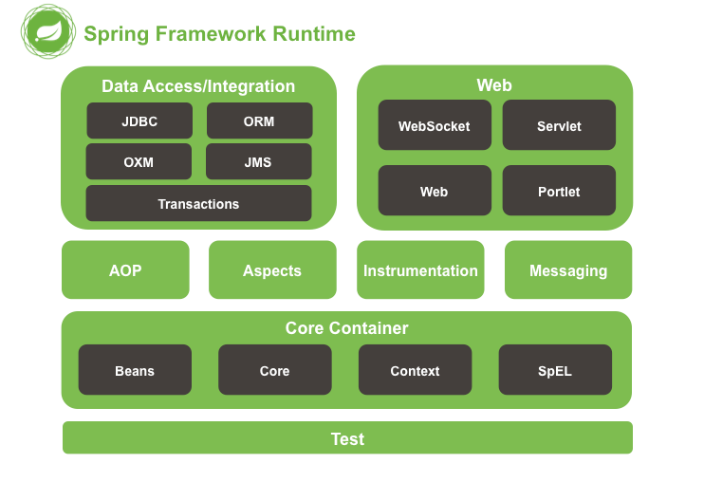
Notes:
Courtesy & Links/Resources:
https://docs.spring.io/spring/docs/current/spring-framework-reference/htmlsingle/

Slide 14
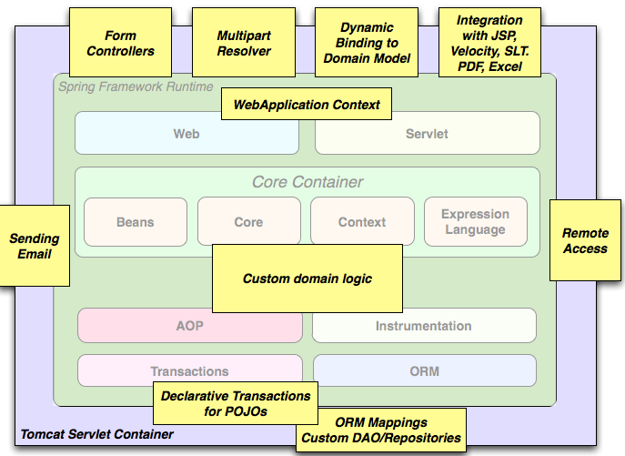
Typical Full-Fledged Spring Web Application
Notes:
Courtesy & Links/Resources:
https://docs.spring.io/spring/docs/current/spring-framework-reference/htmlsingle/

Slide 15
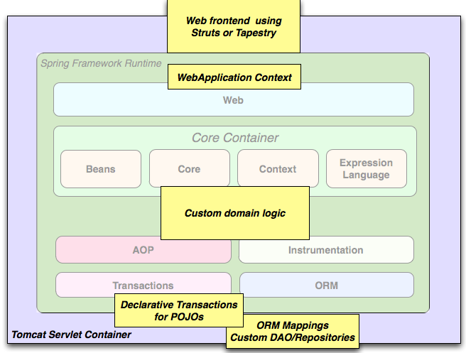
Spring Middle-Tier Using A Third-Party Web Framework
Notes:
Courtesy & Links/Resources:
https://docs.spring.io/spring/docs/current/spring-framework-reference/htmlsingle/

Slide 16
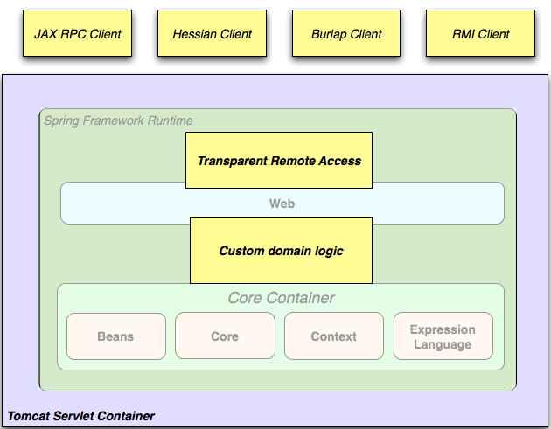
Remoting Usage Scenario
Notes:
Courtesy & Links/Resources:
https://docs.spring.io/spring/docs/current/spring-framework-reference/htmlsingle/

Slide 17
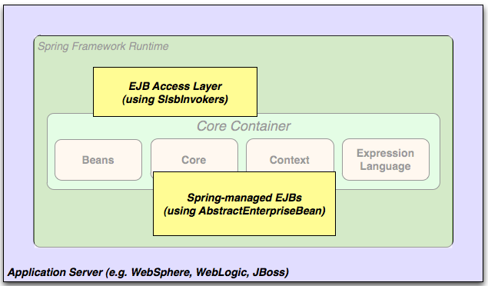
EJB - Wrapping Existing Plain Old Java Object
Notes:
Courtesy & Links/Resources:
https://docs.spring.io/spring/docs/current/spring-framework-reference/htmlsingle/

Slide 18

Common In All Previous Architecture
Notes:
Courtesy & Links/Resources:
https://docs.spring.io/spring/docs/current/spring-framework-reference/htmlsingle/

Slide 19
What Is Bean?
Basic Unit Of Spring Managed Resource Is Called Bean.
Notes:
Courtesy & Links/Resources:

Slide 20
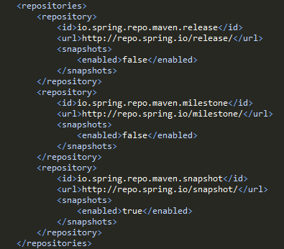
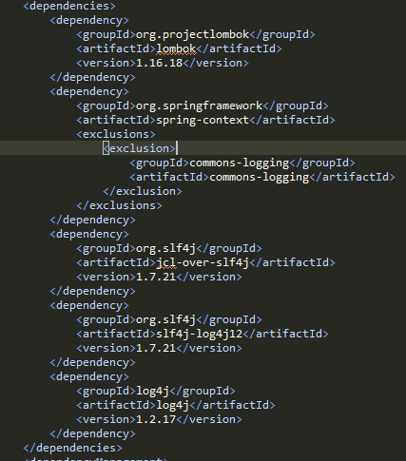
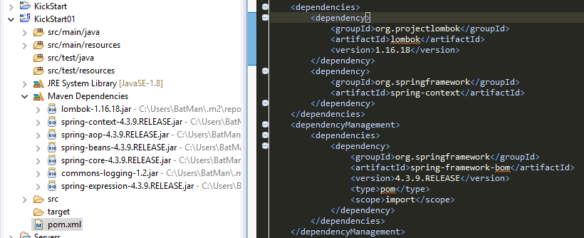
Maven Configuration

Slide 21
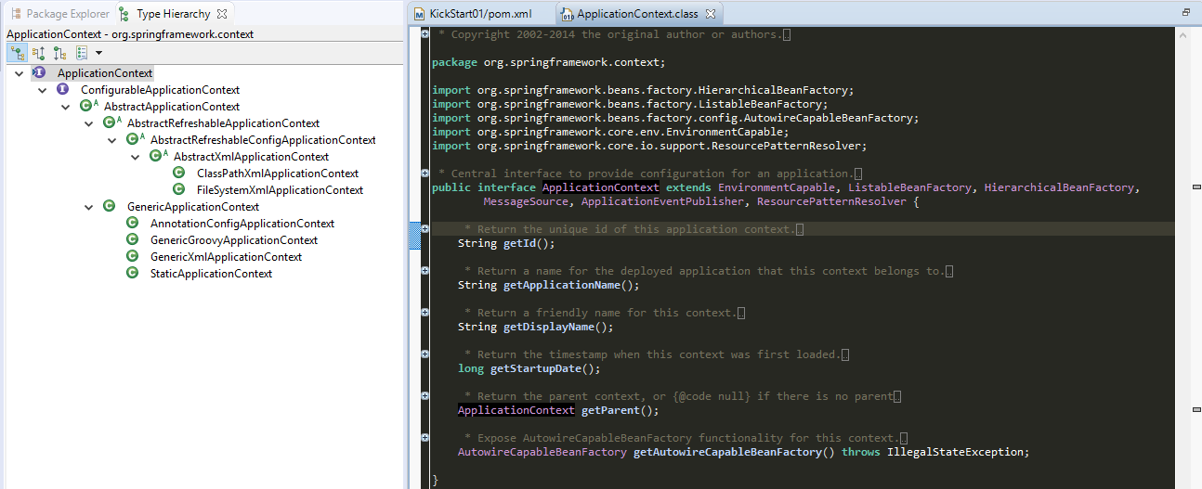
ApplicationContext

Slide 22
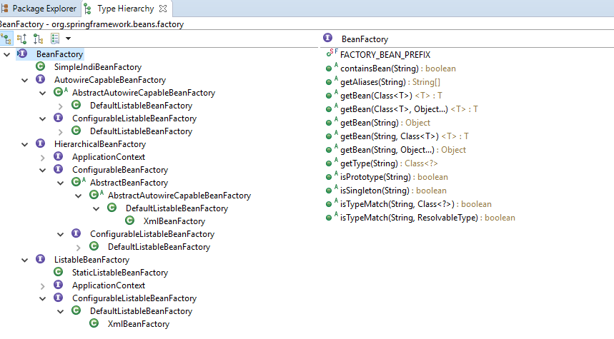
BeanFactory

Slide 23
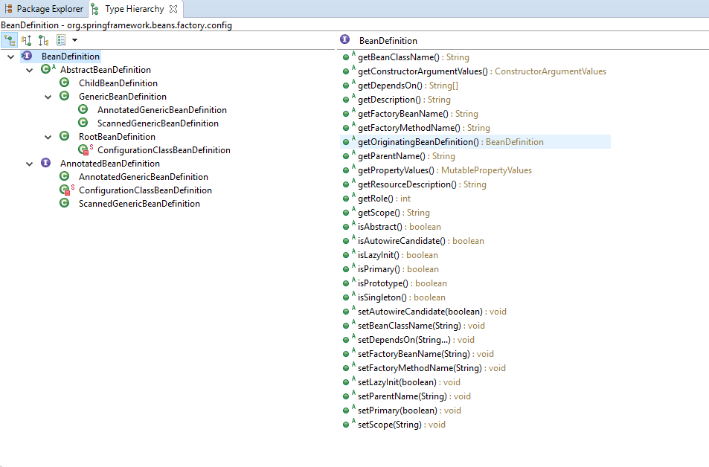
BeanDefinition

Slide 24
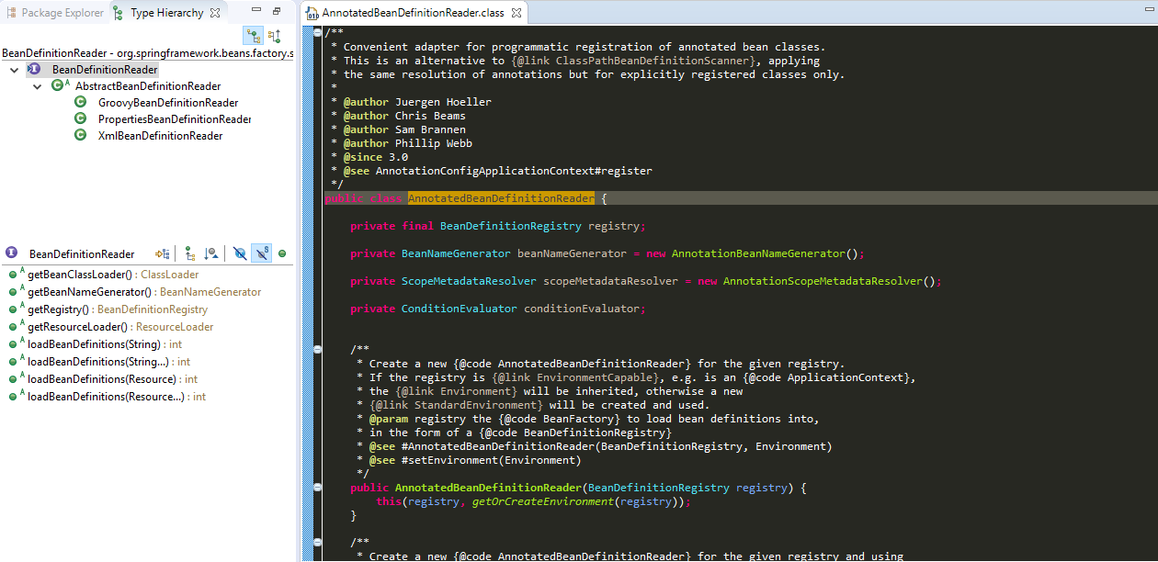
BeanDefinitionReader

Slide 25
Annotation Vs. Xml
Example “Welcome To Spring Framework Core” Using Annotation
Originally, Spring supported defining beans either through properties or an XML file. Since the release of JDK 5
and Spring’s support of Java annotations, Spring (starting from Spring 2.5) also supports using Java annotations when configuring ApplicationContext.

Slide 26

Self Quest: Annotation Vs. Xml
So Which One Is Better?
Notes:
Courtesy & Links/Resources:

Slide 27
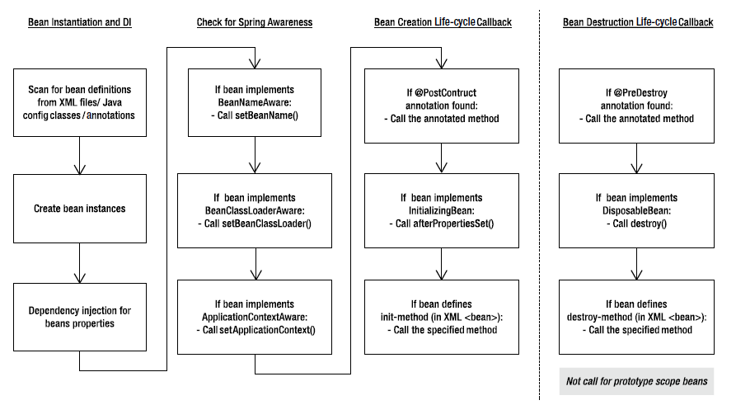
Self-Study Bean Life Cycle
Notes:
Courtesy & Links/Resources:
http://www.wideskills.com/spring/spring-bean-lifecycle
https://stackoverflow.com/questions/25469369/what-do-you-mean-by-callbacks

Slide 28
Example:
BeanFactory
Annotation Configuration
Xml Configuration
Spring Expression Language Bean Property Copy
Manipulate Collection
Nested ApplicationContext
Method Injection
Auto Wire Types
Parent Child Bean
Bean Life Cycle
Factory Bean , Factory Method
Notes:
Courtesy & Links/Resources:

Slide 29
Example:
To Do:
Property Editors
ByteArrayPropertyEditor
ClassEditor
CustomBooleanEditor
CustomCollectionEditor
CustomDateEditor
CustomNumberEditor
FileEditor
InputStreamEditor
LocaleEditor
PatternEditor
PropertiesEditor
StringTrimmerEditor
URLEditor
Implement Custom Property Editor
Use StringTrimmerEditor & Register
Notes:
Courtesy & Links/Resources:

Slide 30
Example:
To Do:
Message Source Example
Implement Internationalization Using Message Source
Event Publish Subscribe
Implement Application Event ,Listener & Publish
Notes:
Courtesy & Links/Resources:

Slide 31
Opinion
Is Spring Good Or Bad For Developers?

Slide 32
History Quiz
Why Spring Framework Named “Spring”?
Spring Represented As A Fresh Start After The “Winter” Of Traditional J2EE.
Notes:
Courtesy & Links/Resources:
https://spring.io/blog/2006/11/09/spring-framework-the-origins-of-a-project-and-a-name

