Slide 1
Working with Enterprise JavaBeans (EJB)
Introduction to EJB 3.1
LEVEL – PRACTITIONER

Slide 2
Selvarajan, Naren Kumar 127813 Santhanalakshmi Natarajan 125233
Naren- SCJP 1.4, SCBCD 2.0, SCWCD 1.4 Santhanalakshmi - SCJP 1.4, SCBCD 2.0, SCWCD 1.4
EJB/PPT/0608/1.0

Slide 3













Icons Used
Questions
Tools
Hands on Exercise
Coding Standards
Test Your Understanding
Case Study
Demonstration
Best Practices & Industry Standards
Icebreaker Activity
Interactive Activity
Additional Learning Sources
Workshop
Session Rules

Slide 4

Session Rules
Please keep your phone on mute during the session.
Please wait for the trainer to pause to take your question.
Please participate in all the quizzes and discussions in the session.

Slide 5
Icebreaker Activity
Polling
Why do you want to learn EJB?
Options:
I am currently working in EJB project, expect the training would help do to my work better.
Expecting a future project in EJB
Out of interest – want to learn a new technology
Notes:
Instructions to Trainer:
Instructions to Facilitator:

Slide 6
Working with Enterprise JavaBeans (EJB): Overview
Introduction:
The Enterprise JavaBeans is a architecture for the development and deployment of component-based business applications.
Applications written using the Enterprise JavaBeans architecture are scalable, transactional, and multi-user secure.

Slide 7
Introduction to EJB Do You Know
Basics of Java Bean components
Web application Development
Servlet and JSP Technology
JDBC
RDBMS concepts and usage of any RDBMS product
SQL queries
Notes:
Instruction to the trainer: Can use a chat window to explain the topics.

Slide 8
Introduction to EJB: Objectives
Objective:
After completing this chapter, you will be able to:
Describe Enterprise Applications
Describe JEE Application Architecture
Define Enterprise Java Bean
Comprehend the role of EJB Container and EJB Server
List the features of EJB3.1
List the types of Enterprise bean
8

Slide 9
Enterprise Applications
An Enterprise is an organization created for carrying out business ventures , Large in size and distribution and deals with the services that are complicated in nature.
Some common design goals of Enterprise applications:
Extensibility and maintainability
Scalability, portability, and availability
Code reuse
Interoperability
Focus on implementing business logic

Slide 10
When to Use EJB
Enterprise Java Bean is the solution for developing enterprise applications which requires
Scalability
Distributable
Transactions to ensure data integrity
the application has variety of clients

Slide 11
JEE Application Architecture
Java Enterprise Edition (JEE) applications divide their functionality across several tiers or functional layers, each of which serves a specific purpose.
A three-tier Web-centric application scenario is widely used as the starting point for many JEE applications. They are:
Client tier - User interaction and data capture occur in the client tier.

Slide 12
JEE Application Architecture
Middle tier- The middle tier is further classified into two sub tiers as Web and EJB tier
Web tier Makes application functionality available on the web. It accesses data and business functionality from other tiers and often encapsulates some user interaction control.
EJB tier Provides portable, scalable, available, and high-performance access to enterprise data and business rules. It offers object persistence and access to business logic implemented as EJBs.

Slide 13
JEE Application Architecture
Data tier
The data tier provides data storage and other information services to the J2EE application and integrates a J2EE application with other enterprise information systems.

Slide 14
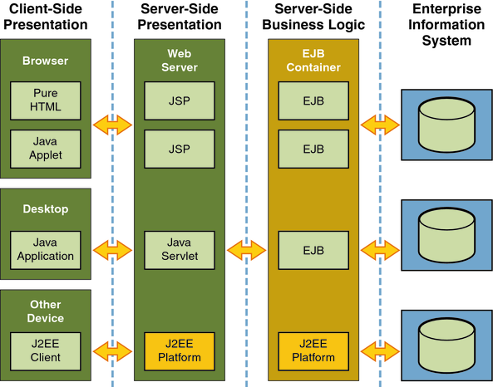
JEE Application Architecture
A pictorial representation of JEE architecture:
courtesy : http://java.sun.com
Courtesy :oracle.com

Slide 15
Introduction to Enterprise Java Beans
Enterprise JavaBeans (EJB) technology is the server-side component architecture for Java Platform, Enterprise Edition (Java EE).
EJB technology enables rapid and simplified development of distributed, transactional, secure and portable applications based on Java technology.

Slide 16
Interactive Activity
Quiz
When do you use EJB?
Participants can answer this question in chat area.
Notes:
Instructions to Trainer:
Instructions to Facilitator:

Slide 17
EJB Container
EJB Container:
The enterprise beans are hosted by an EJB container.
Act as an interface between a component (Bean) and the low-level platform-specific functionality that supports the component (Bean).
Provides a number of useful services enterprise beans. These include:
Transaction Management
Communication Services
Persistence
Error handling
Concurrency
Security and so on

Slide 18
EJB Container
For each enterprise bean, the container is responsible for:
Registering the object
Providing a remote interface for the object
Creating and destroying object instances
Checking security for objects
Managing the active state for the objects
Coordinating distributed transactions
Manage all persistent data within the object

Slide 19
EJB Server
The EJB server provides an environment that supports the execution of applications developed using EJBs.
An EJB Server manages and coordinates the allocation of resources to the applications.
An EJB Container manages the enterprise beans contained within it.
19

Slide 20
Interactive Activity
Quiz
List out the services provided by the container
Participants can answer this question in chat area.
Notes:
Instructions to Trainer:
Instructions to Facilitator:

Slide 21
Types of Enterprise Bean
There are three different types of beans in EJB: session, entity and message-driven. Each has a specific purpose:
Session Beans:
Represents an action or process that must be executed synchronously, such as making a reservation or validating a credit card.
Entity Beans:
Represents data; each entity bean represents a unique record in the database.
Message-Driven Beans
Represents an action or process, which are executed asynchronously, such as initiating a batch process.

Slide 22
EJB 3.0 Features
Fewer required classes and interfaces
Optional deployment descriptors
Entity beans are POJO
Annotation Driven Programming model
Simplified, lightweight persistence for object-relational mapping

Slide 23
EJB 3.1 Features
No Interface Local Client View
Asynchronous Session bean invocations
Singleton Session beans
EJB Timer Service (Not discussed in the training)
Portable JNDI Names
Embeddable EJB Container
EJB 3.1 Lite

Slide 24
Questions

Slide 25
Interactive Activity
Quiz - POLL
State true of False
An entity bean represents actions or process-flow.
A – True
B - False
Notes:
Instructions to Trainer:
Instructions to Facilitator:

Slide 26
Interactive Activity
Quiz - POLL
What are the different type of Enterprise Java Bean Participants can answer this question in chat area.
Notes:
Instructions to Trainer:
Instructions to Facilitator:

Slide 27
Introduction to EJB: Summary
In this session, you have learnt:
Enterprise Java Beans is a server side component architecture that simplifies the process of building enterprise-class distributed component applications in Java.
The EJB container act as an interface between a component (Bean) and the low-level platform-specific functionality that supports the component (Bean).
Types of enterprise beans:
Entity beans, which represent the data in the database
Session bean, which represent the process-flow or an action performed on an entity.
Message-Driven beans that represent action performed asynchronously.
27

Slide 28
Additional Learning Sources
http://www.youtube.com/watch?v=d7PcWbCRrSM

Slide 29

Introduction to EJB: Source
Book - Enterprise JavaBeans 3.0 by Bill Burke & Richard Monson-Haefel
Disclaimer: Parts of the content of this course is based on the materials available from the Web sites and books listed above. The materials that can be accessed from linked sites are not maintained by Cognizant Academy and we are not responsible for the contents thereof. All trademarks, service marks, and trade names in this course are the marks of the respective owner(s).
29

Slide 30
Working with Enterprise JavaBeans (EJB)
You have successfully completed -
Introduction to EJB

