Slide 1

Sage 300 Web SDK 2027.0 Overview
John Thomas (JT)
Principal Software Architect
August 2026

Slide 2
Web SDK
SDK
Wizards
Docs
Resources
Samples
Source
Goal
“The goal of the Web SDK is to get developers up and running quickly and easily.”

Slide 3

Corrected Issues

Slide 4
Corrected Issues
Update proper number of columns for UI Wizard
Updated the Receipts Sample’s ..Behaviour.js file to perform ‘pagehide’ instead of ‘unload’ Important! See the following notice in this presentation
N/A
Misc
Samples
Custom

Slide 5
Chrome Browser
The ‘unload’ event is being deprecated
The unload event is being gradually deprecated by changing the default so that unload handlers stop firing on pages unless a page explicitly opts in to re-enable them. See the following link for the rollout schedule: Deprecating the unload event | Web Platform | Chrome for Developers
This is critical for Sage 300 “stateful” screens since the unload event is where the session is released/destroyed.
For the upcoming 2027.0 release and the N-2 supported releases (2026.3 and 2025.6), a new pattern has been implemented as we have moved away from the unload event.
Third-party developers will also need to make this change.
See section 4.6 of the Upgrade Document (Sage300SDK_2027_0UpgradeGuide.docx) as this is a manual change.

Slide 6

Wizards

Slide 7
Wizards
Code
Sync Global Files
Update Nuget References
Solution
Sync Global Files
Updated Nuget References
Update Accpac Library References
Subclass
Prep
N/A
Sage internal use only
Finder
Generator
Sync Global Files
Update Nuget References
Custom
Non VS
Sync Global Files
Update Nuget References
Subclass
Configs
N/A
Upgrade
Sync Global Files
Update Nuget References
Update Accpac Library References
Custom
Subclass
Compiler
Sync Global Files
Updated Nuget References
Sync any new models
Language
Sync Global Files
Update Nuget References
View Field
Subclass
Web API
N/A
N/A
Sync
N/A
Sage internal wizard only

Slide 8


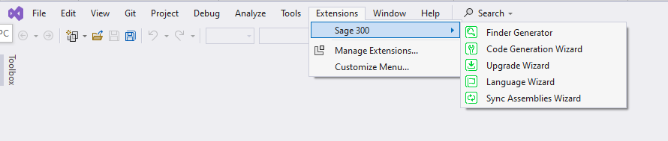
Wizards
Important Information
Wizards are accessible in Visual Studio 2022 (Community, Pro, Enterprise)
New for Sage 300 2027
Wizards are also now accessible in Visual Studio 2026 (Community, Pro, Enterprise)

Slide 9
Wizards
2027.0 uninstall and install instructions
Uninstall all Sage 300 wizards
(Visual Studio 2022/2026 – Extensions → Installed → uninstall all “Sage” wizards
Install Sage 300 Wizards
Visual Studio 2022 or Visual Studio 2026
Solution Wizard (Visual Studio plug-in)
Double-click Sage.CA.SBS.ERP.Sage300.SolutionWizardPackage.vsix
Customization Wizard (Visual Studio plug-in)
Double-click Sage.CA.SBS.ERP.Sage300.CustomizationWizardPackage.vsix
Code Generation Wizard, Finder Generator, Language Resource Wizard, Upgrade Wizard, Sync Assemblies Wizard
Double-click Sage.CA.SBS.ERP.Sage300.WizardPackage.vsix
Note: Now that the plug-in wizards are in Visual Studio 2022/2026, they must reference 64-bit libraries (targeting AnyCPU). Since the wizards access the ACCPAC.Advantage.dll (which targets x86), a local version of ACCPAC.Advantage.dll and supporting DLLs have been placed in the bin folder targeting AnyCPU. This is solely for the wizards as it has not yet been tested in the application.

Slide 10
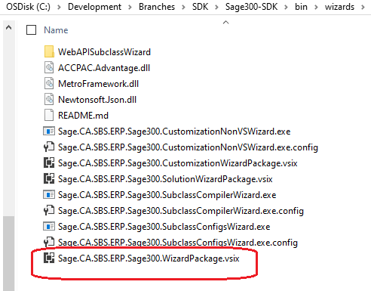
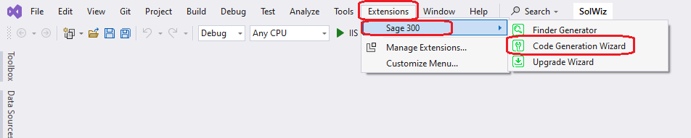
Wizards
Code Generation Wizard
Only accessible in Visual Studio 2022 or 2026
Added to the Wizard Package
Added Web API code generation for 2025.1
Access from Extensions/Sage 300 menu

Slide 11
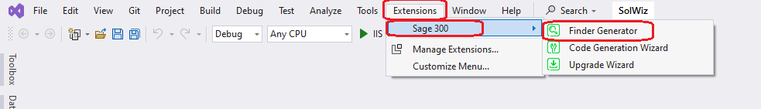
Wizards
Finder Generator
Only accessible in Visual Studio 2022 or 2026
Added to the Wizard Package
Access from Extensions/Sage 300 menu

Slide 12
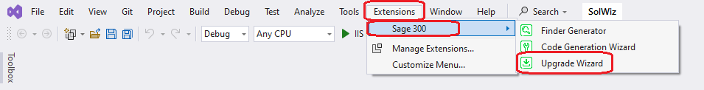
Wizards
Upgrade Wizard
Only accessible in Visual Studio 2022 or 2026
Added to the Wizard Package
Access from Extensions/Sage 300 menu

Slide 13
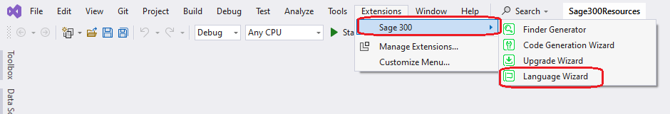
Wizards
Language Resource Wizard
Only accessible in Visual Studio 2022 or 2026
Added to the Wizard Package
Access from Extensions/Sage 300 menu

Slide 14
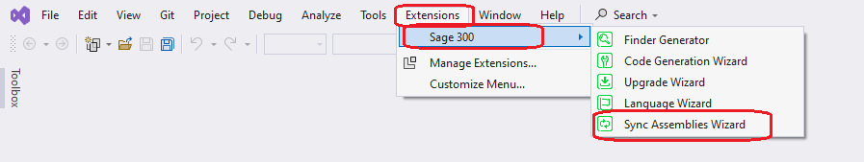
Wizards
Sync Assemblies Wizard
Only accessible in Visual Studio 2022 or 2026
Added to the Wizard Package
Access from Extensions/Sage 300 menu
Sage internal developer usage only

Slide 15
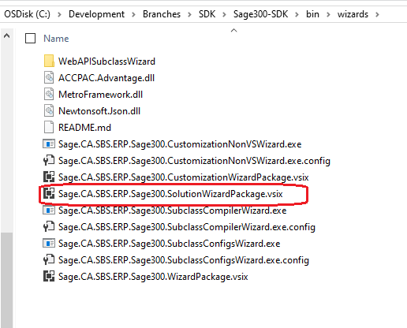
Wizards
Solution Wizard
Only accessible in Visual Studio 2022 or 2026
Package only contains solution wizard
Added Web API solution creation for 2025.1

Slide 16
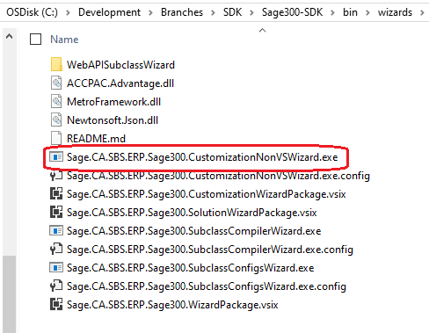
Wizards
Customization Wizard
Executable name

Slide 17
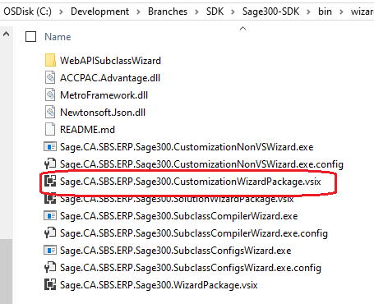
Wizards
Customization Wizard
Only accessible in Visual Studio 2022 or 2026
Package only contains customization wizard

Slide 18
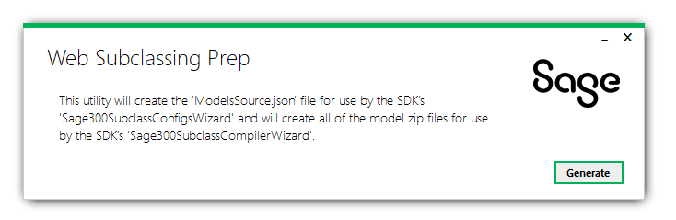
Wizards
Subclassing Prep Utility
Sage internal usage only

Slide 19
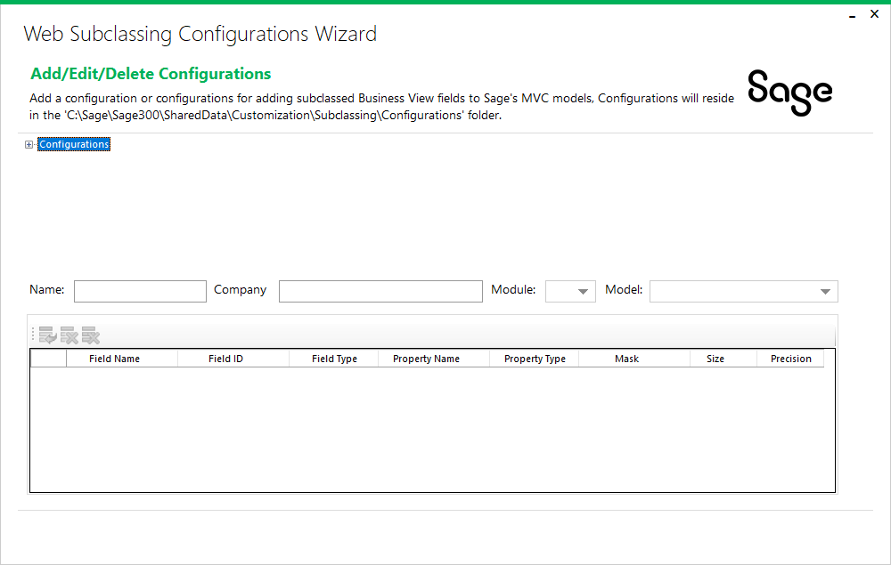
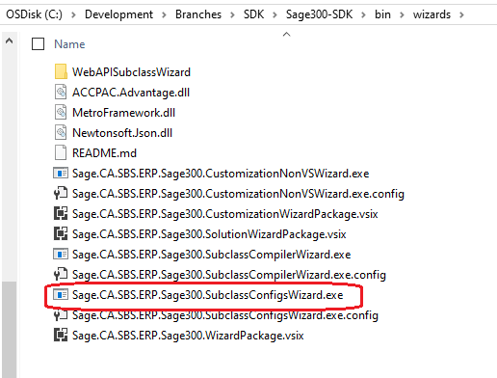
Wizards
Subclassing Configurations Wizard
Create configurations for subclassing web screens

Slide 20
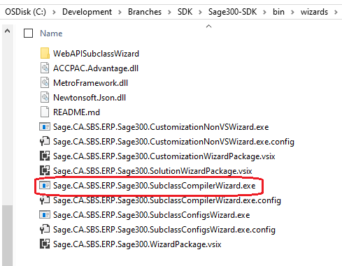
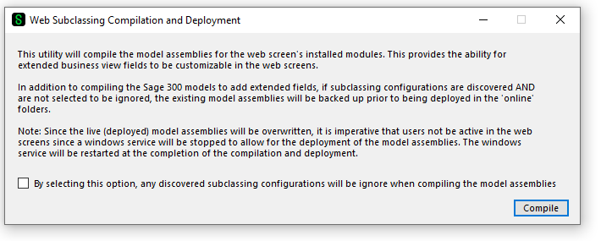
Wizards
Subclassing Compilation and Deployment Wizard
Apply configurations for subclassing web screens

Slide 21
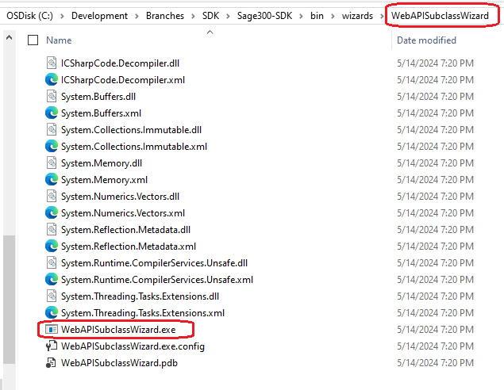
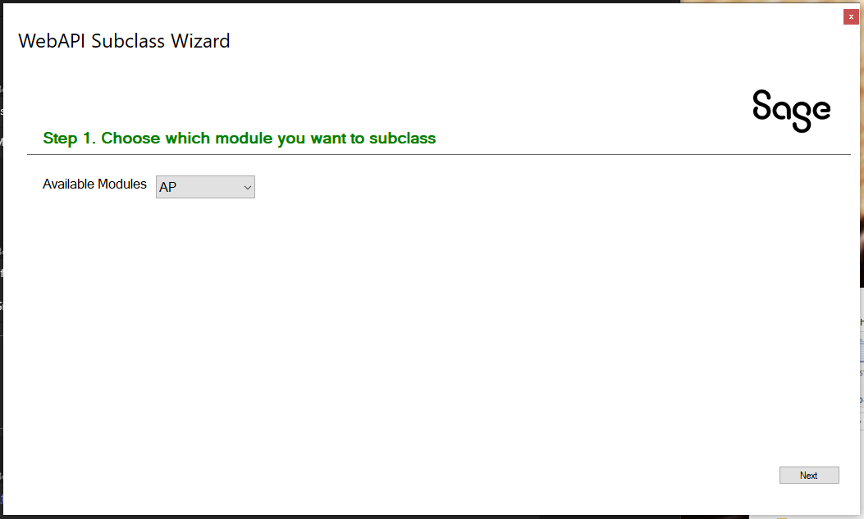
Wizards
Subclassing Web API Wizard
Create partner endpoints for subclassing Web API

Slide 22

Subclassing

Slide 23
Subclassing
Subclassing available in the Web Screens and the Web API since 2024.2
Web Screen Wizards to extend Sage 300 model assemblies
Web API Wizard to extend Sage 300 Web API endpoints
Checkout the Subclassing Design doc in the docs/development folder
Checkout the Wizards docs in the docs/wizards folder
Checkout the presentation from TPAC 2024 in the docs/presentations/TPAC folder which walks through how to use the wizards, deploy modified assemblies, use the Customization Strategy to access the extended properties, use the Web API wizard to create a partner endpoint extending an existing endpoint
Web Screens

Slide 24
Samples

Slide 25
Samples
Sync global files
Update Nuget Package References
Update Accpac Libraries
Web Screens

Slide 26
Web API

Slide 27
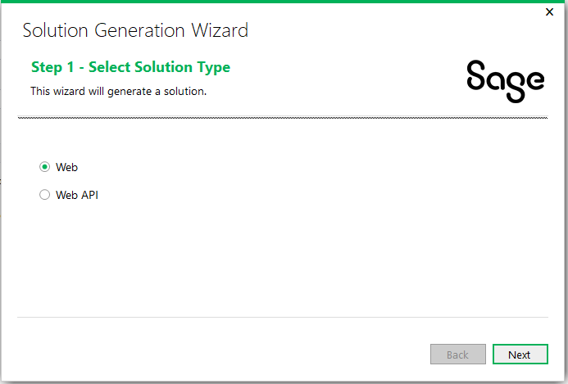
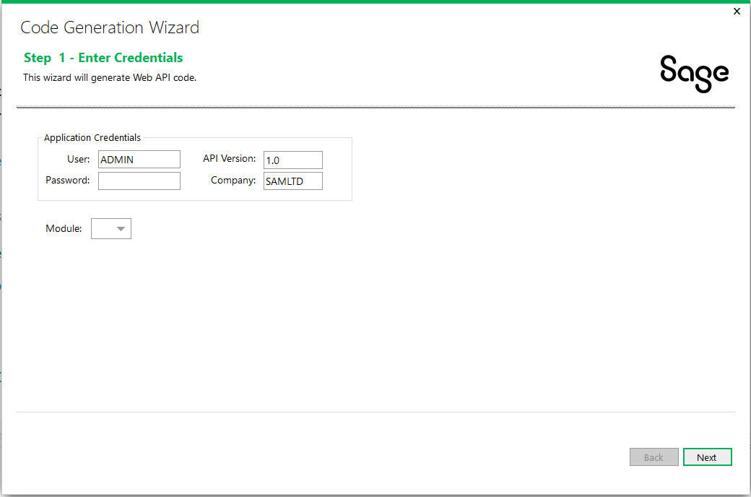
Web API
Subclassing ability added via Web API Subclassing Wizard since 2024.2
Performance improvements for stateful behavior on subsequent API calls
New for 2025.1! Added Partner Web API support to the Solution Wizard and Code Generation Wizards
Web Screens
Note: The generated model class has a TODO that must be resolved before compiling/running. The reason for this is the ROTO ID for the View ID must be manually specified (auto resolving would require the Desktop SDK to be installed).

Slide 28
Proxy & Tester

Slide 29
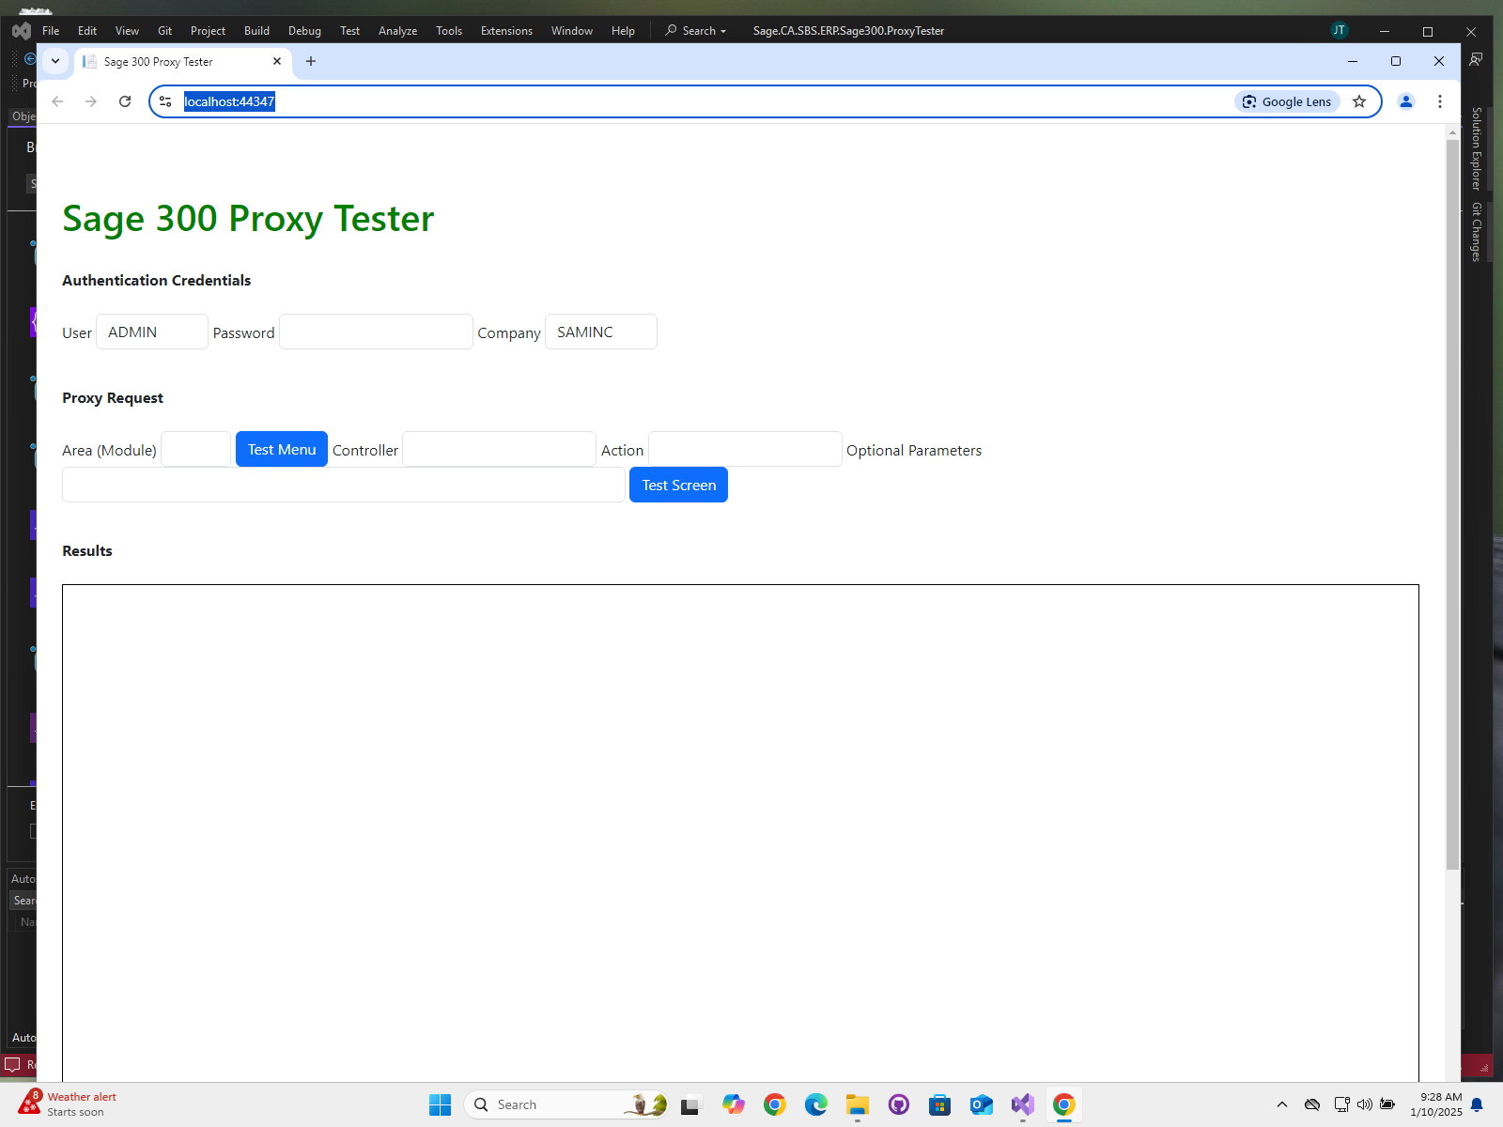
Proxy & Tester
A new Proxy (API) has been added to the Sage Web Screens for 2026.0
Secured with Asymmetric Elliptical Encryption
Any web application with valid Sage 300 credentials can host/display a Sage 300 Web Screen
See doc in docs/utilities folder
A Proxy Tester has been added to the Web SDK to provide valid code snippets and pattern for invoking proxy
See tester in src/utilities folder
Note: A new web.config entry has been created that controls whether https is required. See document for further information.
Web Screens

Slide 30

Documentation and Tutorials

Slide 31
Documentation and Tutorials
Updated CommonCore.chm
Updated upgrade instructions 2026.0 → 2027.0
Web Screens

Slide 32

Miscellaneous

Slide 33
Miscellaneous
FYI
N/A
Web Screens

Slide 34
What’s Coming

Slide 35
What’s Coming
Roadmap
MCP and AI!!
Web Screens
Tentative
AOM included in Web SDK
Hamburger implementation in generated finder code
Enhanced flow in Customization Wizard
Kendo MVVM to replace Knockout Data Binding

Slide 36
GitHub Repository

Slide 37
GitHub Repository
Open Source
https://github.com/SageNADev/Sage300-SDK
2027.0 is available in the “master” branch
2027.1 is available in the “develop” branch
Archives
2026.0 available in “release-2026.0”
2025.1 available in “release-2025.1”
2025.0 available in “release-2025.0”
2024.2 available in “release-2024.2”
2024.0 available in “release-2024.0”
2023.3 available in “release-2023.3”
2023.1 available in “release-2023.1”
2023.0 available in “release-2023.0”
2022.1 available in “release-2022.2”
2022.1 available in “release-2022.1”
2022.0 available in “release-2022.0”
2021.2 available in “release-2021.2”
2021.0 available in “release-2021.0”
2020.2 available in “release-2020.2”
2020.1 available in “release-2020.1”
2020.0 available in “release-2020.0”
Web Screens
2019.2 available in “release-2019.2”
2019.1 available in “release-2019.1”
2019.0 available in “release-2019.0”
2018.2 available in “release-2018.2”
2018.1 available in “release-2018.1”
2018.0 available in “release-2018”
2017.2 available in “release-2017.2”
2017.1 available in “release-2017.1”
2017.0 available in “release-2017”

Slide 38
Partner Requests

Slide 39

Partner Requests
Bring these to the Sage 300 Product Manager
Add these to the Sage 300 Ideas Site
Sage 300 Ideas Forum
Your voice and feedback resounds the loudest!
Web Screens

Slide 40
Thank you!

