Slide 1

Sage Center of Excellence Series AI – What’s real
John Thomas (JT)
Principal Software Architect
June 2026

Slide 2



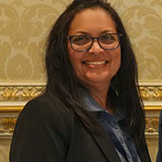
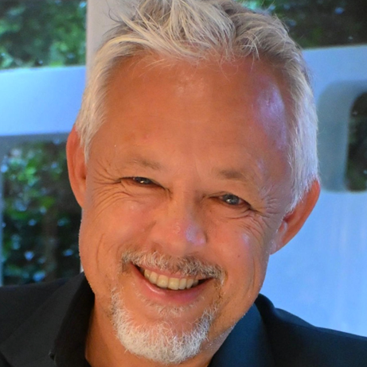
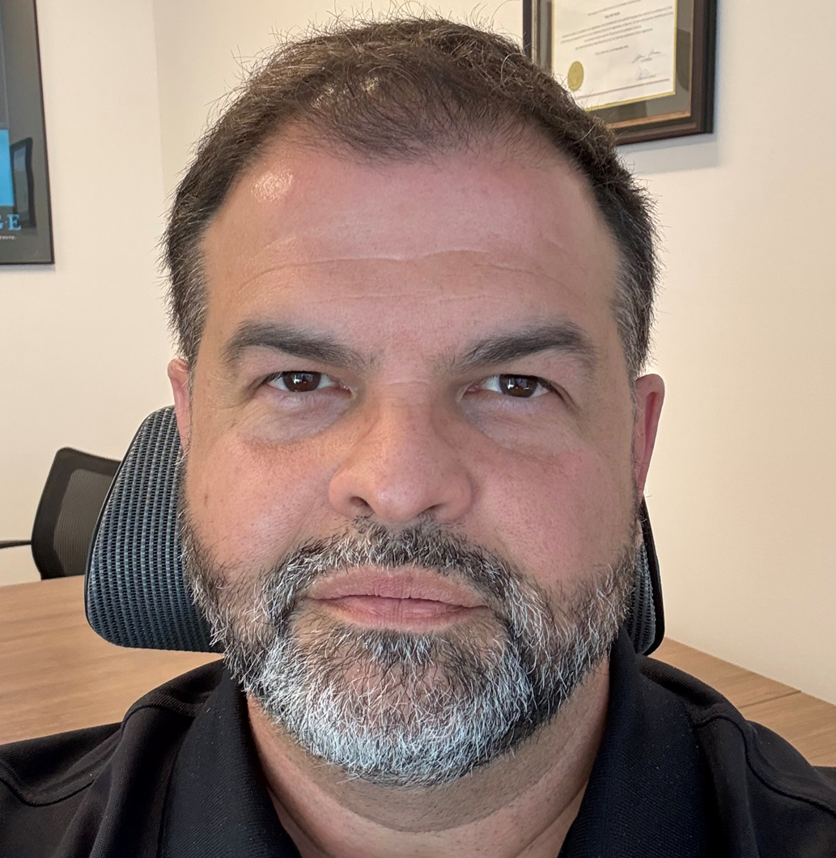

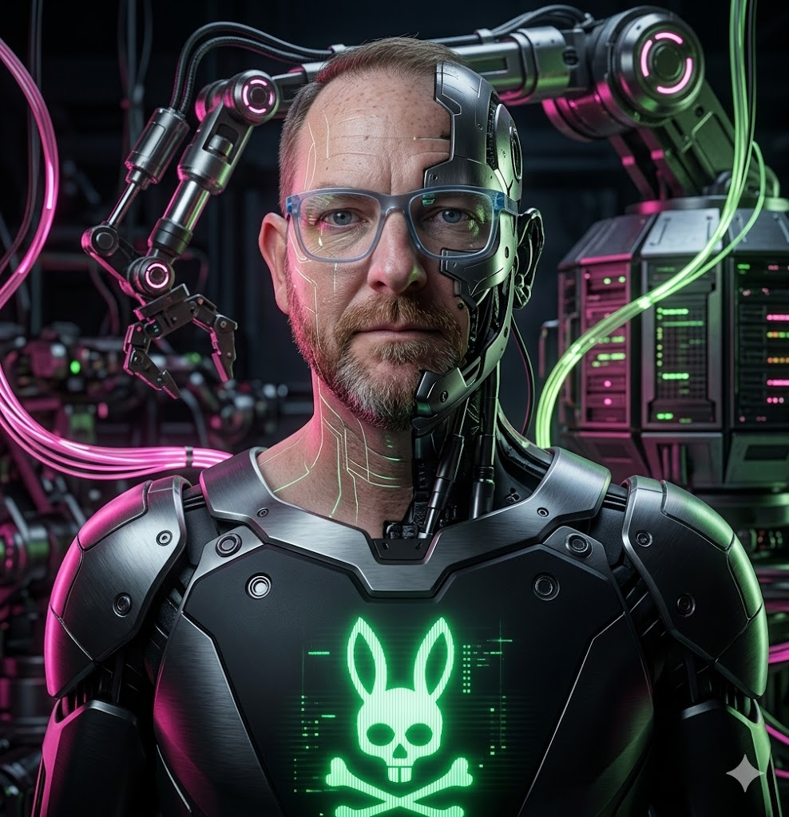


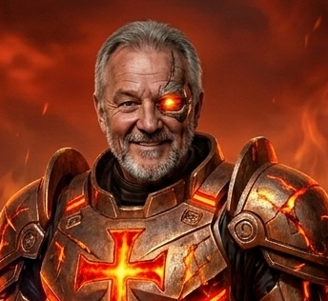

AI Roundtable
John Thomas (JT)
Sage
Sage 300 Architect
Moderator
Ron Sinfield
Sage
Global Senior VP
Head of ERP
Don Thomson
TaiRox
CEO
Bharti Meisuria
BAASS
VP Development &
Mgmt. Consulting
Craig Collins
Granite WMS
CEO
Marco Pomponi
Genatec
ERP Director
Locutus
Loki
The Boss
Kindness is not Weakness
Sir SmilesAlot
The Seer

Slide 3
AI Roundtable - Questions
How has AI changed since your first exposure?
As a business leader, what will you do, or have done, or will not do to empower your business and technology leaders to leverage AI?
There has been a lot of news recently on the cost of AI (tokens). What are your thoughts on these skyrocketing costs , and will this affect your decision to start and/or continue with AI?
What are your thoughts on the recent news that the AI apocalypse (loss of jobs) is overblown? (i.e., News such as “CEOs are uniquely prone to AI psychosis because they are sufficiently distance from the “last mile of work” that still needs to happen to generate the most value with AI”)
How are your teams/company using AI today?
Soaring AI investment reflects a belief in AI to create value but also raises expectations and shortens patience for strategies that do not translate into immediate results. Thoughts?
What about AI are your concerned and excited about?
Now speaking about development, are you leveraging AI to develop your product/solutions and what are your insights?

Slide 4
Thank you!

