Slide 1

Sage 300 - TPAC 2025 Vietnam Web Customization
John Thomas (JT)
Principal Software Architect
October 2025

Slide 2
Table of contents
Vision
Software Architecture
Web Customization
Overview
Simple Customization
Complex Customization
Notes:
And questions, suggestions and feedback are valuable for delivering an API and an SDK that meets as many needs, and requirements of the developer community as possible. So, please let your voice be heard!

Slide 3
Vision
Software Architecture
The Sage 300 Desktop architecture is based on separation of core business logic from user interface and database services
Sage 300 Web Screens aims to be a truly modular, cloud-ready, customizable and extensible business management solution that enables users, customers and partners to achieve a higher level of efficiency and innovation
The Sage 300 Desktop and Web architectures have been created by Sage and is owned by Sage. These architectural technologies are the key distinction between Sage and our competitors.
Notes:
The Sage 300 desktop has been around for decades, and its architecture is solid and fundamentally sound.
The Sage 300 web screens have been around since 2015 and leverages the business and database components of the Sage 300 application. The web screens are architected with the same level of integrity as the other Sage 300 components.
A superior software architecture enables products built within its framework to adapt to fast changing technology and stand the test of time. Sage has made a substantial investment in developing the Sage 300 architectural framework—and this investment continues with the web-based framework for Sage 300 web screens.

Slide 4
Web Customization
Overview
Customizing a web screen is a different experience compared to the desktop where an OCX is inherited, and events, controls, and workflow are added. This is considered an inheritance model. Multiple screens may exist in this scenario (original Sage 300 screen, and multiple partner screens.
Web screens are considered a participation model where unlike the desktop, the customization is applied to the actual Sage 300 web screen. In the event multiple partners customize the same screen, only 1 screen will exist upon applying the customizations.

Slide 5
Web Customization
Simplistic
Create a new customization and apply it to the AP Distribution Sets screen
Click on an Edge/Chrome browser to invoke the web screens (localhost/sage300)
Navigate to the AP Distribution Sets screen where we will be adding a button before the “Save” button called “btnSimple”, which will display the message “Simple Customization”.
Right-click the “Save” button and select “Inspect”
Click on the “Save” button to see that its name is or id is “btnAdd”
In a file explorer, navigate to the c:\{Sage300WebSDK}\bin\wizards folder
Right click on the Sage.CA.SBS.ERP.Sage300.CustomizationWizard.exe and select “properties”
Select the “Unblock” checkbox if there is this option (internet clone safety)
Press “OK”
Double click the Sage.CA.SBS.ERP.Sage300.CustomizationWizard.exe

Slide 6
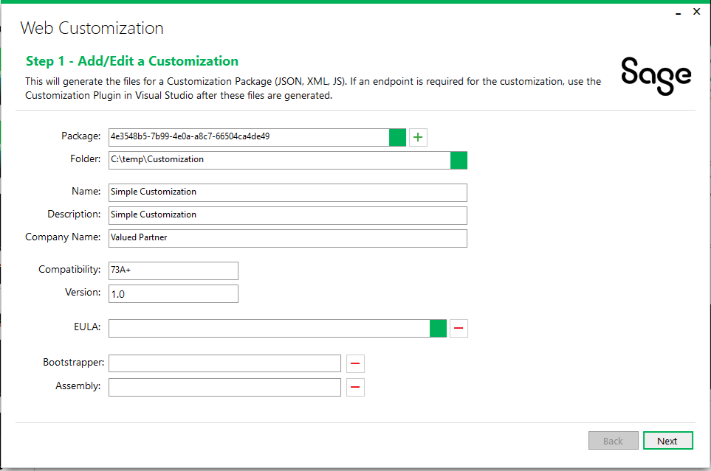
Web Customization
Simplistic
The Customization wizard appears
Press “+” for a new package
Click the ellipse field for the folder and select the “C:\{YourProjectFolder}” folder
Enter “Simple Customization” for the Name field
Enter “Simple Customization” for the Description field
Enter “Valued Partner” for the Company Name field
Press the “Next” button

Slide 7
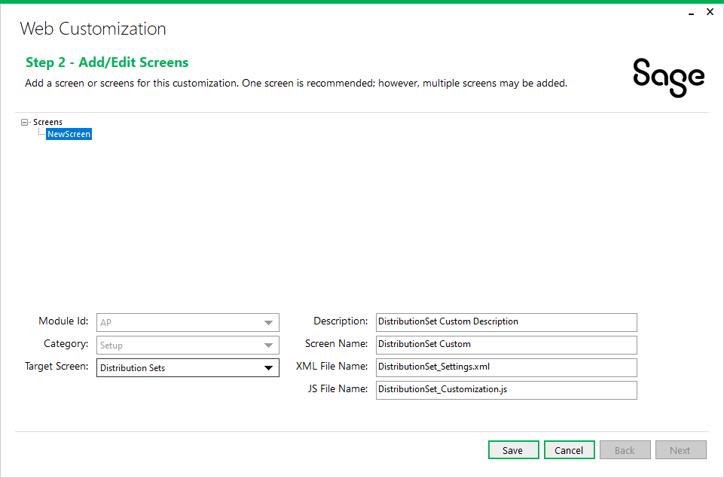
Web Customization
Simplistic
Specify which Sage 300 web screen is to be customized
Right click on “screens” and select “Add Screen”
Select the “AP” module for the Module Id field
Select “Setup” for the Category field
Select “Distribution Sets” for the Target Screen field
Press “Save”
Press “Next”

Slide 8
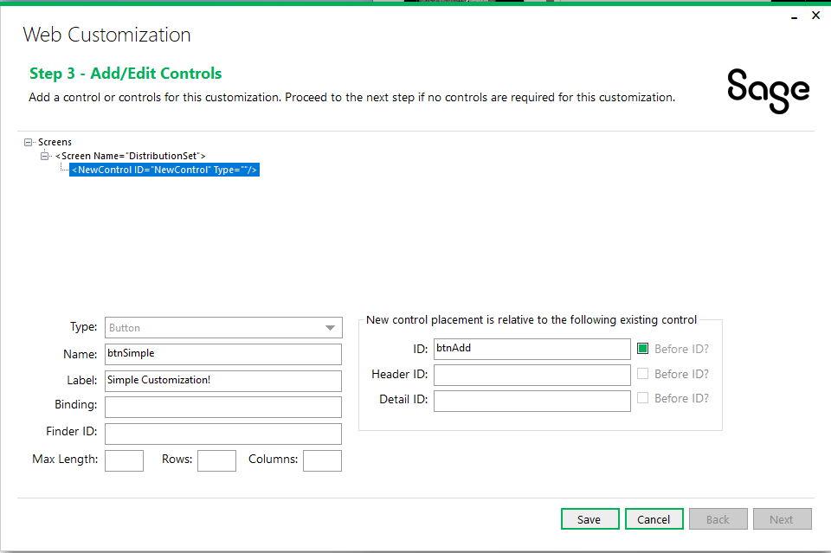
Web Customization
Simplistic
Specify the controls to be added to the Distribution Sets screen
Right click on the “Distribution Set” screen name and select “Add Control”
Select “Button” for the Type field
Enter “btnSimple” for the Name field
Enter “Simple Customization!” for the Label field
Enter “btnAdd” for the ID field
Check the “Before ID?” checkbox
Press “Save”
Press “Next”
Evaluate the settings and press “Generate”
Press “Finish”

Slide 9
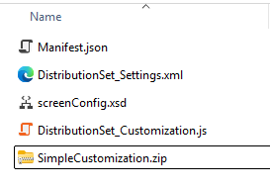
Web Customization
Simplistic
The customization files have been created and navigate to the C:\{YourProjectFolder} folder to view
There will be a JavaScript file, an XML file, an XSD file and a JSON file
Edit the JavaScript file to handle the click even for the btnSimple button
Navigate to the initButtons routine and enter the alert statement for the btnSimple click event
$("#btnSimple").on('click', () => {
alert("Simple Customization clicked!");
});
Save changes to file
Zip these 4 files into a zip file called “SimpleCustomization”

Slide 10
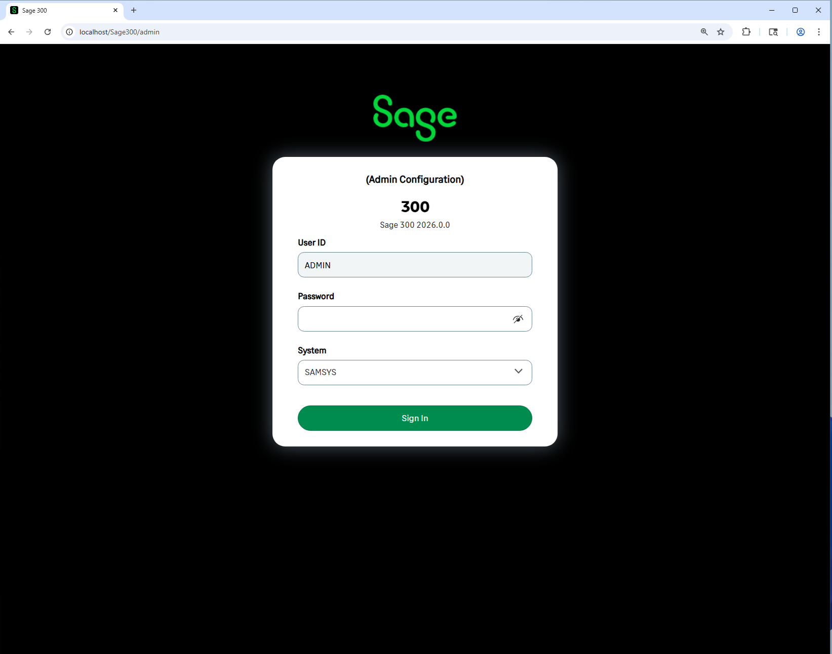
Web Customization
Simplistic
The customization package is ready to be imported
Click on an Edge/Chrome browser and navigate to localhost/sage300/admin
Login to the system database with “ADMIN” password

Slide 11
Web Customization
Simplistic
The customization package is ready to be imported
Press the “Browse” button and navigate to the customization package zip file just created
Press the “Import” button
Press the “Assign” button at the bottom of the screen
Select a company to be assigned for this customization and press “OK”
Sign out of the admin screen and log into sage 300 (localhost/sage300) (assigned company for customization)
Navigate to the AP Distribution Sets screen to see and test the customization
You are now a customization expert!

Slide 12
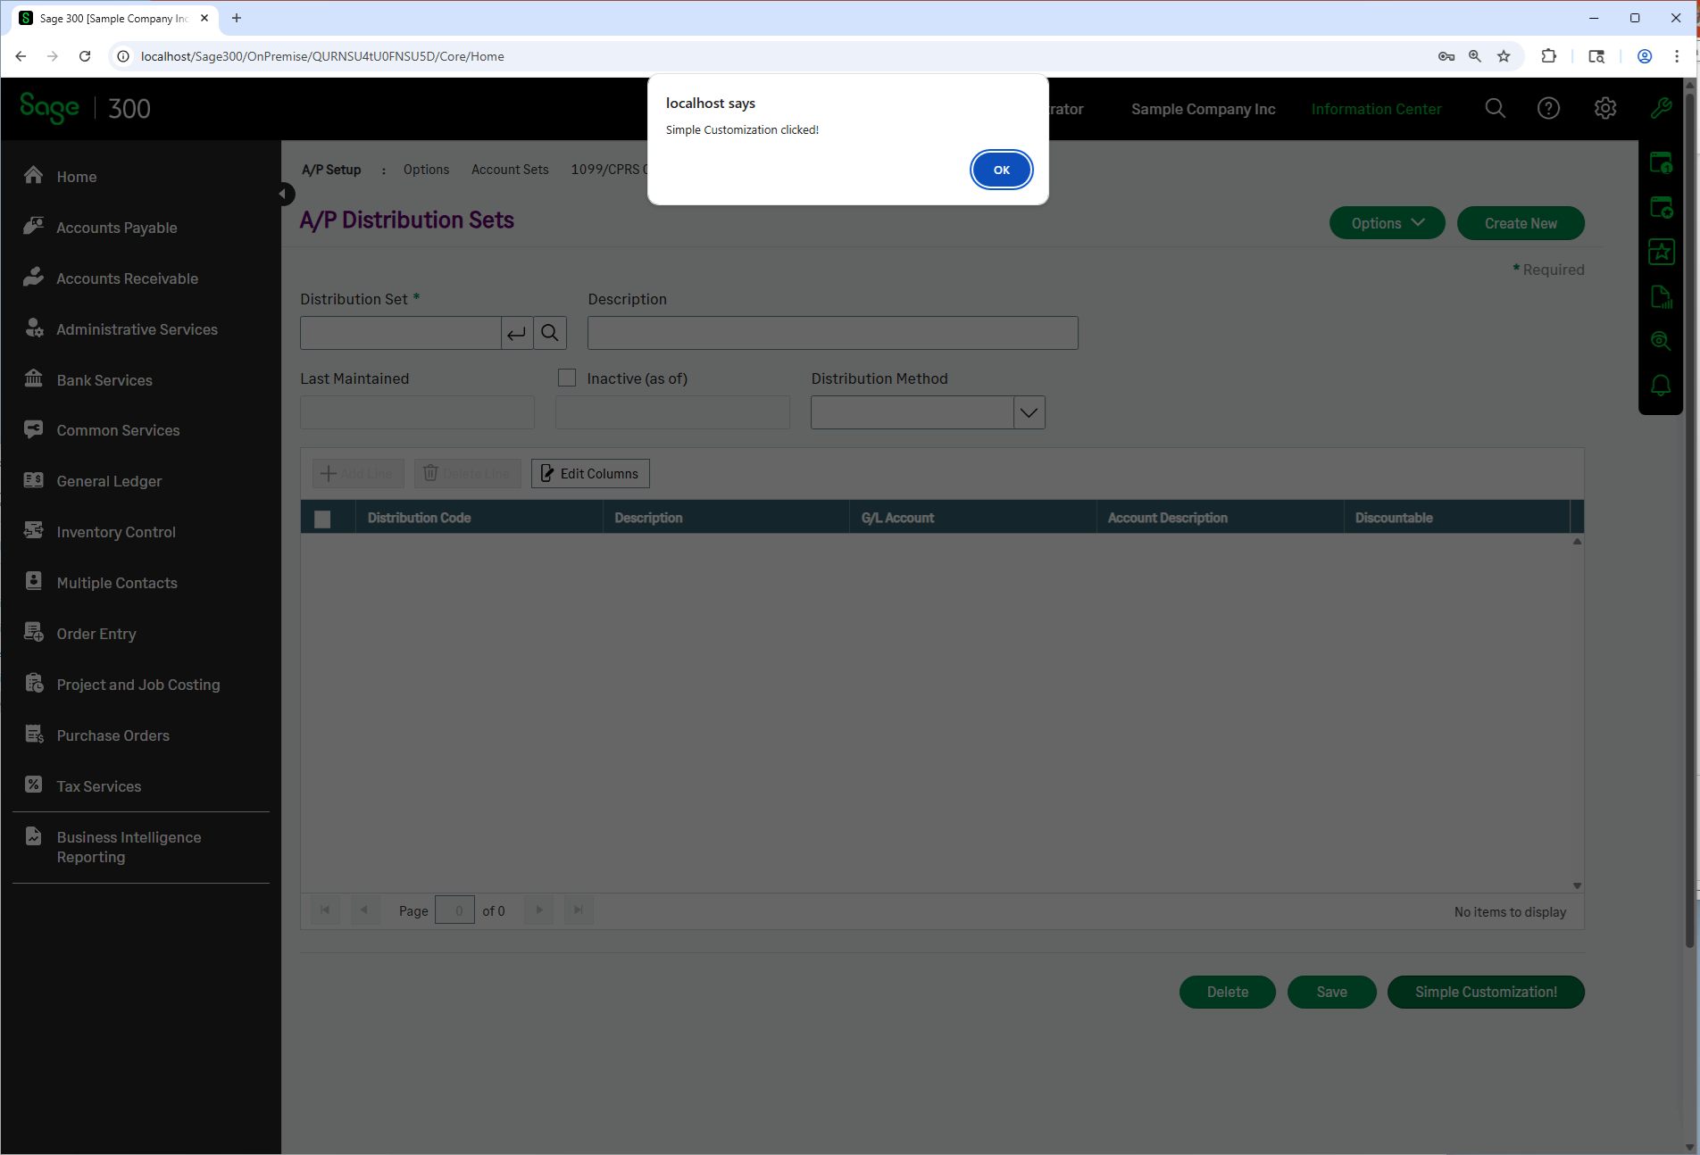
Web Customization
Simplistic

Slide 13
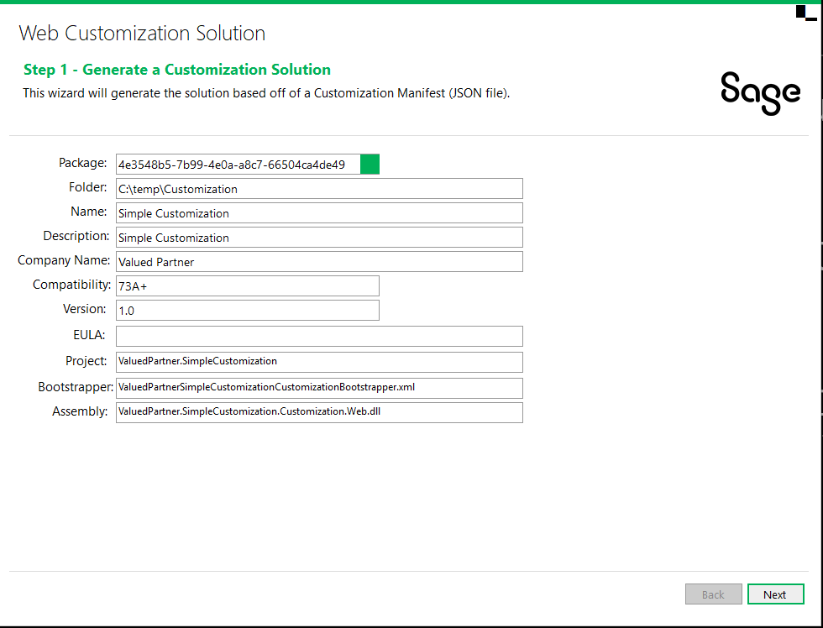
Web Customization
Complex
We will use the customization package created for Distribution Sets to illustrate a complex customization
Run Visual Studio, select New Project, and select the Sage 300 Customization wizard since we will be intercepting the Web Screen’s Save event
When the wizard appears, select the Manifest.json file for the Distribution Sets customization package
Select Next

Slide 14
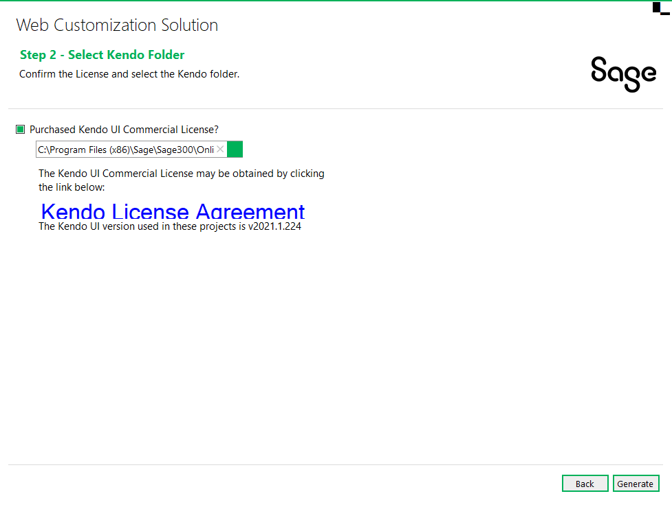
Web Customization
Complex
Select to use the Kendo license
Select Next

Slide 15
Web Customization
Complex
Select to use the Kendo license
Select Generate

Slide 16
Thank you!

