Slide 1

Sage 300 - TPAC 2025 Vietnam Partner Web API
John Thomas (JT)
Principal Software Architect
October 2025

Slide 2
Table of contents
Vision
Software Architecture
Partner Web API
Partner Overview
Notes:
And questions, suggestions and feedback are valuable for delivering an API and an SDK that meets as many needs, and requirements of the developer community as possible. So, please let your voice be heard!

Slide 3
Vision
Software Architecture
The Sage 300 Desktop architecture is based on separation of core business logic from user interface and database services
Sage 300 Web Screens aims to be a truly modular, cloud-ready, customizable and extensible business management solution that enables users, customers and partners to achieve a higher level of efficiency and innovation
The Sage 300 Desktop and Web architectures have been created by Sage and is owned by Sage. These architectural technologies are the key distinction between Sage and our competitors.
Notes:
The Sage 300 desktop has been around for decades, and its architecture is solid and fundamentally sound.
The Sage 300 web screens have been around since 2015 and leverages the business and database components of the Sage 300 application. The web screens are architected with the same level of integrity as the other Sage 300 components.
A superior software architecture enables products built within its framework to adapt to fast changing technology and stand the test of time. Sage has made a substantial investment in developing the Sage 300 architectural framework—and this investment continues with the web-based framework for Sage 300 web screens.

Slide 4
Partner Web API
Overview
Sage 300 offers multiple APIs for accessing Sage 300 data:
COM API, .NET API, and the Web API.
Partners have requested the ability to participate in the Web API to surface or access data in Sage 300 tables created by partners. Of course, this can be done by a partner writing their own Web API, but that is not a seamless solution.
The Partner Web API Wizard allows a partner to deliver discoverable endpoints for the Sage 300 Web API.

Slide 5

Partner Web API
Wizards
The Solution Wizard has been enhanced for the creation of either a Web Screen solution or a Web API solution
The Code Generation Wizard has been enhanced for the generation of either Web Screen code or Web API code
Let’s run the Wizards to generate a new solution and generate code for a specified endpoint
We’ll then compile and deploy the discoverable endpoint to the localhost and access it in the Sage 300 Web API

Slide 6
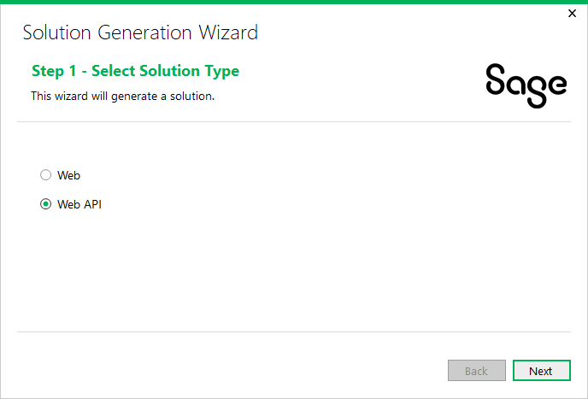
Partner Web API
Solution Wizard
Let’s run the Solution Wizard to create a solution to hold the endpoints that we will later generate with the Code Generation Wizard
Since the Web API does not require UI elements, the Solution Wizard steps for the Web API are minimal

Slide 7
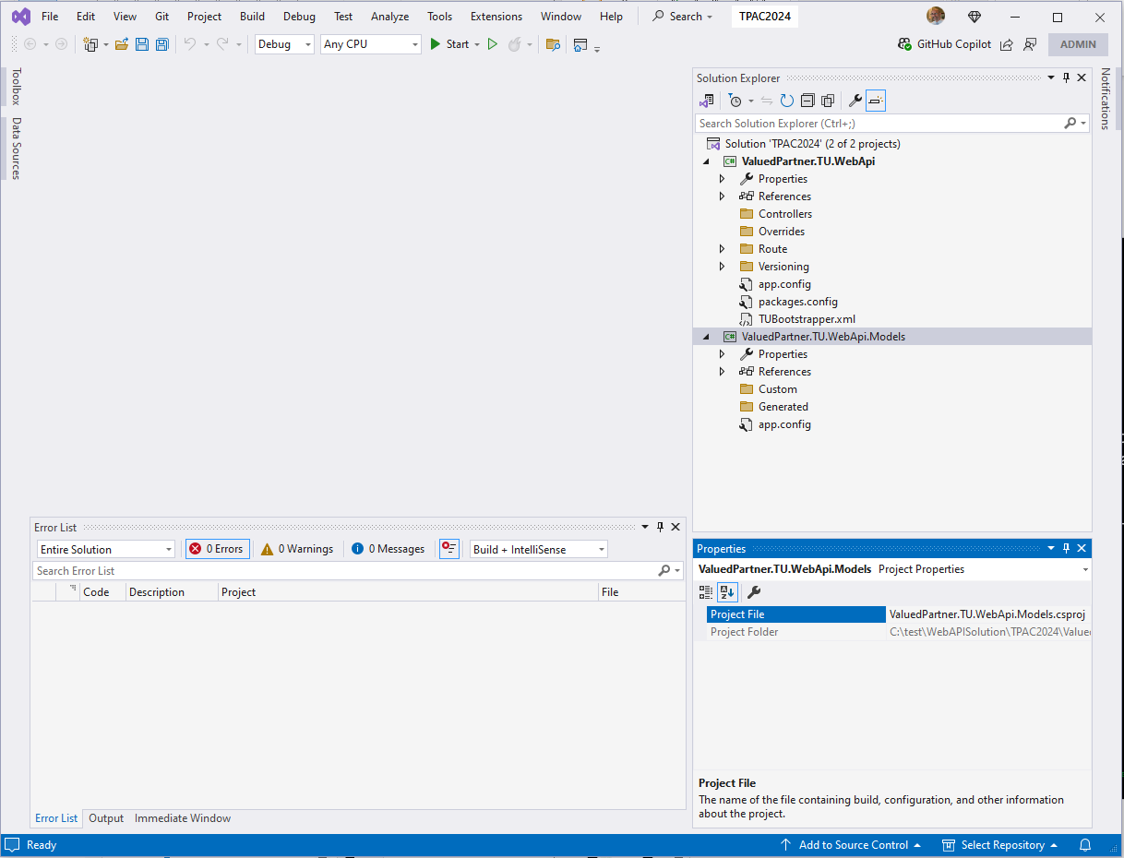
Partner Web API
Web API Solution
Upon completion, a solution is created with two projects whereas the Web Screen solution contains six projects
Restore the Nuget packages and we are ready to generate an endpoint

Slide 8
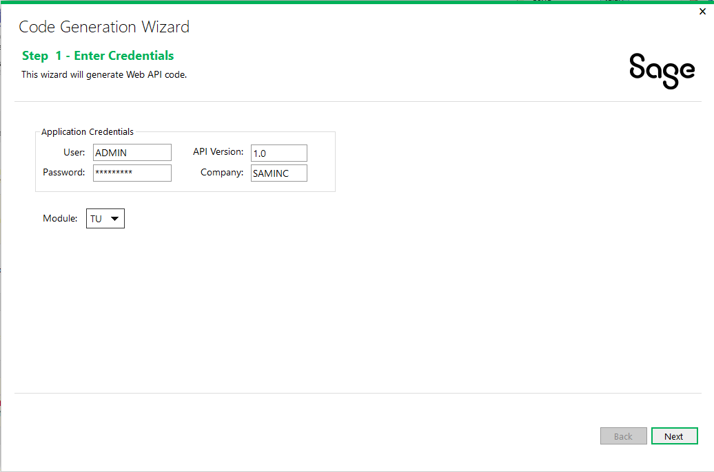
Partner Web API
Code Generation Wizard
Let’s run the Code Generation Wizard to generate an endpoint
Since the Web API does not require UI elements, the Code Generation Wizard steps for the Web API are less than the Web Screen’s steps
No UI Layout Wizard
No Resx Generation
Added API Version field

Slide 9
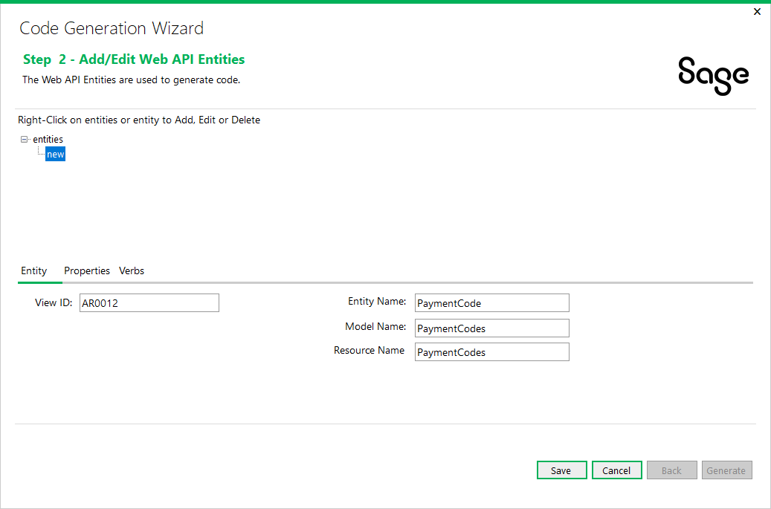
Partner Web API
Code Generation Wizard
Entities are specified just like for Web Screens

Slide 10
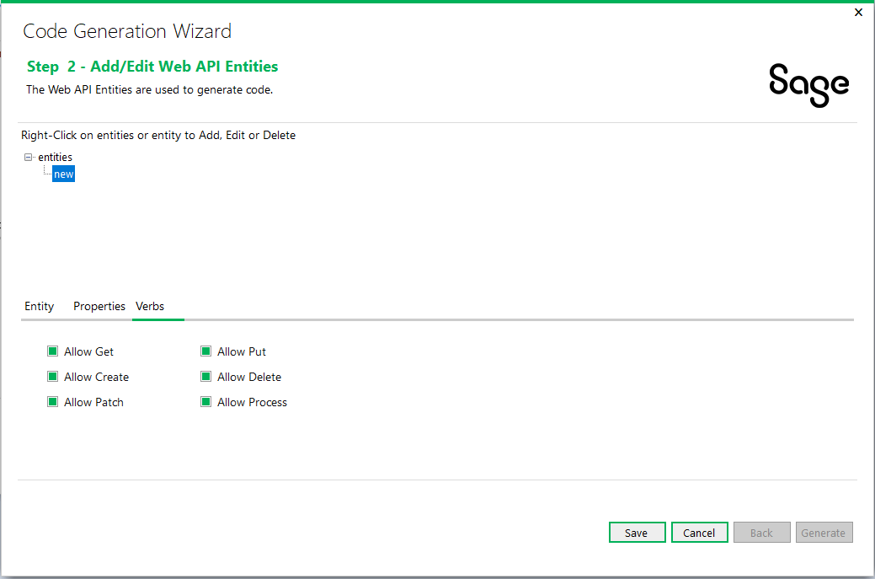
Partner Web API
Code Generation Wizard
A new Verbs tab has been added to allow for selection and deselection of Verbs or Actions for the endpoint

Slide 11
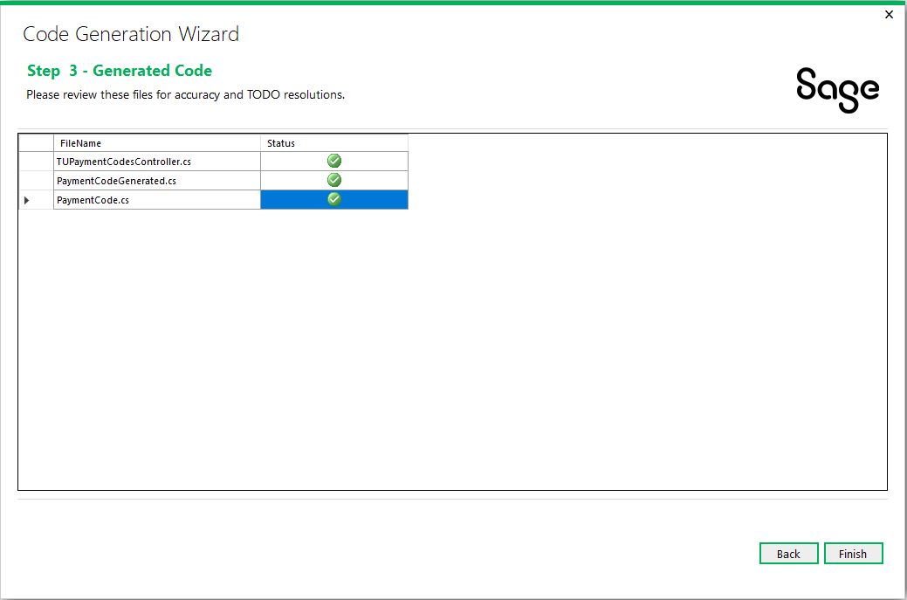
Partner Web API
Code Generation Wizard
Minimal files are generated unlike the Web Screen’s code generation.
We are ready to review and compile!

Slide 12
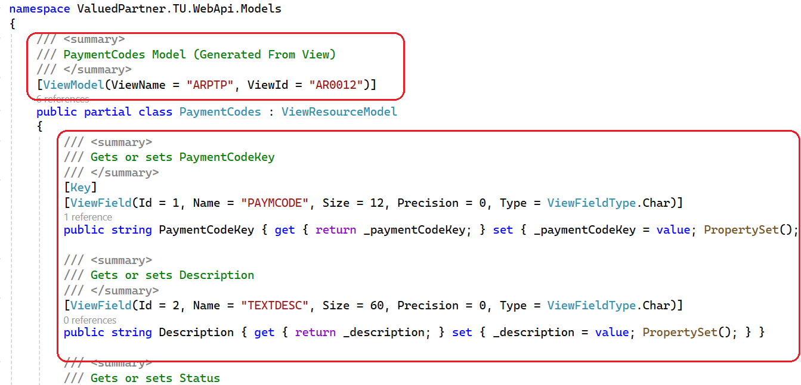
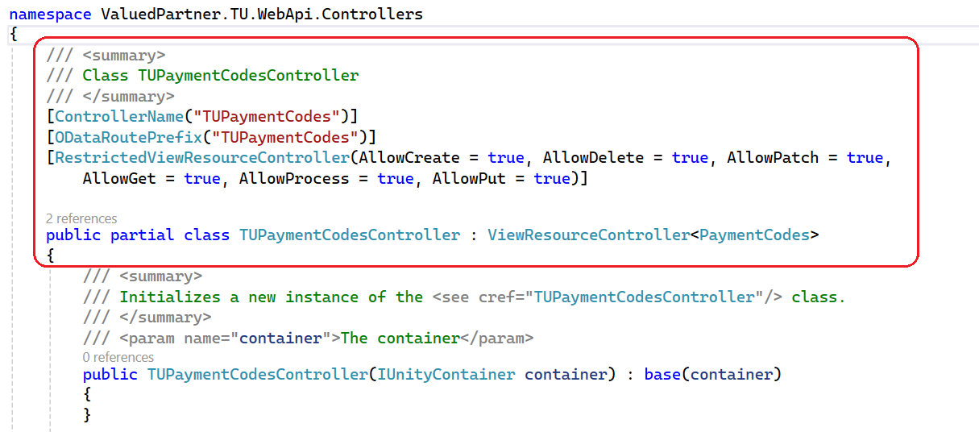
Partner Web API
Web API Project
A model and controller have been generated for the endpoint.
Let’s build to ensure no errors and we are ready to deploy to the WebApi folder.

Slide 13
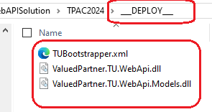
Partner Web API
Web API Assemblies
Upon compiling, a “__DEPLOY__” folder is created with three files that will need to be copied/deployed to the Online\WebApi\bin folder
{module}Bootstrapper.xml - XML file for discovery of partner assemblies
*.{module}.WebApi.dll and *.{module}.WebApi.Models.dll – Partner Assemblies
Let’s run the Sage 300 Web Api to see the new endpoint!

Slide 14
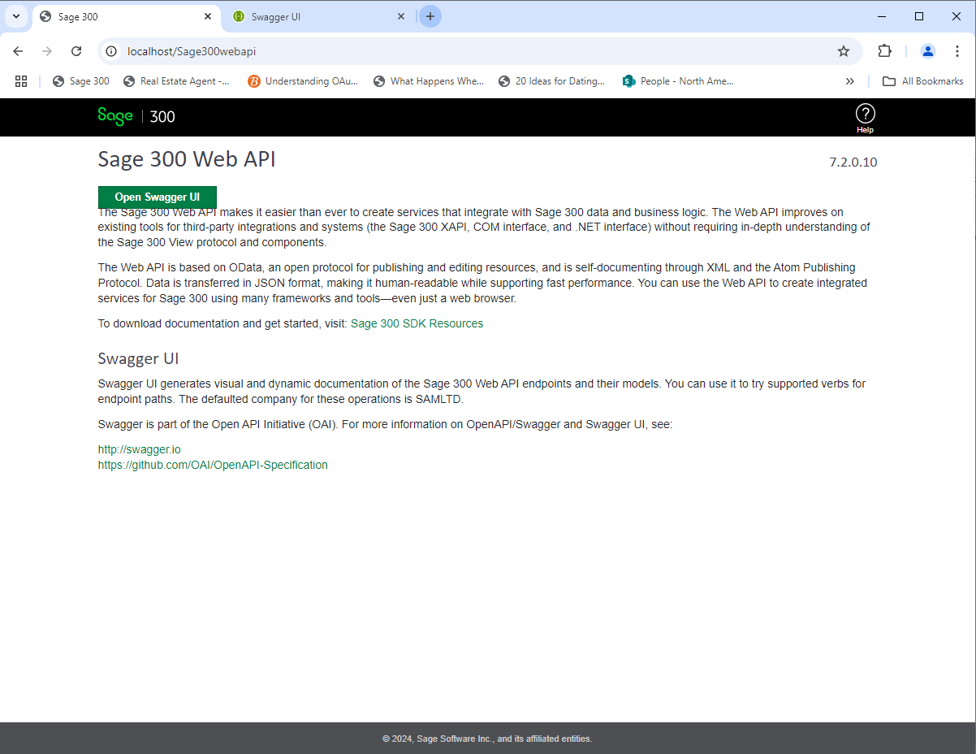
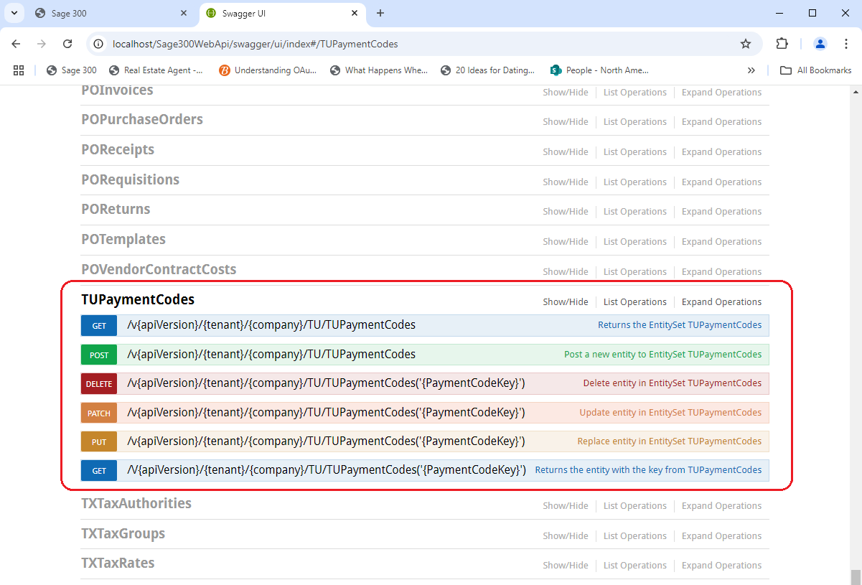
Partner Web API
Sage 300 Web API
Localhost/Sage300WebApi
Select Open Swagger UI
Click on TUPaymentCodes
Let’s try it out!
Hint: If using ADMIN, be sure it is allowed!

Slide 15
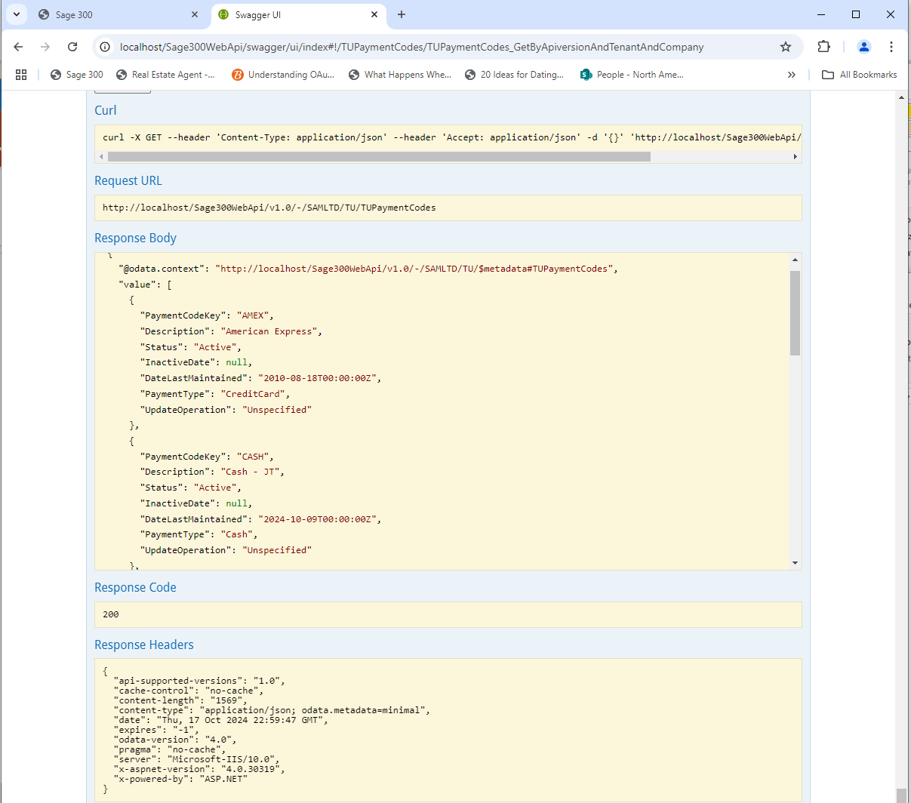
Partner Web API
Sage 300 Web API
Data retrieved!

Slide 16
Partner Web API
Summary
Web API
Easy to use, less data transfer, No UI, consistent, JSON, Integration
Partner Web API
Seamless Integration
Discoverable Endpoints
Solution Wizard enhanced to allow creation of Web API solution
Code Generation Wizard enhanced to allow generation of Web API project code

Slide 17
Thank you!

