Slide 1

Sage 300 - TPAC 2025 Vietnam Proxy and Proxy Tester
John Thomas (JT)
Principal Software Architect
October 2025

Slide 2
Sage 300 Proxy
Partner Web App
Sage 300 Proxy
A gateway to the Sage 300 web screens
Sign in without a UI
Display a web screen in partner web application
Receive a JSON payload of a menu items
Uses Elliptic-Curse Cryptography (ECC)
Proxy Tester in Web SDK used for testing and code snippets
As of 2026.0, CRM and HRMS use this proxy to display web screens in those applications
Note: Uses https by default but can use http with web.config entry
Sage 300 Web Screen

Slide 3
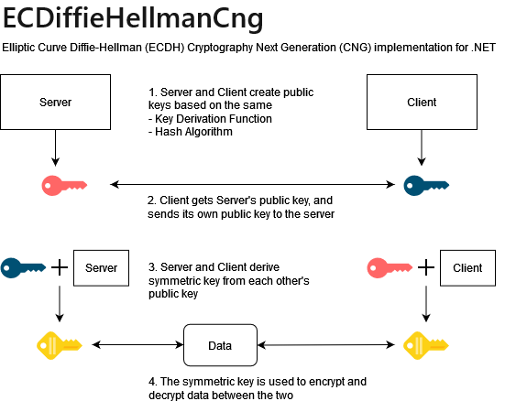
Sage 300 Proxy
Elliptical Encryption
The proxy uses ECDH for encryption
All requests are made with a new public key
Previous proxy had credentials in URL
Now credentials are encrypted in header

Slide 4
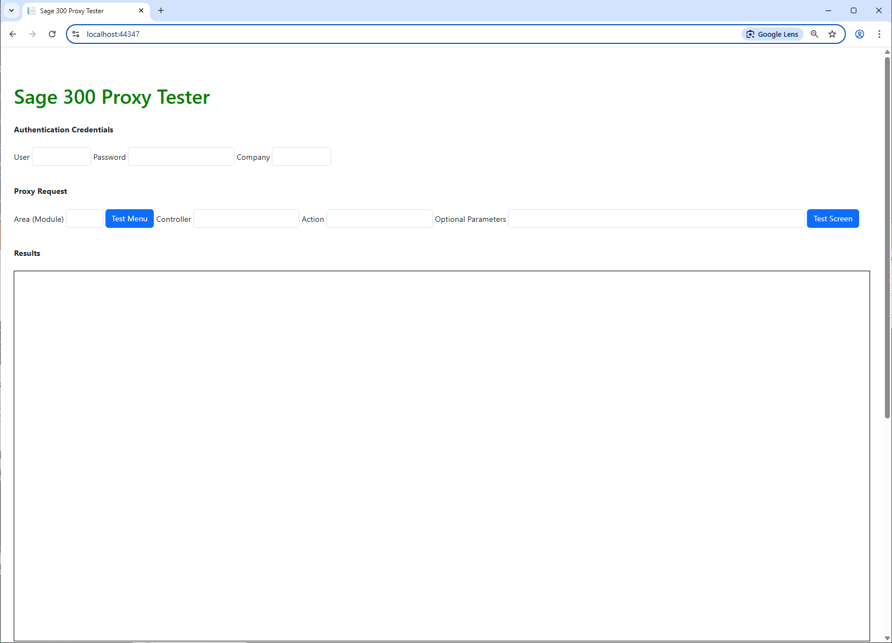
Sage 300 Proxy
Proxy Tester Screen
Enter Sage 300 credentials
Able to retrieve a module’s menu
Able to display a screen (area (module), controller, action)
Optionally specify context to display a screen

Slide 5
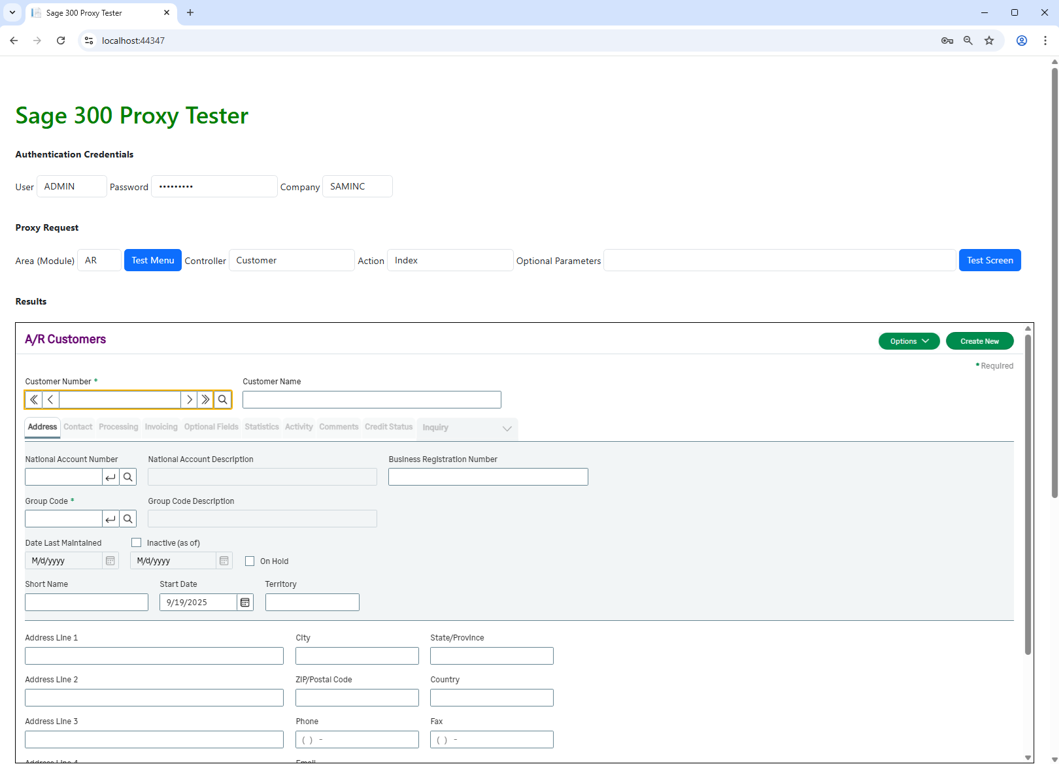
Sage 300 Proxy
Using the Proxy Tester Screen
After entering credentials
After entering “AR”, “Customer”, “Index”, the AR Customers screen is displayed in the iFrame

Slide 6
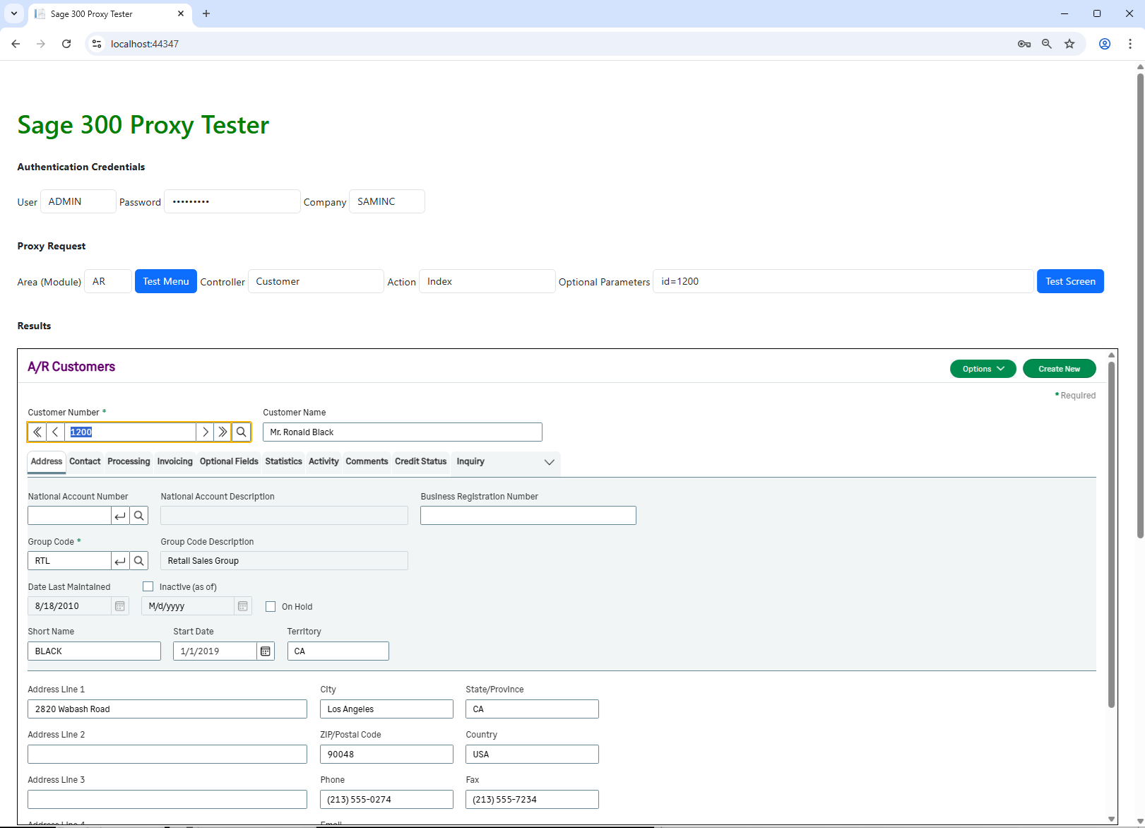
Sage 300 Proxy
Using the Proxy Tester Screen
By simply adding “id=1200” to the Optional Parameters field (parameters to “Index” or specified Action), and selecting the “Test Screen” button, the screen is invoked and displayed in-context!

Slide 7
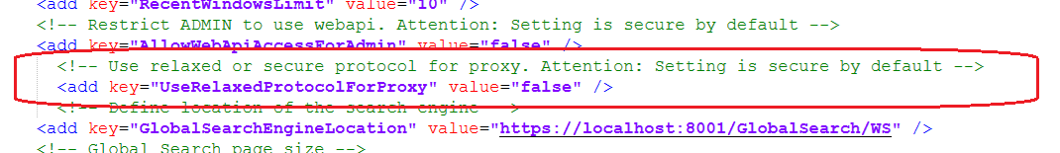
Sage 300 Proxy
Web.config Entry
By default, the proxy can only be used if Sage 300 is setup with a certificate (https)
This is standard for customer installations
But, development, QA, sales, etc. may choose to use http in these environments
A web.config entry seen below will need to be modified in the ..\Online\Web folder to change the value of “UseRelaxedProtocolForProxy” from false to true

Slide 8
Thank you!

