Slide 1
Sage 300 2018.1 Web SDK Overview
John Thomas (JT)
November 2017

Slide 2
Defects Corrected
The module name for a partner’s menu item is not being localized when displayed in the window manager
Resolved in LocalizeMenuItems of the HomeController

Slide 3
Documentation
Upgrade Instructions for 2018.0 to 2018.1
New Coding Patterns document in docs/patterns
Only 1 pattern documented thus far, but it’s a start!
Wizard and Tutorial documents modified with updated screenshots

Slide 4
Solution Wizard
Global Files Updated to 2018.1

Slide 5
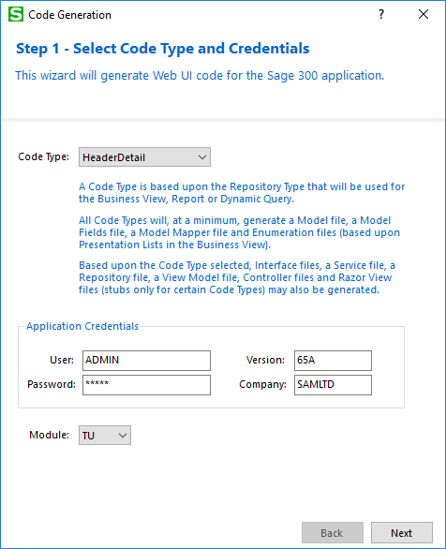
Code Generation Wizard
Global Files Updated to 2018.1
New UI
New HeaderDetail Type
Revised Flow due to multiple views
Credentials, Module, etc. moved to first step

Slide 6
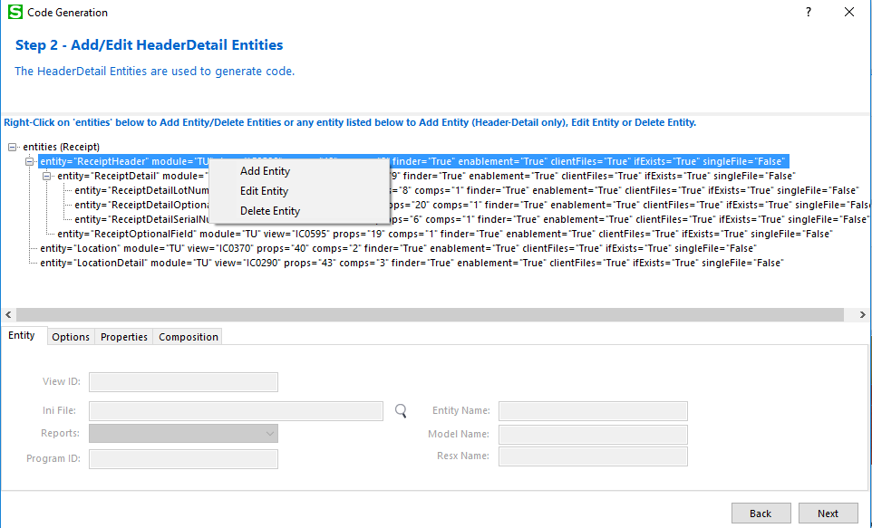
Code Generation Wizard
Revised Flow due to multiple views
New tree control for Add/Edit/Delete Entity
Tree shows hierarchical view
Right-Click tree or existing entity for actions

Slide 7
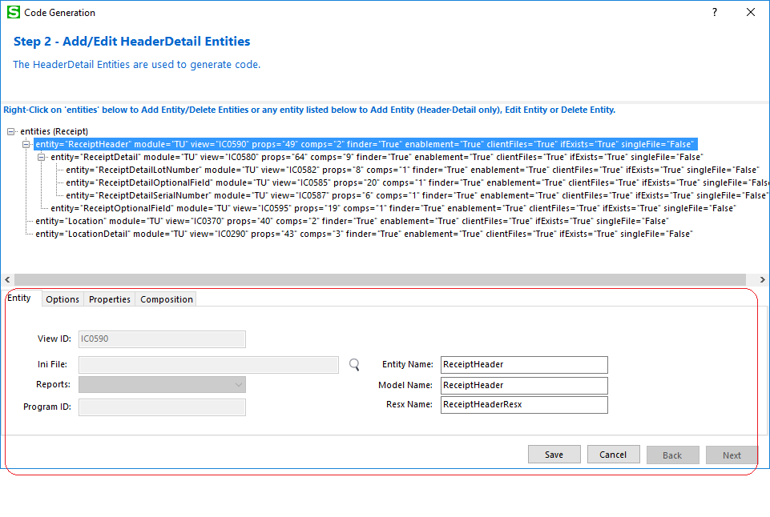
Code Generation Wizard
New Entity Tab for properties specific to the entity
Save/Cancel to update tree

Slide 8
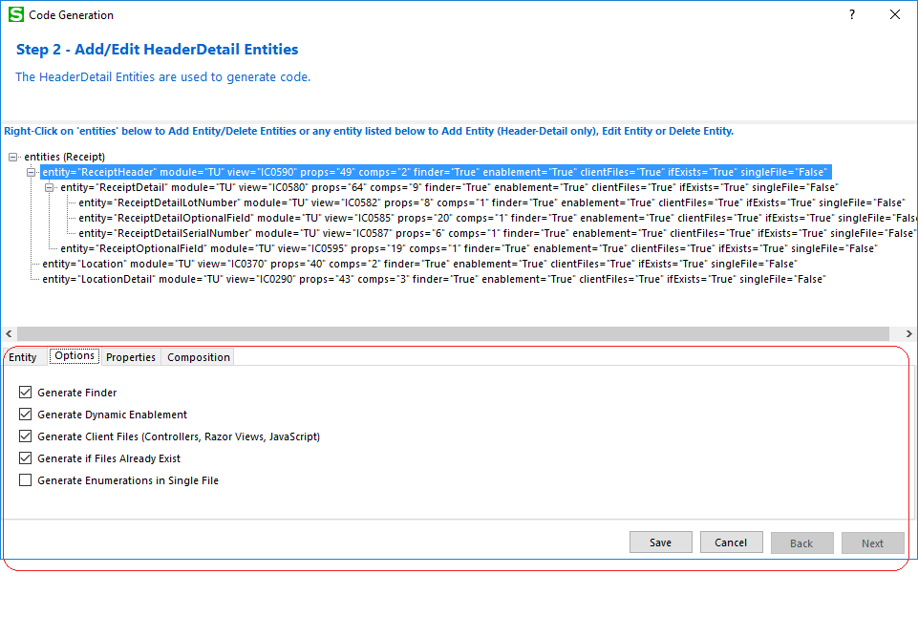
Code Generation Wizard
New Options Tab for options for entity
Save/Cancel to update tree

Slide 9
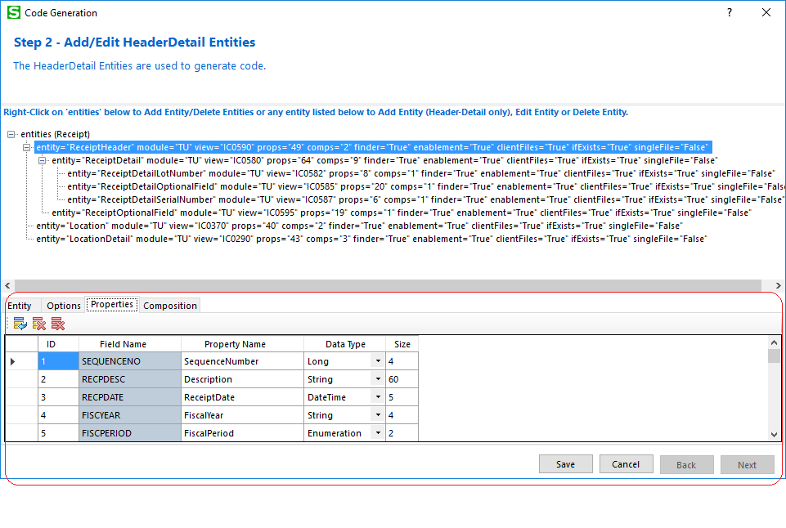
Code Generation Wizard
New Properties Tab to Add/Modify/Delete properties before they are generated
Save/Cancel to update tree

Slide 10
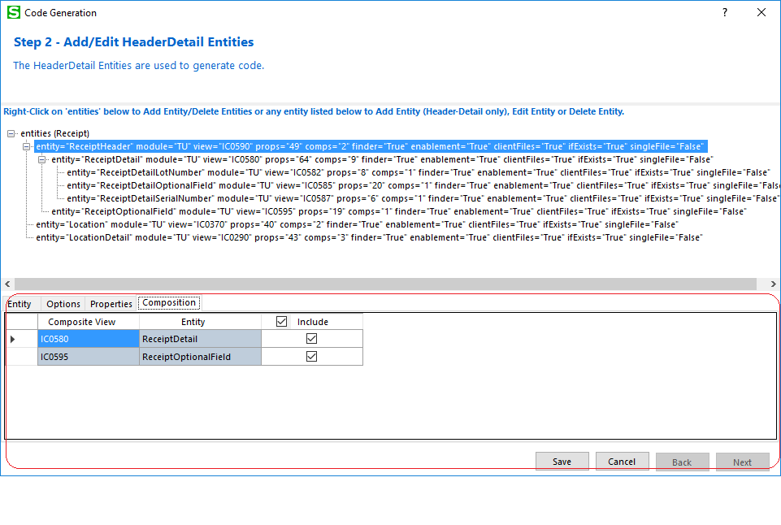
Code Generation Wizard
New Composition Tab for Header-Detail Type to generate composition logic in Business Repository class
Save/Cancel to update tree

Slide 11
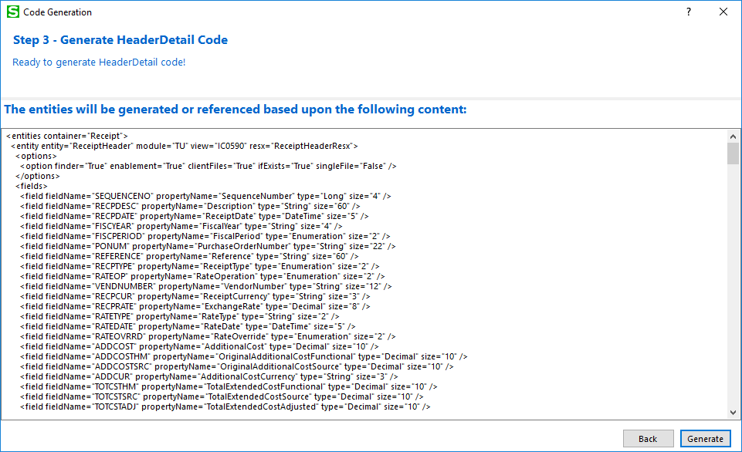
Code Generation Wizard
New XML view of entity or entities being generated to better view before generation

Slide 12
Upgrade Wizard
Upgrades Projects and Solution
Upgrade files from 2018.0 to 2018.1

Slide 13
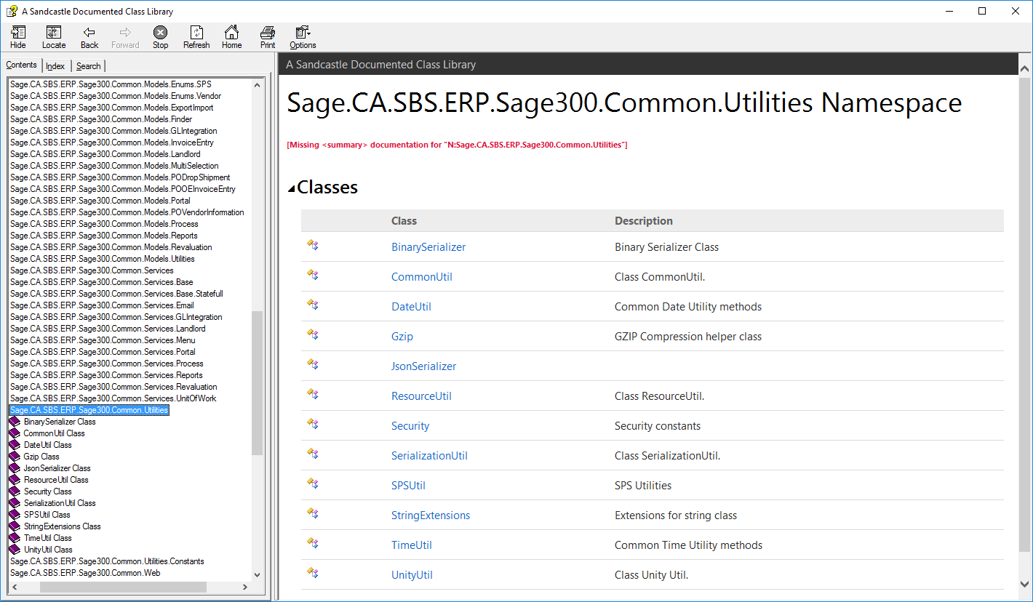
Help File
CommonCore.chm
Updated content
More to be done
Note: Still a work in progress!

Slide 14
Customization Wizard
Global Files Updated to 2018.1
Controller, if generated by Customization Wizard Plugin, now inherits from MultitenantBaseController instead of Controller

Slide 15
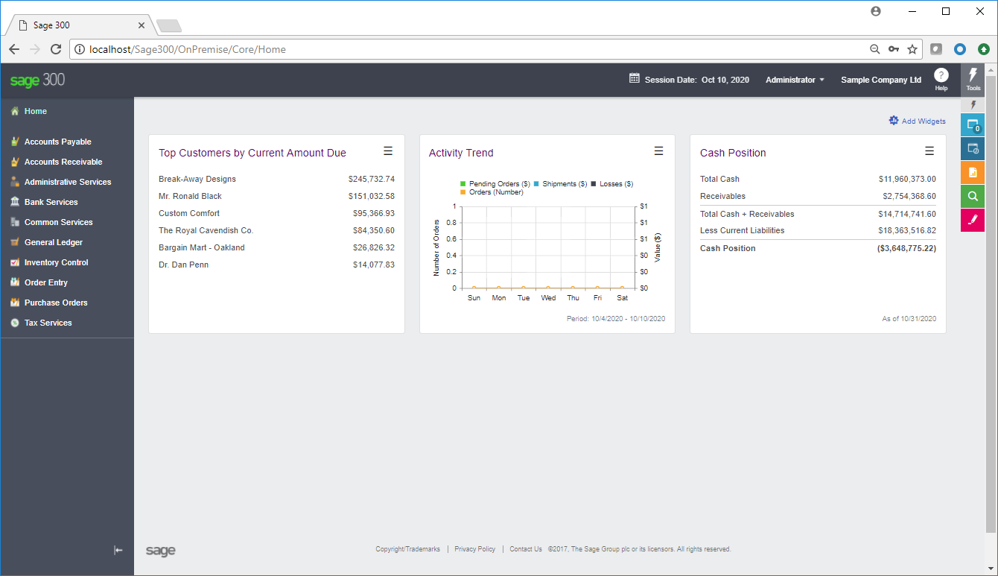
Vertical Menus
New for 2018.1!
No code changes required
Will be assigned default icon in menu
2018.2 will address to allow partner to specify icon in Menu Details XML
Partner will deliver icon, along with assemblies and other files, to a certain folder

Slide 16
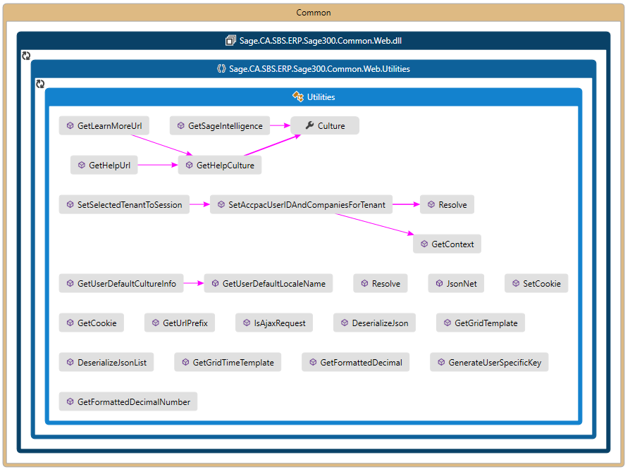
Code Maps
New for 2018.1!
Visual Studio Code Maps
Visual graph of relationships
Locate in the maps folder
Specific Entities
Specific Controllers
Utilities
Helper Classes

Slide 17
Web API
New GL Segments endpoint

Slide 18
GitHub Repository
Open Source
https://github.com/SageNADev/Sage300-SDK
2018.1 is available in the “master” branch
2018.0 is available in the “release-2018” branch (archive)
2017.2 is available in the “release-2017.2” branch (archive)
2017.1 is available in the “release-2017.1” branch (archive)
2017 is available in the “release-2017” branch (archive)
2018.2 is available in the “develop” branch (in-progress)

