Slide 1

B.Tech Project Evaluation Detection and Classification of Cardiac Arrhythmias Using Deep Learning
Presented by :-
Aditya Raj, 2018007210
Sarik Anwar, 2018015190 Shivank Goel, 2018006884
Zeeshan Ahmad, 2018009161
Under the Supervision of:-
Mr. Laxman Singh
Sharda University, Gr. Noida
DEPARTMENT OF COMPUTER SCIENCE & ENGINEERING
SCHOOL OF ENGINEERING AND TECHNOLOGY
13, April, 2022

Slide 2

Approval from guide for the evaluation
Attach the screenshot of the email received from the guide

Slide 3
Contents:
Project Overview
Purpose
Workload Distribution
Improvements/Work done from the last evaluation
Methodology Used
Result
Proof of paper acceptance

Slide 4
Project overview:
Arrhythmia is a heart rhythm condition that causes irregular heartbeats. The electrocardiographic (ECG) signal can reveal abnormalities in the conduction system. An electrocardiogram (ECG) is an important diagnostic tool for detecting heart arrhythmias in clinical practice.
Electrocardiography (ECG) is a crucial and effective diagnostic tool for detecting cardiac abnormalities. The electrocardiogram (ECG) signal is a representation of the heart's bioelectrical activities. The electrocardiogram is a useful tool for determining a person's health status. It provides complete information about physiological processes in the human body and hence can be considered a potential tool for health evaluation.
Any waveform deviations from normal ECG pattern represent numerous cardiac abnormalities including Cardiac Rhythm Disturbances, Improper Blood Flow, Electrolyte Disturbances

Slide 5
Purpose:
To eliminate the need for human detection of arrhythmic beats in the ECG and help doctors simplify their work and be considered for future improvement and development.
To explore various machine learning models for arrhythmia detection in order to obtain a better understanding of the models and to gain insights into what should and will be appropriate for this field of research.

Slide 6
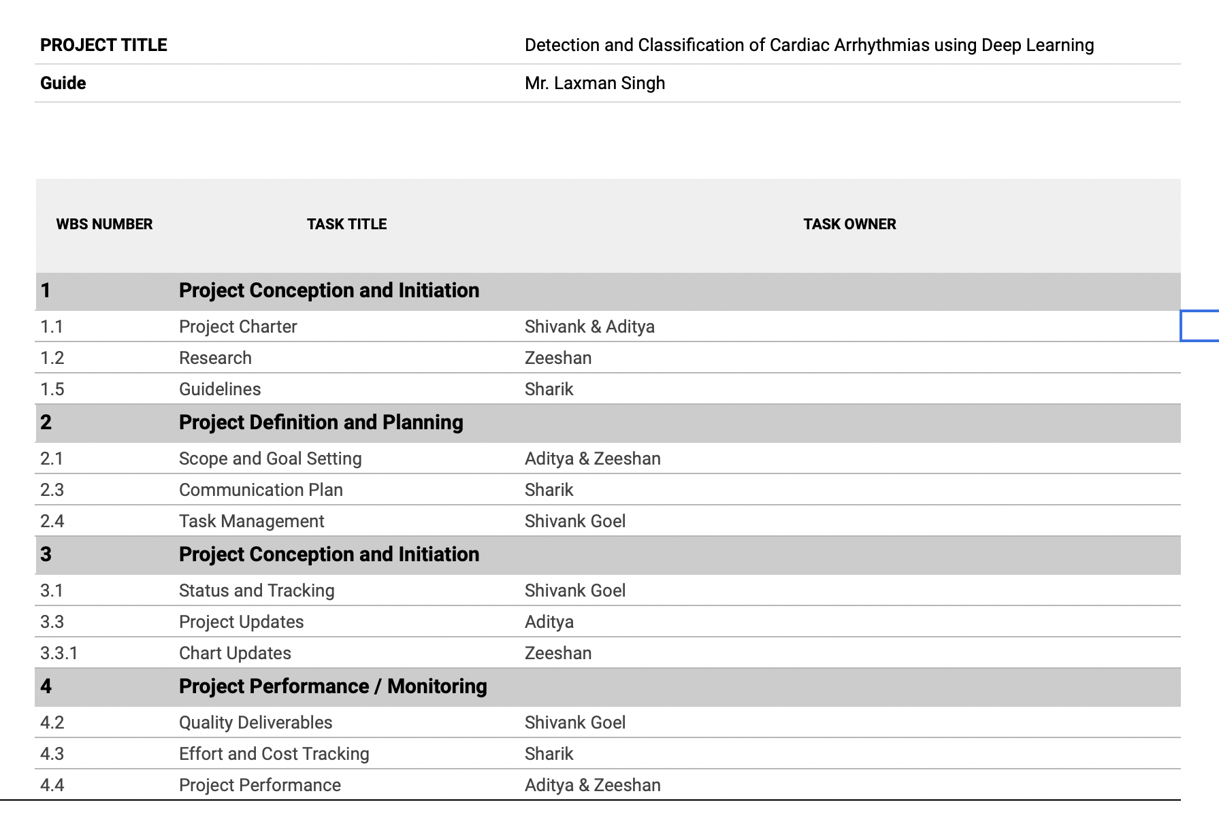
Workload distribution of the team

Slide 7
Methodology
We employed Recurrent Neural Networks to proceed with the categorization and diagnosis of arrhythmic beats. Recurrent Neural Networks are a type of artificial neural network that can process and classify arbitrary sequences of inputs using their internal memory, and the connections between the units form a directed cycle.
The Long Short-Term Memory (LSTM) architecture is a form of recurrent neural network (RNN). LSTMs were created to model temporal sequences, and RNNs' long-range dependencies and memory backup play a critical role, making them more accurate and effective than traditional RNNs. The approach is used after the data has been pre-processed to remove any undesirable, missing, or null signal values.

Slide 8
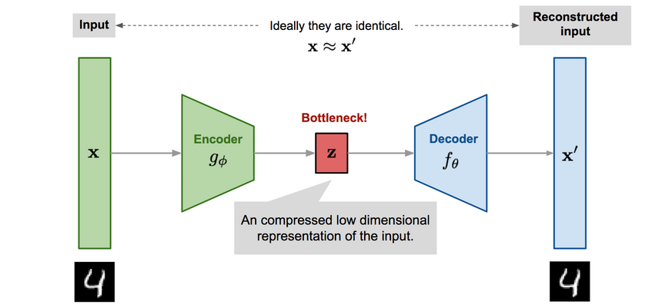
Methodology

Slide 9
Methodology
We extended our research to binary classification of arrhythmias. Previously we were only classifying heart beats into two categories normal or not. We are now classifying heart beats of not normal into 5 types namely normal, Supraventricular, Ventricular Ectopic, fusion and unknown betas.
We have also employed various RNN models to show the comparison and make this research more insightful. We have used Neural Networks, GRU, Resnet and LSTM.

Slide 10
Methodology
Type of heart beat | Label
Non-ecotic Beats (normal beat) | 0
Supraventricular Ectopic Beats | 1
Ventricular Ectopic Beats | 2
Fusion Beats | 3
Unknown Beats | 4

Slide 11
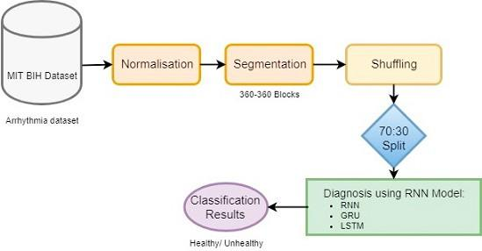
Methodology

Slide 12
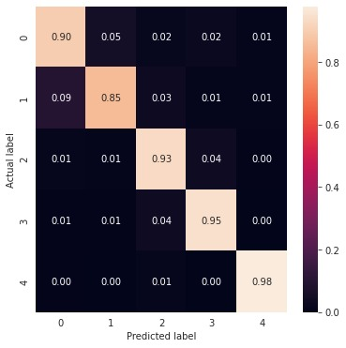
GRU

Slide 13
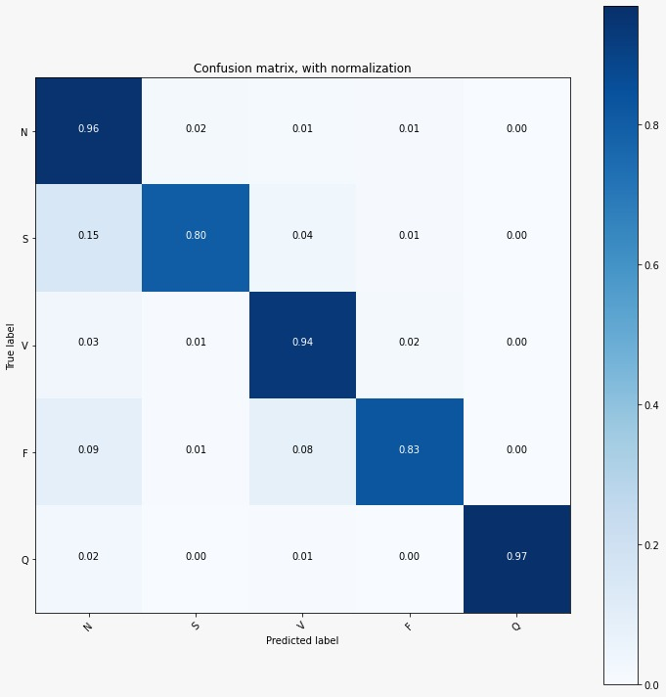
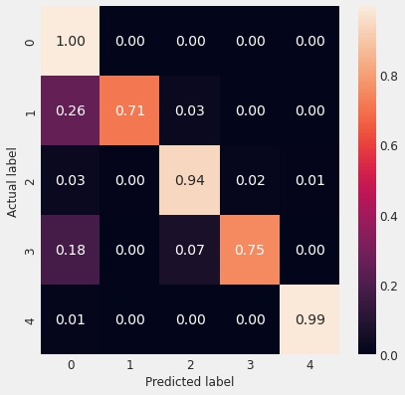
Neural Networks

Slide 14
Resnet

Slide 15
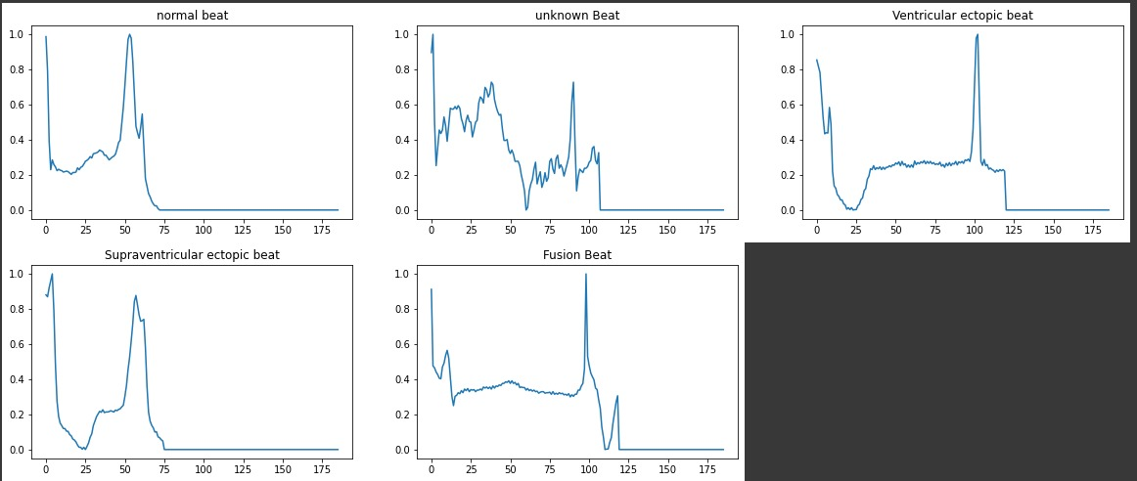
Improvement/Work done from the last evaluation

Slide 16
Result
Model | Accuracy
Neural Network | 95.18
Resnet Model | 89.42
GRU | 94.77
LSTM | 90

Slide 17

Proof of paper accepted or communicated/ Hackathon/ Patent
We have received paper acceptance emails from the following publications : ISICT2022, IJIRSET, IJSRD, IJRES, IJRASET, EPRA, IJSRED, IOSR

Slide 18
Literature Survey
S. No: | TITLE | AUTHOR | OBJECTIVES | Software / Hardware / Programming | Results/Achievement | Dataset
1. | Classification of Arrhythmia by Using Deep Learning with 2-D ECG Spectral Image Representation | Amin Ullah, Syed Muhammad Anwar, Muhammad Bilal , Raja Majid Mehmood | Prediction of cardiovascular diseases (CVDs) with the help of electrocardiogram (ECG) which is one of the most extensively employed signals used in the diagnosis and prediction of cardiovascular diseases | CNN Model (Convolutional neural network), Deep learning, Spectrograms (2-D images) | These results indicate that the prediction and classification of arrhythmia with 2-D ECG representation as spectrograms and the CNN model is a reliable operative technique in the diagnosis of CVDs. It help experts diagnose CVDs by referring to the automated classification of ECG signals. | MIT-BIH arrhythmia dataset
2. | On Arrhythmia Detection by Deep Learning and Multidimensional Representation | K.S. Rajput Biofourmis S. WibowoBiofourmis C. HaoBiofourmis M. Majmudar | Arrhythmia Detection by Deep Learning and Multidimensional Representation | Python | 2D CNN has higher accuracy | ECG Signal Dataset

Slide 19
Literature Survey
S. No: | TITLE | AUTHOR | OBJECTIVES | Software / Hardware / Programming | Results / Achievement | Dataset
3. | Cardiac arrhythmia detection using deep learning | Ali Isina,* SelenOzdalilib | Arrhythmia Detection by Deep Learning and Multidimensional Representation | Python | Transferred deep learning proved to be an efficient automatic cardiac arrhythmia detection method while eliminating the burden of training a deep convolutional neural network from scratch providing an easily applicable technique. | ECG Signal Dataset
4. | Automated detection of cardiac arrhythmia using Deep Learning Techniques. | Swapna G, Soman KP, Vinaya K | The goal of this paper is to apply deep learning techniques in the diagnosis of cardiac arrhythmia using ECG signals. | Python | The performance of deep learning algorithms relies heavily on choosing optimal values for these parameters. Drawback- Though deep learning networks produce excellent results, the disadvantage lies in the insufficient understanding of the complex inner mechanisms of the deep learning networks. | MIT-BIH arrhythmia database

Slide 20
Thank You!

