Slide 1
LAN Standards
Local Area Networks
802 standards
IEEE 802 Protocol Layers vs. OSI Model
Ethernet 802.3
Wireless 802.11

Slide 2
LAN (Local Area Networks)
A LAN is a computer network that covers a small area (home, office, building, campus)
  a few kilometers
LANs have higher data rates (10Mbps to 40Gbps) as compared to WANs
A LAN consists of
  Shared transmission medium
    now so valid today due to switched LANs
  regulations for orderly access to the medium
  set of hardware and software for the interfacing devices

Slide 3
802 standards
IEEE 802.1 - High-Level Interface. It provides for LAN management and bridging standards.
IEEE 802.2 - Logical Link Control
A Data Link layer standard used with IEEE 802.3, 802.4 and 802.5 standards.
IEEE 802.3 - Carrier Sense Multiple Access with Collision Detection
A Physical layer standard specifying a linear bus LAN with a CSMA/CD access method commonly associated with Ethernet and Fast Ethernet.
IEEE 802.4 - Token-bus
A Physical layer standard specifying a token-passing access method on a bus topology. It is used by the Manufacturing Automation Protocol (MAP), developed by General Motors, and by ARCnet.

Slide 4
IEEE 802.5 - Token-ring
A Physical layer standard specifying a token-passing access method on a ring topology.
IEEE 802.6 - Metropolitan Area Network (MAN) Describes a topology known as Distributed Queue Dual Bus (DQDB). This topology consists of two parallel runs of cable to link devices over a metropolitan (city-sized) area. The transmission medium is usually optical fiber and transmission speed in the range of 100 Mbps.
IEEE 802.7 - Broadband Technology The IEEE technical advisory group for broadband LANs. This committee provides
technical advice to other subcommittees on broadband networking techniques.

Slide 5
IEEE 802.8 - Fiber Optics
The IEEE technical advisory group for optical fiber LANs. This committee provides technical advice to other subcommittees on optical fiber networks as alternatives to existing copper-based networks.
IEEE 802.9 - Integrated Services LAN
The IEEE committee working on the integration of voice, data and video traffic over other 802 LANs.
IEEE 802.10 - LAN Security
The IEEE technical advisory group for security. This group is working on the definition of a standard security model that will operate over a variety of networks. It incorporates both authentication and encryption methods.

Slide 6
IEEE 802.11 – Wireless
This group is working on the standardization of media such as spread-spectrum radio, narrowband radio, infrared and transmission over power lines.
IEEE 802.12 - Demand Priority
The IEEE committee charged with the standard for 100 Mbps Ethernet using a
Demand Priority access method, commonly referred to as 100VG-AnyLAN.

Slide 7
LAN Protocol Architecture
Corresponds to lower two layers of OSI model
  But mostly LANs do not follow OSI model
Current LANs are most likely to be based on Ethernet protocols developed by IEEE 802 committee
IEEE 802 reference model
  Logical link control (LLC)
  Media access control (MAC)
  Physical

Slide 8
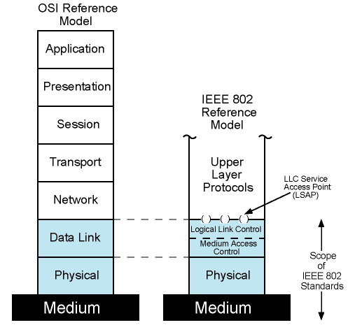
IEEE 802 Protocol Layers vs. OSI Model

Slide 9
Ethernet 802.3
10 Mbps (Standard Ethernet)
  IEEE 802.3
  10base5(2500m extendable ,thick Ethernet,coaxial cable bus topology)
  10base2(thin Ethernet,bus topology, thin coaxial cable)
  10baseT(2 pairs of twisted pair,star topology,max 100m)
  IEEE 802.3ae

Slide 10
Ethernet 802.3
100 Mbps(Fast Ethernet)
  IEEE 802.3u
1 Gbps (Gigabit Ethernet)
  IEEE 802.3ab
  Uses all 4 pairs of the RJ-45 cable
10 Gbps

Slide 11
100Mbps (Fast Ethernet)
Provides low cost data rate of 100Mbps and compatible with standard ethernet
100BaseT4
  to use voice grade cat 3 cables
  3 pairs in each direction with 33.3 Mbps on each using a ternary signalling scheme (8B6T = 8 bits map to 6 trits)
100Base-X
  Unidirectional data rate of 100 Mbps
  4B/5B blocking coding
  Uses two links (one for transmit, one for receive)
  Two types: 100Base-TX and 100Base-FX

Slide 12
100Base-TX
  STP or cat5 UTP (one pair in each direction)
  Maximum cable length 100m
  4B/5B block coding scheme
  at 125 Mhz with special encoding that has 20% overhead
100Base-FX
  Optical fiber (one at each direction)
  NRZ-I coding scheme
  Maximum cable length 100m

Slide 13
Fast Ethernet - Details
Same message format as 10 Mbps Ethernet
Fast Ethernet may run in full duplex mode
  So effective data rate per user becomes 200 Mbps
  Full duplex mode requires star topology with switches
In fact, shared medium no longer exists when switches are used
  no collisions, thus CSMA/CD algorithm no longer needed
  but stations still use CSMA/CD and same message format is used for backward compatibility reasons

Slide 14
Gigabit Ethernet
Strategy same as Fast Ethernet
  New medium and transmission specification
  Retains CSMA/CD protocol and frame format
  Compatible with 10 and 100 Mbps Ethernet
Why gigabit Ethernet?
  10/100 Mbps load from end users creates increased traffic on backbones
    so gigabit Ethernet is meaningful for backbones

Slide 15
Gigabit Ethernet – Physical
1000Base-SX
  2 wires ,one for sending and one for receiving
  NRZ and 8B/10B block coding schemes are used
  Short wavelength, multimode fiber
  Maximum length 550m
1000Base-LX
  Long wavelength, Multi or single mode fiber
  2 wire implementation
  Maximum cable length 5000m

Slide 16
1000Base-CX
  A special STP (<25m) ,one for each direction
  NRZ and 8B/10B block coding schemes are used
  Maximum Length of cable 25m
1000Base-T
  4 pairs, cat5 UTP (bidirectional)
  100 m

Slide 17
A Perspective of IEEE 802 Standards in Network Communication
Logical
Link
Control
(LLC)
802.2
802.1 applies
to both.
Media
Access
Control
(MAC)
802.3
802.4
802.5
802.12

Slide 18
802 Layers - Medium Access Control & Logical Link Control
OSI layer 2 (Data Link) is divided into two in IEEE 802
  Logical Link Control (LLC) layer
  Medium Access Control (MAC) layer
LLC layer
  Interface to higher levels
  flow control
  Based on classical Data Link Control Protocols (so we will cover later)
MAC layer
  Prepare data for transmission
  Error detection
  Address recognition
  Govern access to transmission medium
    Not found in traditional layer 2 data link control

Slide 19
IEEE 802 Layers - Physical
Signal encoding/decoding
Preamble generation/removal
  for synchronization
Bit transmission/reception
Specification for topology and transmission medium

Slide 20
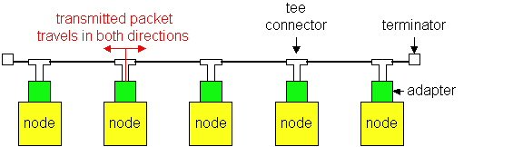
Media Access
LAN Technologies
Ethernet and Wi-Fi are both “multi-access” technologies
  Broadcast medium, shared by many hosts
  Simultaneous transmissions will result in collisions
Media Access Control (MAC) protocol required
  Rules on how to share medium
The Data Link Layer is divided into two Part MAC Media Access Control) Sublayer and LLC (Logic Link Control) Sublayer

Slide 21
MAC Protocols
1.Contention-Based MAC
No control.
Stations try to acquire the medium.
Distributed in nature.
Example :
ALOHA and Slotted ALOHA,CSMA,CSMA/CD.
2.Round-robin based MAC:
token-based protocols.
Token bus.
Token ring.

Slide 22
What is 802.11?
A family of wireless LAN (WLAN) specifications developed by a working group at the Institute of Electrical and Electronic Engineers (IEEE)
Defines standard for WLANs using the following four technologies
  Frequency Hopping Spread Spectrum (FHSS)
  Direct Sequence Spread Spectrum (DSSS)
  Infrared (IR)
  Orthogonal Frequency Division Multiplexing (OFDM)
Versions: 802.11a, 802.11b, 802.11g, 802.11e, 802.11f, 802.11i

