Slide 1

Chapter 16
Stream
Control
Transmission
Protocol
(SCTP)
TCP/IP Protocol Suite
Copyright © The McGraw-Hill Companies, Inc. Permission required for reproduction or display.

Slide 2
OBJECTIVES:
To introduce SCTP as a new transport-layer protocol.
To discuss SCTP services and compare them with TCP.
To list and explain different packet types used in SCTP and discuss the purpose and of each field in each packet.
To discuss SCTP association and explain different scenarios such as association establishment, data transfer, association termination, and association abortion.
To compare and contrast the state transition diagram of SCTP with the corresponding diagram of TCP.
To explain flow control, error control, and congestion control mechanism in SCTP and compare them with the similar mechanisms in TCP.
TCP/IP Protocol Suite

Slide 3
Chapter
Outline
16.1 Introduction
16.2 SCTP Services
16.3 STCP Features
16.4 Packet Format
16.5 An SCTP Association
16.6 State Transition Diagram
16.7 Flow Control
16.8 Error Control
16.9 Congestion Control
TCP/IP Protocol Suite

Slide 4
16-1 INTRODUCTION
Stream Control Transmission Protocol (SCTP) is a new reliable, message-oriented transport-layer protocol. Figure 16.1 shows the relationship of SCTP to the other protocols in the Internet protocol suite. SCTP lies between the application layer and the network layer and serves as the intermediary between the application programs and the network operations.
TCP/IP Protocol Suite

Slide 5
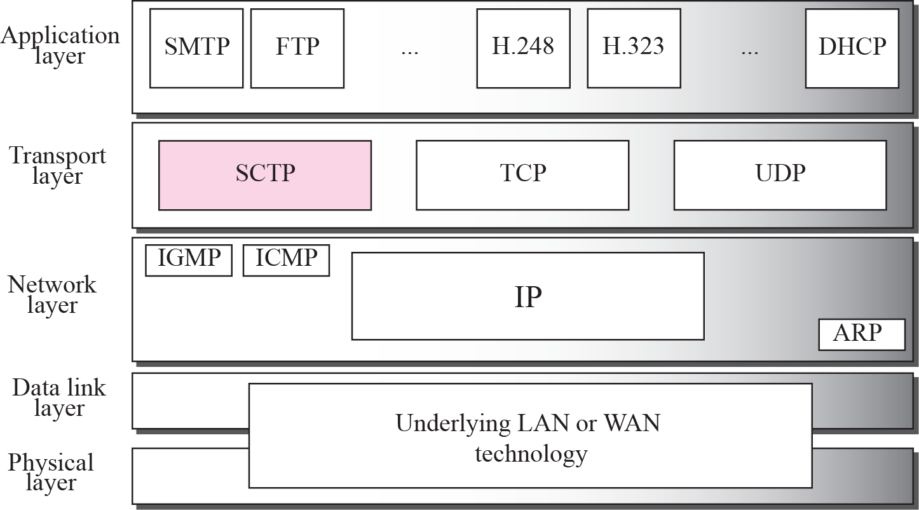
Figure 16.1 TCP/IP Protocol suite
TCP/IP Protocol Suite

Slide 6

Note
SCTP is a message-oriented,
reliable protocol that combines the
best features of UDP and TCP.
TCP/IP Protocol Suite

Slide 7
Comparison
UDP: Message-oriented, Unreliable
TCP: Byte-oriented, Reliable
SCTP
  Message-oriented, Reliable
  Other innovative features
    Association, Data transfer/Delivery
    Fragmentation, Error/Congestion Control
TCP/IP Protocol Suite

Slide 8

TCP/IP Protocol Suite

Slide 9
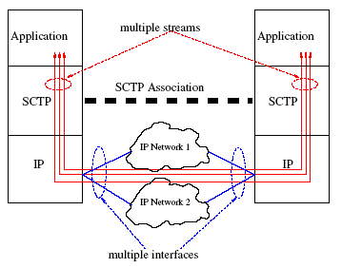

Slide 10
16-2 SCTP SERVICES
Before discussing the operation of SCTP, let us explain the services offered by SCTP to the application layer processes.
TCP/IP Protocol Suite

Slide 11
Topics Discussed in the Section
Process-to-Process Communication
Multiple Streams
Multihoming
Full-Duplex Communication
Connection-Oriented Service
Reliable Service
TCP/IP Protocol Suite

Slide 12
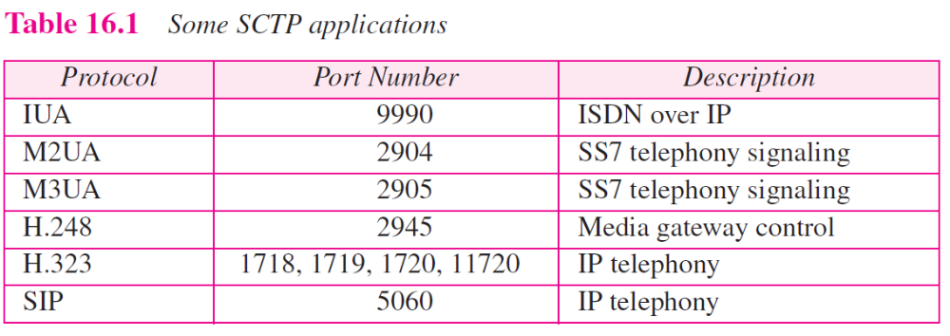
TCP/IP Protocol Suite

Slide 13
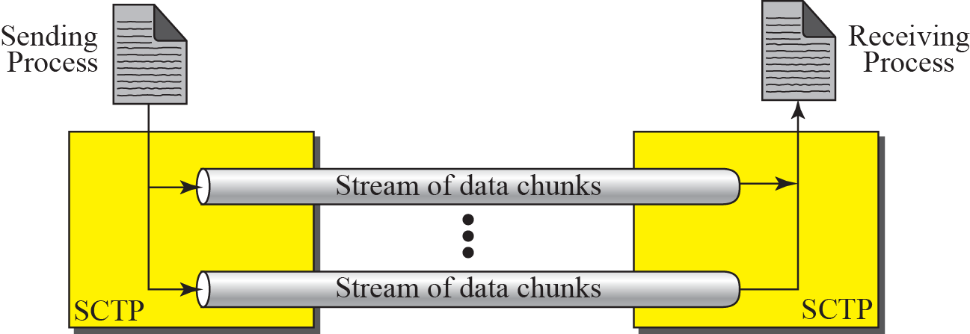
Figure 16.2 Multiple-stream concept
If one of the streams is blocked,
the other streams can still deliver
their data.
TCP/IP Protocol Suite

Slide 14
Note
An association in SCTP can involve multiple streams.
TCP/IP Protocol Suite

Slide 15
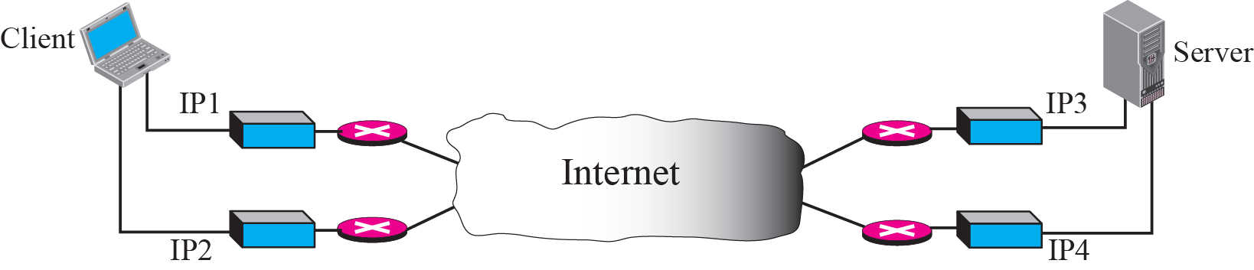
Figure 16.3 Multihoming concept
At present, SCTP does not allow load sharing between different path.
Currently, it is only for fault-tolerance.
TCP/IP Protocol Suite

Slide 16
Note
SCTP association allows multiple IP addresses for each end.
TCP/IP Protocol Suite

Slide 17
16-3 SCTP FEATURES
Let us first discuss the general features of SCTP and then compare them with those of TCP.
TCP/IP Protocol Suite

Slide 18
Topics Discussed in the Section
Transmission Sequence Number (TSN)
Stream Identifier (SI)
Stream Sequence Number (SSN)
Packets
Acknowledgment Number
Flow Control
Error Control
Congestion Control
TCP/IP Protocol Suite

Slide 19
Note
In SCTP, a data chunk is numbered using a TSN.
TCP/IP Protocol Suite

Slide 20
Note
To distinguish between different streams, SCTP uses an SI.
TCP/IP Protocol Suite

Slide 21
Note
To distinguish between different data chunks belonging to the same stream,
SCTP uses SSNs.
TCP/IP Protocol Suite

Slide 22
TCP/IP Protocol Suite

Slide 23
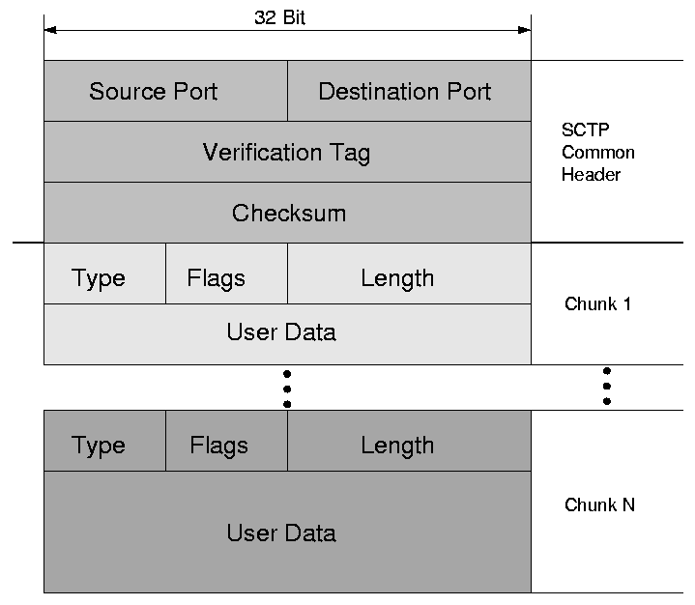
An SCTP-Protocol Data Unit with several chunks

Slide 24
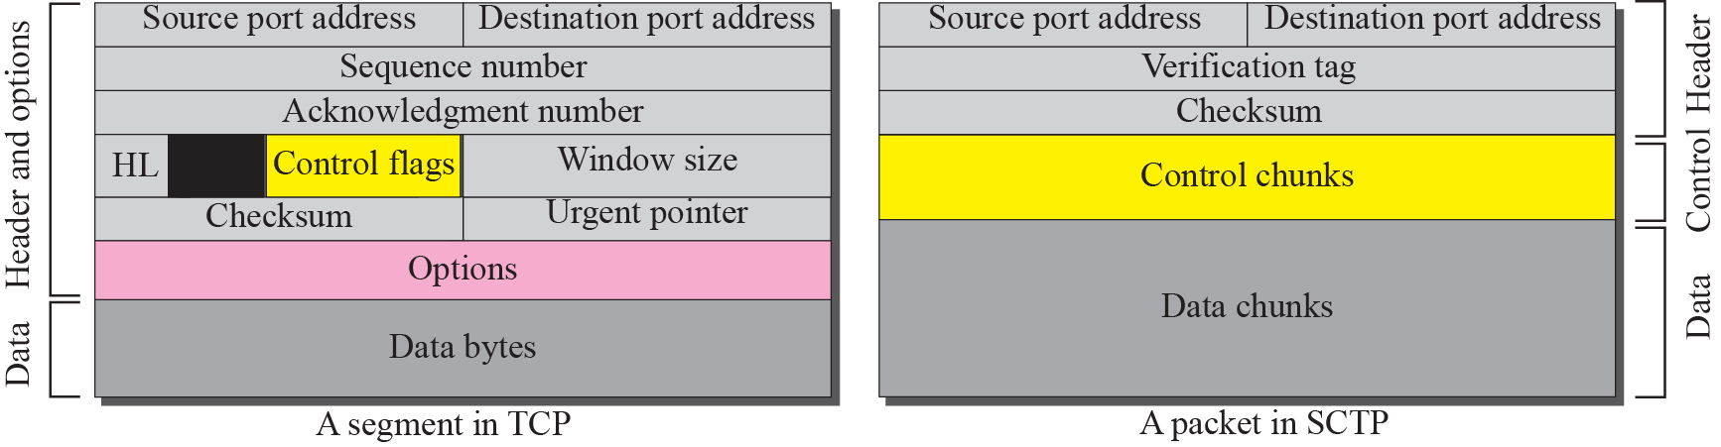
Figure 16.4 Comparison between a TCP segment and an SCTP packet
TCP/IP Protocol Suite

Slide 25
Note
TCP has segments; SCTP has packets.
TCP/IP Protocol Suite

Slide 26
SCTP vs. TCP (1)
Control information
  TCP: part of the header
  SCTP: several types of control chunks
Data
  TCP: one entity in a TCP segment
  SCTP: several data chunks in a packet
Option
  TCP: part of the header
  SCTP: handled by defining new chunk types
TCP/IP Protocol Suite

Slide 27
SCTP vs. TCP (2)
Mandatory part of the header
  TCP: 20 bytes, SCTP: 12 bytes
  Reason:
    TSN in data chunk’s header
    Ack. # and window size are part of control chunk
    No need for header length field (∵no option)
    No need for an urgent pointer
Checksum
  TCP: 16 bits, SCTP: 32 bit
TCP/IP Protocol Suite

Slide 28
SCTP vs. TCP (3)
Association identifier
  TCP: none, SCTP: verification tag
  Multihoming in SCTP
Sequence number
  TCP: one # in the header
  SCTP: TSN, SI and SSN define each data chunk
  SYN and FIN need to consume one seq. #
  Control chunks never use a TSN, SI, or SSN number
TCP/IP Protocol Suite

Slide 29
Note
In SCTP, control information and data information are carried in separate chunks.
TCP/IP Protocol Suite

Slide 30
Chunks streams and packets
In SCTP we have chunks streams and packets
An association may send many packets
A packet may contain several chunks
And chunks may belong to different streams
Ex. Process A wants to send 11 messages to process B in three streams
First 4 msgs in first stream, second 3 messages in second stream and last 4 msgs in third stream asume that one msg fits in to one data chunk
Hence we have 11 chunks in 3 streams

Slide 31
Asume that process delivers all msgs from 1st stream first ,then all msgs from second stream and lastly all from third stream
We also assume that network allows 3 data chunks per packet
Stream numbers are 0,1 and 2.
ACK number:
In SCTP ack numbers are chunk oriented they refer to TSN
ACK numbers are used to acknowledge data chunks only
Control chunks are acked by another control chunks
TCP/IP Protocol Suite

Slide 32
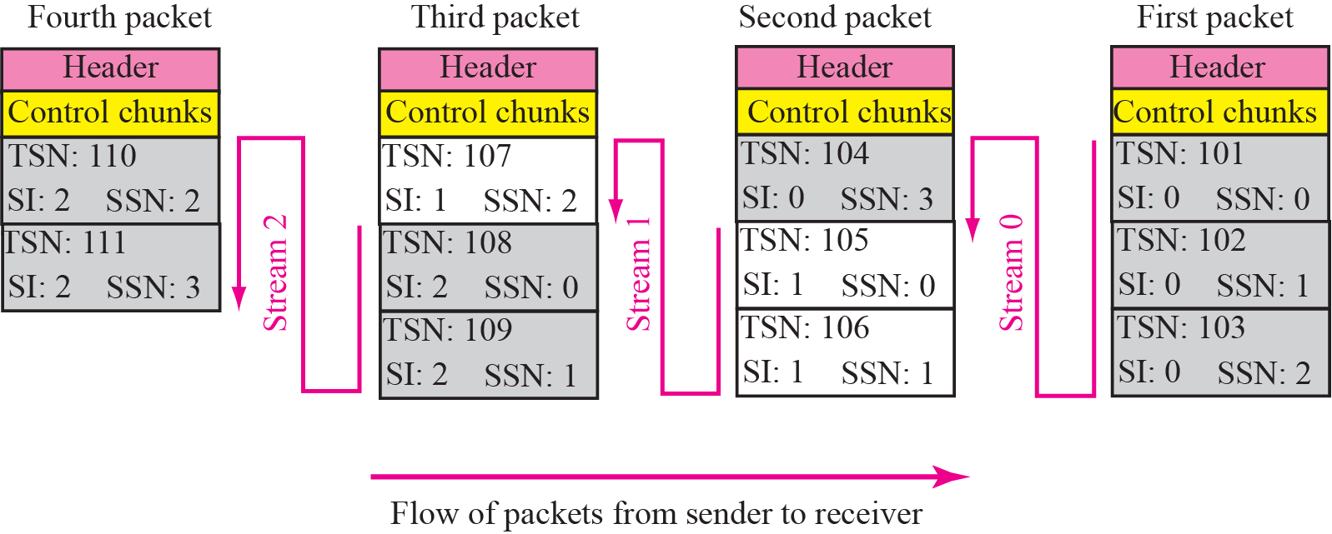
Figure 16.5 Packet, data chunks, and streams
TCP/IP Protocol Suite

Slide 33
Note
Data chunks are identified by three identifiers: TSN, SI, and SSN.
TSN is a cumulative number identifying the association; SI defines the stream;
SSN defines the chunk in a stream.
TCP/IP Protocol Suite

Slide 34
Note
In SCTP, acknowledgment numbers are used to acknowledge only data chunks;
control chunks are acknowledged by other control chunks if necessary.
TCP/IP Protocol Suite

Slide 35
PACKET FORMAT
In this section, we show the format of a packet and different types of chunks. Most of the information presented in this section will become clear later; this section can be skipped in the first reading or used only as the reference. An SCTP packet has a mandatory general header and a set of blocks called chunks. There are two types of chunks: control chunks and data chunks.
TCP/IP Protocol Suite

Slide 36
Topics Discussed in the Section
General Header
Chunks
TCP/IP Protocol Suite

Slide 37
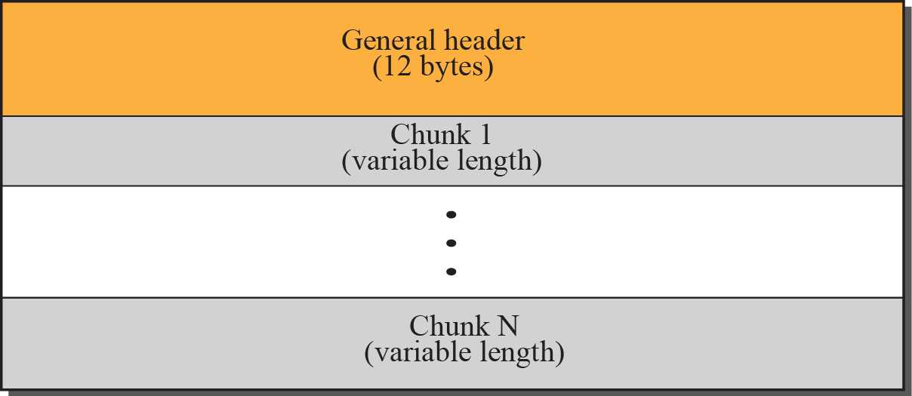
Figure 16.6 SCTP packet format
TCP/IP Protocol Suite

Slide 38
Note
In an SCTP packet, control chunks come before data chunks.
TCP/IP Protocol Suite

Slide 39
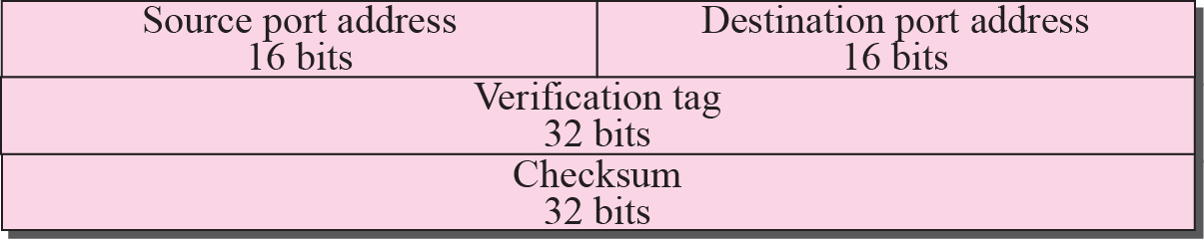
Figure 16.7 Common layout of a chunk
TCP/IP Protocol Suite

Slide 40
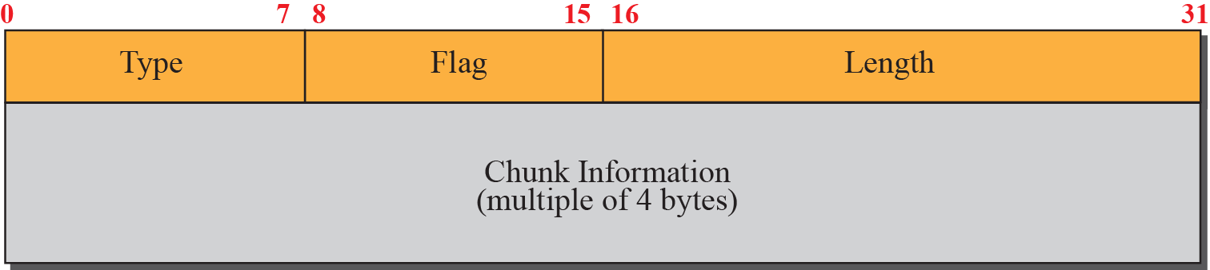
Figure 16.8 Multiple-stream concept
TCP/IP Protocol Suite

Slide 41
Note
Chunks need to terminate on a 32-bit
(4-byte) boundary.
TCP/IP Protocol Suite

Slide 42
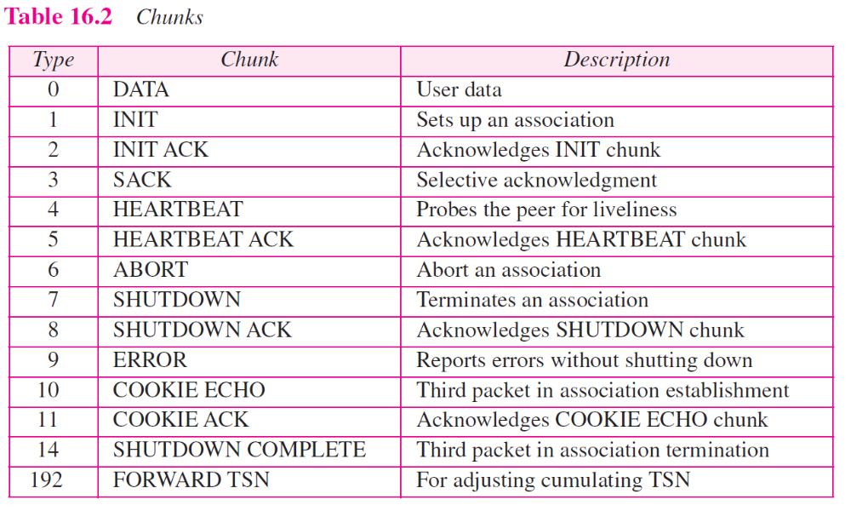
TCP/IP Protocol Suite

Slide 43
Note
The number of padding bytes is not included in the value of the length field.
TCP/IP Protocol Suite

Slide 44
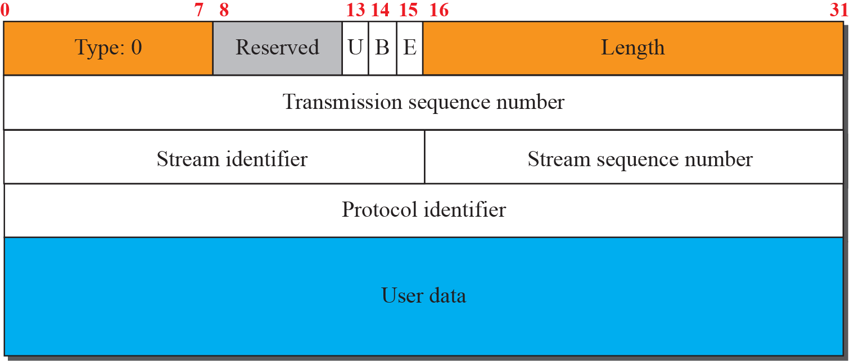
Figure 16.9 Data chunk
TCP/IP Protocol Suite

Slide 45
Note
A DATA chunk cannot carry data belonging to more than one message, but a message can be split into several chunks. The data field of the DATA chunk must carry at least one byte of data, which means the value of length field cannot be less than 17.
TCP/IP Protocol Suite

Slide 46
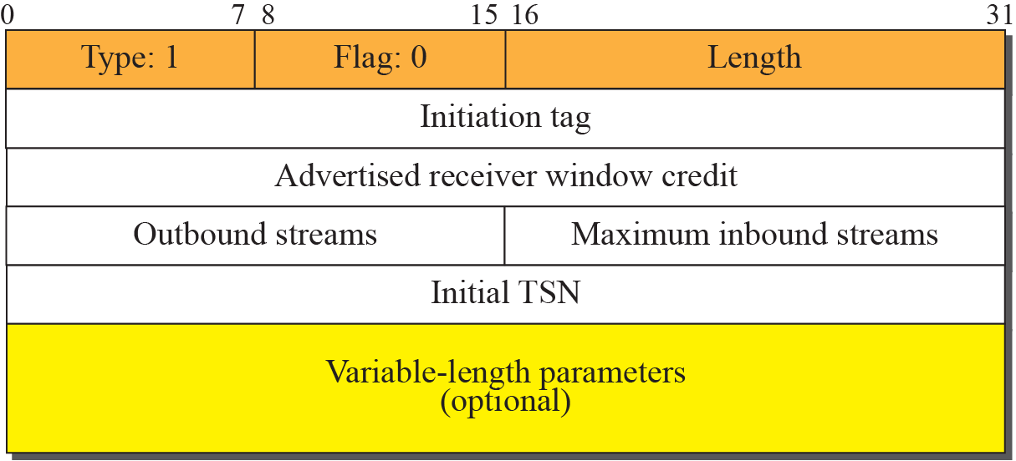
Figure 16.10 INIT chunk
TCP/IP Protocol Suite

Slide 47
Note
No other chunk can be carried in a packet that carries an INIT chunk.
TCP/IP Protocol Suite

Slide 48
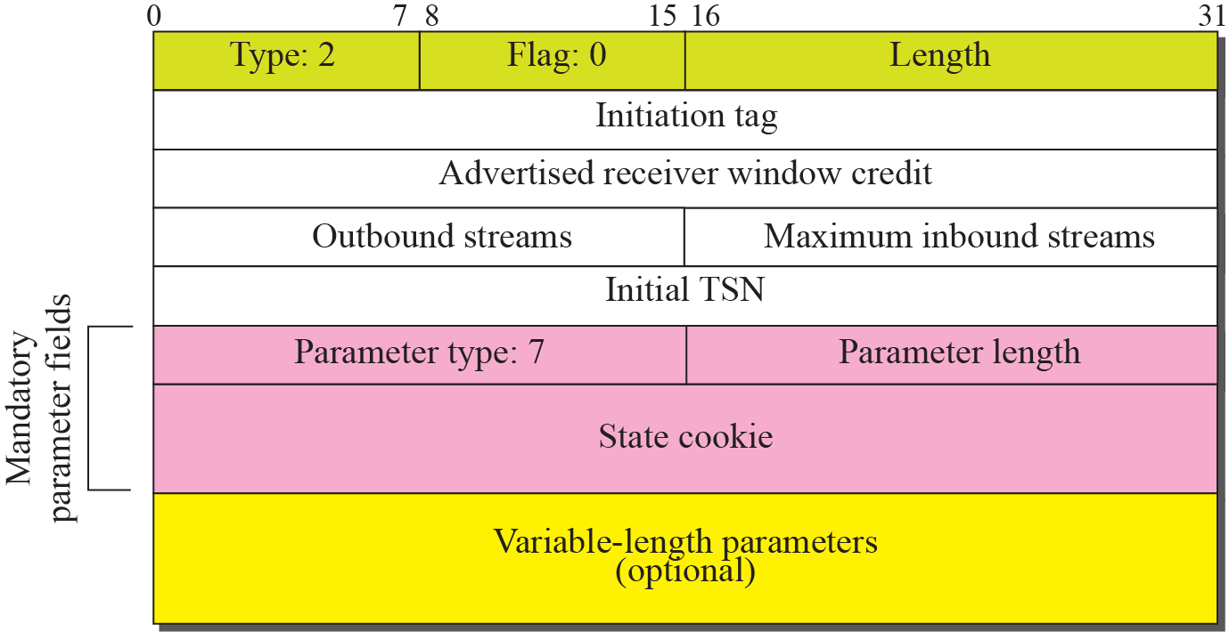
Figure 16.11 INIT ACK chunk
TCP/IP Protocol Suite

Slide 49
Note
No other chunk can be carried in a packet that carries an INIT ACK chunk.
TCP/IP Protocol Suite

Slide 50
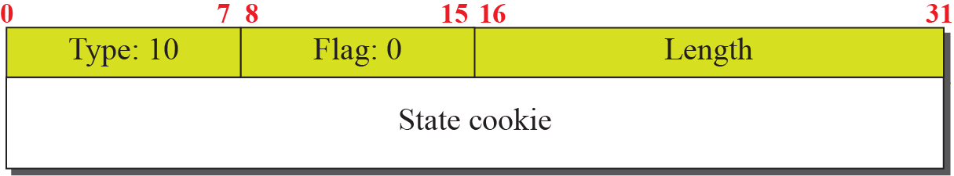
Figure 16.12 COOKIE ECHO chunk
TCP/IP Protocol Suite

Slide 51
Figure 16.13 COOKIE ACK
TCP/IP Protocol Suite

Slide 52
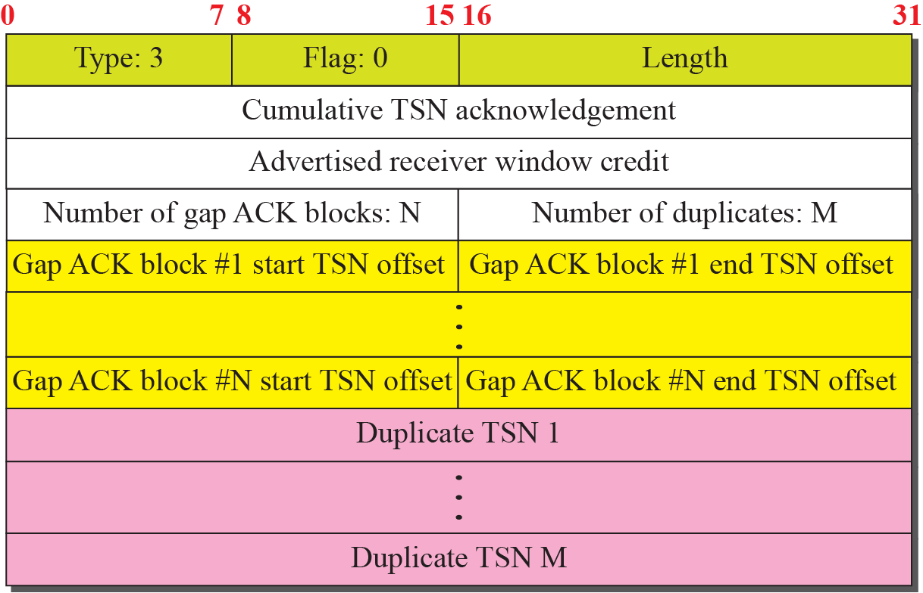
Figure 16.14 SACK chunk
The last data chunk received in sequence
The sequence of received chunks
TCP/IP Protocol Suite

Slide 53
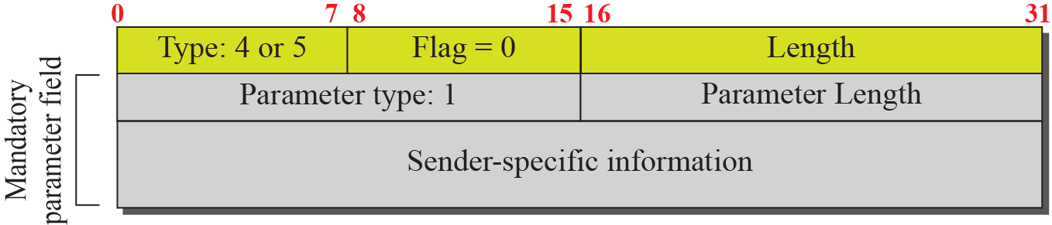
Figure 16.15 HEARTBEAT and HEARTBEAT ACK chunk
(Local time, Address of the sender)
Used to periodically probe the condition of an association
TCP/IP Protocol Suite

Slide 54
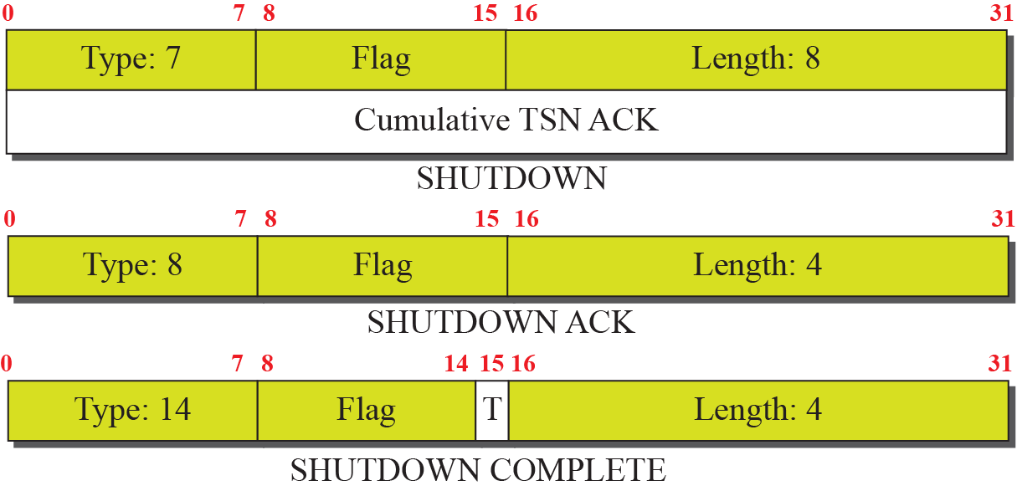
Figure 16.16 SHUTDOWN chunks
TCP/IP Protocol Suite

Slide 55
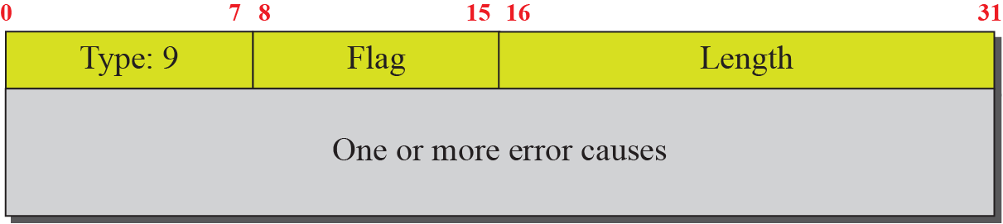
Figure 16.17 ERROR chunk
Sent when an end point finds some error in a received packet
But, which packet is with the error?
TCP/IP Protocol Suite

Slide 56
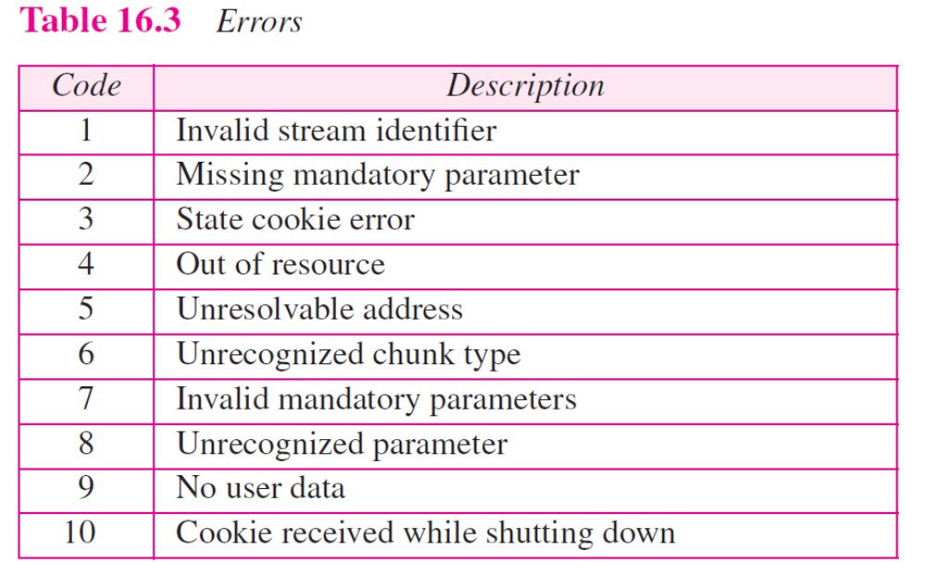
TCP/IP Protocol Suite

Slide 57
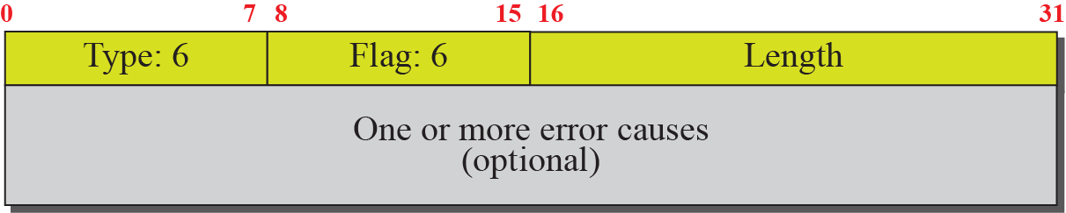
Figure 16.18 ABORT chunk
TCP/IP Protocol Suite

Slide 58
Forward TSN Chunk
Recently added to the standard
(RFC 3758)
Used to inform the receiver to adjust its cumulative TSN
It provides partial reliable service
TCP/IP Protocol Suite

Slide 59
16-5 AN SCTP ASSOCIATION
SCTP, like TCP, is a connection-oriented protocol. However, a connection in SCTP is called an association to emphasize multihoming.
TCP/IP Protocol Suite

Slide 60
Topics Discussed in the Section
Association Establishment
Data Transfer
Association Termination
Association Abortion
TCP/IP Protocol Suite

Slide 61
Note
A connection in SCTP is called an association.
TCP/IP Protocol Suite

Slide 62
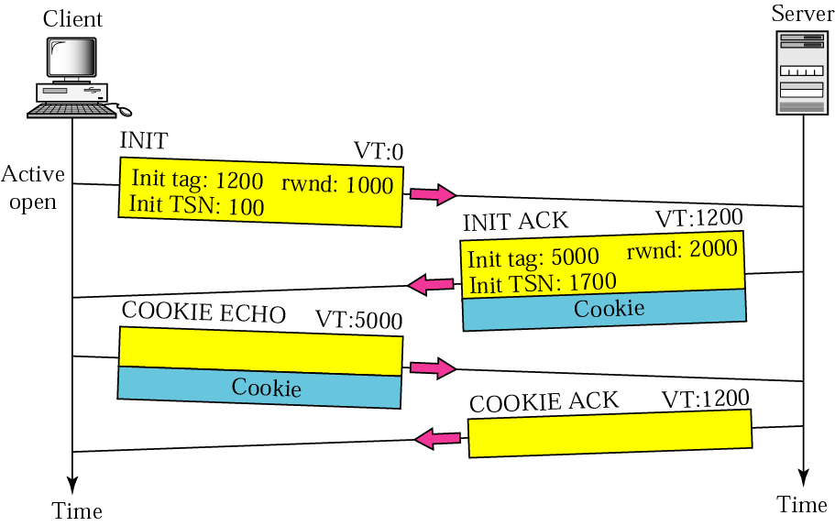
Figure 16.19 Four-way handshaking
TCP/IP Protocol Suite

Slide 63
Verification Tag
In TCP, a connection is identified by a combination of IP addresses and port numbers
  A blind attacker can send segments to a TCP server using randomly chosen source and destination port numbers
  Delayed segment from a previous connection can show up in a new connection that uses the same source and destination port addresses (incarnation)
Two verification tags, one for each direction, identify an association
TIME-WAIT timer
TCP/IP Protocol Suite

Slide 64
Cookie (1)
In TCP
  Each time the server receives a SYN segment, it sets up a TCB and allocates other resources
In SCTP
  Postpone the allocation of resources until the reception of the third packet, when the IP address of the sender is verified
TCP/IP Protocol Suite

Slide 65
Cookie (2)
In SCTP
  The information received in the first packet must somehow be saved until the third packet arrives
  Solution: to pack the information and send it back to the client (cookie)
  The above strategy works if no entity can “eat” a cookie “baked” by the server
  To guarantee this, the server creates a digest from the information using its own secret key
TCP/IP Protocol Suite

Slide 66
Note
No other chunk is allowed in a packet carrying an INIT or INIT ACK chunk.
A COOKIE ECHO or a COOKIE ACK chunk can carry data chunks.
TCP/IP Protocol Suite

Slide 67
Note
In SCTP, only data chunks consume TSNs; data chunks are the only chunks that are acknowledged.
TCP/IP Protocol Suite

Slide 68
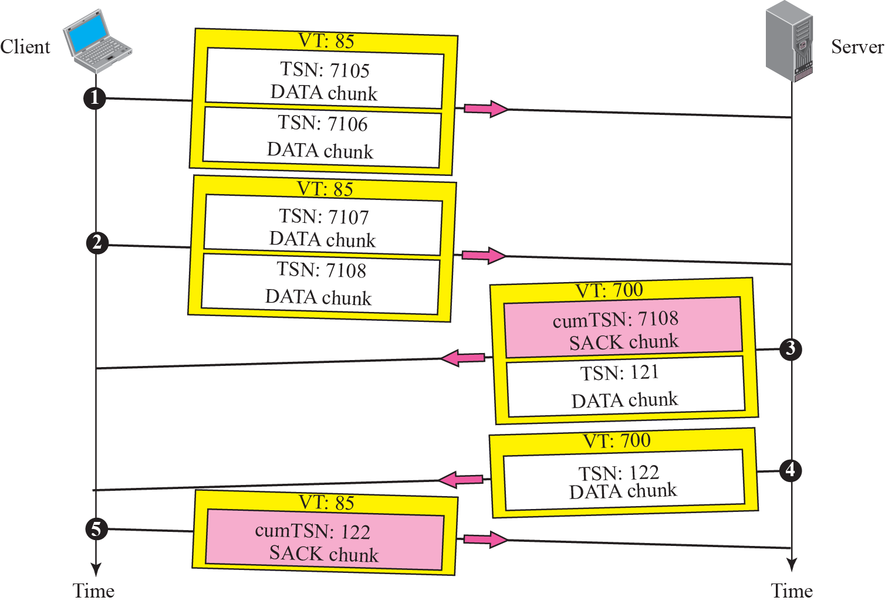
Figure 16.20 Simple data transfer
TCP/IP Protocol Suite

Slide 69
Note
The acknowledgment in SCTP defines the cumulative TSN, the TSN of the last data chunk received in order.
TCP/IP Protocol Suite

Slide 70
Multi-homing Data Transfer
Primary address
  The rest are alternative addresses
  Defined during association establishment
  Determined by the other end
  The process can always override the primary address (explicitly)
  SACK is sent to the address from which the corresponding SCTP packet originated
TCP/IP Protocol Suite

Slide 71
Multi-stream Delivery
Interesting feature in SCTP
  Distinction between data transfer and data delivery
  Data transfer: TSN (error/flow control)
  Data delivery: SI, SSN
Data delivery (in each stream)
  Ordered (default)
  Unordered: using the U flag, do not consume SSNs (U flag with fragmentation?)
TCP/IP Protocol Suite

Slide 72
Fragmentation
IP fragmentation vs. SCTP
  SCTP preserves the boundaries of the msg from process to process when creating a DATA chunk from a message if the size of the msg does not exceed the MTU of the path
SCTP fragmentation
  Each fragment carries a different TSN
  All header chunks carries the same SI, SSN, payload protocol ID, and U flag
  Combination of B and E flag: 11,10,00,01
TCP/IP Protocol Suite

Slide 73
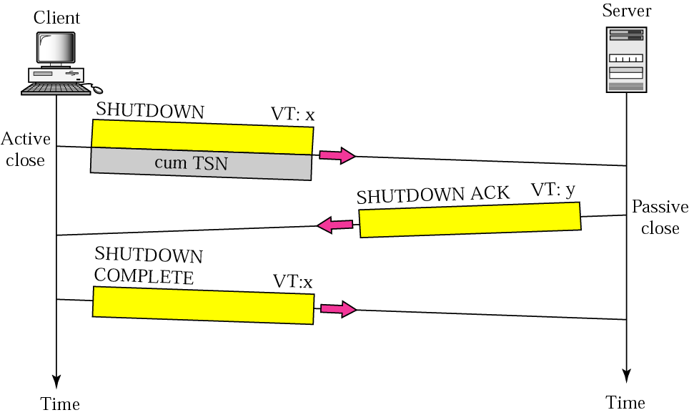
Figure 16.21 Association termination
SCTP does not allow a “half-closed” association
Flush leftover data
TCP/IP Protocol Suite

Slide 74
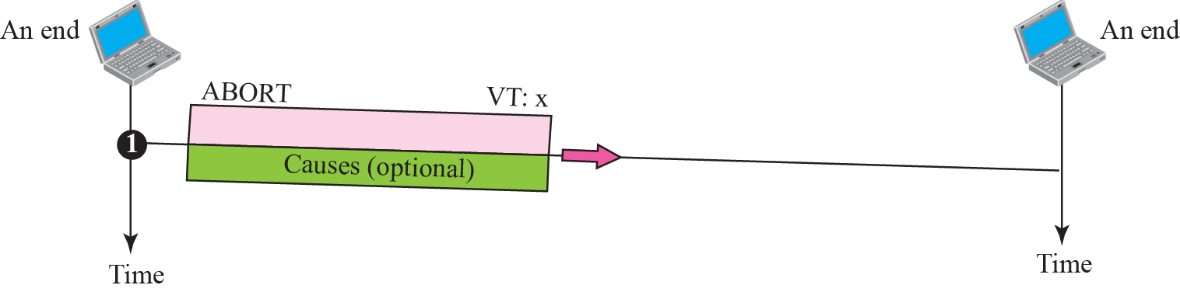
Figure 16.22 Association abortion
TCP/IP Protocol Suite

Slide 75
16-6 STATE TRANSITION DIAGRAM
To keep track of all the different events happening during association establishment, association termination, and data transfer, the SCTP software, like TCP, is implemented as a finite state machine. Figure 16.23 shows the state transition diagram for both client and server.
TCP/IP Protocol Suite

Slide 76
Topics Discussed in the Section
Scenarios
TCP/IP Protocol Suite

Slide 77
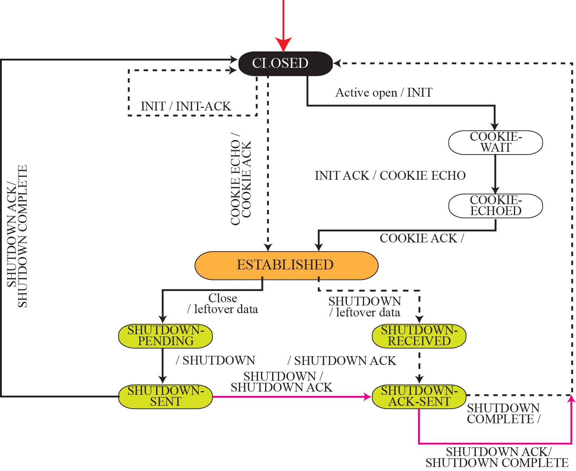
Figure 16.23 State transition diagram
TCP/IP Protocol Suite

Slide 78
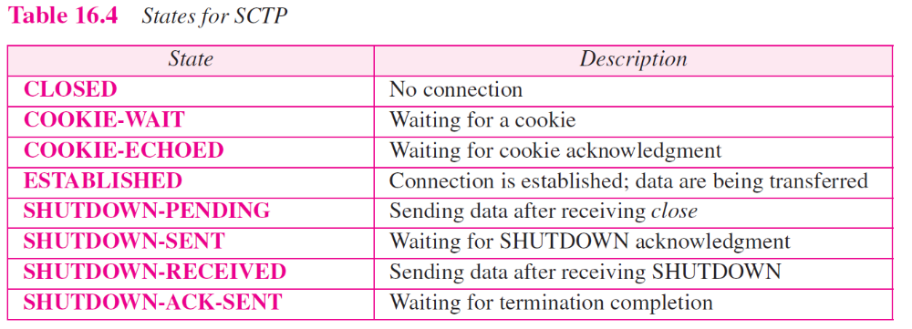
TCP/IP Protocol Suite

Slide 79
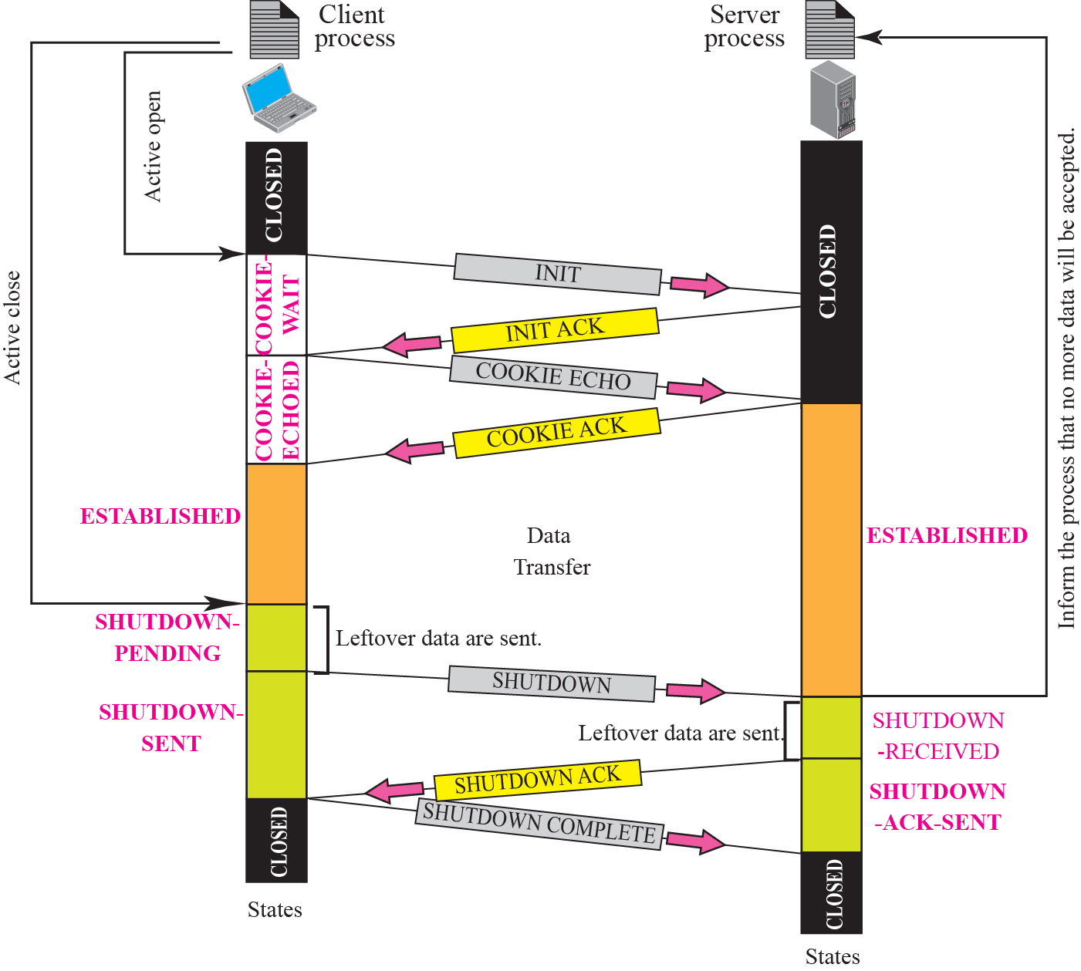
Figure 16.24 A common scenario of state
TCP/IP Protocol Suite

Slide 80
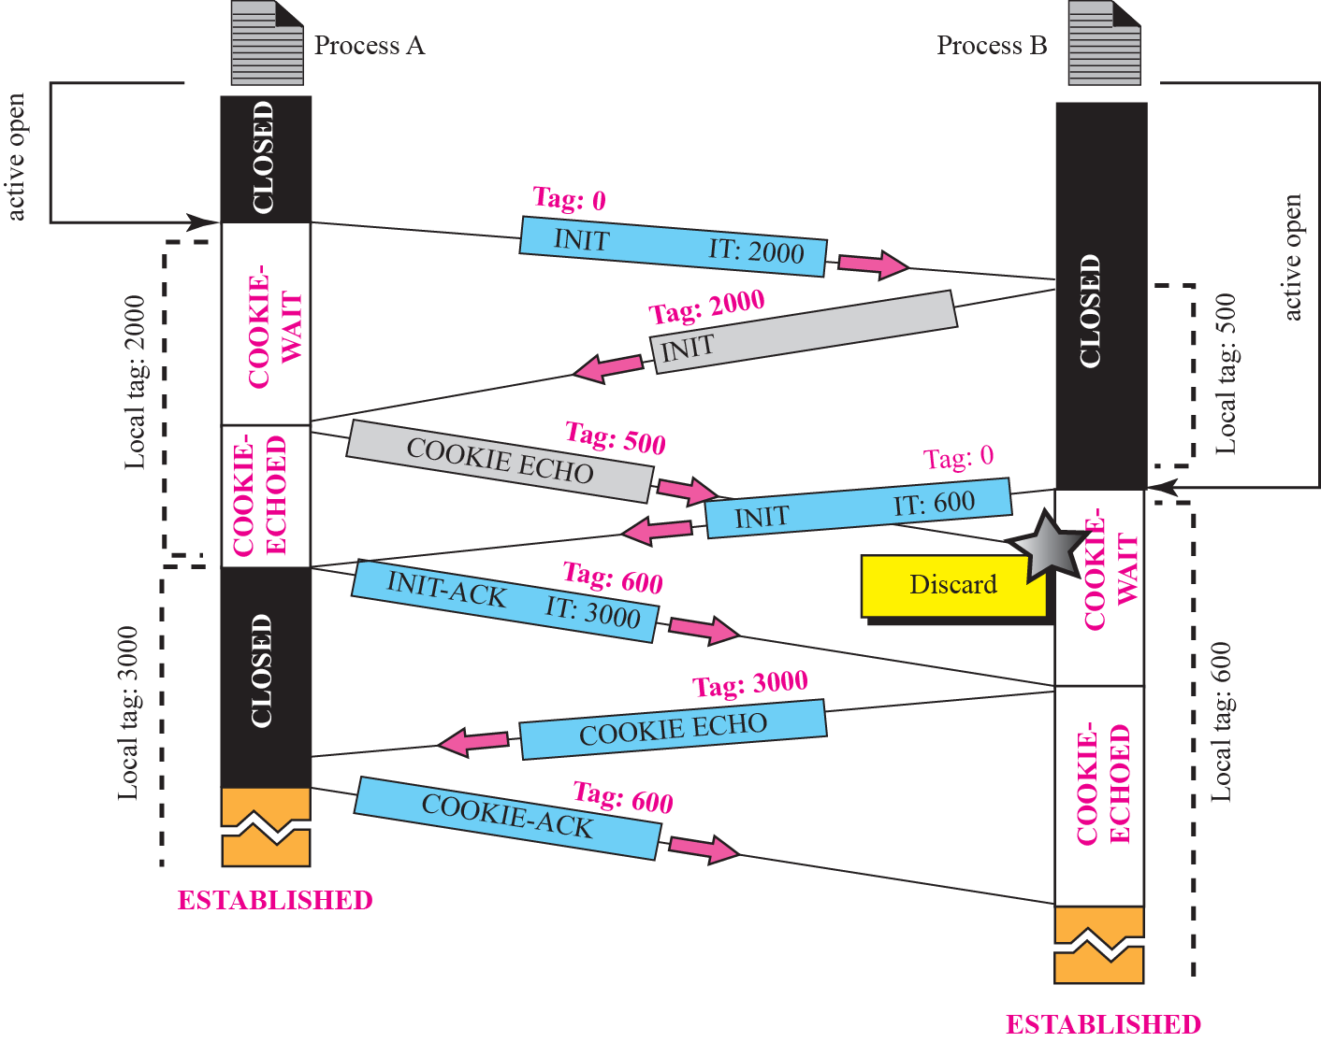
Figure 16.25 Simultaneous open
Each time a packet arrives with a verification tag that does not match the value of the local tag, it is discarded!
TCP/IP Protocol Suite

Slide 81
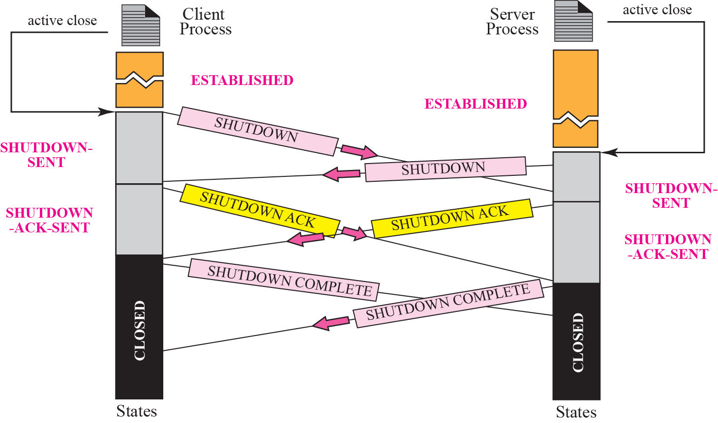
Figure 16.26 Simultaneous close
TCP/IP Protocol Suite

Slide 82
16-7 FLOW CONTROL
Flow control in SCTP is similar to that in TCP. In TCP, we need to deal with only one unit of data, the byte. In SCTP, we need to handle two units of data, the byte and the chunk. The values of rwnd and cwnd are expressed in bytes; the values of TSN and acknowledgments are expressed in chunks.
TCP/IP Protocol Suite

Slide 83
Topics Discussed in the Section
Receiver Site
Sender Site
A Scenario
TCP/IP Protocol Suite

Slide 84
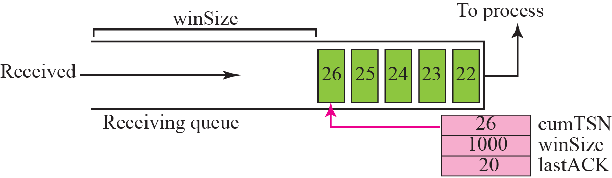
Figure 16.27 Flow control, receiver site
rwnd, cwnd: in bytes
TSN and Acknowledgement : in chunks
TCP/IP Protocol Suite

Slide 85
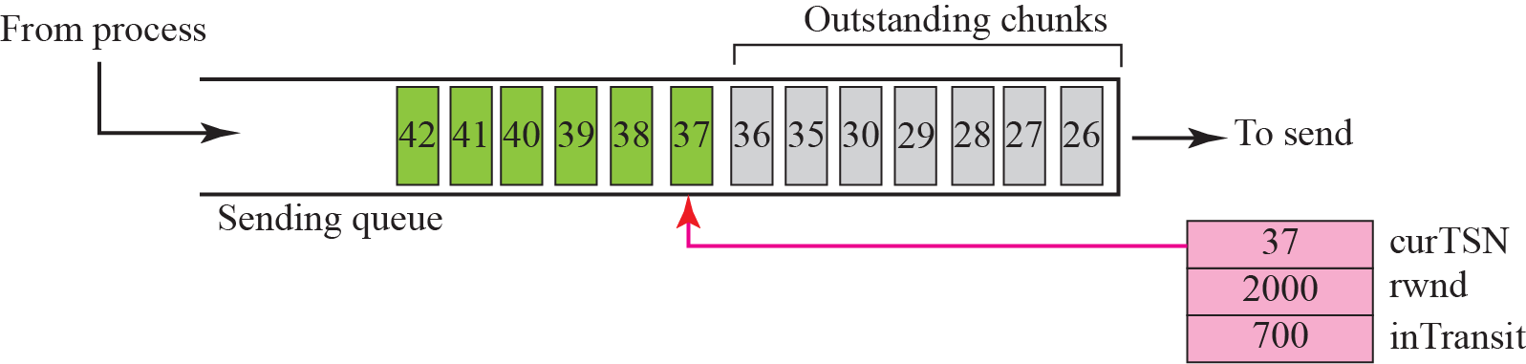
Figure 16.28 Flow control, sender site
1. A chunk pointed to by curTSN can be sent if the size of the data is less than or equal to the quantity (rwnd-inTransit)
Sent but not acknowledged
2. When a SACK is received, the chunks with a TSN less than or equal to the cumulative TSN in the SACK are removed from the queue and discarded. The values of rwnd and inTransit are updated properly
TCP/IP Protocol Suite

Slide 86
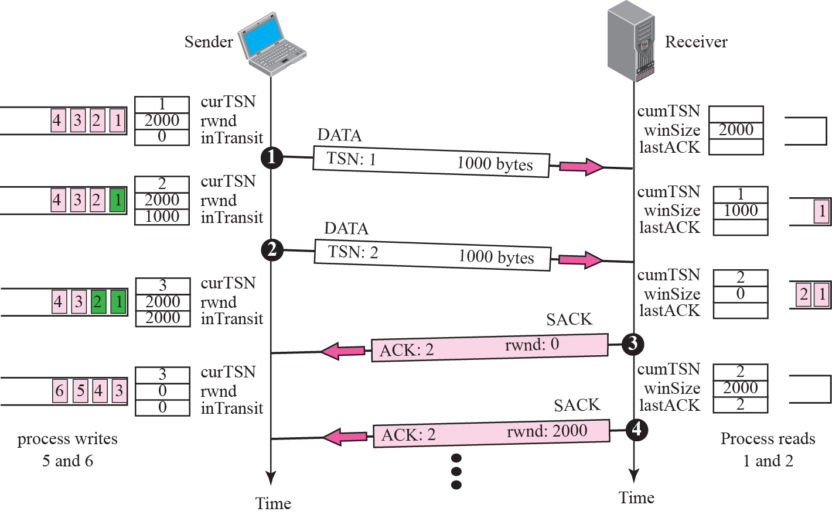
Figure 16.29 Flow control scenario
TCP/IP Protocol Suite

Slide 87
16-8 ERROR CONTROL
SCTP, like TCP, is a reliable transport-layer protocol. It uses a SACK chunk to report the state of the receiver buffer to the sender. Each implementation uses a different set of entities and timers for the receiver and sender sites. We use a very simple design to convey the concept to the reader.
TCP/IP Protocol Suite

Slide 88
Topics Discussed in the Section
Receiver Site
Sender Site
Sending Data Chunks
Generating SANK Chunks
TCP/IP Protocol Suite

Slide 89
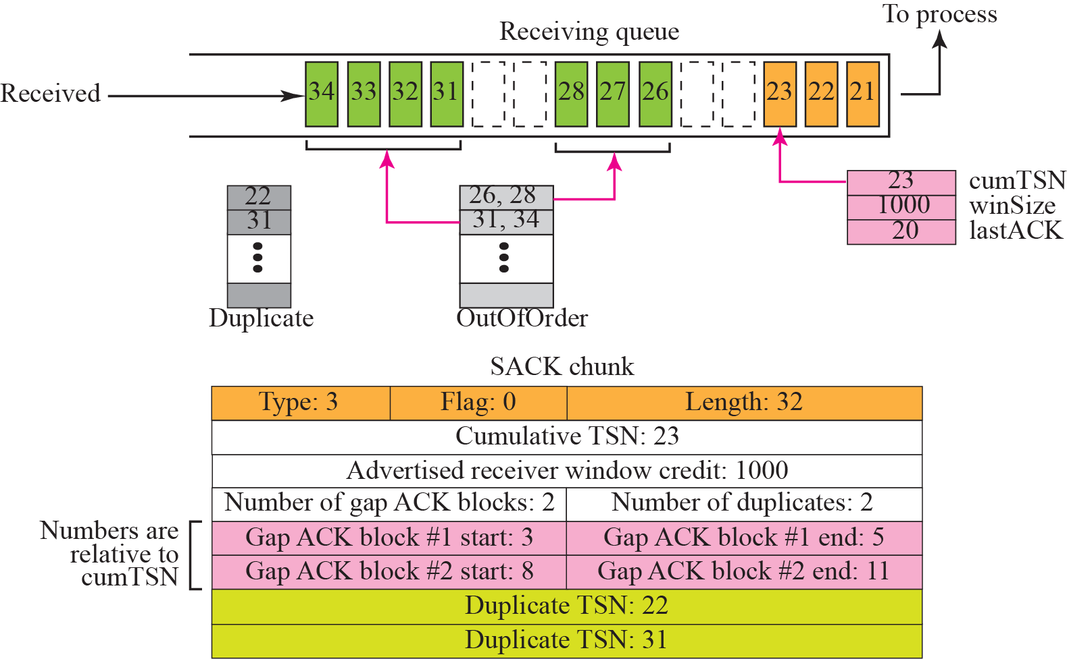
Figure 16.30 Error-control receiver site
11
10
9
8
7
6
5
4
3
2
1
TCP/IP Protocol Suite

Slide 90
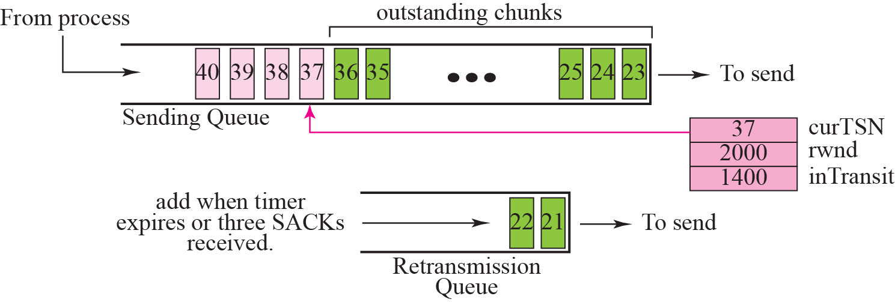
Figure 16.31 Error control, sender site
Assume 100 bytes per chunk
Timeout
4 SACKs
The chunks in the retransmission queue have priority
TCP/IP Protocol Suite

Slide 91
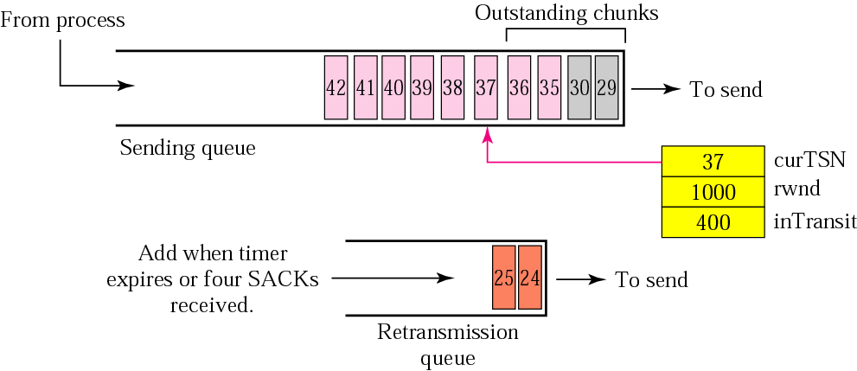
Figure 16.32 New state at the sender site after receiving a SACK chunk
Chunks 26-28, 31-34 are removed.
The value of rwnd is changed to 1000 as advertised in the SACK chunk.
Not include 24, 25
Also assume timer for chunks 24, 25 has expired. New TO is set according to exponential backoff rule in Chapter 12.
4 chunks are now in transit, so inTransit becomes 400.
TCP/IP Protocol Suite

Slide 92
Generating SACK Chunks
Piggybacking
Delay sending of SACK no more than 500ms
An end must send at least one SACK for every other packet it receives
Send a SACK immediately when
  a packet arrives with out-of-order data chunks
  a packet arrives with duplicate data chunks and no new data chunks
TCP/IP Protocol Suite

Slide 93
16-9 CONGESTION CONTROL
SCTP, like TCP, is a transport layer protocol with packets subject to congestion in the network. The SCTP designers have used the same strategies we described for congestion control in Chapter 15 for TCP. SCTP has slow start, congestion avoidance, and congestion detection phases. Like TCP, SCTP also uses fast retransmission and fast recovery.
TCP/IP Protocol Suite

Slide 94
Topics Discussed in the Section
Congestion Control and Multihoming
Explicit Congestion Notification
Need to have different values of cwnd for each IP address
It is a process that enables a receiver to explicitly inform the sender of any congestion experienced in the network.
E.g. the receiver encounters many delayed or lost packets.
TCP/IP Protocol Suite

