Slide 1
Project 1 Airbnb_NYC_2019
Fatemeh Karimnezhad
Tarbiat-Modares University

Slide 2
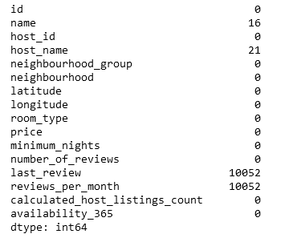
NULL VALUES
There are some null values in columns ‘name’, ‘host name’, ‘last review’ and ‘reviews_per_month’.
The number of null values in ‘name’ and ‘host name’ is less than 30; so I removed them.
The column ‘last review’ is not useful for me and I dropped it.
I put mean of each ‘neighborhood group’ for null values at column ‘reviews_per_month’.
Now, there is no null value in my data set.
Table 1

Slide 3
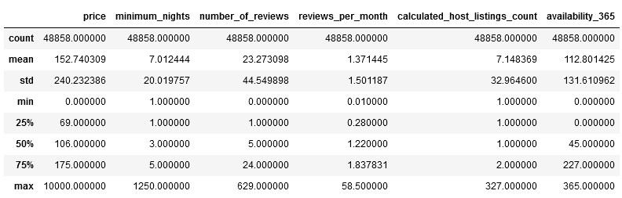
Table 2

Slide 4
Outliers
By looking at table2, we consider that there is a noticeable difference between Max and Q3 in some columns, like price and minimum nights; so, it looks like there are some outliers.
For finding them, I wrote two functions:
first, for finding outliers (using iqr)
second, for replacing them with the ‘median’ in each ‘neighborhood group’.
(I also used 0 instead of outliers in column ‘reviews per month’.)
I didn’t give a complete information about pre processing here; but you can see them in my code:)

Slide 5
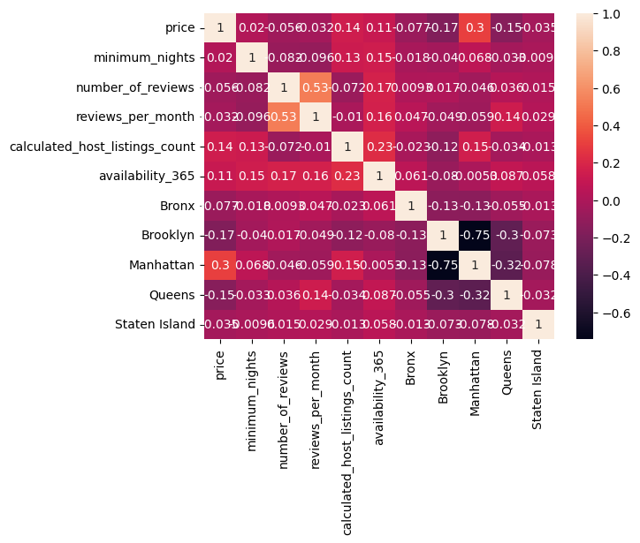
According to this heatmap , there is no strong correlation between our numerical columns. They all are less than 0.7.
Only there is a little correlation between ‘reviews per month’ and ‘number of reviews’.
I think it’s possible to remove one of them.

Slide 6
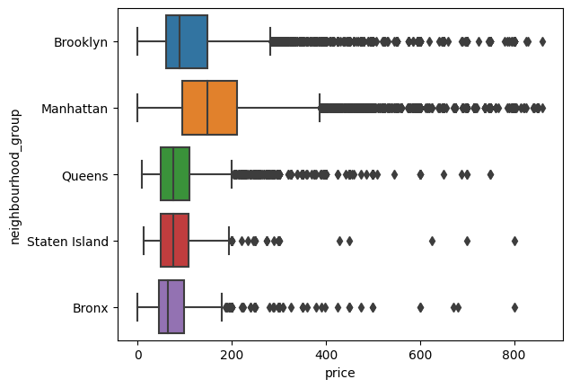
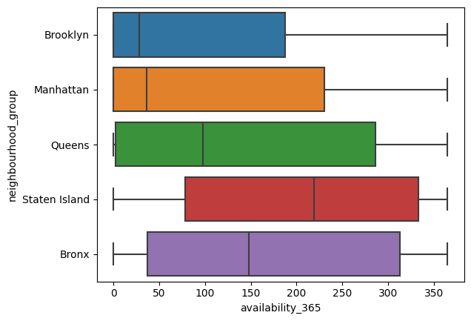
What can we learn from predictions? (ex: locations, prices, reviews, etc)
This plot shows us Manhattan is the most expensive neighborhood group and Bronx and Staten Island are poorest between these groups.
As we can see Brooklyn and Manhattan are the most crowded cities .
Also, Staten Island is the least crowded between our cities.
From these two plots we can understand Manhattan and then Brooklyn are the richest and most crowded cities.

Slide 7
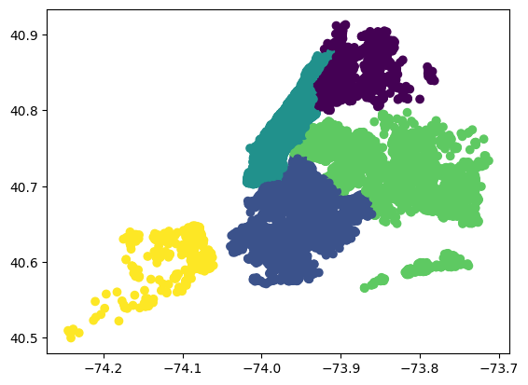
Now let’s take a look at map:
Bronx
Manhattan
Queens
Brooklyn
Staten Island

Slide 8
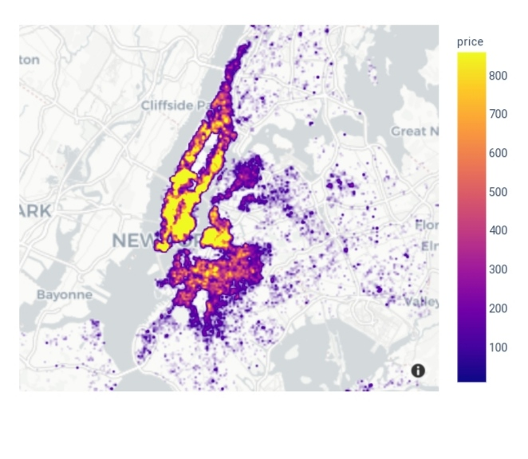
By looking at these two maps, we can find out Manhattan and then Brooklyn are the most expensive cities. (it’s exactly like what we saw in page 6)
Also it shows that most of our data are about these two cities which shows that they are the most crowded cities, too.
Three other cities are both cheaper and less crowded.

Slide 9
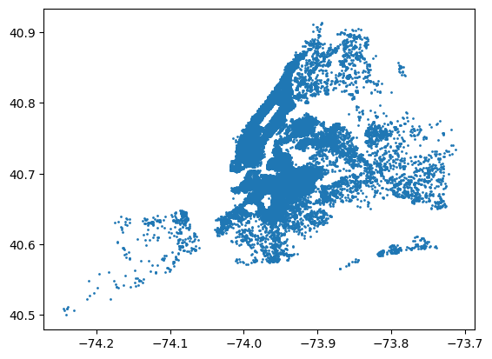
What can we learn about different hosts and areas?
This plot shows the density of different places.
Again, Manhattan and Brooklyn are the most crowded places.
Also by looking at previous map, we could understand it.

Slide 10
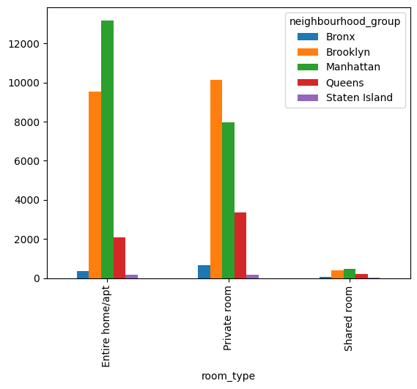
Also in different areas there are some differences in people’s interests; for example , in Manhattan most people like entire home; but in Brooklyn private room is more attractive.
Shared room, overall, are not likely to use.
Bronx and Staten Island are not popular like what we saw before.

Slide 11
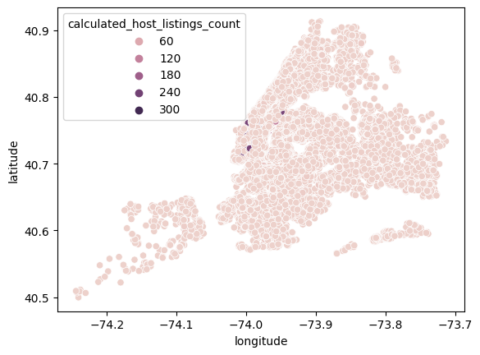
Which hosts are the busiest and why?
At first glance, those who have rooms and houses in Manhattan and Brooklyn, are more likely to be busy; because these two areas are crowded. (just take a look at previous page)
I’m not sure about the definition of calculated host listings, but I think the host who has large amount of it, is the busiest one. By looking at this map, it’s easy to understand the busiest ones, are in Manhattan.

Slide 12
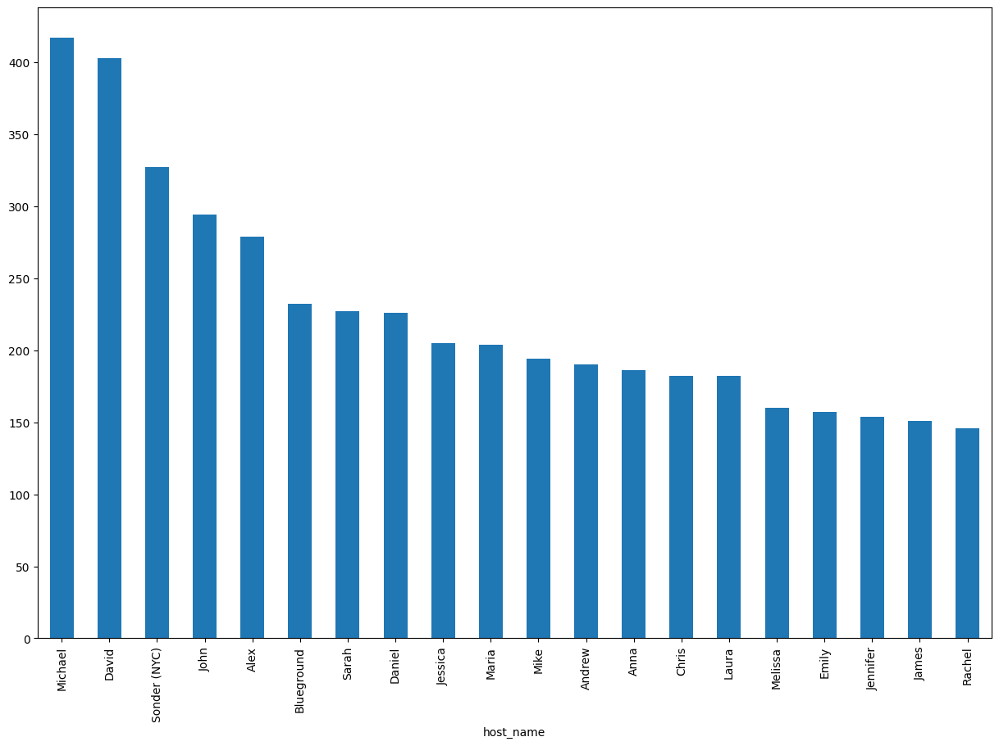
Another way to talking about busiest host is to taking care of how many times their names are repeated in the table.
Here we can see the name of 20 of them.
I believe, according to previous map, many of them are in Manhattan.

Slide 13
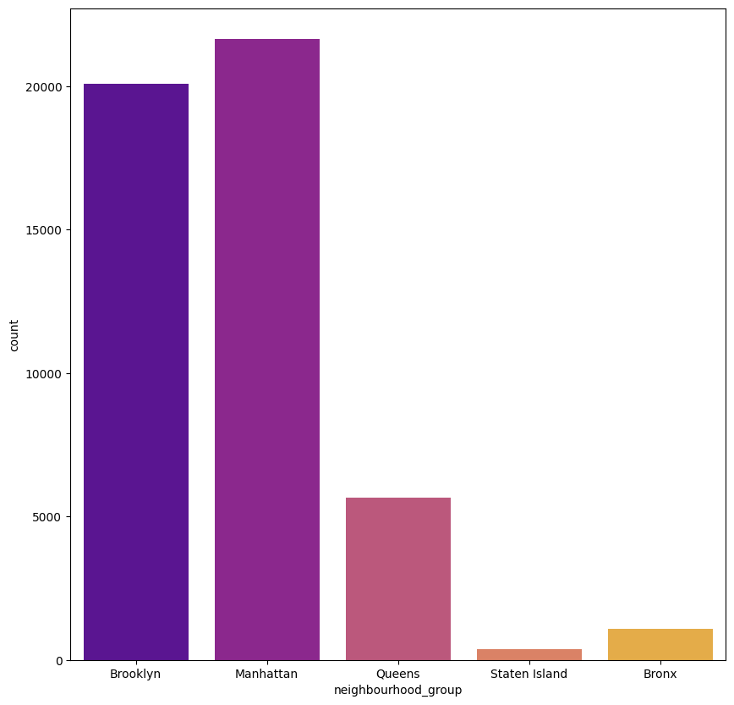
Is there any noticeable difference in traffic among different areas and what could be the reason for it?
Here again, I’m not sure about the definition of traffic:) as I searched on dictionary, it means: 1.travel
2.Movement of vehicles
Let’s work on meaning 1:
The number of rooms in Manhattan and Brooklyn is more than other areas and as we saw in page 6, the availability is less than other places.
This plot shows us there is a noticeable difference between ‘Manhattan and Brooklyn’ and other areas.
We can conclude people mostly like to have a room in Manhattan and Brooklyn; so we have more traffic.(it works for both meanings)

Slide 14
use statistical hypothesis to check if Manhattan is more experience than other areas.
For using hypothesis test, first we have to have an assumption and then we start testing it. For this question, we’ve seen before in a box plot that the prices in Manhattan are higher than other areas. As we want to make some decisions by it, we need to be sure about it. So, we can use this test.
X: price
H0 : mean _{P}(X) = mean _{M}(X)
H1 : mean _{P}(X) < mean _{M}(X)
First step: I checked the mean of both of them:
Manhattan price mean: 185.26 , population mean: 138.70371280036022
It sounds like our hypothesis is correct. Lets check it:
I chose a sample of Manhattan prices. As I checked it, its distribution wasn’t normal; so, I can’t use t_test for it.

Slide 15
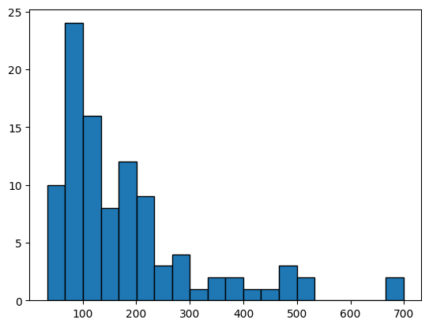
As you can see the distribution is not normal.
I have to use Mann-whiteney test !
Result : statistic=3011967.0 , pvalue=5.563898182135282e-5
Pvalue was less than 5%, so H0 will be rejected and our hypothesis was correct.

Slide 16
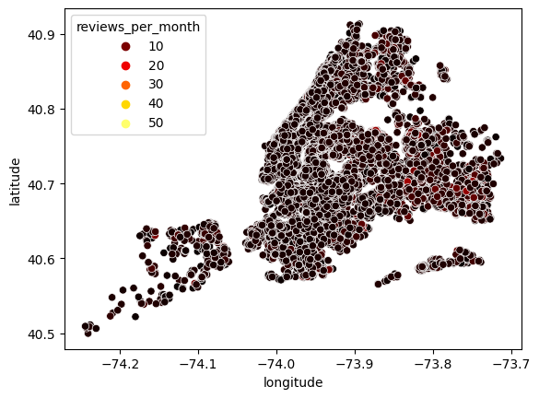
is there any relation between reviews and price?
As we see in this map, in areas like Bronx and Queens, ‘reviews per month’ is more than other cities.
We saw in page 9 that the price in Brooklyn and Manhattan is much higher.
Now we can conclude by increasing price, number of reviews will reduces.

Slide 17
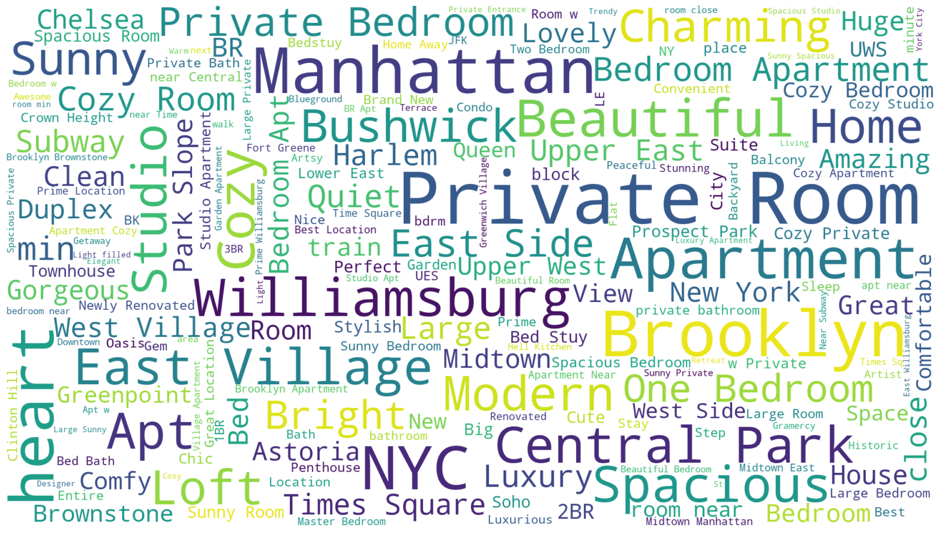
do names give any information to us?
The only way for showing the importance of words that I found, was wordcloud .
By looking at this, we can get that some words like Williamsburg, sunny, east, apartment and etc. are more common than others.

Slide 18
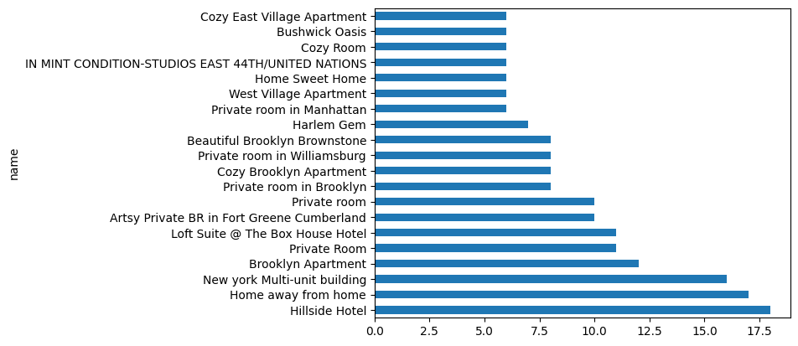
We can see that their are some repeated names, too.

Slide 19
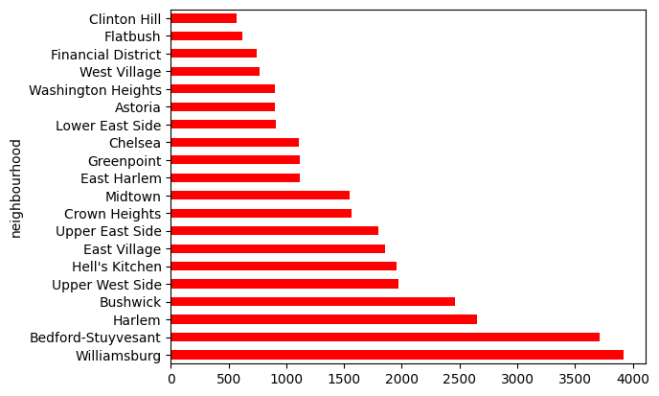
which neighborhoods are more crowded?
here, I bring 20 neighborhoods with the most population.

Slide 20
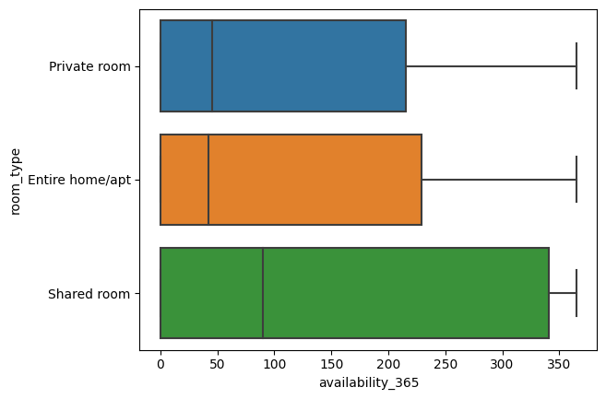
Does the type of room have any effects on other features?
Entire home and private room are more likely to be used by people.
So, if sb wants to have a shared room, it’s easier than wanting two other types. I mean share rooms are available more often.

Slide 21
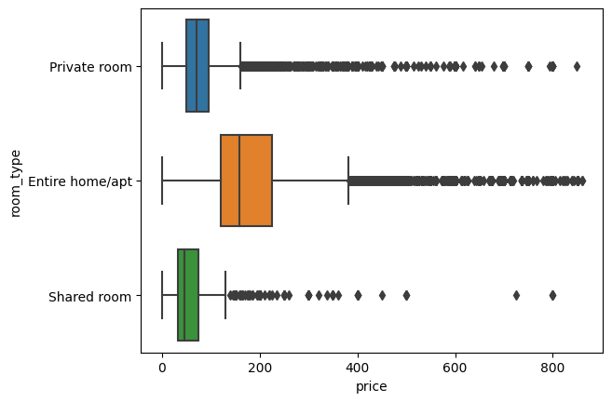
On the other way, entire home is the most expensive and shared room is the cheapest.
We can conclude that shared rooms are not likely to use and it might be the reason of being the cheapest one.
On the other hand, it sounds like most people like to have entire home; some choose it and some others go to have a private room. The reason is price!
Private room is noticeably cheaper than entire home.

