Slide 1
Project 2 Crime
Fatemeh Karimnezhad
Tarbiat Moadares University

Slide 2
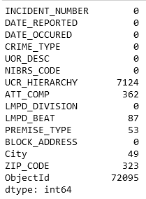
Preprocessing
Null Values :
Here we have many null values in column ‘ObjectId’ .
‘ObjectId’ is not useful value for me; so I dropped it.
I put ‘unknown’ for null values in columns: ‘ATT_COMP’ and ‘UCR_hierarchy’ .
After this part, I had 4 other columns with less than 350 null values. As I have about 272000 rows, I had permission to drop them.
Now I don’t have any other null values.

Slide 3
After filling or dropping null values, it’s time to get rid of duplicated values……
Done! :)
Now I think our data is ready to use; but there might be some problems in our columns.
I’m going to answer questions and if our data was needed to be checked again, I’ll do it later.
For this project, I used crime reports from 2019 to 2022.
let’s work on it.

Slide 4
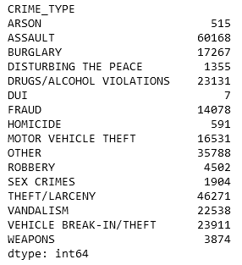
Which crimes are most common?
Here, I bring the number of each crimes in my data.
During 4 years, ‘assault’ and ‘theft’ are the most have the most number of crimes.
next page I’ll bring a plot to show it better.

Slide 5
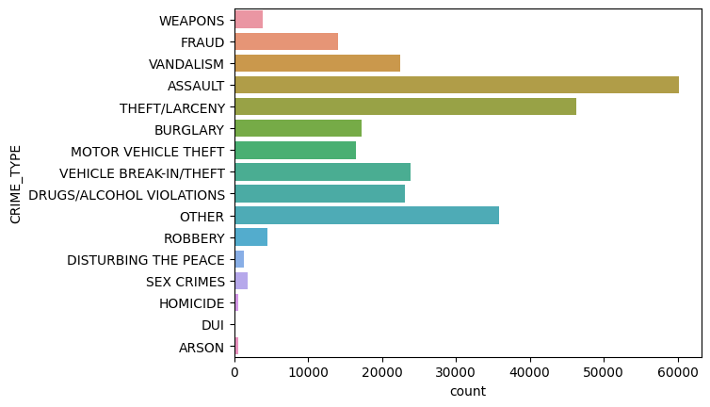
As what we can see, assault and theft are noticeably more than other crimes.

Slide 6
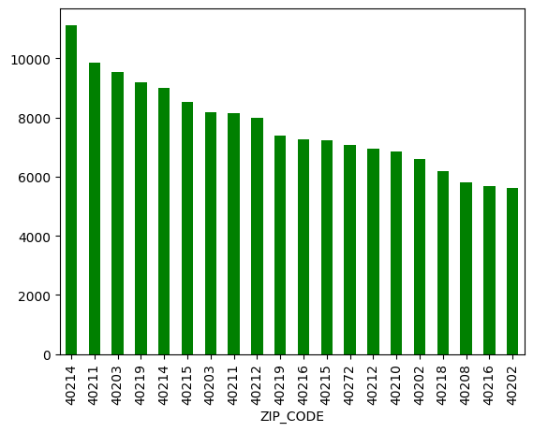
In which zip codes are crimes more likely to occur?
We have 97 zip codes here. I bring only 20 of them in my plot.
These 20 zip codes are the ones with the most crimes occurred.
More than 6000 crimes had happened in these zip codes during last 4 years; so by caring about past, it looks like crimes are more likely to occur in these zip codes

Slide 7
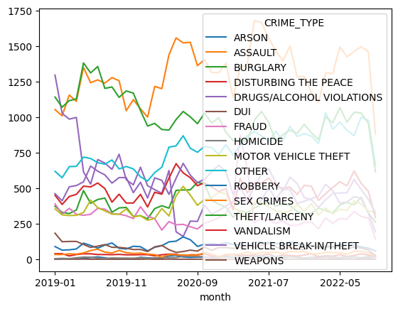
Is there a trend of some crimes increasing and others decreasing in number over these years?
For this part, I needed to make some changes in my data; so I worked on column ‘DATE_REPORTED’.
First of all, I changed its type to datetime; then I made a ‘month’ column.
Using ‘month’ and ‘crime_type’ columns, I could sketch the plot.

Slide 8
By looking at the plot, we can conclude:
1. During these years, burglary reduces.
The reason of reducing the number of burglary could be the starting of covid19. because people stays at home more than before.
2. Using drugs and alcohol is reduced. Maybe it’s because of increasing our information about their bad effects on our health.
3. The number of assault increases.
Also there is something amazing about it which is easy to see; in some months like June and July, we have a pick each year!
4.There is an increase in the number of ‘other’ crimes.
It sounds like some criminals changed their fraud methods
And are using new methods:)

Slide 9
Which crimes take the longest to report?
First, I made a new column which contains the time that takes a crime to be reported.
Then I sorted this column and chose 5000 of them which took the longest to be report.
Then it was time to count and plot them.
So by looking at the result (next page), we can understand ‘fraud’, ‘theft’ and ‘sex crimes’ took the longest to report.

Slide 10
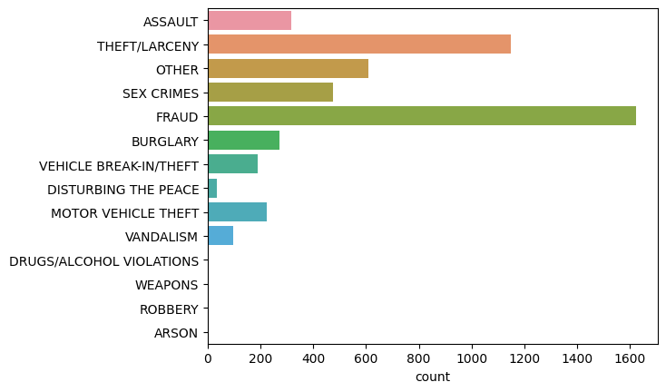

Slide 11
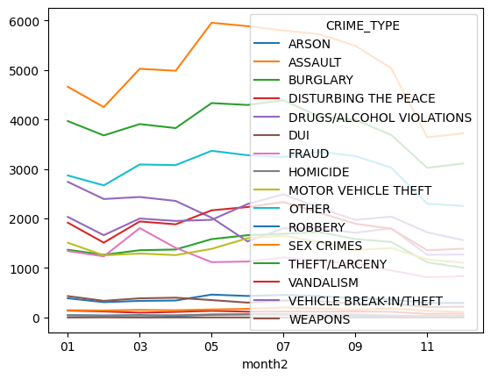
during which months of the year, the number of crimes reduces?

Slide 12
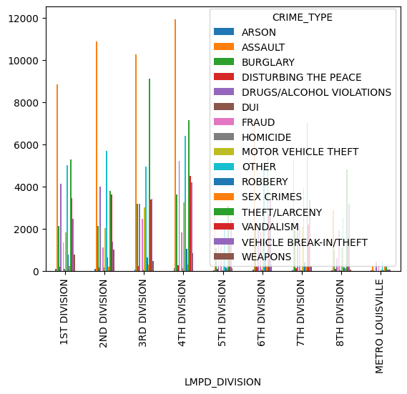
As we can see, the number of crimes reaches its peak during months May-July and then reduces; but we have to care that some crimes follow a different procedure .
For example, using drugs and alcohol increases during the first months of the year. ( it sounds reasonable; because we have too many holidays during these days.)
How is the distribution of crimes over LMPD_division?
4th devision has the most number of ASSULT and as we know, assult was more likely than others to happen.

Slide 13
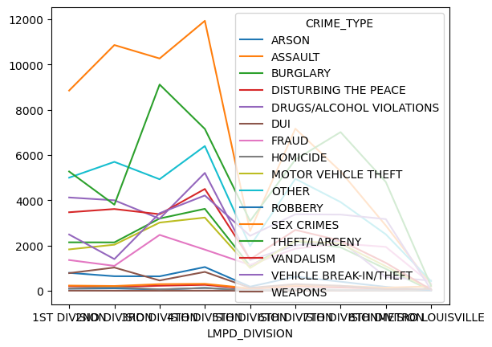
Here, it’s easier to see the result.
Burglary, mostly happens in 3rd division and assult mostly happens in 4th division.
Also, the least number of crimes happens in metro louisville.

Slide 14
Use hypothesis test to show which categorical features are dependant to ‘CRIME_TYPE’.
I used chi2 for checking which categories are dependant.
The result was amazing to me.
I checked the dependancy of uor_desc, lmpd_devision, primise_type, and zipe_code.
They all were dependant to crime_type.

Slide 15
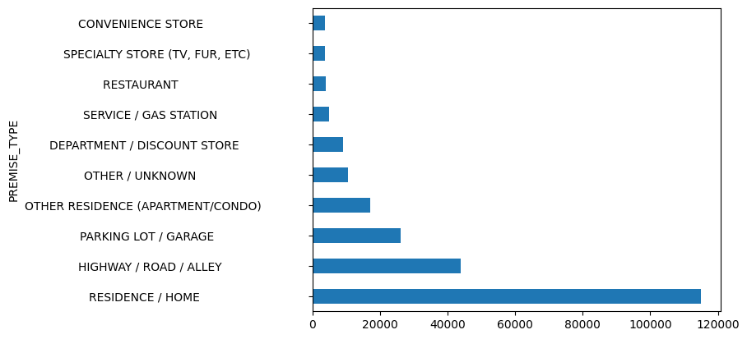
How is the distribution of incidents in top premises over LMPD division?
It’s the distribution of top premises. Next page we’ll see the answer of question.

Slide 16
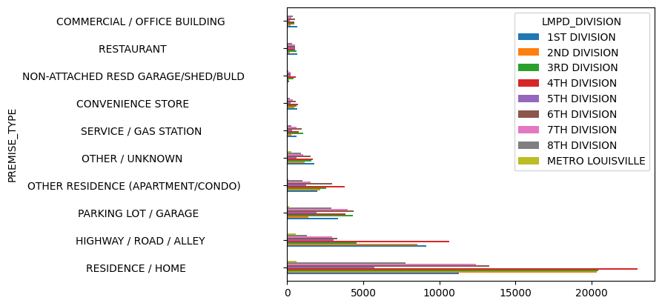
Here we can see the distribution of top premises over LMPD_division.

