Slide 1
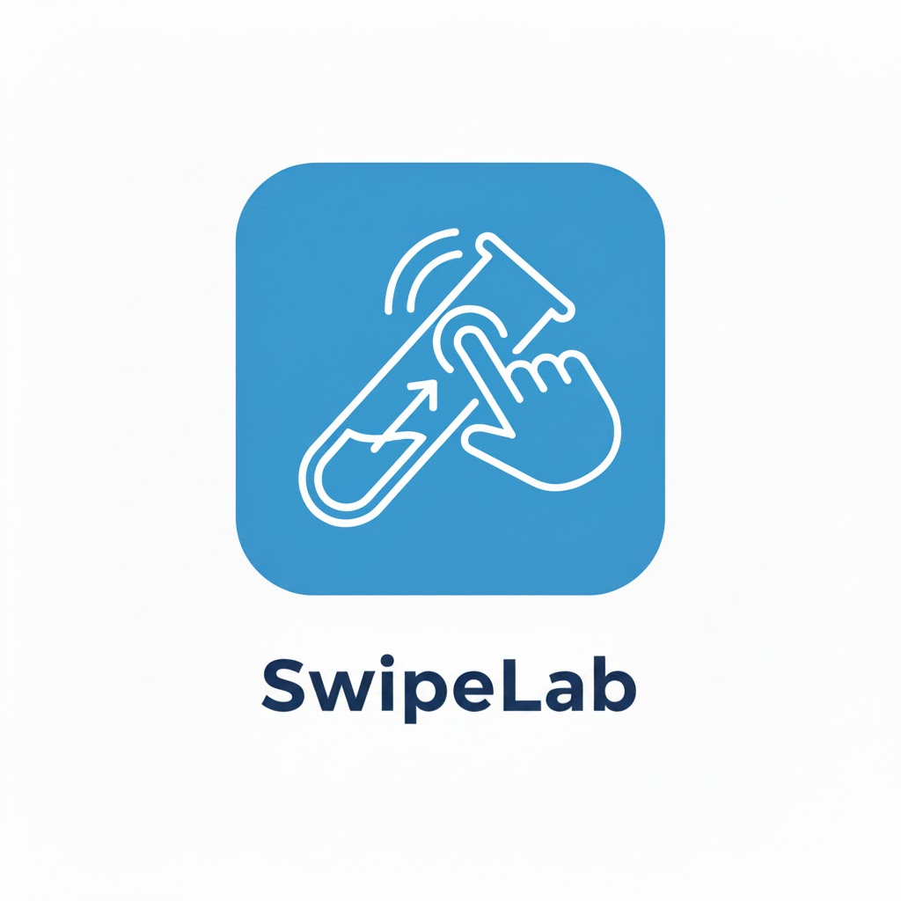
15
Software Engineering
Faculty of Engineering
Ben Gurion University of the Negev

Slide 2
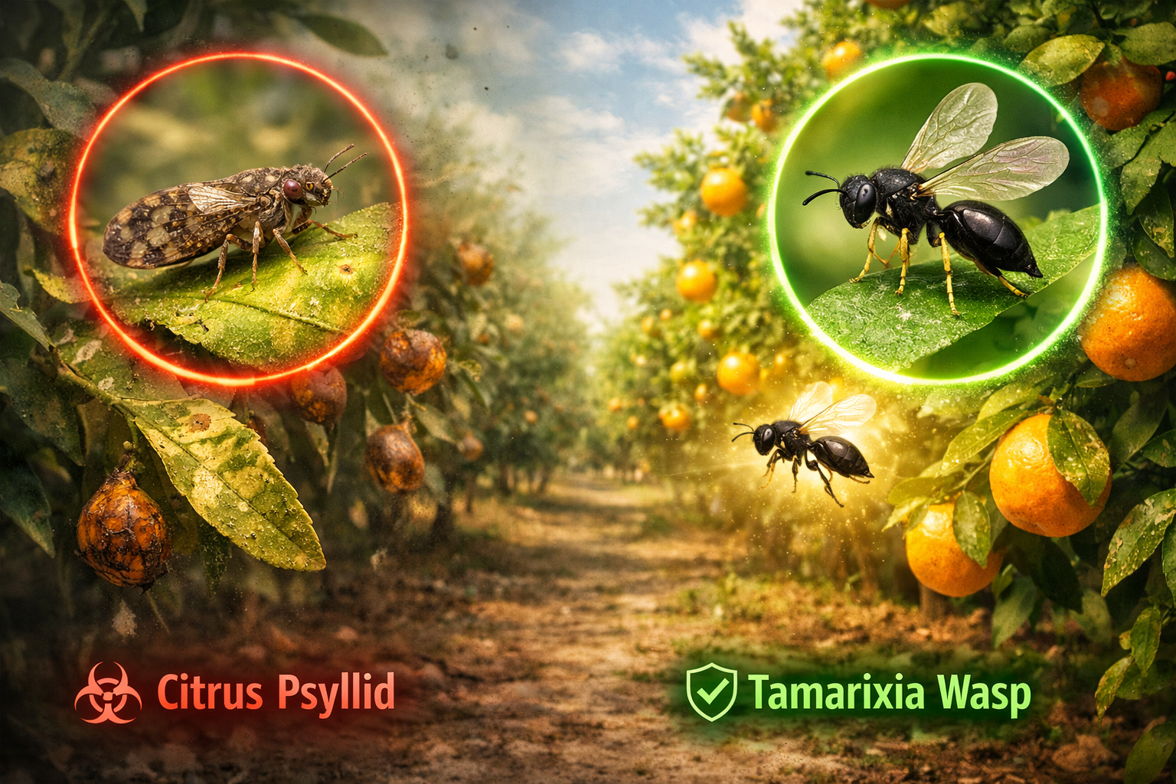

The Motivation Through Example
Protecting Israel’s Citrus Orchards
A Growing Agricultural Threat
The Key Question
Where is Tamarixia located right now?
Can data help us act before the damage spreads?
Notes:
תמריקסיה עשוי להיות הפתרון למזיק פסילת ההדר, מעניין חוקרים, רוצים לדעת איפה הוא נמצא

Slide 3
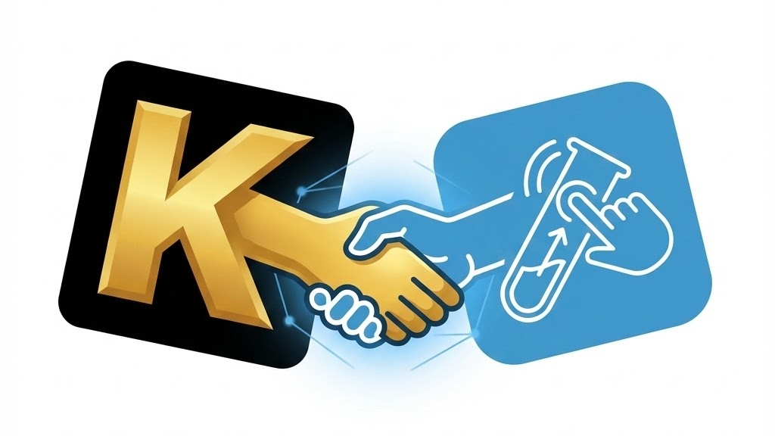
STARdbi
SwipeLab
Notes:
כדי להזין אתStarDBI בדאטה מהשטח בקנה מידה רחב, אנחנו משתמשים ב-Swipelab
פלטפורמה שמאפשרת לאסוף תצפיות מתויגות מאנשים אמיתיים, בצורה פשוטה ויעילה.

Slide 4



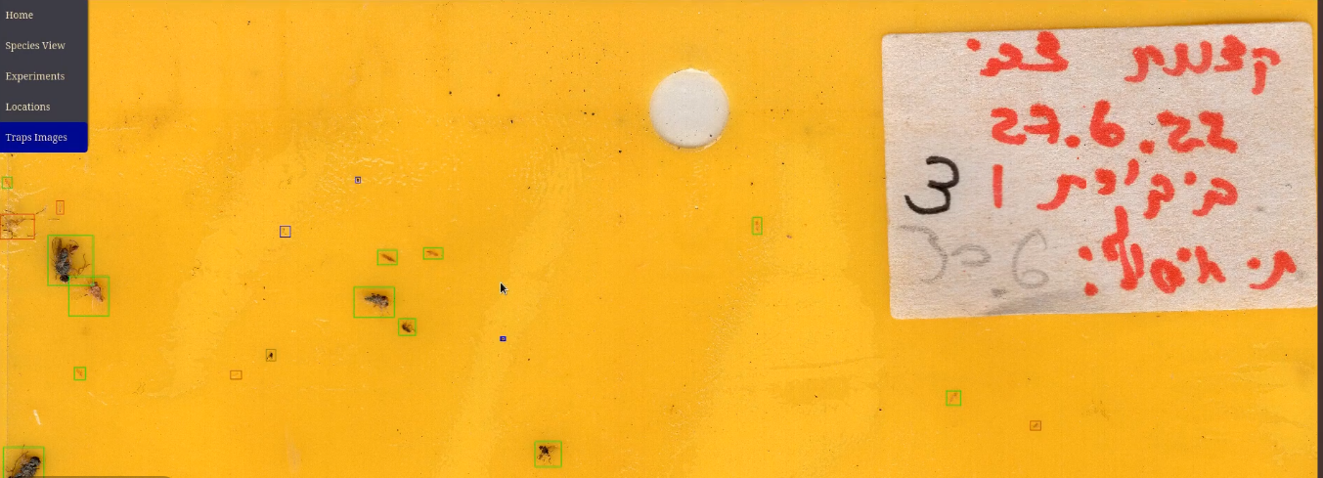
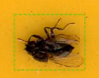
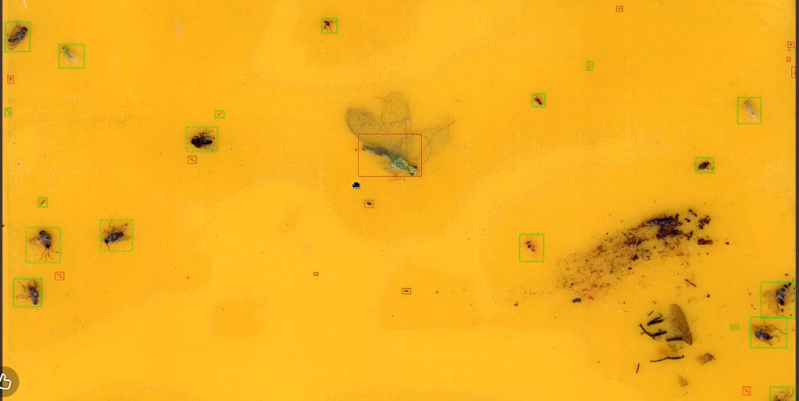
STARdbi – what is it?
STARdbi is a large-scale database contains over 380,000 insect images and trap scans collected from 84 ecological sites.
This extensive dataset is a core component of the research led by our client: Associate Professor Chen Keasar at Ben-Gurion University of the Negev.
Classification Model
Expert Researchers
Notes:
לקצר

Slide 5
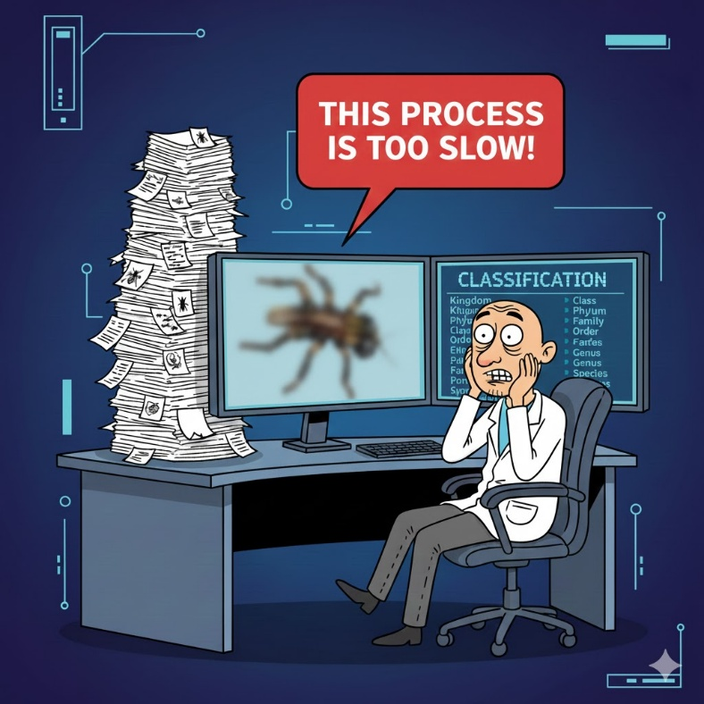

The Problem: The "Labeling Bottleneck"
Scientific analysis and ML models require labeled images
Labeling requires manual classification which is a slow process and does not scale
As a result, large amounts of collected data remain unused
Currently takes around 2-4 minutes for one label
Notes:
עפרי

Slide 6
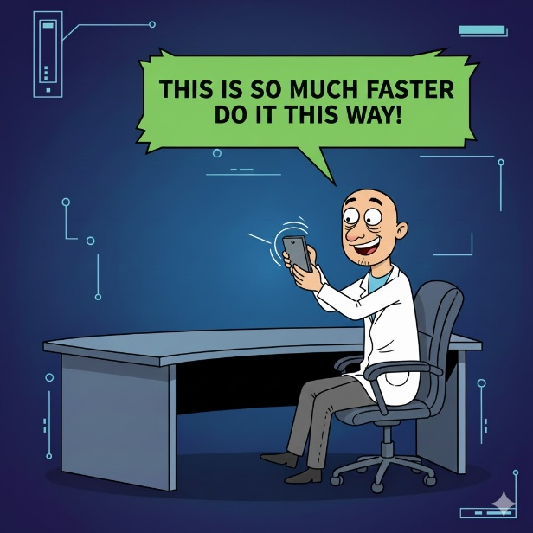
Requirements of SwipeLab
Engaging Interface: Utilizes a game-like, swipe-based interface.
Accessibility: Available on mobile and web platforms.
Ease of Use: Allows non-expert users to easily contribute.
Notes:
אביהוא

Slide 7




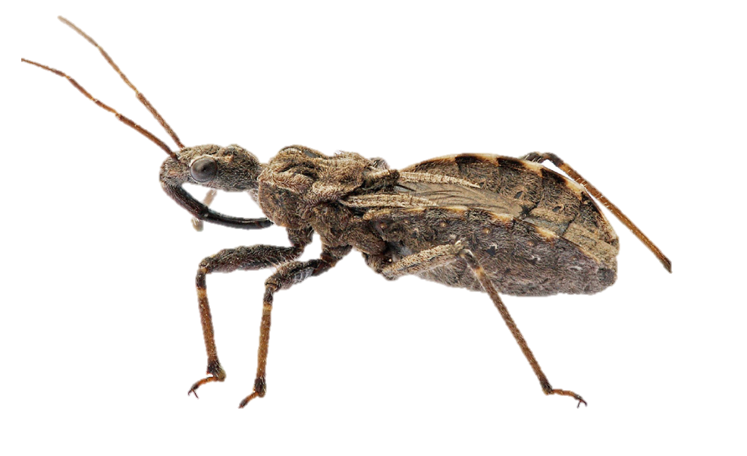











The Solution: Gamified Citizen Science
Score: 7,542
Rank: Expert
3 days streak
User123 Logout
Is this Thaumastocoris?
"SwipeLab" solves this problem
by transforming complex scientific classification
into a simple, "Tinder-like" mobile experience for volunteers.
Reference Photos
Settings My Tasks Leaderboard Stats
Researcher
Labeler
Notes:
שגיא

Slide 8

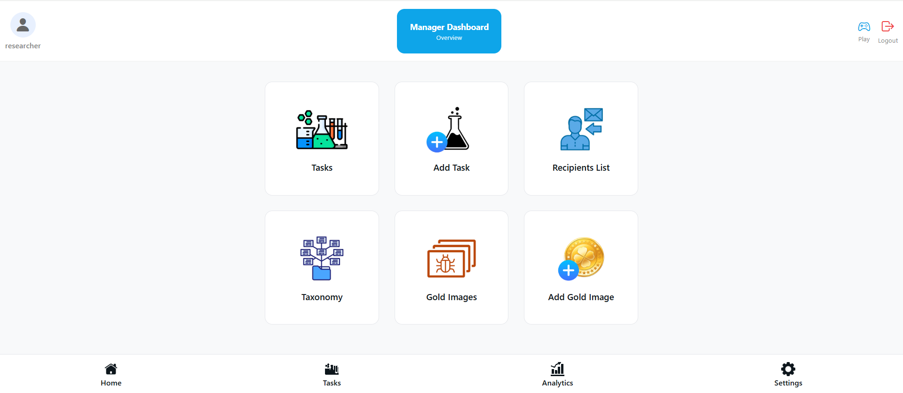
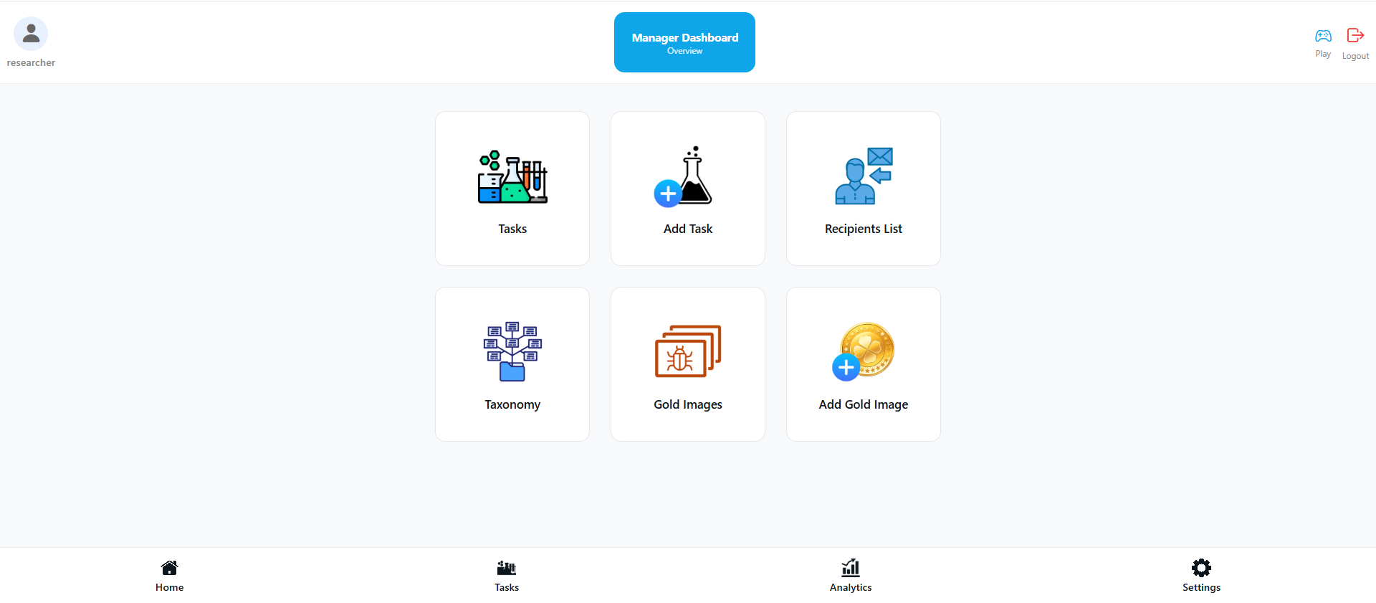
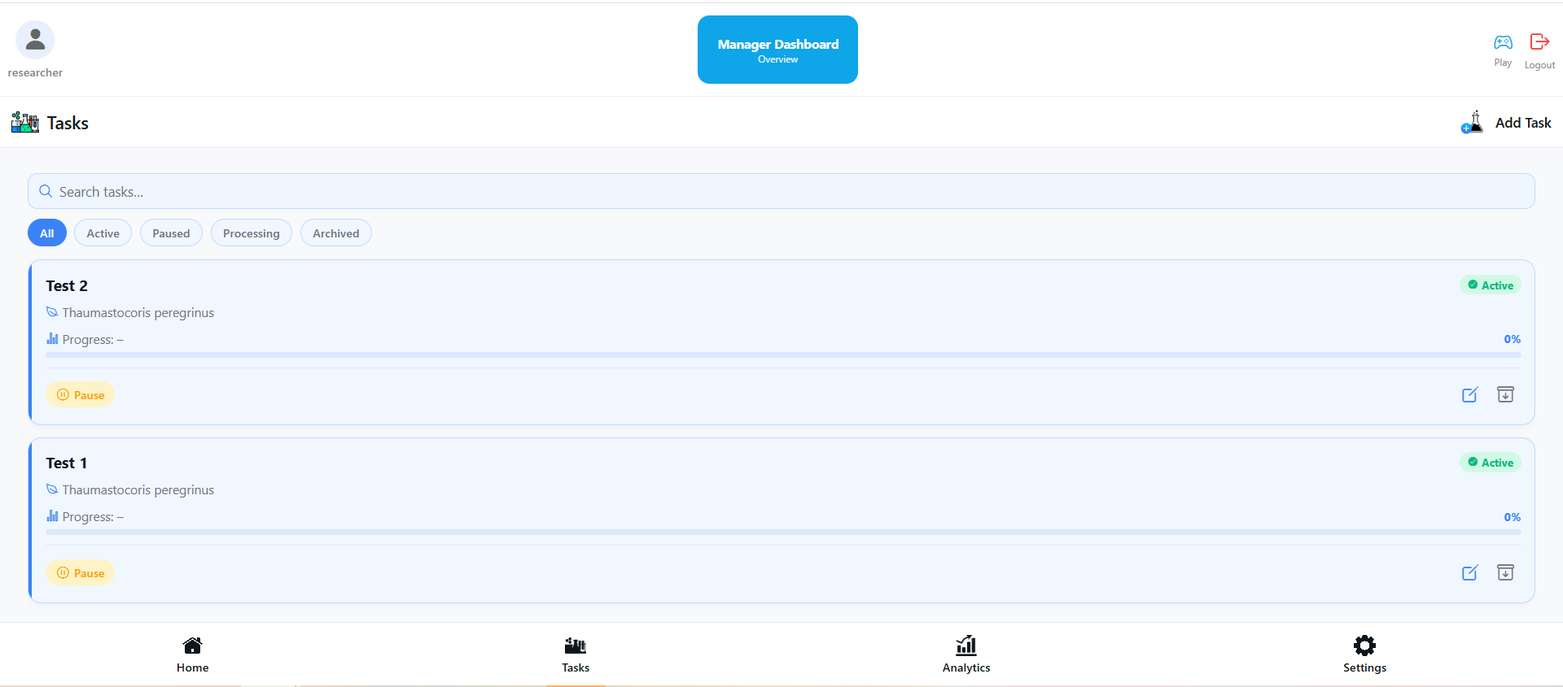










The Researcher Side: From Labels to Insights
Through the Researcher Dashboard, scientists can easily:
Create labeling tasks
Monitor progress
Ensure data labeling quality
Export labeled data
Manager
Switch to play
User123 Logout
Tasks
Add Task
A Very Long Name
Species: Perengrinus
Locations: Sde-Boker, Ze’elim
Experiments: x1, x2, x3
Description: The Perengrinus species plays
an important role in meas…
A Very Short Name
Species: Mantis Religiosa
Artogeia Rapae
Location: North Cape
Experiments: name1, name2
Description: This insects are commonly...
REF
(Active)
REF
(Active)
REF
A Very Average Name
Settings Users Leaderboard Stats

Slide 9



Main Challenges
User Engagement Keeping users motivated over time
Label Variability Noisy, inconsistent user labels
Trust & Abuse Bots, AI-generated answers

Slide 10
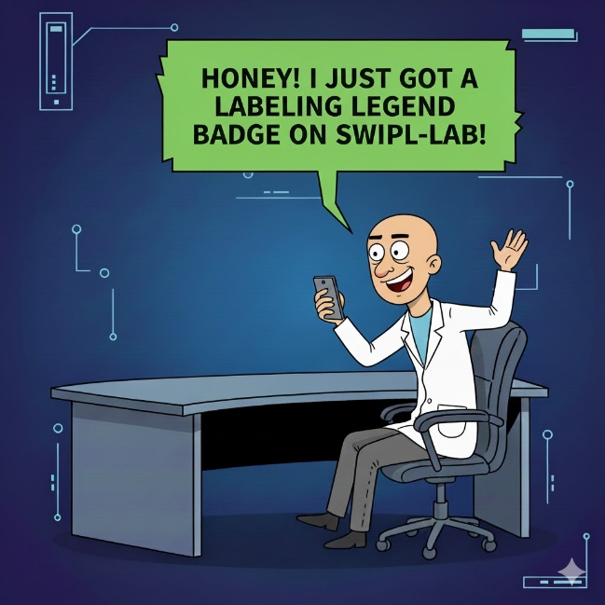
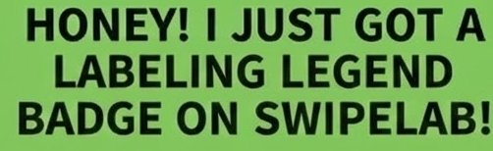

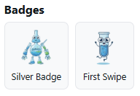
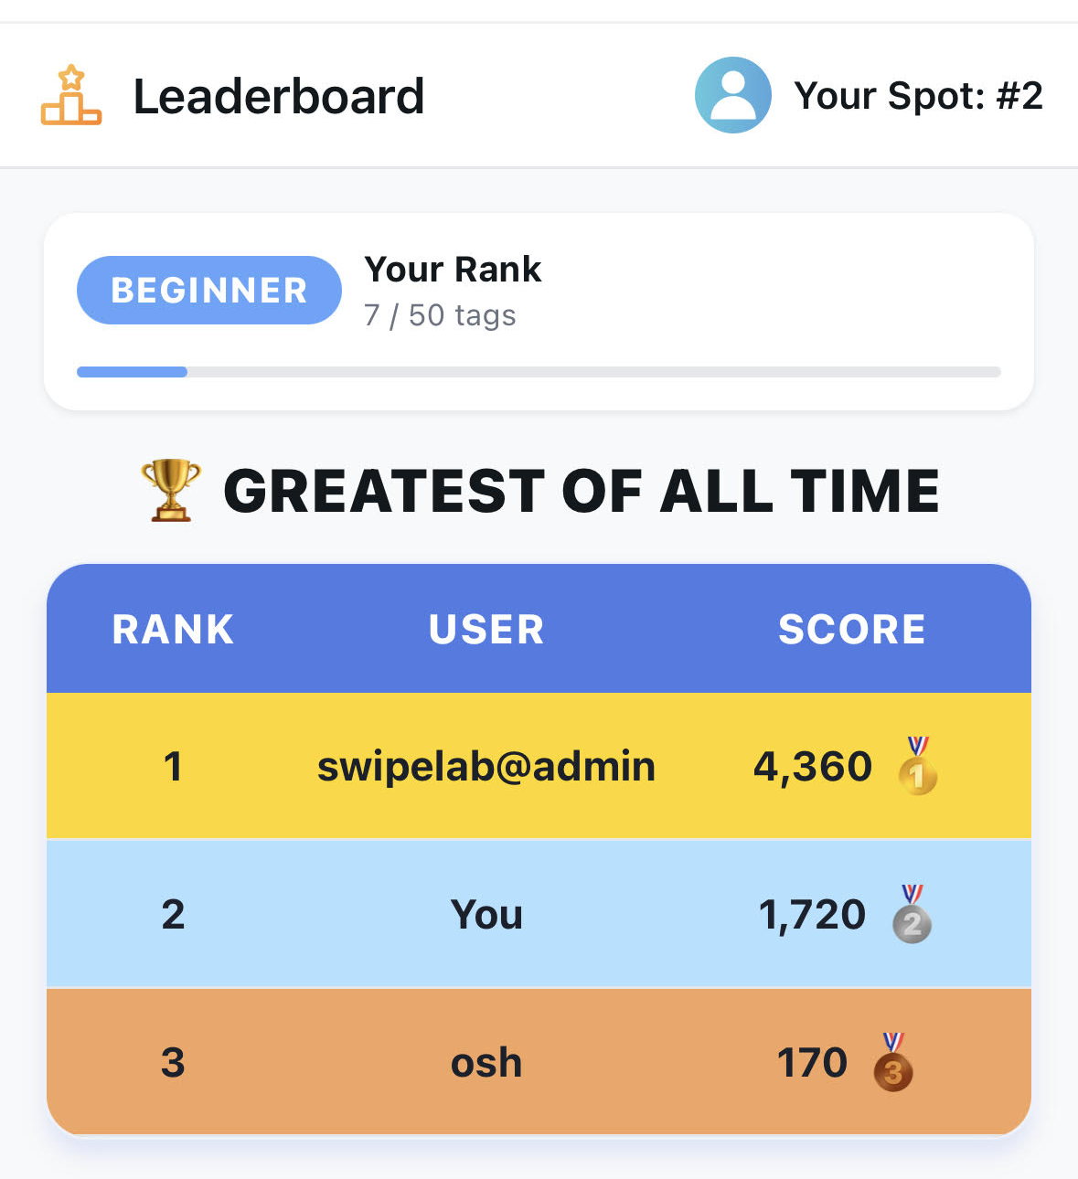
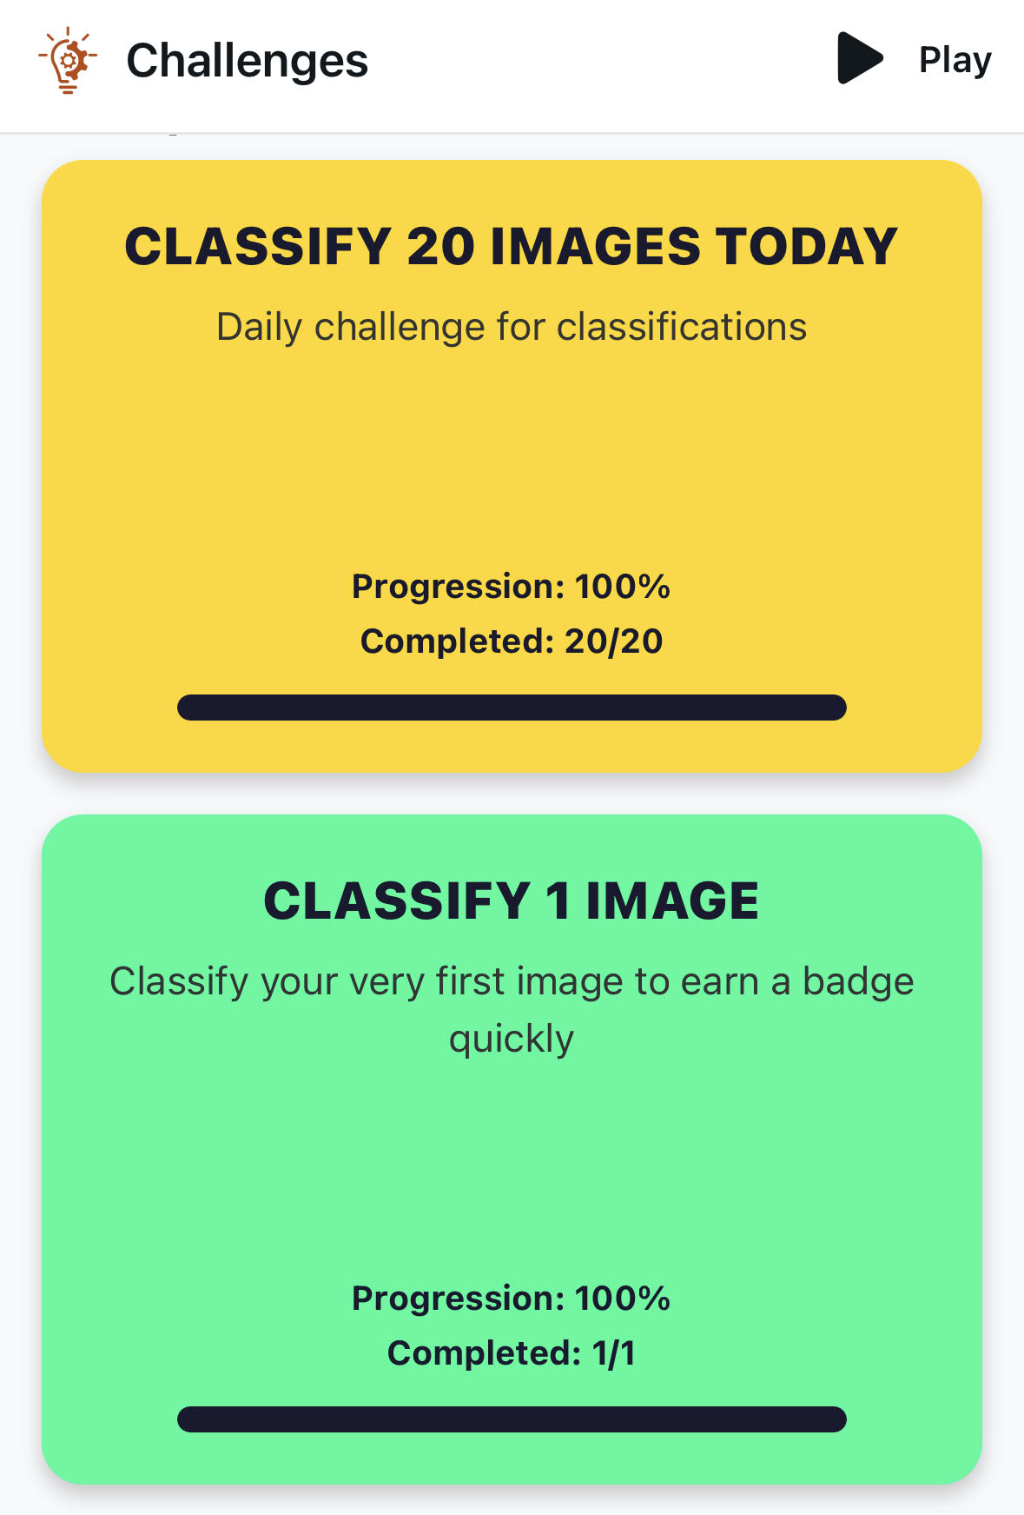
Driving Engagement Through Gamification
To ensure high participation and long-term engagement:
Points
Streaks
Badges
Competitive leaderboards
Notes:
אביהוא

Slide 11


Data Integrity & Fraud Detection
Credibility system based on predefined metrics (consensus, agreement with experts, user reliability)
Researchers control how classifications are used based on credibility
Bot detection identifies suspicious behavior and excludes unreliable inputs
Notes:
אביהוא

Slide 12


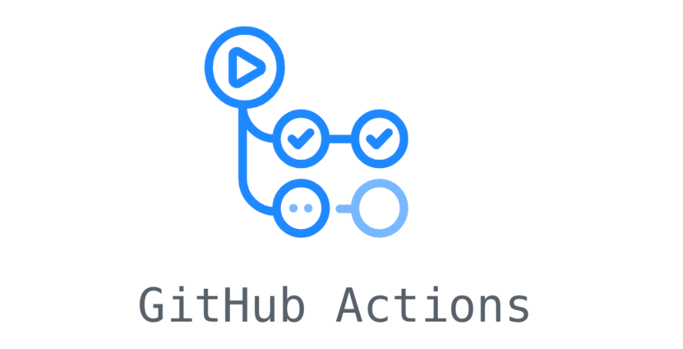

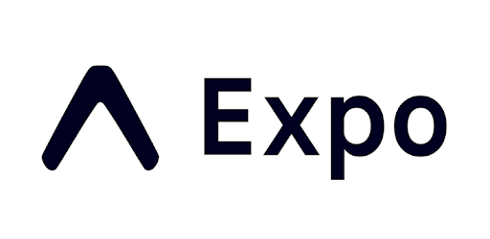

Project Tech Stack
Mobile (Frontend): React Native + Expo
Cross-platform (iOS/Android) with high-performance animations for swiping.
Server (Backend): Java Spring Boot
Robust REST API utilizing Spring Security for OAuth2 (Google Sign-In).
Storage (Database): PostgreSQL
Reliable relational storage for tasks, user stats, and consensus labels.
Infrastructure & DevOps: Docker & GitHub Actions
Containerized deployment with CI/CD for automated testing and stability.
AI tools: Antigravity Gemini & Claude Code & ChatGPT
ChatGPT for designing, Claude Code & Gemini for implementation.
Notes:
עפרי

Slide 13

Tests Strategy Overview
SwipeLab employs a robust, full-stack testing strategy divided into two primary domains:
Backend (Java/Spring Boot): Heavy emphasis on Unit and Integration testing to ensure data integrity, complex gamification logic, and cross-domain eventing.
Frontend (React Native):
Focus on End-to-End (E2E) testing via Playwright to ensure user flows like swiping and reasearcher management work flawlessly.

Slide 14
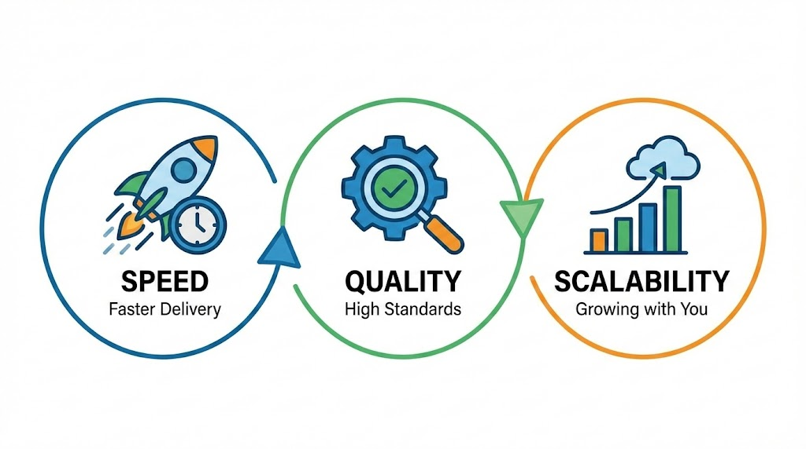
The Value Of SwipeLab
The project brings three core values to the research ecosystem:
Speed, Labeling Quality, and Scalability
Notes:
אביהוא

Slide 15
SwipeLab System Demonstration
Notes:
אביהוא

Slide 16
Questions?

Slide 17
Backup slides

Slide 18
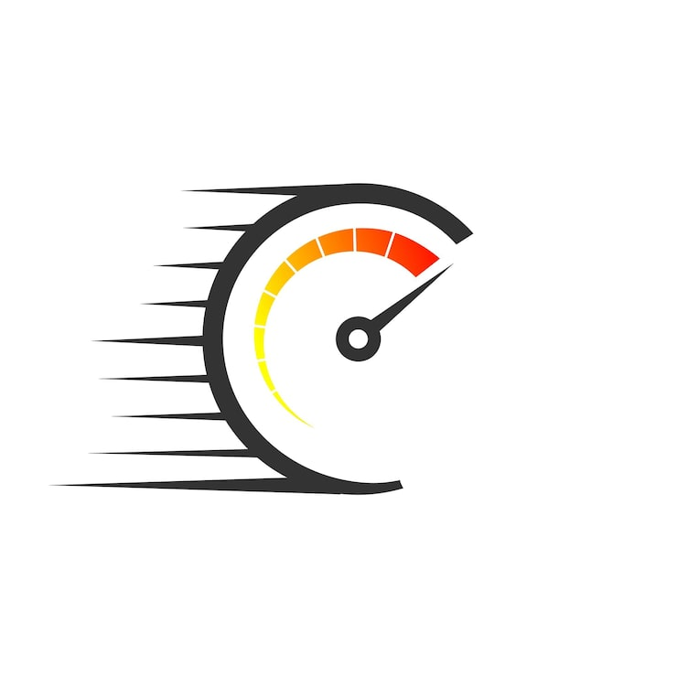







Delivering Faster With AI Tools
Gemini
ChatGPT
Architecture Decisions & Creating Detailed Issues:
Context & Documentation
Code Agents:
Less Tokens
Opus: Plan Only
Sonnet: Implementation
Gemini Pro High:
Plan First → Implementation
Code Review:
Copilot:
Reviewing PRs

Slide 19
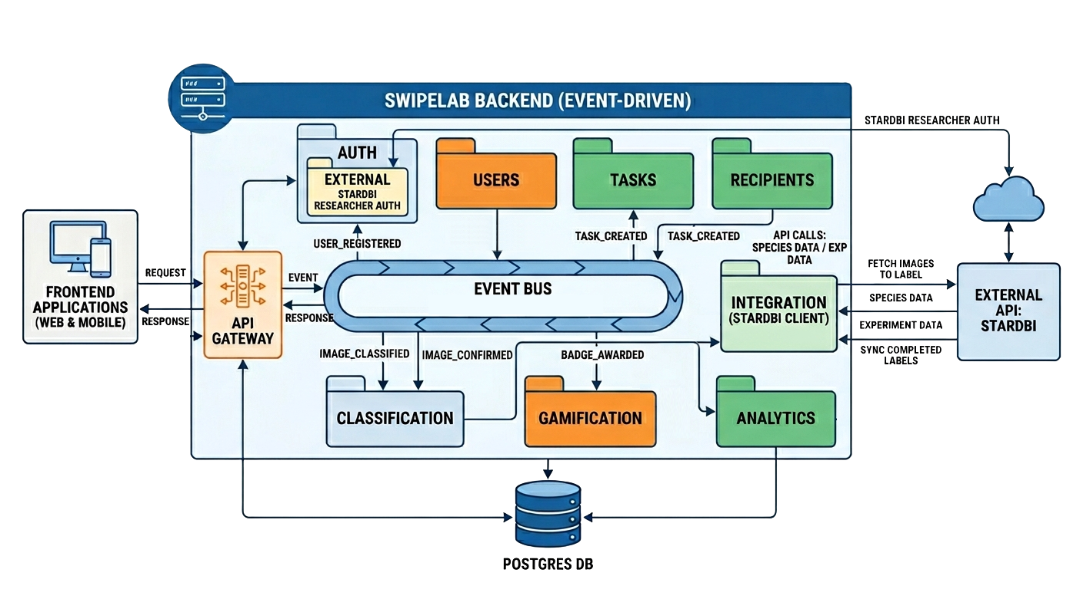
Backend Design
Auth
Tasks
Classification
Users
Analytics
Integration
Recipients
Gamification
STARdbi api

Slide 20


Backend Package Design
api
Controller
Controller
application
Service
Service
domain
Domain Objects
Domain Services
infrastructure
Repositories
Event
Listener
Ready For Scaling!
events
Created
Event
Updated
Event
Submitted
Event
Designed with highly decoupled packages, our architecture is inherently ready for microservices migration.

Slide 21
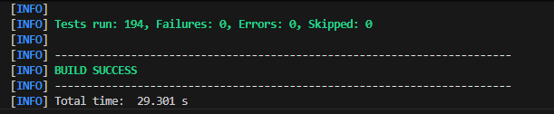
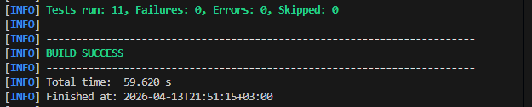
Backend Testing Stack
JUnit 5: Core framework for test execution and lifecycle management.
Mockito: Mocking dependencies (Repositories, services) to isolate unit tests.
Spring Boot Test: Context loading and MockMvc for API endpoint validation.
H2 / Testcontainers: Temporary databases for safe integration testing
The suite follows Domain-Driven Design (DDD), mirroring the main application structure (auth, gamification, tasks, etc.).

Slide 22
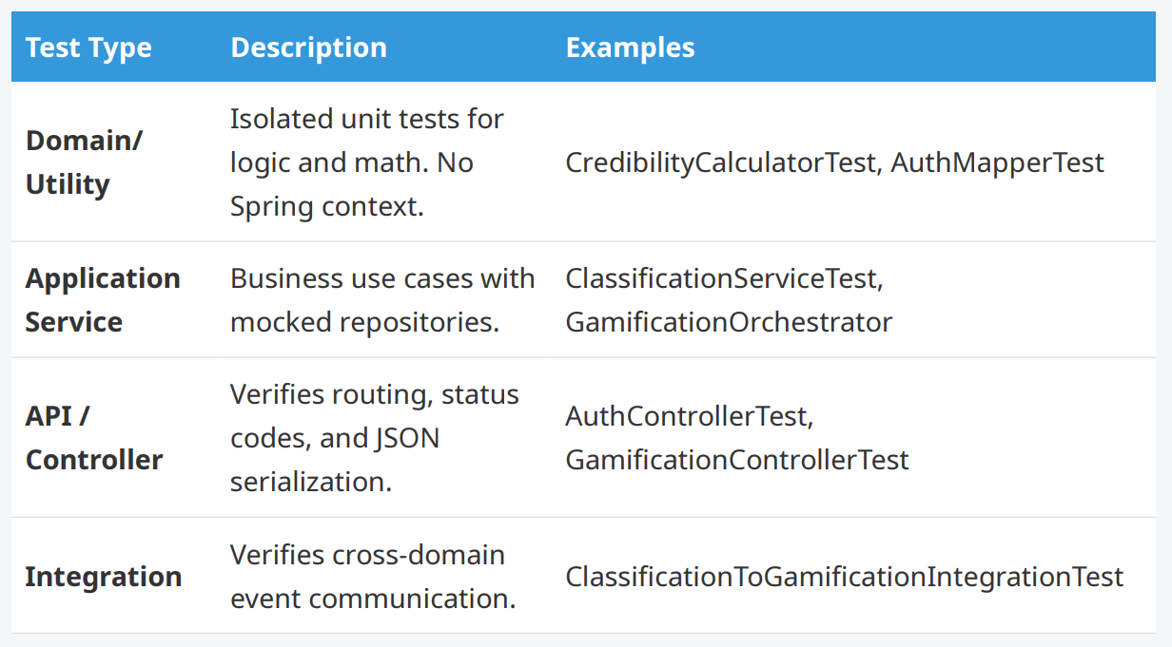
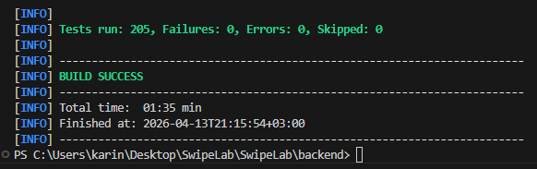
Backend Test Layers

Slide 23
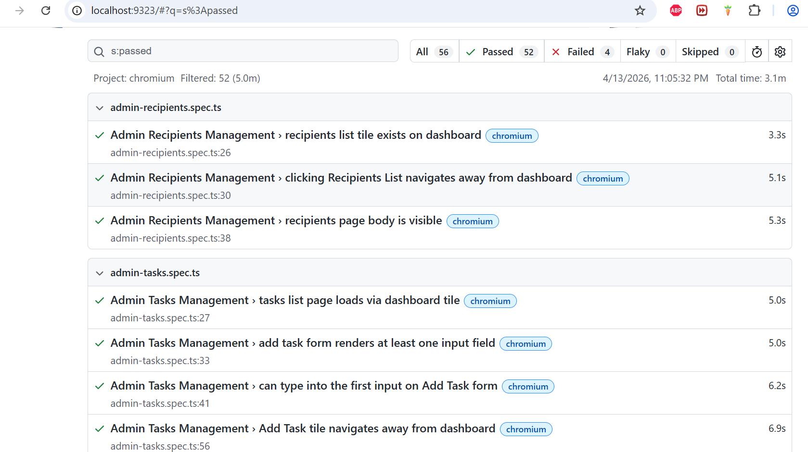
Frontend: User Journeys
Utilizing Playwright to interact with the React Native app exactly as a human user would.
Shared Flows: Authentication (login/reg) and settings updates.
User "Swiper" Flows: Swiping functionality, stats dashboard, credibility scores, and daily challenges.
Admin Flows: High-level metrics view, task creation, and recipient group management.

Slide 24
Conventions & CI/CD Guardrails
Naming: Backend ends in Test.java; Frontend ends in .spec.ts.
Environment: Separate properties for Unit (fast) and Integration (full context) tests.
Data: Usage of factories and MockDataSeeder to avoid brittle hardcoded states.
Gatekeeping: All PRs targeting main MUST pass the full backend and frontend suite before merging.

Slide 25





Credibility Score
Disagree
Agree
Evaluates the accuracy and reliability of a user's image annotations.
The Credibility Score ranges from 0 to 100
The score is calculated using three main metrics:
Accuracy on Gold Standard Images (40%)
Measures the percentage of correct labels on images with a known ground-truth label.
Majority Consensus Agreement (35%)
Measures how often the user’s label matches the community consensus (more than 50% agreement on an image).
Expert Agreement (25%)
Measures the level of agreement between the user and expert researchers using Cohen’s Kappa.
Calculated based on the user's 50 most recent labels.

Slide 26
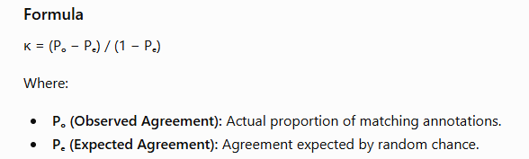
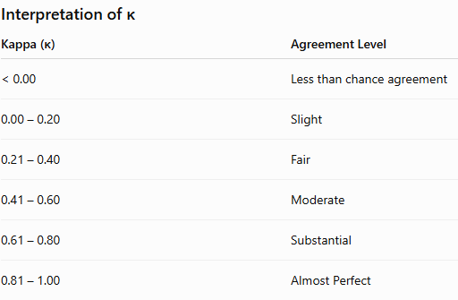
Cohen’s Kappa
Use in Our Project
Measures agreement between a user and expert researchers.
Calculated using the user's 50 most recent labels.
Contributes 25% of the overall Credibility Score.
Higher κ values indicate stronger alignment with expert judgments and higher annotation reliability.

Slide 27


Addressing the Expert Agreement Limitation
Challenge: Expert Disagreement
Experts are often used as the reference standard, but they may disagree on ambiguous images.
As a result, agreement with a single expert may not always reflect the true quality of a user’s labeling.
Solution: Multi-Signal Credibility Scoring
Our system treats expert agreement as an important quality signal, but not as absolute truth.
By combining expert judgments with verified ground-truth labels and community consensus,
the Credibility Score remains robust even when experts disagree on individual cases.

Slide 28
How Our System Addresses This
Multi-factor evaluation: Expert agreement contributes only 25% of the Credibility Score.
Independent validation sources: The remaining 75% comes from:
Gold Standard Images (40%) – objectively verified labels.
Community Consensus (35%) – agreement with the majority of annotators.
Limited influence of experts: Expert agreement is only one component and cannot solely determine a user's credibility.
Missing-data handling: If expert comparisons are unavailable, the score is recalculated using the remaining metrics, preventing unfair penalties.
Focus on recent performance: Expert agreement is computed using the user's 50 most recent annotations, ensuring the score reflects current behavior rather than historical mistakes.

