Slide 1


Name That Baby
Team Members: Chris McCown, Jake Hatcher,
Frances Doyle, Nand Kishore Sagi

Slide 2

Does media influence baby names?
What is the impact of movies and songs on baby names?
Do movies or songs have a bigger impact on chosen names?
Is popularity arising from a media influence lasting?
Notes:
We believe media has an influence on baby names.
What questions did we ask?
Why did we ask these questions?
Did we answer our questions?
Yes
What were our findings?
We found many instances where media did have an influence.

Slide 3
Data Sources
3 data sources
Need actors’ names
Need baby names
Social Security Administration data
1881 to 2018
Need musicians’ names
OMDb API
1911 to present
Box office movies
Billboard API
1959 to present
#1 ranked song weekly

Slide 4

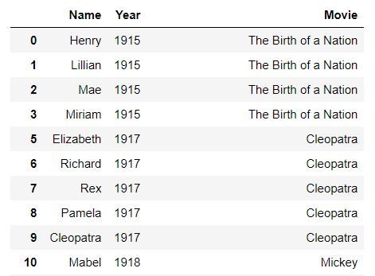
Movie Data Cleanup & Exploration
Name, Year, Source
Limitations
Movie database did not have character names
Movie database only returned four actors

Slide 5
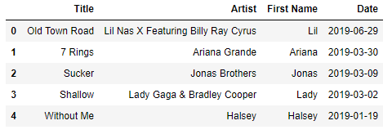
Song Data Cleanup & Exploration
Title, Name, First, Date
Limitations
No individual names for groups
#1 song only

Slide 6
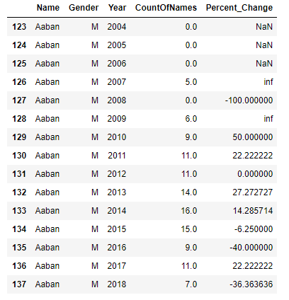
SSA Data Cleanup & Exploration
Name, Year, Count
Limitations
Lack of name data (<5)
Misrepresent date

Slide 7
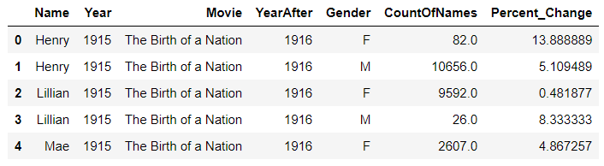
Merging the Data
SSA DataFrame
Merged with DF (CSV)
Year and Name

Slide 8

Analysis

Slide 9
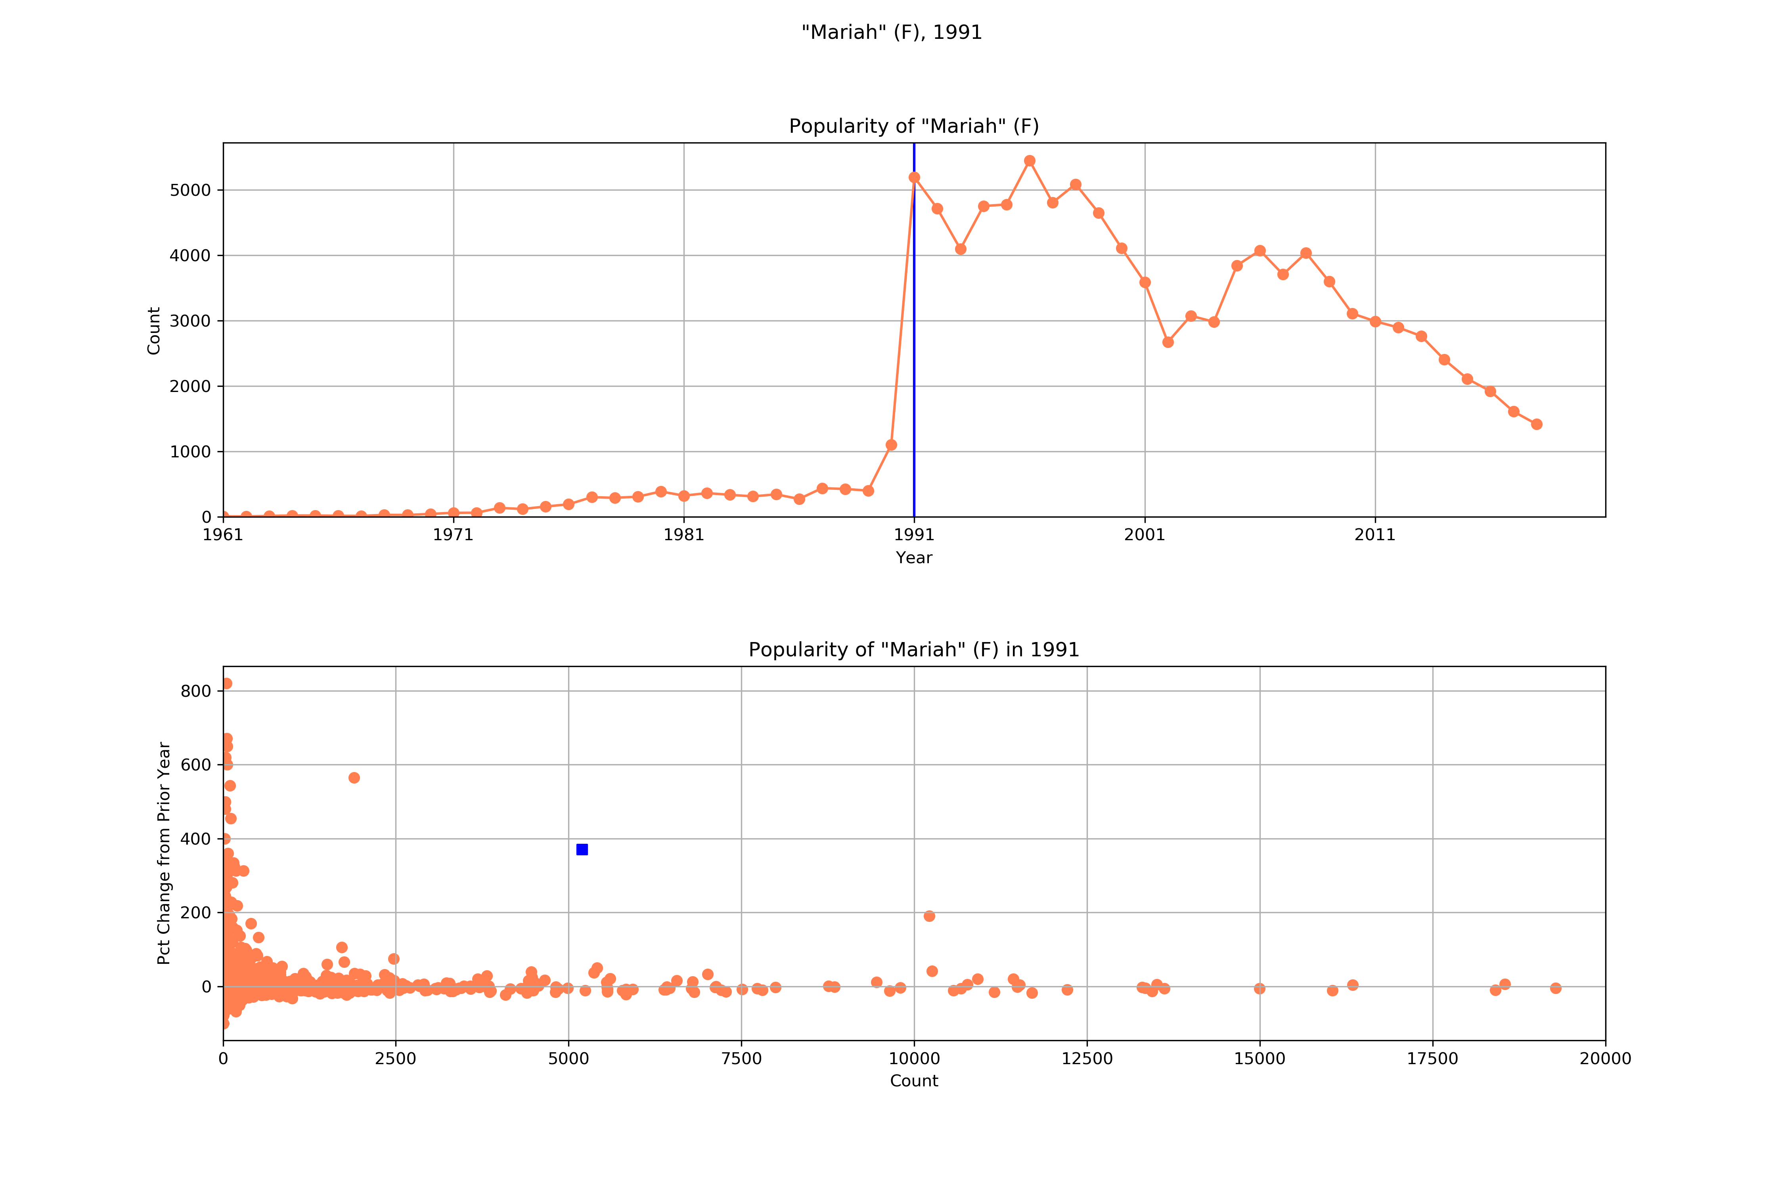
Did we see an impact on baby names from songs?

Slide 10
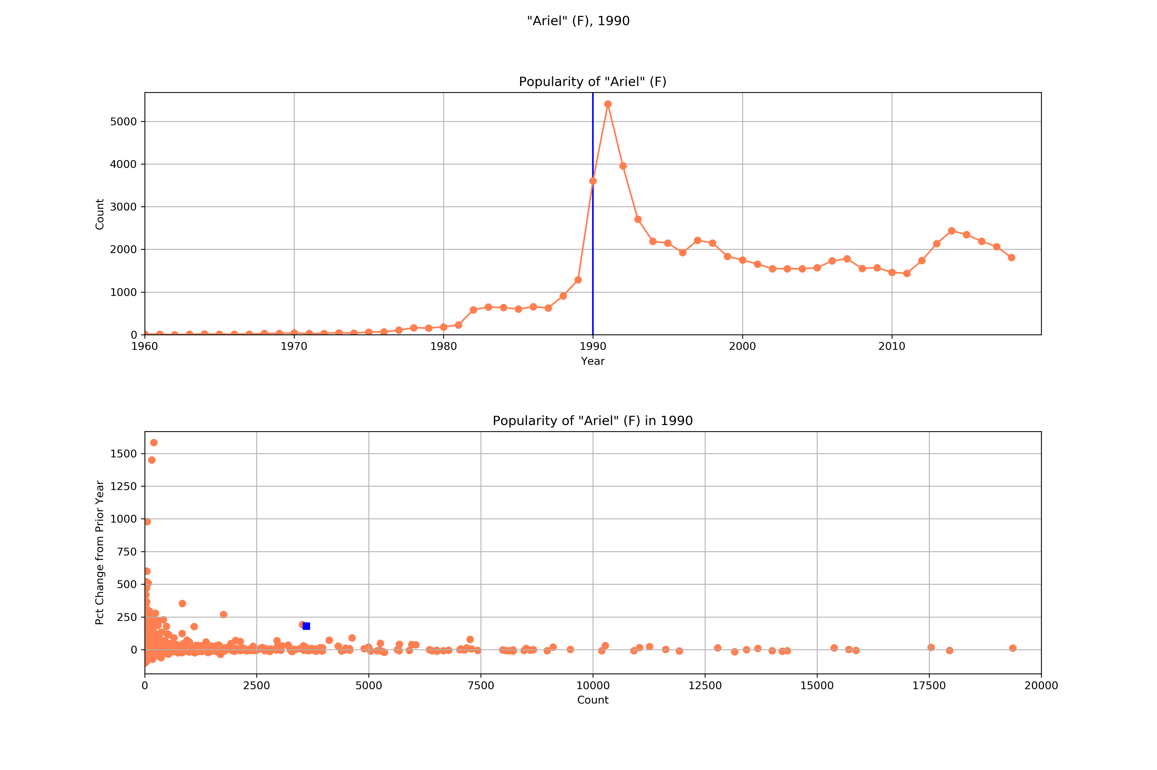
Did we see an impact on baby names from movies?

Slide 11
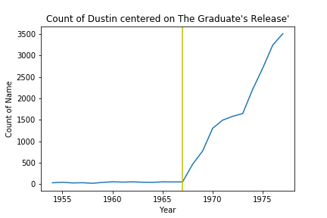
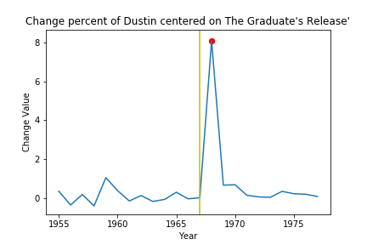
Is popularity arising from a media influence lasting?

Slide 12
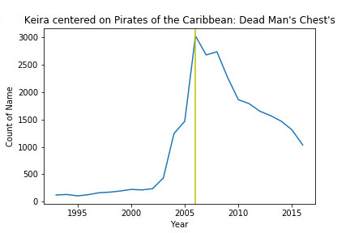
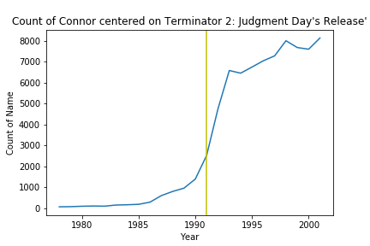
Is popularity arising from a media influence lasting?

Slide 13
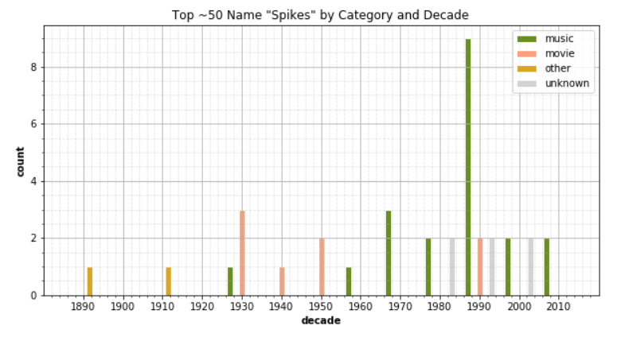
Largest spikes

Slide 14
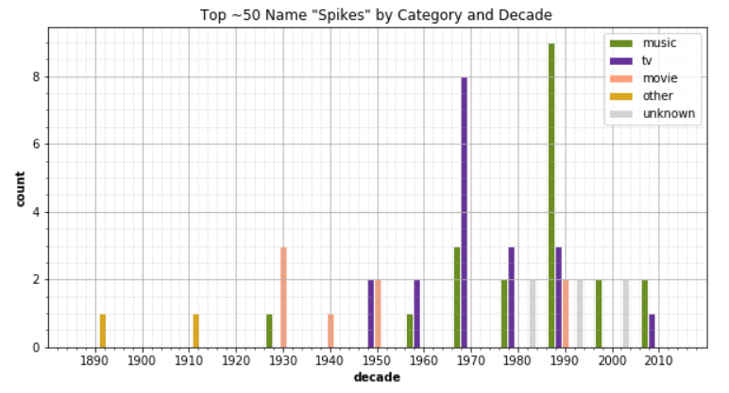
Largest spikes

Slide 15
Post Mortem
Data difficulties
Manual intervention
No gender
Additional scope
Look at more:
Television
Names within songs
Music charts
Movie characters
Books

Slide 16

Questions?

