Slide 1

OPMCodeGenerator
Capstone Project Phase A – 61998
Project Code: 25-2-D-15
Students: Sagi Yosofov, Liroy Ben Shimon
Supervisor: Dr. Natali Levi
1

Slide 2

Problem Definition & Motivation
Problem Definition:
The Existing Gap Between System Specification and Software Implementation.
Motivation:
Improve specification and development alignment
Reduce errors
Save time
Lower costs
2

Slide 3
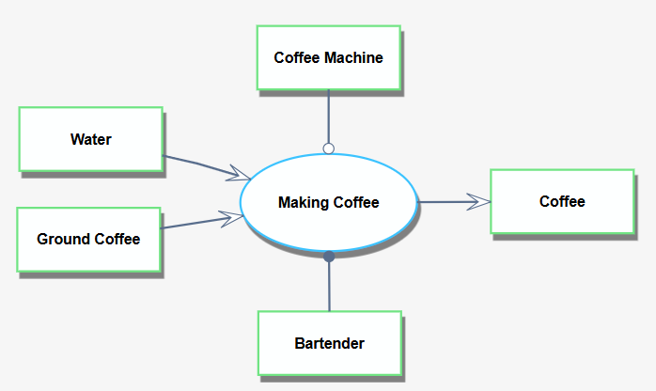
OPM Overview
An approach to systems modeling that represent the function, the structure, and the behavior of any system using only two things:
Objects – things that exist.
Processes – things that affect objects.
In addition, there are relationships that connect objects and processes.

Slide 4
Project Objectives
Teaching AI to understand OPM.
Evaluate AI comprehension of visual and textual input.
Develop an AI-based system that converts OPM models into executable code.
Minimize Interpretation Errors between specification and implementation.
3

Slide 5
Current Solutions
xUML: Executable UML profile for automatic code generation from standard UML diagrams.
MAXIM: Integrating computational and executable capabilities into conceptual models.
Umple: Model-driven tool embedding code directly within UML models for rapid prototyping.
4

Slide 6
Proposed Solution
AI-based system that converts OPM diagrams into software.
Input: OPM diagram, programming language.
Process: AI-powered analysis and translation using Claude API.
Output:
Software written in the chosen programming language.
Downloadable ZIP file.
5

Slide 7
Innovation and Contribution
Innovation:
AI-powered OPM-to-Code system.
Direct translation from specification to implementation.
Impact on Software Engineering:
Faster Development: Start with working code base
Better Alignment: Specification-implementation consistency
Reduced Errors: Minimize human interpretation mistakes
6

Slide 8

Engineering Process Overview
AI Training: Teaching AI platforms to understand OPM methodology.
AI Selection: Claude chosen for best comprehension and accuracy.
Visual and Textual Analysis: Evaluate AI comprehension of visual and textual inputs.
7

Slide 9

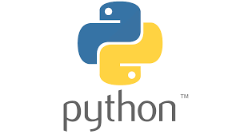

Engineering Process Overview Contd.
AI Training: Teaching Claude how to transform OPM diagram to executable code.
Technology stack decisions:
Backend: Python
Frontend: React.js
AI Service: Claude API
8

Slide 10
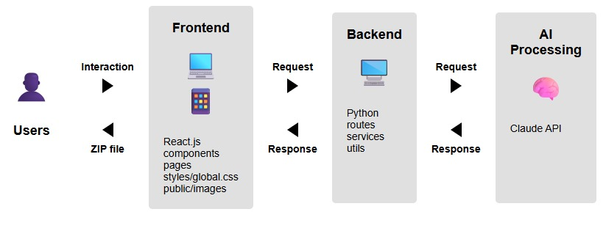
System Architecture
9

Slide 11
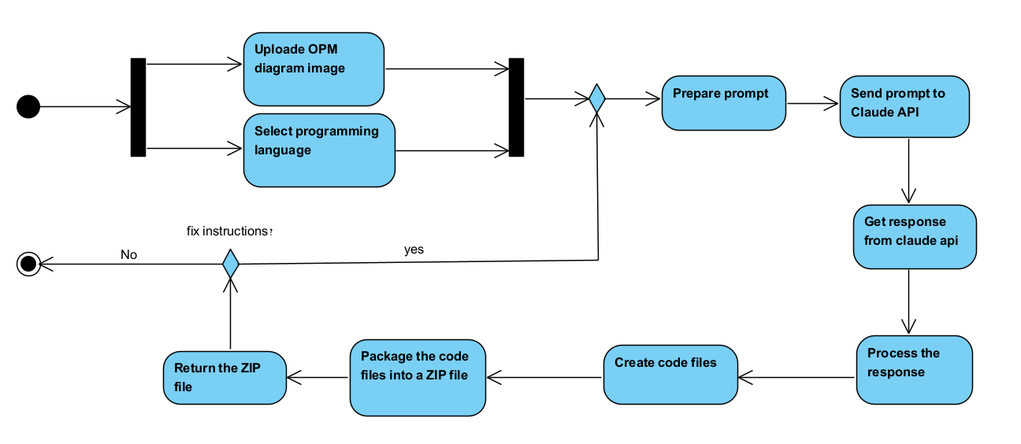
System Flow Diagram
10

Slide 12
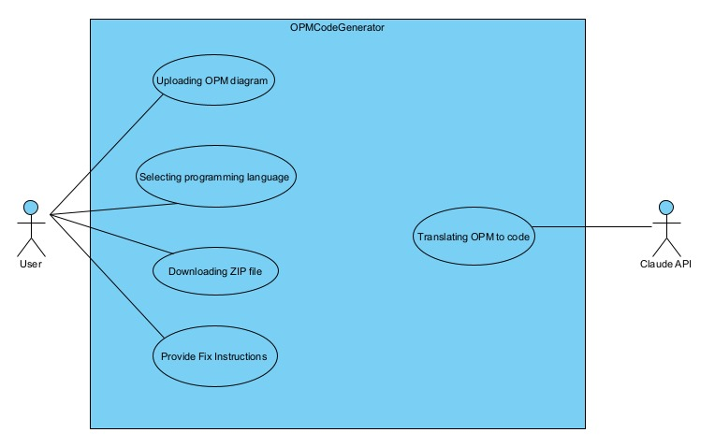
Use Case
11

Slide 13
Testing Plan
Test Description
Expected Results
Code generation accuracy
At least 80% of accuracy of the generated code representing the input diagram.
ZIP file creation and download
Downloadable ZIP file created that contains the code files the system created.
Invalid input – the image doesn't contain OPM diagram
An error message explains that the system expects to get OPM diagram as input.
Response time
From the moment input was sent no more than 3 minutes until response returned.
Usability testing
SUS score>=80.
12

Slide 14
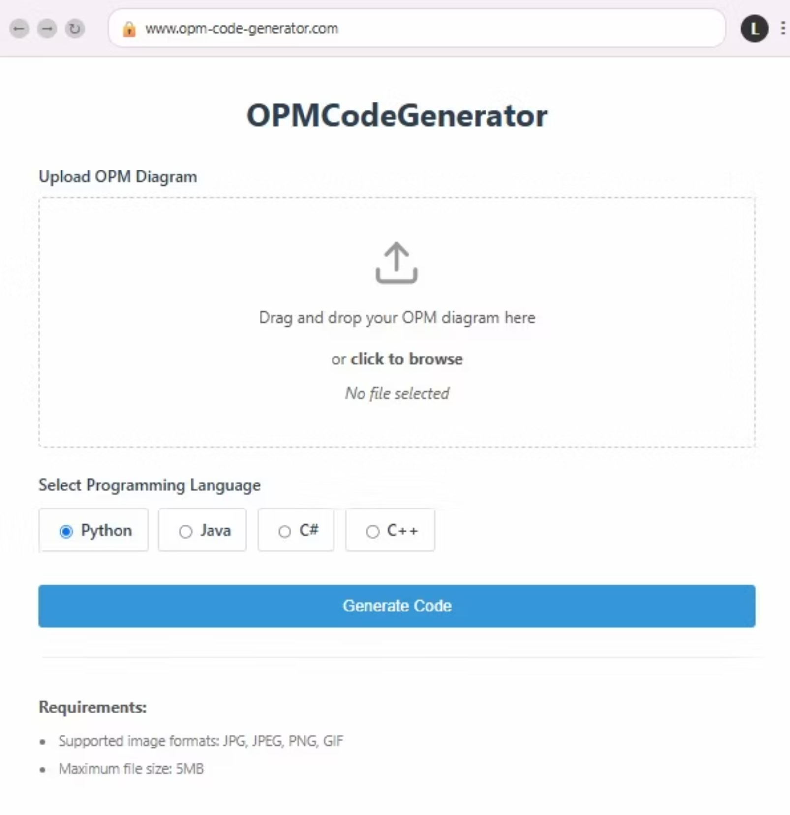
User Interface
13

Slide 15
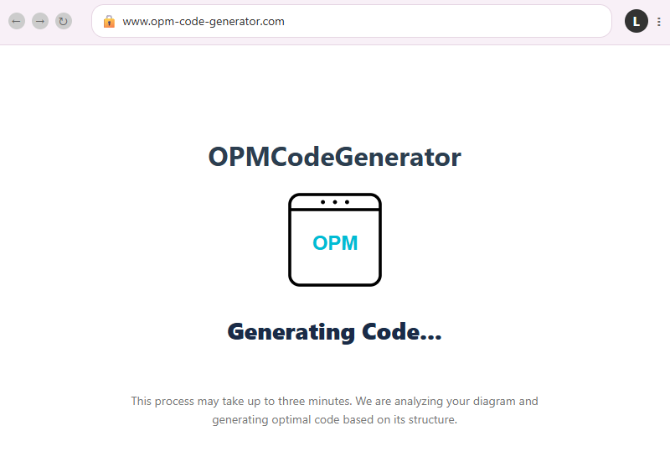
User Interface
14

Slide 16
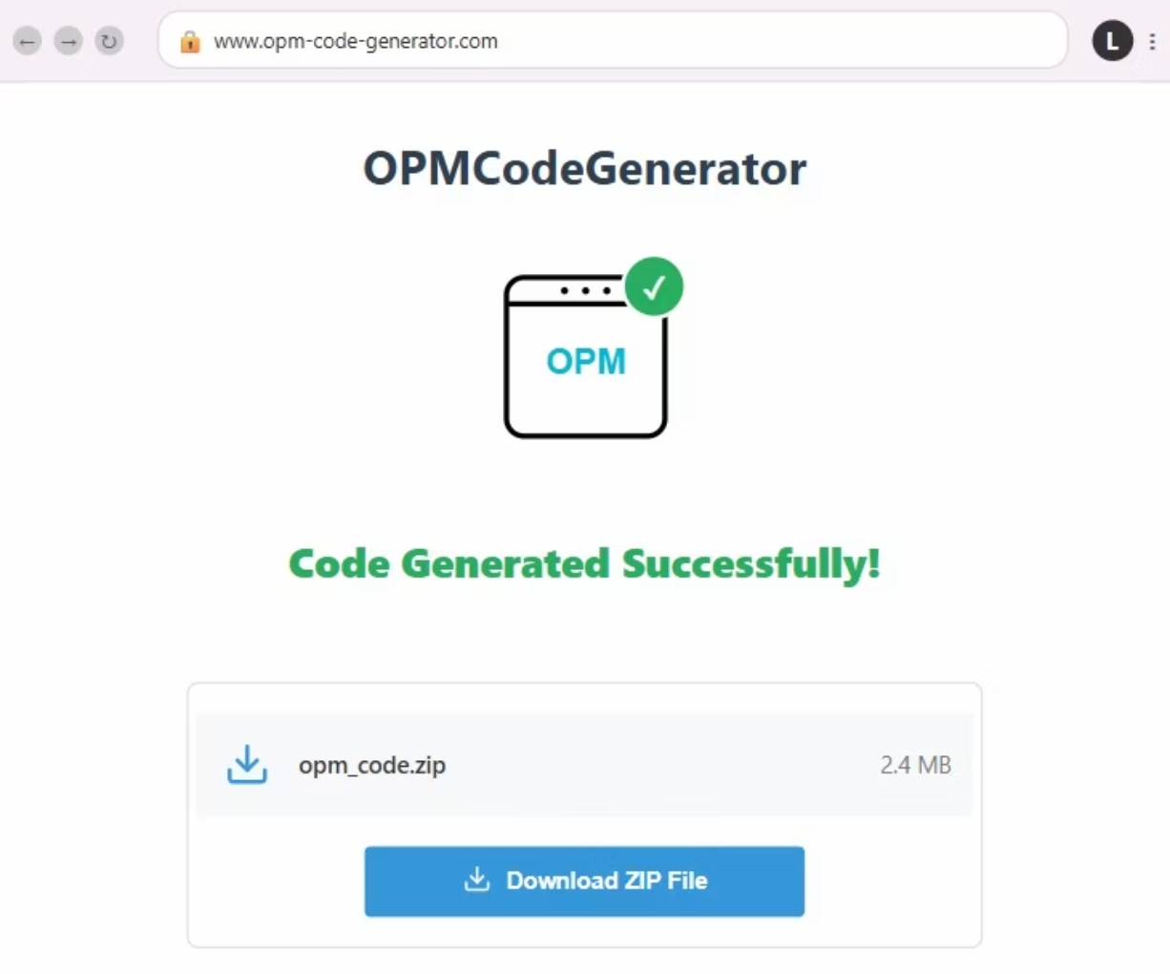
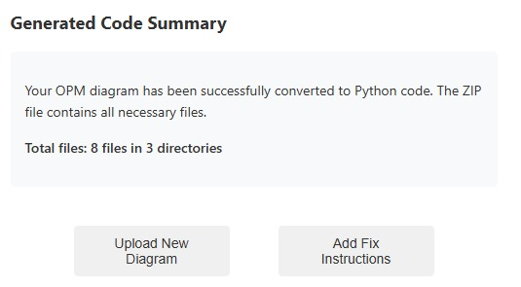
User Interface
15

Slide 17
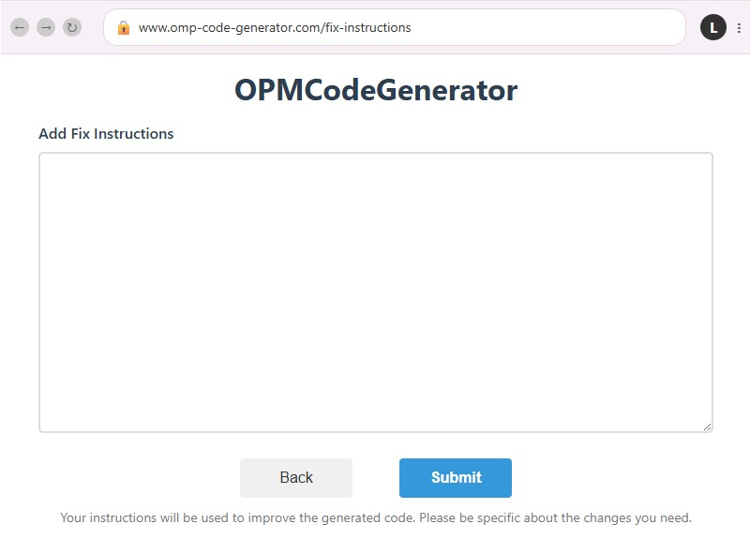
User Interface
16

Slide 18

Summary & Conclusion
Closed gap between requirements and development.
AI-driven transformation of OPM to code.
17

Slide 19

18

Slide 20

19

