Slide 1

COVID-19 and Education Analysis Project
03/10/2024
Haobo Chen

Slide 2
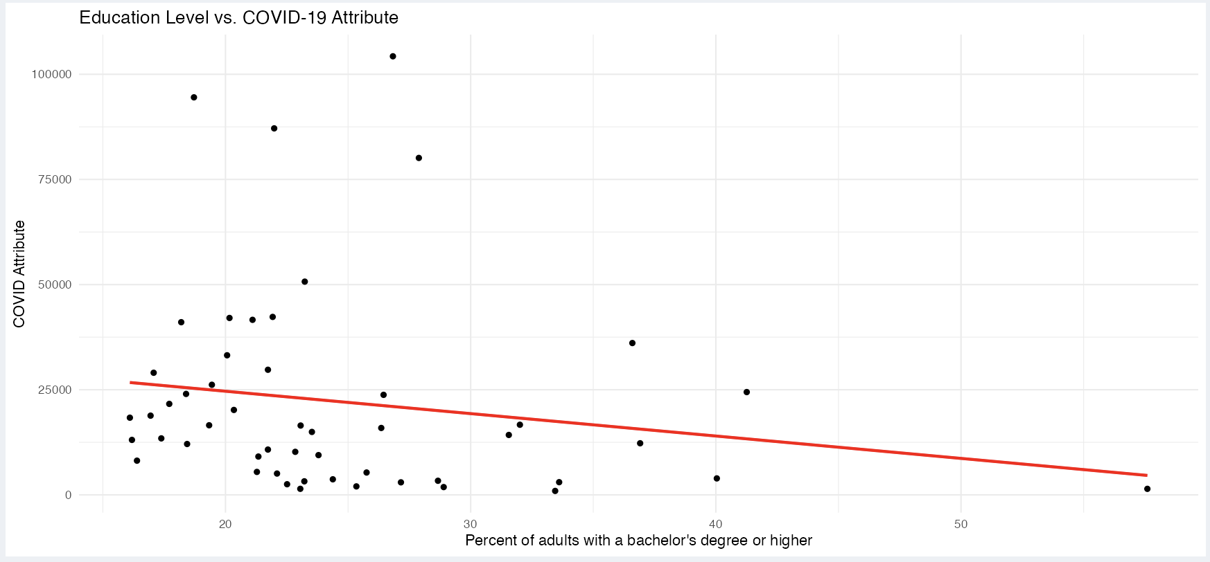
Data Visualization Purpose
The primary goal of this project is to study the relationship between COVID-19 and education level in US.
If there is a relationship between the education level of a state and the COVID-19 condition in that state, including the number of cases, deaths and vaccine condition.

Slide 3
Question
Is there a relationship between the education level of a state and the COVID-19 condition in that state?
What is the relationship between the education level of a state and the COVID-19 vaccine condition in that state?
Have COVID-19 vaccinations been effective in preventing deaths from the virus?

Slide 4
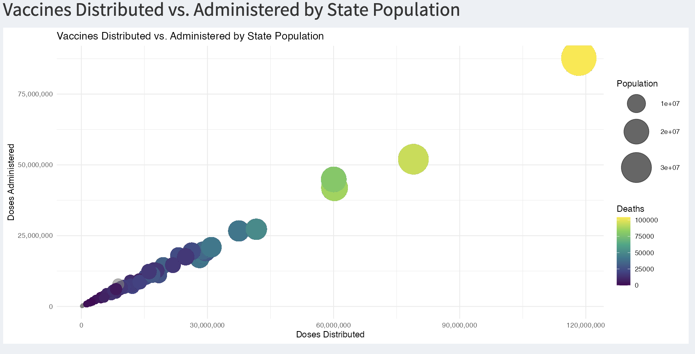
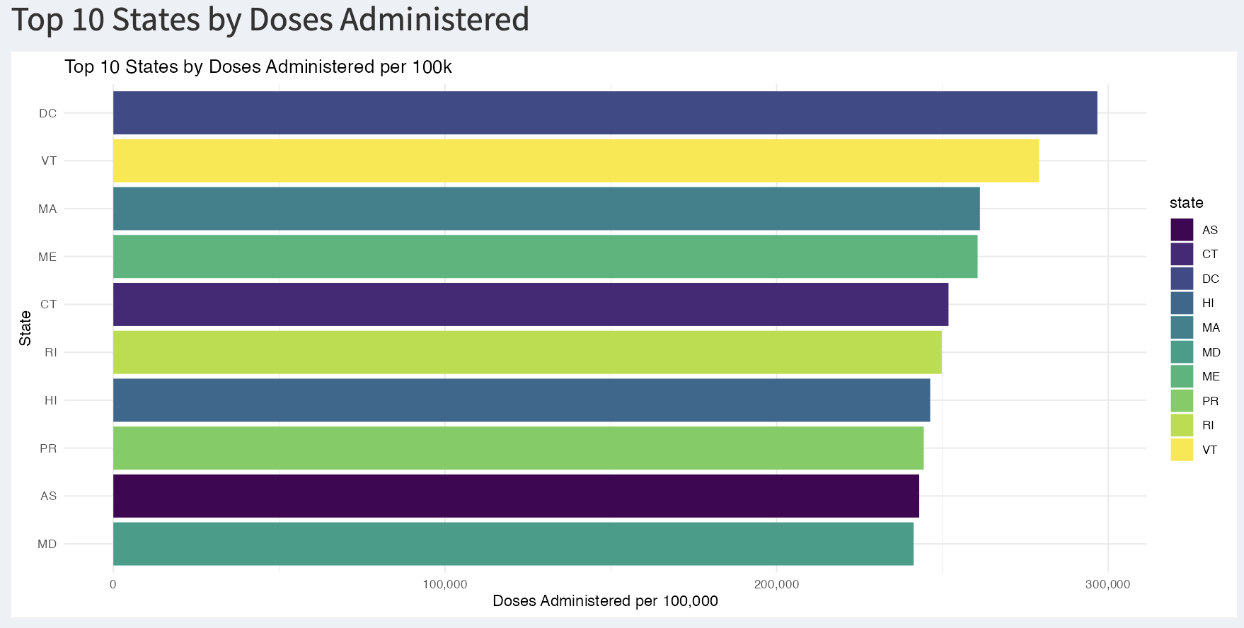
Insight From Data
There is a positive relationship between the education level of a state and the COVID-19 cases and death in all states. The higher the education level, the lower the COVID-19 cases and death are.
The COVID-19 vaccine has been effective in preventing deaths from the virus. The more vaccine distributed, the more vaccine administered, and the less death are.

