Slide 1
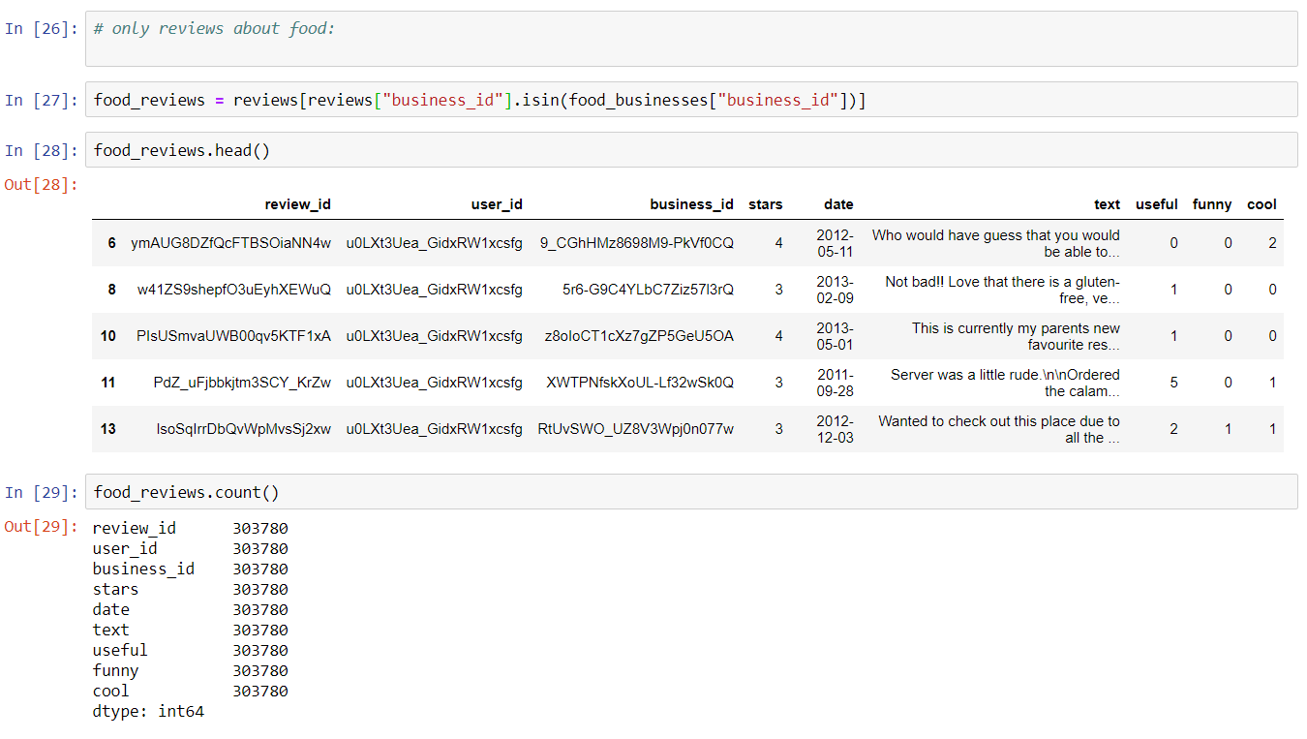
Computing users similarity with TF-IDF:
We filter out all the restaurant reviews in the city of Toronto – for simplicity.

Slide 2
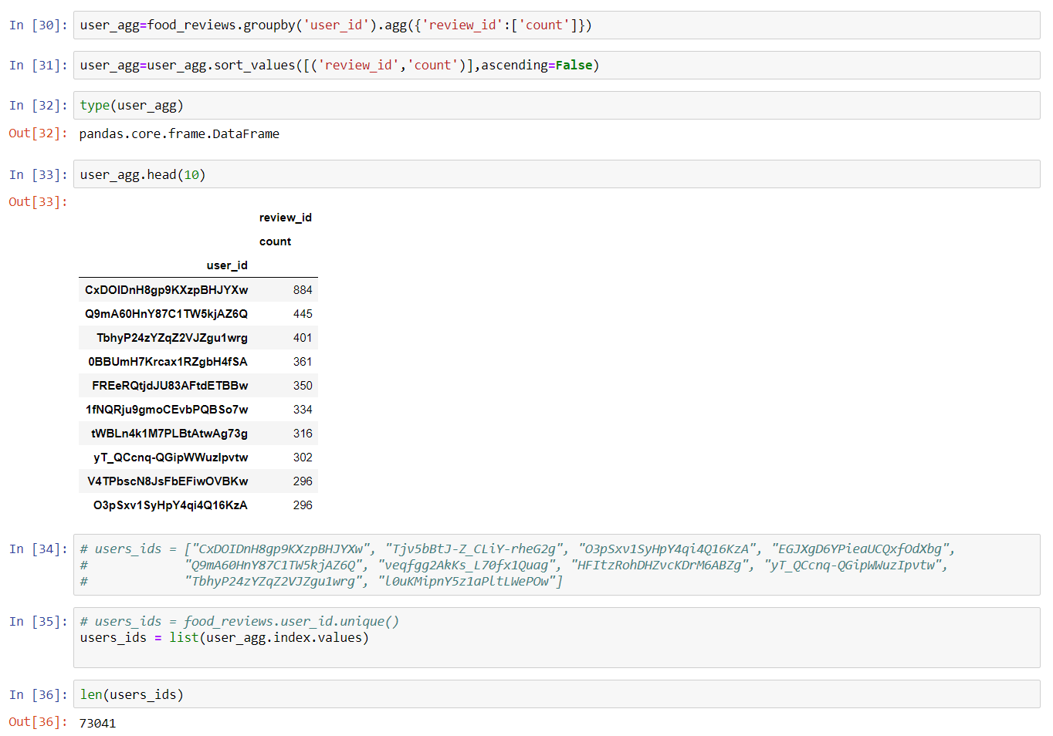
Then we identify all the users with restaurant reviews:

Slide 3
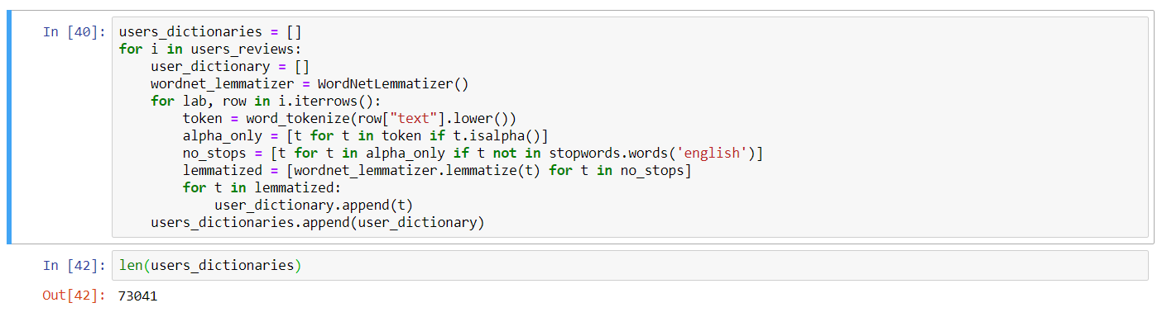
After that we perform NLP on the text reviews written by the users, and create a dictionary of words for each user:

Slide 4
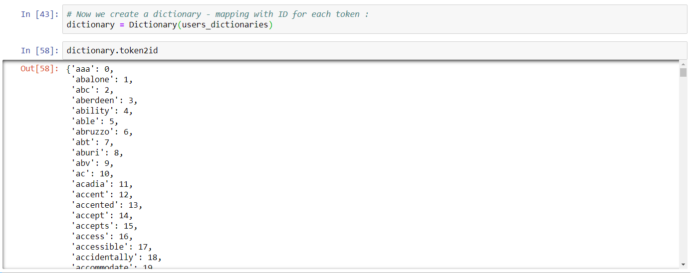
Next we create one big genism dictionary, which is a mapping with id for each token in the users dictionaries:

Slide 5
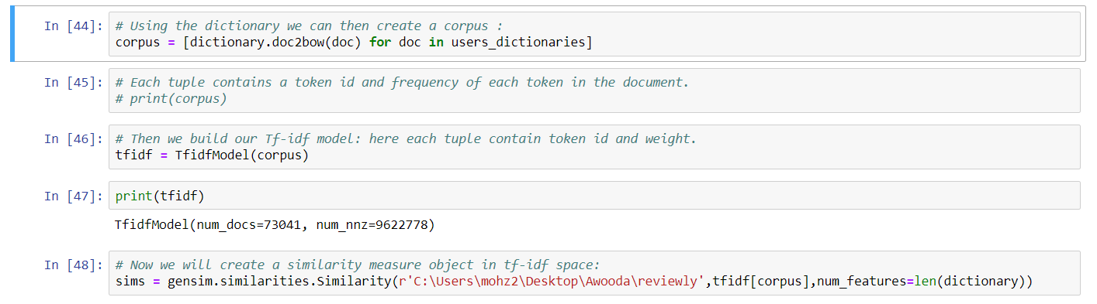
We use the genism dictionary to create a corpus and build our TF-IDF model and a similarity object:

Slide 6
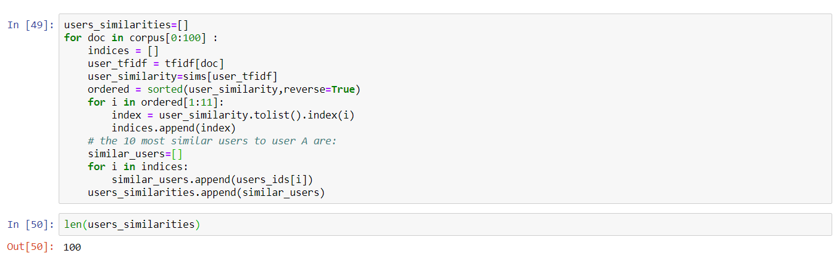
We use the TF-IDF model to compute the similarity of 100 users with all the users and find out the 10 most similar users:

Slide 7
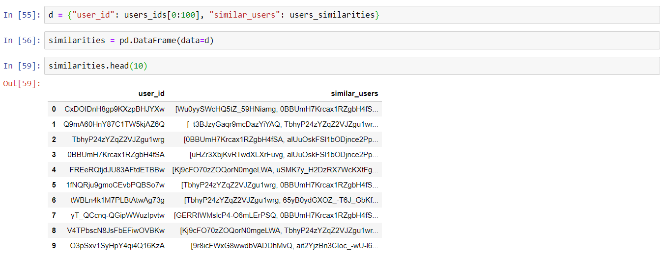
Then we put the 100 users and there 10 most similar users in a dataframe:

