Slide 1
Global Superstore: Sales & Profit Analysis
Exploratory Data Analysis & Business Insights
Author: Sagnik Bhattacharya
Tools: Python · SQL (MySQL) · Excel
Dataset: Global Superstore (Kaggle)

Slide 2
BUSINESS OBJECTIVE
Objective of the Analysis
Understand sales and profit drivers across products, regions, and customers
Identify loss-making areas and operational inefficiencies
Provide data-driven recommendations to improve profitability

Slide 3
DATASET SNAPSHOT
Dataset Overview
51,000+ transaction records
Multiple countries, regions, and markets
Product categories, customer segments, and shipping modes
Sales, profit, discounts, and operational costs

Slide 4
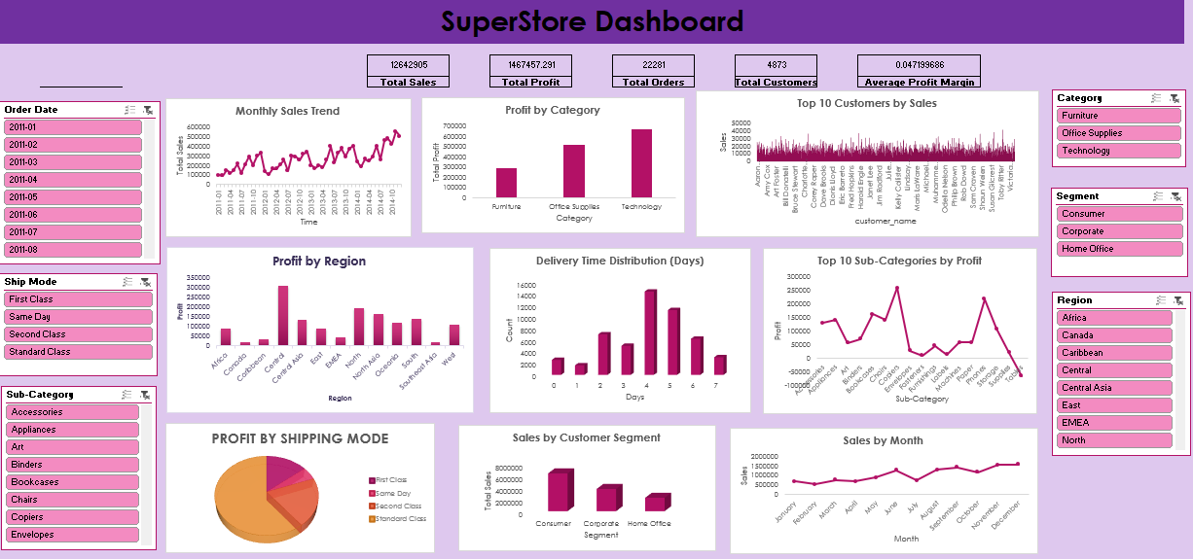
KPI OVERVIEW
Key Business Metrics
Total Sales
Total Profit
Profit Margin
Total Orders
Unique Customers

Slide 5
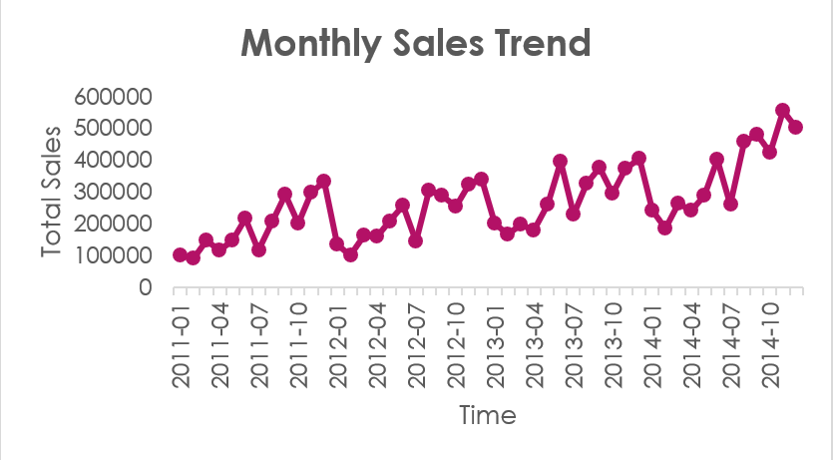
SALES & PROFIT TRENDS
Sales & Profit Over Time
Sales show steady growth across years
Profit displays higher volatility compared to sales
Insight:
Sales growth does not always translate into profit growth due to discounts and shipping costs.

Slide 6
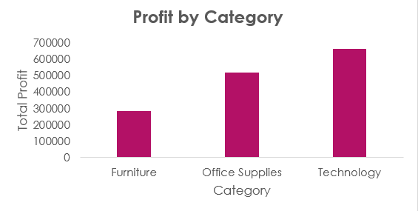
CATEGORY PERFORMANCE
Category-Level Performance
Technology and Office Supplies drive majority of profit
Furniture category consistently underperforms
Insight:
Furniture contributes high sales but weak profitability, indicating pricing or cost issues.

Slide 7
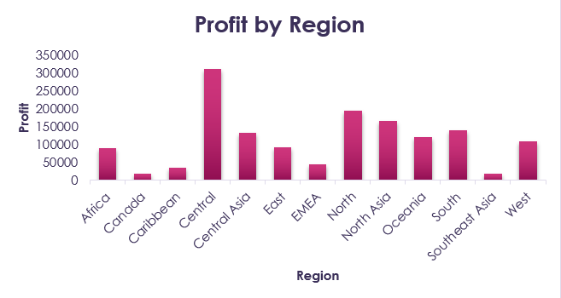
REGIONAL INSIGHTS
Geographic Performance
Certain regions generate strong sales volumes
Some regions exhibit low or negative profit margins
Insight:
High sales regions with low profit indicate potential discount or logistics inefficiencies.

Slide 8
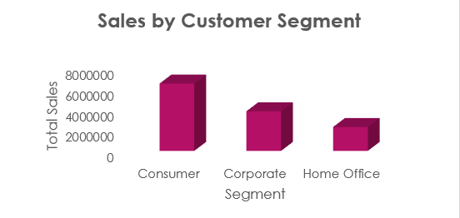
CUSTOMER & SEGMENT ANALYSIS
Customer & Segment Contribution
Corporate and Consumer segments dominate revenue
Revenue is concentrated among a small group of customers
Insight:
A minority of customers contributes a disproportionate share of total revenue (Pareto effect).

Slide 9
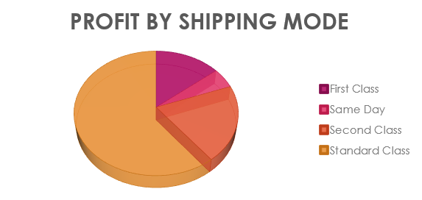
DISCOUNT & SHIPPING IMPACT
Operational Cost Analysis
Higher discounts significantly reduce profit margins
Same Day shipping incurs higher costs with lower profitability
Insight:
Aggressive discounting and fast shipping erode margins without proportional sales gains.

Slide 10
DASHBOARD OVERVIEW
Interactive Dashboard
KPI cards for key metrics
Trend charts for sales and profit
Slicers for Year, Region, Category, Segment, and Shipping Mode
(Designed for dynamic business exploration)

Slide 11
BUSINESS RECOMMENDATIONS
Actionable Recommendations
Optimize discount strategies to protect margins
Re-evaluate loss-making products and sub-categories
Focus on high-value customer segments
Reduce reliance on high-cost shipping modes
Apply region-specific pricing strategies

Slide 12
CONCLUSION
Identified key profitability and operational drivers
Translated data insights into actionable recommendations
Demonstrated end-to-end data analytics skills
Thank You

