Slide 1
Image processing tool for quantitative analysis of the NiCE-View Seq images

Slide 2
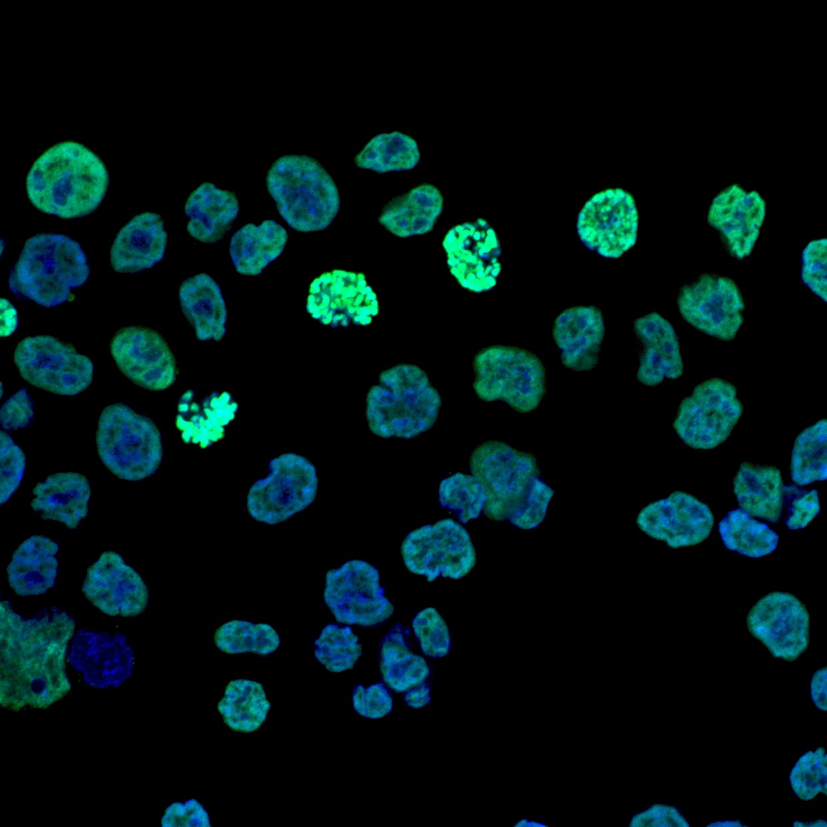
Original Image:

Slide 3
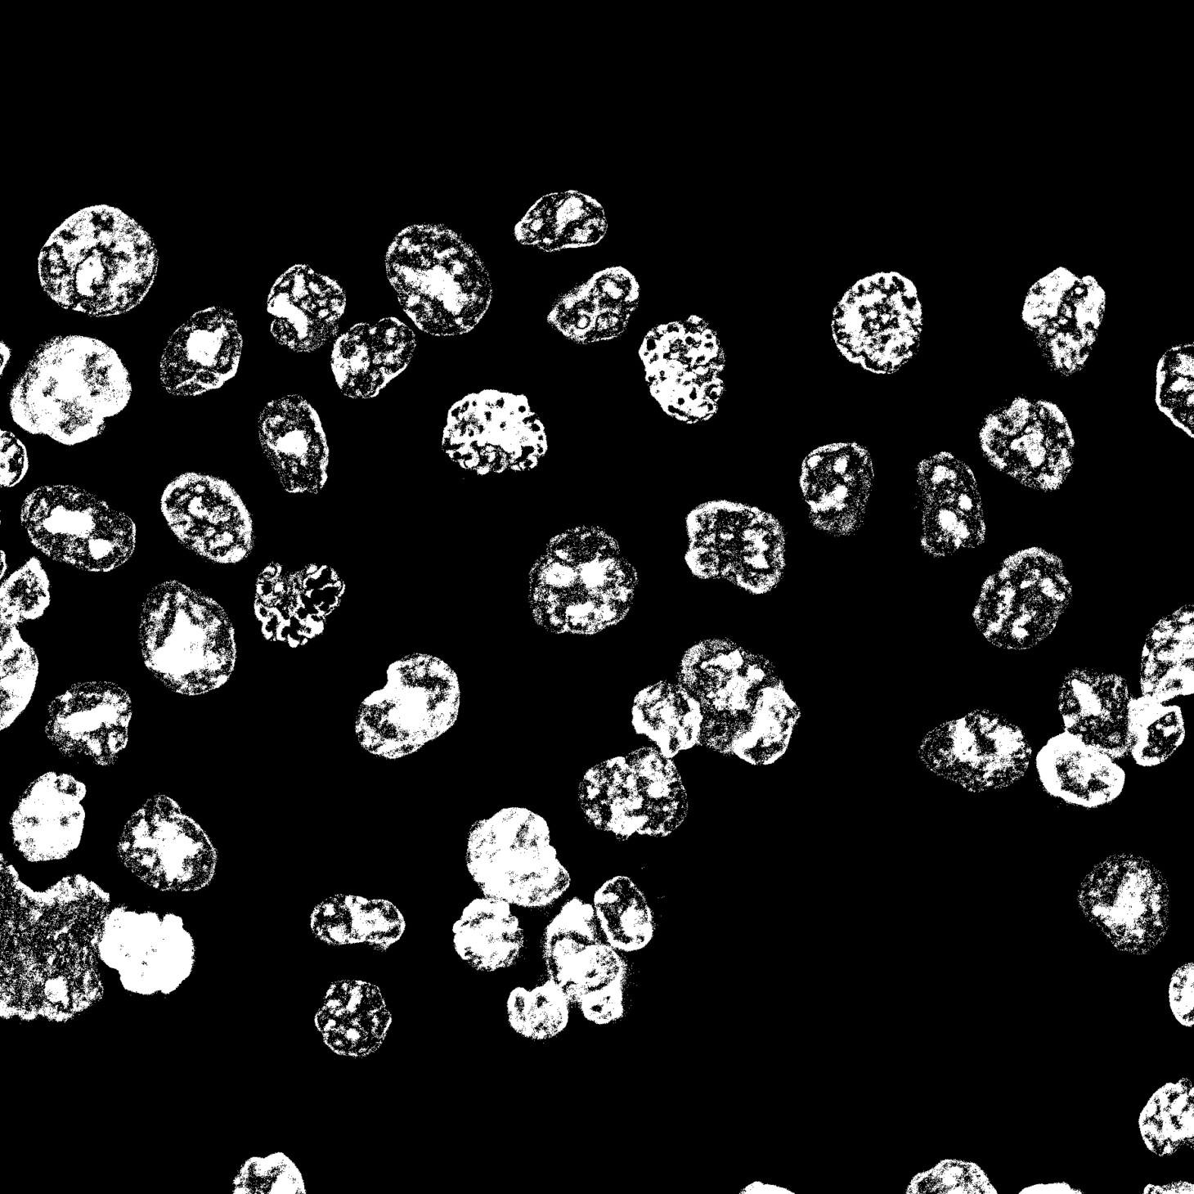
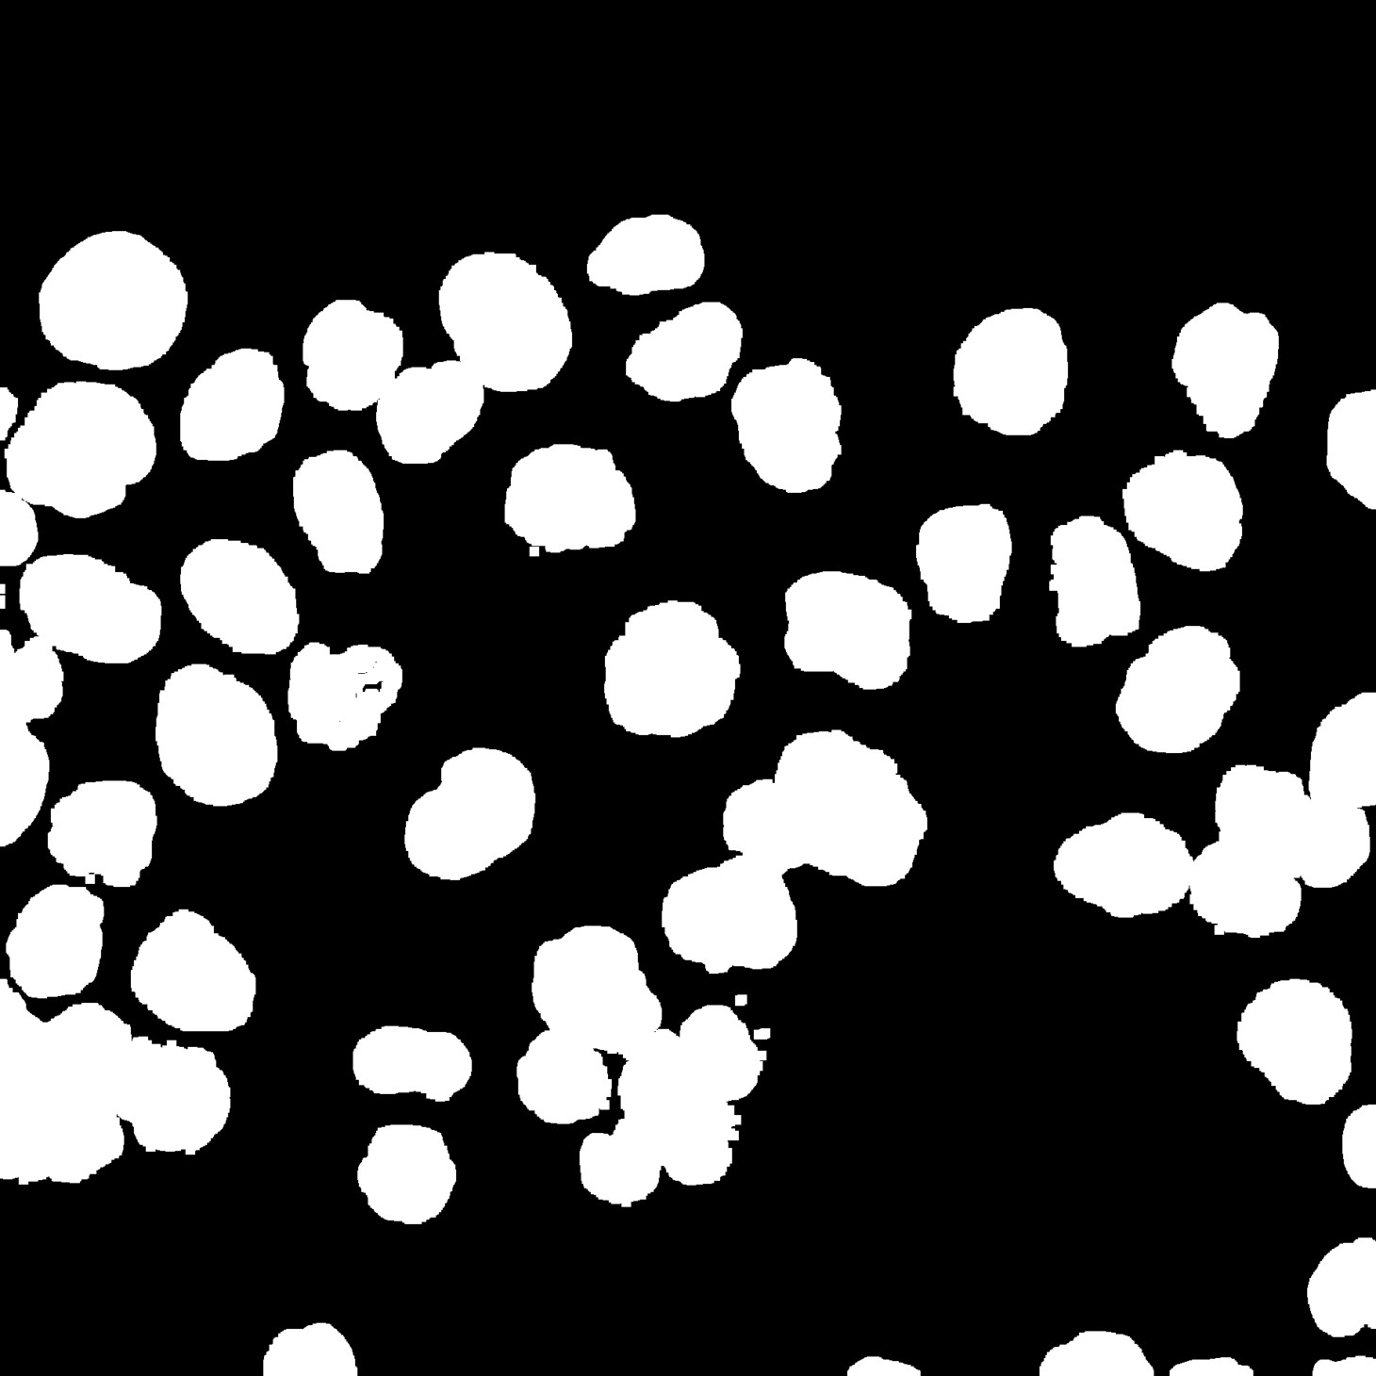
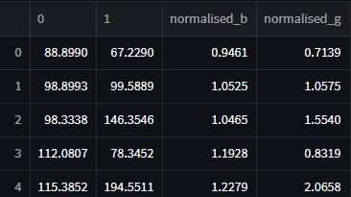
Fig 1.
Flow of the work
Clean the Noise in RGB Space
Pick the right values in HSV to create protein and cell masks
Masking
Apply Dilations upto
Hole closing Morphological operation
Dilation
Applying Distance Transform and thresholding for foreground
Connected components and Watershed Algorithms to label cells and segment Image
Open Chromatin Index
Extracting Intensity Information

Slide 4
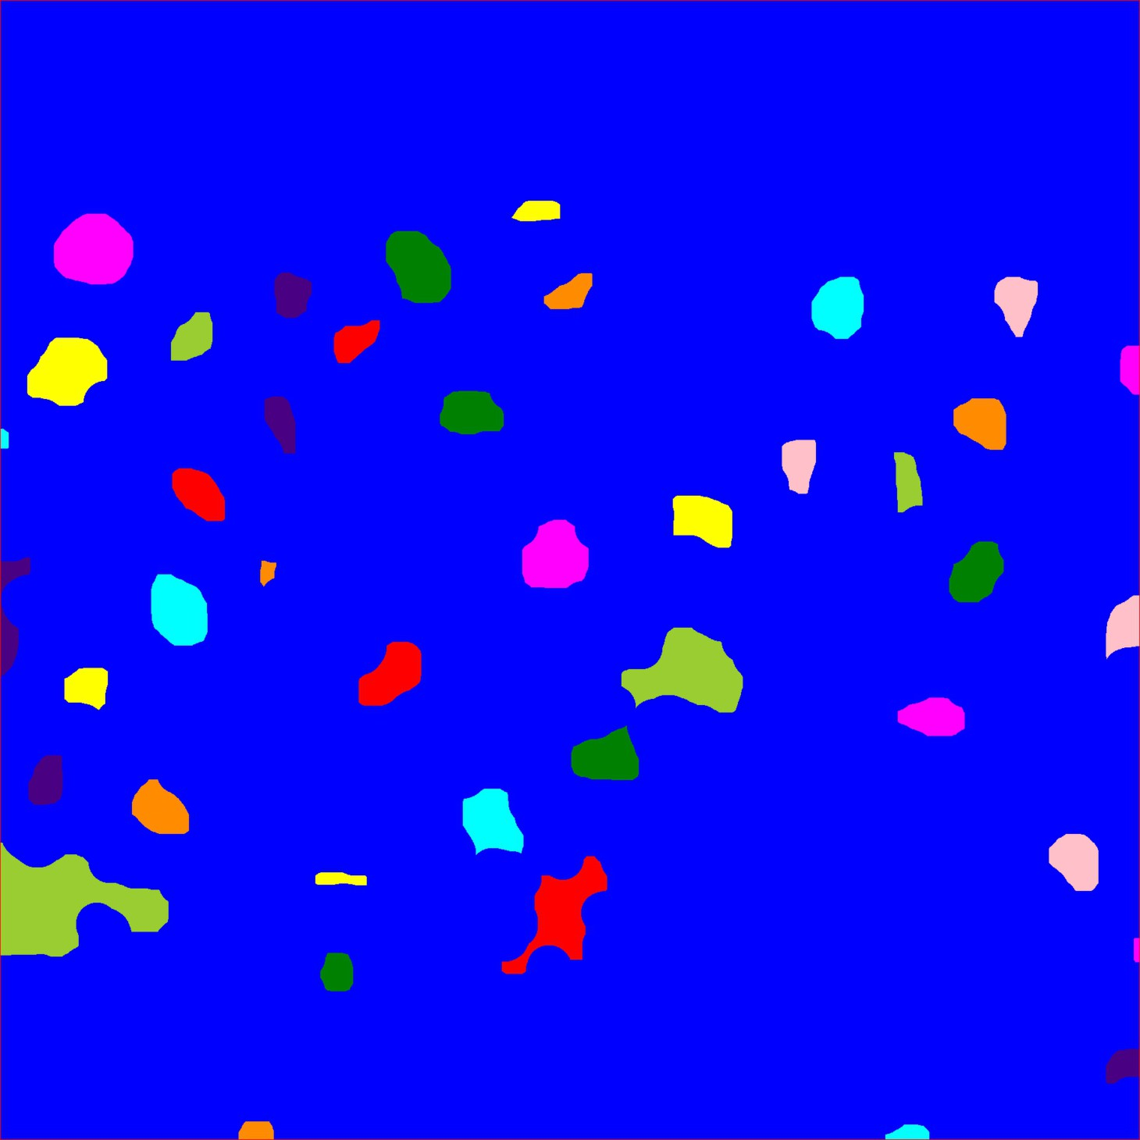
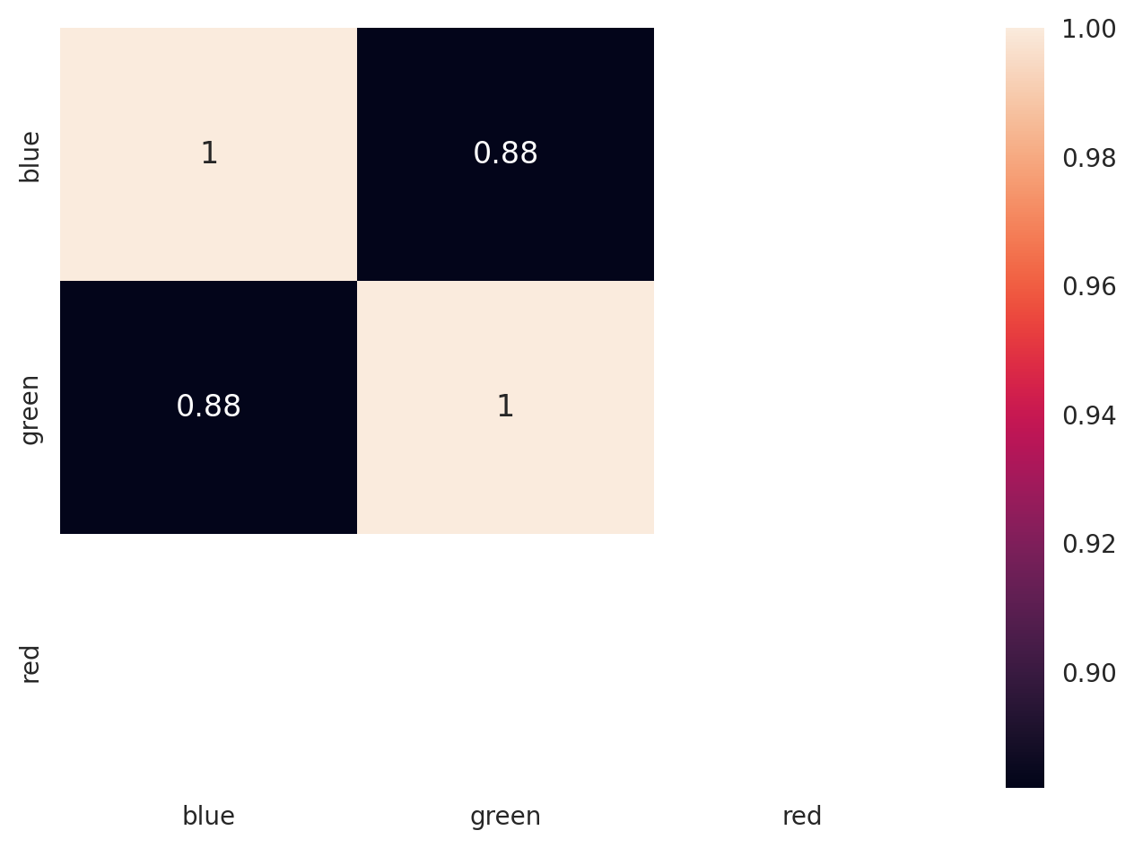
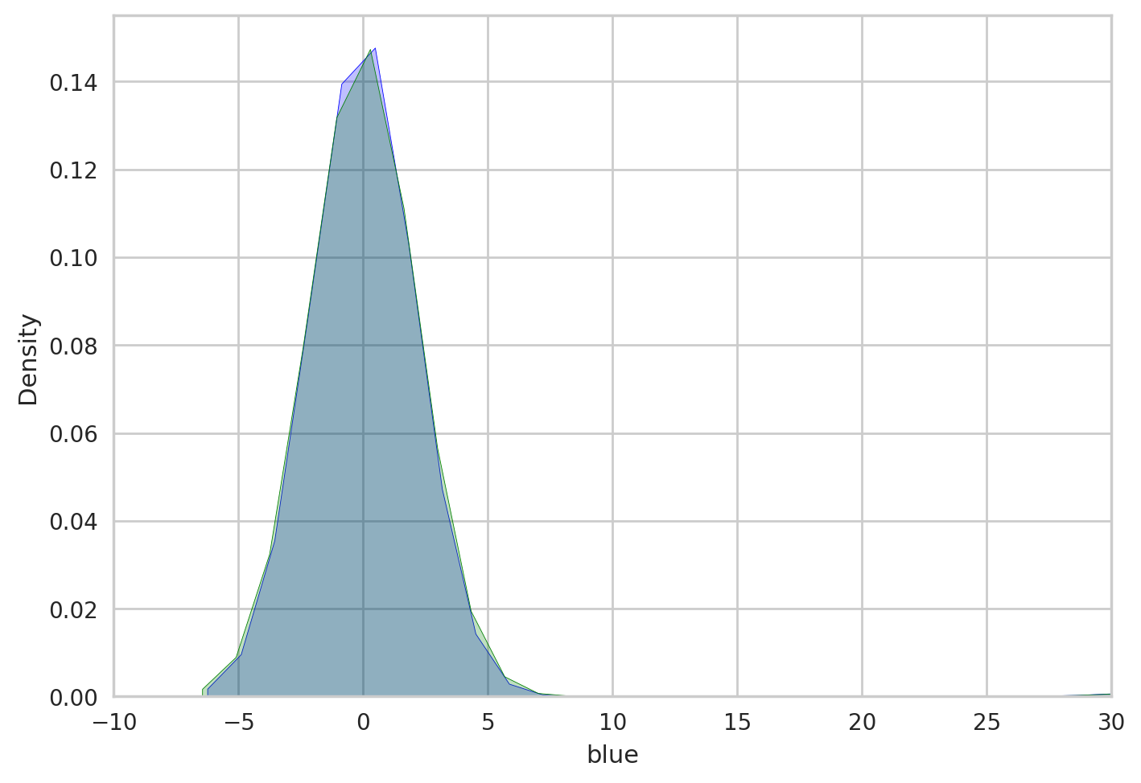
Fig 2. HCT116 control Image study
Masking
Dilation
Identification of each cell
Correlation of color channels
Density plot for color channels
Comparative
Analysis between zeiss software and frame

Slide 5
ROC
Fig 3. Validation of the method
AUC
BOXPLOT
Density plot
Distribution of the intensities for top samples

Slide 6
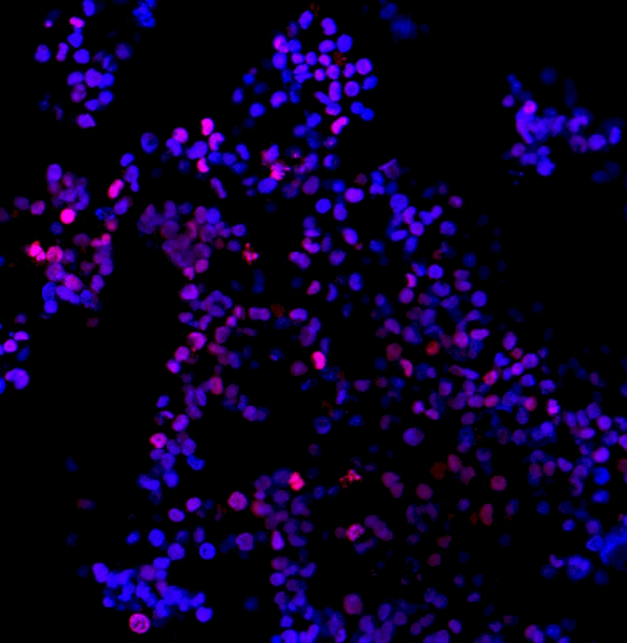
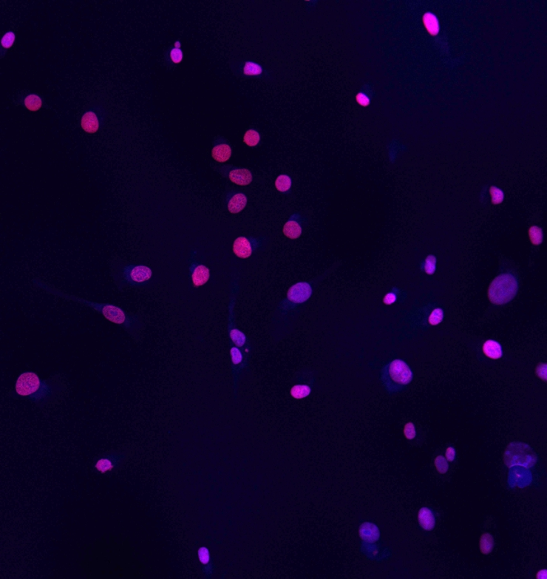
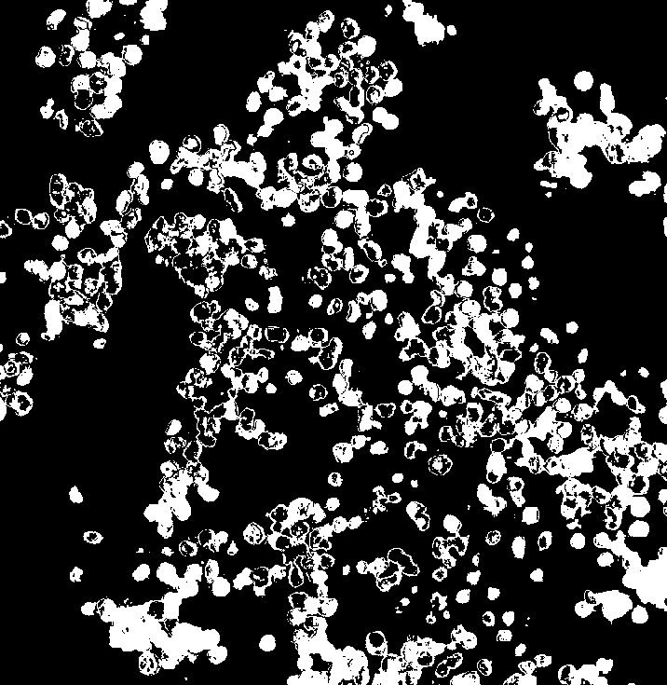
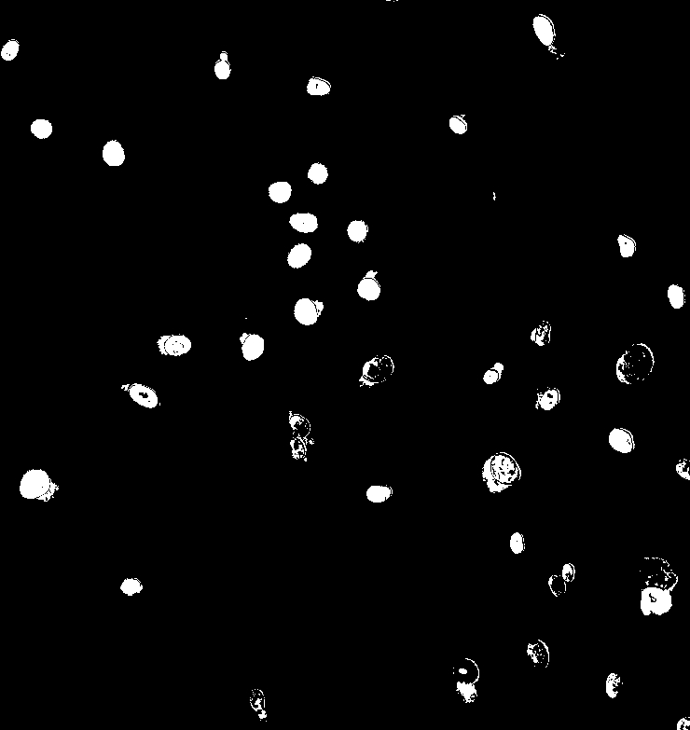
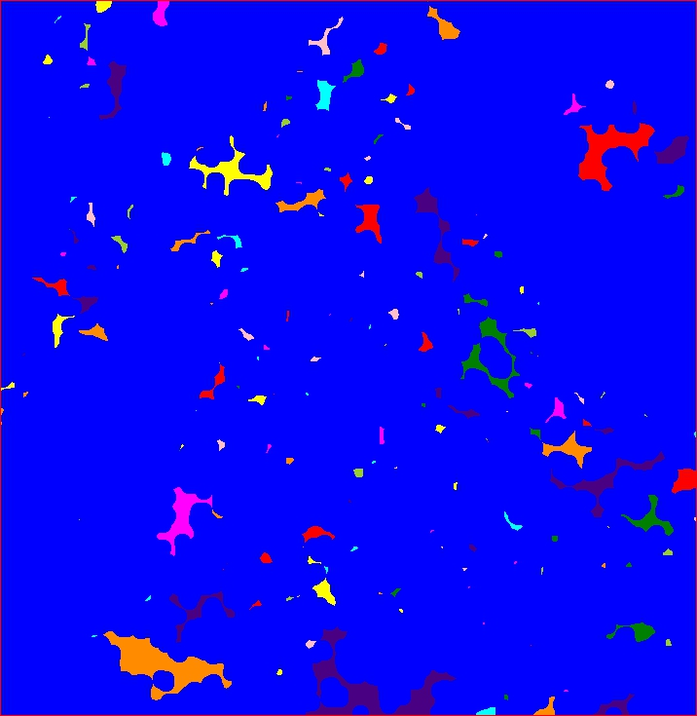
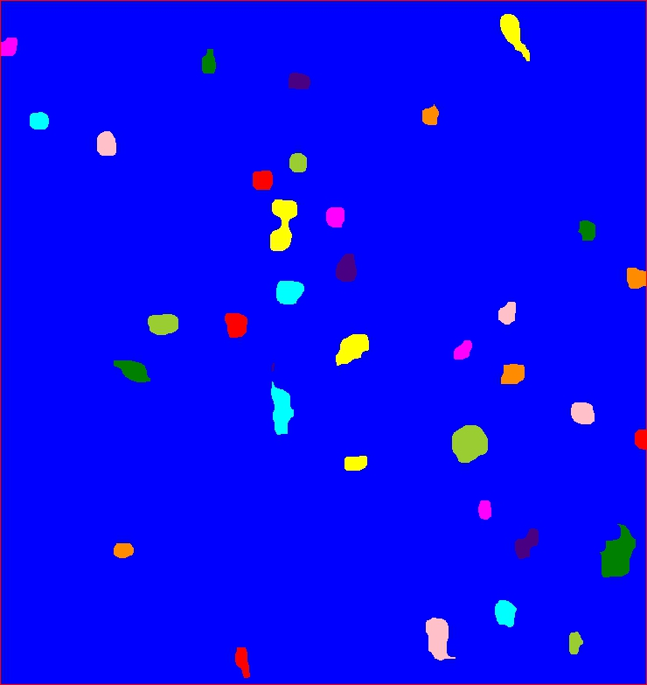
Fig 4.
K562 main Image
HUT78 main Image
Hela main image
K562 masking
HUT78 masking
Hela masking
K562 cell identification
HUT78 cell Identification
Hela cell Identification
K562 color channel correlation
HUT78 color
channel correlation
Hela color channel correlation

Slide 7
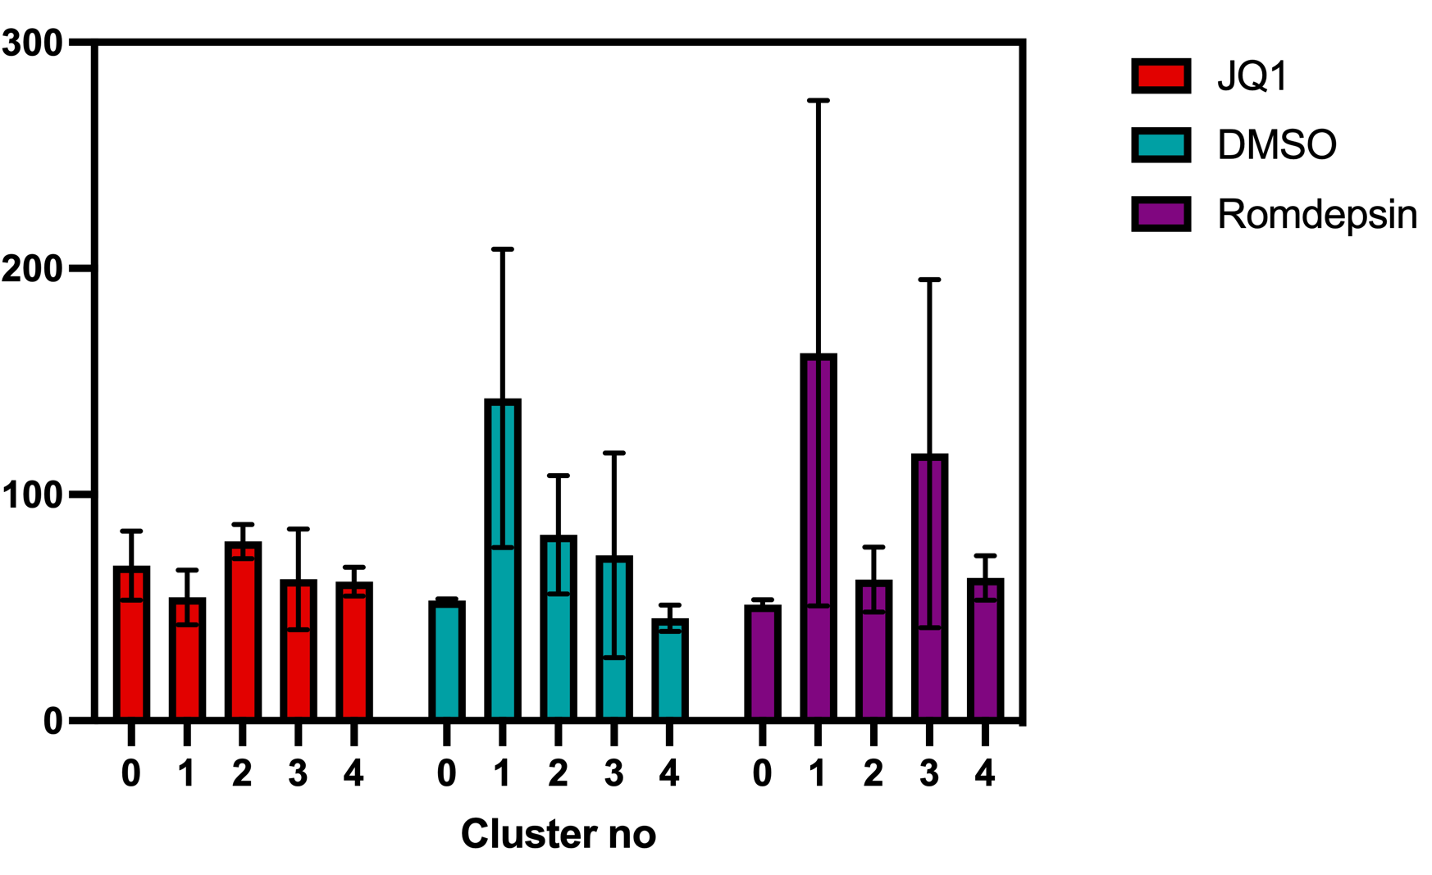
Fig 5. effects of different drug condition and open chromatin Index
Flowchart on different Drug conditions such as TSA, JQ1, DMSO, romidepsin
Boxplot on different conditions
Showing the distribution and OCI thresholding

