Slide 1

















Presentation on
QUICK ACCIDENT RESPONSE

Slide 2
Our understanding of the challenge
Automatic detection of the occurrence of accident.
Inform the authority as quickly as possible.
17.11.2019
BENGALATHON 2019 20: AN IT & E DEPARTMENT INITIATIVE
2

Slide 3
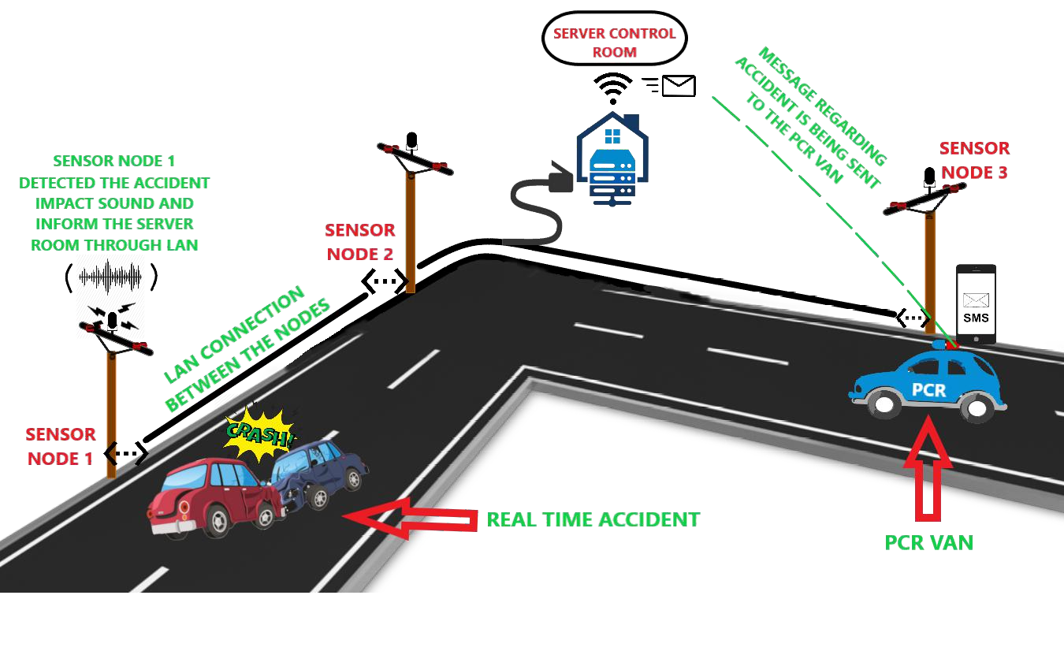



Proposed Solution
Solution Idea :
Installation of the sensor nodes by the roadside.
Connection between each server nodes and the server through Local Area Network.

Slide 4


Proposed Solution (continued)
Objective:
To capture Real time audio for automatic detection of target acoustic event(accident) using Machine Learning technique.
Outcomes:
While the accident is detected, the sms of accident location is sent to the PCR van by the server to attend the accident site immediately.

Slide 5
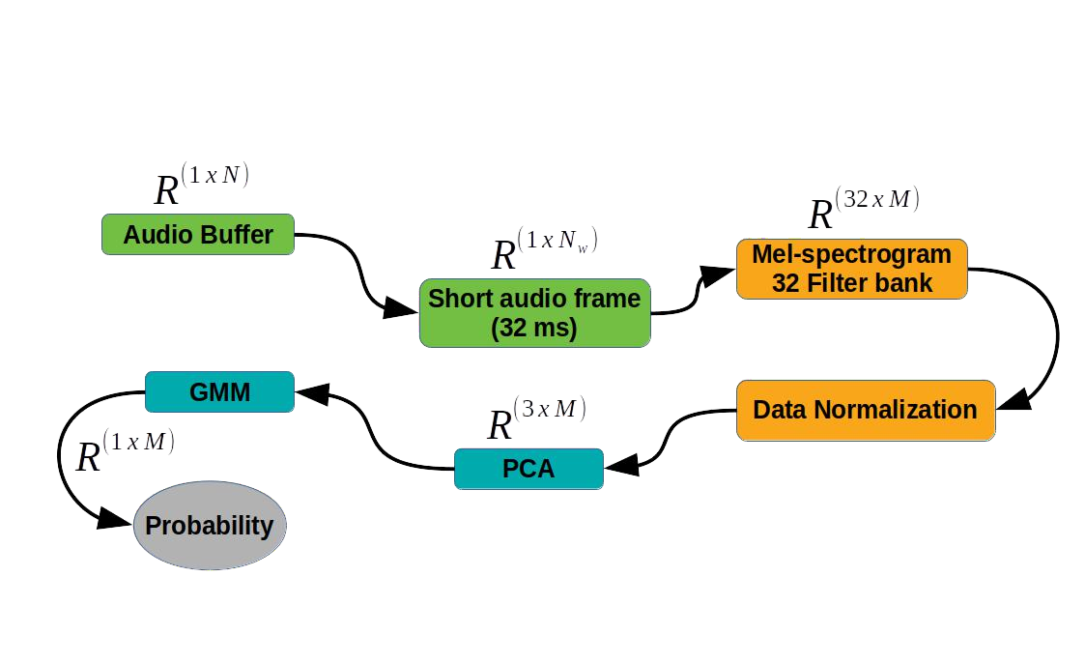
How does it work ?

Slide 6
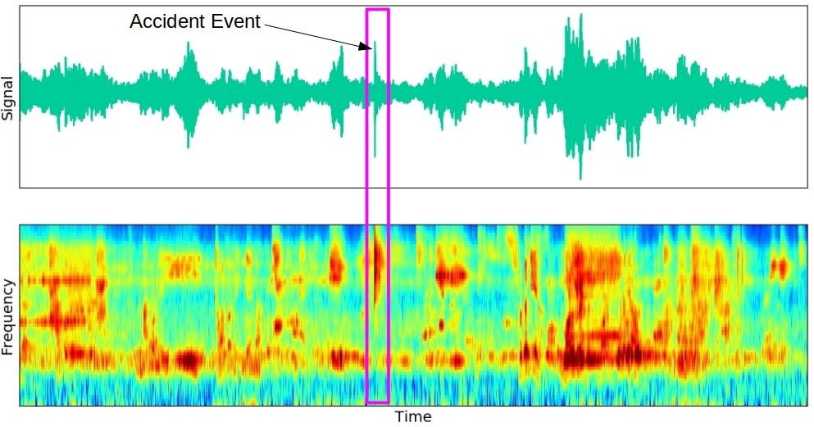
How does it work ?(continued)

Slide 7
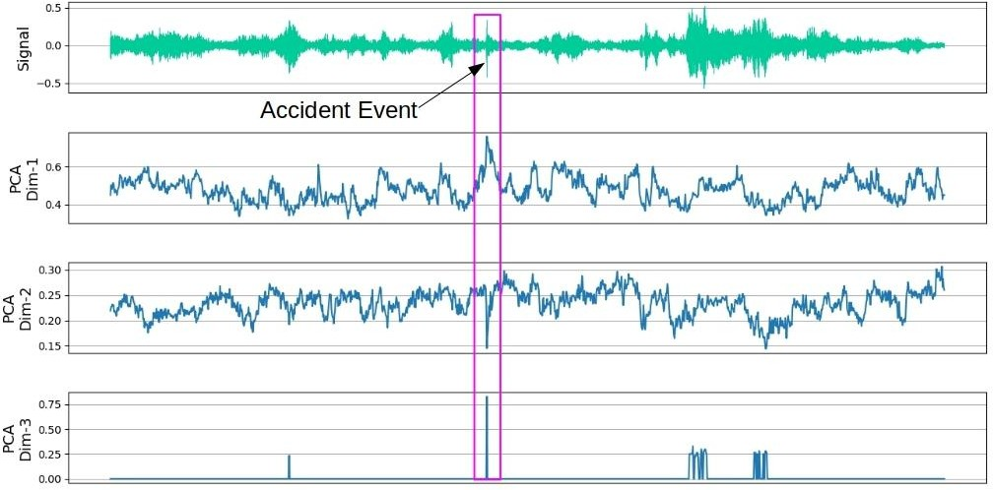
How does it work ?(continued)

Slide 8
What is the USP?
Audio in loop test
Public announcement
Additional uses of microphone
Benefits of placing the sensor nodes by the roadside

Slide 9
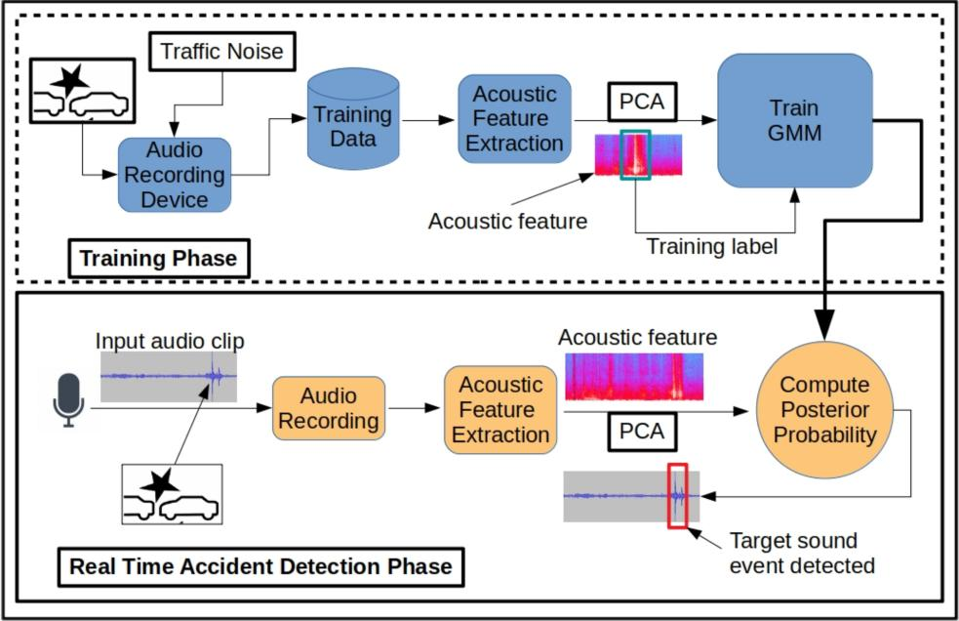
Solution Architecture

Slide 10
Risk, Issues and Mitigation plan
Protection from climatic adversities.
Sensitivity of microphone may be reduced over the passage of time.
To mitigate this risk factors, we are planning to use audio-in- loop testing for identification of microphone sensitivity and fidelity.
17.11.19
BENGALATHON 2019 - 20 AN IT & E DEPARTMENT INITIATIVE

Slide 11
Risk, Issues and Mitigation plan (continued)
Initially, the setup may have a premature database. Now once it is being installed and suppose the accident occurs, that could not be detected.
So we can manually test from the recorded database where the accident occurred and it's sound pattern. So that manual annotations can make the system more accurate, and like this, we can time to time update our system model.
17.11.19
BENGALATHON 2019 - 20 AN IT & E DEPARTMENT INITIATIVE

Slide 12
Thank You

