Slide 1
Study and implement van Emde Boas tree with application to Dijkstra and compare with respect to Binomial Heap
ADVANCED PROBLEM SOLVING
        Prof. Dr. Avinash Sharma
        TA: Dhawal Jain
Contributors:
Sagnik Gupta [2019201003]
Soumalya Bhanja [2019201004]

Slide 2
OBJECTIVE
Dijkstra's Algorithm is used to calculate the shortest path between one node and every other node in a graph.
In this project we aim to improve the time complexity of Dijkstra's single source shortest path algorithm using advanced data structures like van Emde Boas trees and Binomial Heaps.
van Emde Boas trees support various operations of a Priority Queue in minimal worst case time. So, implementing Priority Queue in Dijkstra using van Emde Boas tree helps in improving the time complexity. Similarly Binomial heaps provide faster union or merge operations thus improving the time complexity.
We present a comparison between the two approaches.

Slide 3
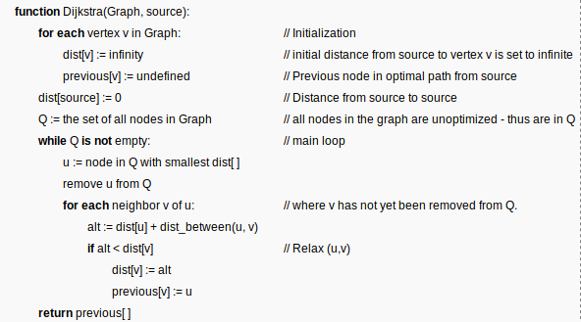
Dijkstra's algorithm:
Dijkstra's Algorithm is used to calculate the shortest path between one node and every other node in a graph.
Algorithm:

Slide 4
Applications of Dijkstra's algorithm:
Used in finding Shortest Path.
Used in geographical Maps to find distance between two locations.
It is used in IP routing to find Open shortest Path First (OSPF).
It is used in the telephone network.

Slide 5
Time Complexity of Dijkstra’s algorithm:
Without Using Priority Queue : O(V^2)
Using Priority Queue and Adjacency List : O((V+E) log V)
V – Number of Vertices in the Graph
E – Number of Edges in the Graph
Now as E > V, the above expression approximates to O(E log V)
We will aim to improve this complexity using advanced data structures like van Emde Boas trees and Binomial Heaps.

Slide 6
Van Emde Boas tree:
A van Emde Boas tree is a tree data structure which implements an associative array with u-bit integer keys. It performs all operations in O(log u) time, or equivalently in O(log log u) time.
van Emde Boas trees support various operations of a Priority Queue such as SEARCH , INSERT , DELETE , MINIMUM, MAXIMUM , SUCCESSOR, and PREDECESSOR in O(lg lg n) time worst case time.
Thus implementing Priority Queue in Dijkstra using vEB tree helps in improving the time complexity from O(E log V) to O(E log log V).

Slide 7
Van Emde Boas tree:
Approach :
Storing values using Bit Vector (O(1) time complexity).
Dividing Bit Vector into Clusters.
Maintaining Binary tree for each cluster.
Maintaining Summary Structure.
Augmenting the tree structure with min and max values for every cluster.

Slide 8
Van Emde Boas tree:
Let n denotes the number of elements currently in the set and ​ u denotes the range of possible values. We call the set {0, 1, 2, ... ,u -1} the ​ universe of values that can be stored and u the universe size.
Thus, we create a bit vector of size u (indices 0 to u-1) where an entry A[x] stores a 1 if x is in the set, and 0 otherwise.
Then we divide the bit vector into √u clusters of size √u, and augment it with min and max values of each cluster.
Our final recursion relation thus becomes
T(u) = T( √ u ) + O(1), thus giving a time complexity of O( lg lg u)

Slide 9
Data fields of vEB Structure
V.size– the size of V, namely u
V.max– the maximum element of V, or NIL if V is empty
V.min– the minimum element of V, or NIL if V is empty
V.clusters– an array of size √u which stores the clusters.
V.summary– a van Emde Boas structure of size √u that keeps track of which clusters are non empty

Slide 10
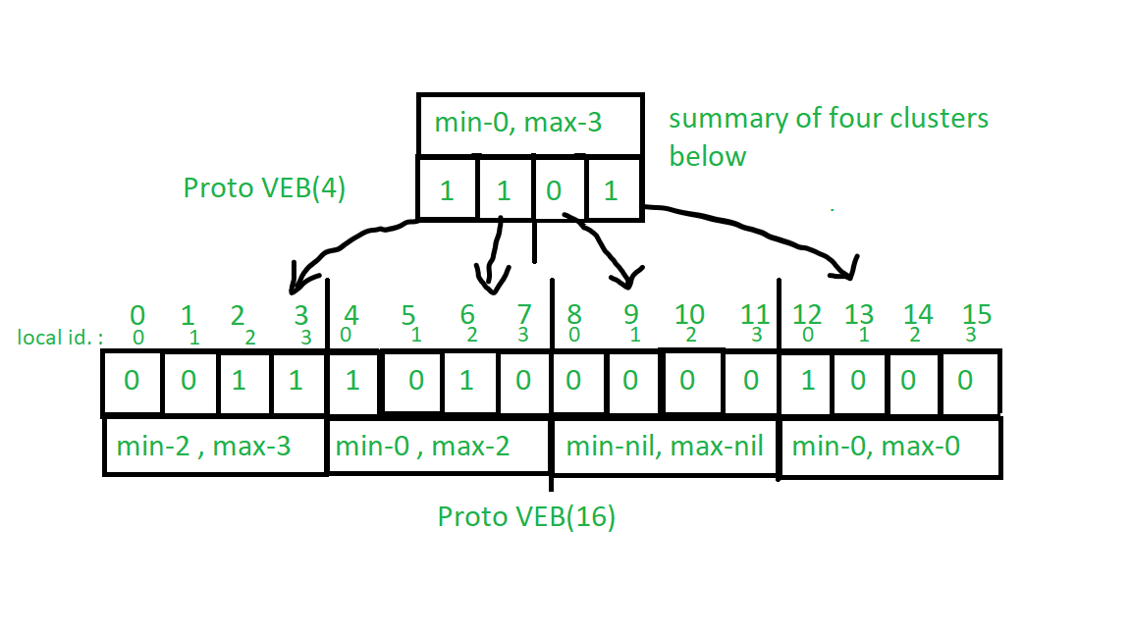
Van Emde Boas tree:

Slide 11
Dijkstra using vEB tree:
Priority Queue is implemented using vEB tree in the implementation of Dijkstra.
The priority queue implementation using vEB is done by using the INSERT and SUCCESSOR operations of vEB tree along with an unordered_map.
The unordered_map is used for storing the nodes having same weights at a given point of time

Slide 12
Dijkstra using vEB tree:
An adjacency list is created for the given graph using an array of vectors of pair.
Now, we start from the source node, assign it a weight of 0 and all other nodes are assigned a weight of INT_MAX. The bit vector corresponding to weight 0 is set to 1 in the vEB tree.
Using the adjacency list, the adjacent vertices of a given vertex are relaxed, i.e, their minimum distance from the source is updated and the corresponding weight is inserted to the vEB tree.
In each iteration we find the successor of the current minimum weight which gives the next minimum vertex required for Dijkstra.

Slide 13
Dijkstra using vEB tree:
The unordered map contains a list of all the nodes that currently have a given weight in a particular iteration.
If that vertex is already relaxed, i.e., the shortest
path to the node has been calculated then that node is removed from other weight keys in the ​ unordered map​.
Thus the ​ unordered map has weights as the keys and corresponding nodes as the values.
The nodes and their corresponding weight after completing the iteration gives the final values of shortest path to these nodes.

Slide 14
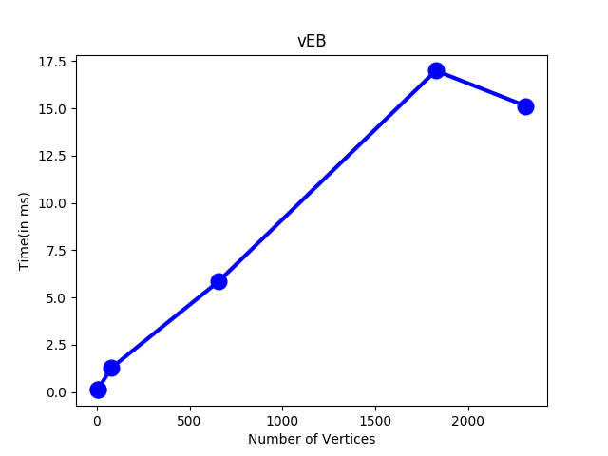
Dijkstra using vEB tree:

Slide 15
BINARY HEAP
A binary heap is a heap data structure that takes the form of a binary tree. It follows the following two properties:
Shape property: a Binary Heap is a complete binary tree
Heap property: A Binary Heap is either Min Heap or Max Heap.
Priority queues can be efficiently implemented using Binary Heap because it supports insert(), delete() and extractmax(), decreaseKey() operations in O(logn) time
So, they are especially used in Graph Algorithms like Dijkstra’s single source shortest path

Slide 16
BINOMIAL HEAP
Binomial Heap is an extension of Binary Heap
A Binomial Heap is a collection of Binomial Trees
Binomial Heap Property:
Every binomial tree in a binomial heap obeys either the min-heap or the max-heap property.
There can only be either one or zero binomial trees for each order. In other words, for every k, there is at most one binomial tree of order k in the heap.
Binomial Heap supports quicker union or merging of two heaps in Θ(logn) at the cost of a slower find minimum operation.

Slide 17
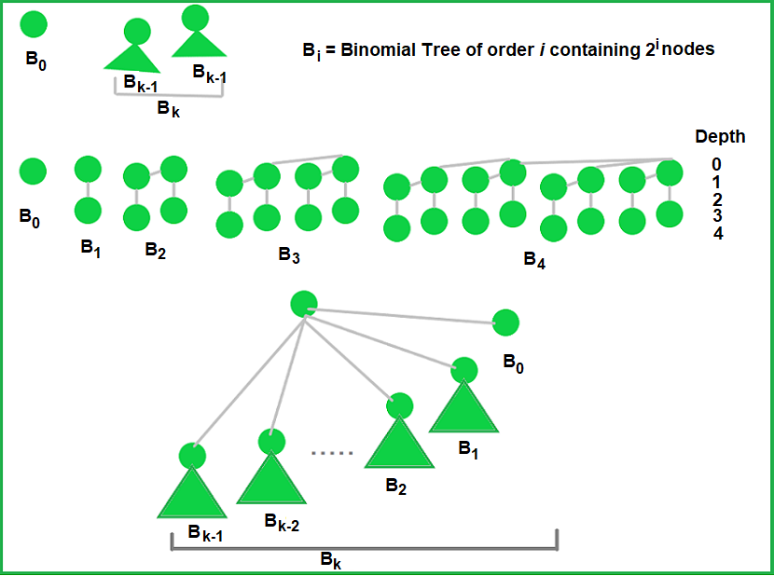
BINOMIAL HEAP

Slide 18
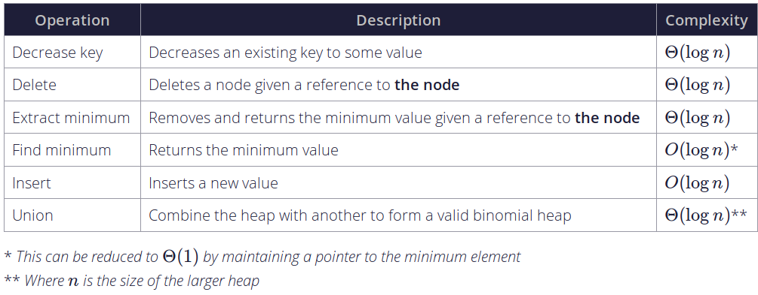
BINOMIAL HEAP
Find minimum: A simple way to find minimum in a binomial heap is to traverse the list of root of Binomial Trees and return the minimum key. This implementation requires O(Logn) time. It can be optimized to O(1) by maintaining a pointer to minimum key root.

Slide 19
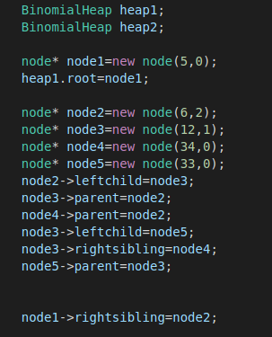
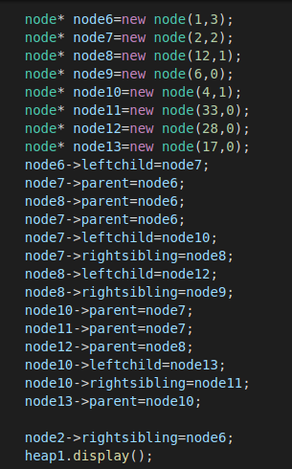
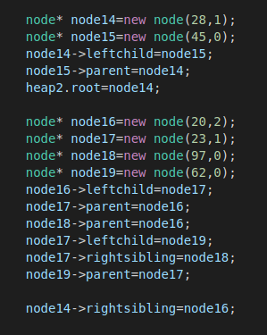
BINOMIAL HEAP
Sample input:
Heap1
Heap1
Heap2

Slide 20
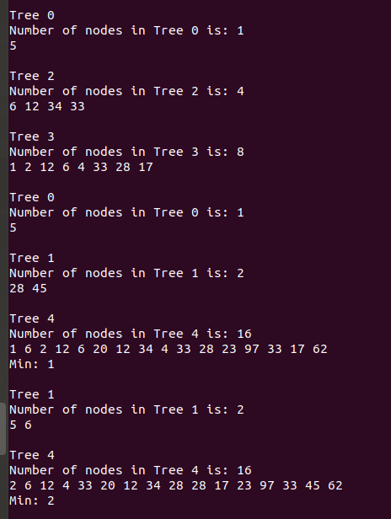
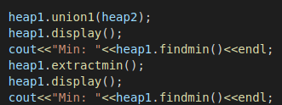
BINOMIAL HEAP
Output:
Operations:

Slide 21
Dijkstra using Binomial Heap
Binomial heap has been used in place of priority queue for implementation of single source shortest path algorithm.
The Dijkstra implementation has been done with INSERT, FIND-MIN and EXTRACT-MIN operations of the Binomial Heap. Initially the source vertex is added to the Binomial Heap.
An unordered map has been maintained which stores the distance along with the list of vertices which are reachable within that distance at that point of time.
The Binomial Heap stores the distance of vertices from the source. INSERT operations are used to add new distances into the Binomial Heap. After successful relaxation operations of vertices, the new distances are added into the Binomial Heap.

Slide 22
Dijkstra using Binomial Heap
The minimum distance is found out in each iteration using FIND-MIN, and the EXTRACT-MIN operation is used to remove minimum values from the Binomial Heap. The iteration continues upto the point when Heap becomes empty.
In each iteration, relaxation operation is performed. The nodes and the final values of the distances upto the nodes give the final values of shortest paths till that node.

Slide 23
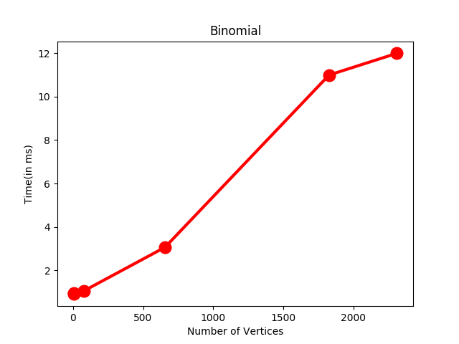
Dijkstra using Binomial Heap

Slide 24
Dijkstra using Binomial Heap
The time complexity of implementing Dijkstra using ​ Binomial Heaps​ looks O(V^2) as there are two nested while loops. If we take a closer look, we can observe that the statements in inner loop are executed O(V+E) times (similar to BFS). The inner loop has decreaseKey()​ operation which takes O(LogV) time. So overall time complexity is:
O(E+V)*O(LogV) which is O((E+V)*LogV)
This can be approximated as O(ELogV)

Slide 25
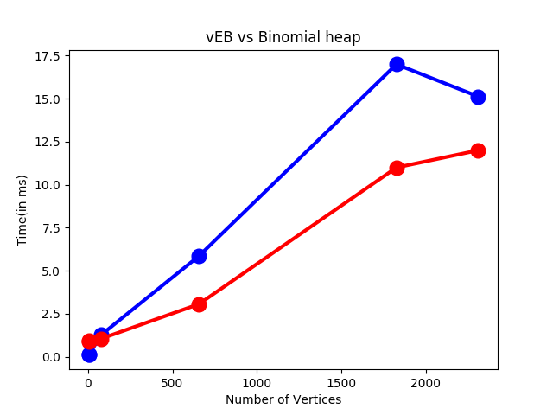
Comparison

Slide 26
Conclusion
The main advantage of vEB tree structure is the improvement in overall time complexity of priority queue. From O(E log V) to O(E log log V) for vEB trees in single source shortest path algorithm.
Binomial heap provides an overall time complexity of O(E log V) for single source shortest path algorithm.

Slide 27
THANK YOU!!

