Slide 1




SHIKSHAK AI
An AI Teacher That Doesn’t Just Answer — It Teaches.
Personalised AI Tutor for Learning AI · Build Fast with AI: AI Build Challenge 2026
STUDENT
AI TEACHER
PERSONALIZED
LEARNING
TEAM BINARY BRAINS
Sagnik Chandra (Team Leader) • Shrusti Jain
SHIKSHAK AI · BUILD FAST WITH AI · AI BUILD CHALLENGE 2026
1

Slide 2



THE PROBLEM
Learning Is Still Too One-Size-Fits-All
Static Learning
AI Chatbots
Human Tutoring
Every student receives the exact same content, at the same pace, regardless of what they already understand or where they struggle.
Conventional chatbots only react to what is asked. A student who doesn’t know the right question to ask gets little real help.
One-on-one tutoring adapts beautifully to the learner, but it is expensive and depends entirely on tutor availability to scale.
Students need an AI that can teach — not just respond.
SHIKSHAK AI · BUILD FAST WITH AI · AI BUILD CHALLENGE 2026
2

Slide 3





OUR SOLUTION
Meet Shikshak AI
A student uploads material or names a topic, sets their level and available time, and Shikshak AI turns that single request into a complete, personalised teaching session — from first explanation to final feedback.
Topic / Material
Learner Context
Personalised
Lesson
Interactive
Teaching
Adaptive
Learning
Assessment
& Feedback
“Teach me this chapter in 20 minutes. I’m a beginner.”
Shikshak AI reads this one sentence as a full brief — goal, level, and time budget — and plans a real lesson around it, not just a single reply.
The result: teaching that begins from where the learner actually is, not a generic starting point.
SHIKSHAK AI · BUILD FAST WITH AI · AI BUILD CHALLENGE 2026
3

Slide 4




HOW SHIKSHAK TEACHES
From Answering to Teaching
Every lesson runs on one repeating loop — the same rhythm a real teacher follows
in a classroom.
A Struggling Student, Step by Step
A student answers incorrectly. Shikshak AI pinpoints exactly where the gap is, swaps in a new explanation or analogy, asks a follow-up question to check whether it landed, and only then moves the lesson forward.
Understand
Continue
Plan
TEACHING
LOOP
Understand & Plan
Groundwork before a single word is taught — what to cover, and in what order.
Adapt
Explain
Explain & Demonstrate
Concepts delivered with examples and visuals suited to the learner’s level.
Evaluate & Adapt
Evaluate
Demonstrate
Every response reshapes what happens in the very next step.
Question
SHIKSHAK AI · BUILD FAST WITH AI · AI BUILD CHALLENGE 2026
4

Slide 5



KEY FEATURES
Built for Personalised, Adaptive Learning
Every feature maps to what a personalised AI tutor must do: guide, adjust, explain and practise.
1
Personalised Learning Path
2
Adaptive Difficulty
3
Adaptive Explanations
A skill map and learning path built from the learner’s goal, level and time budget.
A difficulty calibrator raises or lowers question difficulty from live performance.
A wrong answer triggers a simpler re-explanation with a fresh example, then a re-test.
4
Practice & Spaced Review
5
Grounded in Your Material
6
English & Hindi Voice Lessons
A Practice Lab with targeted questions and code challenges, plus spaced-repetition refresh.
Hybrid retrieval keeps every explanation tied to the learner’s own notes or textbook.
Lessons arrive with a spoken teacher, visual boards and captions in the learner’s language.
One learner, one path: every answer reshapes the next explanation, question and practice set.
SHIKSHAK AI · BUILD FAST WITH AI · AI BUILD CHALLENGE 2026
5

Slide 6
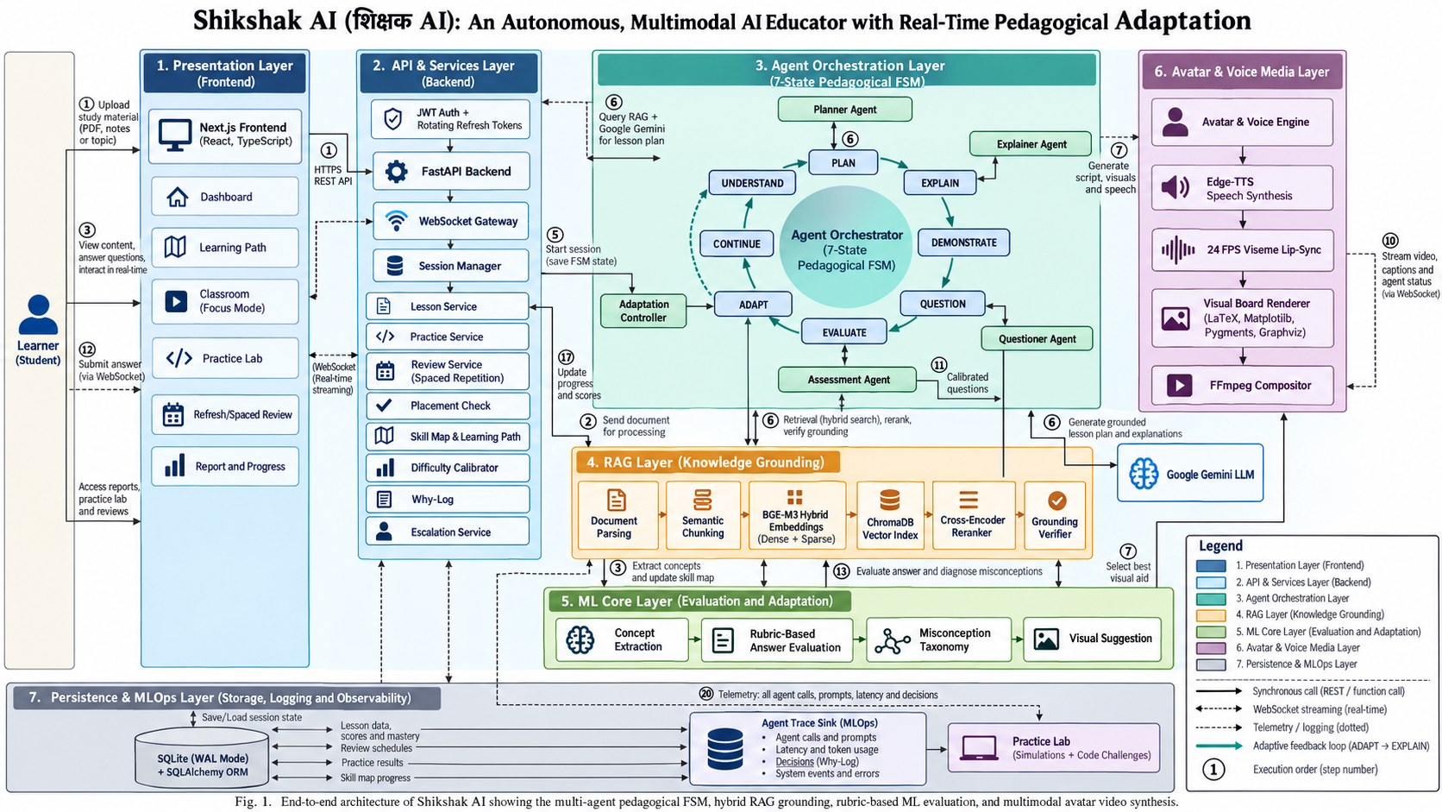
ARCHITECTURE
System Architecture
SHIKSHAK AI · BUILD FAST WITH AI · AI BUILD CHALLENGE 2026
6

Slide 7


TECHNOLOGY STACK
Technology Stack & AI Tools
A modern web stack, an agentic teaching engine and grounded retrieval, with every AI tool disclosed.
Frontend
Backend & Data
AI Teaching Engine
Next.js 16, React 19, TypeScript, Tailwind CSS. Real-time classroom over WebSocket.
FastAPI, SQLAlchemy, SQLite (WAL). JWT auth with rotating refresh tokens.
Planner, Explainer, Questioner and Assessor agents on a 7-state teaching FSM.
Knowledge (RAG)
ML Core
Voice & Video
Document parsing, semantic chunking, hybrid retrieval, reranking and a grounding verifier.
Rubric-based answer grading, misconception taxonomy and concept extraction.
Edge-TTS speech, LaTeX / code / graph boards and FFmpeg video composition.
AI tools disclosure
• In the product: Google Gemini API (planning, teaching, answer judging); BGE-M3 and multilingual-E5 embeddings; Edge-TTS voice.
• In development: Claude Code and Google Antigravity as AI coding assistants. All code was reviewed by the team.
SHIKSHAK AI · BUILD FAST WITH AI · AI BUILD CHALLENGE 2026
7

Slide 8
OUTPUT QUALITY + TESTS
Results & Testing
The full teaching flow is verified end to end, not only the individual parts.
37 / 37
360+
2
~350 MB
end-to-end checks passed
automated tests across modules
languages: English and Hindi
peak memory of the hosted build
What the end-to-end suite verifies
✓
Sign-up, OTP verification, login and token refresh
✓
Checkpoint questions, grading and the adaptation decision
✓
Document upload, concept extraction and lesson planning
✓
Re-explanation, re-test and escalation to a mentor
✓
Live classroom with voice, board video and captions
✓
Assessment report, progress and resume after disconnect
SHIKSHAK AI · BUILD FAST WITH AI · AI BUILD CHALLENGE 2026
8

Slide 9
LIVE DEPLOYMENT + DEMO
Live, Runnable and Easy to Reproduce
Deployed online for anyone to try, with the full-quality build available locally.
Website · Vercel
Backend · Render
AI Teacher · Gemini
Next.js frontend served from a global CDN, always on.
FastAPI with the live WebSocket classroom.
Google Gemini powers planning, teaching and grading.
Live link
Setup instructions
3-minute demo
The deployed web app, shared in the README and the submission form.
README covers clone, install, add a Gemini key and run, in a few commands.
Sign in, create a lesson, answer a question, see the adaptation and the report.
One codebase, two run modes: a lightweight hosted build for easy access, and the full-quality local build with BGE-M3 retrieval, reranking and 1080p avatar video.
SHIKSHAK AI · BUILD FAST WITH AI · AI BUILD CHALLENGE 2026
9

Slide 10

IMPACT + CONCLUSION
Reimagining Personalised Learning
Personalisation
Availability
Scalability
Every learner receives a lesson matched to their level, pace, and goals — not a generic one-size-fits-all path.
Structured teaching support is available whenever a student needs it, without waiting on a tutor’s schedule.
One AI teaching system can support many individualized learning journeys at the same time, at low incremental cost.
Shikshak AI turns AI from a question-answering tool into an adaptive teaching partner.
Next steps: more subjects and Indian languages, teacher dashboards, and classroom pilots.
SHIKSHAK AI · BUILD FAST WITH AI · AI BUILD CHALLENGE 2026
10

Slide 11
Thank You
SHIKSHAK AI
An AI Teacher That Doesn’t Just Answer — It Teaches.
Sagnik Chandra
Shrusti Jain
Team Leader
Team Member
Team Binary Brains · Build Fast with AI: AI Build Challenge 2026
SHIKSHAK AI · BUILD FAST WITH AI · AI BUILD CHALLENGE 2026
11

