Slide 1

CODE KERNEL '26 · DECODE ROUND · IN COLLABORATION WITH CANVAS CLASSES
VidyaSaathi
विद्यासाथी · a learning companion for every student
Adaptive Learn → Solve → Test for Classes 6 to 10, built on Indian board syllabi, with the school teacher at the centre
Team Binary Brains
Sagnik Chandra (Team Lead) · Shrusti Jain
Theme: Adaptive Learning for Classes 6 to 10
Notes:
Introduce VidyaSaathi: Vidya (learning) + Saathi (companion). One line: an adaptive Learn-Solve-Test companion for Classes 6-10 that keeps the teacher at the centre.

Slide 2




Our submission at a glance
WHAT'S INSIDE
01
02
03
04
The problem
Our idea
The teacher
The plan
Root causes, who is affected and why current options fall short
How VidyaSaathi finds where a student stands and adapts Learn, Solve and Test
How it puts the school teacher back at the centre
Architecture, tech stack, testing and how we will measure success

Slide 3
One pace does not fit every learner
01 · DECODING THE PROBLEM
Same lesson, same questions, same speed, for 40+ students who are all at different places.

Slide 4



The gap grows quietly
THE CLASSROOM TODAY
Same lesson, different speeds
Fast learners get bored
Kept at the class pace on topics they already know.
Aarav
already understood, waiting
Meera
Strugglers fall behind
keeping up, just about
A basic missed in Class 6 or 7 breaks the topics built on it.
Ravi
stuck on a Class 6 basic
Nobody really knows
class pace
Tests come at chapter end, after the class has moved on.

Slide 5





Why the gap stays hidden until it is too late
ROOT CAUSE ANALYSIS
Feedback comes late
Prerequisites are invisible
1 teacher : 40+ students
Understanding is checked at chapter end, not while the concept is being taught.
No one maps a Class 9 struggle back to the Class 7 idea underneath it.
A teacher cannot track every student's every concept by hand.
Language mismatch
Uneven access
Doubts go unasked
Many students learn in a language different from the one spoken at home.
Shared family phones, limited data, low-end devices; some have none.
Shy students don't ask in class; tuition adds hours, not understanding.

Slide 6


Three people, one classroom
WHO WE ARE SOLVING FOR
The student
The school teacher
The school
Age 11 to 16 · Classes 6 to 10
Subject teacher and class teacher
Admin and principal
Learns at their own speed
Gets doubts answered at their class level
Practises what they are weak at
In English or Hindi, on a shared phone
Sees who needs help, and why
Answers escalated doubts their way
Builds tests and reads class reports
Stays the one who decides
Board-aligned (CBSE and ICSE)
Teachers auto-assigned to classes
One view of class-wide progress
Low cost, works on existing devices

Slide 7
Why another app won't fix this, but a different one can
EXISTING OPTIONS AND THEIR LIMITS
 | Global adaptive apps | Coaching / tuition | Generic AI chatbots | VidyaSaathi
Follows CBSE / ICSE textbook order | Partly | Yes | No | Yes, chapter by chapter
Adapts while learning, not after | Practice only | No | Only if asked | Learn, Solve and Test
Answers grounded in the syllabus | — | Yes | Can go off-syllabus | Class-level, on-topic
Hindi and Indian examples | Rarely | Varies | Generic | Built in
Teacher at the centre | Bypasses teacher | Replaces teacher | Replaces teacher | Teacher decides
Cost and low-end devices | Subscription | Expensive | Needs data | Free tier, lite mode

Slide 8
VidyaSaathi: a saathi for every student
02 · OUR IDEA
It notices where each student stands and changes what they learn next, how they learn it and how fast they go, while the teacher stays in charge.

Slide 9



Know, adapt, involve the teacher, repeat
THE IDEA IN ONE PICTURE
Know
Adapt
Practise
Involve
Placement check and checkpoints find where the student stands
Difficulty, explanation and pace change after every answer
Practice and spaced review aim at weak concepts
Teacher sees who needs focus and steps in
Our promise: no student waits, no student is left behind unnoticed, and no teacher is replaced. Every adaptive decision is explained in plain words so students, teachers and parents can trust it.

Slide 10





Five signals build a live picture of each student
KEY QUESTION 01 · HOW WILL WE KNOW WHAT A STUDENT UNDERSTOOD?
Placement check
~6 adaptive questions on day one set the starting level and skip what's known
In-lesson checkpoints
The lesson pauses at natural breaks to ask a question
Learner model
Mastery for every concept of the syllabus
Live difficulty level, 1 to 5
Weak concepts and likely misconceptions
When each concept is due for review
A 'focus' signal for the teacher
Doubts asked
What, how often and on which topic
Tests and practice
Topic-wise scores from MCQ / MSQ tests and games
Activity rhythm
Streaks, time away, syllabus coverage

Slide 11
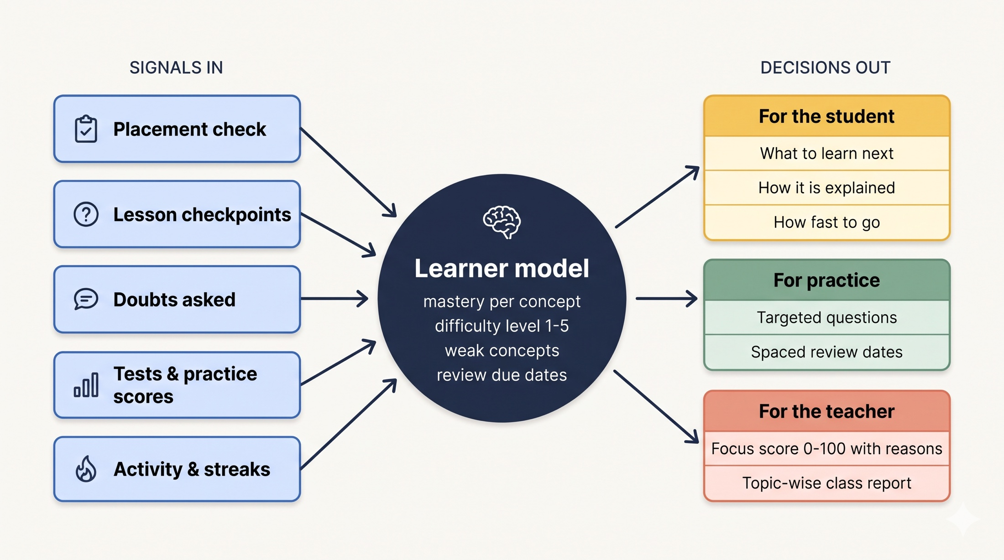
One learner model drives every decision
KEY QUESTION 01 · FROM SIGNALS TO DECISIONS

Slide 12


Learn → Solve → Test, each one adapts
ADAPTING ALL THREE PARTS OF STUDYING
01 Learn
02 Solve
03 Test
Learning a concept
Solving problems
Testing what you know
Board syllabus becomes a personal path
Short video lessons with a teacher avatar and visual boards
Checkpoints mid-lesson; re-explains when wrong
Ask a doubt any time
Practice generated for your weakest concepts
Class- and subject-specific simulations
Topic-wise games that earn points
Harder stretch questions when you're ahead
Teacher-built MCQ / MSQ class tests
Topic-wise report for student and teacher
Class-only leaderboard
Spaced review before you forget

Slide 13

Your syllabus becomes your own path
LEARN · ADAPTING HOW AND HOW FAST
Board → Class → Subject → Chapter → Topic
Path in textbook order
CBSE (NCERT 2025-26) and ICSE syllabi: 560 chapters and about 1,580 topics across Classes 6 to 10. Start anywhere or follow the path.
Integers in daily life
done
Fractions on the number line
done
Live difficulty, 1 to 5
Equivalent fractions
now
Two right in a row: step up and go deeper. A miss: step down. The level carries into the next lesson.
Recap: factors (Class 6)
auto-added
Re-explain ladder
Adding fractions
next
Wrong at a checkpoint: re-explain with a new example, then rebuild in simpler steps, then hand to the teacher.

Slide 14

A video lesson that checks you understood
LEARN · INSIDE A LESSON
Watch
Checkpoint
Adapt
Why?
Avatar teacher + boards: diagrams, equations, plots
Video pauses for a quick question
Right: go deeper. Wrong: simpler, new example
Every change explained in one plain line
Voice in English and Hindi
Natural text-to-speech; boards render Devanagari correctly. Lessons can be paused and resumed exactly where they stopped.
Example "Why?" entry
"You missed the checkpoint on equivalent fractions, so I explained it again using rotis cut into equal parts and lowered the level to 2."

Slide 15




A team of doubt agents, with the teacher as the backstop
LEARN · DOUBTS ANSWERED INSTANTLY, NEVER IGNORED
Listener
Librarian
Tutor
Checker
Teacher
What kind of doubt? meaning, why, how, example, numerical
Where it sits: board, class, chapter, what the lesson said
Explains at class level; simpler on every retry
Ends with one tiny question to self-test
After 3 tries, escalated with full context
Try 1
Try 2
Try 3
Direct answer in 3–5 short sentences
Step by step with an Indian example: cricket, a kirana shop, a train
Back to the most basic idea it depends on

Slide 16


Learning by doing, at your level
SOLVE · PRACTICE THAT KNOWS YOUR WEAK SPOTS
Targeted practice
Simulations
Fresh questions aimed at your weakest concepts: easier where you struggled, a stretch where you're strong.
24 class- and subject-specific labs. Predict → run → see why. E.g. refraction, pendulum, fractions.
Topic games
Spaced review
Quiz Rush, True/False Blitz and Match-up turn revision into points, streaks and badges.
Mastered concepts come back after 2 → 5 → 12 → 30 → 60 days, just before you'd forget.

Slide 17

Tests that lead to action, not just marks
TEST · CHECKING WHAT YOU KNOW, AND WHAT TO DO NEXT
Teacher builds the test
Class 9 Maths · topic report
MCQ and multi-select tests for their own class and subject, in minutes.
Linear equations
41%
Topic-wise report
Each student sees which topics to revisit; the path updates on its own.
Polynomials
58%
Class-only leaderboard
Coordinate geometry
72%
Friendly, animated, and limited to the student's own class.
Number systems
86%
Teacher sees the class
Who is doing well, who is falling behind, and on which topic.
Revisit: Linear equations
Sample data

Slide 18
How does VidyaSaathi empower the school teacher?
03 · GUIDING QUESTION
AI does the noticing and the first answer. The teacher does the deciding and the teaching.

Slide 19

See who needs you, why, and act in one click
THE TEACHER'S DESK
Focus list
Doubt inbox
Need focus now
Class 9-B · Maths
Students ranked by how much they need attention now, each with plain reasons.
Escalated doubts arrive with the full conversation and lesson context.
Ravi K.
62
Test avg 38% · 3 doubts waiting
Sana M.
41
Inactive for 9 days
Reply your way
Tests and reports
Text, notes, a recorded video (auto-deleted after 7 days) or schedule a live class.
Build class tests; read topic-wise results for the whole class.
Arjun P.
24
Low scores in Polynomials
Illustrative view · focus score 0–100

Slide 20

AI assists. The teacher decides.
DESIGNED WITH TEACHERS, NOT AROUND THEM
Transparent, not a black box
Escalation brings them back in
The focus score uses simple published rules: low test average, doubts waiting, inactivity, weak subjects. A teacher can explain every flag to a parent.
When AI tries run out, the student's own subject teacher takes over, with context, so no doubt is left hanging.
Matches how schools work
Saves time, not adds work
Subject teachers and class teachers per board and class; students auto-assigned evenly and consistently.
No manual tracking. The desk sorts 40+ students so the first five minutes go to the ones who need it.

Slide 21
Built for Indian students and classrooms
MUST HAVE
Not a copy of a global app: boards, languages, class sizes and real device access shaped every choice.

Slide 22


Made for our boards, languages and devices
KEY QUESTION 03 · HOW WILL IT WORK IN A TYPICAL INDIAN SCHOOL?
CBSE and ICSE syllabi
English and हिन्दी
Indian examples
Chapter by chapter in textbook order (NCERT 2025-26; Selina / Concise for ICSE). State boards next.
Full interface, lessons and voice in Hindi; doubts in Hinglish are understood. More Indian languages planned.
Cricket, kirana shops, trains, rotis, festivals, monsoon: explanations students recognise.
Phone first, shared devices
Low data, low cost
Large classes
Web app plus native Android / iOS app; separate logins on one family phone.
Hindi loaded only when chosen; lite install; built-in offline teacher works even without an AI key.
Teacher desk is built to scan 40+ students fast: sort, filter and focus list.

Slide 23

Fits into a normal school week
KEY QUESTION 05 · WHO USES IT, AND HOW OFTEN?
Student
Subject teacher
Class teacher
School admin
Daily · 20–30 min
Daily · 5–10 min
Weekly
Monthly
One lesson or practice set after school; doubts any time; games for quick revision.
Check the focus list and doubt inbox; reply or schedule a live class.
Review class progress across subjects; follow up with students who are inactive.
Assign teachers to classes; see syllabus coverage across the school.

Slide 24
How we will build it
04 · THE PLAN
User journey, architecture, the engines inside it, tech stack and how we will measure success.

Slide 25
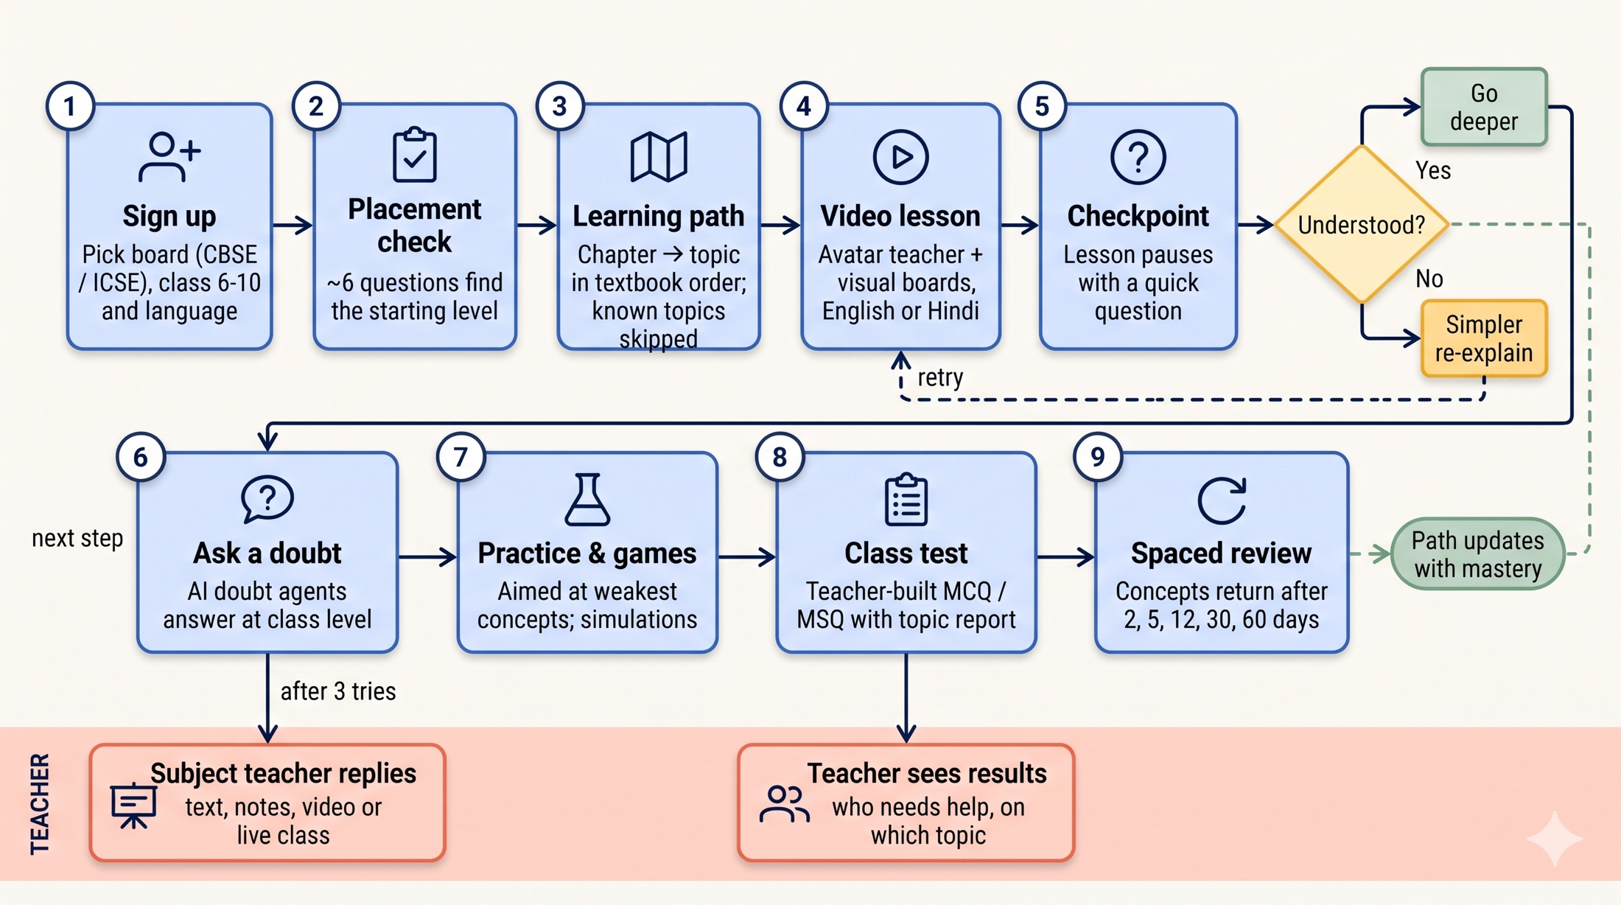
A student's journey through VidyaSaathi
USER FLOW

Slide 26
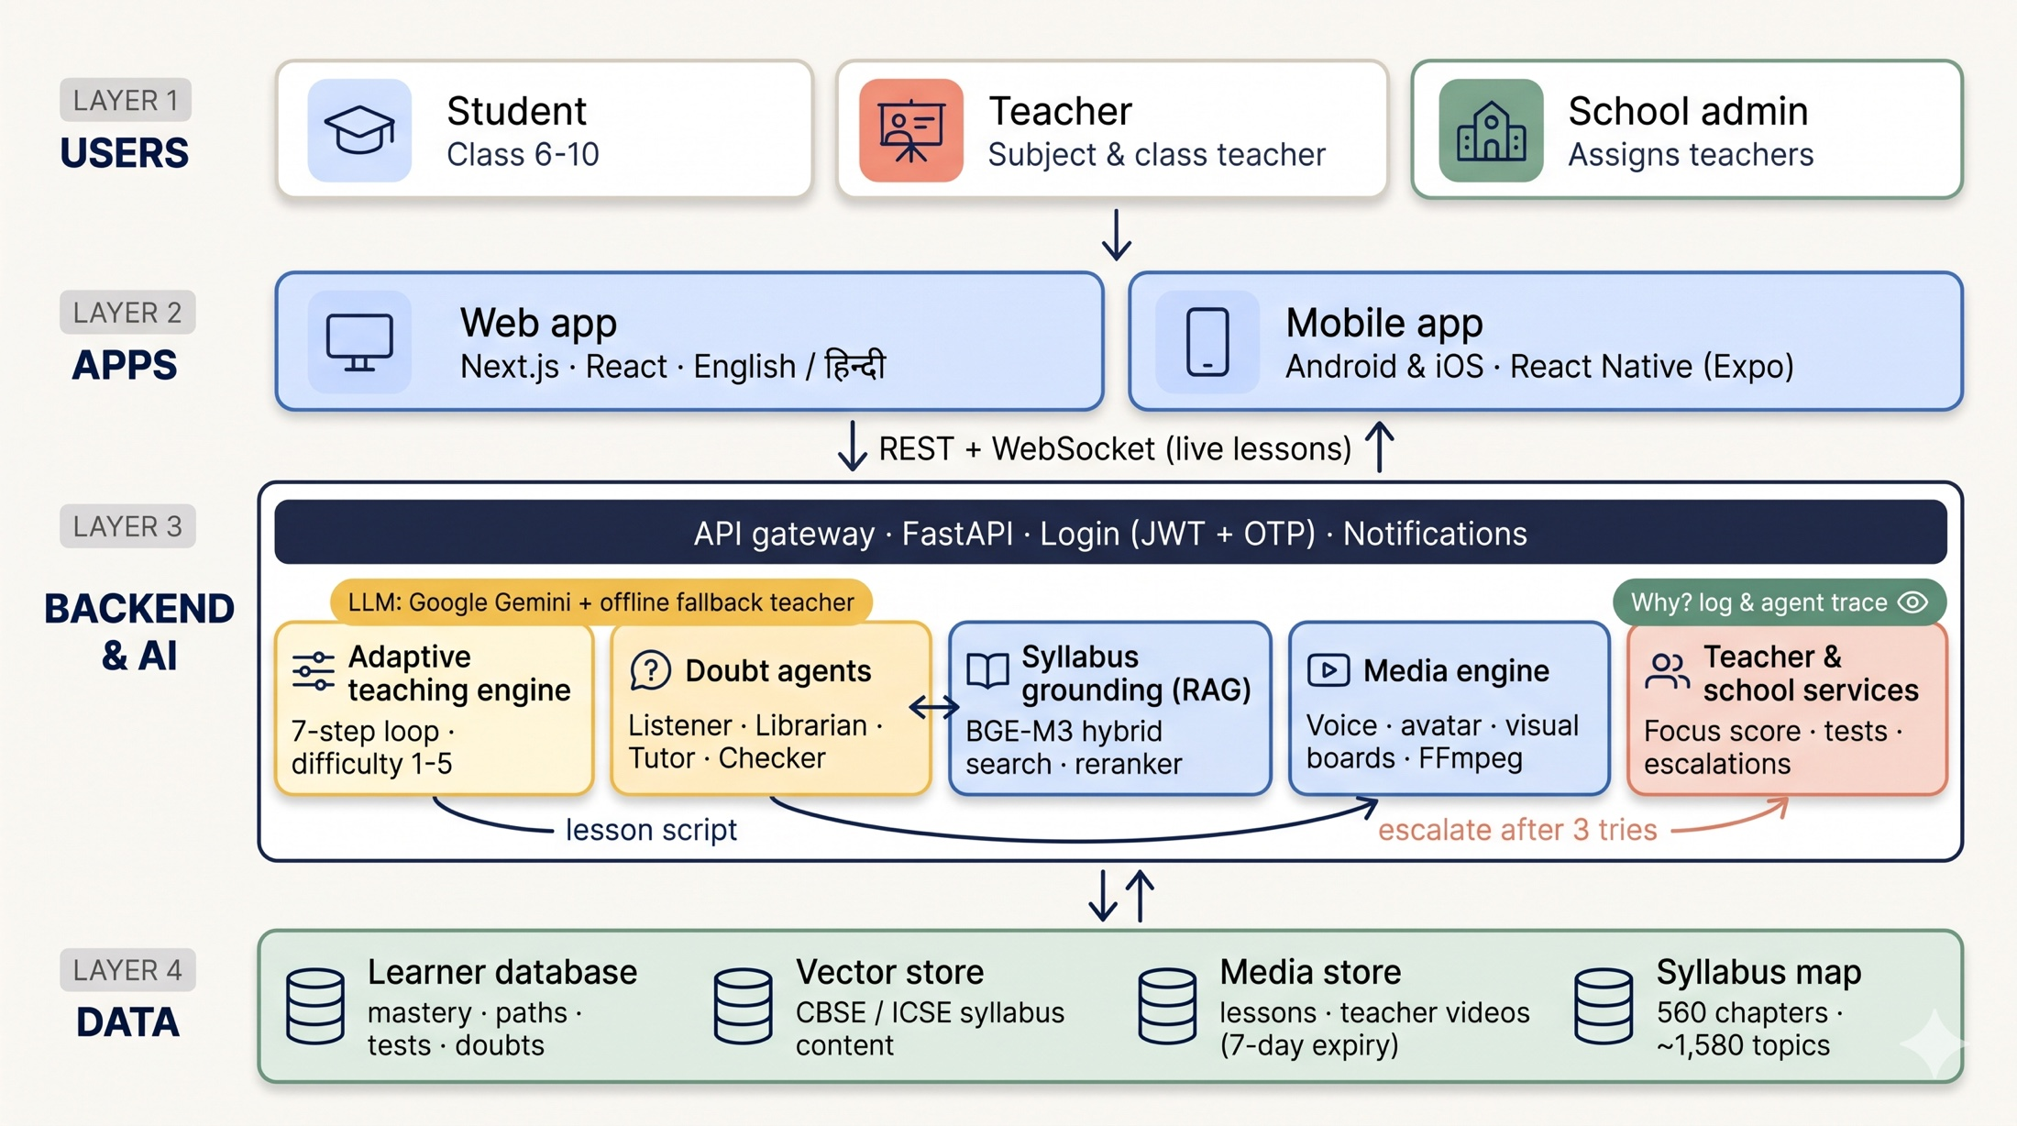
Overall architecture
SYSTEM ARCHITECTURE

Slide 27
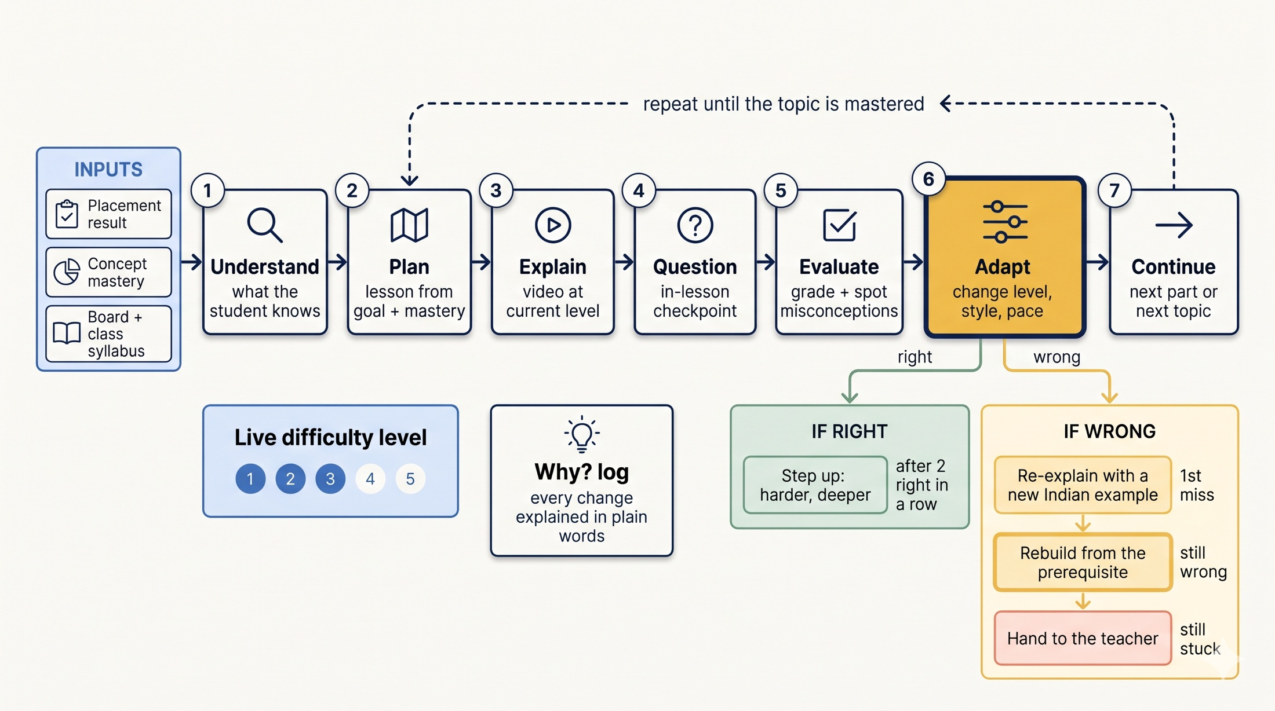
Adaptive teaching engine
COMPONENT DEEP-DIVE

Slide 28
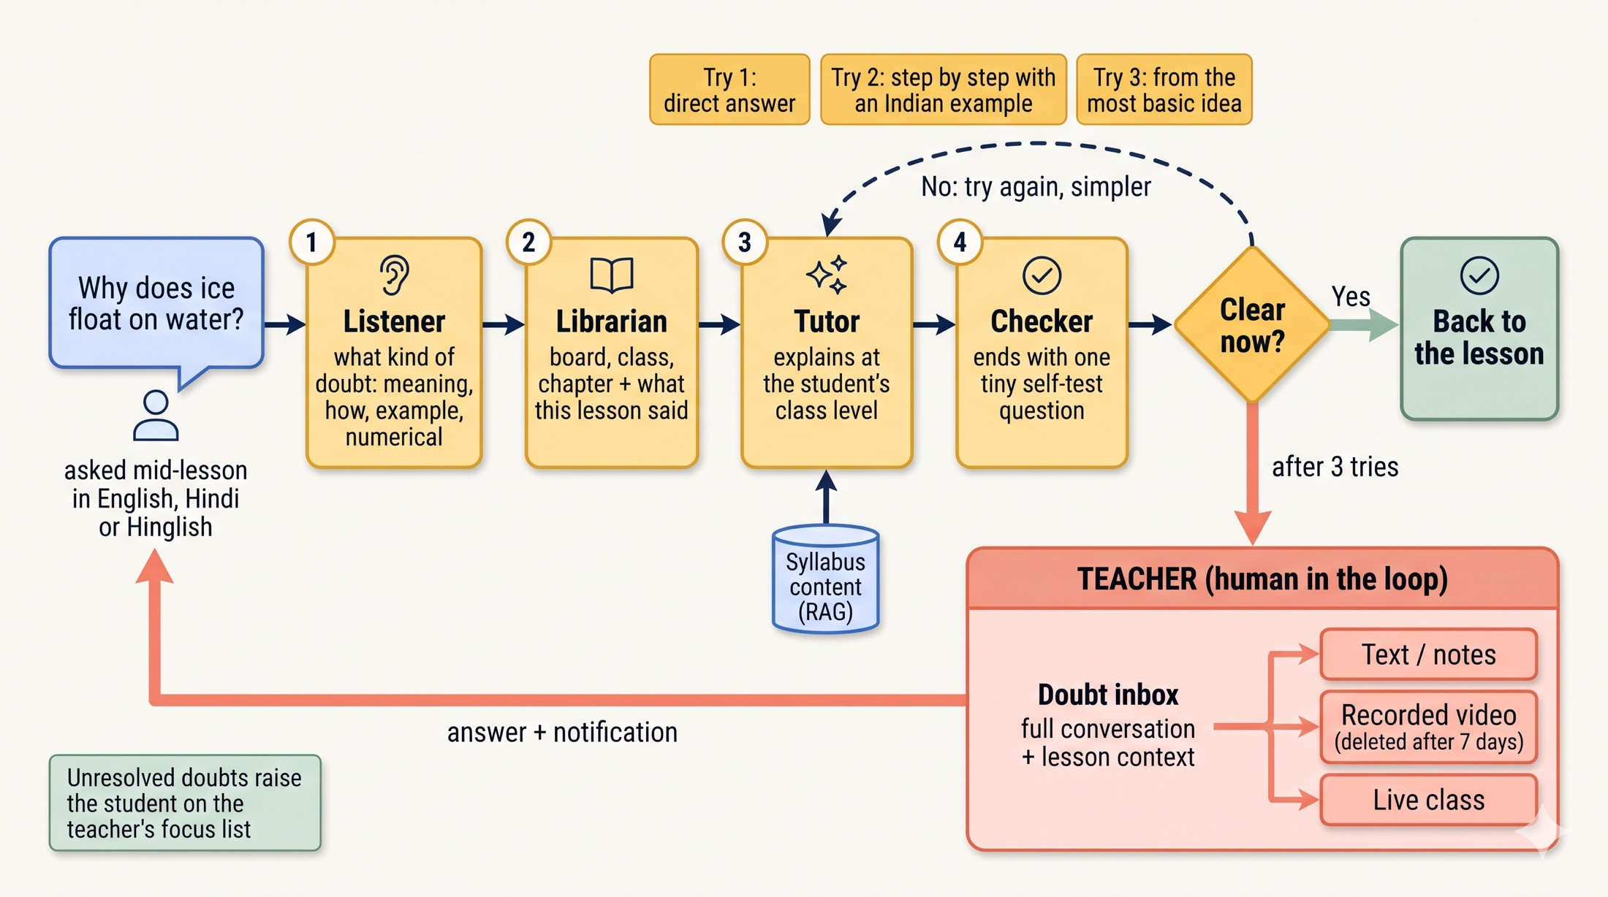
Doubt resolution and teacher escalation
COMPONENT DEEP-DIVE

Slide 29


Proven, low-cost, open technology
PLANNED APPROACH AND TECH STACK
Apps
Backend
Next.js 16 · React 19 · TypeScript · Tailwind
Expo React Native for Android / iOS
Python · FastAPI · WebSockets for live lessons · JWT auth with OTP
AI agents
Grounding (RAG)
Google Gemini · multi-agent tutor on a 7-state loop · offline rule-based fallback
BGE-M3 hybrid search · ChromaDB · cross-encoder reranker · cited answers
Media
Data and ops
Edge-TTS (English, Hindi) · illustrated avatar · Matplotlib / LaTeX boards · FFmpeg
SQLite (WAL) → PostgreSQL at scale · Docker · tests and eval suites

Slide 30


Safe, explainable and on-syllabus
RESPONSIBLE AI FOR CHILDREN
Stays on the syllabus
Every decision explained
Answers are grounded in the student's board, class and current lesson; off-topic questions are declined, not guessed.
The "Why?" log records each adaptive change in plain words for the student and teacher.
Child-safe by design
Works without the cloud AI
Class-only leaderboards, teacher videos auto-deleted after 7 days, OTP-verified accounts, rate limits.
A built-in offline teacher builds answers from lesson notes, so learning never stops.

Slide 31
A pilot plan with clear, honest targets
HOW WE WILL MEASURE SUCCESS
Where
How long
Baseline
1–2 partner schools, Classes 7 and 9, Maths and Science
6 weeks, alongside normal classes
Same pre-test and post-test for every student, plus a teacher survey
Targets we will measure against
+15%
≤ 7 days
60%+
< 10 min
mastery gain
to catch a gap
doubts solved by AI
teacher time / day
post-test vs pre-test on pilot topics
from first miss to a fix or teacher flag
the rest reach the teacher with context
to review focus list and doubts

Slide 32

Why VidyaSaathi fits the challenge
IN SUMMARY
Understands where each student stands
Placement check, checkpoints, doubts and tests feed one learner model per concept.
Adapts Learn, Solve and Test
What comes next, how it's explained and how fast: after every single answer.
Fits Indian classrooms
CBSE and ICSE in textbook order, English and Hindi, phone-first and low data.
Empowers teachers
A focus list with reasons, a doubt inbox and class reports. The teacher decides.
Practical and usable
Short lessons, games and streaks for ages 11–16; transparent, child-safe AI.

Slide 33
Thank you · धन्यवाद
VidyaSaathi: every student at their own pace, every teacher at the centre
Team Binary Brains · Sagnik Chandra (Team Lead) · Shrusti Jain
Code Kernel '26 · X-Kernel, GRIET · in collaboration with Canvas Classes

