Slide 1

MHTECHIN INNOVATION CHALLENGE 2026
Agri·Vision
One farm. One app.
Specialist-grade crop & livestock health: offline, in Hindi, grounded by AI.
AgriTech · Generative AI
Team Binary Brains
Notes:
Title slide.

Slide 2




Agri·Vision
THE PROBLEM
Farm health advice is fragmented, online-only and English-first.
“Her tomatoes have spots. Her cow has lumps. The nearest expert is hours away.”
Fragmented
Online-only
Unsafe & inaccessible
Separate apps and experts for crops and animals.
Cloud apps fail where connectivity is weakest.
English, text-heavy; generic chatbots can invent dosages.
Great agri-AI rarely leaves the lab.
LAB PROTOTYPE
MHTECHIN: CLOUD, DEPLOYMENT, ENTERPRISE
Agri·Vision has already crossed the hardest part: working, measured AI.
Models on a laptop · No GPU serving · No scale
Reliable cloud · Secure data · Millions of users
~86% of Indian farm holdings are small & marginal · 2022 lumpy skin outbreak: ~1 lakh+ cattle deaths [VERIFY + source]
MHTECHIN Innovation Challenge 2026
02 / 10
Notes:
What if one photo was enough?

Slide 3







Agri·Vision
THE SOLUTION
A specialist for every field and every animal.
96%
1. Snap
2. Diagnose
3. Act
Photograph a leaf, plant or animal; add symptoms if you like.
Auto-router picks the specialist; fuses photo, words and sensors.
Clear steps in Hindi or English, saved to your private farm history.
Answered on-device
What to do now
AUTO-ROUTER → SPECIALIST EXPERTS
Row crops specialist
Tree crops specialist
Lumpy-skin specialist
FMD specialist
MHTECHIN Innovation Challenge 2026
03 / 10
Notes:
What if one photo was enough?

Slide 4





Agri·Vision
DIFFERENTIATORS
Built for the last mile, not the lab.
HOW WE COMPARE
 | Generic chatbots | Single-crop apps | Agri·Vision
Offline | ✗ | Partly | ✓
Livestock | ✓ | ✗ | ✓
Hindi | ✓ | Partly | ✓
Citations | ✗ | ✗ | ✓
Admin insights | ✗ | ✗ | ✓
Offline-first
Crop + livestock
Hindi voice & text
Answers on-device
One app
Listen to advice
Grounded GenAI
Explainable
Outbreak watch
Cited, validated, no dosages
Why, alternatives, confidence
Regional early warning
MHTECHIN Innovation Challenge 2026
04 / 10
Notes:
Differentiators vs generic chatbots and single-crop apps.

Slide 5
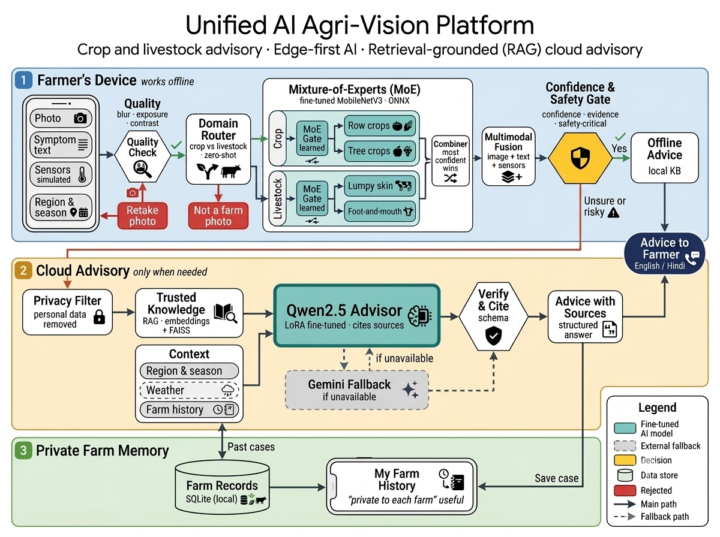




Agri·Vision
ARCHITECTURE & STACK
Fast on the edge, smart in the cloud, private at home.
Edge AI / ML
PyTorch · MobileNetV3 · Mixture-of-Experts · ONNX Runtime
Generative AI
Qwen2.5 + QLoRA · RAG (FAISS) · Gemini fallback · Ollama / vLLM
Speech & language
Hindi ASR (AI4Bharat) · TTS · bilingual UI
Application & APIs
Next.js · TypeScript · Tailwind · FastAPI · OTP login
Data & cloud
SQLite → Postgres · FAISS · weather API · containers
MHTECHIN Innovation Challenge 2026
05 / 10
Notes:
Enterprise-grade stack, built to scale.

Slide 6

Agri·Vision
LIVE DEMO
Let’s diagnose a real farm.
DEMO PATH
1
Farmer login
2
Diagnose a crop (offline)
Scan or visit
Livestock case (cloud AI)
https://minimal-due-realize-glow.trycloudflare.com/
3
4
Farm history
5
Admin & outbreak watch
MHTECHIN Innovation Challenge 2026
06 / 10
Notes:
Live demo.

Slide 7
Agri·Vision
VALIDATION
We tested it like a product, not a demo. Measured, not claimed.
97–98%
94.5%
Specialist accuracy (crops)
Crop diagnosis end-to-end (29 classes)
89.5%
34 → 6
Livestock diagnosis end-to-end
Missed lumpy-skin cases
HELD-OUT DATA
TRUST
RETRIEVAL & TESTS
SAFETY
5,433 crop images · 487 cattle images, never seen in training
≥ 90% sure → right 96.7% of the time
RAG hit@3 = 1.0 · 120 automated tests passing
Missed-disease counts tracked on every release
PlantVillage is lab-style imagery; field validation is the next step. Qwen advisor evaluation in progress; RAG labels preliminary.
MHTECHIN Innovation Challenge 2026
07 / 10
Notes:
Measured, not claimed. Honest limits stated.

Slide 8


Agri·Vision
IMPACT & MODEL
Impact for farmers. A business for partners.
IMPACT
BUSINESS MODEL
Diagnosis in minutes, not days
B2G
State agri & animal-husbandry depts, KVKs: outbreak dashboards, extension at scale.
Fewer livestock deaths via early warning
Co-ops, FPOs, input firms, insurers: consented, aggregated insights.
B2B
Less pesticide misuse
Farmers
Free core diagnosis; premium advisory and alerts.
Voice-first for low-literacy users
A private health record for every farm
Economics
Most checks on-device; cloud AI only for hard cases.
Safety, privacy & responsible AI
PII stripped before any cloud call
Validator blocks dosages, verifies citations
Critical diseases escalated to a vet / agronomist
Confidence shown; “Not enough evidence” over guessing
MHTECHIN Innovation Challenge 2026
08 / 10
Notes:
Farm history private per farm; admin sees aggregated data; demo OTP off in production.

Slide 9
Agri·Vision
ROADMAP
A million farms, with MHTECHIN.
NOW
3–6 MONTHS
SCALE
Prototype
Pilot with MHTECHIN
Million farms
Next.js + FastAPI app
Containerised cloud
Android offline app
4 ONNX experts
GPU-autoscaled vLLM
WhatsApp & IVR voice
Fine-tuned Qwen via Ollama
Managed Postgres + encryption
More languages & crops
49-doc knowledge base
Field pilot: KVKs / dairy co-op
MLOps: CI/CD, drift monitoring
SQLite · Web app
Gateway, auth, rate limits
KVK / ICAR-curated vector DB
WHAT WE BRING
WHAT MHTECHIN BRINGS
Working AI and domain depth.
Cloud, deployment and enterprise scale.
MHTECHIN Innovation Challenge 2026
09 / 10
Notes:
Production cloud architecture: prototype today vs production with MHTECHIN.

Slide 10



Agri·Vision
THANK YOU
One farm. One app. Every farmer.
Our ask: partner with us to pilot Agri·Vision on MHTECHIN’s cloud.
TEAM BINARY BRAINS
Live app:
https://minimal-due-realize-glow.trycloudflare.com/
S
Sagnik Chandra · Team Leader
GitHub:
github.com/Sagnik120/agri-vision-platform
S
Shrusti Jain
Contact:
m25cse027@iitj.ac.in (Sagnik Chandra)
A
Arjun Baidya
Built end-to-end: data, models, cloud AI, app and evaluation.
Thank you / धन्यवाद
MHTECHIN Innovation Challenge 2026
10 / 10
Notes:
Thank you.

