Slide 1
Customer Retention
Sagnik Das

Slide 2
EDA
Exploratory Data Analysis Exploratory Data Analysis is the process of using statistical tools (such as graphs, measures of center, and measures of variation) to investigate data sets in order to understand their important characteristics.

Slide 3
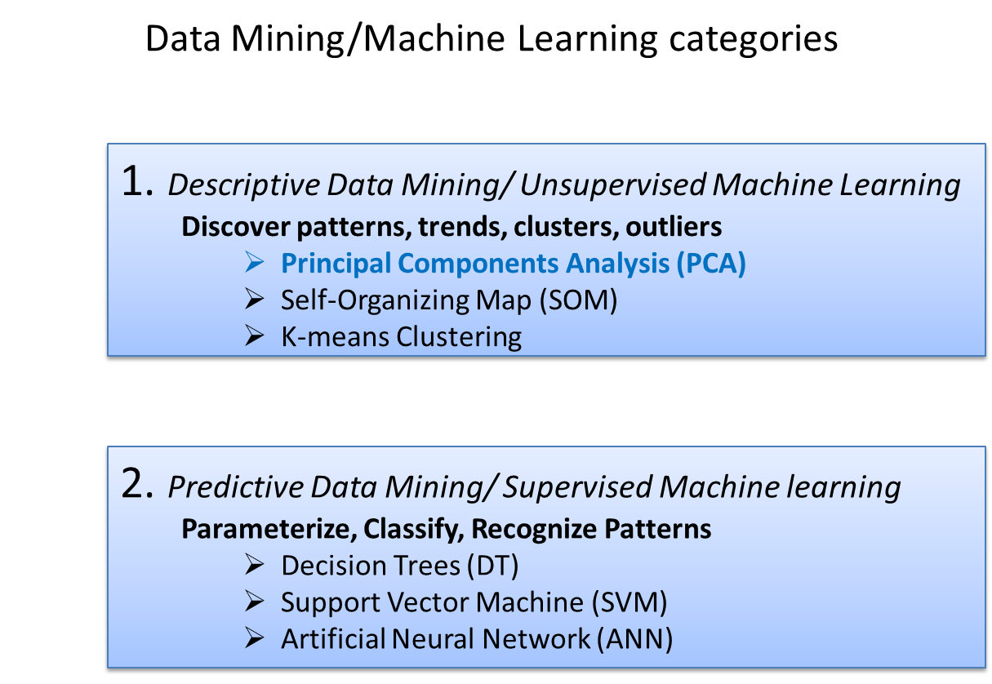

Slide 4
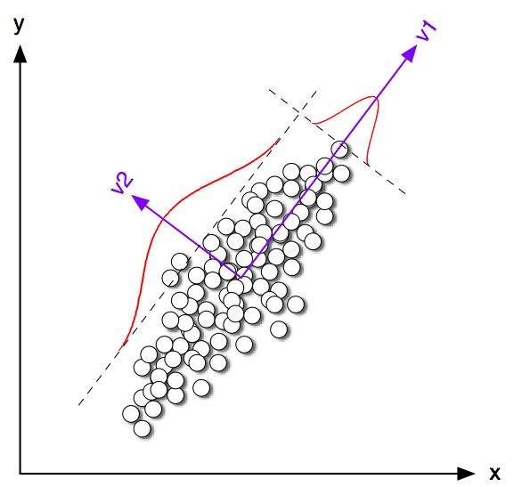
Principal Components Analysis (PCA)
(Karhounen-Loeve transformation)
Linear orthogonal transformation in a new base, in which the data variance is highlighted.
New axes = Principal Components (PCs)
Data = linear combination of PCs

Slide 5
Principal Component Analysis
1. Standardize the original data, if necessary (Dimension Reduction).
It is a process of converting a data set having vast dimensions into a data set with lesser dimensions.
It ensures that the converted data set conveys similar information concisely.
2. Construct the variance-covariance matrix or the correlation matrix.
3. Determine the eigenvalues (λi) and eigenvectors (PCi) of the matrix.
o Data covariance has been eliminated.
o Eigenvalues λ represent the variances of the transformed data.
o PC1 corresponds to the biggest λ (λ1) and summarizes the majority of the data variance.
o PC2 corresponds to λ2 and summarizes the majority of the rest of the data variance etc.
4. Determine the admixture coefficients αi (data projection on the new axes).
o Full data reconstruction: Data = α1PC1 + α2PC2 + … + αkPCk
o Partial reconstruction is usually sufficient: Data ≈ α1PC1 + α2PC2 + … + α5PC5

Slide 6
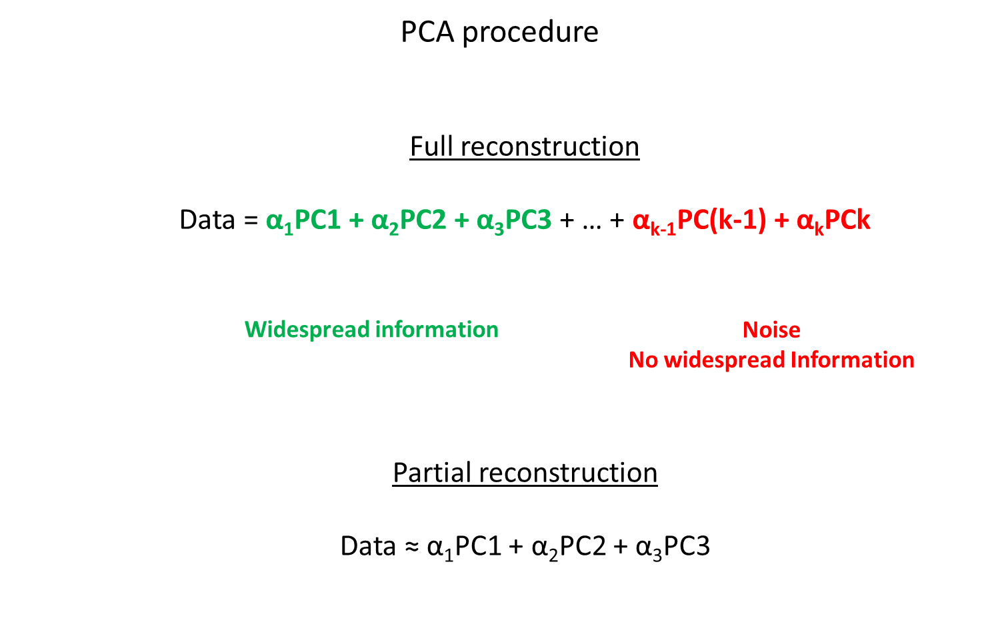

Slide 7
What is classification?
A machine learning task that deals with identifying the class to which an instance belongs
A classifier performs classification

Slide 8
Classification learning
Number of websites
Website Loyalty
Age group
City
Training
phase
Testing
phase
Learning the classifier
from the available data
‘Training set’
(Labeled)
Testing how well the classifier
performs
‘Testing set’

Slide 9
Generating datasets
Methods:
Holdout (2/3rd training, 1/3rd testing)
Cross validation (n – fold)
Divide into n parts
Train on (n-1), test on last
Repeat for different combinations
Bootstrapping
Select random samples to form the training set

Slide 10
Evaluating classifiers
Outcome:
Accuracy
Confusion matrix
If cost-sensitive, the expected cost of classification ( attribute test cost + misclassification cost)
etc.

Slide 11
This ppt allows us to see the steps taken to complete this project. This project allows us to identify the attributes required to increase brand loyalty within different demography by improving different aspects of e-retail marketing. Also, allows us to identify new customers.

