Slide 1
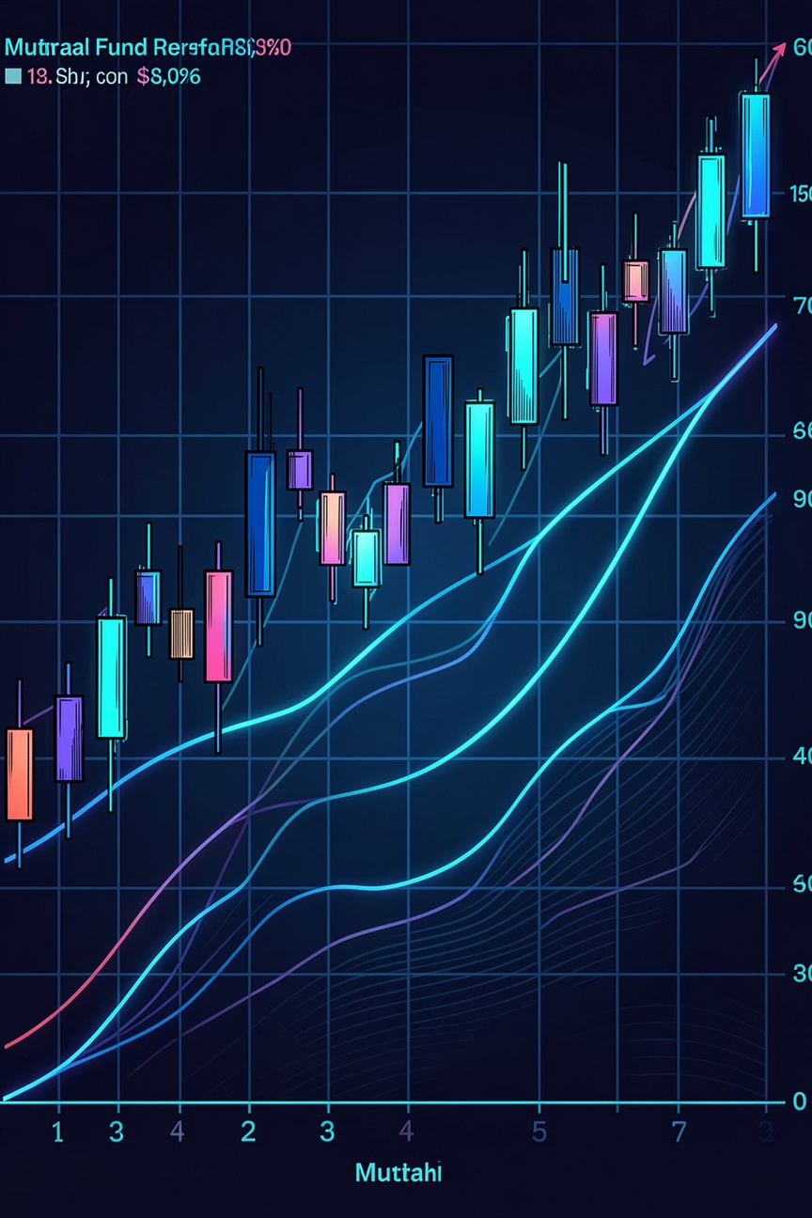

Mutual Fund Analytics Platform
Building an End-to-End Investment Intelligence System for the Indian Mutual Fund Industry
Sagnik Mandal · Bluestock Capstone Project · 2026
Notes:
1

Slide 2
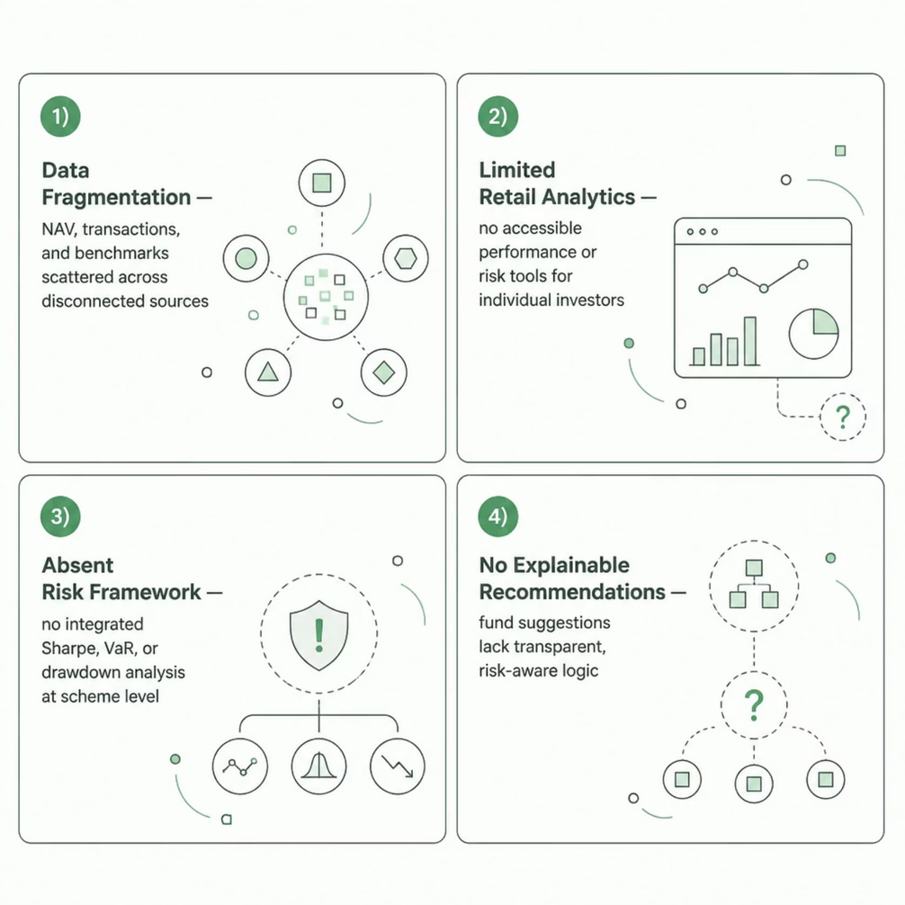
THE CHALLENGE
The Indian Mutual Fund Industry: Scale Without Intelligence
India's mutual fund industry has crossed ₹81 lakh crore in AUM — yet retail investors lack integrated analytics, risk tools, and explainable recommendations.
Platform Objective
Build a unified analytics platform integrating ETL pipelines, performance analytics, investor intelligence, risk modeling, and an explainable recommendation engine.
Notes:
2

Slide 3

ARCHITECTURE
End-to-End Platform Architecture
Data Sources
SQLite Storage
Visualization & Recommendations
Historical CSV, Live NAV API, Benchmarks
Modular, auditable persistence
Power BI dashboards, Risk-Aware Engine
Analytics Layer
ETL Pipeline
EDA, Risk Metrics, Quantitative Analysis
Cleaning, Validation, AMFI Compliance
A modular, auditable architecture ensures data integrity at every stage — from raw ingestion through to investor-facing recommendations and executive dashboards.
Notes:
3

Slide 4
DATA ENGINEERING
Engineering a Production-Grade Data Pipeline
46K
32K
NAV Records
Transactions
Historical and live data points
Investor-level records processed
40
5
Schemes
Risk Categories
Across 10 fund houses
Conservative to aggressive
10 historical CSV datasets + 5 live NAV API feeds integrated
Automated validation with AMFI compliance checks
Duplicate removal, missing value handling, schema normalization
Only 12 missing values detected across YoY growth metrics
Notes:
4

Slide 5
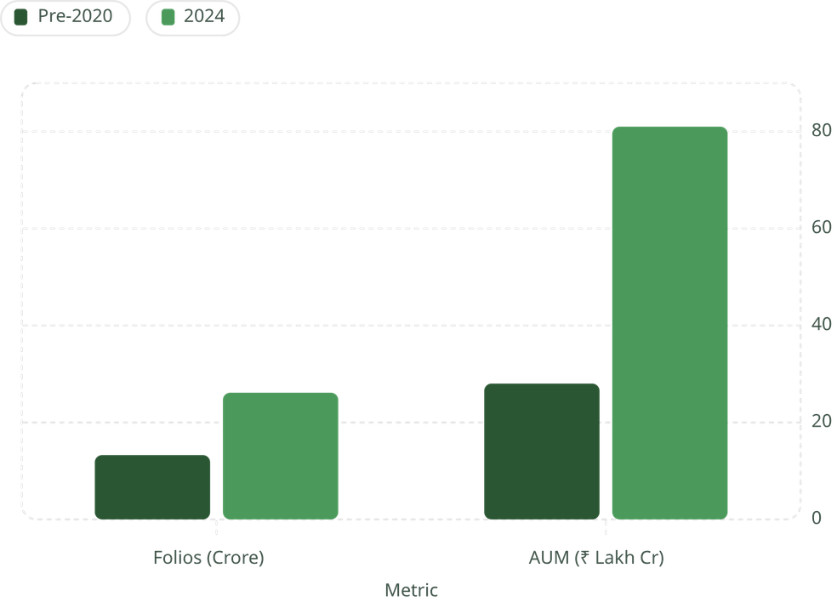

EXPLORATORY ANALYSIS
Industry Growth: The Numbers Tell the Story
Key Findings
Folios doubled from 13.26 crore to 26.12 crore
SIP inflows reached ₹31,002 crore monthly — a record high
AUM crossed ₹81 lakh crore, cementing India's position
Retail participation accelerated sharply post-2023
SIP culture is transforming retail investment behavior at scale.
Notes:
5

Slide 6
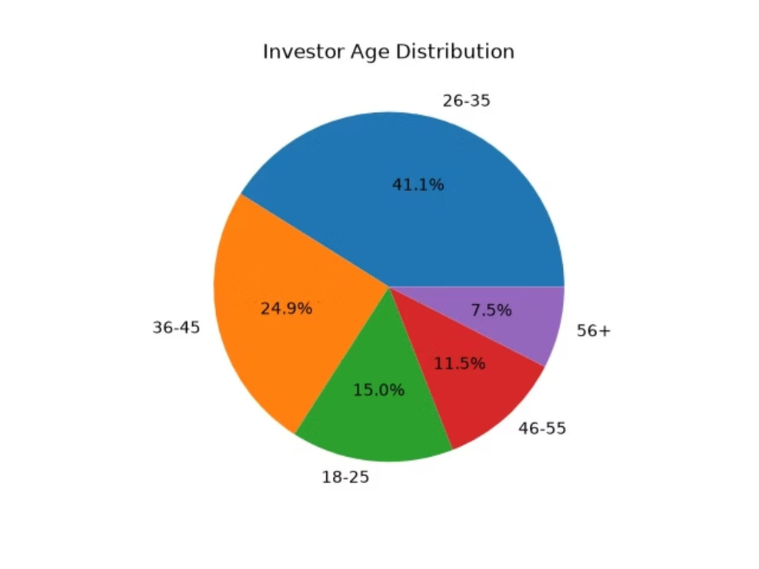
INVESTOR INTELLIGENCE
Who Is Driving India's Mutual Fund Revolution?
Demographic Insights
Age 26–35 dominates participation at 38%
Urban T30 cities contribute the majority of inflows
Lumpsum investments dominate total transaction value
Post-2023 entrants show higher average SIP values
SIP continuity strongly correlates with long-term returns
Notes:
6

Slide 7
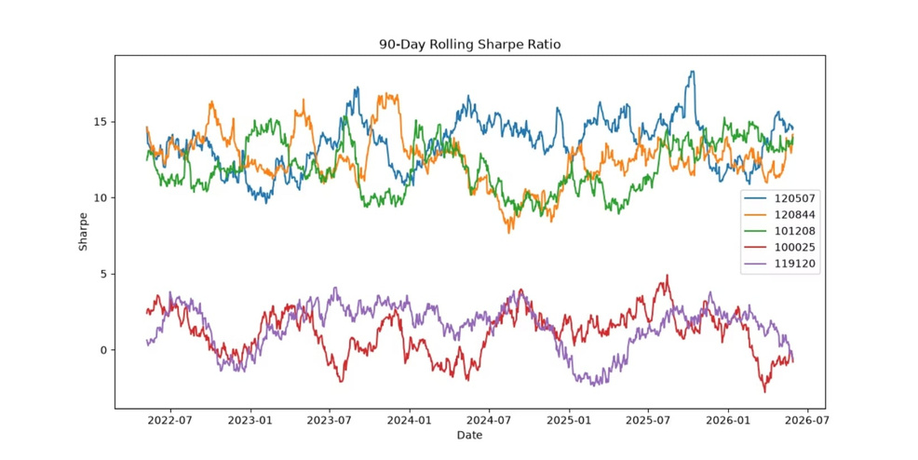
QUANTITATIVE ANALYTICS
Performance Metrics & Risk-Adjusted Returns
Core Metrics
Daily Returns & CAGR — Absolute and annualized performance
Sharpe Ratio — (Return − Risk-Free) / Std Dev
Sortino Ratio — Downside deviation only
Alpha & Beta — Benchmark-relative performance
Max Drawdown — Peak-to-trough decline
Tracking Error — Active risk vs. benchmark
Funds with CAGR above 30% demonstrated superior Sharpe ratios — validating risk-adjusted performance as the primary selection criterion.
Notes:
7

Slide 8
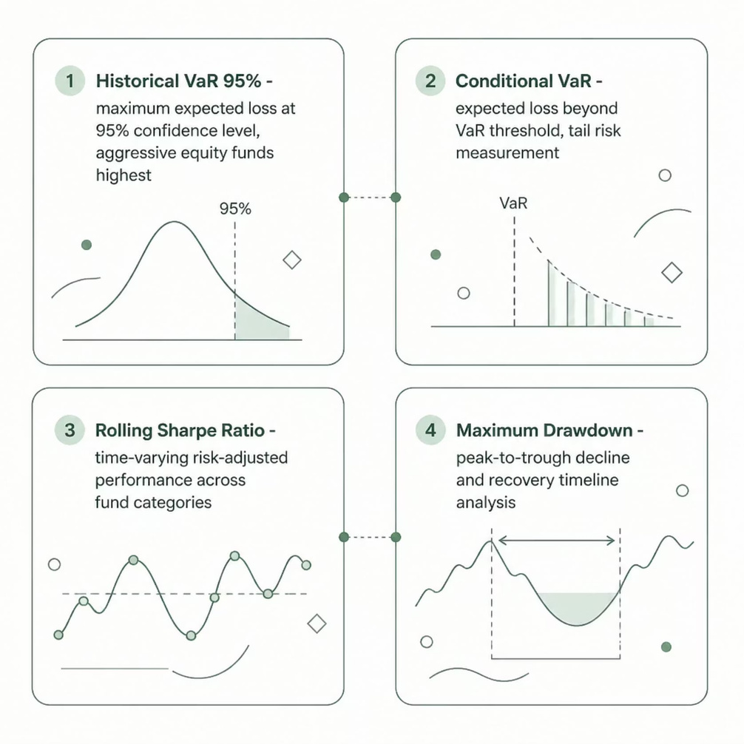
RISK INTELLIGENCE
Risk Analytics & Portfolio Concentration
Risk Framework
Historical VaR (95%) — Maximum expected loss at 95% confidence
Conditional VaR — Expected loss beyond the VaR threshold
Rolling Sharpe Ratio — Time-varying risk-adjusted performance
Drawdown Analysis — Recovery timelines and depth
Aggressive equity funds showed highest VaR; defensive funds maintained superior downside protection.
Sector Allocation
Concentration Risk
Diversification Benefit
HHI concentration metrics reveal diversification quality across schemes.
Highly concentrated portfolios carried larger downside risk.
Diversified portfolios exhibited significantly lower volatility.
Notes:
8

Slide 9

RECOMMENDATION ENGINE
Risk-Aware Fund Recommendations
Top 3 Recommendations
Risk Profiling
Multi‑Criteria Filter
Each investor profile receives a personalized, explainable shortlist — filtered by Sharpe ranking, drawdown constraints, and category suitability.
Low Risk
Moderate Risk
High Risk
Liquid & debt funds with minimal drawdown and stable returns
Hybrid & balanced funds with strong Sharpe ratios
Equity funds with superior CAGR and acceptable drawdown
Notes:
9

Slide 10
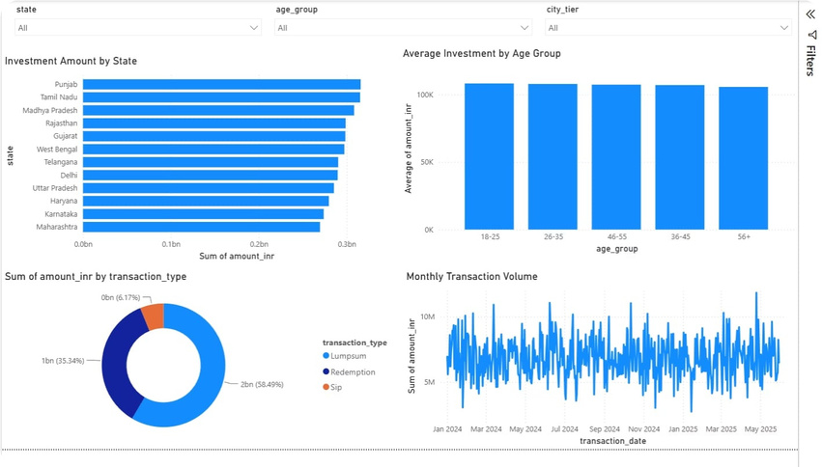
DASHBOARD & INSIGHTS
Power BI Dashboard & Key Business Insights
Four Dashboard Pages
Industry Overview — AUM, folios, SIP trends
Fund Performance — Returns, rankings, risk metrics
Investor Analytics — Demographics, cohort analysis
SIP & Market Trends — Inflows, continuity, benchmarks
Interactive slicers, drill-through navigation, and dynamic filtering enable self-service exploration for analysts and executives.
SIP Inflows
Liquid Funds
Risk-Adjusted
Record ₹31,002 Cr monthly
Dominate category inflows
Outperforms raw returns
Younger Investors
Diversification
Driving participation growth
Reduces downside risk
Notes:
10

