Slide 1
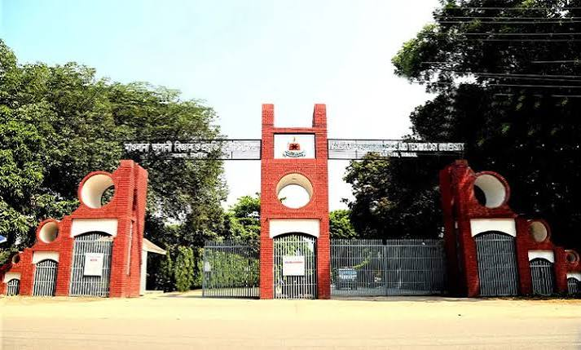

Quantum-safe security for future wireless communication networks
Presenter Name: Abdullah Al Mamun Sagor
ID: IT22059
Department of ICT, Mawlana Bhashani Science and Technology University (MBSTU), Bangladesh

Slide 2
Presentation Outline
01
Introduction and research problem
02
Related work and research gap
03
Proposed solution and methodology
04
Experiments and results
05
Conclusion
Quantum-safe 5G/6G security
02
ID: IT22059

Slide 3
Introduction and Research Problem
Shor’s algorithm on a quantum computer would break the RSA/ECC cryptography protecting 5G and 6G.
01
Radio networks are long-lived: “harvest now, decrypt later” already threatens today’s traffic and subscriber identities
02
5G still relies on classical public-key crypto (e.g., ECIES for SUCI, TLS/IPsec on core links); no post-quantum migration path yet
03
How can 5G/6G adopt post-quantum cryptography without breaking latency and device constraints?
Quantum-safe 5G/6G security
03
ID: IT22059

Slide 4
Related Work and Research Gap
Study / approach | Key idea | Relevant limitation
Shor, SIAM J. Comput., 1997 [2] | Efficient factoring and discrete logs on a quantum computer | Needs large fault-tolerant hardware; timeline uncertain
NIST FIPS 203/204/205, 2024 [1] | Standardised lattice- and hash-based KEM and signatures | Larger keys and signatures than ECC
3GPP TS 33.501 [3] | 5G security architecture with ECIES and 256-bit algorithms | Public-key parts remain classical
Research gap
No practical, crypto-agile hybrid migration path that weighs PQC overhead across 5G/6G network segments
Quantum-safe 5G/6G security
ID: IT22059
04

Slide 5
Methodology
Crypto-agile hybrid PQC migration framework for 5G/6G
01
Inventory public-key use
UE / USIM
RAN (gNB)
SUCI, N2/N3 IPsec, TLS, OTA signing
Hybrid ML-KEM + X25519 key exchange
02
Hybrid deployment
ML-DSA / SLH-DSA signatures · AES-256
Classical + PQC KEM; PQ signatures; 256-bit symmetric
5G Core (SBA)
03
Roadmap output
Per-segment overhead and migration phases
Quantum-safe 5G/6G security
05
ID: IT22059

Slide 6
Experimental Setup
Data / study setting
NIST FIPS 203/204/205 parameter sets; 5G/6G threat model
Baselines / comparisons
X25519, ECDSA P-256, RSA-2048 vs ML-KEM-768, ML-DSA-65
Evaluation metrics
Public key, ciphertext, signature size (bytes)
Implementation / protocol
Analytical comparison from published parameters
Quantum-safe 5G/6G security
06
ID: IT22059

Slide 7
Results and Discussion
Main finding
PQC key exchange adds ~2.2 KB per handshake (about 35× X25519).
Fine for core links; material for constrained radio and IoT paths.
Key-exchange bytes on the wire (public key + ciphertext), from FIPS 203 sizes.
Quantum-safe 5G/6G security
07
ID: IT22059

Slide 8
Quantitative Comparison
Method | Public key (B) | Ciphertext (B) | Security basis
X25519 (classical) | 32 | 32 | Elliptic-curve DLP
ML-KEM-768 (FIPS 203) | 1,184 | 1,088 | Module-LWE
Hybrid X25519 + ML-KEM-768 | 1,216 | 1,120 | Either assumption
The hybrid keeps classical security while adding quantum resistance for about 2.3 KB of overhead.
Quantum-safe 5G/6G security
08
ID: IT22059

Slide 9
Conclusions and Future work
5G/6G should migrate now to hybrid, crypto-agile post-quantum security.
01
Mapped PQC (ML-KEM, ML-DSA, SLH-DSA) onto 5G/6G segments with a hybrid migration framework
02
Limitation: size-based analysis; latency and energy on real devices not yet measured
03
Next: testbed evaluation on UE/gNB and 6G-specific PQ channel design
Quantum-safe 5G/6G security
09
ID: IT22059

Slide 10
Selected References
[1] NIST, “FIPS 203: Module-lattice-based key-encapsulation mechanism standard,” 2024.
[2] P. W. Shor, “Polynomial-time algorithms for prime factorization and discrete logarithms on a quantum computer,” SIAM J. Comput., 1997.
[3] 3GPP, “TS 33.501: Security architecture and procedures for 5G system.”
[4] NIST, “FIPS 204: Module-lattice-based digital signature standard,” 2024.
Quantum-safe 5G/6G security
10
ID: IT22059

Slide 11
Thank You
Questions and Discussion
Name: Abdullah Al Mamun Sagor
ID: IT22059
Dept. of ICT, Mawlana Bhashani Science and Technology University (MBSTU)
Email address : it22059@mbstu.ac.bd
Quantum-safe 5G/6G security
11
ID: IT22059

