Slide 1
It is a combination of development and organization team.
Devops
Devlopment
organisation

Slide 2
Development Operation
Developer git Deploy
jenkins
Build
maven
Testing
Quality Assurance Maintainence
Monitoring
cloud watch, aws
Chef
Docker
Ansible
Kubernetes
Puppet

Slide 3
Why was devops build?
It was build because there was no co-ordination between development & organisation team
1) Water fall Methodology
Step by step
In this we cannot sell the product to the customer unless it is completely ready i.e we cannot sell the app to the customer unless it is completely ready.
2) Agile Methodology
Here the work was divided into phases but every employee was isolated from each other

Slide 4
3) Devops
Because of all the above problems we combined development and operation team and new team was formed known as devops.
Devops is not a tool or software or framework
Devops is a successor of Agile Methodology.
It is a combination of tools which helps for automation of whole infrastructure
It is a methodology that allows a single team to manage the entire application developmet , testing, and operations

Slide 5
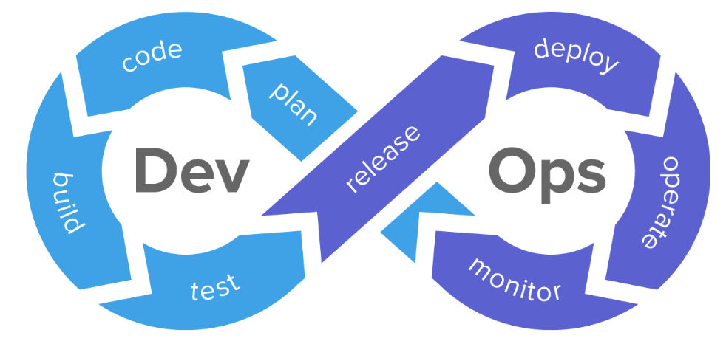

Slide 6
Bacis of AWS Cloud ( Amazon Web Service)
What is server?
Server is a device which provides you service and it gives service to many people at a single time.
Why AWS cloud is required?
If you want to startup company you will need Server, software , license , networking, routing, switch, gateway, cabling, A.c, employee, maintenance. AWS says that you don’t have to pay for all this individually instead you can take it from cloud

Slide 7
Cloud provides you with the following
Infrastructure as a service
Platform as a service
Software as a service
AWS PUBLIC CLOUD
MICROSOFT AZURE
GOOGLE CLOUD
CHINESE COMPANY ALIBABA
These are the market leaders who provide us the service

Slide 8
AWS Public cloud has
24 Region and 76 availability zone
Every region has min 2 and max 6 availability zone
(region means country where data centres are there
What is cloud?
Whatever you are accessing from internet i.e you are indirectly accessing from cloud. So if you want to use cloud it is essential to have internet.
It is a service which gives you a ability to share your resources to the remote location and you can pay according to your usage
It is a service which includes resources like server, storage, database, networking, software, analytics and intelligence. Eg Google drive

Slide 9
LINUX
1964 Bell lab New Jercy O.S which is multipurpose and multiuser
1969 Bell lab withdraw the project. Dennis Ritche & Ken Thompson made O.S called UNICS ( Uniplexed Information & Computing Service)
1975 next version i.e UNIX V6 came
Many companies made there own UNIX version
IBM-AIC, SUN Solaris, Apple mac OS, HP-UX
1991 Linus Torvald through study of MINUX he mad LINUX
Between 1991-1995
There was free software moment at the same time there was GNU moment. In GNU they set so many software's free . Linux was combined with GNU

Slide 10
Linux is basically a kernel and it was combined with GNU and then it was called Operating system
LINUX + GNU Operating System
(Kernel)
Kernel is a computer program at the core of a computers operating system and generally has complete control over everything in the system

Slide 11
Through Linux companies made different versions of linux some were free and some were paid
RED HAT ENTERPRISE
FEDORA
LINUX DEBIAN
OTHERS UBUNTU
CENT OS
AMAZON LINUX
KALI LINUX
Even Android was made from Linux the Kernel of android was Linux only

Slide 12
login as : ec2 user
l_ l_ l_
l_ l_ l_
l_ l_ l_
[ec2-user @ ip – 17214-121~] $ sudo su
[root @ io- 17214-43 ec2 user] #
User mode
Super user do
Switch user
Root user

Slide 13
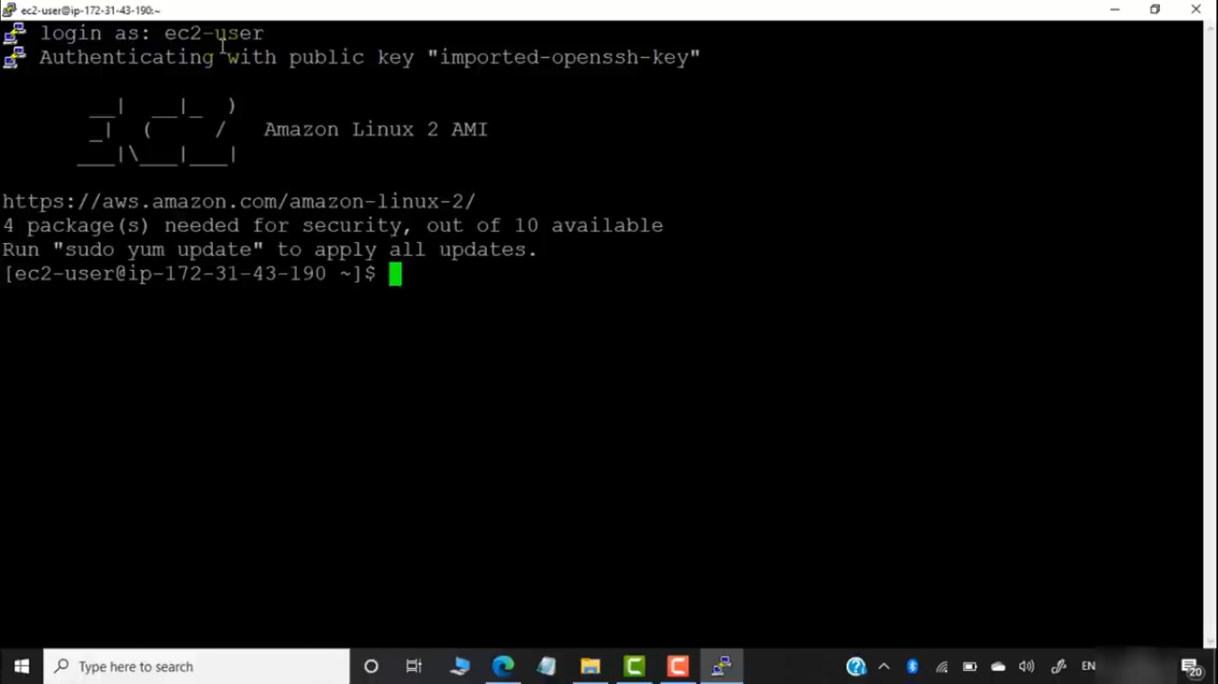

Slide 14
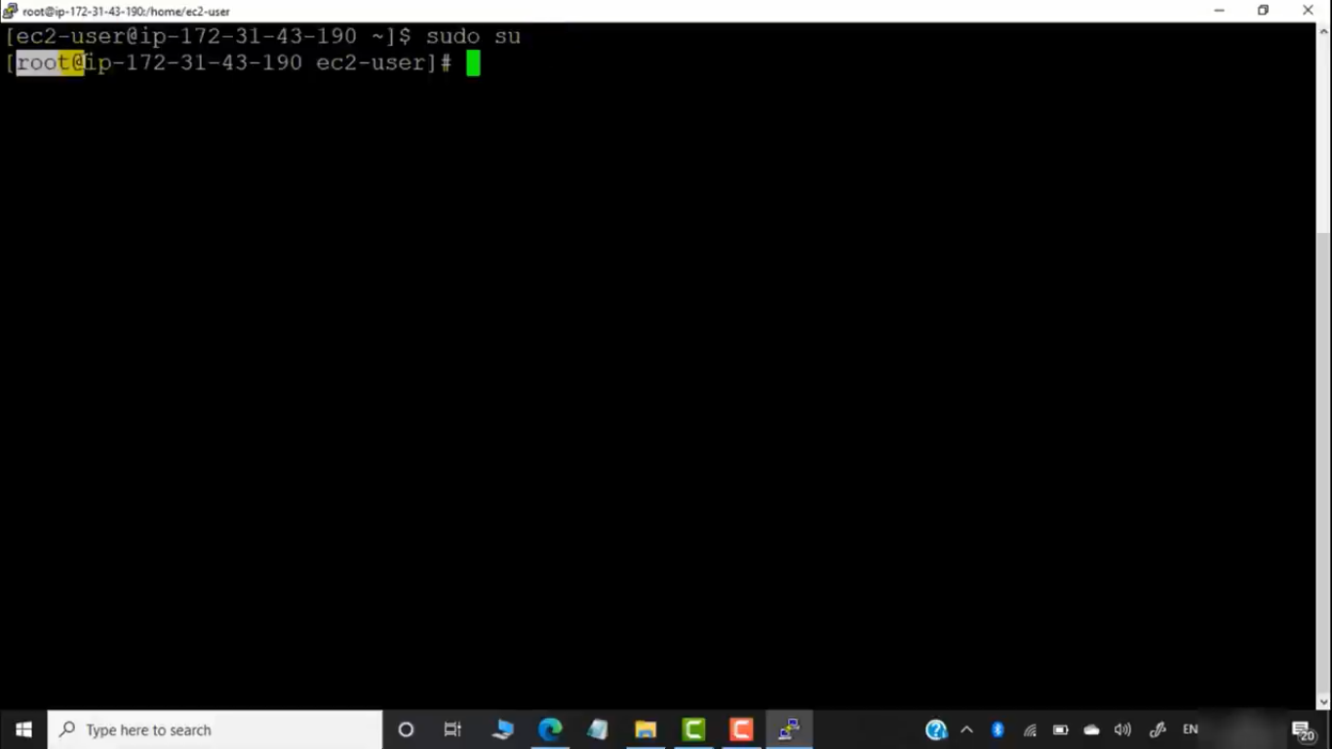

Slide 15
LINUX COMMANDS
Linux is case sensitive so write all alphabets in small letters only
To create file in Linux
cat
touch
vi/uim
nano
tac
Editor command

Slide 16
cat [concatenate file ]
To create a single file
To add more than one file into single file
To copy the content of x into y
touch
Create empty file
Create multiple empty file
Change all time stamp of a file
touch -a
Access time : last time when file was access
touch -m
Modify time: last time when file was modified

Slide 17
Practical no. 1
login as : ec2 user
[ec2-user @ ip – 17214-121~] $ sudo su
[root @ ip- 17214-43 ec2 user] # cat >file1
[root @ ip-] #

Slide 18
[root @ ip-] # cat >file1 to create a new file
hello
cntrl +d to exit from file
[root @ ip-] # ls to check the list of file created
file1
[root @ ip-] # cat file1 to check what is written in file1
hello
[root @ ip-] # cat >>file1 add content in already existing file
hi cntrl +d

Slide 19
[root @ ip-] # cat file1 to check what is written in file1
hello
hi
[root @ ip-] # cat >file2 to create a new file2
thank you cntrl +d
[root @ ip-] # ls to check the list of file created
file1 file2
[root @ ip-] # cat file1 >>file2 copy data of file 1 in file2
cat file2 to check what is written in file2
hello
hi
thank you

Slide 20
[root @ ip-] # cat file1 file 2 >all to combine content of two files & add that content in new file
[root @ ip-] # cat all to check what is written in file named all
hello
hi
thank you
Touch file1
Touch file1 file2 file3
Touch file2
Stat file2
Touch –a file3
Touch –m file4

