Slide 1

AUDIBLE - INSIGHTS in INDIA

Slide 2


OBJECTIVES
Provide an overview of the audiobook dataset in India.
Highlight key trends and audience preferences.
Identify opportunities for growth in the audiobook market.

Slide 3
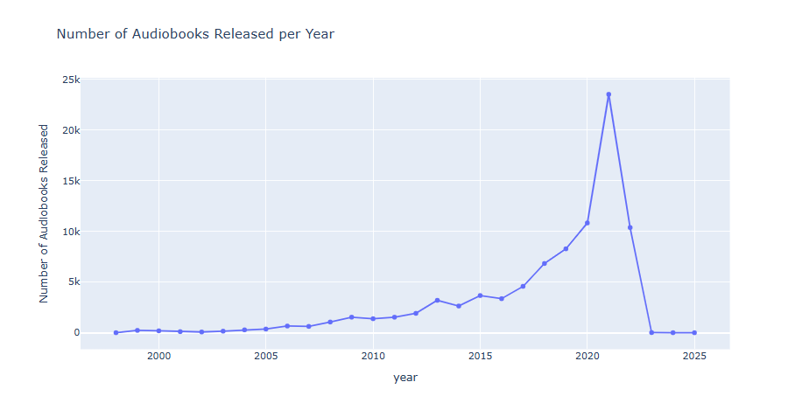
Annual Audiobook Releases

Slide 4
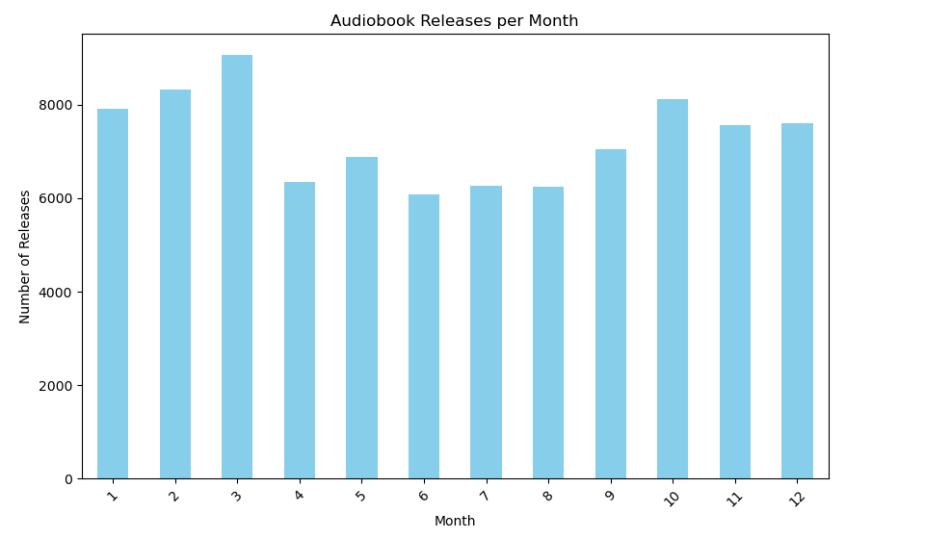

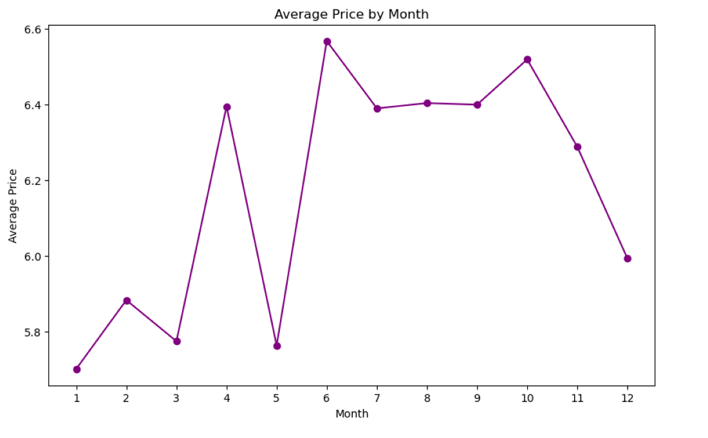
Monthly Audiobook Releases & Average Pricing
As the number of releases per month increases, the price of audiobooks tends to decrease. This observation suggests that during months with a higher volume of audiobook releases, there is greater competition in the market, leading to more competitive pricing strategies.

Slide 5
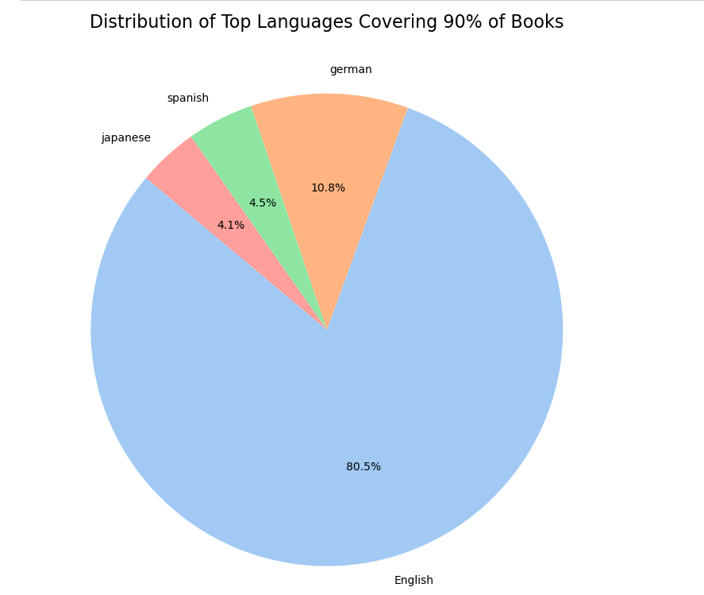

Slide 6
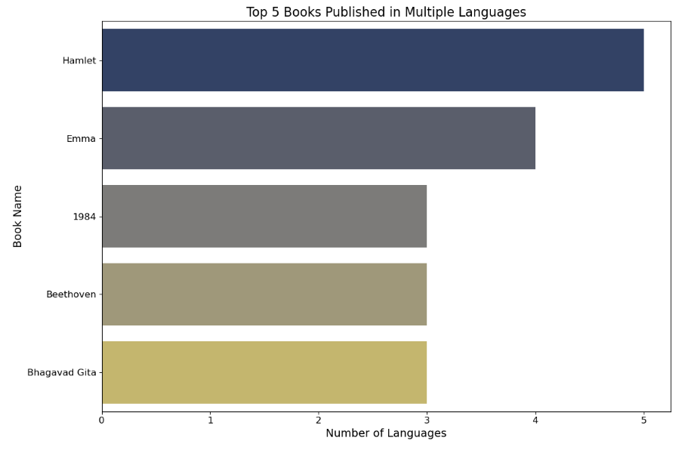
Top 5 Audiobooks Published in Multiple Languages
z

Slide 7
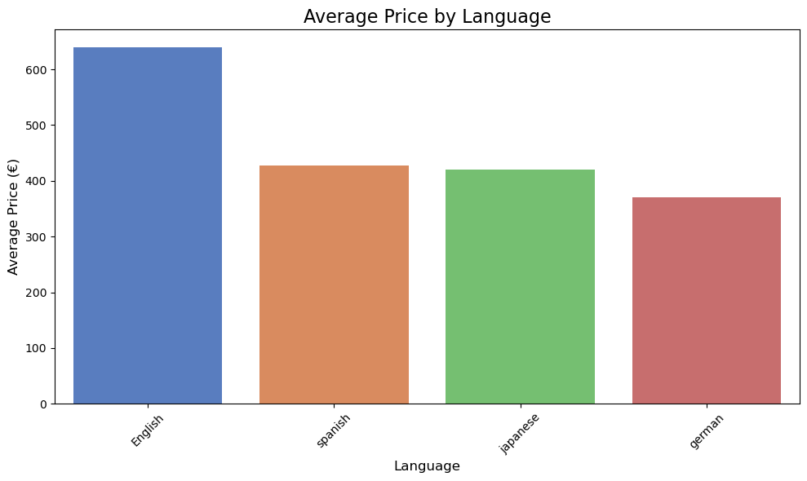

Slide 8
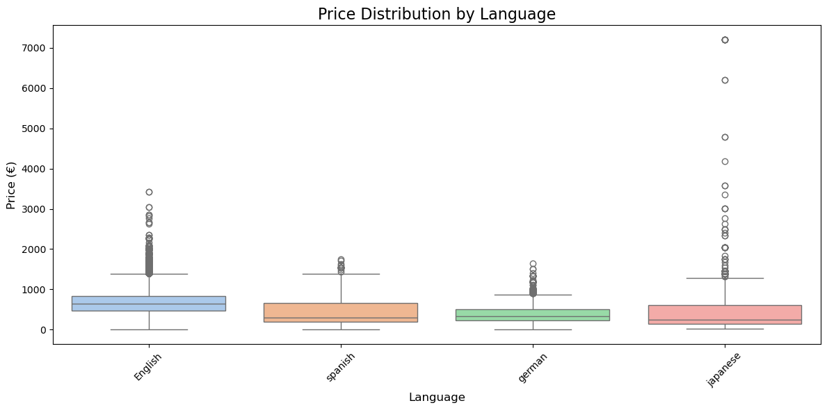

Slide 9
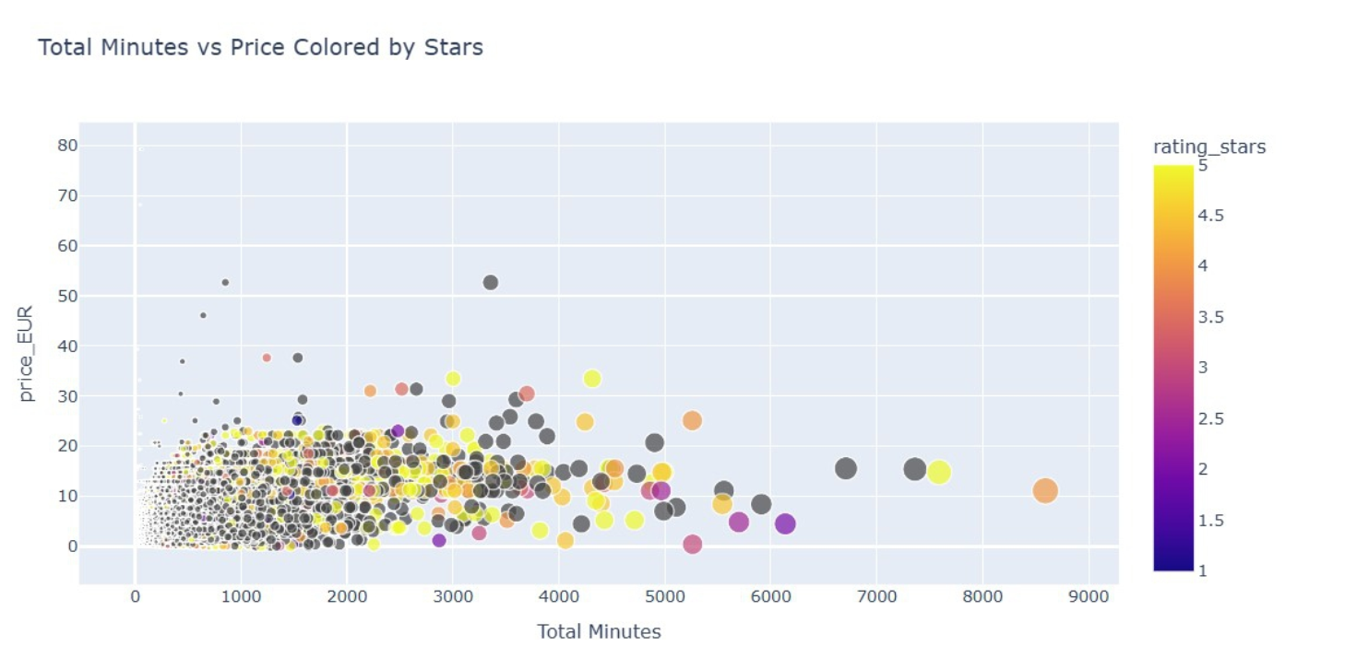
Price vs Duration by Rating

Slide 10

Conclusions
The Indian audiobooks market has seen tremendous growth over the past 15 years, driven by technological advancements, increased smartphone penetration, and growing digital literacy
Especially during the COVID-19 pandemic, the audiobooks market in India experienced significant growth
During months with fewer releases, audiobooks are priced higher, as there is less competition, allowing sellers to set premium price and vice versa
English is the king of audio languages distribution in the Audible Platform and the most expensive one whereas Indian languages are not widely used
Hamlet by William Shakespeare is published in most languages
Shorter, affordable audiobooks dominate the market. However, audiobooks with higher total minutes can command higher prices
The Indian audiobooks market seems to transitioning from niche to mainstream

Slide 11

Thank you Zarmakoupis Konstantinos Pantis Giannis Sagropoulos Konstantinos source: https://www.kaggle.com/datasets/snehangsude/audible-dataset
z

