Slide 1

School of Computing Science and Engineering
School Of Computing Science And Engineering
B. Tech CSE
2022-23
Semester 6 (Winter Batch)
Project IV
Title: IoT task scheduling in fog computing systems (OPTIMISED)
Team Member’s Details BT3192
S. No. | Participant Name | Mobile NO. | Mail ID
1 | Manish Kumar | 7827043684 | sahmanish10987@gmail.com
2 | Tarun Kumar | 8076831042 | Tarun.20scse1010846@galgotiasuniversity.edu.in
3 | Anirudh Kumar | 8125758436 | Anirudh.20scse1010801@galgotioasuniversity.edu.in
Faculty (College) Mentor’s Details
S. No. | Mentor Name | Mobile NO. | Mail ID
1 | Dr. Krishna K. Agrawal | 7398032912 | krishna.agrawal@galgotiasuniversity.edu.in
Project IV B. Tech CSE Sem 6

Slide 2
School of Computing Science and Engineering
1. Introduction
Problem: Need of real-time response and low latency
Solution: Become a viable platform for processing emerging IoT applications
Benefit of Fog Computing : Highly distributed, Dynamic and Resource-constrained
Challenge: Deploying fog computing resources effectively for executing heterogeneous/homogenous and delay sensitive IoT tasks is a fundamental challenge.
Project IV B. Tech CSE Sem 6

Slide 3
School of Computing Science and Engineering
2. Related Work
2.1 Delay aware algorithm – Due to the importance of the response time for IoT application requests, many researchers have considered this aspect in their optimization goals
2.2 Energy efficient algorithm – Energy efficiency is one of the major concerns in IoT ecosystem. Therefore, minimizing energy consumption of the FNs is considered to be one of the objectives in recent studies.
2.3 Joint delay-aware and energy efficient algorithm – Considering both of the delay requirement of IoT tasks and the energy consumption of FNs has become an active research area nowadays.
Project IV B. Tech CSE Sem 6

Slide 4
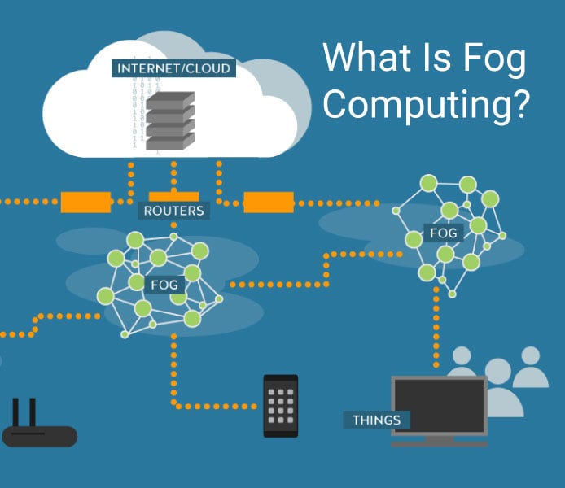
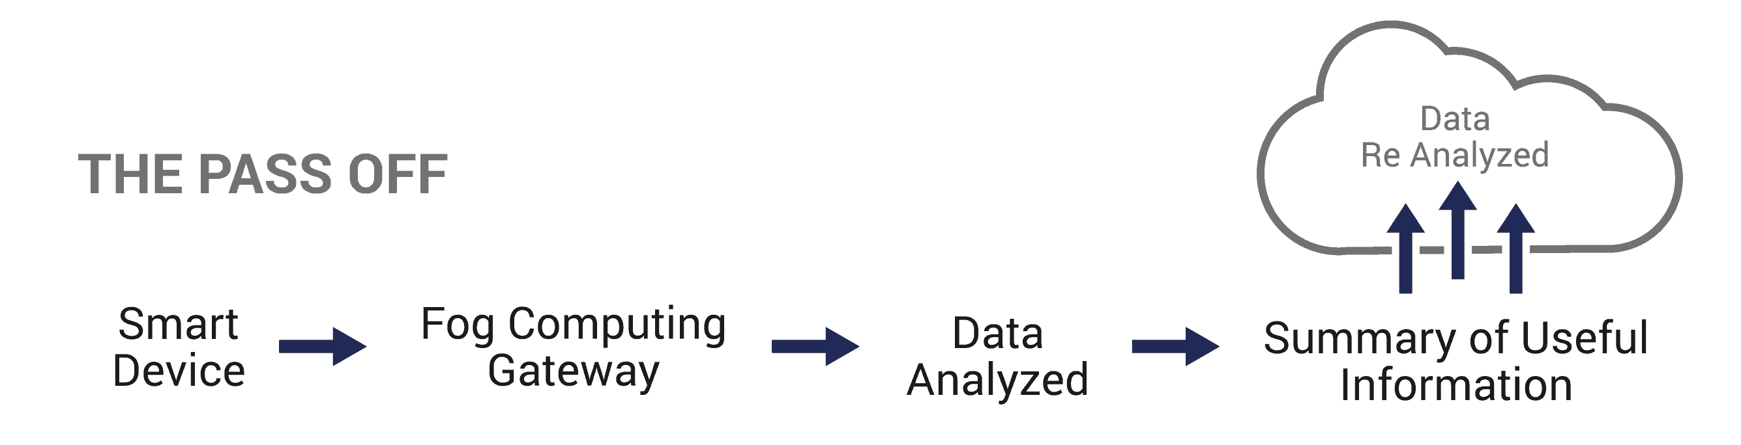
School of Computing Science and Engineering
3. System Model
The high-level System Architecture of the IoT-fog – cloud environment, which consists of four parts, namely IoT devices, gateways, fog environment and cloud environment.
Fig 1: The Proposed System Architecture
Project IV B. Tech CSE Sem 6

Slide 5
School of Computing Science and Engineering
4. Problem Formulation
First, the basic elements and decision variables of the optimization problem are introduced.
Then, the response time and energy models are described. Finally, the problem overview is given.
Basic elements : Fog nodes and submitted tasks from IoT devices are the key elements of our model.
Fog Nodes: A fog network consists of several interconnected FNs which form a mesh topology.
Decision variables
Response time
Energy Consumption
Project IV B. Tech CSE Sem 6

Slide 6
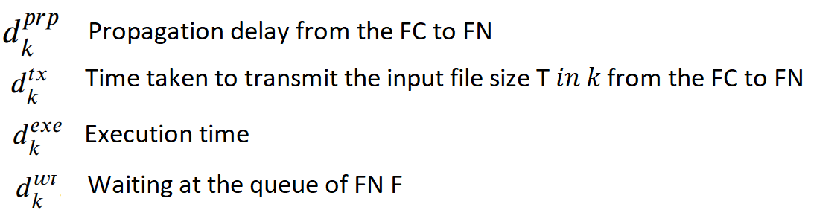
School of Computing Science and Engineering
4.1 PSG Algorithm
Step 1: Sorting tasks in non-descending order of their predefined deadline.
Step 2: Response time of a given task on all available FNs is computed using Eq
Based on the result, the FNs are divided into two groups: DSList and USList.
DSList : List of deadline satisfied fog nodes that meet the deadline of the task
USList : List of FNs that do not satisfy the requested deadline of the task
Project IV B. Tech CSE Sem 6

Slide 7
School of Computing Science and Engineering
4.1 PSG Algorithm
Step 3: Assignment of FN to Tasks: For each FN in DSList:
Energy consumption of the system is estimated by mapping of the given task to that FN.
Restricted candidate list (RCL) is created by the best FNs, i.e., those whose provide the least increase of energy consumption to the system.
FN is randomly chosen from RCL and the task is assigned to that.
Step 4: If the DSList is empty, i.e., none of the FNs can meet the task deadline, the task is mapped to the FNs in the USList with the minimum deadline violation time.
If DSList is not empty
Algorithm calls SEMI-GREEDY strategy
Otherwise:
It calls MIN-VIOL strategy
Project IV B. Tech CSE Sem 6

Slide 8
School of Computing Science and Engineering
5. Performance Evaluation
Parameter: Performance of the proposed task scheduling approaches with respect to the percentage of IoT tasks
Compared with existing algorithms, the experiment results confirm that the proposed algorithms improve
Deadline Requirement: Percentage of tasks meeting their deadline requirement up to 1.35x
Deadline Violation Time: Decrease up to 97.6% compared to the second-best results
Energy consumption of fog resources : Optimized
Makespan of the system : Optimized
Project IV B. Tech CSE Sem 6

Slide 9
School of Computing Science and Engineering
6. Performance Analysis with Existing Algos
(1) First Come First Serve (FCFS) : Simple task scheduling algorithm which aims to balance the load among the computing nodes of the environment. In the FCFS policy, the first IoT task that arrives at the FC is the first task to be scheduled. For each task, a FN is randomly selected to process the task.
(2) Earliest Deadline First (EDF): EDF is a delay-aware scheduling algorithm where it gives higher priority to tasks with the lower deadline. Similar to FCFS, the FN selection phase is based on the random strategy.
(3) Greedy for Energy (GfE) : Similar to the FCFS, except node selection phase is different. GfE assigns each task to the FN that offers the most energy-saving for the system.
(4) Detour : This scheme includes three aspects:
(a) local decision-making process
(b) optimal FN selection
(c) optimal path selection
Project IV B. Tech CSE Sem 6

Slide 10
School of Computing Science and Engineering
7. Conclusion and Future Work
Conclusion:
Studied the scheduling of IoT tasks in a heterogeneous fog network
Optimizes the total energy consumption of the system while meeting the deadline of the tasks.
If the deadline of a given task is not met:
Allocation of task to a fog node with minimum violation of deadline
To achieve these goals, two efficient priority aware semi-greedy algorithms are proposed
Results : Proposed algorithms significantly outperform existing algorithms:
Percentage of IoT tasks that meet their deadline requirement
Total energy consumption and makespan of the system
Total amount of the deadline violation time.
Future work:
To plan to improve the proposed algorithms to schedule the dependent IoT tasks.
To evaluate the performance of the proposed algorithms under different real-world datasets.
Project IV B. Tech CSE Sem 6

Slide 11
School of Computing Science and Engineering
8. References and Bibliography
https://www.sciencedirect.com/science/article/abs/pii/S1084804522000029
https://slogix.in/fog-computing/deadline-aware-and-energy-efficient-iot-task-scheduling-in-fog-computing-systems-a-semi-greedy-approach/
https://ieeexplore.ieee.org/document/8863944 (https://doi.org/10.1109/JIOT.2019.2946426)
Project IV B. Tech CSE Sem 6

