Slide 1
Smart Result Analysis
Result PDF to Excel Converter
BY
Roshan bhattad (32411)
Saharsh burse (32417)
Project Guide
Prof. Sandeep Dhende

Slide 2
ABSTRACT
The main focus of problem was that previously the college faculty had to
create the excel sheet manually from the pdf data.
it was time consuming and often prone to human typing error such error could lead to wrong analysis of student performance data.
The main Objective of this project is efficiently converting pdf data to excel file automatically and with error free data.

Slide 3
CONTENT
INTRODUCTION
OBJECTIVE
SOFTWARE REQUIREMENT
PROGRAM INPUT & OUTPUT
FLOWCHART
LIBRARY,CLASS & FUNCTIONS USED
CONCLUSION

Slide 4
iNTRODUCTION
Smart result analyzer software converts pdf formatted pdf to smartly organized Excel sheet so that the college department can easily analyze the data according to their need. it is specially designed for SPPU Engineering results provided by the university.

Slide 5
objectives
Convert SPPU result pdf to excel sheet
Create Congratulation Sheet for Toopers List and Overall Class Result using data from created excel file.

Slide 6
SOFTWARE REQUIREMENT
Java JDK 1.8 Or Higher
JAVA library
Pdfbox
Apache Poi
Java Regex
Java FX

Slide 7
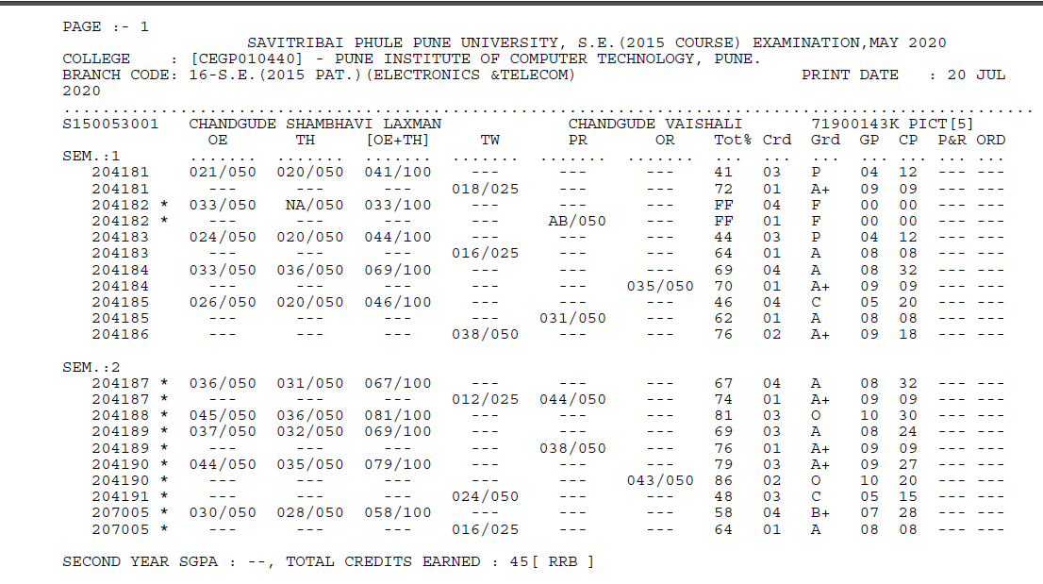
sppu result pdf format

Slide 8
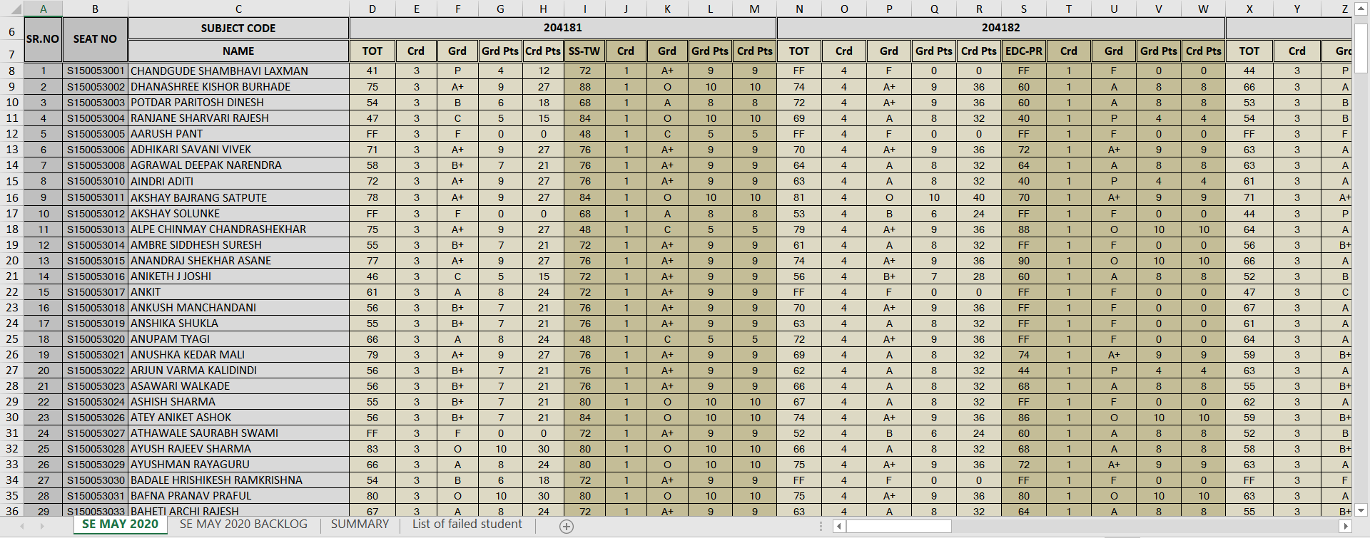
Required output

Slide 9
Flow of Code
START
Run Code
GUI Display
User Selects
Year , sem & PDF file
Main Fun runs with selected parameters
Pdf file loaded in code
Extract subject marks & write into excel
Extract Student Seat no. & Name & write into excel sheet
Text is pdf is scanned to study result pattern
Initialization of Excel sheet
Calculate sgpa using values in excel
Find sgpa from Pdf file
Extract Earned credits and final result
Write the excel sheet created into excel file

Slide 10
JAVA FX GUI (Graphical User Interface)
JavaFX is an open source, next generation client application platform for desktop, mobile and embedded systems built on Java.
JavaFX is intended to replace swing in Java applications as a GUI framework.
FXML is the XML based Declarative mark up language. The coding can be done in FXML to provide the more enhanced GUI to the user.
In this project we will use frame(scene),radio buttons, Labels(text),and buttons.

Slide 11
Java apache pdfbox
Apache PDFBox is an open-source Java library that supports the development and conversion of PDF documents.
PDFBox is used to develop Java programs that can create, convert, and manipulate PDF documents.
Properties used in this project:-
Extract Text − Using PDFBox, you can extract Unicode text from PDF files.
Split & Merge − Using PDFBox, you can divide a single PDF file into multiple files.
Pattern & Matcher-Using PDFBox, you can search a particular text or pattern through text.

Slide 12
Java apache poi
Apache POI is a popular API that allows programmers to create, modify, and display MS Office files using Java programs. It is an open source library developed and distributed by Apache Software Foundation to design or modify Microsoft Office files using Java program.
XSSFWorkbook − This class has methods to read and write Microsoft Excel and OpenOffice xml files in .xls or .xlsx format.

Slide 13
Some Functions Used
createSheet():-Creates an XSSFSheet for this workbook, adds it to the sheets, and returns the high level representation. createCellStyle():-Creates a new XSSFCellStyle and adds it to the workbook's style table. createCell(int columnIndex):- Creates new cells within the row and returns it. AutoSizeColumn(int column):-Adjusts the column width to fit the contents. AddMergedRegion(CellRangeAddress region):-Adds a merged region of cells (hence those cells form one).

Slide 14
conclusion
We have converted pdf Result file to excel sheet
We have created Congratulation Sheet

