Slide 1




ENERGY CONSUMPTION TREND ANALYSIS WITH POWER BI
NAME : SAHANA S M
EMAIL ID : eng22ds0015@gmail.com
AICTE Student ID: STU670e7ace809971729002190 AICTE Internship ID: INTERNSHIP_173070615967287aef12823

Slide 2
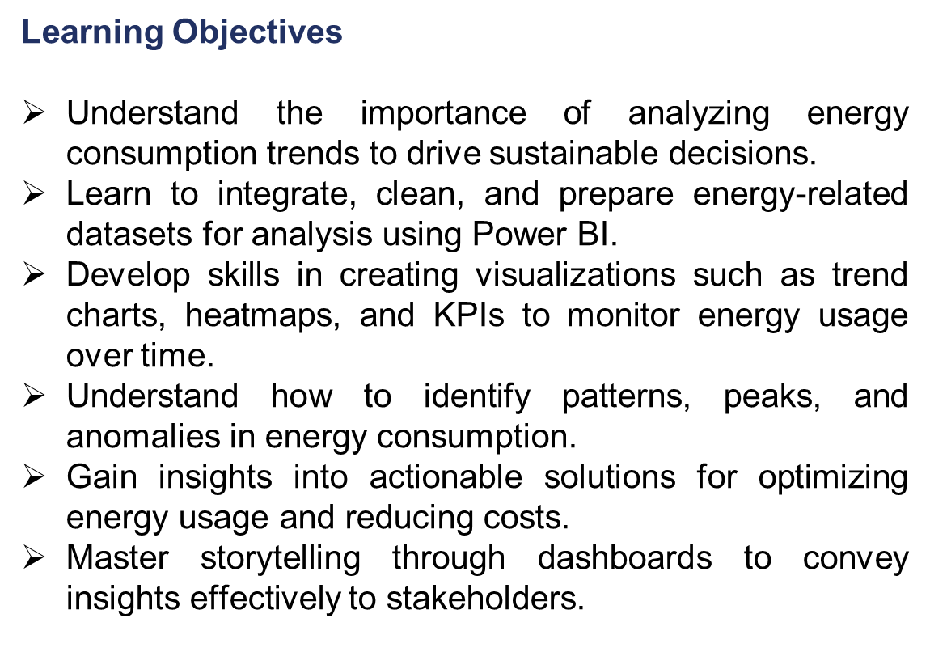

GOAL
Source :
www.freepik.com/

Slide 3
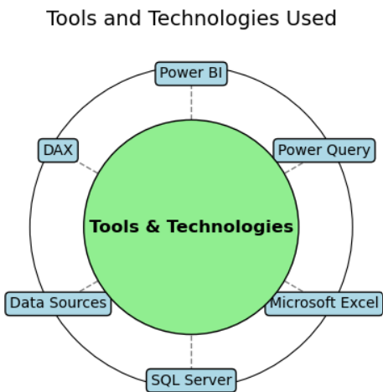
Tools and Technology used
Power BI: For creating interactive dashboards and visualizations.
Power Query: For data cleaning, transformation, and modeling.
Microsoft Excel: For preliminary data preparation or integration with Power BI.
SQL Server (optional): For querying and extracting energy consumption data.
Data Sources: Energy consumption reports (CSV, Excel, or database).
DAX (Data Analysis Expressions): For creating custom measures and calculated columns in Power BI.

Slide 4
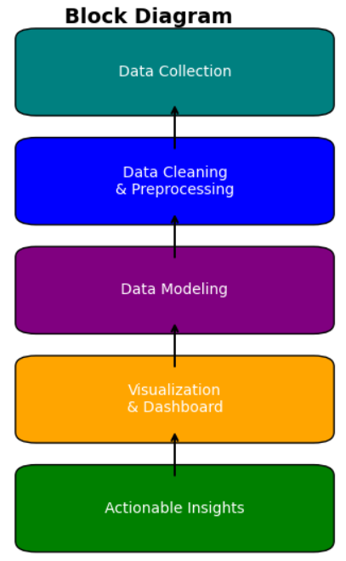
Methodology
Data Collection
Obtain energy consumption data from relevant sources
Use formats like CSV, Excel, or SQL database tables for initial exploration.
Data Cleaning and Preprocessing
Handle missing or inconsistent data using Power Query.
Normalize time-series data (hourly, daily, monthly) for uniform analysis.
Define relevant dimensions (time, location, energy type) and measures (kWh, cost, CO2 emissions).
Data Modeling
Create relationships between tables for an efficient data model.
Use DAX for advanced calculations, such as total consumption, average usage, or percentage increases.

Slide 5

Methodology
4.Visualization and Dashboard Design
Build key visualizations:
Line charts for trend analysis.
Bar charts for location-wise or type-wise consumption comparison.
KPIs to monitor metrics like total consumption, peak usage, or savings.
Heatmaps to identify high-consumption periods.
5.Analysis and Insights
Identify patterns in energy usage (e.g., peak hours, seasonal spikes).
Detect anomalies or inefficiencies in energy usage.
Highlight areas for cost savings or emission reduction.
6.Dashboard Deployment
Publish the dashboard using Power BI Service for sharing with stakeholders

Slide 6
Problem Statement:
Limited insights into energy usage by region, time, and type.
No forecasting of future energy consumption for better planning.
Lack of real-time data for monitoring inefficiencies and spikes.
High energy costs and the need for optimization.
Environmental goals that require better energy efficiency tracking.
Objective is to create an interactive Power BI dashboard that provides real-time monitoring, predictive analytics, and detailed insights into energy consumption, enabling businesses to reduce costs, improve efficiency, and meet sustainability targets.

Slide 7
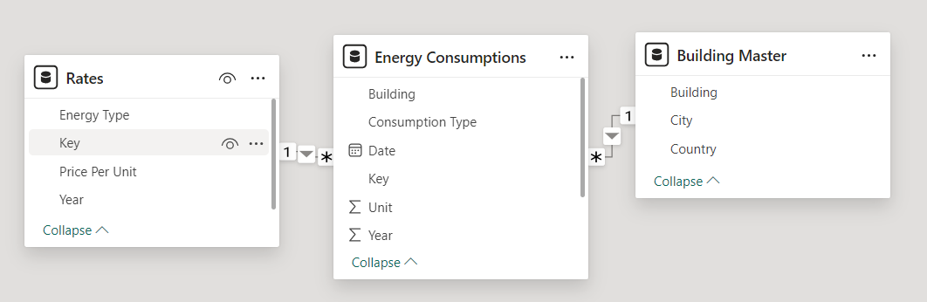
Solution:
Develop an interactive Power BI dashboard to visualize energy consumption trends over time.
Provide granular insights into energy usage patterns by region, time, and energy type.
Use predictive analytics to forecast future energy consumption and identify potential savings.
Integrate real-time data (if available) to monitor current energy usage.
Offer actionable recommendations for reducing energy costs and improving energy efficiency.
Combine Building Master, Energy Consumption, and Rates tables.
Establish relationships for seamless analysis

Slide 8
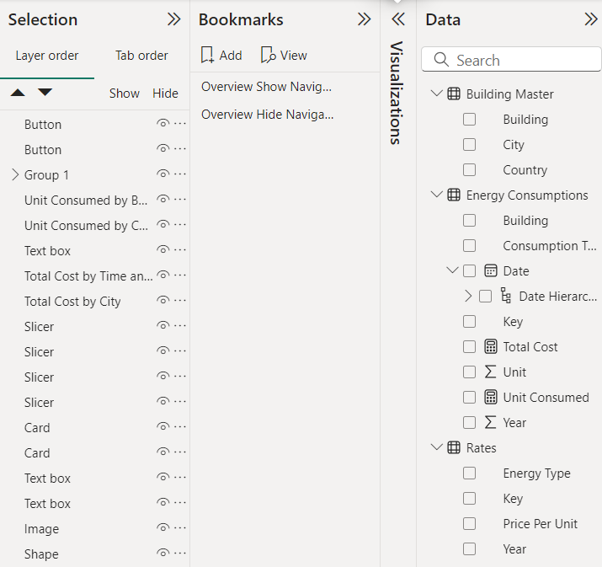
Solution:
Display the Key Metrics Cards
Energy Consumption Dashboard:
Visualize water, electricity, and gas consumption trends.
Adding slicers to filter by building, year, and energy type.

Slide 9
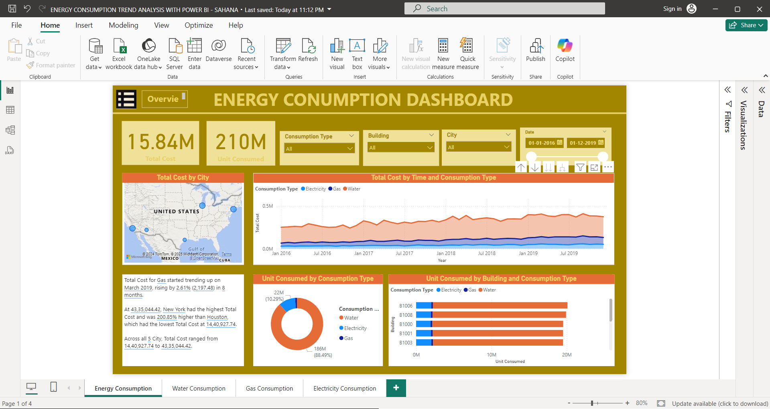

Slide 10
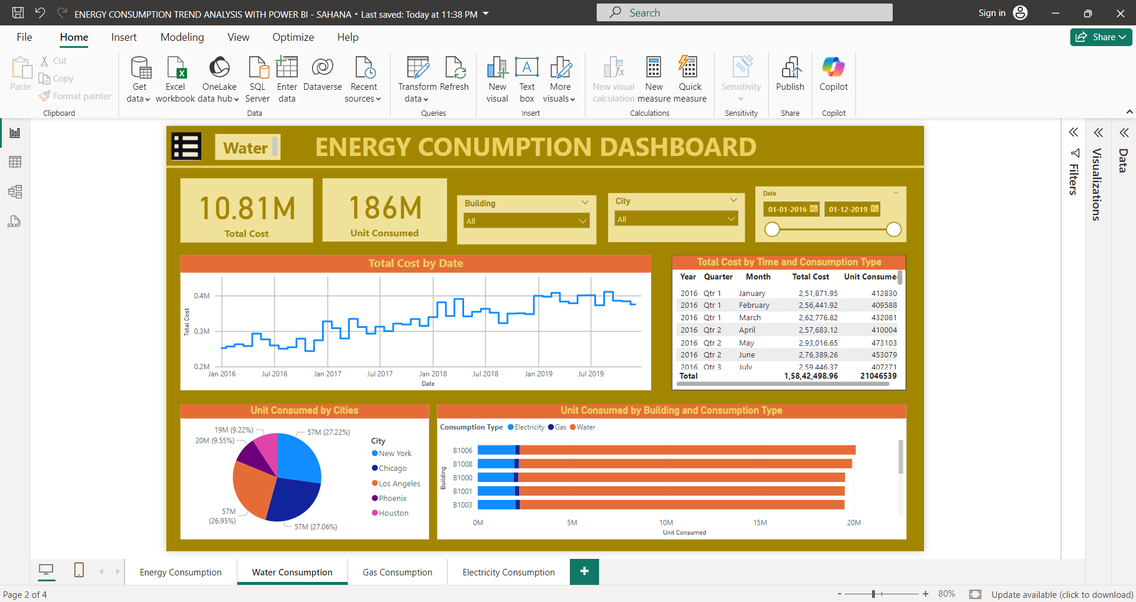

Slide 11
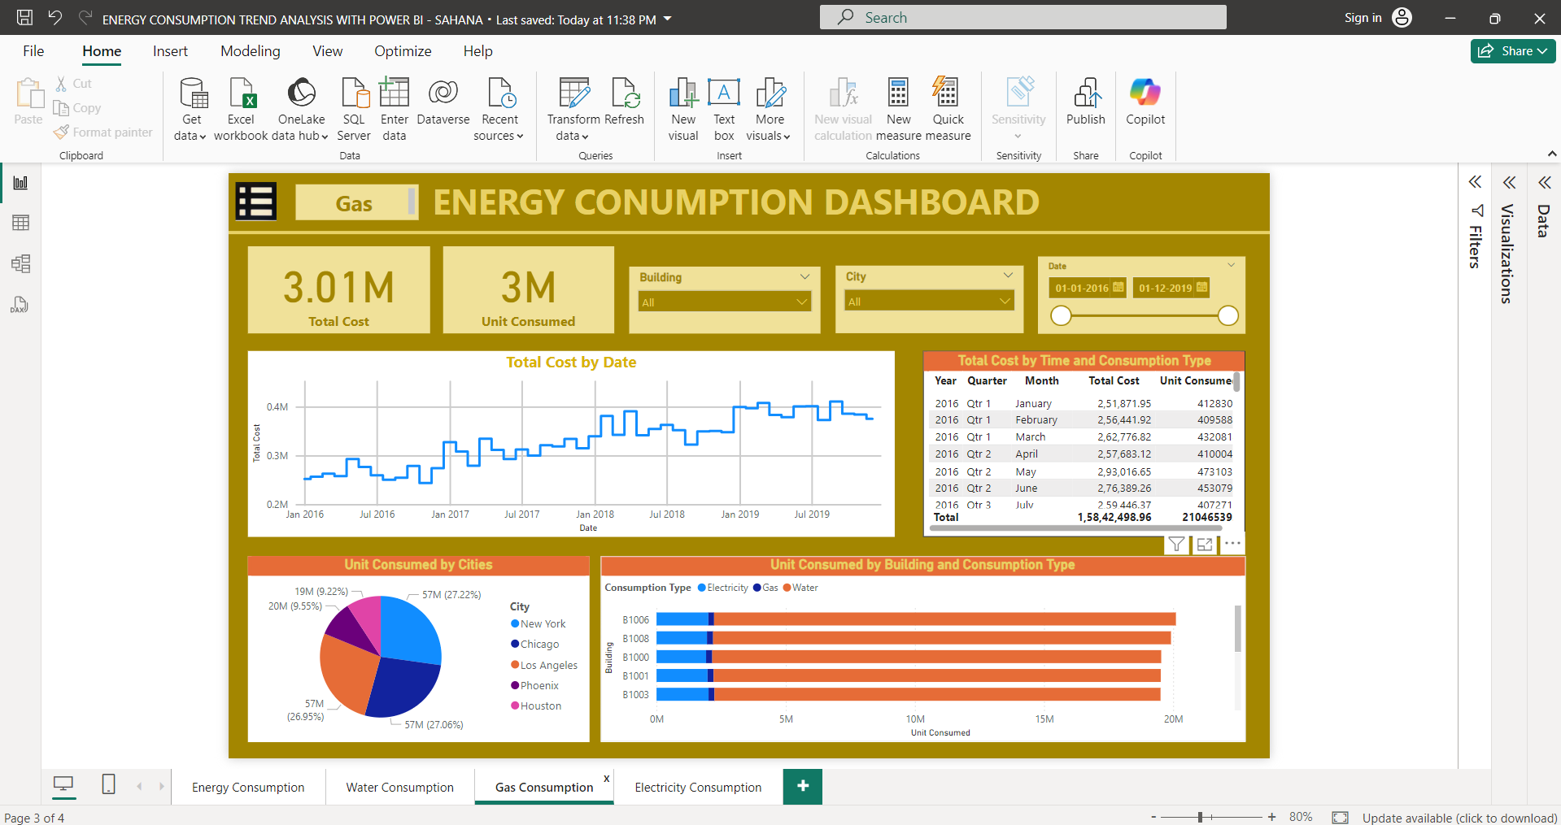

Slide 12
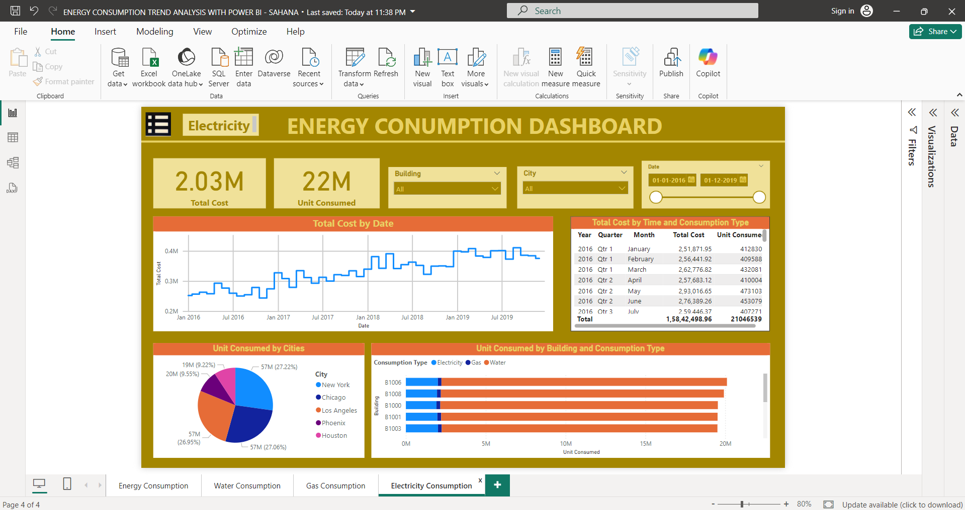

Slide 13
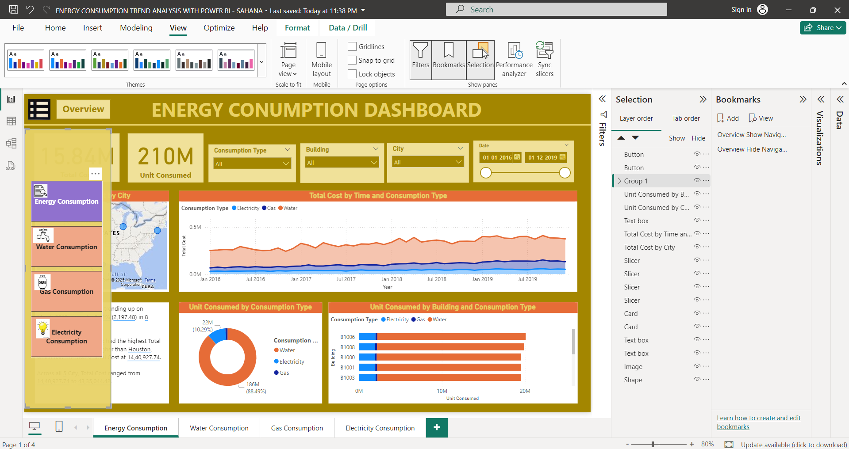

Slide 14
Conclusion:
The Energy Consumption Dashboard enables stakeholders to monitor, analyze, and optimize energy usage effectively.
By leveraging visual insights, organizations can make data-driven decisions to reduce energy costs and contribute to sustainability goals.
This project demonstrates the power of Power BI as a tool for transforming raw energy data into actionable business intelligence.

