Slide 1
NAAN MUDHALVAN (6TH SEMESTER)
GENERATIVE AI (GenAI)
ADVANCING DIABETIC RETINOPATHY (DR) DETECTION
A Deep Learning Approach to detect the Diabetes Retinopathy
using EfficientNet B3 Architecture
Priyasahaana M.
2021503037

Slide 2
AGENDA
Problem Statement
Proposed System/Solution
System Development Approach
Algorithm and Deployment
Who are the End Users?
Wow in the Solution (Novelty Added)
Result
Conclusion

Slide 3
PROBLEM STATEMENT
Diabetic Retinopathy (DR) is the leading cause of global blindness in diabetic individuals, necessitating timely and accurate diagnosis for effective treatment.
Manual diagnosis is slow, labor-intensive, and prone to errors due to subjective biases.
There's a need for AI-driven image analysis to enhance early detection and management, leveraging advancements in Deep Learning and Artificial Intelligence to improve patient outcomes in the fight against DR.

Slide 4
PROPOSED SYSTEM/SOLUTION
Model Development: Utilized EfficientNetB3 architecture with additional dense layers for classification.
Training and Evaluation: Trained the model over 50 epochs, monitoring accuracy and loss. Evaluated on training, validation, and test datasets, generating confusion matrix and classification report.
Model Persistence: Saved the trained model for future use or deployment.

Slide 5
SYSTEM DEVELOPMENT APPROACH
Hardware Requirements Analysis: Assess hardware needs based on the computational demands of the chosen deep learning model and dataset size. Consider factors such as GPU availability, memory requirements, and processing power to ensure efficient model training and inference.
Software Environment Setup: Set up the software environment including installing necessary libraries, frameworks (e.g., TensorFlow, Keras), and tools for deep learning development. Ensure compatibility with the selected hardware infrastructure and operating system.

Slide 6
SYSTEM DEVELOPMENT APPROACH
Data Processing and Model Development: Preprocess data using software tools for cleaning, exploration, and transformation. Develop the deep learning model using software frameworks, leveraging hardware acceleration (e.g., GPU) for faster training.
Performance Optimization and Monitoring: Optimize model performance through software techniques such as hyperparameter tuning, regularization, and model architecture adjustments. Monitor hardware resources and software processes during training to optimize efficiency and troubleshoot any issues.

Slide 7
ALGORITHM & DEPLOYMENT
Data Preparation:
Collect the dataset containing images of retinas categorized into different classes of diabetic retinopathy severity.
Split the dataset into training, validation, and testing sets.
Data Augmentation and Preprocessing:
Implement data augmentation techniques such as rotation, zoom, and flip to increase the diversity of the training dataset.
Preprocess the images by resizing them to a uniform size and normalizing pixel values.
Model Architecture Selection and Development:
Choose the EfficientNetB3 architecture as the base model for feature extraction.
Add additional layers on top of the base model for classification.
Compile the model with appropriate optimizer, loss function, and evaluation metrics.

Slide 8
ALGORITHM & DEPLOYMENT
Model Training and Evaluation:
Train the model on the training dataset while monitoring its performance on the validation set.
Evaluate the trained model on both the validation and test datasets to assess its generalization performance.
Model Deployment:
Save the trained model to disk for future use or deployment.
Integrate the model into a deployment environment, ensuring compatibility with hardware and software dependencies.
Test the deployed model to ensure proper functioning and performance in the production environment.
Monitoring and Maintenance:
Implement monitoring systems to track the deployed model's performance and detect any issues.
Schedule regular maintenance to update the model, address any drift in data distribution, and improve performance over time.

Slide 9
WHO ARE THE END USERS ?
Diabetic Patients – The diabetic patients can use this model’s output to check their severity level for further treatement (if needed).
Medical Professionals – Doctors and other medical professionals can use this model to check the severity of Diabetic Retinopathy in patients for further assistance.

Slide 10
WOW IN THE SOLUTION (NOVELTY ADDED):
EfficientNetB3: Utilizing the cutting-edge EfficientNetB3 architecture for efficient yet powerful feature extraction.
Comprehensive Metrics: Providing detailed evaluation metrics like classification report for a deeper understanding of model performance.
Advanced Regularization: Incorporating advanced regularization techniques such as dropout and batch normalization for improved model robustness and generalization.

Slide 11
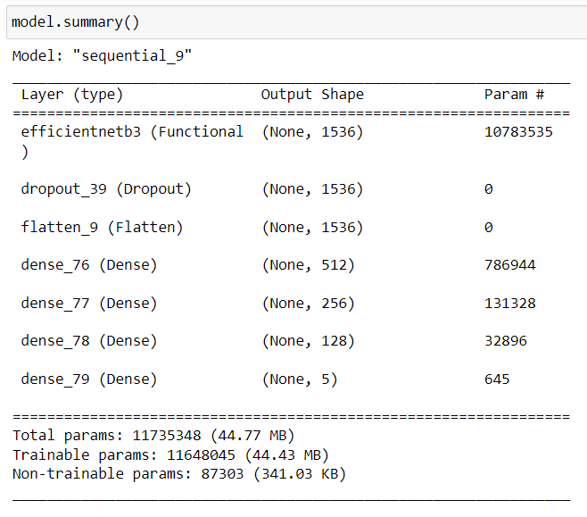
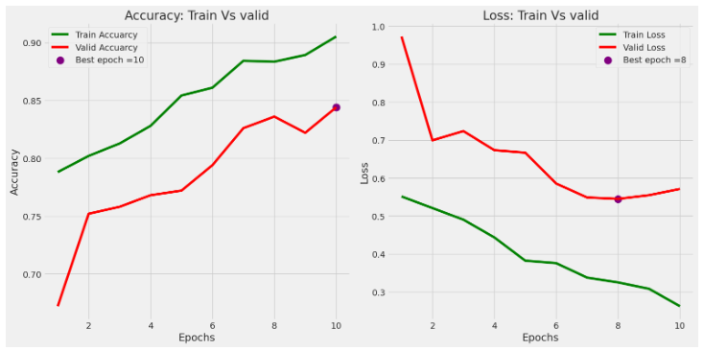
RESULT

Slide 12
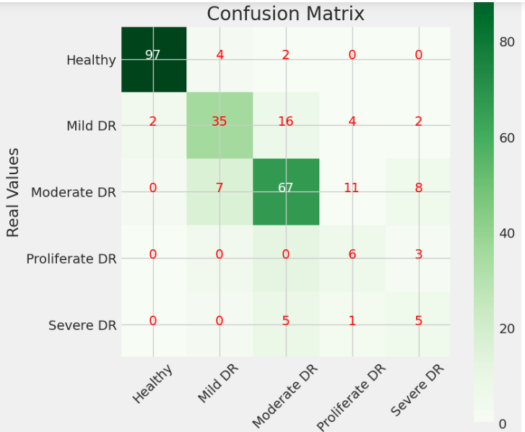
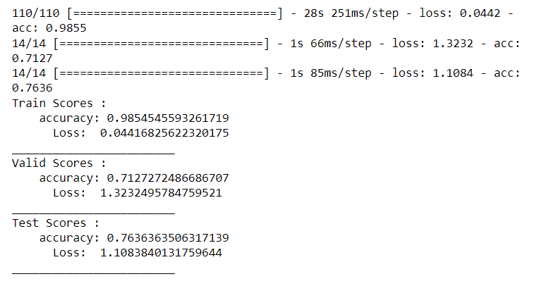
RESULT

Slide 13
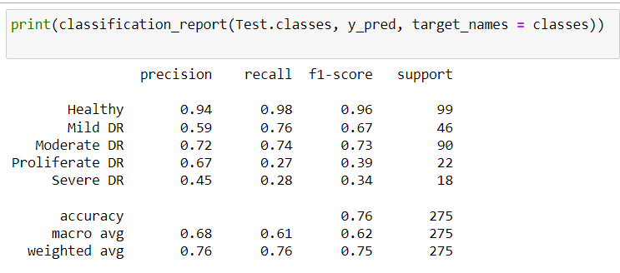
RESULT

Slide 14
CONCLUSION
Effective Classification: The developed deep learning model effectively classifies diabetic retinopathy severity from retinal images, achieving satisfactory accuracy and loss metrics on both training and validation datasets.
Robust Generalization: Through rigorous training and evaluation, the model demonstrates robust generalization capabilities, showing promising performance on unseen validation and test datasets.
Deployment Readiness: With the trained model saved for future use, the project concludes with a deployable solution ready for integration into real-world applications, facilitating automated diabetic retinopathy severity assessment.

Slide 15
REFERENCES
https://www.tensorflow.org/
https://keras.io/
https://numpy.org/
https://www.tensorflow.org/api_docs/python/tf/keras/applications/EfficientNetB3
scikit-learn: Machine Learning in Python --- scikit.learn 1.4.1 Documentation

Slide 16
THANK YOU

