Slide 1


K.RAMAKRISHNAN COLLEGE OF TECHNOLOGY (AUTONOMOUS), TRICHY.
DEPARTMENT OF COMPUTER SCIENCE AND ENGINEERING
20CS5501 DESIGN PROJECT-1
Batch No. : 3 Date : 07.12.2024
1

Slide 2













FACE RECOGNITION BASED ATTENDANCE MONITORING SYSTEM
Guided by
Ms. Sowmiya V, M.E.,
Team Members
Sahaana S (811722104127)
Sharvini S (811722104145) Sridarseni K P (811722104152)
1

Slide 3
OBJECTIVE OF THE PROJECT
To develop a face recognition-based attendance system that addresses the limitations of existing methods by improving accuracy, especially in scenarios involving sophisticated disguises or alterations.
Evaluate and Compare Techniques: Analyze the performance of various existing face recognition techniques to identify the most effective method for reliable recognition and authentication.
Optimize Training Requirements: Minimize the number of facial images required for training the model, thereby enhancing efficiency while maintaining high accuracy and reliability in real- world applications.
Enhance Accuracy: Improve recognition performance, particularly under challenging conditions, to ensure dependable attendance tracking and authentication.

Slide 4

ABSTRACT
The "Face Recognition-Based Attendance System" is a smart and efficient solution to automate attendance tracking in academic and professional environments. This project leverages advancements in facial recognition technology to address common challenges, including accuracy and usability. While traditional systems require extensive training data, this system seeks to minimize training samples without compromising reliability. The proposed system incorporates Haar Cascades for robust face detection and Local Binary Patterns Histogram (LBPH) or deep learning models for accurate face recognition. Real- time image processing, including grayscale conversion and face cropping, ensures efficient data handling. The system is built with a user-friendly interface using Tkinter, which facilitates interaction and visualization. A combination of CSV file management and image storage ensures secure and systematic record-keeping, while a real-time clock enables accurate time-stamping for attendance logging. This innovative approach not only enhances recognition accuracy but also improves scalability and efficiency, making it a viable solution for modern attendance management systems.

Slide 5
LITERATURE SURVEY
TITLE OF THE PAPER | AUTHOR (S) | PUBLISHER | PAPER GIST | TECHNOLOG Y USED | DRAWBACKS
genfaces for ecognition | Matthew Turk, Alex Pentland | Journal of Cognitive Neuroscience | To reduce the dimensionality of facial images while preserving essential features for recognition. | Principal Component Analysis (PCA) , Linear algebra for dimensionality reduction. | The eigenfaces method is highly sensitive to variations in lighting, pose, expression, and occlusion, leading to reduced accuracy in real-world conditions.
eepFace: Closing e Gap to Human- vel Performance in ce Verification | Yaniv Taigman, Ming Yang, Marc'Aurelio Ranzato, Lior Wolf | Proceedings of the IEEE Conference on Computer Vision and Pattern Recognition (CVPR) | DeepFace was one of the first deep learning-based face recognition systems to achieve near-human accuracy. | Deep Convolutional Neural Networks (CNNs) , 3D face alignment for better invariance. | DeepFace, despite its high accuracy, requires large amounts of labeled data and significant computational resources for training.
eep Face ecognition | Omkar M. Parkhi, Andrea Vedaldi, Andrew Zisserman | Proceedings of the British Machine Vision Conference (BMVC) | The paper focused on training the model on large-scale datasets for robust face recognition. | VGGNet-based Convolutional Neural Network ,Large-scale dataset training. | It struggles with extreme variations in pose, occlusion, and lighting, limiting its real- world applicability in uncontrolled environments.
ce Detection and ecognition by umans: A Meta- alytic Survey | Rachael S. Robbins, Graham Hole | Cognitive Psychology Journal | This meta-analysis reviewed human cognitive abilities in face detection and | Meta-analytical surveyAnalysis of cognitive psychology techniques | The paper focuses on human face detection and recognition, but its findings may not directly translate to machine learning
5

Slide 6
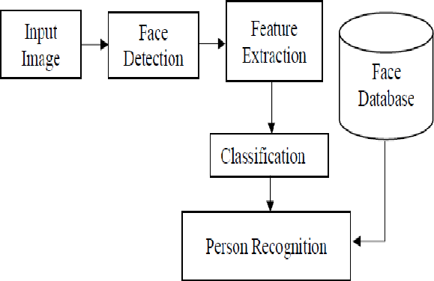
EXISTING SYSTEM ARCHITECTURE

Slide 7
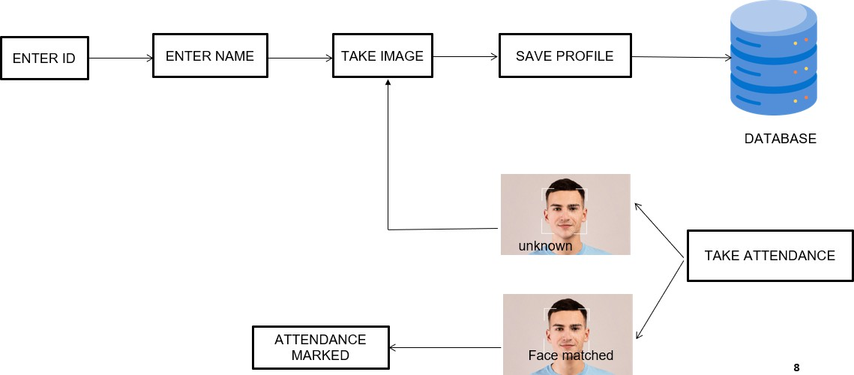
PROPOSED SYSTEM ARCHITECTURE

Slide 8
SOFTWARE AND HARDWARE REQUIREMENTS
HARDWARE
Camera
8 GB RAM
500 MB to 1 GB storage
2.0 GHz Processor
SOFTWARE
Python
OpenCV
MySQL
Web-based interfaces

Slide 9




MODULES
GUI CREATION MODULE
FACE-RECOGNITION MODULE
IMAGE PROCESSING MODULE
DATE STORAGE MODULE
DATA HANDLING MODULE

Slide 10




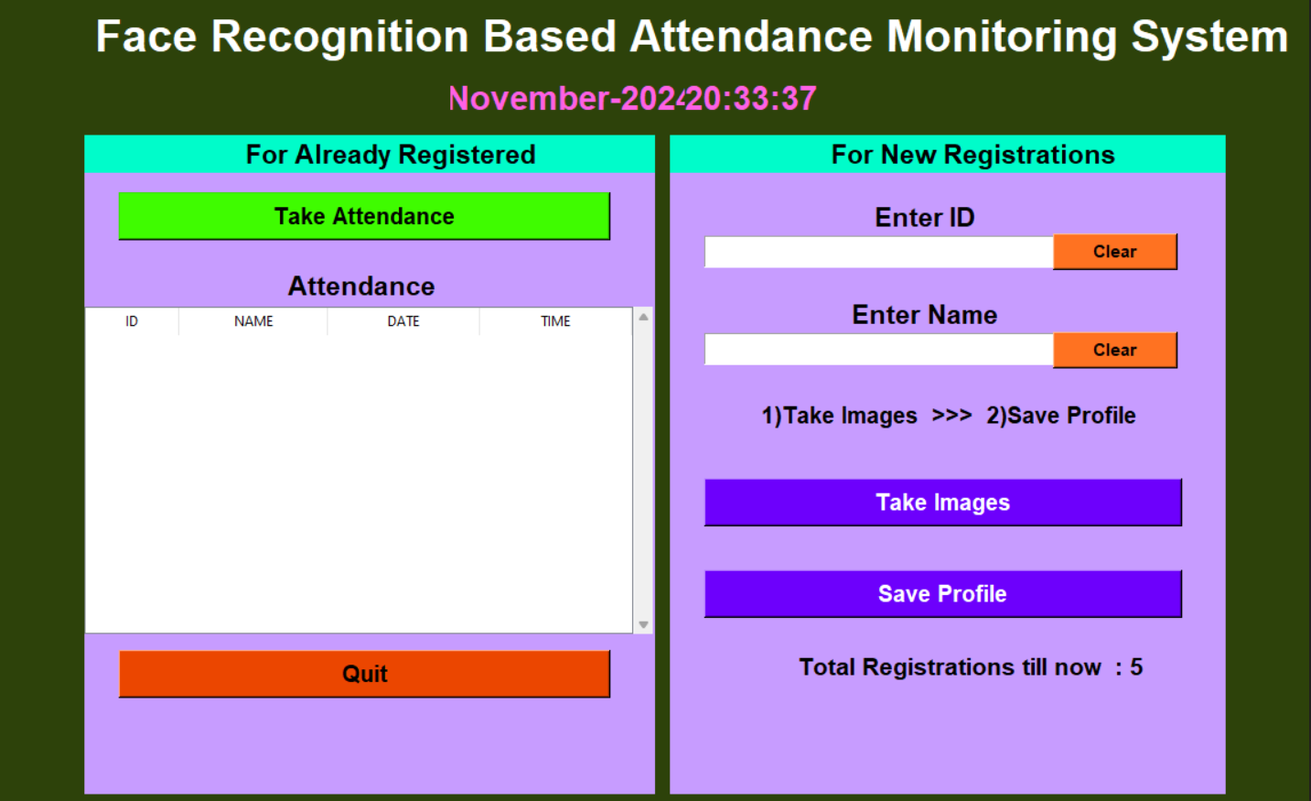
GUI CREATION MODULE-1
The GUI (Graphical User Interface) module is an essential part of the system that allows users to interact with the Face Recognition-Based Attendance Monitoring System.
The GUI allows for tasks like enrolling students, capturing attendance, viewing records.

Slide 11


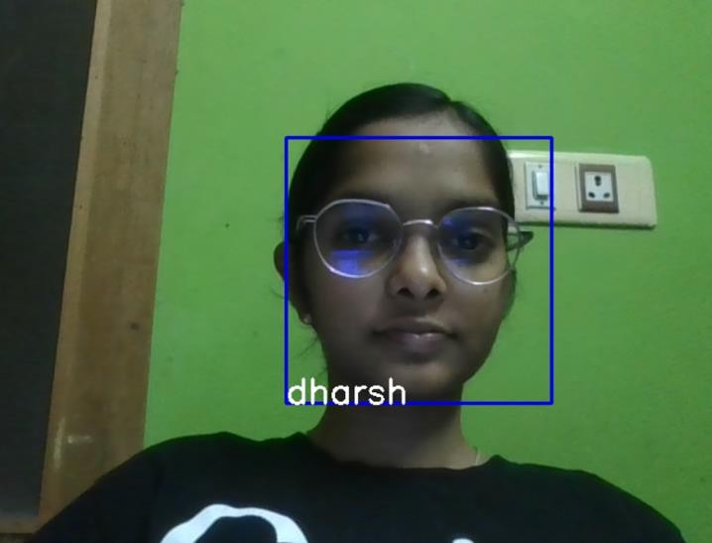
FACE RECOGNITION MODULE-2
It is the core component of the attendance system. This module handles the process of detecting and recognizing faces from images.
It is responsible for matching a person's face to a stored dataset and updating the attendance records accordingly.

Slide 12

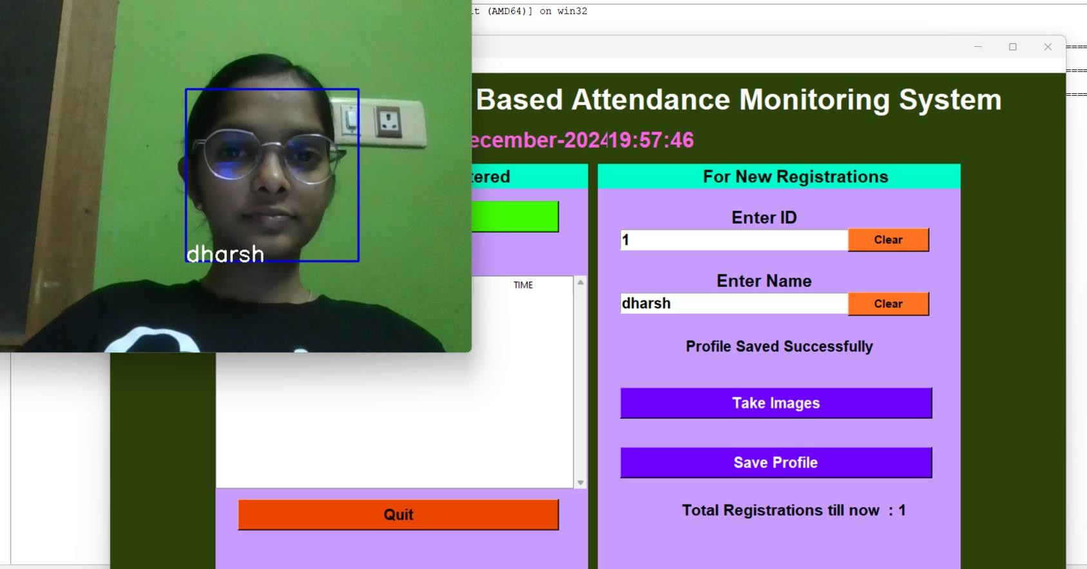
IMAGE PROCESSING MODULE-3
The Image Processing Module is an essential component of a face recognition system, as it deals with handling and preprocessing images to ensure accurate face detection and recognition.

Slide 13

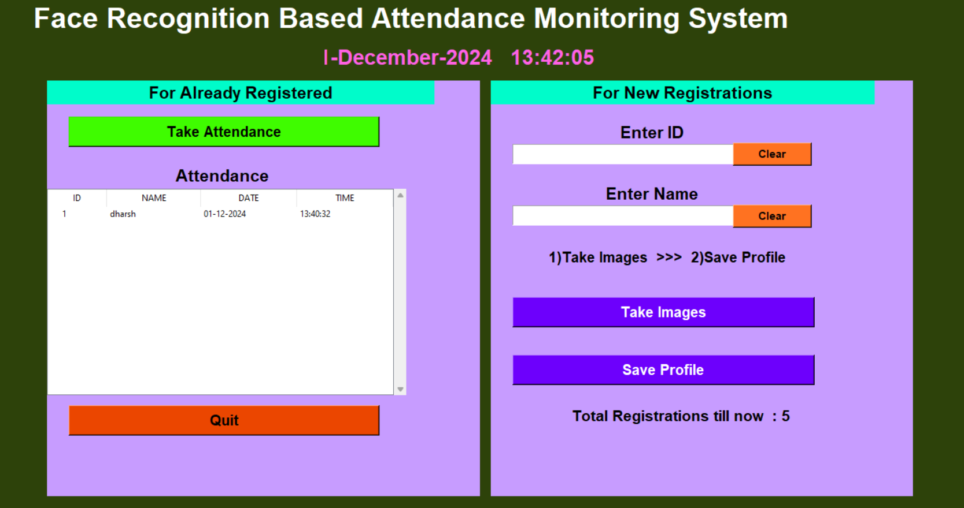
DATA STORAGE MODULE-4
The Date Storage Module is an essential component of the system that manages storing and accessing attendance data, such as student IDs, face recognition data, and attendance status.
This module handles the recording and retrieval of data related to student attendance, ensuring it is securely saved and easily accessible for analysis or reporting.

Slide 14

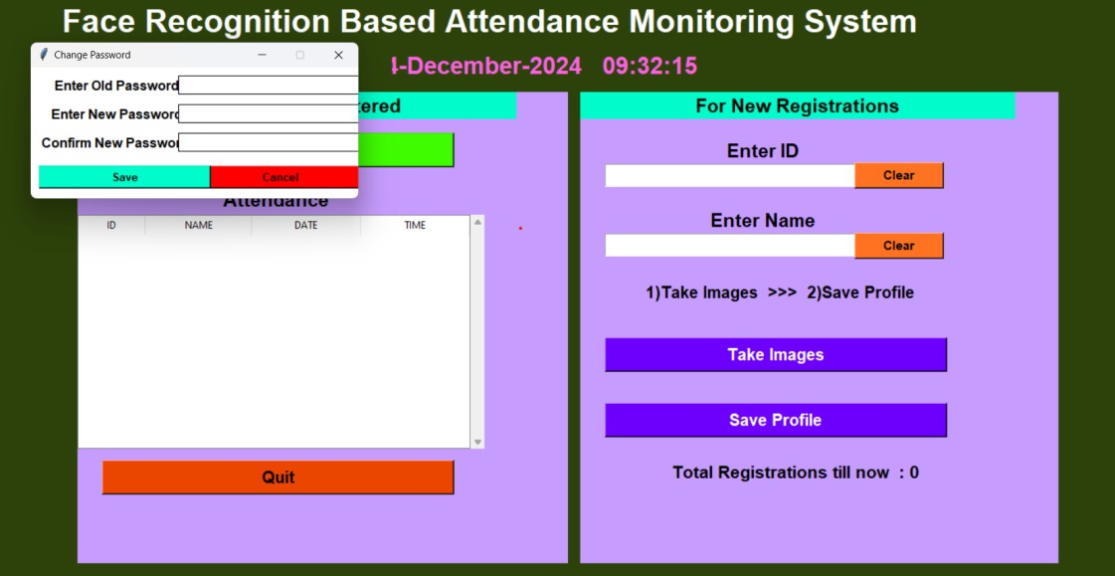
DATA HANDLING MODULE-5
The Data Handling Module is responsible for processing and managing all the data interactions within the system.
This module handles various data operations, such as data input/output, processing attendance records, storing data in databases or files, and generating reports.
This module interacts with the Image Processing, Date Storage, and Face Recognition modules to provide a seamless experience in managing attendance.

Slide 15
RESULTS AND DISCUSSION
The system was able to accurately detect and recognize faces of students using a webcam in real-time. The use of Haar Cascade Classifiers for face detection, combined with LBPH (Local Binary Patterns Histogram) or deep learning models for recognition, ensured robust and efficient identification of faces.
The system was equipped with a simple password protection mechanism to restrict unauthorized access. Admin users could set, change, and verify passwords to secure critical operations like training the recognition system, registering new students, and changing system settings.
The application featured a real-time clock that displayed the current time on the GUI, helping users keep track of when a student's attendance was marked.
The image capturing process for training was efficient, with the system capturing a sufficient number of faces. This helped improve the accuracy of the face recognition model.

Slide 16


CONCLUSION
In conclusion, a face recognition system is a powerful tool for enhancing security by verifying identities through facial features. By integrating key modules—GUI Creation, Face Recognition, Image Processing, Data Storage, and Data Handling— the system ensures seamless operation, accurate recognition, and secure data management.
Effective preprocessing, feature extraction, and robust recognition algorithms enable the system to distinguish genuine users from imposters with high accuracy. The GUI Creation Module provides an intuitive interface, while the Data Storage and Data Handling Modules ensure secure, efficient management of facial templates and related data.
Overall, the face recognition system delivers a reliable, user-friendly, and secure solution for identity verification, making it invaluable in various security applications.

Slide 17

REFERENCE
Turk, M., & Pentland, A. (1991). Eigenfaces for recognition. Journal of Cognitive
Neuroscience, 3(1), 71–86.
Taigman, Y., Yang, M., Ranzato, M. A., & Wolf, L. (2014). DeepFace: Closing the gap to human-level performance in face verification. Proceedings of the IEEE Conference on Computer Vision and Pattern Recognition (CVPR), 1701–1708.
Parkhi, O. M., Vedaldi, A., & Zisserman, A. (2015). Deep Face Recognition. British Machine Vision Conference (BMVC).
Hu, J., Shen, L., Albanie, S., & Sun, G. (2018). Squeeze-and-Excitation Networks. Proceedings of the IEEE Conference on Computer Vision and Pattern Recognition (CVPR),
pp. 7132-7141
04-12-2024
17

Slide 18

THANK YOU
18

