Slide 1

TOP RATED TV SHOWS ON NETFLIX
Notes:
Good evening everyone!
I’m Sahaanah Jayakumar and my project is about the top rated TV shows featured on Netflix.

Slide 2
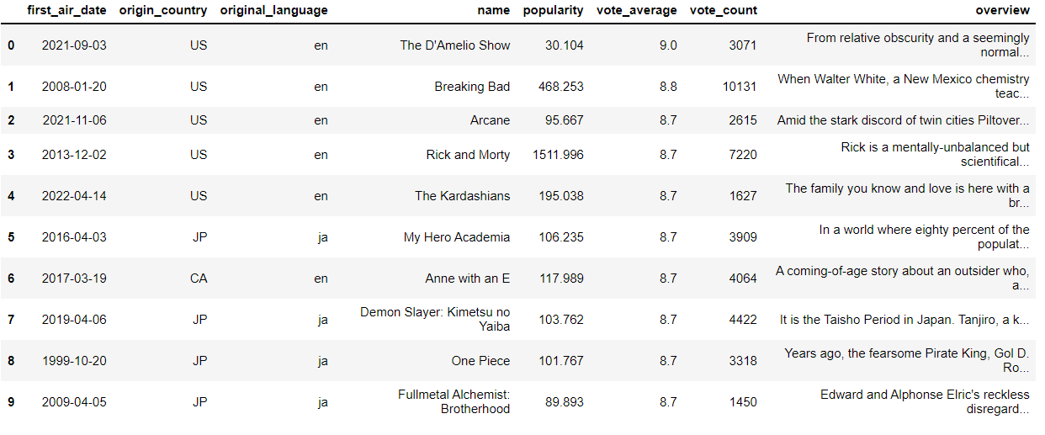
Dataset
Notes:
Here’s a small snippet of my dataset which I collected from Kaggle. It consists of about 2,500 rows and 10 columns.

Slide 3

Dataset Description
1) first_air_date - The date when the show was first aired on television.
2) origin_country - The country where the show was created / originates from.
3) original_language - The original language of the show.
4) name - Name of the show in English. Note that names in original language are not included in this dataset.
5) popularity - A metric that measures how popular a TV show is based on consumer views.
6) vote_average - Average of the total number of votes the show received.
7) vote_count - The number of votes the show received.
8) overview - A brief description of the show.
Notes:
The dataset includes important features like the name of the show, country and language of origin, popularity of each TV show, average of votes received, number of votes received and a brief description of each show

Slide 4
Possible Questions
Which is the most popular TV show?
01
Which is the most voted TV show by the audience?
02
Which TV show has the best rating?
03
Which country contributes to the most number of votes?
04
Which original language is the most watched?
05
Notes:
With the help of this dataset, I have arrived at solutions to some questions like:

Slide 5

Tools
Python : Matplotlib, Seaborn and Plotly packages
PowerBI
Notes:
Some of the tools that I have accessed for this project are python packages like matplotlib, seaborn and plotly and PowerBI

Slide 6
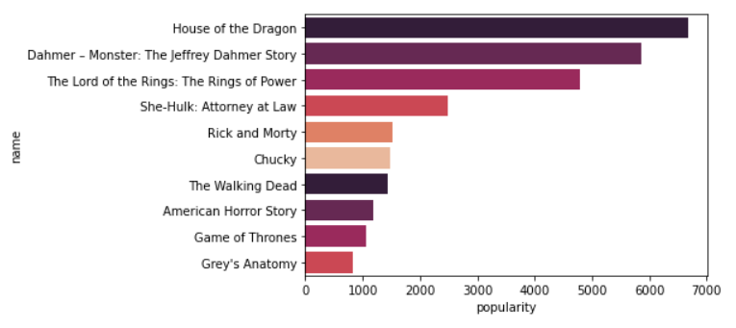
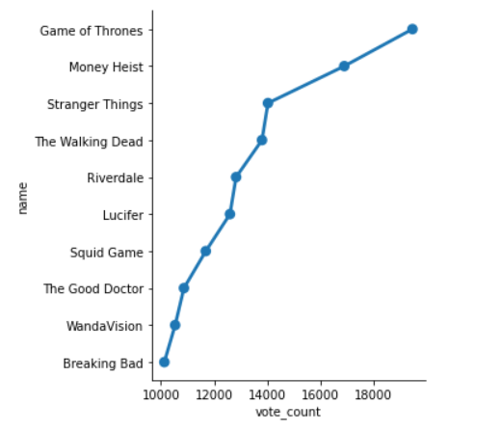
Top 10 TV shows based on popularity and number of votes
House of the Dragon is the most popular TV show Game of Thrones has the most number of votes
Notes:
These visuals represent the top 10 TV shows based on various criteria.
The bar chart on the left indicates that House of the Dragon is the popular TV show which has the most number of user views followed by Dahmer Monster and Lord of the Rings respectively.
From the factor plot to the right, it is observed that Game of Thrones has won may people’s hearts by securing the most number of votes

Slide 7
USA accounts for the majority of vote average
English accounts for the majority of vote count
Notes:
Moreover, USA is the country which contributes to the most number of average votes by users and the TV shows made in English contribute majorly to the total number of user votes.

Slide 8
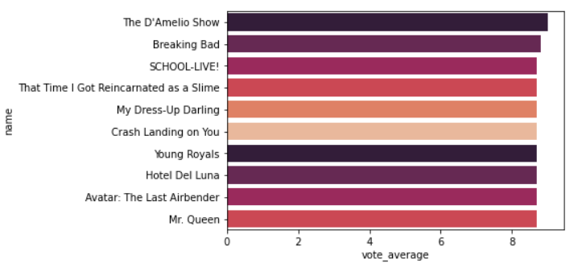
Top 10 TV shows based on vote average
The D'Amelio show has been rated by the public as the best TV show
Notes:
Ultimately, The D’Amelio show has been rated by the public as the best TV show followed by Breaking Bad and School Live
It can be noticed that there is a very insignificant difference in the ratings of other TV shows, making it a tight competition.

Slide 9
Key Takeaways
Highlight key findings and patterns discovered.
Ensure clarity and relevance for the target audience.
Effective Visualization
Provide practical suggestions based on insights.
Identify areas for further exploration.

Slide 10

Thank You

