Slide 1
NEXTGEN-ISP
An Integrated ERP & CRM Platform for Internet Service Providers
BY P S SAHAD
2026
NextGenISP | ISP Management Platform | Confidential

Slide 2
Introduction
What is NextGenISP?
• NextGenISP is a full-stack ISP Management Information System built to digitize and automate all operations of an Internet Service Provider.
ERP — Enterprise Resource Planning
• Automates all internal business processes into a single platform.
• → Resource Mgmt: Hardware inventory, MAC address binding, device tracking
• → Workforce Planning: Dual-role staff (Field + Technical) with Workload Monitor
• → Financial Ops: Invoice generation, billing cycles, payment gateway
• → Infrastructure: GeoJSON zone management, NOC live map, outage control
CRM — Customer Relationship Management
• Manages the complete subscriber lifecycle from lead to loyal customer.
• → Lead Management: LEAD → VERIFIED → ACTIVE onboarding pipeline
• → Self-Service Portal: Speed test, diagnostics, bills, AI chatbot
• → Support & Ticketing: Physical & Logical issue routing to right staff
• → Broadcast Engine: Zone-targeted email campaigns for outage alerts
2026
NextGenISP | ISP Management Platform | Confidential

Slide 3
Abstract
• Traditional ISPs manage operations through spreadsheets, WhatsApp, and manual processes — creating data silos, billing errors, and poor customer experience.
NextGenISP solves this by providing:
• ✦ Public Portal — Self-service plan selection & new connection registration
• ✦ Admin Command Center — Full business management in one dashboard
• ✦ Dual-Staff Dashboards — Physical install (Field) + Logical config (Technical)
• ✦ Customer Self-Service — Speed gauge, diagnostic terminal, billing, AI chatbot
• ✦ Live NOC War Room — GeoJSON zone map with real-time customer pins
• ✦ Targeted Broadcasts — Zone/role-based email alerts with customer name preview
Key Innovations:
• → Animated SVG Speedometer simulating plan-based real speeds
• → Hacker-style Diagnostic Terminal with auto ticket raising
• → UPI QR payment gateway
• → Chatbot using JavaScript decision-tree for instant FAQ resolution
2026
NextGenISP | ISP Management Platform | Confidential

Slide 4
Problem Statement
Problem
Impact
✗ Customer data in Excel / WhatsApp
No traceability, data loss risk
✗ No formal ticket/complaint system
Complaints ignored or delayed
✗ Field staff managed via phone calls
No tracking, wasted site visits
✗ Manual invoice generation
Billing errors, late payments
✗ No geographic network visibility
Cannot identify area-wise outages
✗ Hardware not tracked post-delivery
No MAC binding, security risk
✗ Customers call for basic queries
High support load, slow response
✗ No centralized broadcast capability
Cannot alert customers during outages
There is a need for a unified digital system managing all ISP operations — from customer onboarding to network monitoring.
2026
NextGenISP | ISP Management Platform | Confidential

Slide 5
Existing System vs Proposed System
Feature
Existing (Manual)
Proposed (NextGenISP)
Customer Registration
Paper forms / walk-in
Online portal + ID proof upload
Plan Selection
Phone call with agent
Self-service catalog with filters
Installation Tracking
WhatsApp messages
Two-phase digital task board
Billing
Manual invoice printing
Auto-invoices + payment gateway
Support Tickets
Verbal, no tracking
Typed tickets with auto-routing
Network Monitoring
Engineers go on-site
Live Leaflet.js NOC map
Staff Workload
No visibility
Workload charts per staff member
Mass Communication
Manual SMS blast
Targeted zone-aware broadcast
Hardware Tracking
No records
MAC binding + inventory system
Customer Self-Service
None
Speed test, diagnostics, chatbot
2026
NextGenISP | ISP Management Platform | Confidential

Slide 6
Data Flow Diagram (DFD)
Levels of System Data Flow
Level 0 — Context Diagram (The Big Picture)
The entire system is a single process: "NextGenISP Platform".
External Entities: Visitor · Customer · Admin · Field Staff · Technical Staff · Email System
Level 1 — Main Processes (6 Core Functions)
[1.0] User & Auth Management → JWT Token, Role-locked Dashboard
[2.0] Plan & Hardware Mgmt → Public plan listing, Subscriptions
[3.0] Installation Management → Field task board, MAC binding
[4.0] Billing & Payments → Invoice generation, Payment records
[5.0] Support & Ticketing → Ticket creation, Staff routing, Resolution
[6.0] NOC / Network Ops → Maintenance alerts, Live map visualization
Level 2 — Installation Sub-Process (Drill-Down)
[3.1] Admin creates task → [3.2] Field Staff does physical install → [3.3] Tech Staff does logical config → [3.4] Customer ACTIVE
2026
NextGenISP | ISP Management Platform | Confidential

Slide 7
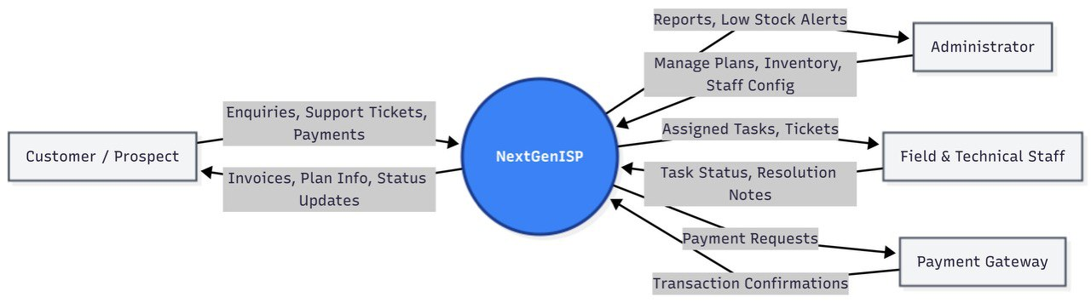
Level 0 DFD

Slide 8
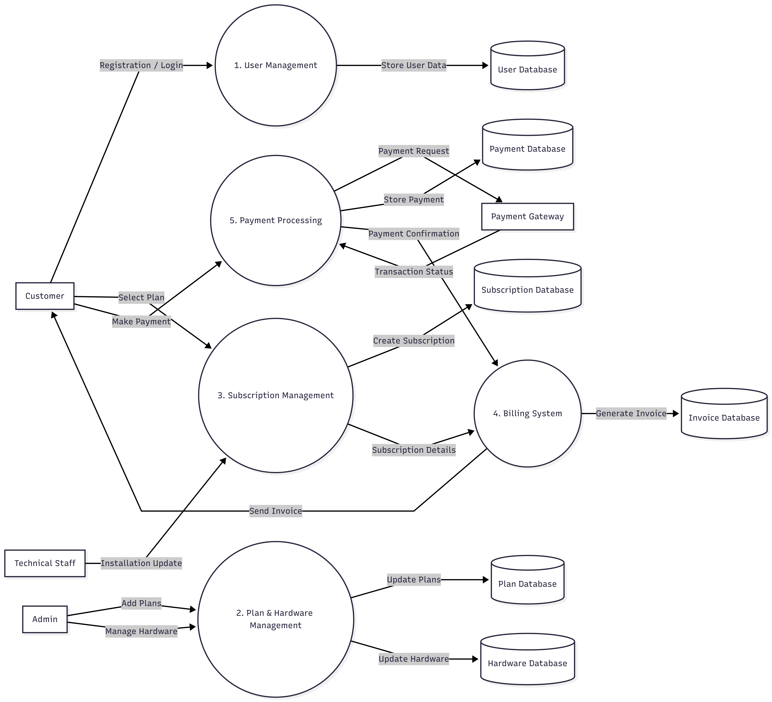
Level 1 DFD

Slide 9
ER Diagram
Entity-Relationship Description
Core Entities & Relationships
Area (Geographic anchor)
→ User (Customer) belongs to one Area [Many-to-One FK]
→ Plan is available in multiple Areas [Many-to-Many]
User (Most connected entity)
→ Holds a Subscription → Plan [FK chain]
→ Subscription generates monthly Invoices [One-to-Many]
→ Raises Tickets assigned to Staff [Two FKs on User table]
→ Linked to InstallationTask as Customer, Field Staff, OR Tech Staff [×3 FKs]
InstallationTask (Operations hub)
→ References: Customer, Field Staff, Tech Staff, Plan, Hardware
→ Stores router MAC address, own-device model, one-time charges
Supporting entities: Ticket → ChatMessage | InventoryItem → AssetAssignment
2026
NextGenISP | ISP Management Platform | Confidential

Slide 10
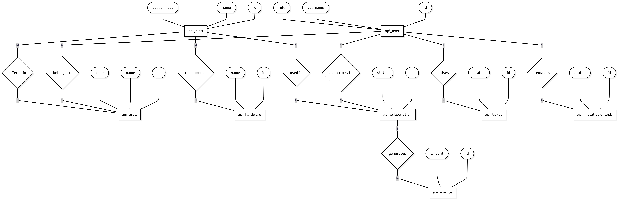
ER DIAGRAM

Slide 11
Database Schema — Part 1
13 Tables across 8 Groups
area
subscription
id PK
user_id FK
name, code (UNIQUE)
plan_id FK
coordinates (GeoJSON)
status ENUM: ACTIVE|EXPIRED|SUSPENDED
is_under_maintenance
start_date, end_date, billing_cycle
maintenance_message
invoice
user (extends AbstractUser)
subscription_id FK
id PK
amount, due_date
username, email, password
status ENUM: PENDING|PAID|OVERDUE
role ENUM: ADMIN|TECH|FIELD|CUSTOMER
status ENUM: LEAD→ACTIVE→SUSPENDED
payment
area_id FK, phone_number, address
invoice_id FK
latitude, longitude, id_proof
transaction_id (UNIQUE)
plan
amount, method (CASH|ONLINE)
id PK
hardware
name, speed_mbps, price
id PK
plan_type ENUM: FIBER|WIRELESS
name, price
data_limit_gb (FUP cap)
specifications (JSON)
areas M2M→ area
image, is_active
recommended_hardware M2M→ hardware
2026
NextGenISP | ISP Management Platform | Confidential

Slide 12
Database Schema — Part 2
Remaining Tables & Relationships
ticket
installationtask
customer_id FK → user
customer_id FK → user
assigned_to_id FK → user
assigned_staff_id FK → user (Field)
ticket_type ENUM: LOGICAL|PHYSICAL|INSTALLATION
assigned_technical_staff_id FK (Tech)
status ENUM: OPEN→IN_PROGRESS→RESOLVED→CLOSED
plan_id FK, hardware_id FK
subject, description
own_router_mac, own_router_model
status ENUM: PENDING→PHYSICAL_COMPLETED→CLOSED
chatmessage
one_time_charge, router_mac, notes
ticket_id FK
inventoryitem
sender_id FK → user
message, created_at
name, sku (UNIQUE)
quantity, unit_price
enquiry
category: ROUTER|CABLE|CONNECTOR
name, phone, email
assetassignment
status ENUM: OPEN→CONTACTED→CONVERTED
assigned_to_id FK → user
item_id FK
user_id FK
serial_number, is_returned
area ← user → subscription → invoice → payment | user → ticket → chatmessage | user → installationtask | inventoryitem → assetassignment
2026
NextGenISP | ISP Management Platform | Confidential

Slide 13
Module Descriptions
5 Core Modules of the System
01
Public Portal
Visitors browse plans, hardware, and register. Account created as LEAD for admin verification.
Pages: Home · Plan List · Router Detail · Register · Login
02
Admin Dashboard
Verify users, manage plans/zones/hardware, view workload charts, send targeted broadcasts.
Pages: AdminDash · ManageUsers · ManagePlans · ManageAreas · Broadcast · WorkloadMonitor
03
War Room (NOC)
Live Leaflet.js map with GeoJSON zone polygons. Color-coded customer pins. Toggle maintenance mode per zone.
Pages: NetworkMap · Outage Tracker
04
Staff Dashboards (Two-Phase)
Field Staff: physical cabling, MAC capture. Technical Staff: logical config (PPPoE/DHCP/VLAN), KB articles.
Pages: FieldDash · FieldRepairs · TechDash · TechRepairs · KnowledgeBase
05
Customer Self-Service Portal
Plan status, speed gauge, diagnostic terminal, bill history, UPI/Razorpay payment, tickets, AI chatbot.
Pages: CustDash · BillHistory · Support · Chatbot
2026
NextGenISP | ISP Management Platform | Confidential

Slide 14
Advantages of the Project
✓ End-to-End Digitization
✓ Hardware Accountability
No paperwork — entire ISP workflow is digital from lead to active subscriber
MAC binding and inventory tracking prevent unauthorized device usage
✓ Real-Time Visibility
✓ Scalable Role Architecture
Admin sees live NOC map, workload charts, outages, and revenue at a glance
New roles can be added via DB config — zero code changes needed
✓ Dual-Staff Workflow
✓ Geographic Intelligence
Physical and logical roles are separated, eliminating assignment confusion
GeoJSON polygon zones tie plans, customers, and alerts to geography
✓ Self-Service Empowerment
✓ Automated Billing
Customers resolve issues themselves — speed test, diagnostics, chatbot
Invoice generation, payment tracking, defaulter detection — fully automated
✓ Targeted Communications
✓ Secure & Authenticated
Zone-level broadcast ensures only affected users receive alerts
JWT-based auth + role-locked API endpoints at every backend view
| ISP Management Platform |

Slide 15
Future Scope
What Comes Next
Standard Enhancements
✦ Real Razorpay Integration — Webhook-based payment confirmation for production
✦ Progressive Web App (PWA) — Field Staff access tasks offline on mobile
✦ WhatsApp / SMS Notifications — Instant payment reminders via Twilio
✦ Usage-Based FUP Enforcement — Auto-suspend on data cap breach
AI / Machine Learning Enhancements
🤖 Predictive Maintenance (ML) — Forecast fiber degradation by zone before customers notice
🤖 Auto Ticket Triage (LLM) — Classify complaints as LOGICAL/PHYSICAL and assign right staff
🤖 Dynamic Bandwidth QoS (AI) — Prioritize premium customers during peak hours automatically
🤖 Churn Prediction — Identify customers likely to cancel and trigger retention campaigns
Infrastructure Scaling
⚙ PostgreSQL Migration · Docker Containerization · WebSocket Real-Time Ticket Chat
| ISP Management Platform |

Slide 16
Thank You
| ISP Management Platform |

