Slide 1
RNN – Introduction and intuition
Arunabh singh w8d2

Slide 2
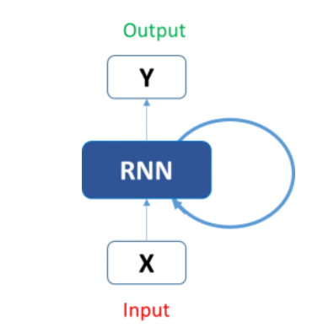
What is an RNN
RNN is a form of neural network that has recurrent cells.
An input to RNN consists of previous layer output as well as output from its CELL output from a previous time state at t-1.
So how do we take advantage of this ?

Slide 3
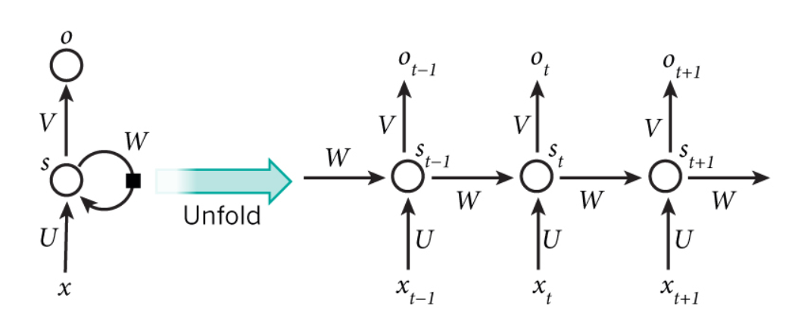
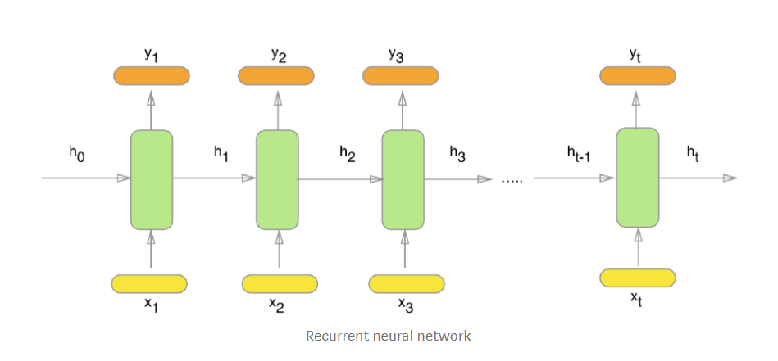
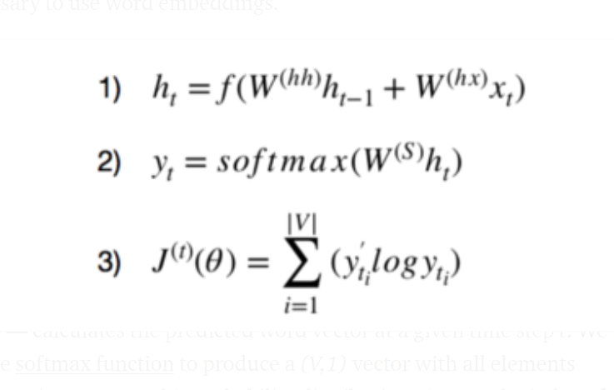
UNFOLDING an RNN
RNN node in a layer N will accept output from layer N-1 as input as well as input from its own cell generated at time t-1.
x_1, x_2, x_3, …, x_t represent the input words from the text, y_1, y_2, y_3, …, y_t represent the predicted next words and h_0, h_1, h_2, h_3, …, h_t hold the information for the previous input words

Slide 4
More on sequential models
RNN belongs to family of sequential models.
Sequential models have a property of using inputs from previous time state to predict current state.
Basically they rely on pas is predictor of the future. Which holds to true for sequential data.
Example of sequential data: stock price, text data etc.
For using text data in a machine learning format the text is split into words and each word is converted into a vector of numbers like [0.5,0.6,0.34,…..67] for a word like ‘trust’ and so on.
For the sequence ABCDEFGHIJKLMNOPQRSTUVWXYZ to know what comes after and this has to be learnt as sequence.
Similarly for the reverse sequence ZYXWVUTSRQPONMLKJIHGFEDCBA. That’s why it is hard to say it without thinking.
To predict j the model needs to know that its’ output was I previously and this input will go the model again and it will predict j.

Slide 5
WHY order matters ?
YOU may think why cant a regular neural network model what an RNN does and why do we need to learn a new architecture.
‘This movie is good. Is it not?’ -→[‘this’ , ‘movie’, ’is’, ’good’, ’NOT’]
‘This movie is NOT good’ -→[‘this’ , ‘movie’, ’is’, ‘NOT’,’ good’]
‘this is a very good movie’ -> [‘this’ ,’movie’,’good’,’very’]
It is important to know the sequence of words to predict correct sentiment or the next word in the sequence.
No information about sequence is captured above.
In other words it is underfitting or not fitting correctly to the data.

Slide 6
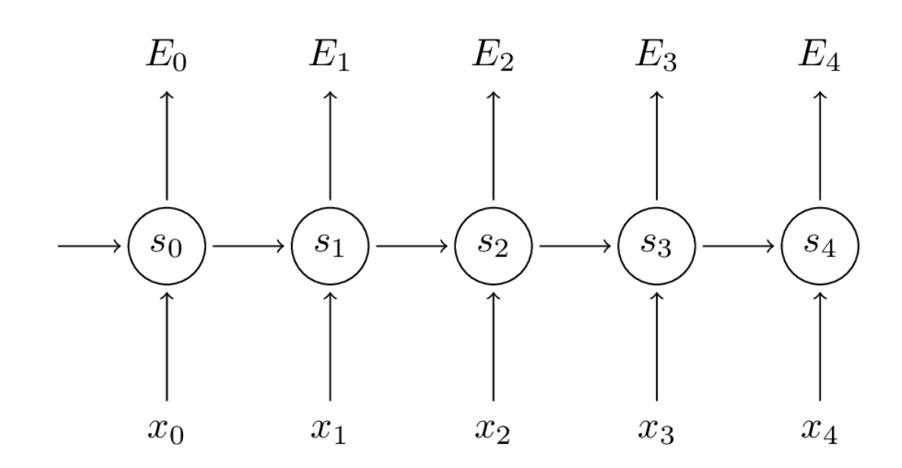
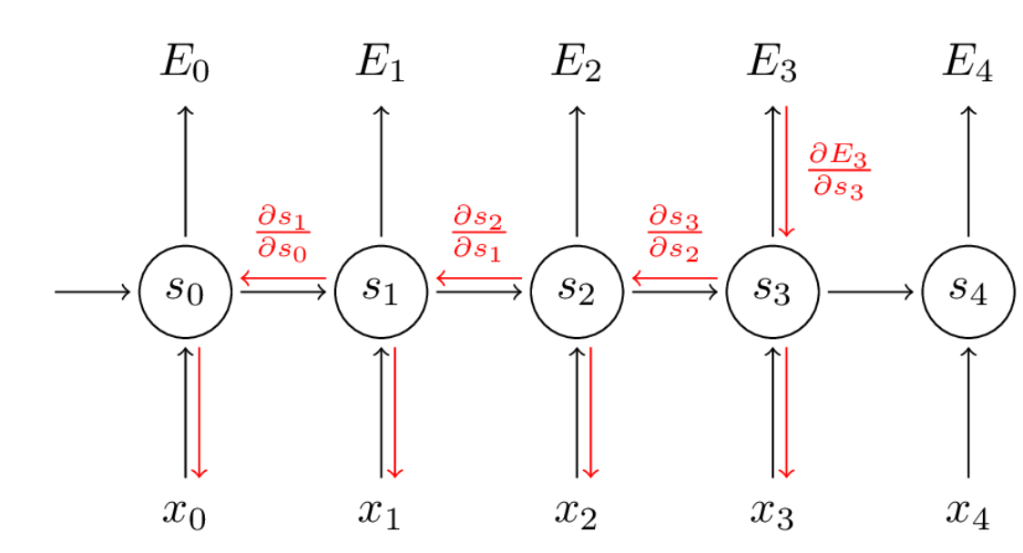
Bptt
Gradient is calculated using cost function at word 3
So Error at word 3 determines the error in activation function S3. So these weights are V which need to be updated.
Since S3 is takes input from S2 and X3 which are Wx and U weight vectors. These get updated accordingly.
So Error at each word is propagated backward till the first word or first element in the sequence is reached.
This way we use stochastic Gradient Descent to update the weights and be able to predict the sequence.

Slide 7
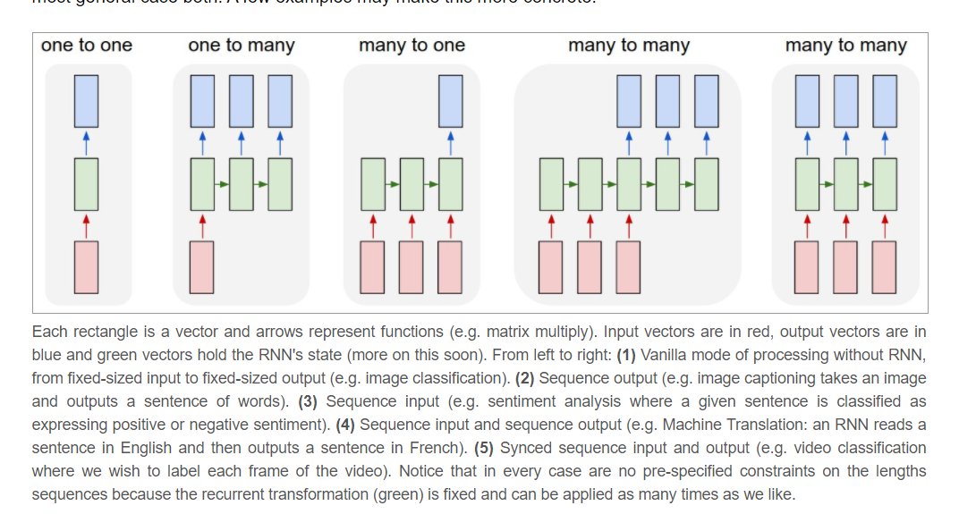
Types of RNN

Slide 8
Character level rnn
As a working example, suppose we only had a vocabulary of four possible letters “helo”, and wanted to train an RNN on the training sequence “hello”.
This training sequence is in fact a source of 4 separate training examples:
1. The probability of “e” should be likely given the context of “h”,
2. “l” should be likely in the context of “he”,
3. “l” should also be likely given the context of “hel”,
and finally 4. “o” should be likely given the context of “hell”.
we will encode each character into a vector using 1-of-k encoding (i.e. all zero except for a single one at the index of the character in the vocabulary), and feed them into the RNN one at a time.
We will then observe a sequence of 4-dimensional output vectors (one dimension per character), which we interpret as the confidence the RNN currently assigns to each character coming next in the sequence

Slide 9
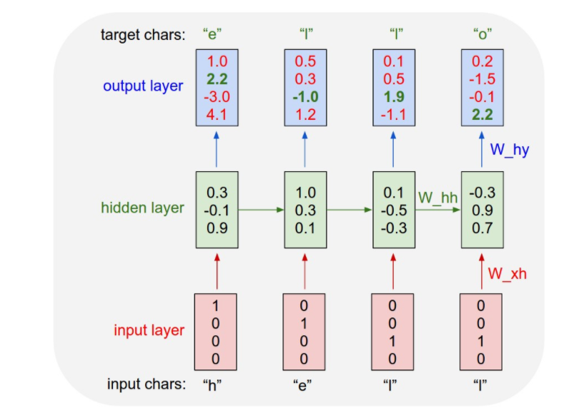
Example Visualized
An example RNN with 4-dimensional input and output layers, and a hidden layer of 3 units (neurons)
first time step when the RNN saw the character “h” it assigned confidence of 1.0 to the next letter being “h”, 2.2 to letter “e”, -3.0 to “l”, and 4.1 to “o”.

Slide 10
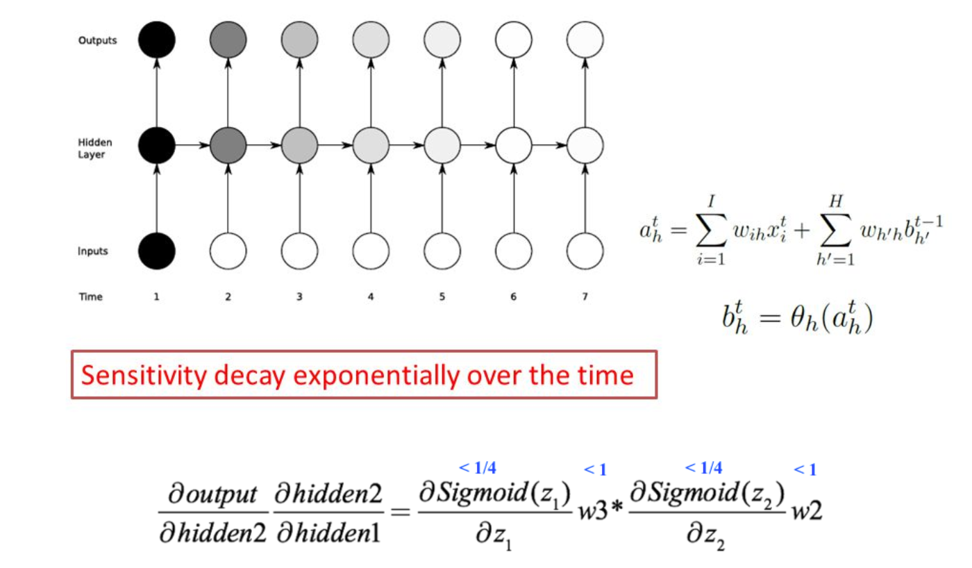
Vanishing exploding gradients
RNN’s have a problem of forgetting words or sequence long back.
This is because derivatives start decreasing and become zero faR back.
So the layers near the input never update
This problem is solved using lstm

Slide 11
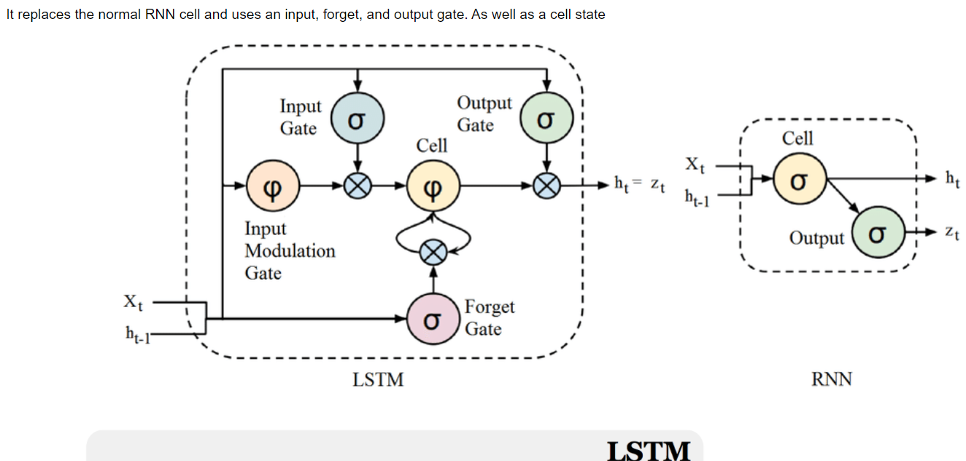
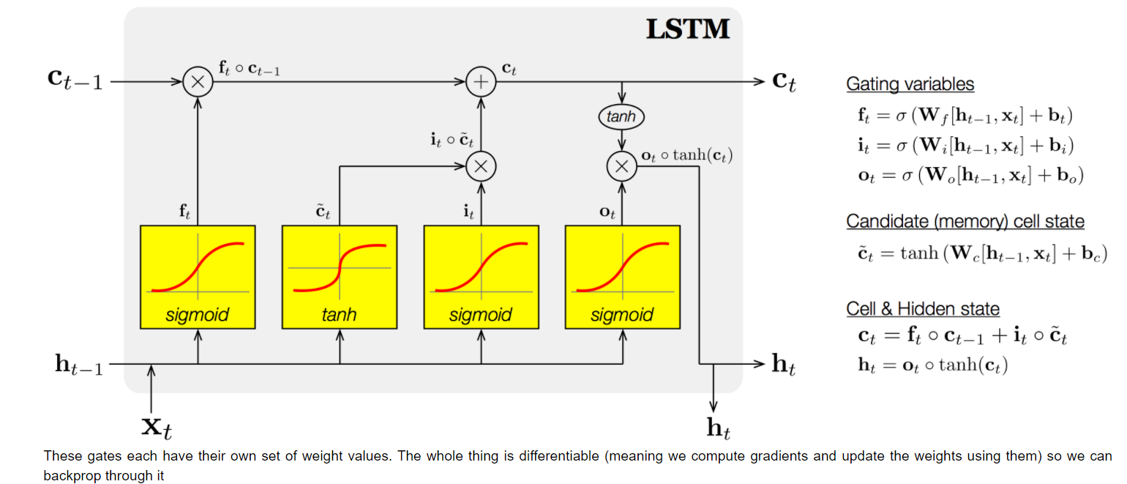
LSTM
Uses forget, input gate and cell state.

Slide 12
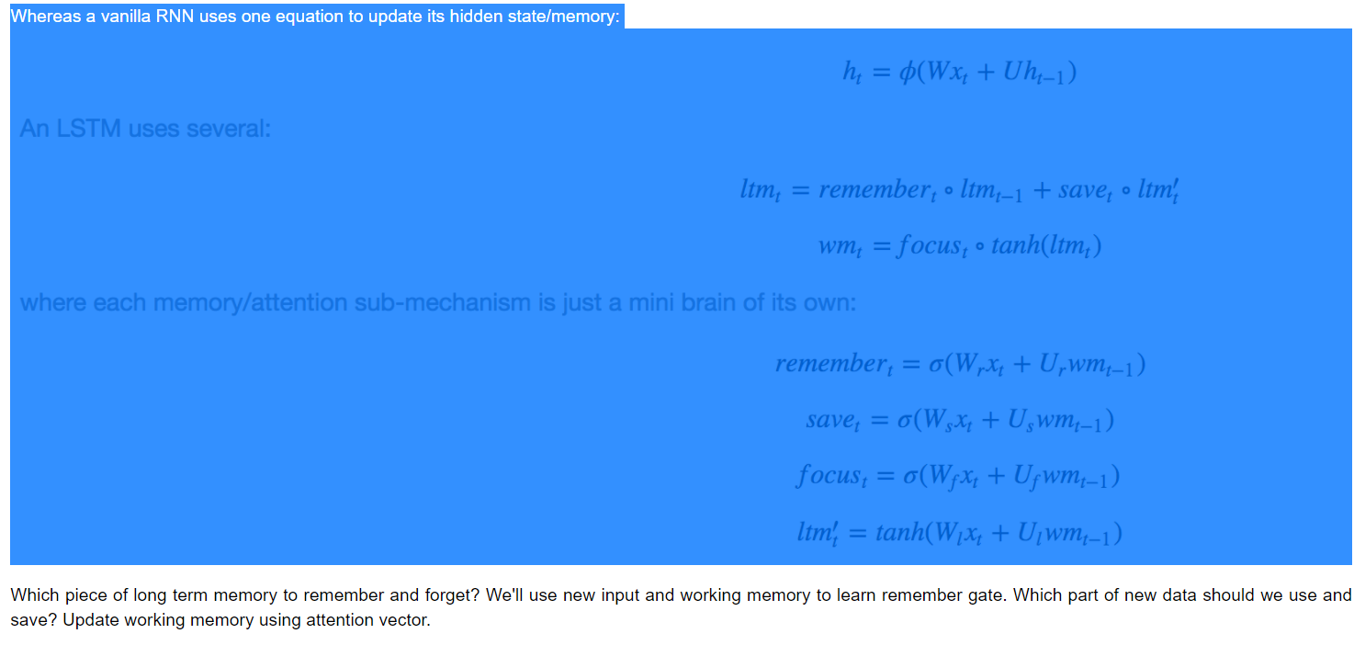
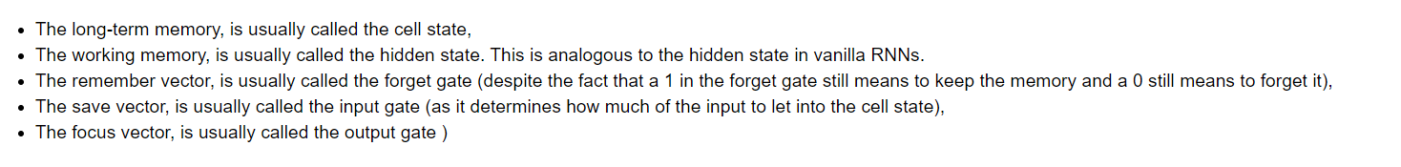
LSTM memory

