Slide 1
GANs
Arunabh – Lighthouse Labs W9D3 July 2020 Cohort

Slide 2
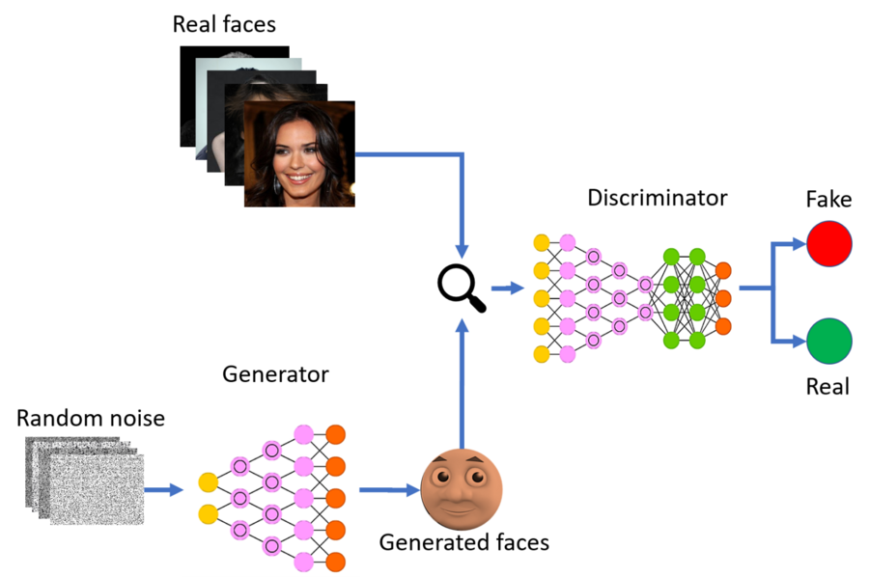
What are GAN’s
GAN stands for Generative Adversarial Networks
It consists of two Neural Networks trying to outwit each other.
These 2 networks are known as Generator and Discriminator.
GAN representation

Slide 3
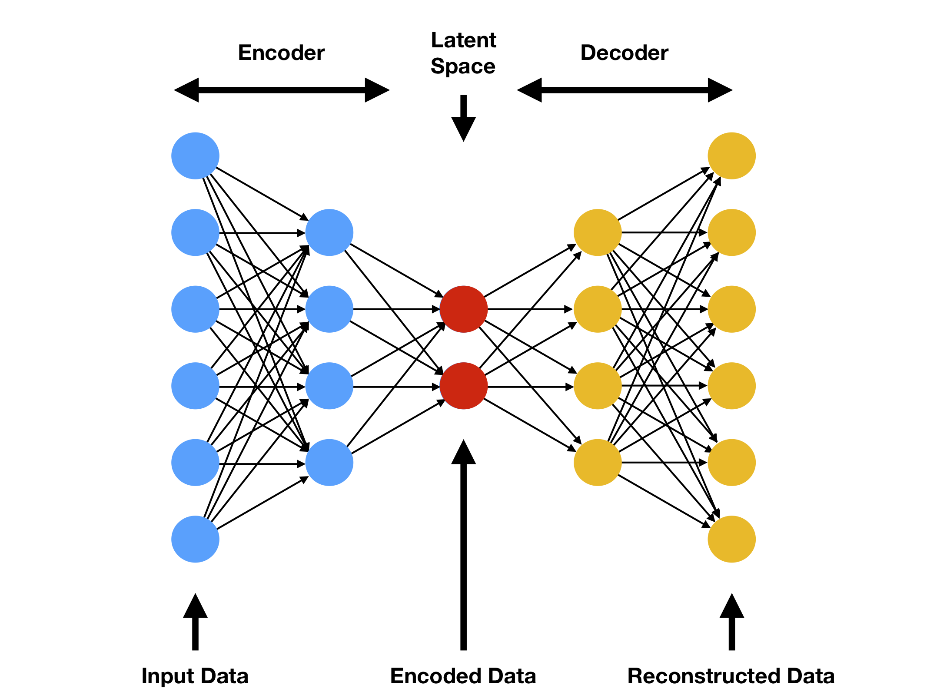
Auto Encoders
Auto Encoder is a Neural network that encodes data onto a latent space or onto a set of latent variables.
Now with this compressed representation of data, it can reproduce new data.
The first part is known as the Encoder and the next is known as Decoder.

Slide 4
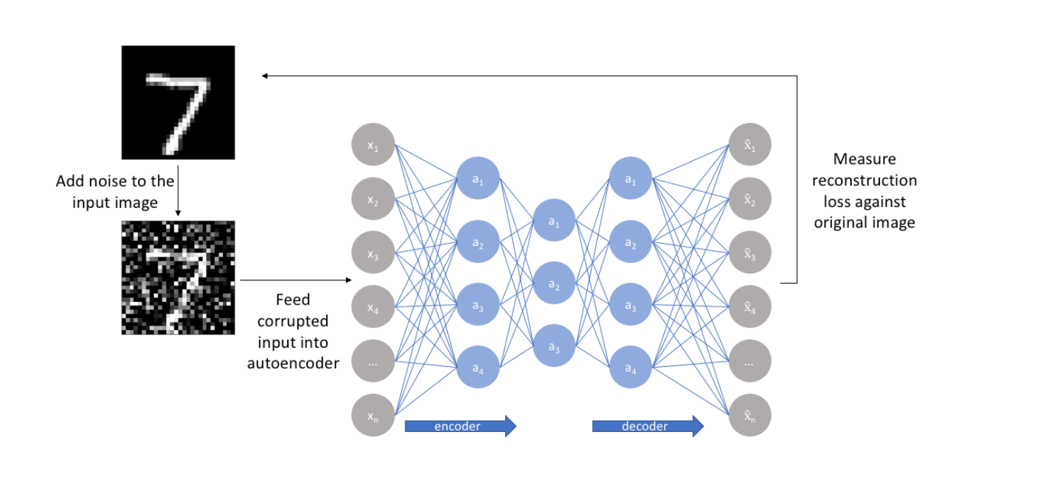
Use Case of Auto Encoder
As shown next to us, auto encoders can reconstruct an image and denoise it.
This is but just one application.
Our interest in auto-encoder is how they do this.

Slide 5
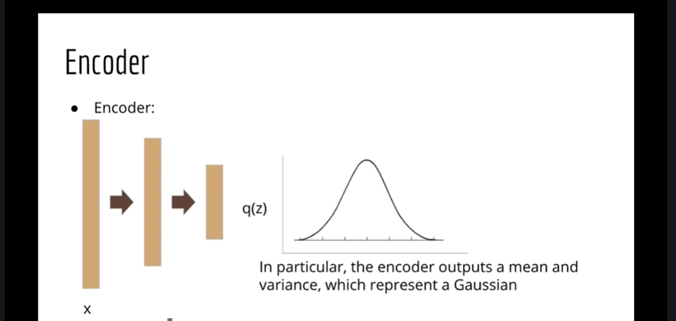
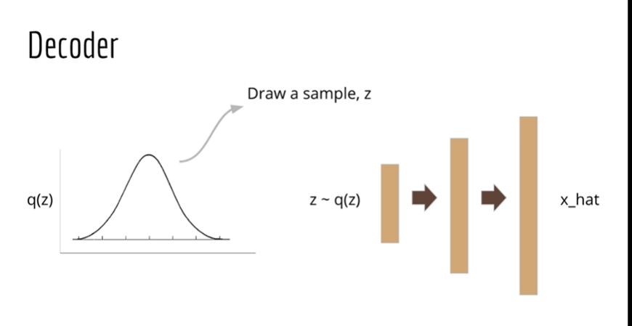
Gaussian Latent Space
Auto Encoder creates a distribution in hidden layer or latent space.
This is used to draw samples and create new outputs.
Source: Udemy-Lazy Programmer

Slide 6
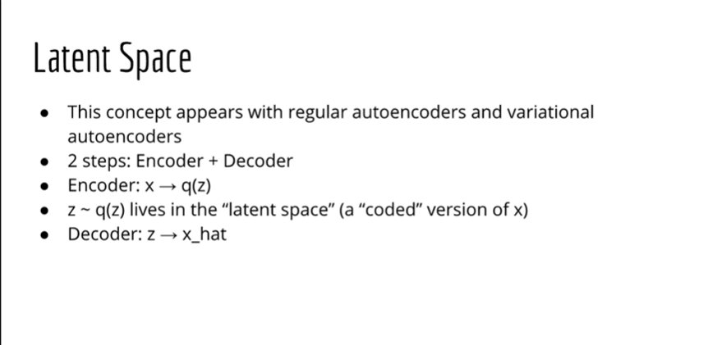
Working of Auto Encoder Decoder
Source: Udemy-Lazy Programmer

Slide 7
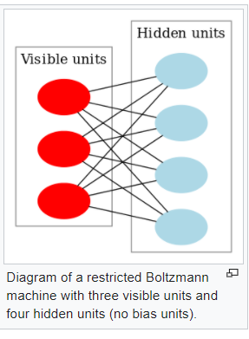
Comparison with other probabilistic models
Restricted Boltzmann can generate samples too.
But we do not know how many iterations will be good enough.
However, GAN’s generate samples in a single pass.
RBM learns a distribution over its inputs.

Slide 8
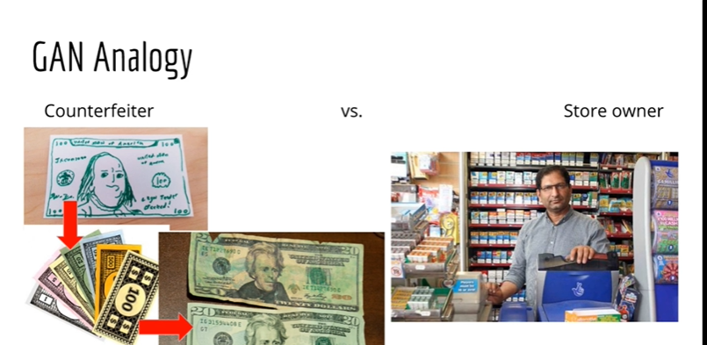
GAN Analogy
GANs can be thought of similar to a store owner and customer trying to use counterfeit notes.
The counterfeiter learns and tries to create more realistic counterfeit notes.
The shopkeeper learns to discriminate between fake and real.
This is similar to discriminator and generator in a GAN.
This process can keep going on forever.
GANs do not use anything we haven’t already learnt.
Source: Udemy-Lazy Programmer

Slide 9
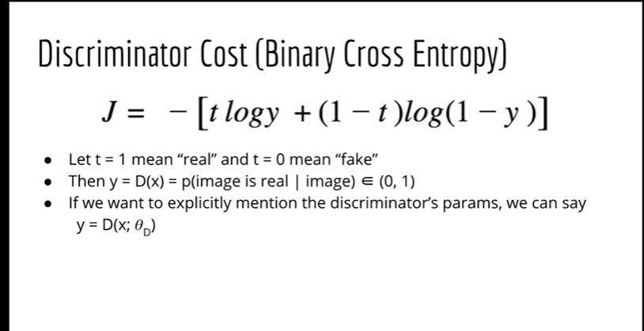
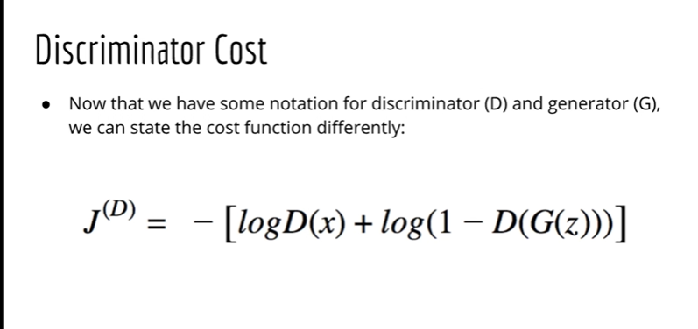
GAN cost functions
The two networks in a GAN are trying to optimize opposite things. So we can say that the 2 cost functions need to be opposites.
We can say there are two classes that a discriminator is trying to predict. One is real sample other fake sample.
So this is a binary classification problem and we can try to use the cross entropy loss function.
Source: Udemy-Lazy Programmer

Slide 10
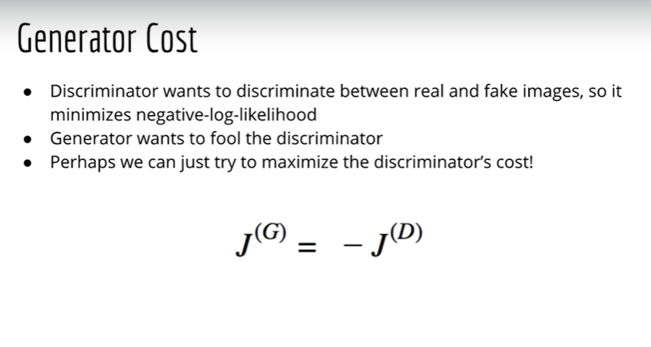
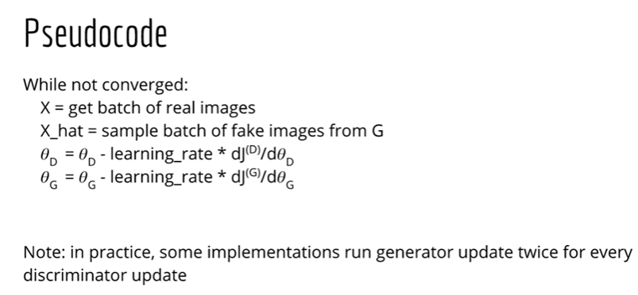
Generator Cost Function and Algorithm
Source: Udemy-Lazy Programmer

Slide 11
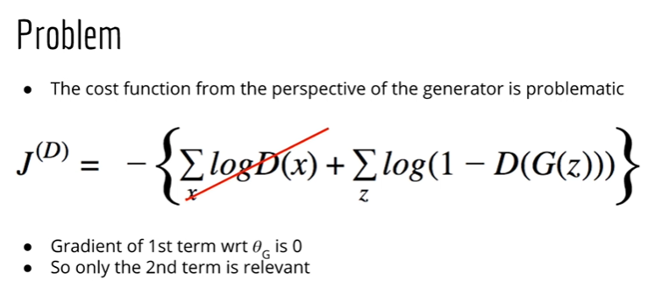
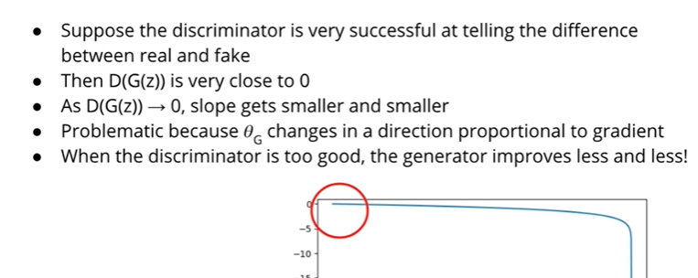
Correcting cost function for Generator
Source: Udemy-Lazy Programmer

Slide 12
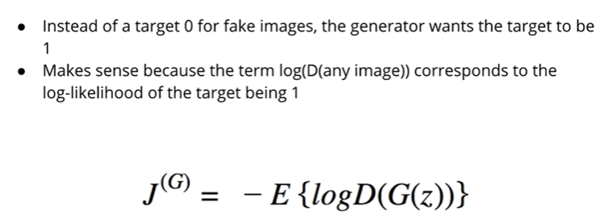
New Generator Cost
The two cost are not opposites anymore and have a zero sum.
This important to note as we optimize the GAN now.
Source: Udemy-Lazy Programmer

Slide 13
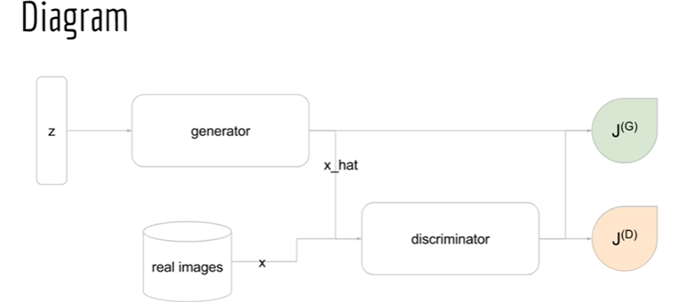
Final GAN diagram
Starting from left we have z which is a latent variable generated from a uniform distribution.
Generator will use the distribution to generate x_hat or fake samples.
Discriminator will be fed both real and fake images.
Then we have cost functions which optimize both the networks respectively.
Source: Udemy-Lazy Programmer

Slide 14
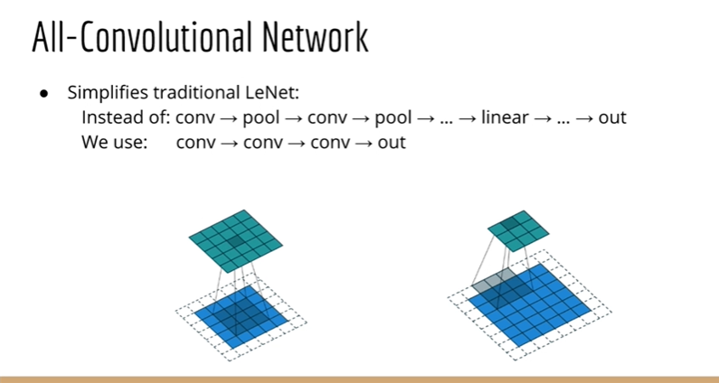
DCGAN
A.k.a Deep Convolutional GAN.
Uses batch normalization which means normalizing the data at every layer in a Neural Network.
DCGAN follows a style of Neural Network called All Convolutional Network.
This Network does not uses pooling layer to reduce dimensions. Instead just uses bigger stride of 2.

Slide 15
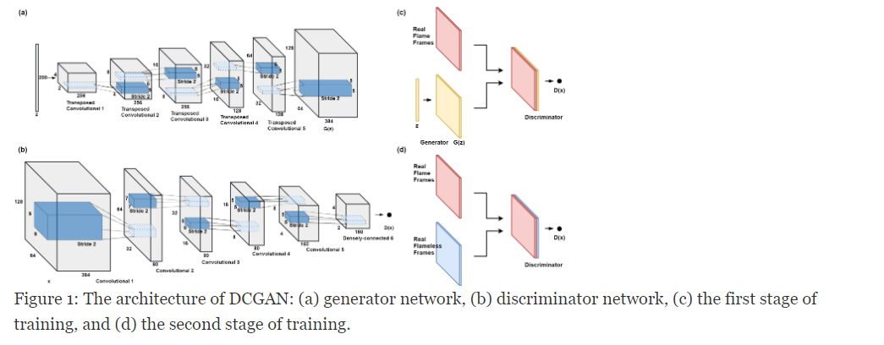
DCGAN overall structure

Slide 16
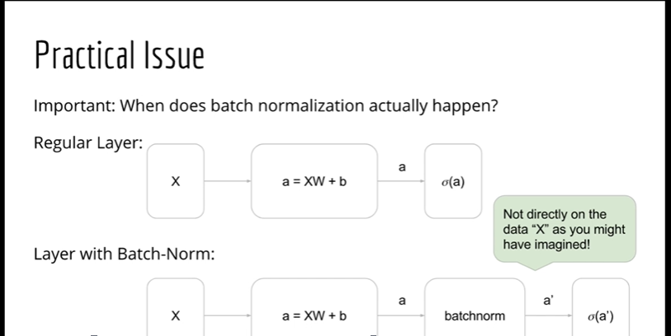
Batch Normalization 1
Batch normalization happens as follows:
First-→ weights*X + bias
Second → Batch Normalization
Third → activation function

Slide 17
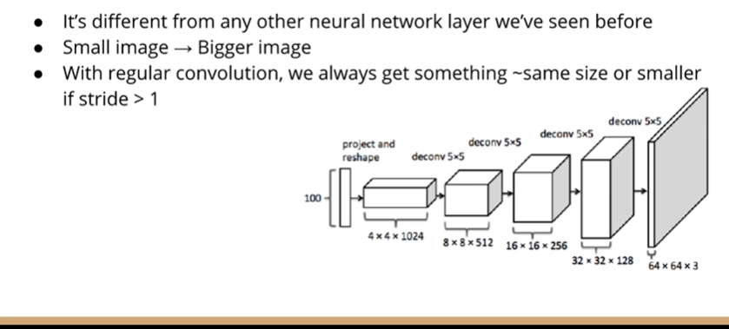
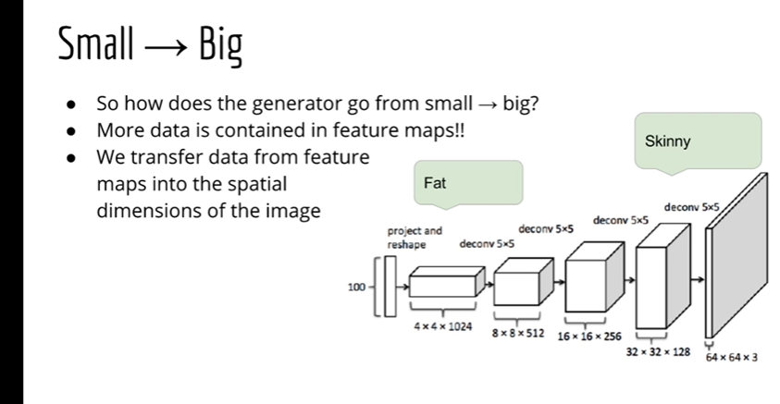
Strided Convolution

Slide 18
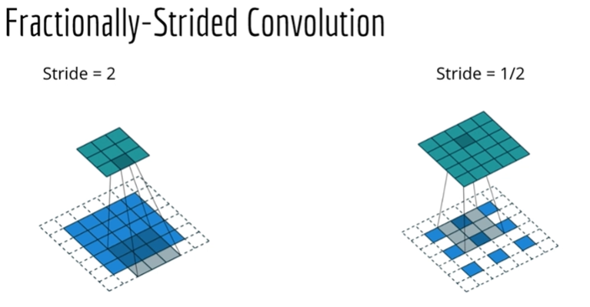
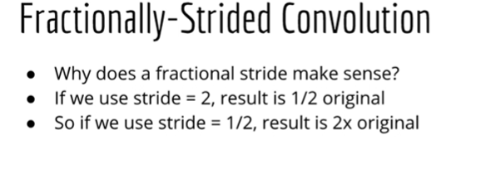
Fractionally Strided Convolution
Takes ½ strides and creates gaps between pixels.
This creats images that are bigger in size.

