Slide 1
NLP1
Sep 2020 Cohort LHL
Arunabh Singh

Slide 2
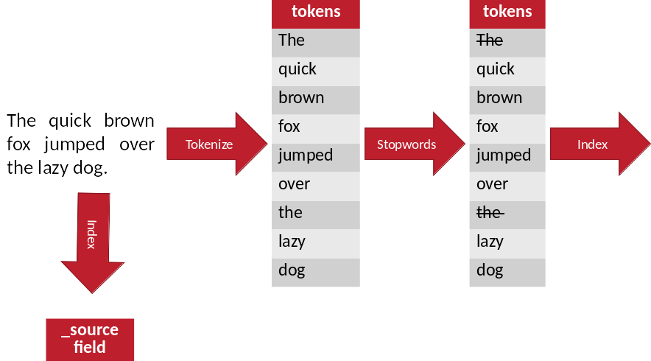
Stopword Removal
Connecting words that are used to form a sentence and serve no purpose in finding relational patterns.

Slide 3
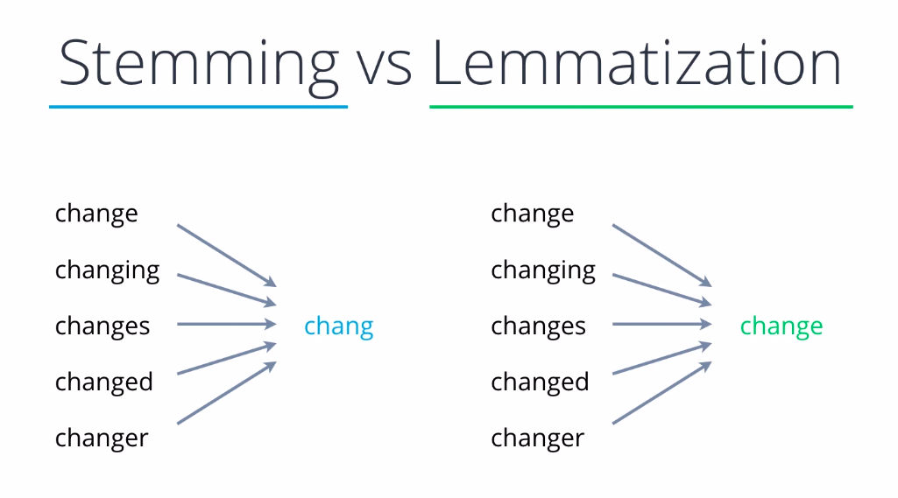
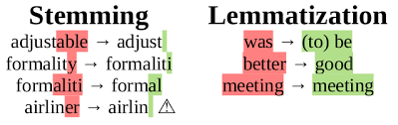
Lemmatization and Stemming

Slide 4
What are Word Embeddings?
texts converted into numbers and there may be different numerical representations of the same text
It is a beautiful day.
It = [1,0,0,0,0]
Beautiful = [0,0,0,1,0]
This is a very simple representation of words into numbers using One-Hot Encoding.

Slide 5
Different types of Word Embeddings
Frequency Based Embedding
Prediction Based Embedding
Frequency based Embedding
There are generally three types of vectors that we encounter under this category.
Count Vector
TF-IDF Vector
Prediction Based Embedding
CBOW
Skip-Gram

Slide 6
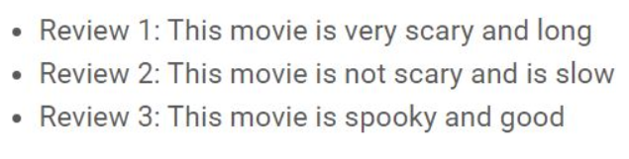
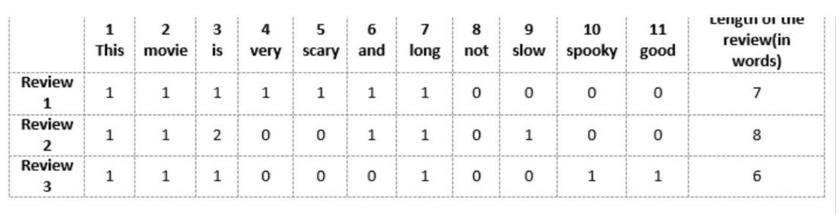
Count Vectorizer/ Bag of Words
Corpus C of D documents {d1,d2…..dD} and N unique tokens extracted out of the corpus C.
The N tokens will form our dictionary and the size of the Count Vector matrix M will be given by D X N

Slide 7
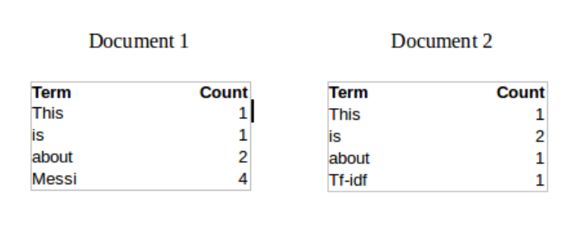
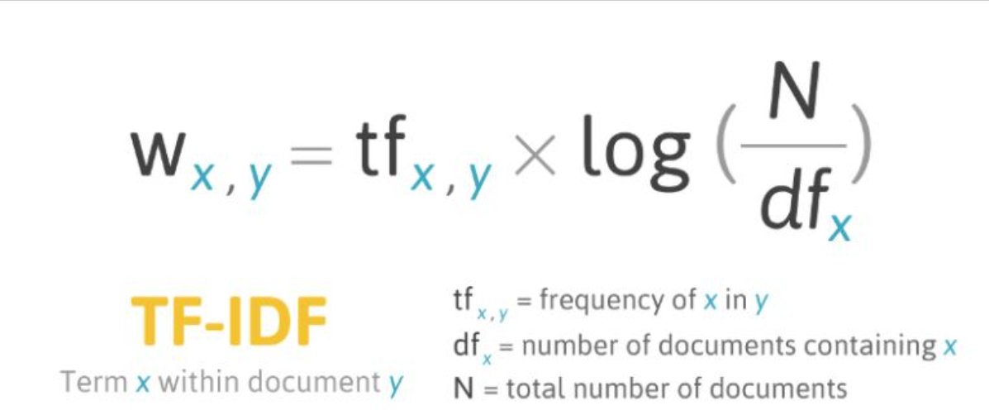
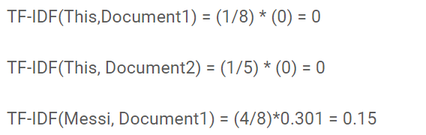
Tf-Idf Vectorizer

Slide 8
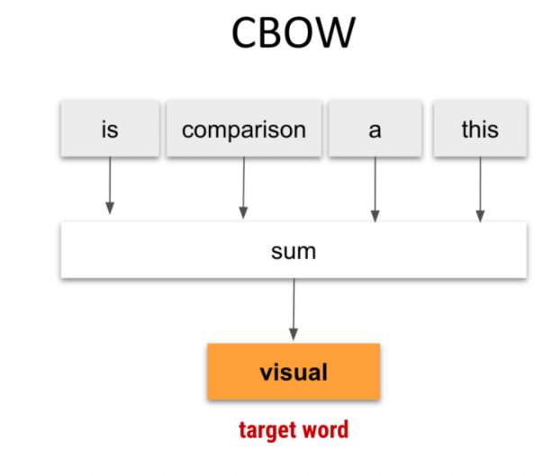
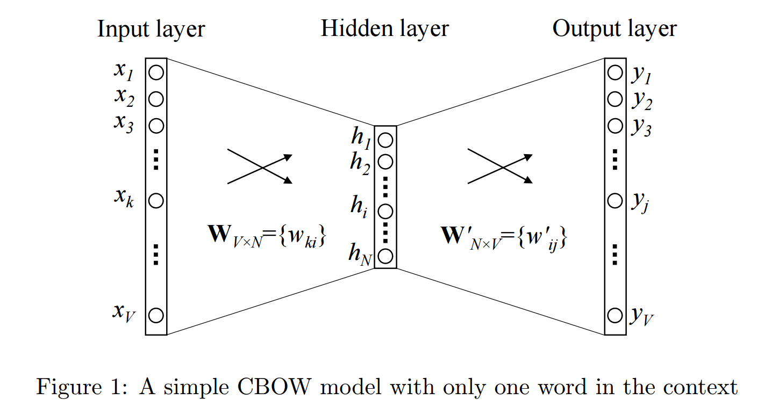
CBOW (Continuous Bag of words)
The way CBOW work is that it tends to predict the probability of a word given a context

Slide 9
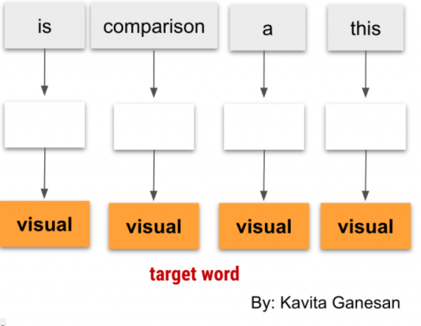
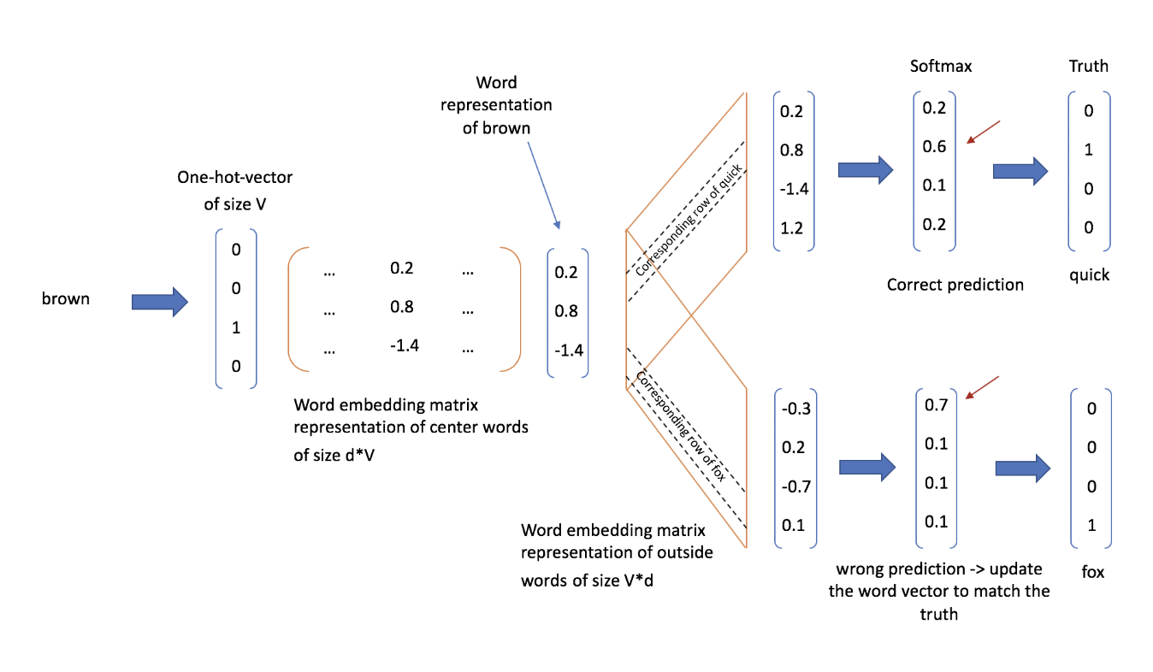
Skipgram Model
The SkipGram model on the other hand, learns to predict a word based on a neighboring word. To put it simply, given a word, it learns to predict another word in it’s context.

Slide 10
Word2Vec Interactive Demo
http://bionlp-www.utu.fi/wv_demo/
https://remykarem.github.io/word2vec-demo/

Slide 11
GLoVe

