Slide 1


to acquire
Acquisition of Organon & Co.
Investment Banking Pitchbook
$14.00 / share $11.75bn enterprise value All-cash
Confidential — prepared for educational purposes only

Slide 2
OVERVIEW
Transaction Summary
Acquirer
Sun Pharmaceutical Industries (NSE: SUNPHARMA)
HOUSE VIEW
Target
Organon & Co. (NYSE: OGN)
PROCEED
Consideration
$14.00 / share, 100% cash
conditional on diligence & financing execution
Enterprise value
~$11.75bn
Equity value
~$3.65bn
Financing
$12bn committed bridge + ~$2.25bn cash
6.2x
~15–20%
Net leverage at close
~2.3x
EV / EBITDA
Disc. to DCF
Break fee
$120m
+60%
~2.3x
Expected close
Early 2027
Yr-1 EPS accretion
Net leverage
Sun Pharma – Organon Acquisition Analysis
Confidential — Educational · 2

Slide 3
EXECUTIVE SUMMARY
Why This Deal
Highlights
Value creation
Key risks
Top-25 global pharma; ~$12.4bn revenue
Women's health + top-10 biosimilars platform
Low ~6.2x entry multiple
China (~$800m) & Korea entry
Buy ~$1.9bn EBITDA below intrinsic value
> $350m cost synergies (2–4 yrs)
Deleverage on Organon's strong FCF
~+60% Year-1 EPS accretion
Established-brands secular decline
Refinancing the ~$9.5bn bridge
Nexplanon sales-practice probe
Biosimilar price erosion
Sun Pharma – Organon Acquisition Analysis
Confidential — Educational · 3

Slide 4
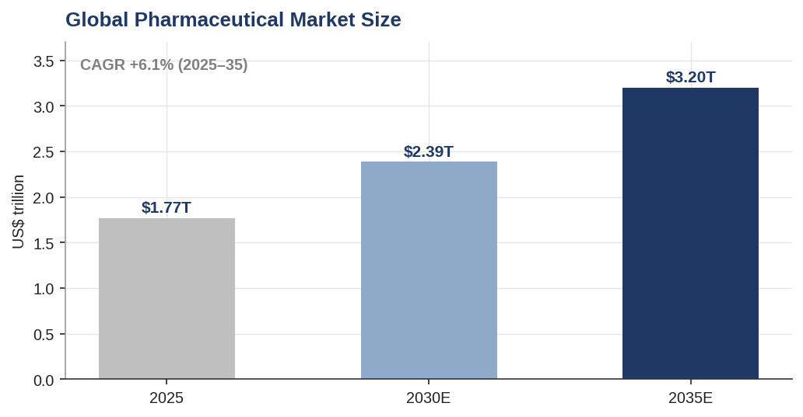
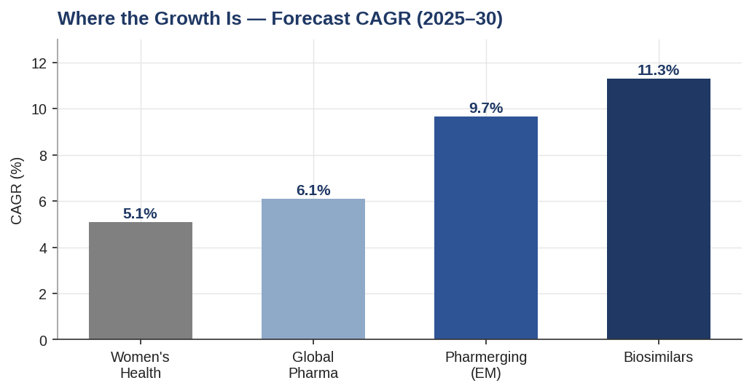
INDUSTRY
A Large, Steady Market — With Faster Pockets
Global pharma ~$1.77T (2025) growing ~6%; biosimilars (~11%) and emerging markets (~10%) are the engines.
Sun Pharma – Organon Acquisition Analysis
Confidential — Educational · 4

Slide 5
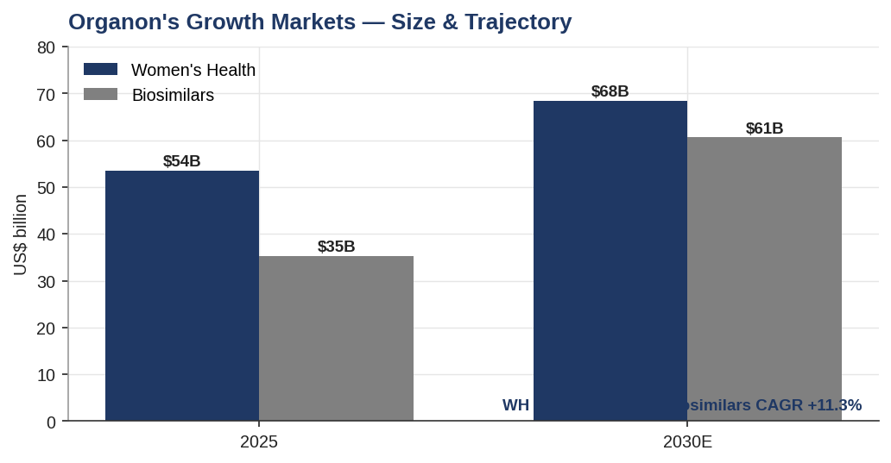
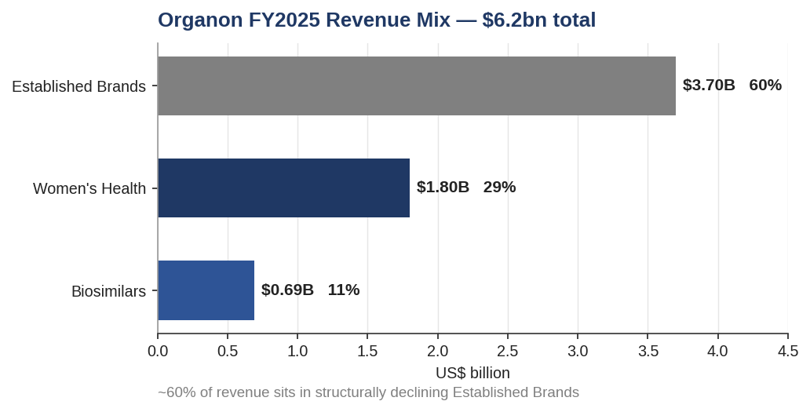
INDUSTRY
Organon Straddles Growth and Decline
~60% of Organon revenue is in structurally declining Established Brands; the growth markets are the smaller ~40%.
Sun Pharma – Organon Acquisition Analysis
Confidential — Educational · 5

Slide 6

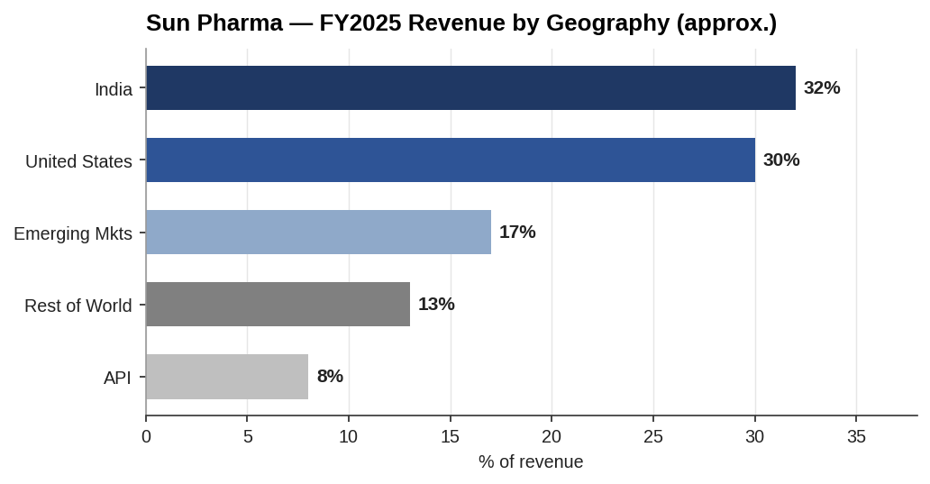
ACQUIRER
Sun Pharma — Growth, Low-Cost, Net Cash
~$6.2bn
~29%
FY25 revenue (+9%)
EBITDA margin
~$3.1bn
54.5%
Net cash
Promoter holding
India's largest pharma; low-cost, API-integrated manufacturing.
Global specialty franchise (Ilumya, Winlevi, Cequa).
Deep emerging-market distribution.
Sun Pharma – Organon Acquisition Analysis
Confidential — Educational · 6

Slide 7

TARGET
Organon — Cash-Generative, Levered, in Transition
$6.2bn
30.7%
FY25 revenue (−3%)
Adj. EBITDA margin
~$8.1bn
~$0.9-1.0bn
Net debt
FCF / yr
Governance flag
Oct 2025: CEO resigned amid an Audit Committee probe into Nexplanon channel-stuffing — a diligence and reps-and-warranties issue.
Sun Pharma – Organon Acquisition Analysis
Confidential — Educational · 7

Slide 8
STRATEGIC RATIONALE
Why Sun Buys · Why Organon Sells
Why Sun Pharma buys
Why Organon sells
Scale to top-25 global pharma
US commercial platform + women's health
Top-10 biosimilars, faster than building
China / Korea market entry
Cheap ~6.2x entry multiple
Depressed equity from debt + dividend cut
All-cash certainty for holders
Leadership vacuum after CEO exit
Sun a better owner of the assets
Synergies: Cost >$350m (2–4 yrs) · Revenue (China/EM cross-sell) · Financial/tax (interest shield, USD match)
Sun Pharma – Organon Acquisition Analysis
Confidential — Educational · 8

Slide 9
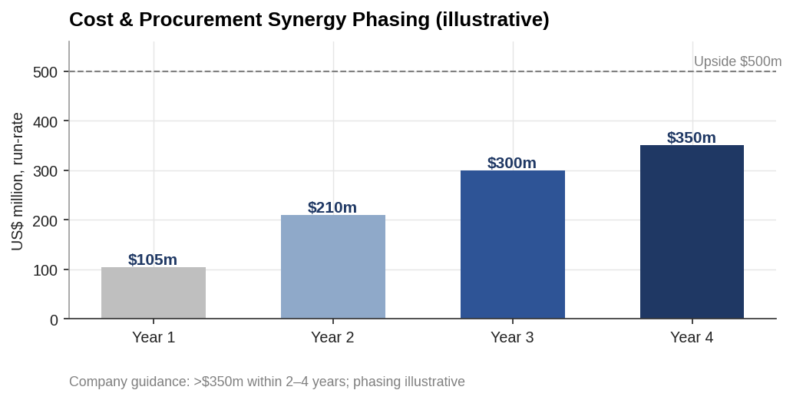
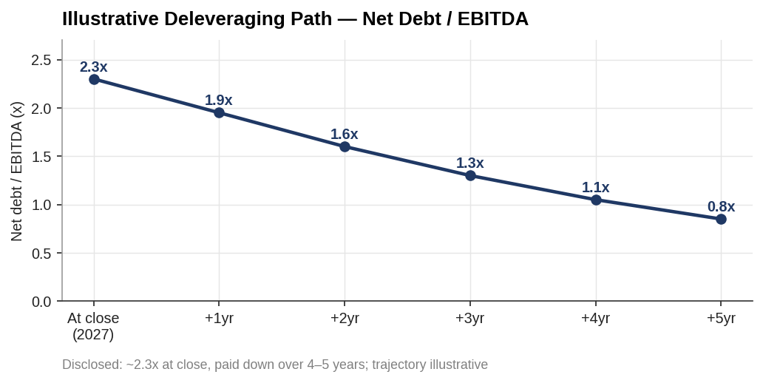
SYNERGIES
Synergy Build & Deleveraging Path
Sun Pharma – Organon Acquisition Analysis
Confidential — Educational · 9

Slide 10
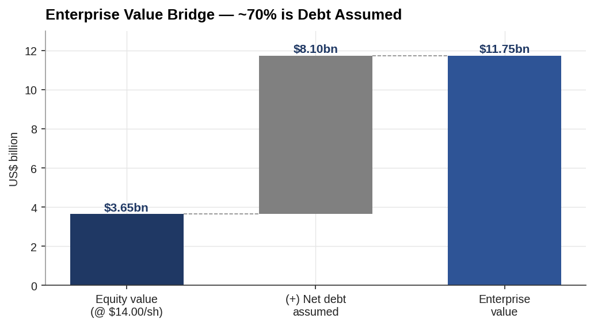
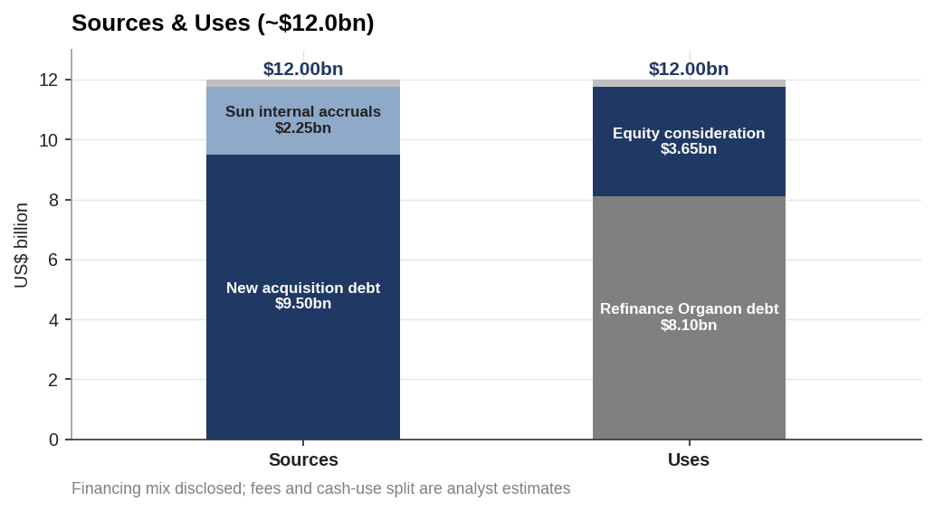
DEAL STRUCTURE
~70% of EV Is Debt Assumed
Sun Pharma – Organon Acquisition Analysis
Confidential — Educational · 10

Slide 11
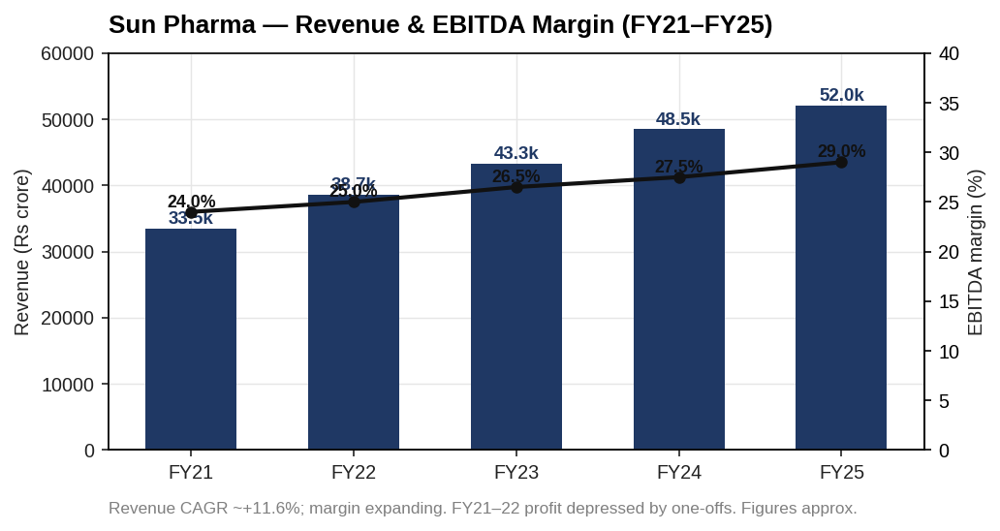
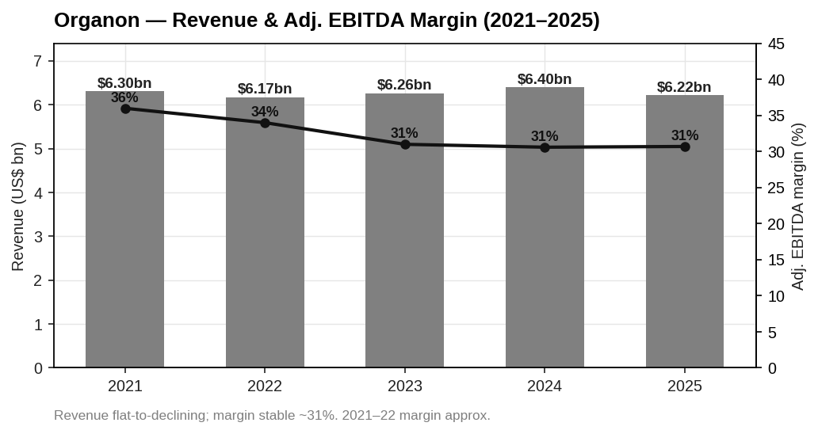
FINANCIAL ANALYSIS
Opposite Financial Profiles
Sun: ~12% revenue CAGR, margin expanding, net cash. Organon: flat revenue, stable ~31% margin, heavy debt.
Sun Pharma – Organon Acquisition Analysis
Confidential — Educational · 11

Slide 12
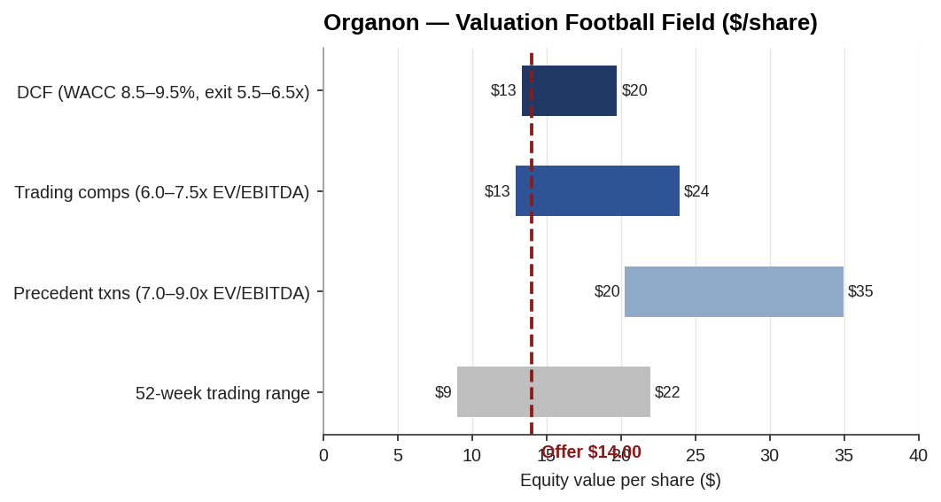
VALUATION
Football Field — Offer at the Low End
$16.5
Base DCF / share
$14.00
Offer / share
~+18%
Base value vs offer
Fair-to-cheap for Sun; defensible for Organon's board given leverage & decline.
Sun Pharma – Organon Acquisition Analysis
Confidential — Educational · 12

Slide 13
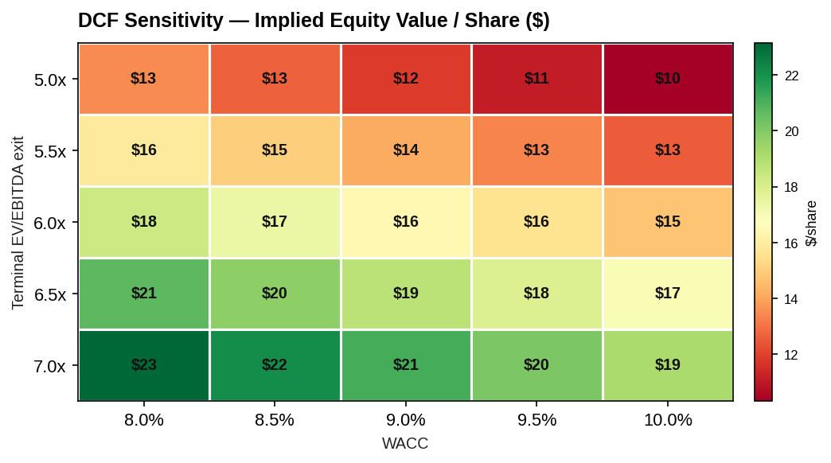
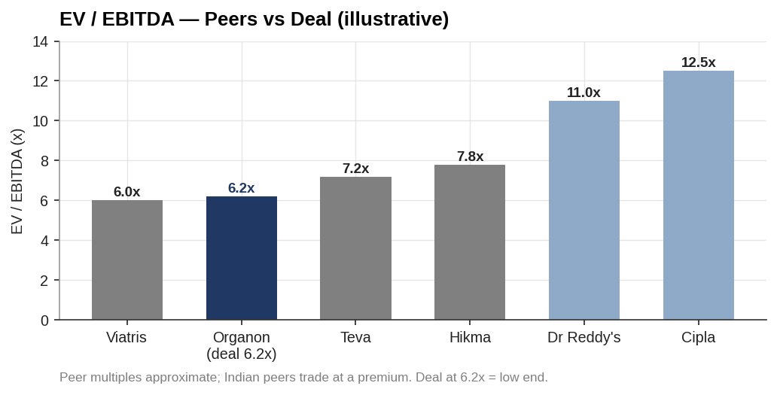
VALUATION
Sensitivity & Comparables
Sun Pharma – Organon Acquisition Analysis
Confidential — Educational · 13

Slide 14
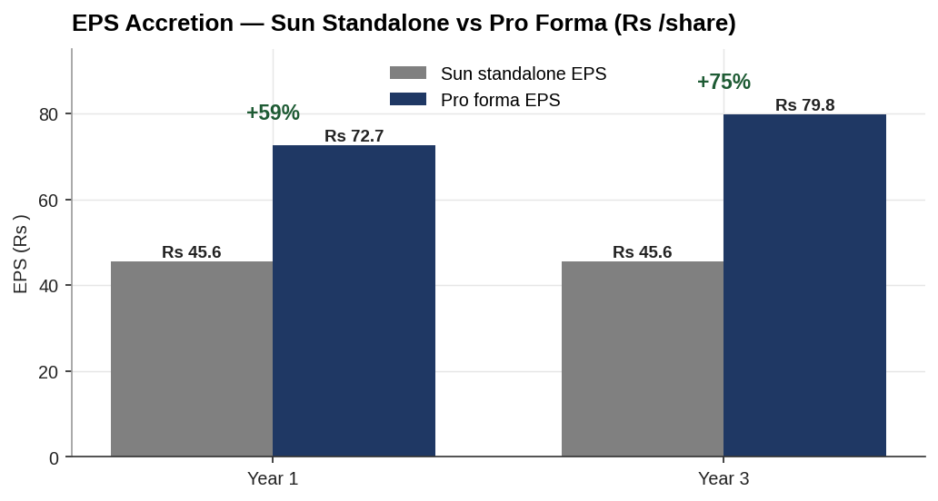
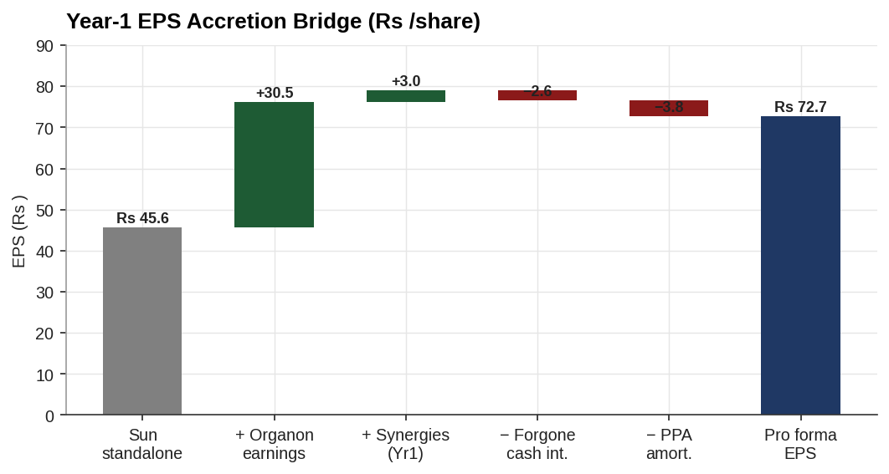
MERGER MODEL
Materially EPS Accretive — But Leverage-Driven
All-cash, no new shares: Organon's earnings yield far exceeds the after-tax cost of debt. Judge on returns & deleveraging, not EPS.
Sun Pharma – Organon Acquisition Analysis
Confidential — Educational · 14

Slide 15
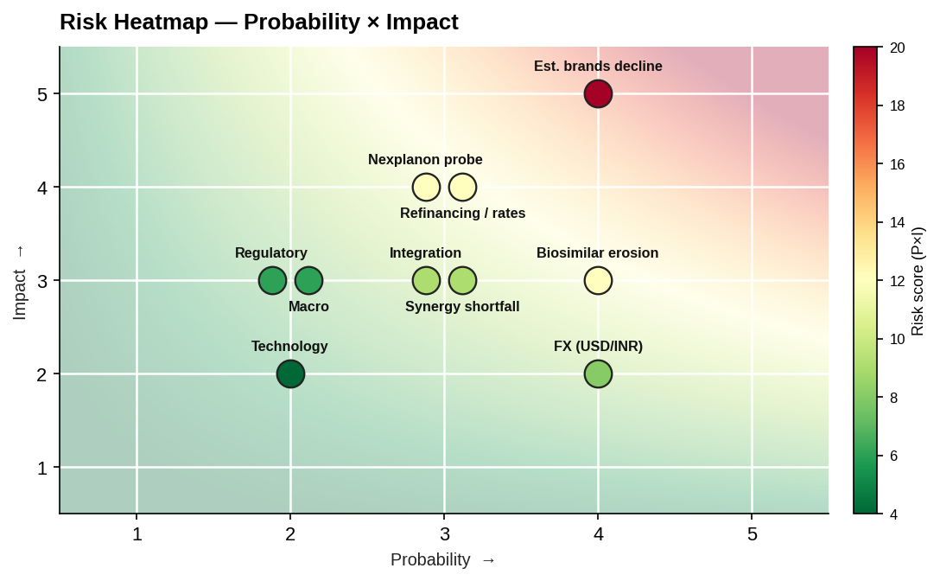
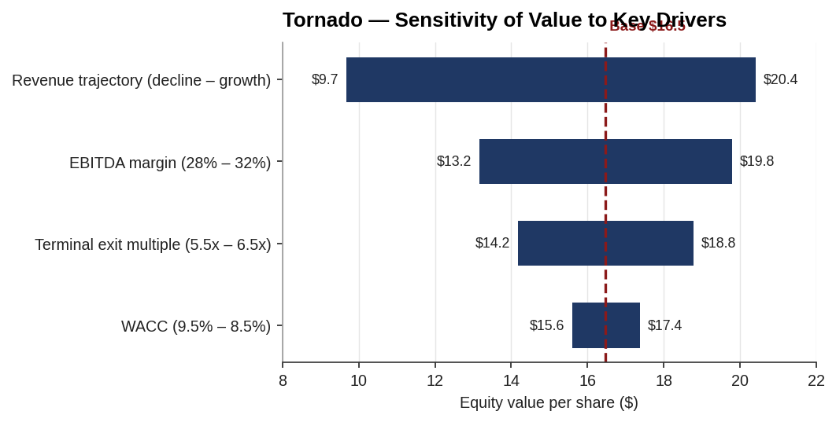
RISK
Concentrated, Underwrite-able Risk
Sun Pharma – Organon Acquisition Analysis
Confidential — Educational · 15

Slide 16
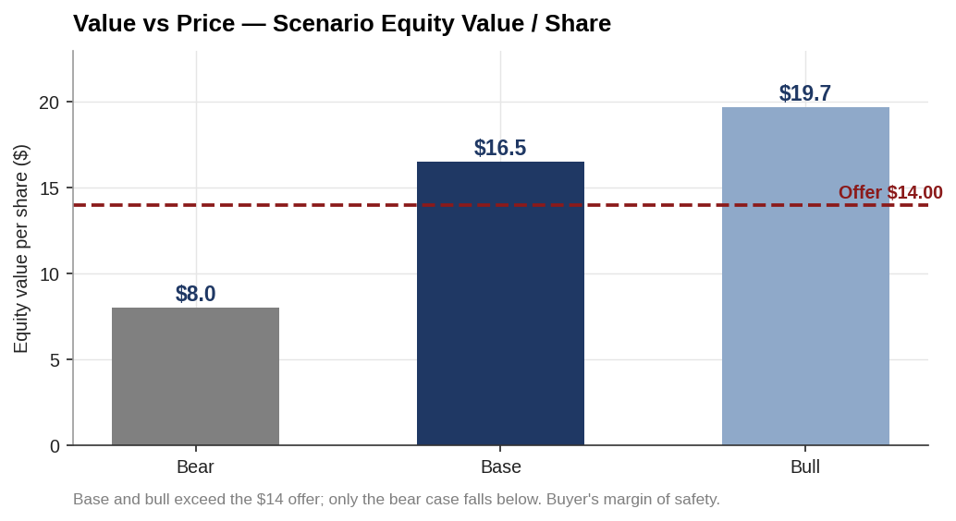
RECOMMENDATION
Value vs Price — Proceed
PROCEED
conditional on diligence (Nexplanon revenue base) and securing permanent financing at a manageable spread.
Base and bull cases exceed the $14 offer; only the bear falls below.
Value from discount to intrinsic worth + synergies + deleveraging.
Sun Pharma – Organon Acquisition Analysis
Confidential — Educational · 16

Slide 17
Recommendation: PROCEED
Sun Pharma / Organon — $14.00 per share, all-cash, ~$11.75bn EV
Confidential — prepared for educational purposes only. Analyst estimates; see research report for sources and assumptions.

