Slide 1
Speech compression using Auto Encoders
CSCI B 659 DLSP Final Project Presentation
Sahaj Singh Maini, Siva Charan Mangavalli
INDIANA UNIVERSITY BLOOMINGTON

Slide 2
Problem Statement
Speech/audio data is stored with a lossless or lossy quality in an uncompressed or compressed formats
There are lossy compression formats like MP3 and AAC, works by reducing certain components of sound that are inaudible for the human ear
WAV format is uncompressed and a lossless audio format, takes up significant space for individual files, good for archiving and editing
FLAC is compressed and a lossless audio format, with significant reduction in size of file size without loss in audio quality
In the current project we are interested in compressing the WAV speech data to a lower size using auto encoders without losing much quality
It could help in exploring DL for speech file compression, optimizing storage, faster transfer and access of large files

Slide 3
Previous Work
Duan et.al. trained VAE to encrypt images into a lower dimension.
Used PSNR and MSE to evaluate the reconstructed images.
The authors claim it is fast and easier to encrypt and reconstruct with low distortion.
It is focused towards images and encryption more than efficient compression of the data.
Srihari worked on an End to End Optimized speech coding using Deep Neural networks.
He used a wideband speech coding pipeline consisting (compression, quantization and decompression).
Use PESQ score for evaluating the reconstruction.
It works well over the bit rates (9kbps ~ 24 kbps). It is not focused on the compression ratio, rather on the quality of the reconstruction.

Slide 4
Previous Work
3. Mohit Goyal et.al proposes using RNN and encoder for lossless compression of sequential data.
Works well for sequence data like genome sequences and DNA sequences etc.
Use the Compression ratio for different datasets as an evaluation metric.
It is not tested on speech or audio data.
4. Amund Vedal proposed the use of VQ VAE for compression of audio spectrograms using a discrete quantization method.
VQ-VAE uses categorical prior and posterior distribution. Uses Wavenet architecture for audio.
It achieves a 9x compression with good reconstruction quality. Used MSE as an evaluation metric.
Produces some distorted results for a few samples in the data.

Slide 5
Proposed Approach Compared to Existing Work
Similar to other approaches, attempted using Mel Spectrogram, STFT and RFFT for TIMIT data. Trained multiple architectures(VAE & AE) using Fully Connected Networks, CNNs
Most existing methods using autoencoders for compression require comparably complicated and larger models which lead to larger training and inference time.
Most existing methods are computationally more expensive and require large amounts of computational resources to achieve robust performance.
We plan to train a simple model that would work on limited resources with faster inference time.

Slide 6
Proposed approach- Part 1
STFT spectrograms (n-fft=1024, hop-length=512) with log(A+C) normalization and min-max scaling, divided in chunks of fixed length as input
Eight-layered CNN autoencoder with dropout regularization. Denormalization and re-scaled output converted to time domain using Griffin-Lim algorithm.
Data compression ratio of 6:1
Tune and evaluate the model on test data by calculating the SNR and PESQ scores on the reconstructed samples

Slide 7
Components- Part 1
Encoder
Decoder
Data Preprocessing
Reconstruction
Evaluation
Pre-processing - Librosa and Numpy. (generating spectrograms, normalization, scaling)
Autoencoder model constructed using Tensorflow
First four layers of the model are encoder layers and the last four layers are decoder layers.
Converted to time-domain using Griffin-Lim
Evaluate the reconstructed samples using SNR function and PESQ library
Trained on Google Colab ( 2.2 GHz CPU, Tesla K80 GPU, 13 GB RAM)

Slide 8
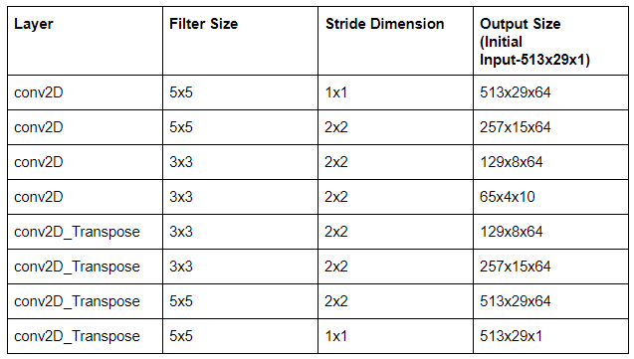
Components- Part 1
Architecture-

Slide 9
Experiments And Evaluation Metrics- Part 1
Used Mel spectrogram did not yield good results for the same approach.
Generated spectrograms using multiple different STFT parameters for evaluation
Evaluated multiple different CNN based autoencoder architectures with different regularization techniques (L2, L1)
Evaluated the resulting audio files using SNR and PESQ that are commonly used for comparison of Speech Signals
SNR close to 0, and high PESQ (Perceptual Evaluation of Speech Quality) corresponds to good reconstruction. (range of PESQ score is -0.5 to 4.5)

Slide 10
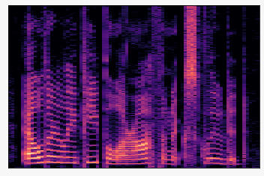

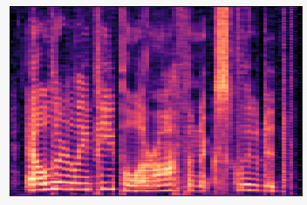
Results- Part 1
Original Audio
Frequency
Metric | Value
Mean SNR | 6.555
Mean PESQ Narrow Band | 1.751
Mean PESQ Wide Band | 1.458
Time
Reconstruction
Frequency
We can hear that although the voice quality is affected, the background noise is very low.
Time

Slide 11
Proposed approach- Part 2
Load WAV files and scale the values to [-1,1], apply RFFT to speech files and divide the data into chunks of fixed length.
Train a simple feed forward fully connected neural network (four hidden layers) with a batch size equal to number resulting RFFT chunks of one speech file at a time.
Convert output to time-domain using IRFFT
Compression ratio of 4:1
Tune and evaluate the model on test data by calculating the SNR and PESQ scores on the reconstructed samples

Slide 12
Components- Part 2
Encoder
Decoder
Data Preprocessing
Reconstruction
Evaluation
Used TensorFlow audio decoder to load the data, SciPy rfft function to convert the data to real valued fast Fourier transform
Encoder and Decoder networks are simple FCN networks
Reconstruct using the irfft function in SciPy and convert to wav using audio encode function in TensorFlow
Evaluate the reconstructed samples using SNR function and PESQ library
Trained on Google Colab ( 2.2 GHz CPU, Tesla K80 GPU, 13 GB RAM)

Slide 13
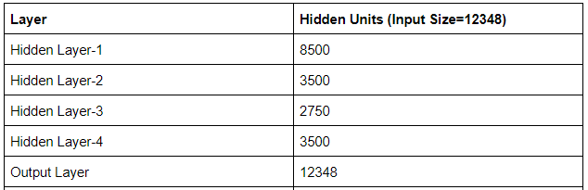
Components- Part 2
Architecture

Slide 14
Experiments and Evaluation Metrics- Part 2
For the RFFT approach, we modified the latent embedding dimension to see the effect on reconstruction
Determined the parameters by tuning them and checking the validation error
Used SNR and PESQ scores, commonly used metrics for comparing speech signals
SNR close to 0, and high PESQ (Perceptual Evaluation of Speech Quality) corresponds to good reconstruction. (range of PESQ score is -0.5 to 4.5)

Slide 15
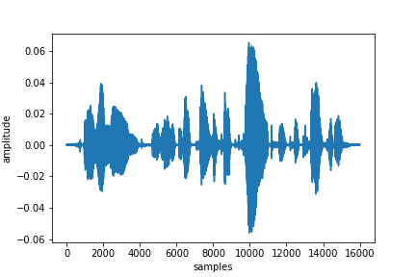
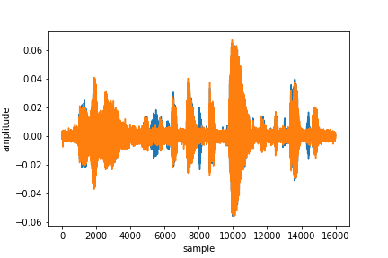
Results- Part 2
Original
Metric | Value
Mean SNR | -2.006
Mean PESQ Narrow Band | 1.641
Mean PESQ Wide Band | 1.1785
Reconstructed
Although the voice quality retains, the background noise is significant.

Slide 16
Discussion
Initially trained VAE and Beta-VAE on Mel spectrograms after normalizing and scaling data but reconstruction loss does not converge low enough.
Forcing VAE to learn the latent distribution for a multitude of speakers is not very intuitive and is not practical for compression purposes.
More emphasis on the input data pre-processing for better result (normalization and scaling)
Trained Mel spectrograms and STFT spectrograms with multiple CNN autoencoders and reconstructing the audio using Griffin-Lim algorithm while using STFT spectrograms led to encouraging results with the reconstruction heavily depending on the STFT parameters.
Speech compression is not very intuitive compared to image compression or sequence compressions using DNN’s

Slide 17
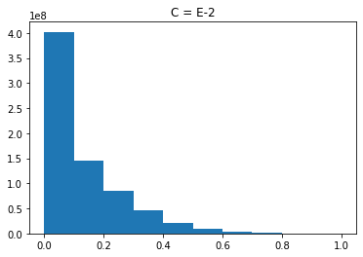
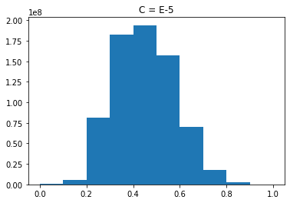
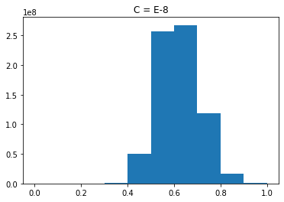


Discussion
Normalization
Scaling
[0, 1] & [-1,1]
$A =\log\left(A+c\right)$
c$=( small decimal)$
Appropriate value of c transforms the data into a Near Normal distribution

Slide 18
Future Work
A general framework for better intuition on training deep learning models on audio data.
Evaluate out by varying the sizes of latent space to see how it effects the reconstruction.
Optimizing the model for faster training and inference.
Evaluate ConvLSTM based architecture for compression.
Implement and evaluate MobileNet architectures for the same task

Slide 19
Conclusion
The proposed approaches provide satisfactory performance.
Converted speech data to RFFT, trained with Fully Connected Networks, gives the reconstructions with good voice quality while having higher background noise
Converted speech data to STFT spectrogram trained with CNN, gives reconstructions with low background noise while having a reduced voice quality (distorted while being highly interpretable)
Once optimized for faster training and inference on a better resource could be used on edge devices to compress and store the speech data

Slide 20
References
Garofolo, J. S., Lamel, L. F., Fisher, W. M., Fiscus, J. G., & Pallett, D. S. (1993). DARPA TIMIT acoustic-phonetic continous speech corpus CD-ROM. NIST speech disc 1-1.1. NASA STI/Recon technical report n, 93.
Duan, X., Liu, J., & Zhang, E. (2019). Efficient image encryption and compression based on a VAE generative model. Journal of Real-Time Image Processing, 16(3), 765-773.
Kankanahalli, S. (2018, April). End-to-end optimized speech coding with deep neural networks. In 2018 IEEE International Conference on Acoustics, Speech and Signal Processing (ICASSP) (pp. 2521-2525). IEEE.
Hsu, W. N., Zhang, Y., & Glass, J. (2017). Learning latent representations for speech generation and transformation. arXiv preprint arXiv:1704.04222.
Amund Hansen Vedal “Unsupervised Audio Spectrogram Compression using Vector Quantized Autoencoders Master thesis”
Mohit Goyal, Kedar Tatwawadi, Shubham Chandak and Idoia Ochoa “DeepZip: Lossless Data Compression using Recurrent Neural Networks”

Slide 21
Thank You

