Slide 1
RESEARCH DIRECTION · AMORTIZED WARM-START OPTIMIZATION
Steer or Screen?
How to spend a learned cost-to-go when warm-start budget is scarce
STEER
vs
SCREEN
gradient-descend a surrogate · vs · rank many samples, solve the best few
Presented by [Your Name] · Prepared for Prof. [Advisor]

Slide 2





PART 1
The same hard problem, solved again and again
Many deployed systems re-solve one parametric optimization every step — only the parameters change.
Model-predictive control
Why the seed matters
re-solves a trajectory problem every timestep
When the objective is nonconvex, the starting point (the warm-start) decides not just how fast the solver converges, but which local minimum it falls into.
Portfolio optimization
re-optimizes continuously as prices move
Robotic manipulation
A naive seed drops into the nearest basin — usually not the deepest one.
re-plans as the scene in front of it shifts
02

Slide 3


PART 2
The literature measures “faster,” not “better basin”
Learned warm-starts are known to cut iterations. Reaching a lower minimum at equal cost is a strictly stronger claim.
Well established
The open question
Learned seeds reduce solver iterations and runtime versus naive initialization — a closer basin, faster convergence.
Does the learned seed reach a lower minimum at equal solver cost? That needs a better basin, not merely a nearer one.
“Measuring faster is easy and common. Measuring better basin, at equal cost is neither — and it is where the interesting uncertainty lives.”
03

Slide 4


THE RESEARCH QUESTION (RQ5)
Same trained model. Same solver budget. Steer or screen?
Given a conditional generative model over good solutions and a learned cost-to-go g(z,θ), with a fixed budget of expensive solver calls — how should we spend it?
OPTION A
OPTION B
Steer
Screen
Run cheap gradient descent on the surrogate g(z,θ) in latent space toward a low-predicted-cost point, decode it, and hand one refined seed to the solver.
Bet: the smooth latent lets us search for a better basin without spending solver calls.
Draw many latent samples, rank them with the surrogate g, and spend the budget solving only the top-ranked few.
Bet: use the cost signal as a filter over diverse seeds, not as a gradient toward one.
Both use the identical trained components. They differ only in how the scarce budget is spent.
Notes:
This is the heart of the pitch. Emphasize: both options use the IDENTICAL trained model and surrogate. The only variable is how the scarce solver budget is spent. Steering = one refined seed via gradient descent; Screening = many samples, filter, solve the best few.

Slide 5




PART 3
A controlled, budget-matched comparison
A dimension-general family of nonconvex wells where the deepest basin moves with the instance parameter θ.
The landscape
Two regimes
Two test shifts
K Gaussian wells + a mild bowl. Each well’s depth depends on θ, so the global basin moves as θ changes — a genuine learning problem, not a lookup.
A — low-dim / densely covered (D=2, P=2, K=6).
B — high-dim / sparsely covered (D=8, P=6, K=12).
In-distribution (θ matches training) and a mean-and-variance shift away from training, to test robustness.
The one thing rationed: solver calls
A “query” is one solver call — the expensive operation. Every method is compared at a matched budget B. Cheap surrogate-gradient steps are free and uncounted. Metric: optimality gap vs. a large-multistart reference (median and 90th-percentile tail).
05

Slide 6
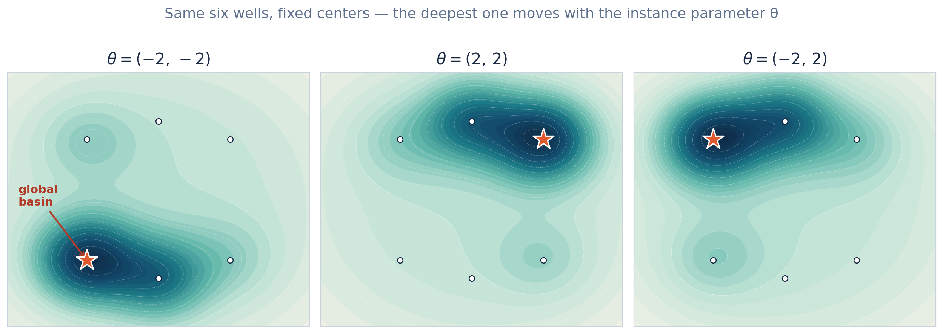
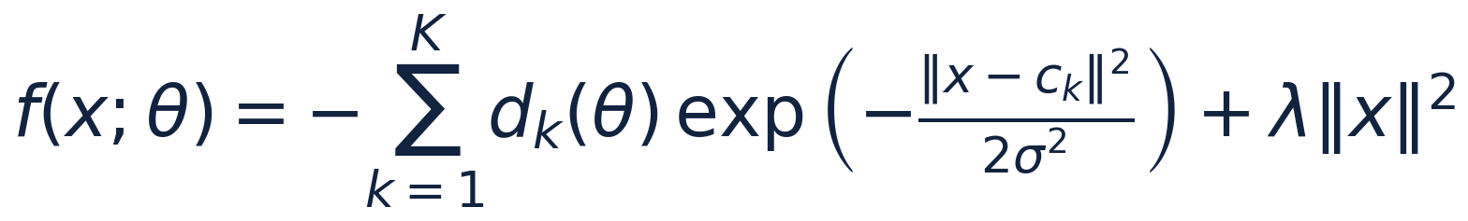
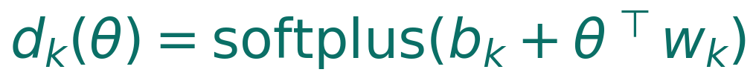
PART 3
The landscape, up close: a moving global basin
A dimension-general family of nonconvex wells — a clean, controllable stand-in for real multi-basin structure.
The objective family
Wells K Gaussian dips at fixed centers c_k — the candidate basins.
Depth d_k(θ) A softplus of θ, so each well’s depth shifts with the instance.
A naive seed falls into the nearest well; a good seed must learn which well to head toward for a given θ.
Bowl λ‖x‖² A mild quadratic that keeps the problem bounded.
Regime A
D=2, P=2, K=6 · dense (shown)
Regime B
D=8, P=6, K=12 · high-dim & sparse
Key property: the deepest well — the global basin — moves as θ varies.
06

Slide 7
PART 4
Six ways to spend the budget
All learned methods share the same trained model and surrogate — so the comparison isolates strategy, not training.
random
retrieval
Baseline
Baseline
B uniform random seeds; solve all, keep best.
The B nearest-θ training solutions as seeds.
sample-pick
sample-screen
Sample
Screen
Draw B latents, decode, solve all, keep best.
Draw a large pool, rank by g, solve the top-B.
latent-opt (trust)
latent-opt (no trust)
Steer
Steer
Descend g + trust penalty, decode, solve B.
Same, τ=0 — exposes surrogate exploitation.
The decisive comparison: latent-opt (trust) vs sample-screen — does steering beat using the very same cost signal as a filter?
07

Slide 8
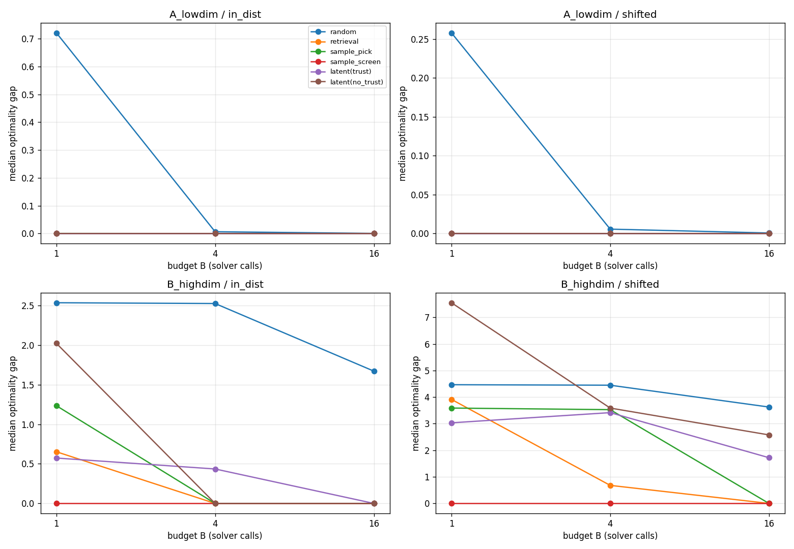

PART 5
Low-dim regime: nobody earns their complexity
In the densely-covered 2-D space, plain nearest-neighbor retrieval already solves it — no learned method wins.
0.72
≈ 0
random gap at B=1
every structured method
A warning about toy benchmarks
In two dimensions, retrieval looks unbeatable and every method — steering included — sits on the floor at the median.
Any warm-start study reporting only low-dim, in-distribution results is measuring the benchmark, not the method.
Fig. 1 — median optimality gap vs. matched budget B (top row: low-dim regime A).
08

Slide 9
PART 5
High-dim regime: the cost-to-go pays off — as a screen
In the sparse, high-dimensional space the methods separate, and one dominates everywhere.
0.00
B = 1
1.32 → 0
sample-screen median gap — every budget, in-dist & shifted
screen already hits zero at a single solver call, even under shift
screen’s p90 tail at B=1 — far tighter than any rival
Regime B, shifted — median gap (p90)
method | B=1 | B=4 | B=16
sample-screen | 0.00 (6.36) | 0.00 (1.29) | 0.00 (0.00)
sample-pick | 3.59 | 3.53 | 0.00 (4.39)
retrieval | 3.92 | 0.68 | 0.00
latent-opt (trust) | 3.03 | 3.42 | 1.72
random | 4.47 | 4.45 | 3.63
Screening dominates
Ranking a pool of samples by the learned cost-to-go and solving only the best few is, by a wide margin, the most reliable way to spend a scarce budget — reaching the global basin even from a single solver call under distribution shift.
09

Slide 10


PART 5
Steering never wins — and gets worse with budget
The one capability a smooth latent adds turns out to be a liability when the budget is scarce.
Median gap as budget grows (latent-opt, in-dist)
The mechanism: diversity collapse
B = 1
B = 4
B = 16
Gradient descent pushes all B latents into the same low-g region. The B seeds become near-duplicates, so multi-start buys almost nothing.
Sampling methods spread their seeds out and convert extra budget into extra basin coverage. Steering cannot — so its median gap is flat or worsens as B grows.
0.573
0.435
0.000*
* “flat then late” — screening was already at 0.00 from B=1. Steering only arrives at large budget, and stays high under shift.
Steering helps over blind sampling — but is dominated by screening everywhere it matters, and forfeits the diversity scarce-budget multi-start depends on.
By B=16 under shift it is the second-worst method — beaten even by blind sample-pick.
10

Slide 11
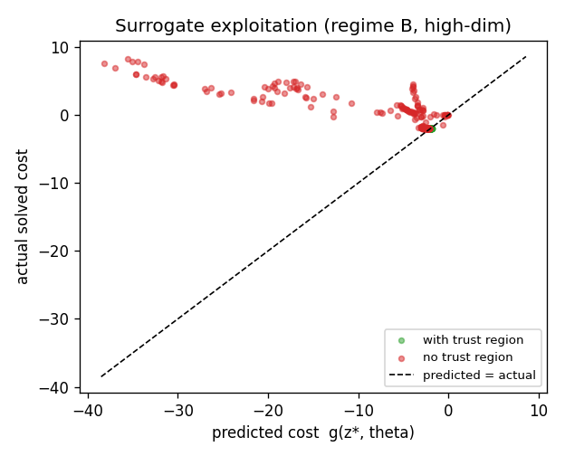
PART 5
The trust region is necessary but not sufficient
Without it, gradient descent exploits the surrogate off-manifold — promising low cost it cannot deliver.
No trust region (red)
The surrogate confidently predicts very low cost, but the decoded seed solves to high cost — points far below the diagonal. It is the worst method at B=1 in the hard regime.
With trust region (green)
The penalty pulls latents back to where g is accurate — predictions stay honest and tightly clustered. But this only rescues steering from catastrophe; it reaches parity-to-worse against screening, never better.
Fig. 2 — predicted vs. actual solved cost, high-dim regime.
11

Slide 12
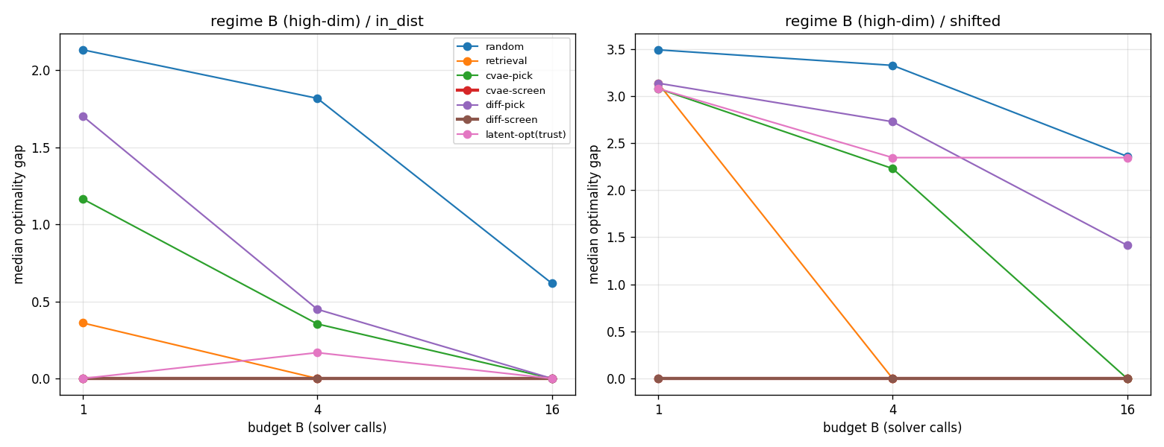

PART 5
Is it the latent, or the ranker? Diffusion vs. VAE
Swap the generator, move the ranker into solution space — and see what actually carries the weight.
Fig. 3 — median gap vs. budget, high-dim regime: two screening curves hug the floor; two “pick” curves track well above.
Screen wins regardless of generator
Neither generator helps alone
The asset is portable
vae-screen and diff-screen are statistically indistinguishable — both at a median gap of zero.
vae-pick and diff-pick are both mediocre; the diffusion model’s celebrated diversity buys nothing unranked.
A solution-space ranker screens any sampler equally well — so the useful object is the cost-to-go, not the latent.
12

Slide 13
THE VERDICT ON RQ5
Steering is the wrong instrument. The cost-to-go is the asset.
Latent steering loses
Screening wins
The signal is generator-agnostic
It never wins where the choice matters, and degrades with budget by collapsing seed diversity.
The learned cost-to-go, used as a ranker over diverse samples, reaches the global basin at every budget.
A solution-space ranker sharpens a diffusion sampler and a VAE equally — neither works without it.
Practical recommendation: invest in a good cost-to-go predictor, spend the query budget on the samples it ranks best, and treat latent steering as promising only if diversity is explicitly restored.
Notes:
Land the verdict slowly. The exciting hypothesis (steering) loses; the humble one (cost-to-go as a ranker) wins and is generator-agnostic. This is what motivates my proposed directions on the next slide.

Slide 14
WHERE I WANT TO CONTRIBUTE
What I want to research next
The negative result opens five concrete directions. These are the ones I’d most like to pursue.
01
Diversified steering
04
A theory of diversity collapse
Add a repulsion / quality-diversity term so steering targets several distinct low-cost modes. The one route by which latent geometry might still earn its place.
Bound the effective number of distinct basins reached as a function of steering strength — turning the empirical mechanism into a principle.
02
Higher dimension + real constraints
05
Scale the sampler
Push P higher and move to a genuine trajectory-optimization / MPC family to test whether screening’s reliability and retrieval’s collapse persist beyond synthetic wells.
Re-examine the pick-vs-pick comparison with a larger, better-tuned diffusion / flow-matching model now that screen-vs-pick is settled.
03
Stress-test the ranker
My starting point
Characterize how screening degrades as the cost-to-go’s ranking accuracy drops — the assumption the entire result rests on.
Directions 1 and 3 are self-contained and buildable on the existing code — I’d propose beginning there, then scaling toward a real MPC family.
14
Notes:
Frame these as MY agenda. If asked where to start: directions 1 (diversified steering) and 3 (stress-test the ranker) are the most self-contained and testable on the existing script.

