Slide 1
TENSOR DECOMPOSITIONS · SPARSE CODING · BENCHMARK
A Unified Projection Framework for Tensor-Structured Dictionary Learning
Six dictionaries, one harness — and an efficiency ranking system that says which one to use when
Sahaj Chhetri
August 17, 2026
Notes:
Talk covers a controlled comparison of five tensor-structured dictionaries plus an unstructured baseline, all sharing one sparse-coding harness, and a three-layer ranking system for deciding between them.

Slide 2
MOTIVATION
2
Flattening a patch discards its structure
Classical dictionary learning models a signal as y ≈ Dx, with unit-norm atoms and a sparse code. For a multiway patch the standard recipe flattens it to a vector of length n = ∏ᵢ nᵢ.
Spatial neighbourhoods and spectral smoothness — exactly the redundancy that makes the data cheap to encode — are discarded by the flattening.
The dictionary then carries n·K free numbers, which grows multiplicatively with tensor order: each extra mode multiplies the parameter count.
More free parameters than the data's true complexity needs invites over-fitting, and on noisy data the extra capacity is spent modelling noise.
25,920
free parameters — vectorized dictionary, 6×6×6 patches, K = 120 atoms
2,160
the same 120 atoms under a CP-structured dictionary — 12× smaller
126
Tucker mode factors covering 343 implicit atoms — 206× compression
Notes:
The parameter blow-up is the headline problem: it is multiplicative in tensor order, and the capacity it buys is a liability on noisy data.

Slide 3
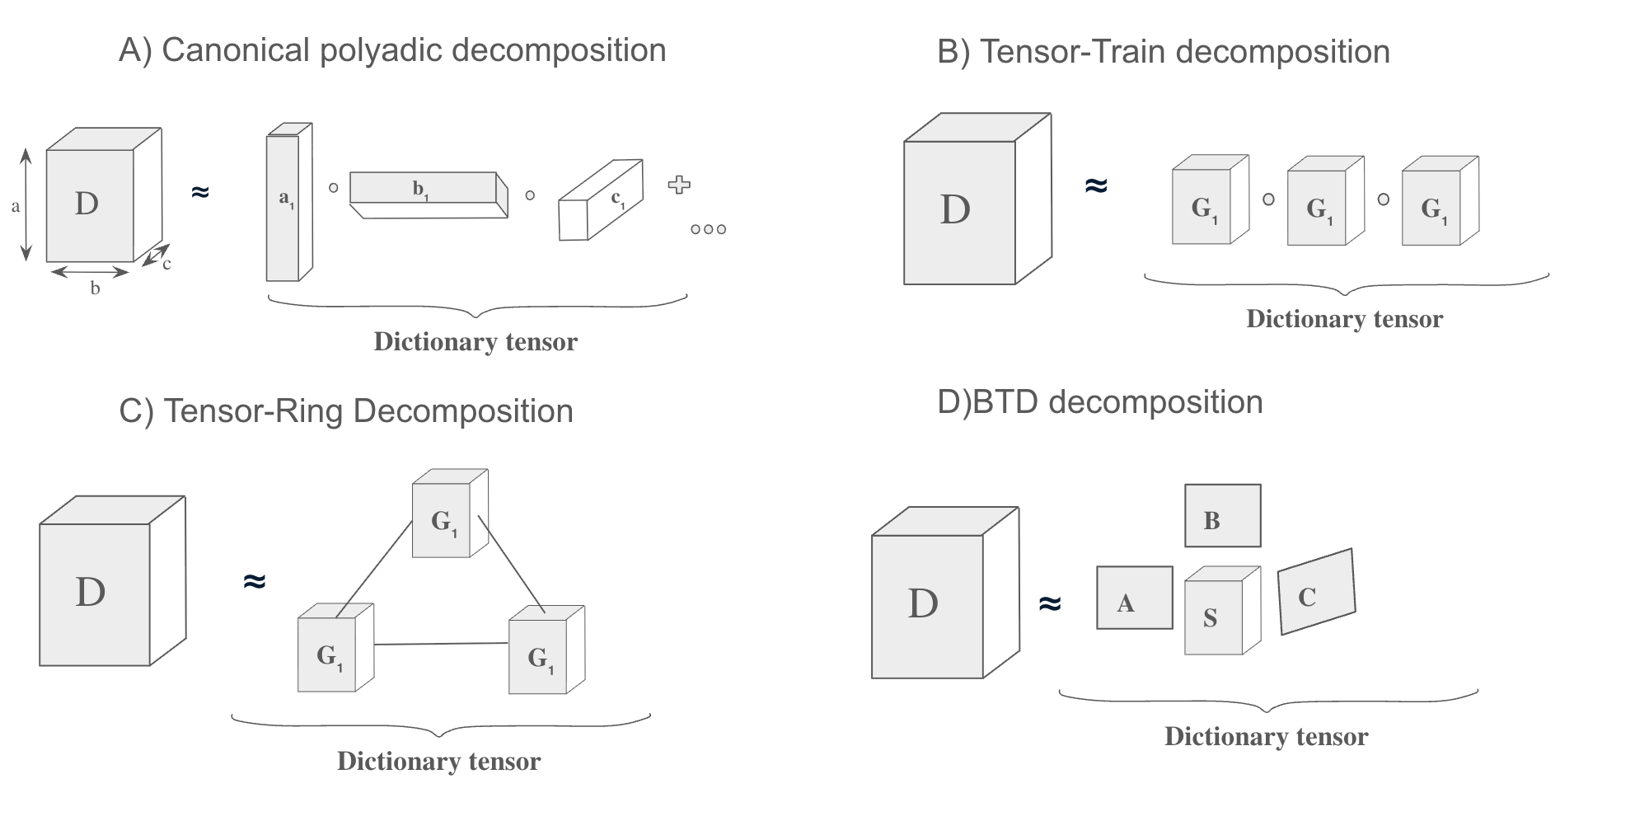
THE FIX
3
Constrain the atom, not the data
Tensor decompositions repair both problems by forcing each atom into a low-parameter format — representing the same patch at low rank rather than discarding its structure. The sparse code stays sparse regardless of dictionary size, so only the nonzero entries are ever stored or touched.
Notes:
Figure 1 from the paper: CP, Tensor-Train, Tensor-Ring and BTD each impose a different low-parameter format on the dictionary tensor. At three modes the saving is modest; it compounds sharply as modes are added.

Slide 4
CONTRIBUTIONS
4
Four things this work puts on the table
1
One harness
2
A projection view
CP, Tucker, TT, TR, BTD and an unstructured baseline share the same OMP sparse coding, the same reconstruction and the same evaluation — so only atom structure differs.
CP / TT / TR / BTD are realized as one line changed inside the K-SVD atom update; Tucker is matched in-harness via separable alternating least squares.
3
A ranking system
4
Three regimes tested
Three layers, objective to opinionated: Pareto dominance, an accuracy-per-parameter scalar, and profile-weighted composite tiers.
Synthetic mixed-structure patches, real RGB patches and a hyperspectral cube — including a matched-parameter-budget rate–distortion study across noise levels.
Notes:
The framework is deliberately extensible: a new decomposition costs one projector and one parameter-count rule.

Slide 5
EXPERIMENTAL DESIGN
5
What is held identical, and what is allowed to vary
Cross-method comparisons in this literature are unreliable because each construction ships with its own optimizer — an observed gap may reflect the optimizer or hand-picked settings rather than the decomposition.
=
Held identical
≠
Allowed to vary
The sparse-coding objective and its solver — Orthogonal Matching Pursuit against the effective dictionary D
Reconstruction: the same linear map x ↦ Dx for every method
Training data, noise level, sparsity cap and random seeds
Evaluation: denoising PSNR against clean held-out test patches
How each atom is parameterized — the decomposition format it is projected onto
How many free parameters that parameterization costs to store
The rank knob each format exposes (CP rank R, TT/TR rank r, BTD block rank L)
Because the objective and its solver are shared, the accuracy comparison is apples-to-apples.
Notes:
This is the core methodological claim of the paper: only the atom structure differs between arms.

Slide 6
BACKGROUND
6
The loop everything plugs into: K-SVD with OMP
01
02
03
Sparse coding
Atom update
Alternate
OMP holds D fixed and picks atoms one at a time, re-solving all chosen coefficients by least squares after every pick. The residual stays orthogonal to the span already selected, so no atom is chosen twice.
→
With the support fixed, each atom is refit from a rank-one SVD of the restricted error matrix E — the error present when atom k is absent, taken only over the signals that already use it.
→
The two steps repeat until reconstruction error stops falling. Restricting to Ω is what keeps the atom update and the sparsity pattern consistent across iterations.
E = Y|Ω − D X|Ω + dₖ xₖᵀ
The final term is easy to misread as adding error — in fact it un-subtracts atom k, leaving exactly the gap a new atom must fill: not the error left after atom k has worked, but the error present when atom k is absent.
Notes:
Orthogonality is what distinguishes OMP from plain matching pursuit. The restricted error matrix is the piece most often misread — the +dx term cancels atom k out of the reconstruction sum.

Slide 7
THE PROJECTION VIEW
7
Where a decomposition can enter
Structure on each atom
Structure on the whole dictionary
CP · TT · TR · BTD
TUCKER
Each atom is itself a low-parameter tensor. Atoms are independent, so the constraint is enforced atom-by-atom: take the optimal unconstrained atom from the K-SVD rank-one step and project — “snap” — it onto the decomposition’s manifold. Four of the six methods differ by exactly this one line.
Every atom is built from one shared set of per-mode vectors, so the constraint couples all atoms — there is no single atom to project. The update instead re-fits the shared mode factors by separable alternating least squares, each mode an exact closed-form solve.
CP ⇒ Khatri–Rao
TUCKER ⇒ KRONECKER
D = A ⊙ B ⊙ C
D = U₃ ⊗ U₂ ⊗ U₁
Storage falls from n₁n₂n₃K to (n₁+n₂+n₃)K.
The core plays the role of the sparse code.
The Khatri–Rao is the column-matched Kronecker: CP keeps only matched triples, Tucker keeps all k₁k₂k₃ combinations.
Notes:
This split organizes the whole paper: four methods are a projection; Tucker needs a different update because its constraint is shared.

Slide 8
PARAMETER ACCOUNTING
8
What each format actually costs to store
Method | Dictionary form | Stored parameters
Vectorized | free atoms | K ∏ᵢ nᵢ
CP (rank R) | D = A ⊙ B ⊙ C (Khatri–Rao) | K R S
Tucker | D = Uₙ ⊗ ⋯ ⊗ U₁ (Kronecker) | Σᵢ nᵢkᵢ
TT (rank r, N = 3) | chain of cores | K [ r(n₁+n₃) + r²n₂ ]
TR (rank r) | ring of cores | K r² S
BTD (L, b blocks) | sum of Tucker blocks | K b (Lᴺ + L S)
Reading the table
S = Σᵢ nᵢ; the atom shape is (n₁, …, nₙ).
The dictionary count is the storage budget we compare on.
The sparse code (or Tucker core) is per-sample and excluded from every method equally.
For Tucker the atom count is ∏ᵢ kᵢ — only the mode factors are stored.
Every count is multiplicative in K except Tucker's, which is additive across modes — that single asymmetry drives most of what follows.
Notes:
Tucker stores three shared mode dictionaries, so parameters grow roughly linearly with mode dimension while the atom count grows multiplicatively.

Slide 9
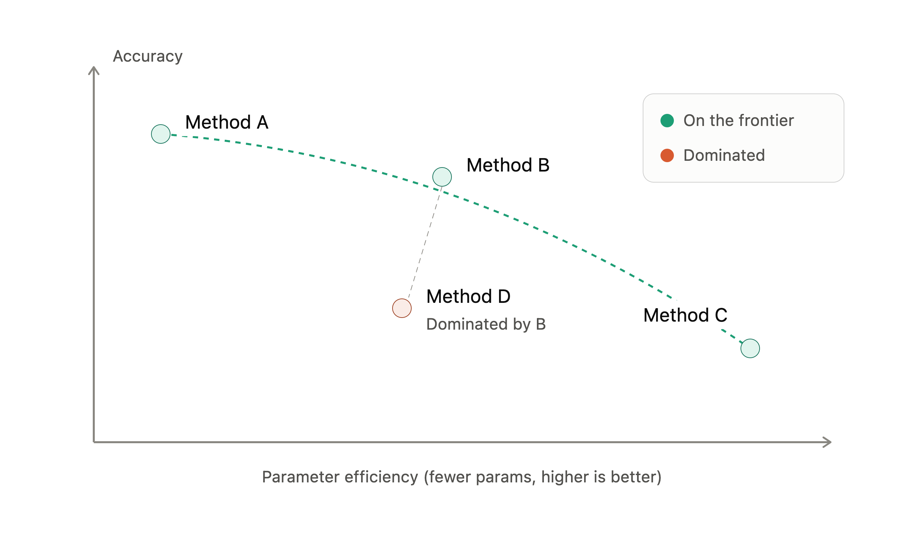
EFFICIENCY RANKING
9
Three layers, from objective to opinionated
LAYER 1
Pareto dominance
Weight-free. On accuracy and parameter-efficiency, a method is dominated if another is at least as good on both and strictly better on one. No non-negative weighting can rescue it.
LAYER 2
An interpretable scalar
E = PSNR / log₁₀(params) — decibels of fidelity retained per order of magnitude of parameters spent. Needs no reference method and no stored weights.
LAYER 3
Profile-weighted tiers
The non-dominated methods form the rate–distortion frontier; Layers 2 and 3 only rank what survives Layer 1.
Each axis min–max normalized, combined under a named profile (Balanced, Quality, Compression, Realtime), then graded S ≥ 0.80, A ≥ 0.65, B ≥ 0.45, C ≥ 0.25, else D.
Notes:
Efficiency is multi-objective — accuracy, parameter thrift, training speed, robustness. The layers are ordered so the objective claim comes first.

Slide 10
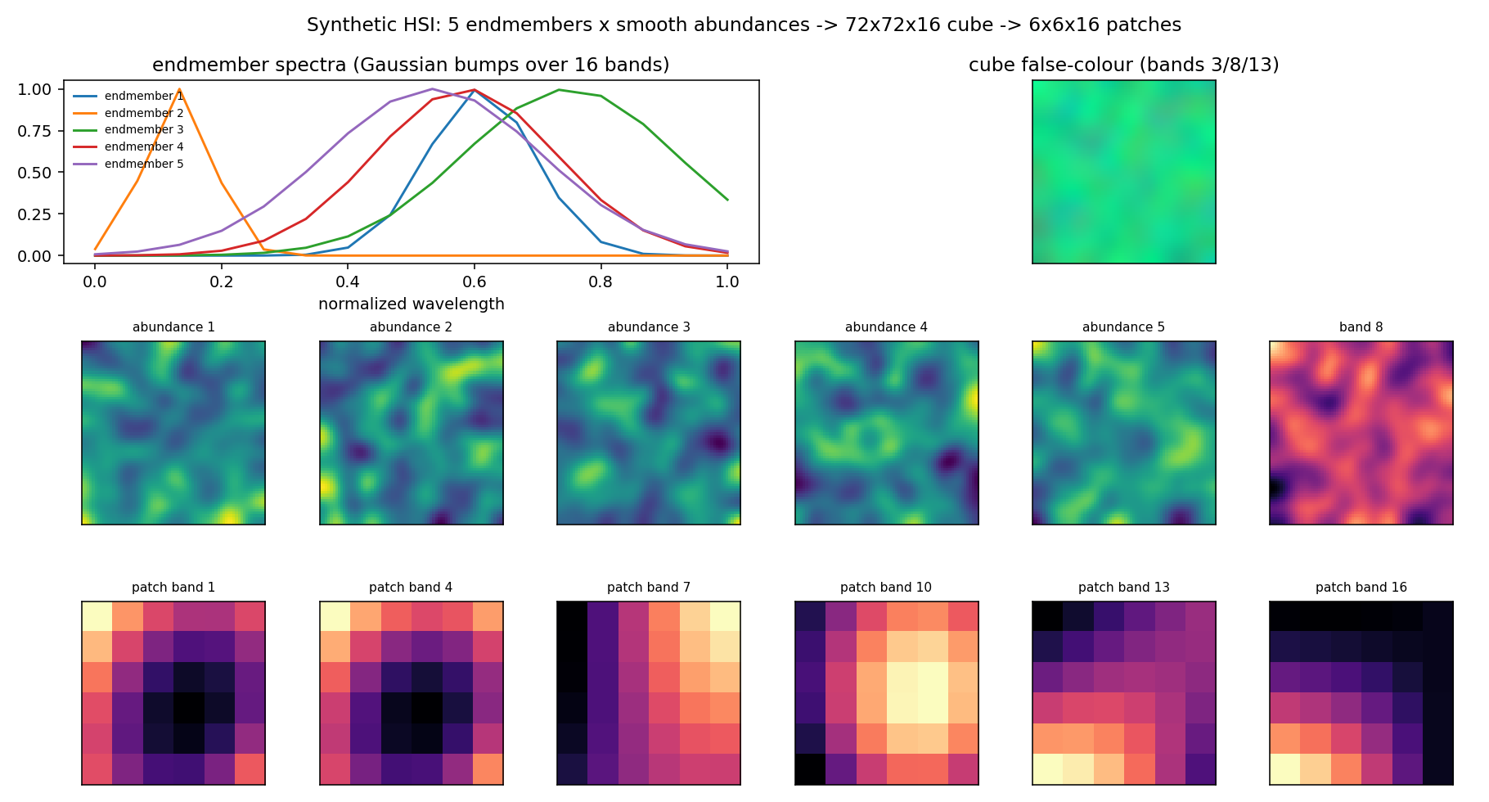
DATA
10
Three datasets, three different questions
Synthetic mixed-structure
6×6×6
Ground-truth atoms that are 40% separable, 40% low-TT-rank and 20% dense, so no structure is trivially favoured. Rank swept directly rather than tiered.
Real RGB patches
8×8×3
Sampled from a standard photograph, mean-removed and normalized. No ground truth, so the full three-layer ranking is applied at fixed hyperparameters.
Hyperspectral cube
6×6×16
The synthetic HSI cube: five endmember spectra mixed by smooth abundance maps into a 72×72×16 cube, cut into 6×6×16 patches. No real capture is used.
Five Gaussian endmember spectra mixed by smooth abundance maps: genuinely low-rank with one fat spectral mode. Evaluated at matched parameter budget.
Dictionaries are learned on noisy training patches and evaluated by denoising PSNR against clean held-out test patches, averaged over random seeds. Decomposition primitives use TensorLy.
Notes:
Each dataset gets a different depth of analysis on purpose — rank sweep, full tiering, and matched budget respectively.

Slide 11
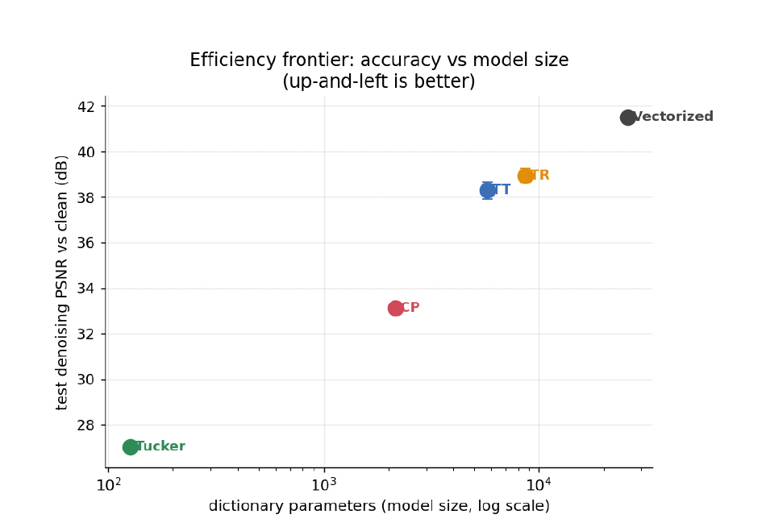
RESULT 1 · SYNTHETIC
11
On rich, clean data the unstructured baseline wins
Model | Params | Compression | PSNR (dB)
Vectorized | 25,920 | 1.0× | 41.49
CP | 2,160 | 12.0× | 33.14
Tucker† | 126 | 205.7× | 27.01
TT | 5,760 | 4.5× | 38.29
TR | 8,640 | 3.0× | 38.95
† initial out-of-harness Tucker optimizer — diagnosed and corrected later in the talk.
The baseline buys its 41.5 dB with the largest dictionary by an order of magnitude — warranted, since nothing constrains it.
CP is the most compact per atom at 12× smaller, but least accurate at fixed atom count; TT and TR occupy the middle.
At rank 1, CP, TT and TR coincide exactly — all three collapse to the same outer product a ∘ b ∘ c.
Efficiency frontier: test PSNR versus dictionary parameters (log scale). Up-and-left is better.
Notes:
Every structured method trades accuracy for compression here. The interesting part is why — next slide.

Slide 12
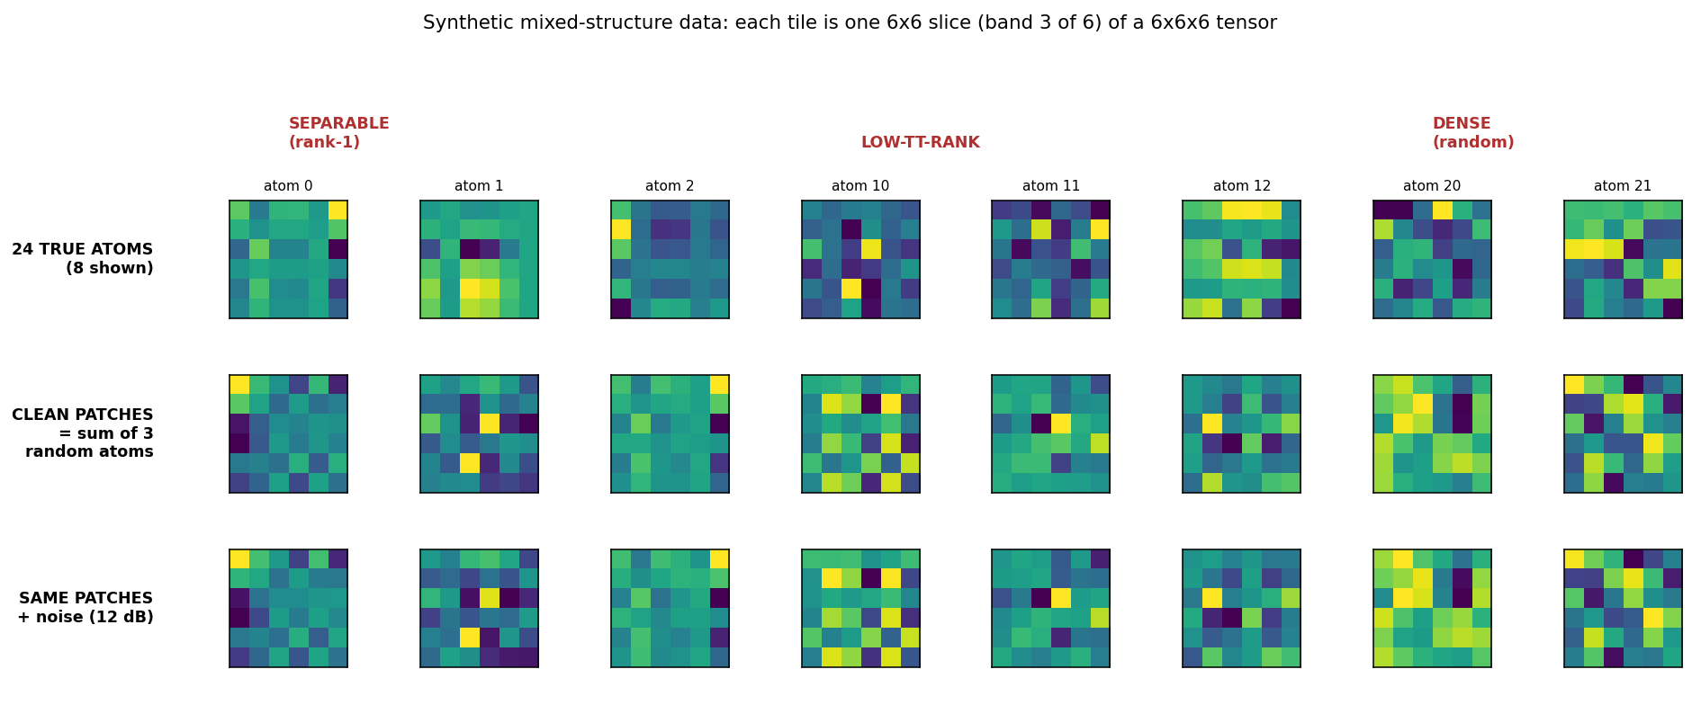
RESULT 1 · DIAGNOSIS
12
20% of the signal has no tensor structure to exploit
40%
separable (rank-one)
40%
low-TT-rank
20%
dense — incompressible
Any method that constrains its atoms to a tensor format is fundamentally limited on the dense fifth of the data, however well it is optimized. At 12 dB, noise imposes no strong regularization — so the baseline's extra representational freedom converts directly into accuracy.
Notes:
Eight of the 24 ground-truth atoms, spanning separable, low-TT-rank and dense components, with their clean and 12 dB noisy patches. Only the dense ones lack compressible structure.

Slide 13
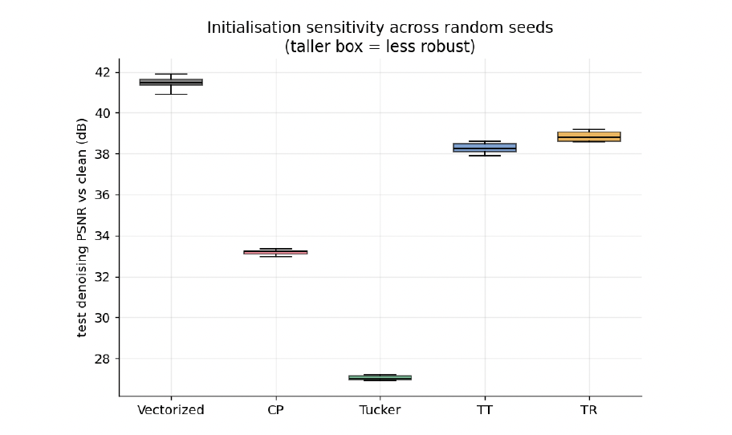
RESULT 1 · ROBUSTNESS
13
Constraint buys stability across initializations
Each method is run over multiple seeds and the spread of resulting PSNR plotted as a box.
The unstructured baseline varies most; the constrained models converge to roughly the same answer regardless of initialization.
Structured decompositions with spatial meaning are therefore not just smaller — they are more reproducible.
Seed variance is often a readout of optimiser quality, not model quality.
Taller box = more sensitive to which random seed you happened to get.
Exact-linear-solve fitting — ALS blocks, TT-SVD truncations — yields tight bars; genuinely non-convex search yields wide ones.
Notes:
This foreshadows the Tucker diagnosis: wide error bars were a symptom of a bad optimizer, not of the Tucker format.

Slide 14
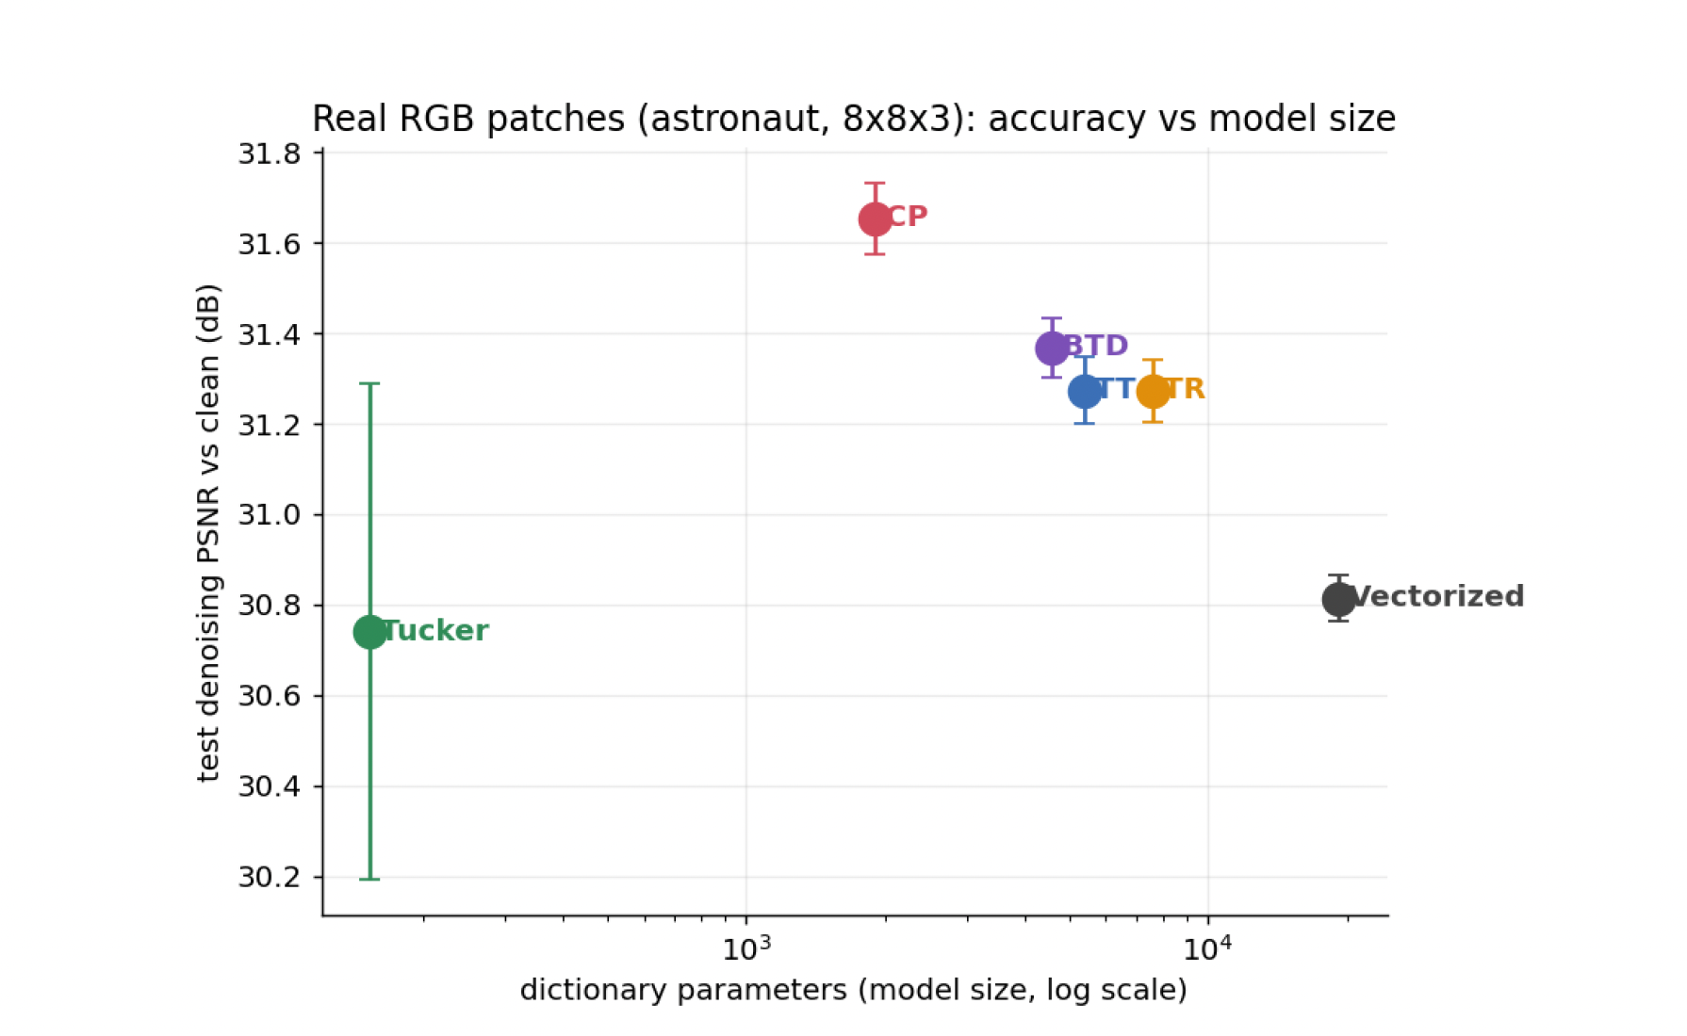
RESULT 2 · REAL RGB
14
On real patches the conclusion inverts
Model | Params | Compr. | PSNR (dB)
Vectorized | 19,200 | 1.0× | 30.81
CP | 1,900 | 10.1× | 31.65
Tucker† | 153 | 125.5× | 30.74
TT | 5,400 | 3.6× | 31.27
TR | 7,600 | 2.5× | 31.27
BTD | 4,600 | 4.2× | 31.37
† initial out-of-harness Tucker optimizer.
Natural patches are smooth and approximately low-rank — neighbouring pixels correlate, colour channels correlate — so the dense component that punished tensor methods on synthetic data barely exists here.
With thousands more free parameters than the data's complexity needs, the vectorized dictionary spends them fitting noise. Classic over-fitting: capacity becomes a liability.
The structured methods cannot fit the noise even if they wanted to — their constraint accidentally functions as a regularizer.
31.65 dB vs 30.81 dB
CP beats the unstructured baseline while using 10× fewer parameters. Every structured method except the initial Tucker does the same.
Notes:
The regime flip is the paper's central empirical result: structure helps exactly when the data is genuinely low-rank and the measurements are noisy.

Slide 15
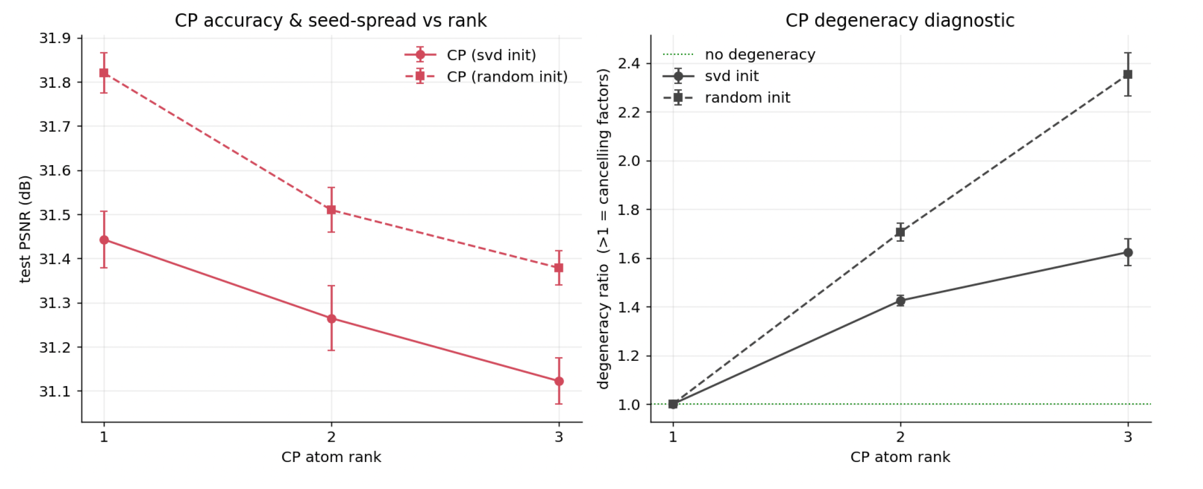
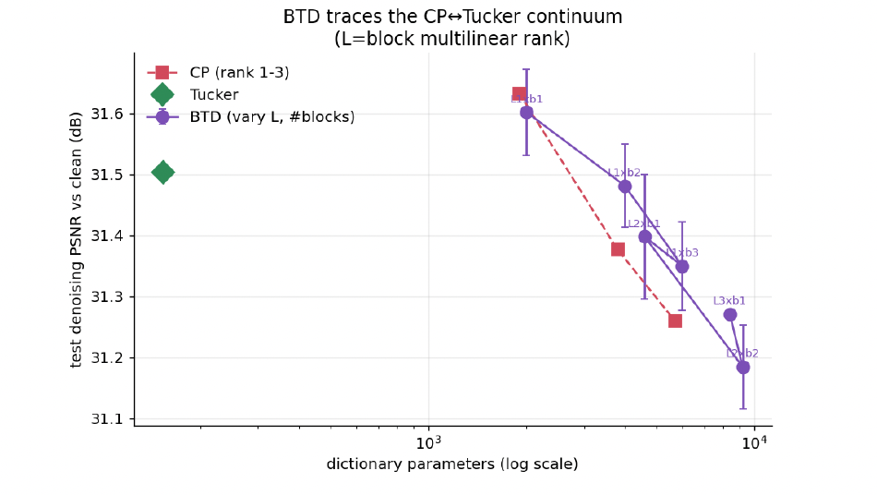
RESULT 2 · DIAGNOSTICS
15
Two things worth knowing before picking a format
CP instability
BTD interpolates CP and Tucker
A degeneracy ratio — component magnitudes over the norm of their sum — is 1.0 for rank-one atoms and climbs with rank, far worse under random init than SVD warm-start (2.35 vs 1.62 at rank 3). Reconstruction can look fine while the factorization is internally degenerate: a warning if the factors themselves go downstream.
Sweeping block rank L and block count traces a continuum: the L = 1, one-block configuration lands exactly on CP rank-one, confirming the endpoint identity, and the family runs toward Tucker. In this noisy regime the most constrained point is best — extra capacity fits noise.
Notes:
BTD is useful conceptually: it shows CP and Tucker are endpoints of one family rather than unrelated choices.

Slide 16
REFINEMENT · SECTION 6.3
16
An optimizer bug, not a structural verdict
The original Tucker-DL failed on an objective mismatch: it learned its three mode dictionaries in isolation, Y₍₁₎ ≈ U₁X₁ and so on — but a Tucker dictionary is never seen alone, only as D = U₃ ⊗ U₂ ⊗ U₁.
The fix: keep OMP against the Kronecker dictionary, then update by separable ALS — solve U₁ with (U₂,U₃) fixed, then U₂, then U₃ — where each sub-problem is an exact closed-form least-squares block.
RGB PATCHES
SYNTHETIC DATA
30.66 dB
→
32.16 ± 0.09 dB
27.01 dB
→
29.45 ± 0.69 dB
at an identical parameter budget — quality and seed stability improved together.
at an identical parameter budget — quality and seed stability improved together.
A fairness correction to one optimizer moved Tucker from last place to a Pareto-dominant winner at identical size — implementation confounds can dominate structural differences.
Notes:
This is the honesty slide. The first Tucker number in the tables was not a verdict on Tucker; it was a verdict on an out-of-harness optimizer.

Slide 17
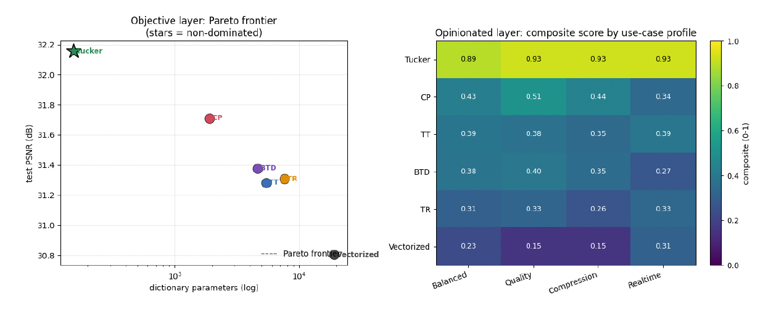
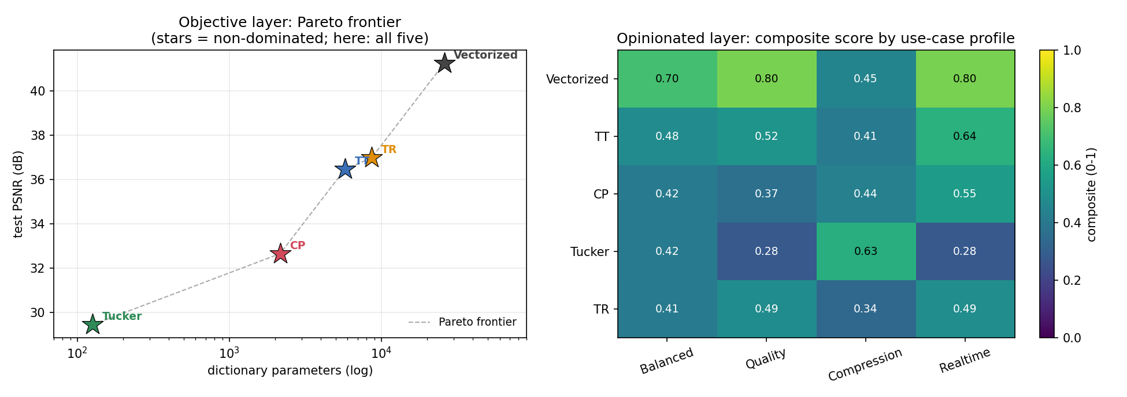
RANKING APPLIED
17
Efficiency ranking with the corrected Tucker
Model | PSNR | Params | E | Pareto | Tier | Bal.
Tucker | 32.16 | 153 | 14.72 | yes | S | 0.892
CP | 31.71 | 1,900 | 9.67 | no | C | 0.429
TT | 31.28 | 5,400 | 8.38 | no | C | 0.389
BTD | 31.38 | 4,600 | 8.57 | no | C | 0.385
TR | 31.31 | 7,600 | 8.07 | no | C | 0.306
Vectorized | 30.80 | 19,200 | 7.19 | no | D | 0.230
Real RGB patches: only Tucker sits on the frontier.
A caveat that keeps the comparison honest
Tucker's 9×9×3 grid yields 9·9·3 = 243 implicit atoms for 153 explicit parameters, where the other methods get about 100 atoms at the same count. Part of its edge is extra atoms at the same sparsity level — not purely structural advantage. That is exactly why the matched-budget experiment matters.
Synthetic patches: the frontier is monotone, so the objective layer prunes nothing — all five are Pareto-optimal.
Notes:
Note the contrast between the two panels: on synthetic data Layer 1 prunes nothing, so the opinionated layers do all the work.

Slide 18
RESULT 3 · HYPERSPECTRAL
18
Matched budget removes the hand-picked ranks
We fix a parameter budget and let each method auto-select its rank and atom count to spend it, sweeping the budget to trace a rate–distortion curve and repeating across noise levels.
A fat mode is not a high order
Giving Tensor-Train a large third mode did not hand it the win. TT's advantage is high tensor order, not one wide mode.
The ranking does not flip with noise
Between heavy (6 dB) and light (18 dB) noise only the absolute PSNR shifts; the ordering is stable.
Less is more on a low-rank cube
Accuracy falls as the budget grows: the baseline leads at 5,000 parameters partly because its atoms cost 576 each.
*Tucker operates at 304 parameters — it cannot reach the budget without exceeding a reasonable atom cap, so “best at 5,000 parameters” understates its per-parameter efficiency.
Notes:
The HSI benchmark is split into train, validation and test: each configuration trains on train, the rank is chosen on validation, and the selected model is evaluated once on test.

Slide 19
DISCUSSION
19
Three themes
i
ii
iii
Regime dependence
Confounds can dominate structure
Matched-parameter is not matched-atom
There is no absolute best decomposition. The unstructured baseline wins on rich clean synthetic data; structured dictionaries win on noisy real patches where their constraint regularizes; at matched budget on a low-rank cube, few full atoms or a tiny Tucker are most efficient. Which to use is a function of signal order, noise and intrinsic rank — not a fixed ranking.
The Tucker rebuild moved it from last to first at identical size purely by fixing the optimizer. The matched-budget study then revised the earlier “structure wins” story by revealing that some of that advantage was really the freedom to buy many cheap atoms.
At equal storage the baseline is forced into few heavily regularized atoms while structured methods spend the same budget on many. Which budget is “fair” depends on whether you care about storage or per-atom quality.
Notes:
If someone remembers one slide, this is it.

Slide 20
LIMITATIONS
20
What these numbers do not say
Implementations, not canonical algorithms
Modest data, seed-only error bars
CP / TT / TR / BTD here are projection variants inside a shared K-SVD loop — not jointly optimized factors, PALM-based TT-DL or SeDiL. The labels rank these implementations, not the definitive performance of those methods.
Hundreds of patches, single images, a few noise levels; the bars capture seed variance alone, and the HSI cube is synthetic rather than a real capture.
The budget study caps atom counts
The speed axis understates tensor methods
Capping for tractability bounds Tucker artificially — it is why Tucker sits at the far left of the rate–distortion curve rather than on it.
The harness materializes the full effective dictionary and runs identical OMP for fairness, discarding the fast structured transforms that are a genuine computational advantage of Kronecker and TT dictionaries.
A fuller treatment would report several implementations per structure and show the spread — these are natural next steps rather than flaws to hide.
Notes:
Being explicit here is what makes the ranking claims defensible.

Slide 21
CONCLUSION
21
One harness, six dictionaries,
and a ranking that can be re-derived anywhere
CONNECTED
MEASURED
EXTENSIBLE
Five tensor-structured dictionaries and an unstructured baseline that differ only in how each atom is parameterized — linked to dictionary learning through the Khatri–Rao and Kronecker forms.
Across synthetic, real and hyperspectral data the best decomposition is regime-dependent, and implementation confounds can outweigh structural differences.
A matched parameter budget both tightens and, in places, reverses naive conclusions. A new decomposition is one projector and one parameter rule away.
Sahaj Chhetri · August 17, 2026 · Primitives via TensorLy
Notes:
Close on extensibility: the framework is designed so new decompositions plug in and the ranking can be re-derived on any dataset.

