Slide 1
Large-Scale Social Media Sentiment and Trend Analytics Using MongoDB
BIG DATA ANALYTICS · COURSE PROJECT
2.94 million real tweets · MongoDB aggregation · NLP · Apache Spark · Parquet data lake · sharded cluster
Sahaj Saliya
23BIT128
Hil Kalathiya
23BIT092
Department of Information and Communication Technology
info.sahaj.si/BDA-Analytics · github.com/SahajIVVIX-1/BDA-Analytics
Notes:
Introduce the project and the team. We built a complete batch analytics platform for social media text on one 16 GB machine, with MongoDB as storage and compute, and then extended it with a Big Data Lab: Spark, a Parquet data lake and a sharded MongoDB cluster. The live website and the source code are linked on this slide.

Slide 2
The project at a glance
OVERVIEW
2.94M
2,843
12
real tweets stored and analysed
accounts, 2012 to 2018
purpose-built MongoDB indexes
36×
147 s
20×
faster dashboard with rollups
Spark run over every raw row
faster queries with partitioned Parquet
Ingest → clean → enrich with NLP → aggregate in MongoDB → serve through FastAPI → explore in a React dashboard; then the same archive through Spark, a data lake and a sharded cluster.
Notes:
Six numbers summarise the work. 2.94 million tweets from 2,843 accounts are stored with 12 indexes. Pre-aggregated rollups make dashboard pages about 36 times faster. In the Big Data Lab, Spark processes all rows in 147 seconds and partition pruning makes queries up to 20 times faster than reading CSV.

Slide 3
Problem and objectives
WHY THIS PROJECT
Ingest at scale: stream, validate and bulk-load millions of posts.
Model for queries: schema validation and indexes matched to access patterns.
Enrich: sentiment, topics and keywords on a CPU, no GPU.
Aggregate: MongoDB pipelines and pre-computed rollups.
Serve and show: FastAPI service and a React dashboard.
Measure: experiments at 100K, 500K, 1M and 2.95M documents.
Go distributed: Spark, a Parquet lake and sharding in the Big Data Lab.
The problem
Social media produces large volumes of short, noisy, multilingual text. Patterns such as mood shifts, coordinated campaigns, sudden spikes and trending hashtags cannot be found by reading individual posts.
We need a system that ingests millions of posts, enriches them, aggregates them fast enough for interactive use, and explains the numbers it shows.
Notes:
The problem is volume and noise: individual posts tell you nothing about trends. Our objectives cover the full pipeline, from ingestion to the dashboard, with every design decision backed by a measurement. The final objective, going distributed, is covered by the Big Data Lab.

Slide 4
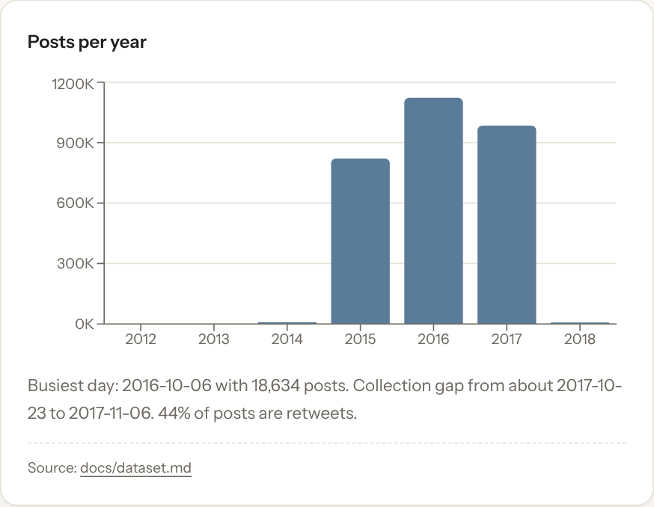
Dataset: 2.94 million IRA troll tweets
DATA
Source: FiveThirtyEight russian-troll-tweets (Linvill and Warren, Clemson University), CC BY 4.0.
Size: 2,946,207 rows read, 2,944,814 stored, 13 CSV files, 1.14 GB.
Span: 2012-02-02 to 2018-05-30; 99.5% of posts in 2015 to 2017.
Fields: text, date, language, region, author, followers, account category, post type.
Missing: sentiment labels (predicted), engagement counts (synthetic and flagged), time zone (UTC assumed).
Caveat: a state-linked influence operation, so results do not describe public opinion.
Posts per year in the stored collection
Notes:
The data is a real, public archive of tweets from accounts Twitter linked to the Internet Research Agency. Almost all activity is in 2015 to 2017, peaking around the 2016 US election. The dataset has no sentiment labels and no engagement counts, so sentiment is predicted and engagement is synthetic and clearly flagged.

Slide 5
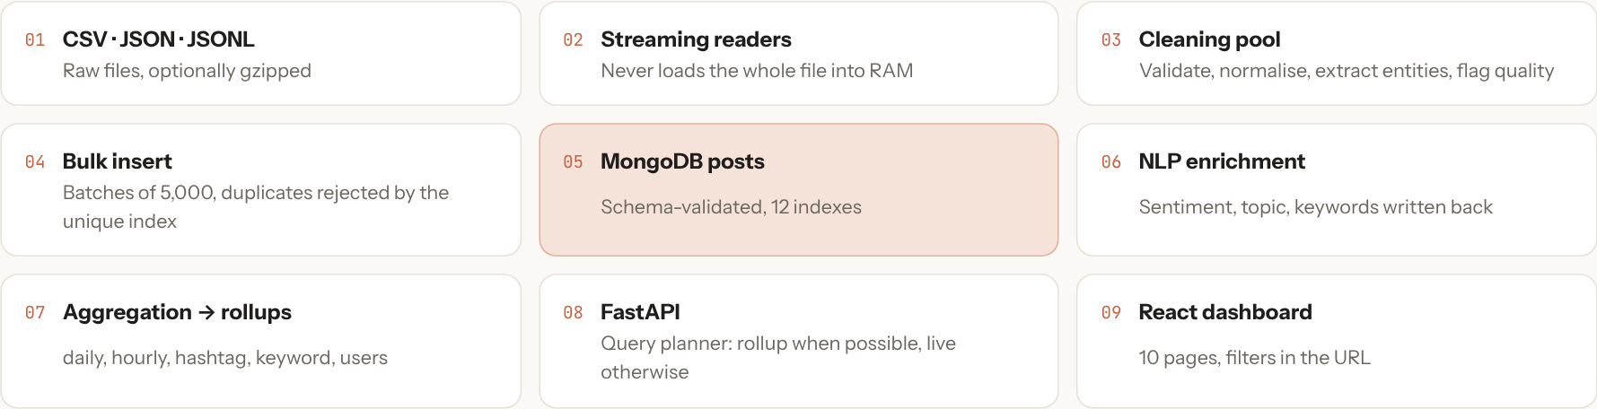
Architecture: from CSV to dashboard
SYSTEM DESIGN
Data flow of the platform
Ingest
Enrich
Aggregate
Serve
Explore
Stream 13 CSVs, validate, clean, bulk insert in batches.
Sentiment, topics and keywords, written back with bulk updates.
Daily, hourly, hashtag, keyword and account rollups.
FastAPI with a query planner: rollup or live pipeline.
React dashboard with filters and a data explorer.
Notes:
The platform is a batch pipeline. Raw CSV files are streamed and validated, cleaned and bulk-loaded into MongoDB. An enrichment job adds NLP fields. Aggregation pipelines materialise rollups. The API decides per request whether a rollup can answer the question or a live pipeline is needed, and the dashboard presents the results.

Slide 6
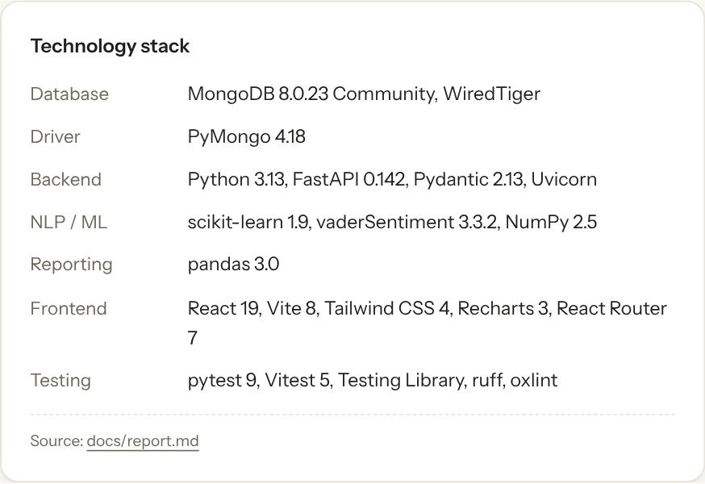
Technology stack
SYSTEM DESIGN
MongoDB 8: storage and the main compute engine (aggregation, $setWindowFields, rollups).
Python 3.13: streaming ingestion, cleaning with multiprocessing, PyMongo bulk writes.
scikit-learn and VADER: TF-IDF, logistic regression, Naive Bayes and NMF topics.
FastAPI: REST endpoints and a planner that picks rollups or live pipelines.
React and Vite: the dashboard and the showcase website.
Apache Spark 4.2 and Parquet: the Big Data Lab data lake.
Sharded MongoDB: config server, three shards and mongos via Docker Compose.
Notes:
Every component runs on a laptop-class machine. MongoDB is not just storage; most analytics run inside it as aggregation pipelines. The NLP models are deliberately lightweight so they run on a CPU. Spark and the sharded cluster were added for the Big Data Lab.

Slide 7
The five Vs in this project
BIG DATA CHARACTERISTICS
Volume
Velocity
Variety
Veracity
Value
2.94M posts and 1.14 GB of raw CSV; a 4.4M-row keyword rollup.
Batch: about 10,000 records/s ingest and 20,000 rows/s in Spark.
Text, timestamps, numbers and categories in 50+ languages.
Duplicates, empty texts, missing labels and engagement.
Trends, anomalies and sentiment shifts around real events.
How we handle it
Streaming readers, bulk writes, Parquet compression.
How we handle it
Batches of 5,000, parallel workers, incremental rollups.
How we handle it
Schema validation, language mapping, per-language topics.
How we handle it
1,392 duplicate ids dropped; synthetic values flagged.
How we handle it
Dashboard, trend score, three anomaly methods.
Notes:
Each of the five Vs maps to something concrete in the project. Volume is the 2.94 million posts. Velocity is batch throughput rather than streaming. Variety is mixed field types and many languages. Veracity is handled by validation, de-duplication and honest labelling of synthetic values. Value is the trends and anomalies the dashboard surfaces.

Slide 8
CAP theorem and the Hadoop ecosystem
BIG DATA CHARACTERISTICS
Hadoop component | Role | In this project
HDFS | distributed file storage | Parquet data lake, partitioned folders
MapReduce | map, shuffle, reduce | Spark stages with shuffle exchanges
Hive | SQL over files | Spark SQL on silver and gold tables
HBase / NoSQL | key-value at scale | MongoDB documents, 12 indexes
Region servers | horizontal scaling | MongoDB sharding, hashed and ranged keys
Kylin / cubes | pre-aggregation | gold tables and MongoDB rollups
Mahout | batch ML | scikit-learn sentiment and NMF topics
YARN | resource manager | Spark local[*] scheduler
Sqoop / Flume | ingestion | streaming CSV readers, upload API
CAP: MongoDB is CP
With majority write concern and primary reads, a partitioned minority stops accepting writes rather than serve stale data. Consistency is chosen over availability during a partition.
Why it matters
Every classic Hadoop role has a counterpart here, so the project covers the ecosystem with tools that run on one machine and scale out to a cluster unchanged.
Notes:
MongoDB with majority writes is a CP system: under a network partition the minority side cannot elect a primary, so it refuses writes. The right side maps every classic Hadoop component to what we used instead: Parquet files for HDFS, Spark for MapReduce, Spark SQL for Hive and sharded MongoDB for HBase.

Slide 9
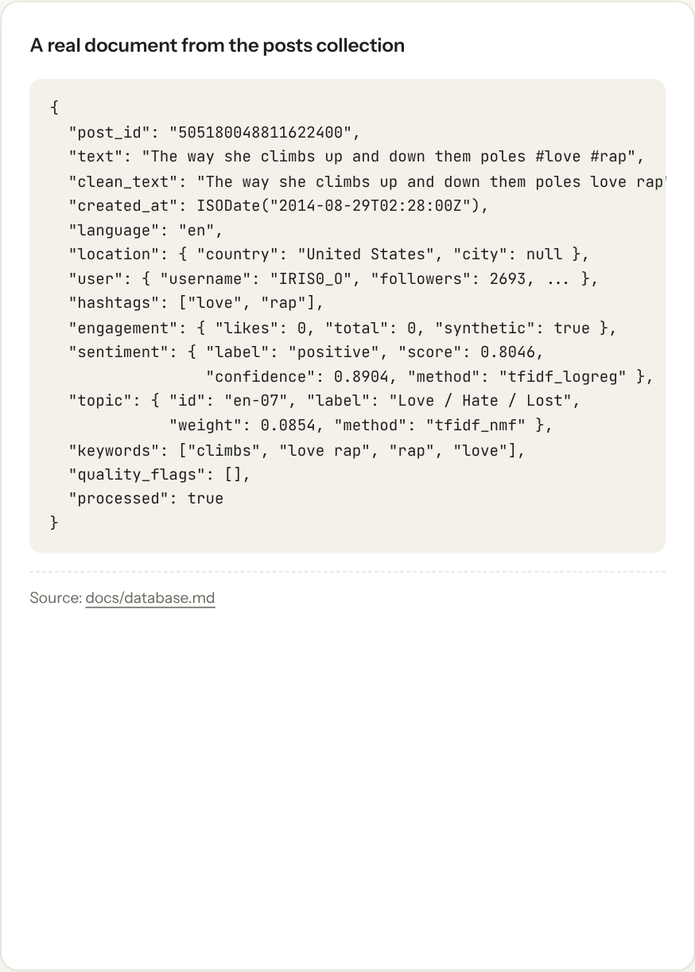
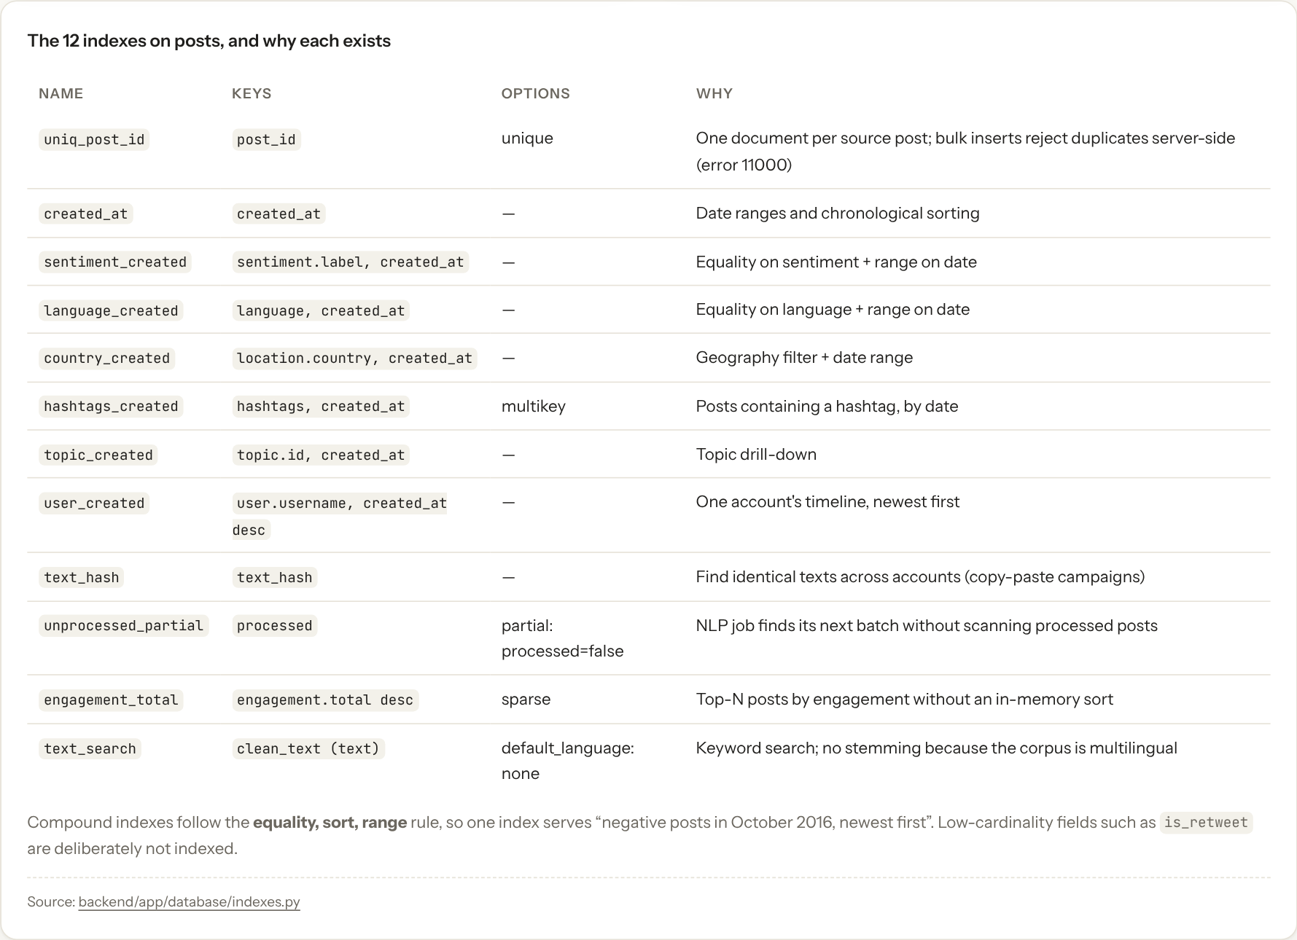
MongoDB design: documents, collections, indexes
STORAGE
The 12 indexes on posts and why each exists
One schema-validated posts collection plus rollup collections (daily_cube, hourly, hashtag, keyword, account). Each index matches a dashboard query; compound indexes put the equality field first and the date range last.
A real document
Notes:
Each post is one document with nested NLP and engagement fields. The collection has a JSON schema validator. The twelve indexes are not generic: each one exists because a specific dashboard query needs it. Compound indexes follow the equality, sort, range rule.

Slide 10
Ingestion scales linearly
RESULTS · INGESTION
Throughput: 9,916 to 11,815 records/s at every size.
Batch size: 100 docs gave 7,909 rec/s; 500 to 20,000 gave about 11,500.
Parallel cleaning: 2 workers 1.9× faster than 1 on 4 vCPUs.
Index after load: 16% less total time than loading with all indexes.
Cleaning: normalise text, extract hashtags, mentions and URLs, map languages, drop duplicates.
Full run: 297 s to load 2.94M posts + 311 s to build indexes = 608 s.
Notes:
Load time grows in proportion to data size, which means throughput is constant at about ten thousand records per second. Batches of 500 or more avoid paying a network round trip per document. Building secondary indexes after the bulk load was 16 percent faster in total than maintaining them during the load.

Slide 11
Indexes versus collection scans on 2.94M posts
RESULTS · QUERIES
25×–3000×
faster with the matching index
2,944,814
documents read by every scan
With an index, MongoDB reads only the matching documents (50 to 33,703), so time follows the result size, not the collection size.
Notes:
A collection scan reads all 2.94 million documents and takes three to five seconds whatever the query. With the right index, the query reads only the documents it returns. The account lookup goes from 3.3 seconds to under one millisecond. Checking explain plans confirmed each query used its intended index.

Slide 12
Pre-aggregation makes the dashboard interactive
RESULTS · AGGREGATION
34×–44×
faster from the daily_cube rollup
Rollups are MongoDB pipelines ending in $merge.
Full rebuild of five rollups: 470 s; after an upload only affected days are recomputed.
A query planner uses a rollup when it can and a live pipeline when it must.
Notes:
Live aggregation over all posts takes 15 to 37 seconds per dashboard page, which is too slow for interactive use. The same answers from the daily rollup take under one second. The cost is a one-time rebuild of about eight minutes, and incremental refresh after uploads.

Slide 13
Sentiment analysis
NLP
Logistic regression was chosen on validation macro-F1 (0.650). It is below published TweetEval baselines and not validated on this dataset, so the split is a model output, not ground truth.
Notes:
We compared a lexicon method, VADER, with two TF-IDF classifiers on the standard TweetEval benchmark. Logistic regression won with a test macro-F1 of 0.58. Applied to the 2.1 million English posts it predicts about half neutral, a third negative and a sixth positive. We state clearly that this is out-of-domain and not validated.

Slide 14
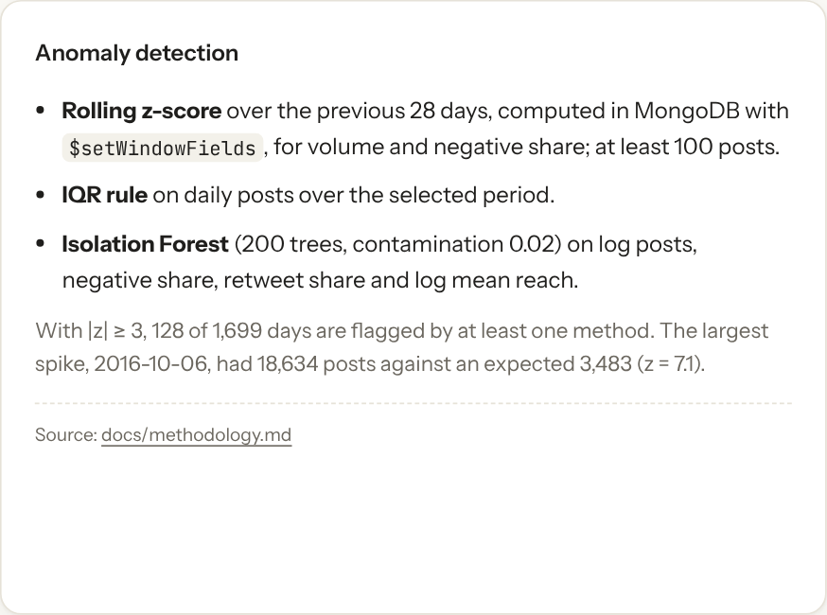
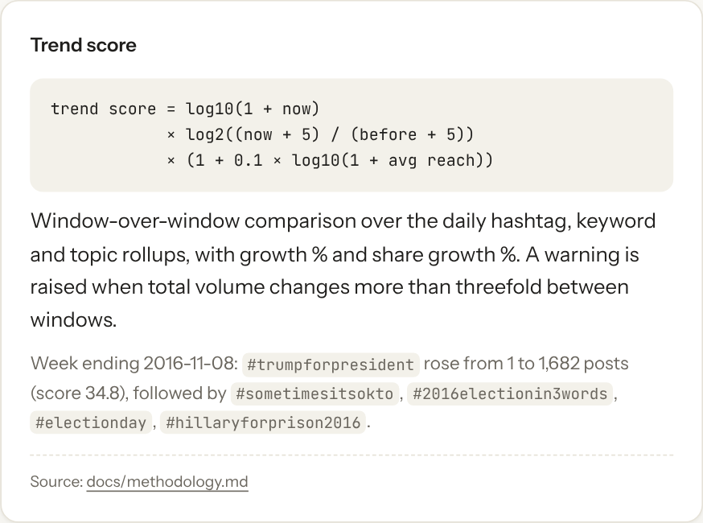
Topics, trends, engagement and anomalies
ANALYTICS
Topics (NMF)
Trend score
Anomalies
16 English and 12 Russian topics from TF-IDF 1-2 grams, e.g. "Trump / Donald", "Police / Shooting", "Black / Blacklivesmatter".
Window over window growth weighted by volume and reach. Week to 2016-11-08: #trumpforpresident rose from 1 to 1,682 posts (score 34.8).
Rolling 28-day z-score with $setWindowFields, IQR and Isolation Forest. 128 of 1,699 days flagged; 2016-10-06 had 18,634 posts vs 3,483 expected (z = 7.1).
Notes:
Topics come from non-negative matrix factorisation, one model per language. Trends compare two time windows and weight growth by volume. Anomaly detection runs three methods; the z-score is computed inside MongoDB using window functions. The biggest spike, 6 October 2016, is flagged by two methods. Engagement analytics use synthetic likes and shares, labelled as such.

Slide 15
NLP throughput on a CPU
RESULTS · NLP
5,213
10,355
posts/s end to end, 1 worker
posts/s end to end, 2 workers
The enrichment job reads, runs both models and bulk-writes results.
With two or more workers, 16 of 19 s were spent waiting on database writes: writes, not models, became the limit.
At that rate all 2.94M posts enrich in about 5 minutes (extrapolated).
Notes:
The models themselves process twenty thousand or more texts per second. End to end, with reading and writing, one worker achieves five thousand posts per second and two workers ten thousand. Beyond that the database writes are the bottleneck, which is a classic Big Data lesson: find the real bottleneck before adding parallelism.

Slide 16
Big Data Lab
The same archive processed with Apache Spark into a bronze, silver and gold Parquet data lake, then loaded into a three-shard MongoDB cluster.
Notes:
The second part of the project goes distributed. We process the same raw CSV with Spark, store the result as a layered data lake in Parquet, and compare hashed and ranged shard keys on a sharded MongoDB cluster.

Slide 17
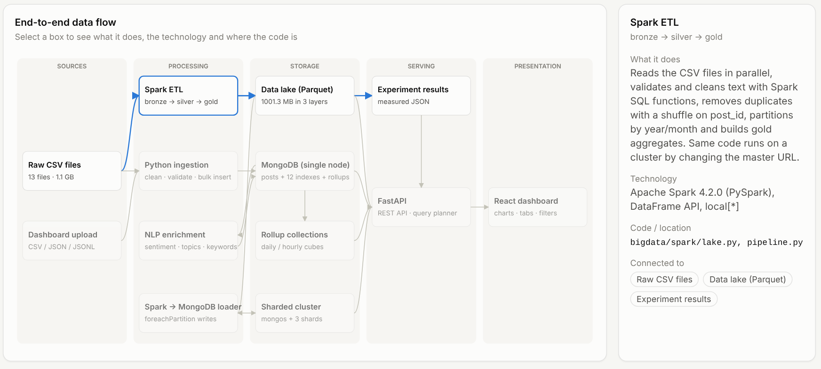
Big Data Lab architecture
BIG DATA LAB
Notes:
Raw CSV goes into the bronze layer unchanged. Spark validates and cleans it into silver, partitioned by year and month. Small gold tables answer dashboard questions directly. The silver layer is also loaded into a sharded MongoDB cluster through mongos.

Slide 18
Spark pipeline: 2.94M rows in 147 seconds
APACHE SPARK
Lazy evaluation: transformations build a plan; actions like write run it.
Stages and shuffles: dropDuplicates(post_id) moves equal ids to one task, the MapReduce pattern.
Same logic as Python: output matched the Python pipeline field for field on a 1,000-row sample.
Portable: change local[*] to a YARN or Kubernetes master to run on a cluster.
2,945,912
2,944,519
1,392
20K rows/s
raw rows in
silver posts out
duplicate ids dropped
overall throughput
Notes:
The Spark job has four stages. Silver is the heaviest because it applies the cleaning regular expressions and a shuffle for de-duplication. The whole archive takes 147 seconds, about twenty thousand rows per second, on four cores.

Slide 19
Spark scaling with cores and data size
APACHE SPARK
Efficiency 92% at 2 cores and 62% at 4: shuffles and I/O do not parallelise perfectly.
100K rows: 4,840 rows/s; 2.94M rows: 26,185 rows/s. Fixed start-up cost dominates small inputs.
Notes:
Doubling cores from one to two nearly doubles speed. Going to four gives 2.48 times, because the shuffle and disk I/O become the limit. Spark is also inefficient on small data: on 100 thousand rows its fixed start-up cost dominates, so it shines only at scale.

Slide 20
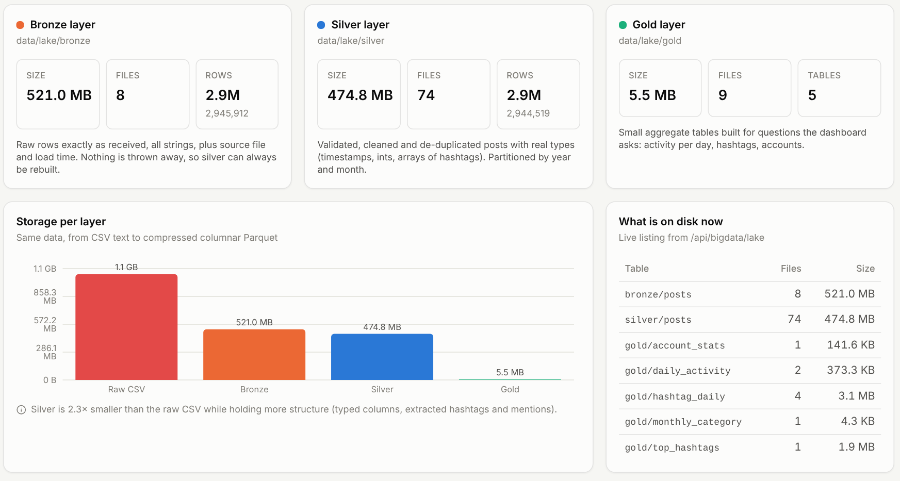
Medallion data lake: bronze, silver, gold
DATA LAKE
Bronze: raw rows as Parquet plus lineage columns.
Silver: cleaned, 74 year/month partitions.
Gold: five small aggregate tables.
Notes:
The lake follows the medallion pattern. Bronze keeps the raw data so any later step can be re-run. Silver is clean and partitioned. Gold holds small tables that answer questions directly. Columnar compression cuts the 1.14 GB CSV to about half, and gold is under 6 MB.

Slide 21
File formats and partition pruning
DATA LAKE
zstd Parquet is 5.7× smaller than JSON. Partitioning by year and month lets Spark read 1 of 74 folders: 20× faster than CSV for a one-month query.
Notes:
Columnar formats store each column together, so they compress well and a query reads only the columns it needs. Partitioning goes further: a query filtered on one month opens a single folder out of 74. That is partition pruning, and it gives a 20 times speed-up over CSV.

Slide 22
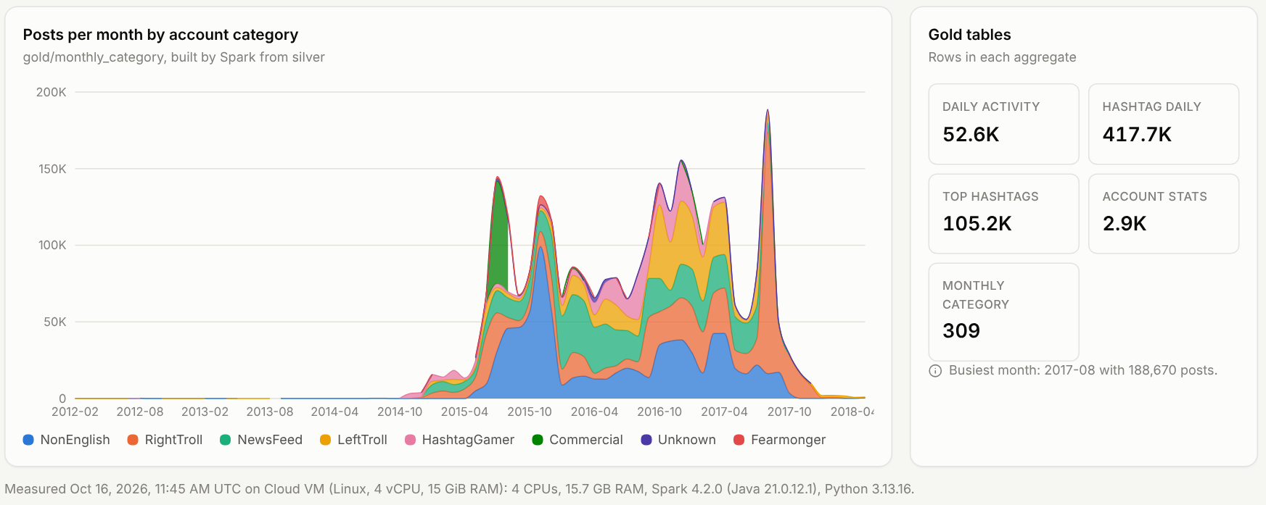
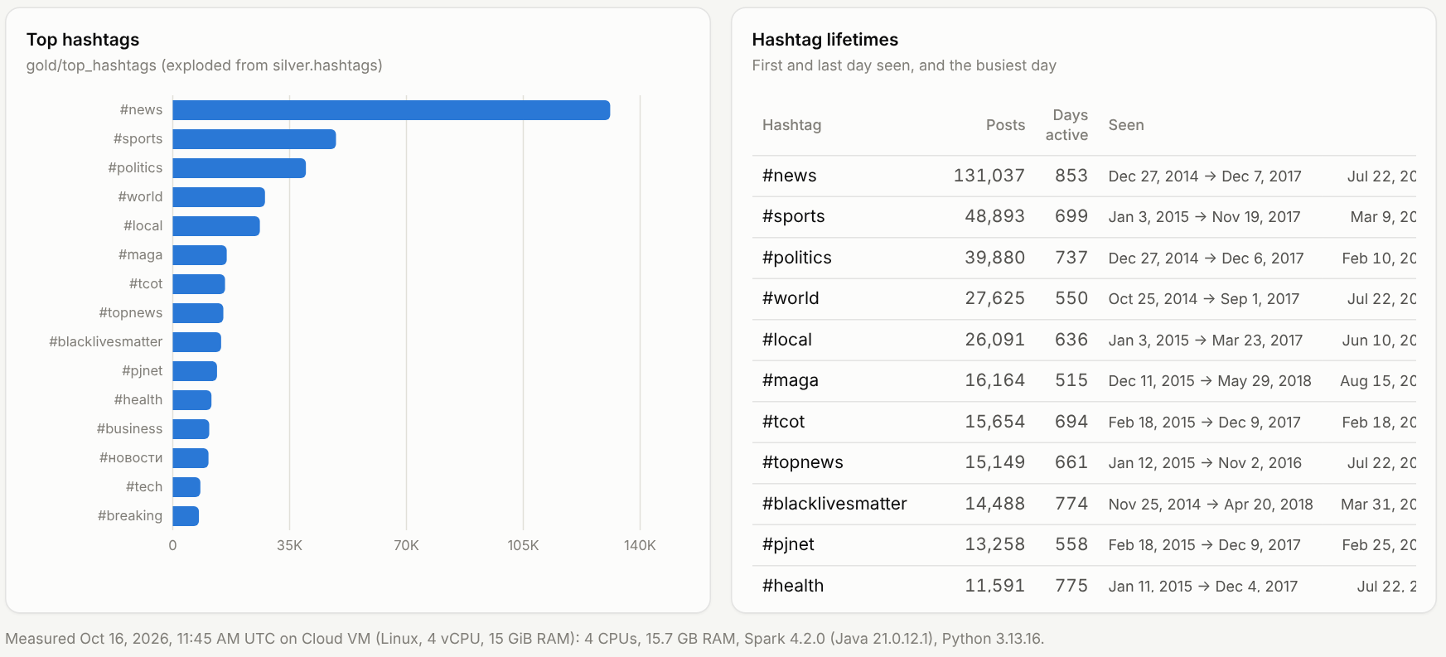
Gold layer insights
DATA LAKE
Five gold tables, 5.8 MB
• Daily activity by account category
• Hashtag counts per day
• Top hashtags with first and last use
• Account statistics
• Monthly category totals
Each table answers one dashboard question directly, so the website reads a few kilobytes instead of 2.94M rows. Activity peaks around the 2016 US election, with news-feed and right-troll accounts dominating.
Notes:
These views come straight from the gold tables: monthly activity by account category and the top hashtags. Each gold table is a few megabytes at most, so the website can load them instantly.

Slide 23
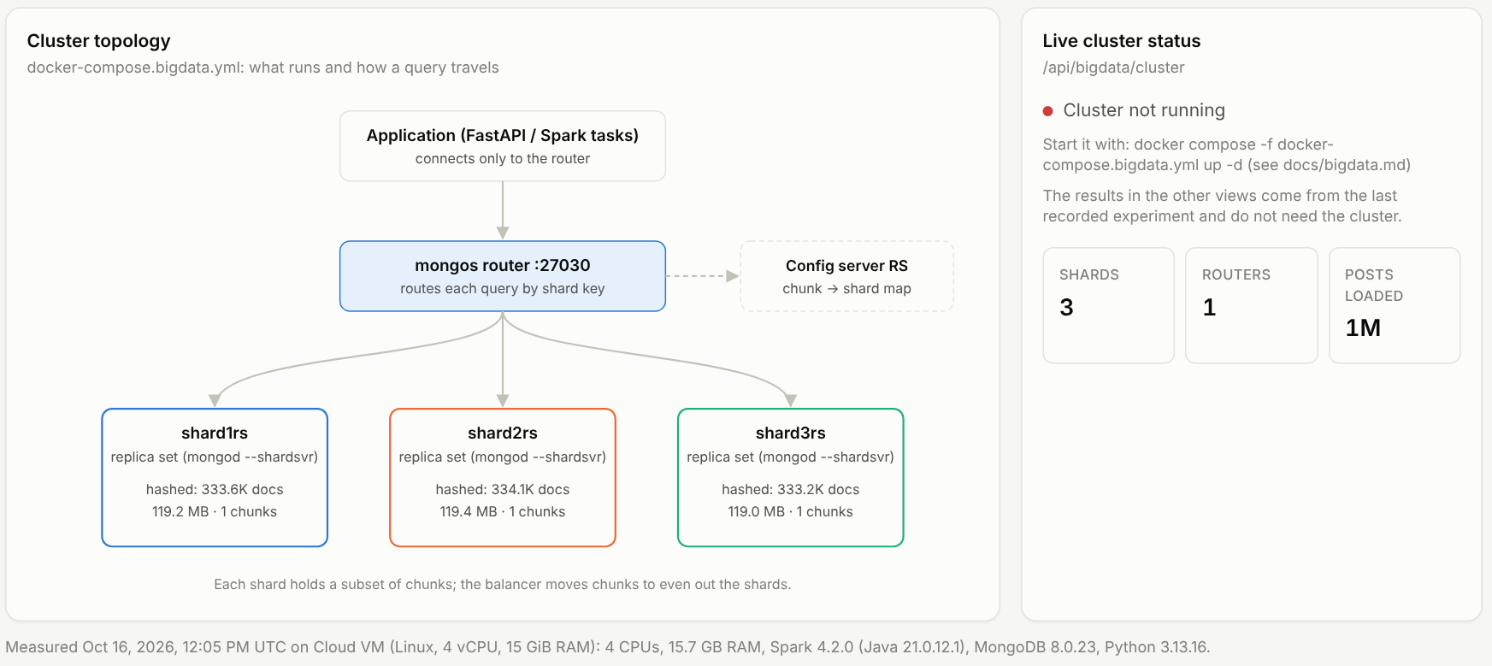
Sharding MongoDB: hashed versus ranged keys
SHARDING
Hashed key: post_id
Even spread (33.3% per shard). Lookups by post_id hit 1 shard; date ranges are broadcast to all 3.
Ranged key: created_at
Query on 1M posts | Hashed key | Ranged key
Lookup by post_id | 1 shard | all 3 shards
One-week date range | all 3 shards | 1 shard
Documents per shard | 33.3–33.4% | 33.3–33.4%
Pre-split at the terciles, also 33.3% per shard. A one-week range hits 1 shard; a post_id lookup goes to all 3.
Notes:
The cluster has a config server, three shards and a mongos router. We loaded one million posts twice, with two shard keys. Both spread data evenly. The difference is routing: the shard key decides which queries are targeted to one shard and which must be broadcast to all of them.

Slide 24
Sharding results
SHARDING
Aggregation is 2.2 to 2.5× faster: each shard groups a third in parallel and mongos merges.
Writes through mongos were slower (51,160 vs 64,670 docs/s): routing has a cost.
Choose the shard key from the most common query, not from the data alone.
Notes:
Scatter-gather aggregation is where sharding pays off: each shard does a third of the work in parallel. Writes are slower because every insert goes through the router. The lesson is that the shard key is a query design decision.

Slide 25
Limitations and future scope
HONEST LIMITS
Limitations
Future scope
• One machine: Spark in local mode, all shards on one host.
• Batch, not real time.
• Troll-account archive, not public opinion.
• Engagement is synthetic and flagged.
• Sentiment: English only, macro-F1 0.58, not validated on this data.
• Two thirds of posts have no topic at the chosen threshold.
• No API authentication: local use only.
• Transformer sentiment (Twitter RoBERTa) on a GPU.
• BERTopic or coherence-chosen topic counts.
• Multi-node Spark on YARN or Kubernetes.
• Kafka with Spark Structured Streaming.
• Replica sets on separate hosts with a failover test.
• Spark MLlib versions of the models.
• Retweet and mention network analysis.
Notes:
We are explicit about limits. Everything ran on one machine, so the Big Data Lab demonstrates distributed concepts rather than cluster throughput. The data describes an influence operation, engagement is synthetic, and sentiment accuracy is modest. Future work would move to real clusters, streaming and stronger models.

Slide 26
Conclusion
Streaming, bulk writes, matched indexes, in-database aggregation and pre-aggregation make 2.94M posts interactive on one machine. Spark, a partitioned Parquet lake and sharding add the distributed side, and every claim is measured.
Thank you · Sahaj Saliya (23BIT128) · Hil Kalathiya (23BIT092)
Live site: info.sahaj.si/BDA-Analytics
Code: github.com/SahajIVVIX-1/BDA-Analytics
Notes:
To conclude: the core Big Data techniques, streaming, batching, parallelism, indexing, computing inside the database and pre-aggregating, are what make three million posts interactive. The Big Data Lab shows the distributed versions of the same ideas. Thank you; we are happy to take questions and show the live site.

