Slide 1
A PROJECT ON “TIC TAC TOE”
Kantipur Engineering College
Sahaj Shakya (29/BEX/2070)
2014/04/22

Slide 2
OUTLINES
INRODUCTION
OBJECTIVES
FEATURES
WORKFLOW
RESULT (OUTCOMES)
CONCLUSION

Slide 3
INTRODUCTION
3X3 pencil game for two players.
Placing three respective marks in a horizontal, vertical or diagonal row wins the game.
The game ends when three in a row is obtained.

Slide 4
OBJECTIVES
To use various commands & function of C-language.
To provide fun & entertainment.
To be more friendly working in C-language.

Slide 5
FEATURES
Strategic games
Compatible in any windows os computer
Multiplayer

Slide 6
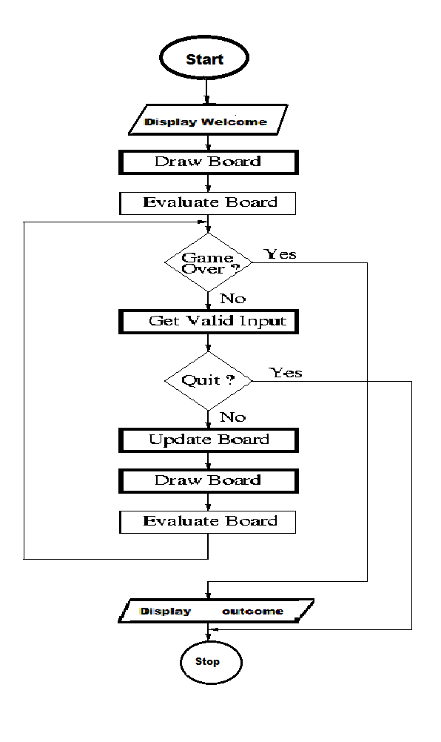
WORKFLOW

Slide 7
GAMEPLAY
There are two players and 3X3 grid.
The grid is full with numeric character from 1 to 9 with respective rows and columns.
Each player marks its X and 0's by replacing the numeric character in a sequence order.
The objective of the game is to win (3 markers in a row, column or diagonally).
The match either ends in win or draw.

Slide 8
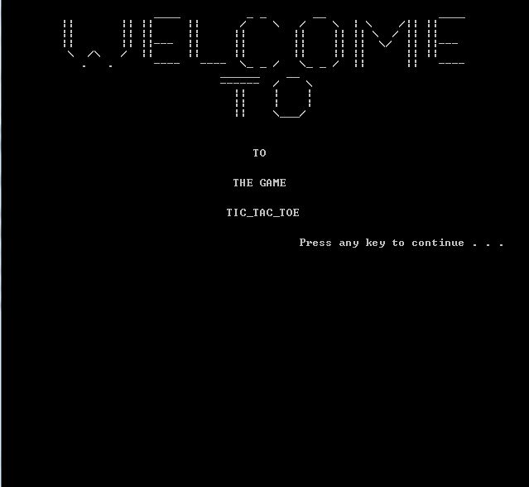
RESULTS

Slide 9
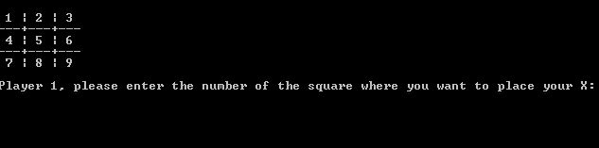
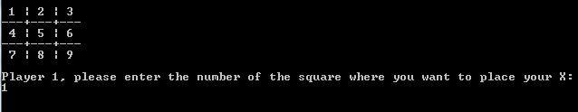

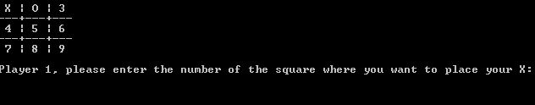

Slide 10
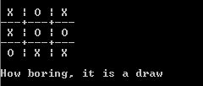

Slide 11


Slide 12
CONCLUSION
We expect to:
learn about C-programming.
Create Application.
Provide fun

Slide 13
THANK
YOU

