Slide 1
LUMBERJACK
Team Sorting Squad
Chinnavengannagari vinoothna (200010009)
Kavali Sri Vyshnavi Devi (200010023)
Manche Pavanitha (200010027)
Nandyala Sahaja (200010032)

Slide 2
Problem Statement
You are a lumberjack in a roadside forest. Every day you would like to cut down trees of the maximum value in the limited time that you have. We represent a forest as a rectangular grid of dimensions n by n points. Each edge between the neighboring grid points has a length of 1. At the position of each point, there could be a tree. Each tree is described using the following parameters:
● height h
● thickness d
● unit weight c
● unit value p
We calculate the value of each tree according to the formula: 𝑝 Â· ℎ Â· 𝑑. To cut down the tree, you have to reach it first. You can move only along the edges between the neighboring grid points. To cut down the tree at the position that you occupy you have to select one of four directions (along grid lines) in which the tree will fall. At the beginning of the day, you start in the lower-left corner of the forest, which is located at the point (0,0). You can assume that there is no tree there. If the tree that you cut falls on the other tree, which is lighter than the one that is falling, then this tree will also fall without being cut directly. We say that the tree is heavier if the total weight calculated as 𝑐 Â· 𝑑 Â· ℎ is greater than the total weight of the second tree. In this way, one can achieve a domino effect by pushing one tree onto another. We assume that a tree falls on the other when the distance between them is less than the height of this tree. Weights of trees do not cumulate - we always take into account only the weight of the tree, which directly fell onto another. If for example tree A falls onto tree B and its weight is greater than weight of tree B then it can push tree B onto another tree C located in the same direction if the distance between B and C is smaller to height of B and, moreover, tree C is lighter than tree B. When comparing trees B and C we do not take into account tree A that lays on tree B. Moreover, if tree B is not lighter than tree A then it blocks tree A and it will not have a chance to fall onto tree C.
Calculate the biggest profit that you can reach during t time units and provide a corresponding sequence of movements. Assume that the walk between the two neighboring grid points takes 1 unit of time, and cutting the tree takes d units of time.

Slide 3
FLOW CHART
Assigning maximum profit giving list to trees dictionary
Input
path2
cal_profit()
While loop
path1
Print direction to reach tree and cut tree direction
path1
cal_profit()

Slide 4
Variables used
trees(x,y,h,d,c,p) - dictionary-to store input
temp1 - to store the trees which are being cut in up direction
temp2 - to store the trees which are being cut in down direction
temp3 - to store the trees which are being cut in right direction
temp4 - to store the trees which are being cut in left direction
t, time_limit - to keep track of time
fullprofit, total_profit - Used to store profit
uProfit,lProfit,rProfit,dProfit - profit returned by respective direction
Current_x,current_y - to get current direction of lumberjack

Slide 5
FUNCTIONS USED
upProfit
downProfit
leftProfit
rightProfit
path1
path2
cal_profit

Slide 6
upProfit / downProfit / leftProfit / rightProfit functions
These functions are used to find out the profit made by the tree due to domino effect in respective direction.
Initially, the variables uProfit, dProfit, rProfit and lProfit are assigned the value “0” globally and these variables are used in functions upProfit, downProfit, leftProfit, rightProfit respectively.
After that, the trees are sorted and added to a list according to the direction in which they are to the tree passed in the argument of the function.
After that, for each tree in this list, the condition for the domino effect is checked and if it is matched, then it is appended to another list to keep track of trees that are fallen due to the domino effect, and profit for it is calculated.
These steps are the same in each of these functions but variables for each one are different.

Slide 7
Cal_Profit function
This function is used to find out in which direction a tree should be cut in order to get maximum profit from domino effect.
In this function first upProfit function is called and the value of profit in upward direction (uProfit) is stored in current profit.
Next dProfit function is called and if the profit in down direction is more than current profit then current profit is replaced with profit
Similarly rightProfit and leftProfit functions are called and if values in that direction are greater than current profit then current profit will replaced by them.
At the end of this function, the direction in which profit is more is returned.

Slide 8
Path1/Path2 functions
This function is used to sort the trees so that one can decide which tree to cut first in the remaining time limit with maximum profit.
Initially, the function checks for the trees which can be cut in the remaining time left and append those trees into an empty list.
In the path1 function, this list is sorted using the ratio of total profit (including profit by domino effect) to the time required to travel and cut a given tree from the current position, and the next priority for sorting is given to the value of the tree.
In the path2 function, this list is sorted using the ratio of value to the time required to travel and cut a given tree from the current position, and the last priority for sorting is given to the value of the tree.
At last, these functions return the sorted list of trees and the total profit gained from the first tree in the sorted list.

Slide 9
Description of algorithm
In the first step, the input is taken from the user, and the properties of each tree are taken in a dictionary and appended to a list called trees.
And for each tree in the input, the value for the key “tree_profit” is the current profit returned from the cal_profit function.
After that, the trees list is assigned the list that was returned when the path1 function is called.
Next, we run a while loop until the total time taken to travel and to cut the trees does not exceed the time limit and also until the number of trees which are yet to be cut reaches 0.
In the first step of this while loop, the direction in which the tree should be cut is decided by calling the cal_profit function.

Slide 10
Description of algorithm
The directions needed to go to that particular tree from the current position are printed in the next step.
After going to that tree, the direction in which the tree is supposed to be cut is checked by the direction value returned from the cal_profit function and then the cutting direction is printed.
The trees which were cut in this process are removed from the trees list.
Later, the path1 and path2 functions are called. The trees list is assigned the list that was returned from the function which gives the highest path_profit.
This is the end of the while loop and this loop runs until the given condition is false.

Slide 11
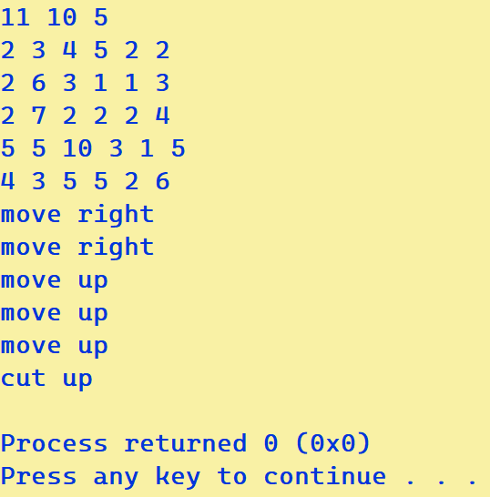
For the given input, the output is as following...

Slide 12
The programming language that is used for solving this problem is Python
After using above algorithm, the total profit that we have obtained is 122,183,591.00

Slide 13


