Slide 1
SECTION 01
Foundation & Ecosystem
Eclipse SDV Foundation, Active Project Catalogue, Scope & Platform Architecture Concept

Slide 2
Program introduction
OVERVIEW
Purpose
Development of a reusable, vehicle-agnostic Eclipse SDV platform
Core Principle: "Develop once. Configure per vehicle. Deploy across compatible vehicles."
What students & researchers gain from one reusable platform
A single implementation supports practical learning across vehicle software, hardware integration, cloud workflows and advanced research.
Software & AI Competencies
• Real SDV Exposure:
Use official Eclipse SDV projects (Kuksa, Velocitas, Ankaios, Kanto, Zenoh) in a modern architecture.
• End-to-End Workflows:
Build mobile, vehicle, cloud, diagnostics, dashboard UI and automated OTA lifecycle flows.
• AI & Edge Intelligence:
Explore automatic AI DBC->VSS mapping and autonomous runtime software configuration.
Hardware & Research Extensibility
• Embedded Hardware:
Integrate Lab Skateboard DBW CAN interfaces, Jetson AGX Orin/Nano ARM64 compute, and x86 edge nodes.
• Multi-Course Value:
Support embedded software, Linux OS, networking, cloud orchestration, AI and vehicle testing courses.
• Extensible Research:
Enable future work in autonomous adaptation, digital twin frameworks, and fleet telemetry.
Reusable for laboratories, hackathons, research and industry demonstrations.
Educational & Validation Prototype: Controlled track use; no public road use or production safety claims.
1

Slide 3
Introduction to Eclipse SDV
ECOSYSTEM
Eclipse SDV is an open automotive software ecosystem hosted by the Eclipse Foundation. The ecosystem brings together modular projects for vehicle applications, data, communications, orchestration, runtime platforms, cloud integration, diagnostics and engineering.
Ecosystem Utilization Guidelines
• Modular Building Blocks:
Use official open-source project building blocks rather than create every layer from scratch.
• Blueprint Architecture:
Start from reproducible Eclipse SDV blueprint patterns for OTA, fleet management and telemetry.
Implementation Strategy
• Targeted Coherent Stack:
Select a coherent subset for the SKATEBOARD APM implementation while maintaining vehicle-agnostic portability.
• Evaluation Strategy:
Evaluate overlapping or alternative projects separately instead of forcing every project into one runtime.
Official Catalogue Source: eclipsesdv.org/projects
3

Slide 4
Active Project Catalogue (Part 1/4 — Cloud & Vehicle Apps)
CATALOGUE
Project Name | Category / Layer | 1–2 Line Functional Description
Eclipse SDV Blueprints | Cloud & Fleet Services | Reference implementations combining SDV technologies into end-to-end vehicle architecture patterns.
Eclipse SDV Dev Console | Cloud & Fleet Services | Integrated developer console streamlining the automotive software lifecycle from dev to release.
Eclipse Symphony | Cloud & Fleet Services | End-to-end cloud orchestrator for distributing container workloads across edge nodes and vehicle fleets.
Eclipse LMOS | Cloud & Fleet Services | Language Model Operating System — AI platform for complex automotive reasoning & diagnostic agents.
Eclipse SDV Landscape | Cloud & Fleet Services | Continuously maintained visual map documenting project relationships, maturity levels, and integration paths.
Eclipse SDV Hephaestus | Cloud & Fleet Services | Open tooling and contributor scaffolding lowering entry barriers for new developers joining the ecosystem.
Eclipse Velocitas | Vehicle Apps & Services | Development framework & SDK for writing containerized C++ and Python vehicle applications.
Eclipse Kuksa | Vehicle Apps & Services | Vehicle abstraction broker connecting COVESA VSS signals to vehicle applications.
Eclipse Open Vehicle API | Vehicle Apps & Services | Standardized API definitions exposing vehicle capabilities to applications running on high-performance compute.
4

Slide 5
Active Project Catalogue (Part 2/4 — Orchestration & Runtime)
CATALOGUE
Project Name | Category / Layer | 1–2 Line Functional Description
Eclipse Chariott | Vehicle Apps & Services | In-vehicle app routing broker enabling dynamic service discovery and inter-application communication.
Eclipse Ibeji | Vehicle Apps & Services | Extensible digital twin framework modeling physical vehicle state and hardware capabilities.
Eclipse uProtocol | Vehicle Apps & Services | Ubiquitous transport protocol unifying cloud-to-edge and inter-process (IPC) messaging.
Eclipse Ankaios | Orchestration & Runtime | Workload orchestrator managing microservice container lifecycles dynamically on vehicle compute nodes.
Eclipse Kanto | Orchestration & Runtime | Lightweight container engine & edge software stack managing containerized microservice applications.
Eclipse BlueChi | Orchestration & Runtime | Lightweight multi-node service orchestrator optimized for systemd Linux nodes in vehicle networks.
Eclipse Pullpiri | Orchestration & Runtime | Dynamic embedded micro-app runtime environment managing embedded micro-applications.
Eclipse S-CORE | Orchestration & Runtime | Standardized core runtime environment for automotive ECU execution platforms.
Eclipse Leda | Orchestration & Runtime | Pre-integrated Linux distribution bundling core Eclipse SDV runtime components into a ready-to-run image.
5

Slide 6
Active Project Catalogue (Part 3/4 — Middleware & Testing)
CATALOGUE
Project Name | Category / Layer | 1–2 Line Functional Description
Eclipse Zenoh | Middleware & Comms | Zero-overhead pub/sub/query protocol for low-latency edge communication & inter-ECU data exchange.
Eclipse iceoryx2 | Middleware & Comms | Zero-copy shared memory IPC implementation written in Rust for real-time safety-critical communication.
Eclipse eCAL | Middleware & Comms | Enhanced Communication Abstraction Layer providing high-throughput IPC pub/sub communication.
Eclipse p3com | Middleware & Comms | High-speed inter-process communication protocol for embedded automotive platforms.
Eclipse Mosquitto | Middleware & Comms | Lightweight MQTT message broker used for vehicle telemetry sync and cloud messaging.
Eclipse OpenSOVD | Diagnostics | Implementation of ISO 17978 RESTful Service-Oriented Vehicle Diagnostics API.
Eclipse openDuT | Testing & HIL | Test automation framework connecting distributed Hardware-in-the-Loop (HIL) test benches.
Eclipse OpenXilEnv | Testing & SIL | PC simulation environment for Software-in-the-Loop (SIL) ECU application testing.
6

Slide 7
Active Project Catalogue (Part 4/4 — Data, Security & Tools)
CATALOGUE
Project Name | Category / Layer | 1–2 Line Functional Description
COVESA VSS v4.0 | Data & Standards | Standardized taxonomy defining vehicle signals, sensors, and actuator attributes.
Eclipse Data Space | Data Sharing | Federated data sharing infrastructure enforcing data sovereignty across vehicle fleets.
Eclipse Security Core | Security | In-vehicle HSM key management, cryptographic services, and secure boot infrastructure.
Eclipse ThreadX | RTOS Platform | Safety-certified deterministic real-time operating system (RTOS) for ECU microcontrollers.
Eclipse Cantian | Incubating / Hypervisor | Micro-kernel hypervisor spatial isolation tooling providing separation for mixed-criticality ECUs.
Eclipse Muto | Incubating / ROS | Dynamic adaptive platform framework designed for ROS-based autonomous vehicle nodes.
Eclipse AICE | Incubating / AI Code | AI Code Engine extensions providing LLM-assisted automotive C++/Rust code generation & verification.
Eclipse AgDrive | Incubating / DBW | Open-source agricultural & off-highway vehicle Drive-by-Wire SDK for heavy machinery automation.
Eclipse AutoCore | Incubating / Hardware | Embedded hardware-acceleration abstractions for automotive NPUs, GPUs, and vision processing units.
7

Slide 8
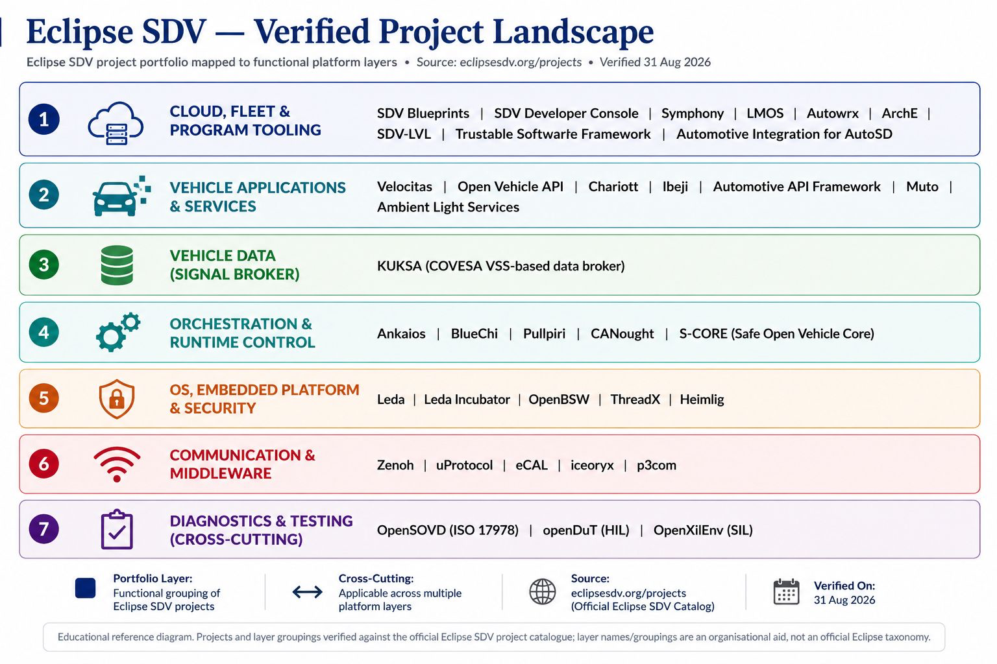

Complete Eclipse SDV Project Landscape
LANDSCAPE
8

Slide 9
Use cases to be supported
DEMONSTRATIONS
Here is a prioritized list of use cases expected (highest priority at top):
Use case | Expected demonstration on Lab Skateboard Platform
Companion lock/unlock | Authenticated mobile command operates dedicated vehicle latch & returns confirmed status.
Vehicle status & telemetry | Display speed, battery, steer angle, DBW mode, ECU health locally on Dashboard & remotely.
Remote diagnostics | Read software inventory, health, faults, logs and VSS signal values using OpenSOVD REST API.
Remote OTA | Deploy updated container workload, verify behavior change, and demonstrate automatic rollback on fail.
AI-assisted emergency braking | Detect obstacle target and command low-speed stop via standardized VSS layer (Safety DBW intact).
9

Slide 10
Reduced Eclipse SDV Stack
STACK
Project Name | Selection Status | Role in Reusable SDV Platform | Target Use Case
Eclipse Kuksa | CORE | Vehicle data broker exposing standardized COVESA VSS tree | Vehicle data, telemetry & signal abstraction
Eclipse Velocitas | CORE | C++/Python containerized vehicle application development SDK | Vehicle applications & business logic
Eclipse Ankaios | CORE | Container workload orchestrator managing microservices on node | Software deployment, container lifecycle
Eclipse Kanto | CORE | Lightweight container engine & edge runtime manager | Always-on startup, edge container execution
Eclipse Zenoh | CORE | Zero-overhead pub/sub protocol for low-latency edge comms | Vehicle-to-cloud telemetry & IPC messaging
Eclipse OpenSOVD | CORE | ISO 17978 RESTful Service-Oriented Diagnostics implementation | Remote vehicle diagnostics, faults & logs
Eclipse uProtocol | OPTIONAL | Ubiquitous transport protocol unifying cloud-to-edge messaging | Multi-node IPC & heterogeneous messaging
Eclipse openDuT | OPTIONAL | Automated test bench framework connecting distributed HIL testing | Remote HIL test automation & validation
Eclipse OpenXilEnv | OPTIONAL | PC SIL simulation environment for ECU application testing | Software-in-the-Loop simulation testing
Eclipse LMOS | FUTURE | Language Model Operating System for AI diagnostic reasoning | AI-assisted diagnostic agent reasoning
10

Slide 11
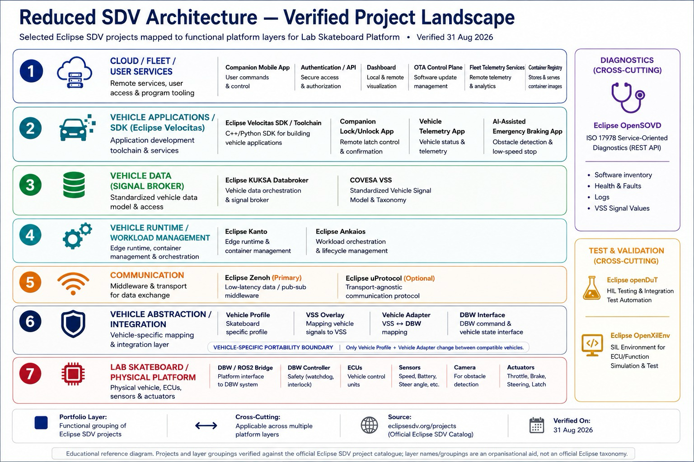
Proposed Reduced Stack Architecture
IMPLEMENTATION
11

Slide 12
Project scope definition
SCOPE
Scope coverage
The project scope spans six coordinated areas needed to define, build, connect, onboard and validate the SDV platform.
Architecture & Software Scope
• System Definition:
Requirements, target architecture, vehicle abstraction layer, VSS signal model and acceptance criteria.
• Vehicle Software:
Linux platform, Kanto/Ankaios containers, Velocitas apps, Kuksa data broker, and Zenoh middleware.
• Diagnostics & Testing:
Service-oriented OpenSOVD diagnostics, openDuT HIL test automation, and OpenXilEnv SIL simulation.
Hardware, Platform & Research Scope
• Hardware & Vehicle:
Lab Skateboard DBW vehicle, CAN 2.0B interface, Jetson AGX Orin/Nano ARM64 & x86 compute platforms.
• Cloud & Companion:
Vehicle SDV Dashboard UI, backend APIs, telemetry sync, remote diagnostics, and OTA campaign services.
• SDV SYSTEM CONTROL:
Vehicle Profile specification, DBC-to-VSS signal mapping overlay & container deployment pipelines.
A bounded, vehicle-agnostic scope keeps the platform reusable across labs, research tracks, and industry demonstrations.
12

Slide 13
Current Vehicle — Lab Skateboard Platform
HARDWARE
SKATEBOARD APM CAN / DBW Architecture
• Vehicle Platform:
SKATEBOARD APM Drive-by-Wire vehicle (Physical validation platform).
• Physical Interface:
CAN 2.0B Bus interface operating at 500 kbps / 1 Mbps.
• General Request (CAN):
PGN / CAN ID: 0x1228 / 0797 (Command targets & control requests).
• General Status (CAN):
PGN / CAN ID: 0x1291 / 0109 (Vehicle status & telemetry feedback).
Documented CAN Signals & Safety
• Steering Control:
Steer_Cmd (+-540 deg target angle) + Steering Angle Feedback.
• Throttle & Brake:
Throttle_Cmd (0-100% target) & Vehicle Brake status feedback.
• Vehicle Operational Modes:
Drive Mode, Speed Mode, DBW Mode, Turtle Mode, CCU Enable.
• Safety & Interlocks:
Emergency Switch Status, LLC Stop, Vehicle Interlock, Charging Connector Status.
IMPORTANT ARCHITECTURAL ISOLATION RULE:
SKATEBOARD-specific CAN IDs are NEVER placed directly in vehicle applications. They are isolated inside a dedicated Vehicle Adapter behind the KUKSA / VSS abstraction layer.
13

Slide 14
Vehicle-Agnostic Platform Concept
ARCHITECTURE
Major Architectural Message: "Develop once. Configure per vehicle. Deploy across compatible vehicles."
Core Platform Principles
• Vehicle-Independent Software:
Applications, KUKSA VSS data model, container orchestration, and OTA mechanisms remain 100% identical across vehicles.
• Vehicle Integration Boundary:
Isolated behind Vehicle Profile and Vehicle Adapter. Only the adapter translates standardized VSS to CAN/DBC.
• Target Vehicle Scope:
Designed for compatible vehicles satisfying defined minimum compute, OS, and communication requirements.
Multi-Vehicle Deployment Model
• Lab Skateboard Vehicle (Current):
Uses Vehicle Profile + SKATEBOARD CAN Adapter (0x1228 / 0x1291 DBC signals) ➔ Same Velocitas App Layer.
• Vehicle B (Future Compatible):
Uses Vehicle B Profile + Vehicle B Adapter (Different CAN/Ethernet DBC) ➔ Same Velocitas App Layer.
• Vehicle C (Future Compatible):
Uses Vehicle C Profile + Vehicle C Adapter (Different CAN/DBC) ➔ Same Velocitas App Layer.
Key Architectural Distinction:
The SKATEBOARD APM is our FIRST physical validation vehicle — it is NOT the architectural limitation of the platform.
14

Slide 15
Minimum Compatible Vehicle Requirements
PLATFORM
Domain / Subsystem | Minimum Platform Requirement | Validation on Reference Implementations
Compute & CPU | ARM64 or x86_64 multi-core processor (Min 4 Cores, 8GB RAM) | Jetson AGX Orin / Orin Nano (ARM64) & Lenovo ThinkEdge SE50 (x86)
Operating System | Linux Kernel >= 5.4 with systemd, cgroups v2 & container runtime | Ubuntu Linux 20.04 / 22.04 LTS & Eclipse Leda pre-integrated distro
Communication | CAN 2.0B / CAN-FD or Automotive Ethernet (100BASE-T1) | SKATEBOARD APM DBW CAN Bus at 500 kbps / 1 Mbps
Vehicle Abstraction | OEM CAN DBC file or signal matrix exposing drive, speed & status | SKATEBOARD APM DBC File parsed via AI DBC->VSS Mapper into COVESA VSS
Actuation Boundary | Drive-by-Wire (DBW) or electronic control interface for steering/speed | SKATEBOARD APM DBW Module with safety watchdog heartbeat counter
15

Slide 16
SECTION 02
System Setup & Subsystem Layers
Multi-Layer Architecture, Vehicle Abstraction Boundary & Multi-Architecture Strategy

Slide 17
| SYSTEM SETUP
Vehicle Abstraction & Integration
ABSTRACTION
Vehicle-Independent Layer (Standardized)
• Standardized Application Layer:
Velocitas applications consume only standard COVESA VSS signal names (e.g. 'Vehicle.Speed', 'Vehicle.Cabin.Door.IsLocked').
• Hardware & Protocol Independence:
Applications never contain hardcoded CAN IDs or OEM-specific byte offsets. They remain 100% portable.
• KUKSA VSS Data Broker:
Acts as the central decoupling boundary between high-level vehicle applications and low-level CAN networks.
OTA / CLOUD ➜ OTA Control Plane | Fleet Telemetry Services | Container Registry
VEHICLE RUNTIME ➜ Eclipse Kanto (Container Engine) | Eclipse Ankaios (Workload Orchestrator)
VEHICLE APPLICATIONS ➜ Eclipse Velocitas (App SDK) | Vehicle Telemetry App | ADAS Service App
VEHICLE DATA ➜ Eclipse Kuksa (Signal Broker) | COVESA VSS v4.0 Standard Taxonomy
Vehicle-Specific Integration Boundary
• Vehicle Profile:
Defines the specific vehicle's capabilities, CAN DBC mappings, and VSS signal conversion rules.
• Lab Skateboard Vehicle Adapter:
Translates Kuksa VSS updates into Lab Skateboard-specific CAN frames (0x1228 General Request) and decodes 0x1291 General Status.
• Vehicle B Adapter (Future):
Translates Kuksa VSS updates into Vehicle B's specific CAN/Ethernet protocol without altering application code.
COMMUNICATION ➜ Eclipse Zenoh (Low-Latency Pub/Sub) | uProtocol Transport Layer
VEHICLE ABSTRACTION ➜ Lab Skateboard Vehicle Profile | VSS Overlay | Lab Skateboard Vehicle Adapter (DBC / CAN)
Lab Skateboard DBW ACTUATION ➜ CAN 2.0B Bus (0x1228 Request / 0x1291 Status) ➔ Actuators & ECUs
STRICT TECHNICAL BOUNDARY RULE:
Velocitas Application ➔ KUKSA / VSS ➔ Vehicle Profile ➔ Lab Skateboard Vehicle Adapter ➔ Lab Skateboard CAN (0x1228 / 0x1291) ➔ DBW Controller.
17

Slide 18
| SYSTEM SETUP
Vehicle Applications & Telemetry Subsystem
APPLICATIONS
Containerized Vehicle Application Layer
• Velocitas C++/Python SDK: Provides high-level SDK for writing containerized vehicle applications.
• Telemetry & ADAS Services: Implements real-time speed/steer data processing and obstacle detection.
• Vehicle Decoupling: Consumes standardized VSS data tree directly from Kuksa Broker.
OTA / CLOUD ➜ SDV Blueprints | OTA Control Plane | Fleet Telemetry Services | Container Registry
VEHICLE RUNTIME ➜ Eclipse Leda Platform | Eclipse Kanto (Container Engine) | Eclipse Ankaios (Orchestrator)
VEHICLE APPLICATIONS ➜ Eclipse Velocitas (App SDK) | Vehicle Telemetry App | ADAS Service App
VEHICLE DATA ➜ Eclipse Kuksa (Signal Broker) | COVESA VSS v4.0 Standard Taxonomy
Publish/Subscribe Telemetry Pipeline
• Eclipse Zenoh Middleware: Zero-overhead pub/sub protocol enabling ultra-low-latency IPC communication.
• Cloud & Dashboard Sync: Syncs vehicle operational state to local Dashboard UI and remote cloud services.
• Companion Command Receiver: Listens for remote lock/unlock commands via MQTT/Zenoh messaging.
COMMUNICATION ➜ Eclipse Zenoh (Low-Latency Pub/Sub) | uProtocol Transport Layer
VEHICLE ABSTRACTION ➜ Lab Skateboard Vehicle Profile | VSS Overlay | Lab Skateboard Vehicle Adapter (DBC / CAN)
Lab Skateboard DBW ACTUATION ➜ CAN 2.0B Bus (0x1228 Request / 0x1291 Status) ➔ Actuators & ECUs
SYSTEM SETUP HIGHLIGHT: Demonstrates interaction across Vehicle Applications, Vehicle Data, and Communication layers.

Slide 19
| SYSTEM SETUP
Workload Orchestration & Edge Runtime Subsystem
ORCHESTRATION
Pre-Integrated Vehicle Linux Distribution
• Eclipse Leda Distro: Pre-integrated Linux operating system bundling core Eclipse SDV execution components.
• Container Engine: Eclipse Kanto light-weight container engine running microservices on compute nodes.
• System Automation: Automated Linux systemd startup services for zero-terminal boot execution.
OTA / CLOUD ➜ SDV Blueprints | OTA Control Plane | Fleet Telemetry Services | Container Registry
VEHICLE RUNTIME ➜ Eclipse Leda Platform | Eclipse Kanto (Container Engine) | Eclipse Ankaios (Orchestrator)
VEHICLE APPLICATIONS ➜ Eclipse Velocitas (App SDK) | Vehicle Telemetry App | ADAS Service App
VEHICLE DATA ➜ Eclipse Kuksa (Signal Broker) | COVESA VSS v4.0 Standard Taxonomy
Microservice Workload Orchestrator
• Eclipse Ankaios: Dynamically manages container lifecycles across heterogeneous vehicle edge nodes.
• Workload Deployment: Deploy, stop, restart, and update containerized applications remotely.
• Isolation & Resource Controls: Enforces cgroups v2 memory, CPU, and process isolation per container.
COMMUNICATION ➜ Eclipse Zenoh (Low-Latency Pub/Sub) | uProtocol Transport Layer
VEHICLE ABSTRACTION ➜ Lab Skateboard Vehicle Profile | VSS Overlay | Lab Skateboard Vehicle Adapter (DBC / CAN)
Lab Skateboard DBW ACTUATION ➜ CAN 2.0B Bus (0x1228 Request / 0x1291 Status) ➔ Actuators & ECUs
SYSTEM SETUP HIGHLIGHT: Demonstrates interaction across OTA/Cloud Control, Vehicle Runtime, and Application layers.

Slide 20
| SYSTEM SETUP
Service-Oriented Diagnostics & HIL/SIL Test Subsystem
DIAGNOSTICS
ISO 17978 Service-Oriented Vehicle Diagnostics
• Eclipse OpenSOVD Agent: Implements ISO 17978 RESTful Service-Oriented Vehicle Diagnostics.
• Diagnostic API Endpoints: Exposes HTTP REST endpoints for software inventory, fault codes, and logs.
• VSS Signal Inspection: Provides live inspection of VSS data broker tree and ECU health metrics.
OTA / CLOUD ➜ SDV Blueprints | OTA Control Plane | Fleet Telemetry Services | Container Registry
VEHICLE RUNTIME ➜ Eclipse Leda Platform | Eclipse Kanto (Container Engine) | Eclipse Ankaios (Orchestrator)
VEHICLE APPLICATIONS ➜ Eclipse Velocitas (App SDK) | Vehicle Telemetry App | ADAS Service App
VEHICLE DATA ➜ Eclipse Kuksa (Signal Broker) | COVESA VSS v4.0 Standard Taxonomy
Distributed HIL & SIL Test Automation
• Eclipse openDuT: Test automation framework connecting distributed Hardware-in-the-Loop (HIL) test benches.
• Eclipse OpenXilEnv: PC simulation environment for Software-in-the-Loop (SIL) ECU application testing.
• Digital Vehicle Prototyping: Validates vehicle applications before deployment to physical hardware.
COMMUNICATION ➜ Eclipse Zenoh (Low-Latency Pub/Sub) | uProtocol Transport Layer
VEHICLE ABSTRACTION ➜ Lab Skateboard Vehicle Profile | VSS Overlay | Lab Skateboard Vehicle Adapter (DBC / CAN)
Lab Skateboard DBW ACTUATION ➜ CAN 2.0B Bus (0x1228 Request / 0x1291 Status) ➔ Actuators & ECUs
SYSTEM SETUP HIGHLIGHT: Demonstrates interaction across Vehicle Data, Vehicle Abstraction, and Physical Vehicle layers.

Slide 21
| SYSTEM SETUP
Vehicle Profile & Drive-by-Wire Actuation Boundary
ACTUATION
Versioned Vehicle Profile Specification
• Vehicle Schema Overlay: Machine-readable profile capturing CAN DBC signal definitions and VSS mappings.
• Hardware Capabilities: Encapsulates steering DBW (+-540 deg), throttle (0-100%), and brake actuation limits.
• Multi-Vehicle Portability: Enables clean substitution of physical vehicles without altering application code.
OTA / CLOUD ➜ SDV Blueprints | OTA Control Plane | Fleet Telemetry Services | Container Registry
VEHICLE RUNTIME ➜ Eclipse Leda Platform | Eclipse Kanto (Container Engine) | Eclipse Ankaios (Orchestrator)
VEHICLE APPLICATIONS ➜ Eclipse Velocitas (App SDK) | Vehicle Telemetry App | ADAS Service App
VEHICLE DATA ➜ Eclipse Kuksa (Signal Broker) | COVESA VSS v4.0 Standard Taxonomy
Safety Watchdog & Interlock Boundary
• Lab Skateboard Vehicle Adapter: Converts Kuksa VSS updates into Lab Skateboard CAN frames (0x1228 / 0x1291).
• Safety Watchdog Heartbeat: Transmits continuous safety heartbeat counter to DBW interlock controller.
• Low-Level Actuation: Commands physical steer, speed, and emergency brake actuators on CAN 2.0B bus.
COMMUNICATION ➜ Eclipse Zenoh (Low-Latency Pub/Sub) | uProtocol Transport Layer
VEHICLE ABSTRACTION ➜ Lab Skateboard Vehicle Profile | VSS Overlay | Lab Skateboard Vehicle Adapter (DBC / CAN)
Lab Skateboard DBW ACTUATION ➜ CAN 2.0B Bus (0x1228 Request / 0x1291 Status) ➔ Actuators & ECUs
SYSTEM SETUP HIGHLIGHT: Demonstrates interaction across Vehicle Abstraction and Physical DBW Actuation layers.

Slide 22
SECTION 03
Operational & Execution Workflow
Vehicle Onboarding, Automated Runtime Startup, Operator UI & OTA Lifecycle

Slide 23
SYSTEM FLOW
First-Time Vehicle Onboarding Concept
ONBOARDING
Phase 1: Discovery & AI Mapping
• 1. Vehicle Discovery:
Connect onboarding tool to new compatible vehicle via Ethernet/USB/CAN.
• 2. Compatibility Check:
Verify compute platform (ARM64/x86), Linux OS, RAM, and CAN interfaces.
• 3. DBC Upload & AI Mapping:
Upload vehicle CAN DBC file; AI DBC->VSS Mapper generates candidate VSS overlay.
• 4. Deterministic Validation:
Validator verifies mappings against safety rules; user reviews confidence scores.
• 5. Profile Generation:
Generates versioned Vehicle Profile and compiles vehicle-specific Vehicle Adapter.
Phase 2: Installation & Readiness
• 6. Install SDV Runtime:
Deploys Kanto container engine, Ankaios orchestrator, and Kuksa VSS data broker.
• 7. Install Applications:
Deploys Velocitas vehicle apps (Telemetry, Diagnostics, ADAS, Companion service).
• 8. System Self-Test:
Executes automated diagnostic self-test across CAN communication & containers.
• 9. Automatic Startup Config:
Configures systemd automatic startup services for zero-terminal Runtime boot.
• 10. Registration & Ready:
Registers onboarded vehicle into local Dashboard UI & OTA Control Plane ➔ READY.
23

Slide 24
First-Time Onboarding — User GUI Workflow
ONBOARDING UI
GUI Onboarding Stage | User Interface Action | Underlying Automated System Process
1. Add New Vehicle | Select [Add Vehicle] ➔ Displays discovered vehicle 'Lab Skateboard' | Auto-detects CAN 2.0B interface & ARM64/x86 compute capability
2. Upload DBC File | Browse & select 'lab_skateboard.dbc' ➔ Click [Begin Onboarding] | Invokes DBC Parser & extracts CAN IDs 0x1228, 0x1291 and signal specs
3. AI VSS Mapping | Displays Mapping Table: 'Vehicle Speed ➔ Vehicle.Speed (96%)' | AI LLM Embeddings match signals; Deterministic Validator checks rules
4. Review & Confirm | User reviews mappings & clicks [Approve Mapping & Install] | Generates Lab Skateboard Vehicle Profile & compiles Lab Skateboard Vehicle Adapter
5. Installation & Test | Progress Bar: 'Installing SDV Stack...' ➔ 'Running Self-Test...' | Deploys Kanto, Kuksa, Velocitas; configures systemd auto-start service
6. Onboarding Complete | Displays 'Vehicle Successfully Onboarded' ➔ Click [Open Dashboard] | Registers vehicle in Dashboard & OTA Control Plane ➔ Platform Ready
24

Slide 25
Runtime / Always-On SDV Runtime
AUTOMATION
Boot Sequence (Steps 1–4)
• 1. Vehicle Runtime:
Vehicle ignition / main power switch engaged by driver.
• 2. Compute Boot:
Vehicle compute (Jetson ARM64 / x86 ECU) powers up & boots Linux OS.
• 3. Linux systemd Auto-Start:
Systemd automatically initializes SDV runtime service without human intervention.
• 4. Container Engine Init:
Kanto container engine and Ankaios workload orchestrator start up.
Runtime Readiness (Steps 5–8)
• 5. KUKSA Data Broker:
Kuksa VSS data broker initializes & loads compiled Lab Skateboard Vehicle Profile.
• 6. Vehicle Adapter & Apps:
Lab Skateboard Adapter binds to CAN bus (0x1228/0x1291); Velocitas apps start up.
• 7. Telemetry & Diagnostics:
OpenSOVD diagnostics & Zenoh telemetry channels establish sync.
• 8. Dashboard UI Ready:
Vehicle SDV Dashboard UI launches ➔ SDV Platform READY (Zero Terminals).
25

Slide 26
Normal Startup vs. First-Time Installation
WORKFLOW
Workflow Phase | First-Time Vehicle Onboarding (One-Time) | Normal Vehicle Runtime Startup (Every Time)
Trigger Event | New compatible vehicle connected for first time | Driver turns vehicle ignition / power switch ON
User Action | Launches Onboarding UI & selects DBC file | Zero user action required (Automated boot)
System Process | DBC parsing, AI DBC->VSS mapping & validation | Linux systemd initializes auto-start services
Profile & Adapter | Generates Vehicle Profile & compiles Vehicle Adapter | Loads existing Vehicle Profile & Vehicle Adapter
Software Deployment | Downloads & installs Kanto, Kuksa & Velocitas apps | Kanto container engine resumes container workloads
Validation Check | Executes initial system diagnostic self-test | Performs fast telemetry & sensor health check
Final Output State | Registers vehicle in Dashboard UI ➔ ONBOARDED | Vehicle SDV Dashboard displays READY status
26

Slide 27
Vehicle SDV User Interface & Dashboard
DASHBOARD
Automotive Dashboard Layout
• Vehicle Identification:
Vehicle: Lab Skateboard Drive-by-Wire Platform | Status: SYSTEM READY
• Live Telemetry Display:
Vehicle Speed: 12.4 km/h | Battery: 78% | Drive Mode: AUTO | Steer Angle: +14.2 deg
• Runtime Health Status:
KUKSA VSS Broker: ● Running | Applications: ● 5 Active | Comms: ● Connected
Subsystem Status & Navigation
• Diagnostics Status:
OpenSOVD Diagnostic Agent: ● Healthy (0 Active Fault Codes)
• OTA Status:
OTA Lifecycle Agent: ● Up to Date (Software Version v1.2.0)
• Navigation Tabs:
[ Overview ] [ Applications ] [ Diagnostics ] [ OTA Updates ] [ Settings ]
27

Slide 28
User Application Management UI
APPLICATIONS
Application Name | Functional Description | Runtime Status | User Management Actions
Vehicle Telemetry App | Exposes speed, battery & steer signals to cloud | ● Running | [View Signals] [Restart]
Vehicle Monitor App | Tracks ECU health, CAN watchdog & diagnostics | ● Running | [View Logs] [Restart]
OpenSOVD Diagnostic Agent | ISO 17978 RESTful diagnostic service endpoint | ● Running | [View Faults] [Run Diag]
ADAS Service App | Lane & obstacle detection assistance logic | ● Running | [View Stream] [Configure]
Companion Lock Service | Processes mobile app lock/unlock commands | ● Running | [View Status] [Restart]
OTA Lifecycle Agent | Checks container registry & handles updates | ● Standby | [Check Update] [View Version]
28

Slide 29
Developer Experience vs. Normal User Experience
EXPERIENCE
1. Developer World
• Primary Hardware:
Jetson AGX Orin / Orin Nano ARM64 & x86 Dev Compute.
• Development Tools:
Git, Terminal, Docker CLI, Python, VS Code, Ankaios CLI.
• Workflows:
Code edits, multi-arch builds, CI pipelines, local container testing & logs.
2. System / Control Layer
• Control Software:
Eclipse Kanto, Eclipse Ankaios, Eclipse Kuksa, Zenoh.
• System Automation:
Linux systemd auto-start services, management APIs & OTA agent.
3. Normal User World
• Primary Interface:
Vehicle SDV Dashboard UI & Mobile Companion App.
• User Interaction:
Runtime vehicle, view status, manage apps & OTA updates.
• Zero Technical Clutter:
NO terminals, NO Docker commands, NO CLI scripts.
29

Slide 30
Over-The-Air (OTA) User & Technical Lifecycle
LIFECYCLE
User OTA Experience
• 1. Notification UI:
Dashboard displays 'Software Update v1.2.0 Available' with release notes.
• 2. User Trigger:
User selects [Install Now] or schedules update duration.
• 3. Progress Tracking:
UI displays clean progress: Downloading ➔ Verifying ➔ Staging ➔ Activating.
• 4. Automated Rollback:
If post-install health check fails ➔ System automatically rolls back to stable v1.1.0.
Technical OTA Pipeline
• 1. CI / Build:
Developer pushes code ➔ CI builds multi-arch container images (ARM64 & AMD64).
• 2. Registry & Control:
Pushes signed artifacts to Container Registry; OTA Control Plane stages release.
• 3. Target Selection:
OTA Agent checks vehicle compatibility, CPU arch & Profile before download.
• 4. Deployment & Health:
Kanto updates container ➔ Health check validates VSS signals & DBW watchdog.
30

Slide 31
Final Integrated System Architecture
MASTER ARCH
31

Slide 32
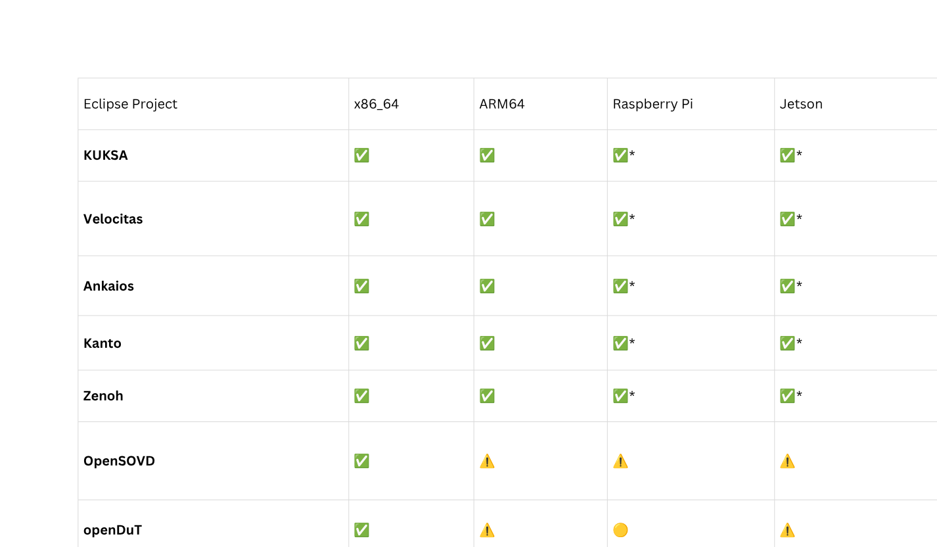
Project Compatibility & Platform Support
Legend: ✅ Verified at software/platform level · 🟡 Demonstrated/strong evidence · ⚠️ Requires target-specific validation
* Individual project compatibility does not imply complete end-to-end stack validation.
32

Slide 33
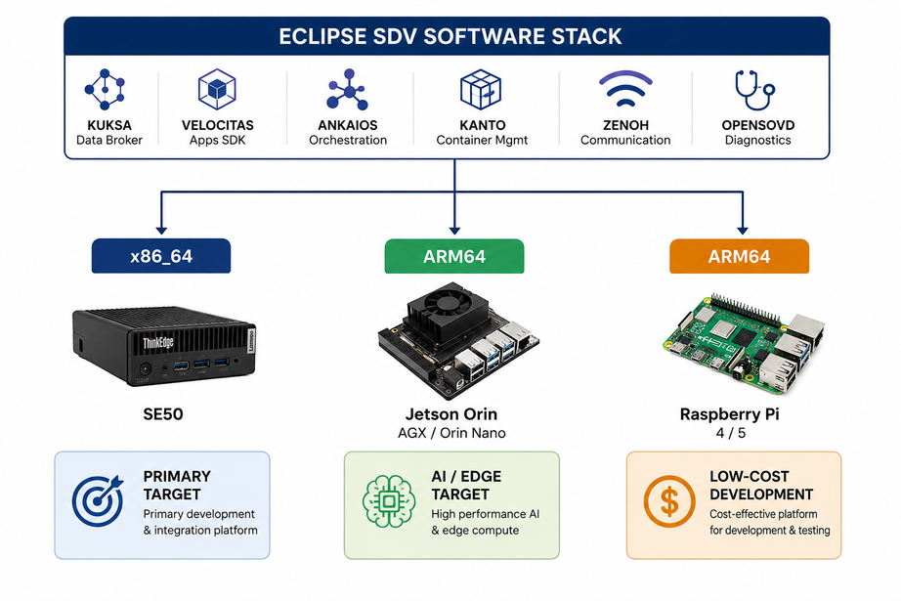
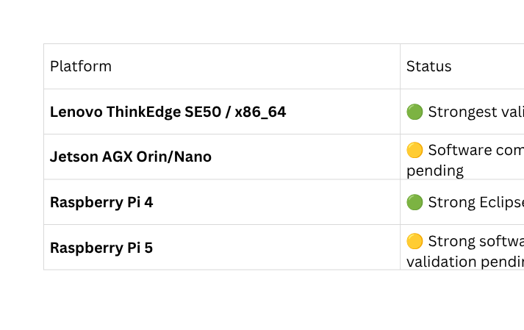
Platform Portability — Recommended Deployment Targets
Software portability is established at the architecture level; vehicle-interface portability requires re-validation for each target vehicle/platform.
33

Slide 34
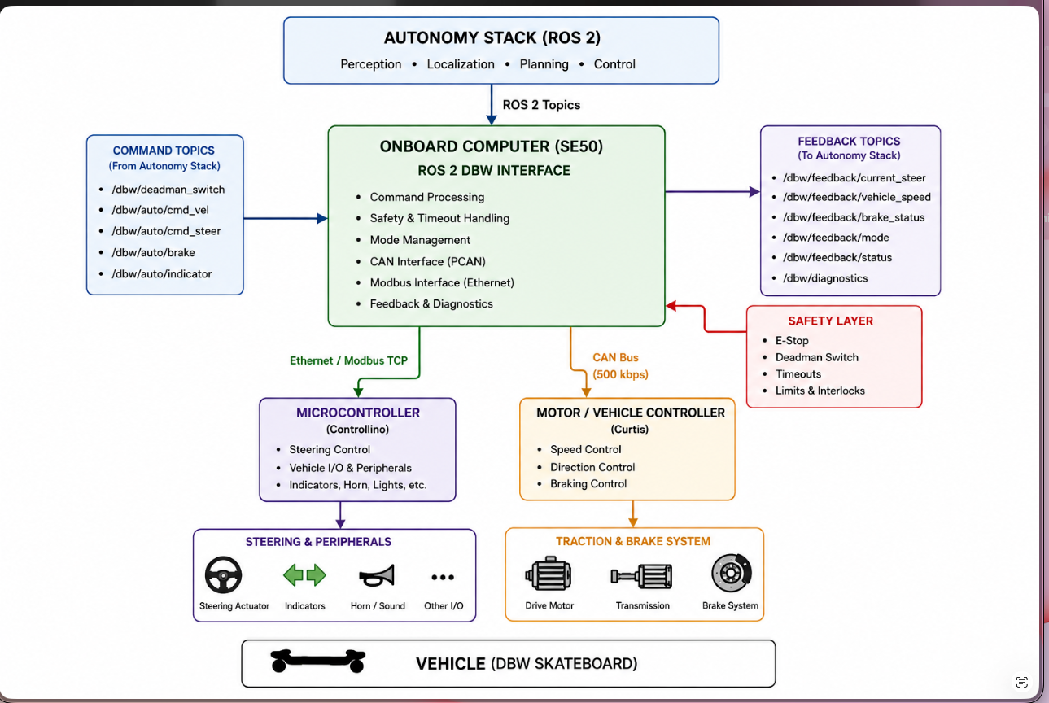

Architecture with skateboard
34

Slide 35
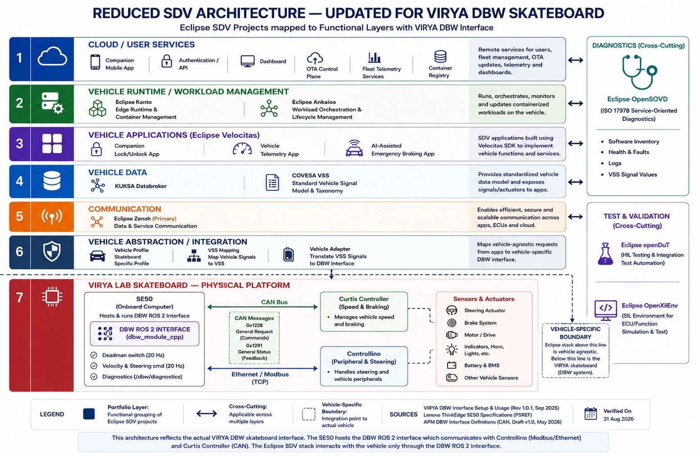
Architecture with skateboard
35

Slide 36
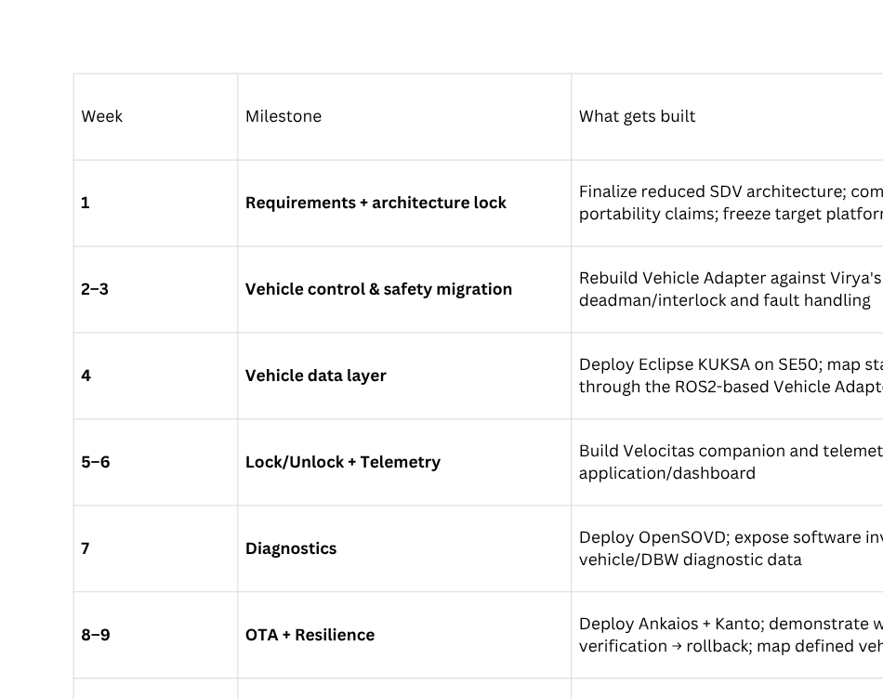
Milestone Schedule — Infosys Eclipse SDV RC/Skateboard Demo
36

Slide 37
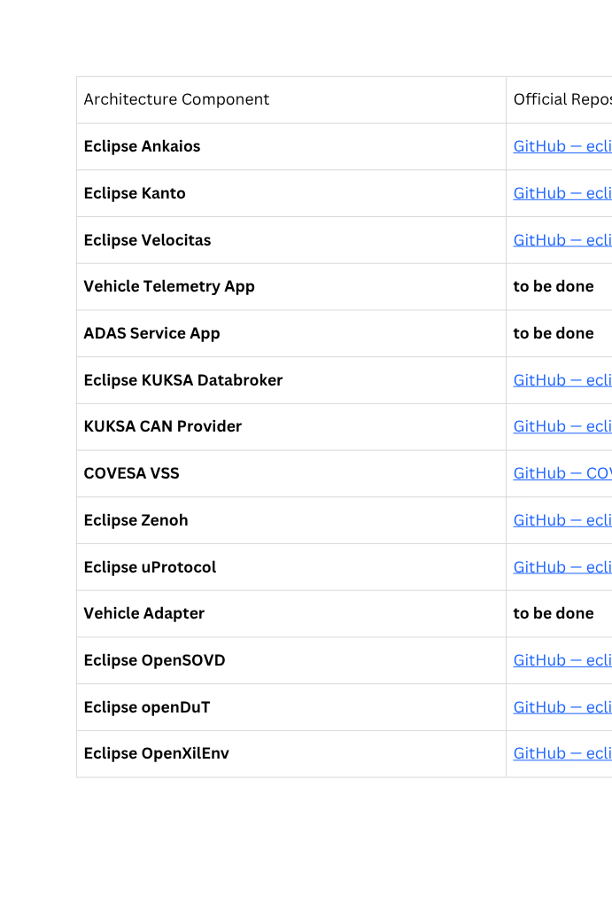
Github links
37

Slide 38
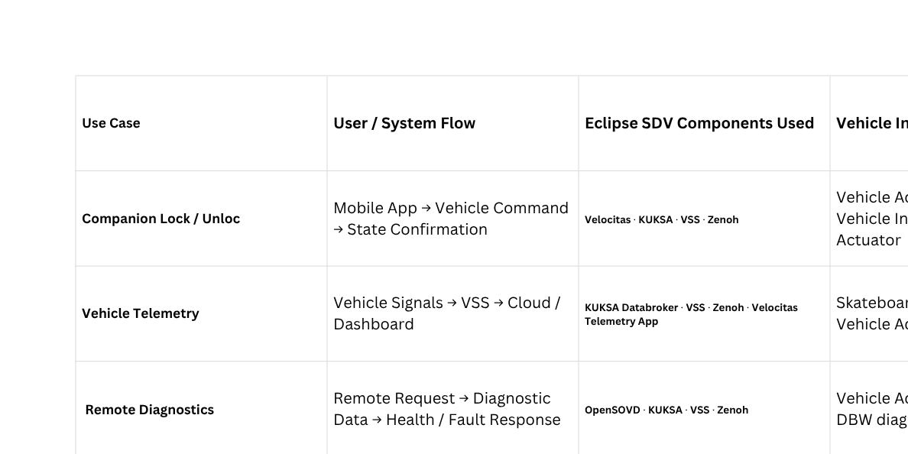
USE CASE MAPPING
38

Slide 39
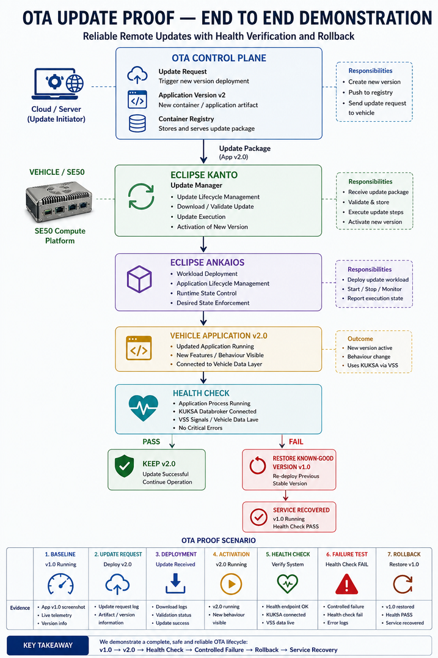
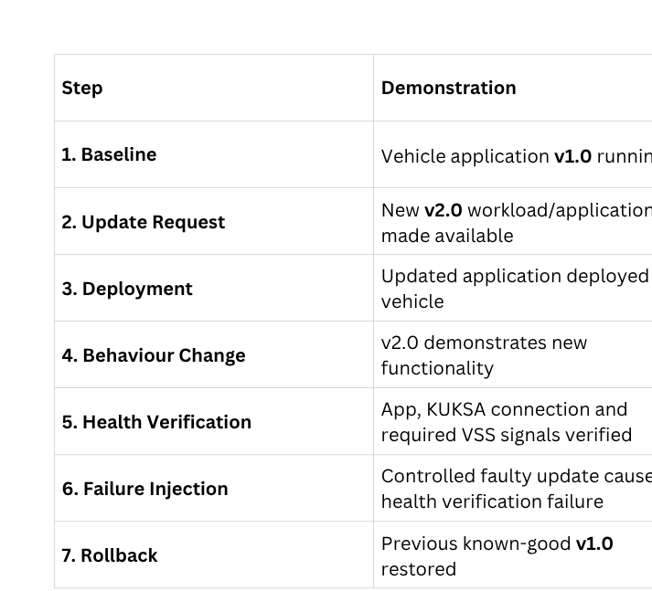
OTA PROOF
39

Slide 40

THANK YOU
THANK YOU
THANK YOU

